Slide 1
Being Active
Fitness friend

Slide 2
Activity and heart disease
Why is regular exercise important to prevent heart disease?
What are some reasons people don’t do more exercise and activity?
How could people fit more activity and exercise into their daily lives?

Slide 3
A ‘Fitness friend’ device
How could a wearable device help people to remember to do more exercise?
Look at the prototype. How do you think it is programmed to work?

Slide 4
Fitness friend algorithm
Write an algorithm to create a ‘Fitness friend’ device using the micro:bit.
When finished, share and debug your algorithms.
When START button pressed
- REPEAT until STOP button pressed
- count 25 minutes (1500000 seconds)
- OUTPUT audio beep for 1 second
- OUTPUT visual display ‘move!’
When STOP button pressed, STOP
Start
Count 25 mins
Make audio sound
Display visual message
Repeat until stop

Slide 5
Creating your Fitness friend device
Using the MakeCode editor and your algorithm, write a program to create your Fitness friend device.
Remember to test and debug regularly.
Once finished, download and copy to your micro:bit to test and run.
Compare your programs and devices. Have you used the same code?

Slide 6
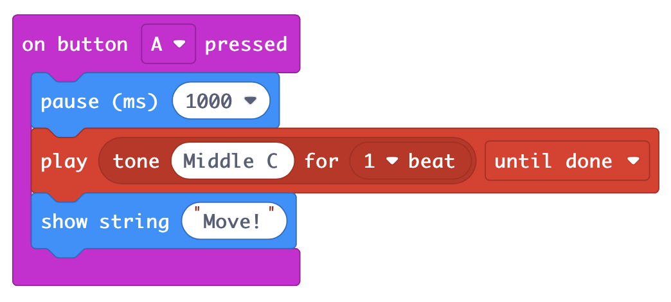
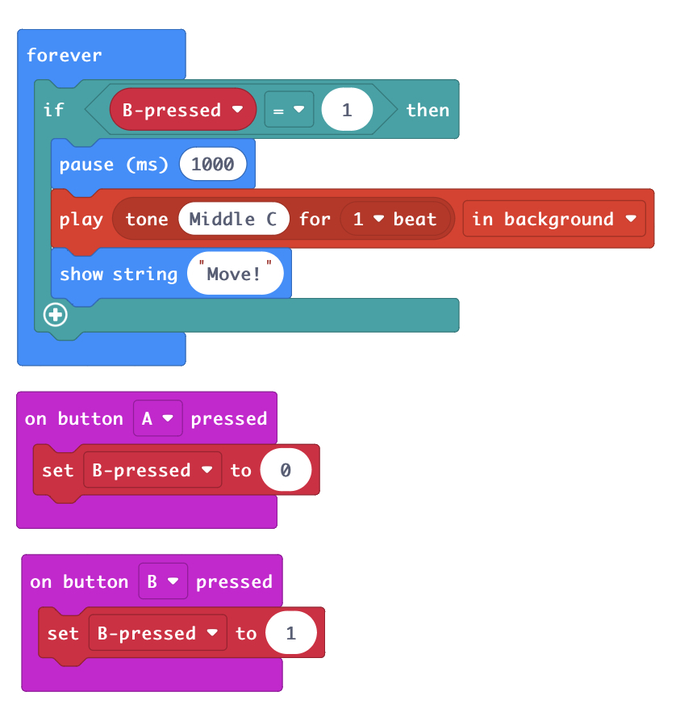
Fitness friend program examples
Simple Fitness friend program
Fitness friend more complex

Slide 7
Sharing learning
What have you learnt from creating your ‘Fitness friend’?
What problems did you have and how did you solve them?
Do you think the ‘Fitness friend’ will achieve its aim of helping people be more active? Why?

Slide 8
Licensing information
Published by the Micro:bit Educational Foundation microbit.org
Licence: Attribution-ShareAlike 4.0 International (CC BY-SA 4.0)

