Slide 1
ages 9-11
Barefoot meets micro:bit
Litter Hunt - Lesson 2

Slide 2
Learning objectives
I can design a counting device using the micro:bit
I can program a counting device using the MakeCode editor
I can use a counting device to record data

Slide 3
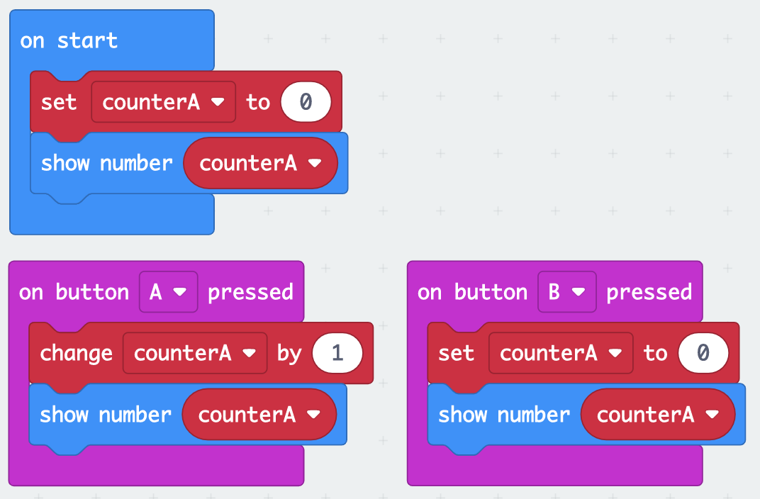
Using variables
A variable allows us to store data within our programs.
Which blocks initialise the value of counterA?
Which blocks display the value of counterA on the LEDs?
Which block increases the value of counterA by 1?
Which block reset the value of counterA to 0?

Slide 4
Litter analysis problem
A local environmental organisation is concerned about the amount of litter in our area.
The organisation have heard the micro:bit can be used to store data and have asked if you can design a program to record litter in the local area.
They would like the following information recorded:
Number of litter items that can be recycled
Number of litter items that cannot be recycled
Can you create a program to store this information?

Slide 5
Litter analysis problem
The local environmental organisation have said the program should function in the following way:
When the program starts, set the number of items recycled and not recycled to be zero
When button A is pressed, increase recycled by 1 and show its value
When button B is pressed, increase not recycled by 1 and show its value
When the micro:bit is shaken, display the following:
“Recycled”, followed by the value of recycled
Pause for 1 second
“Not recycled”, followed by the value of not recycled

Slide 6
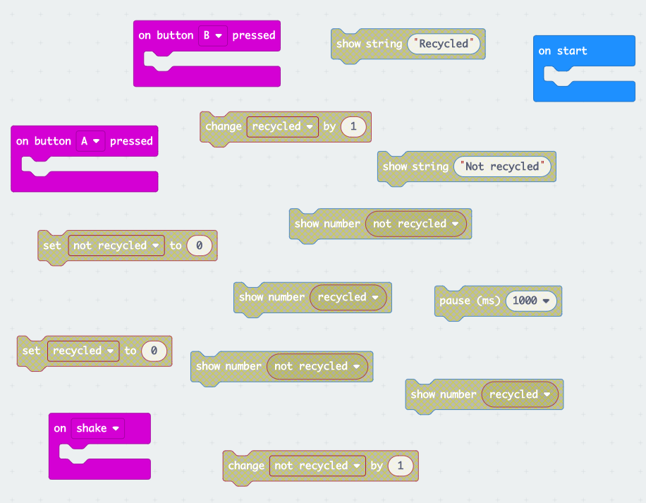
Rearrange the blocks
bit.ly/mb-bf

Slide 7
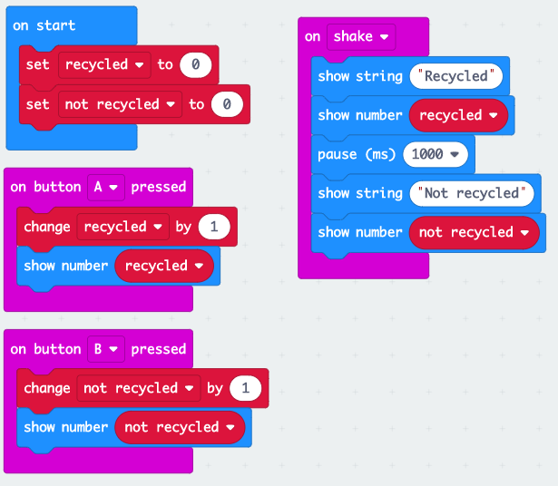

Slide 8
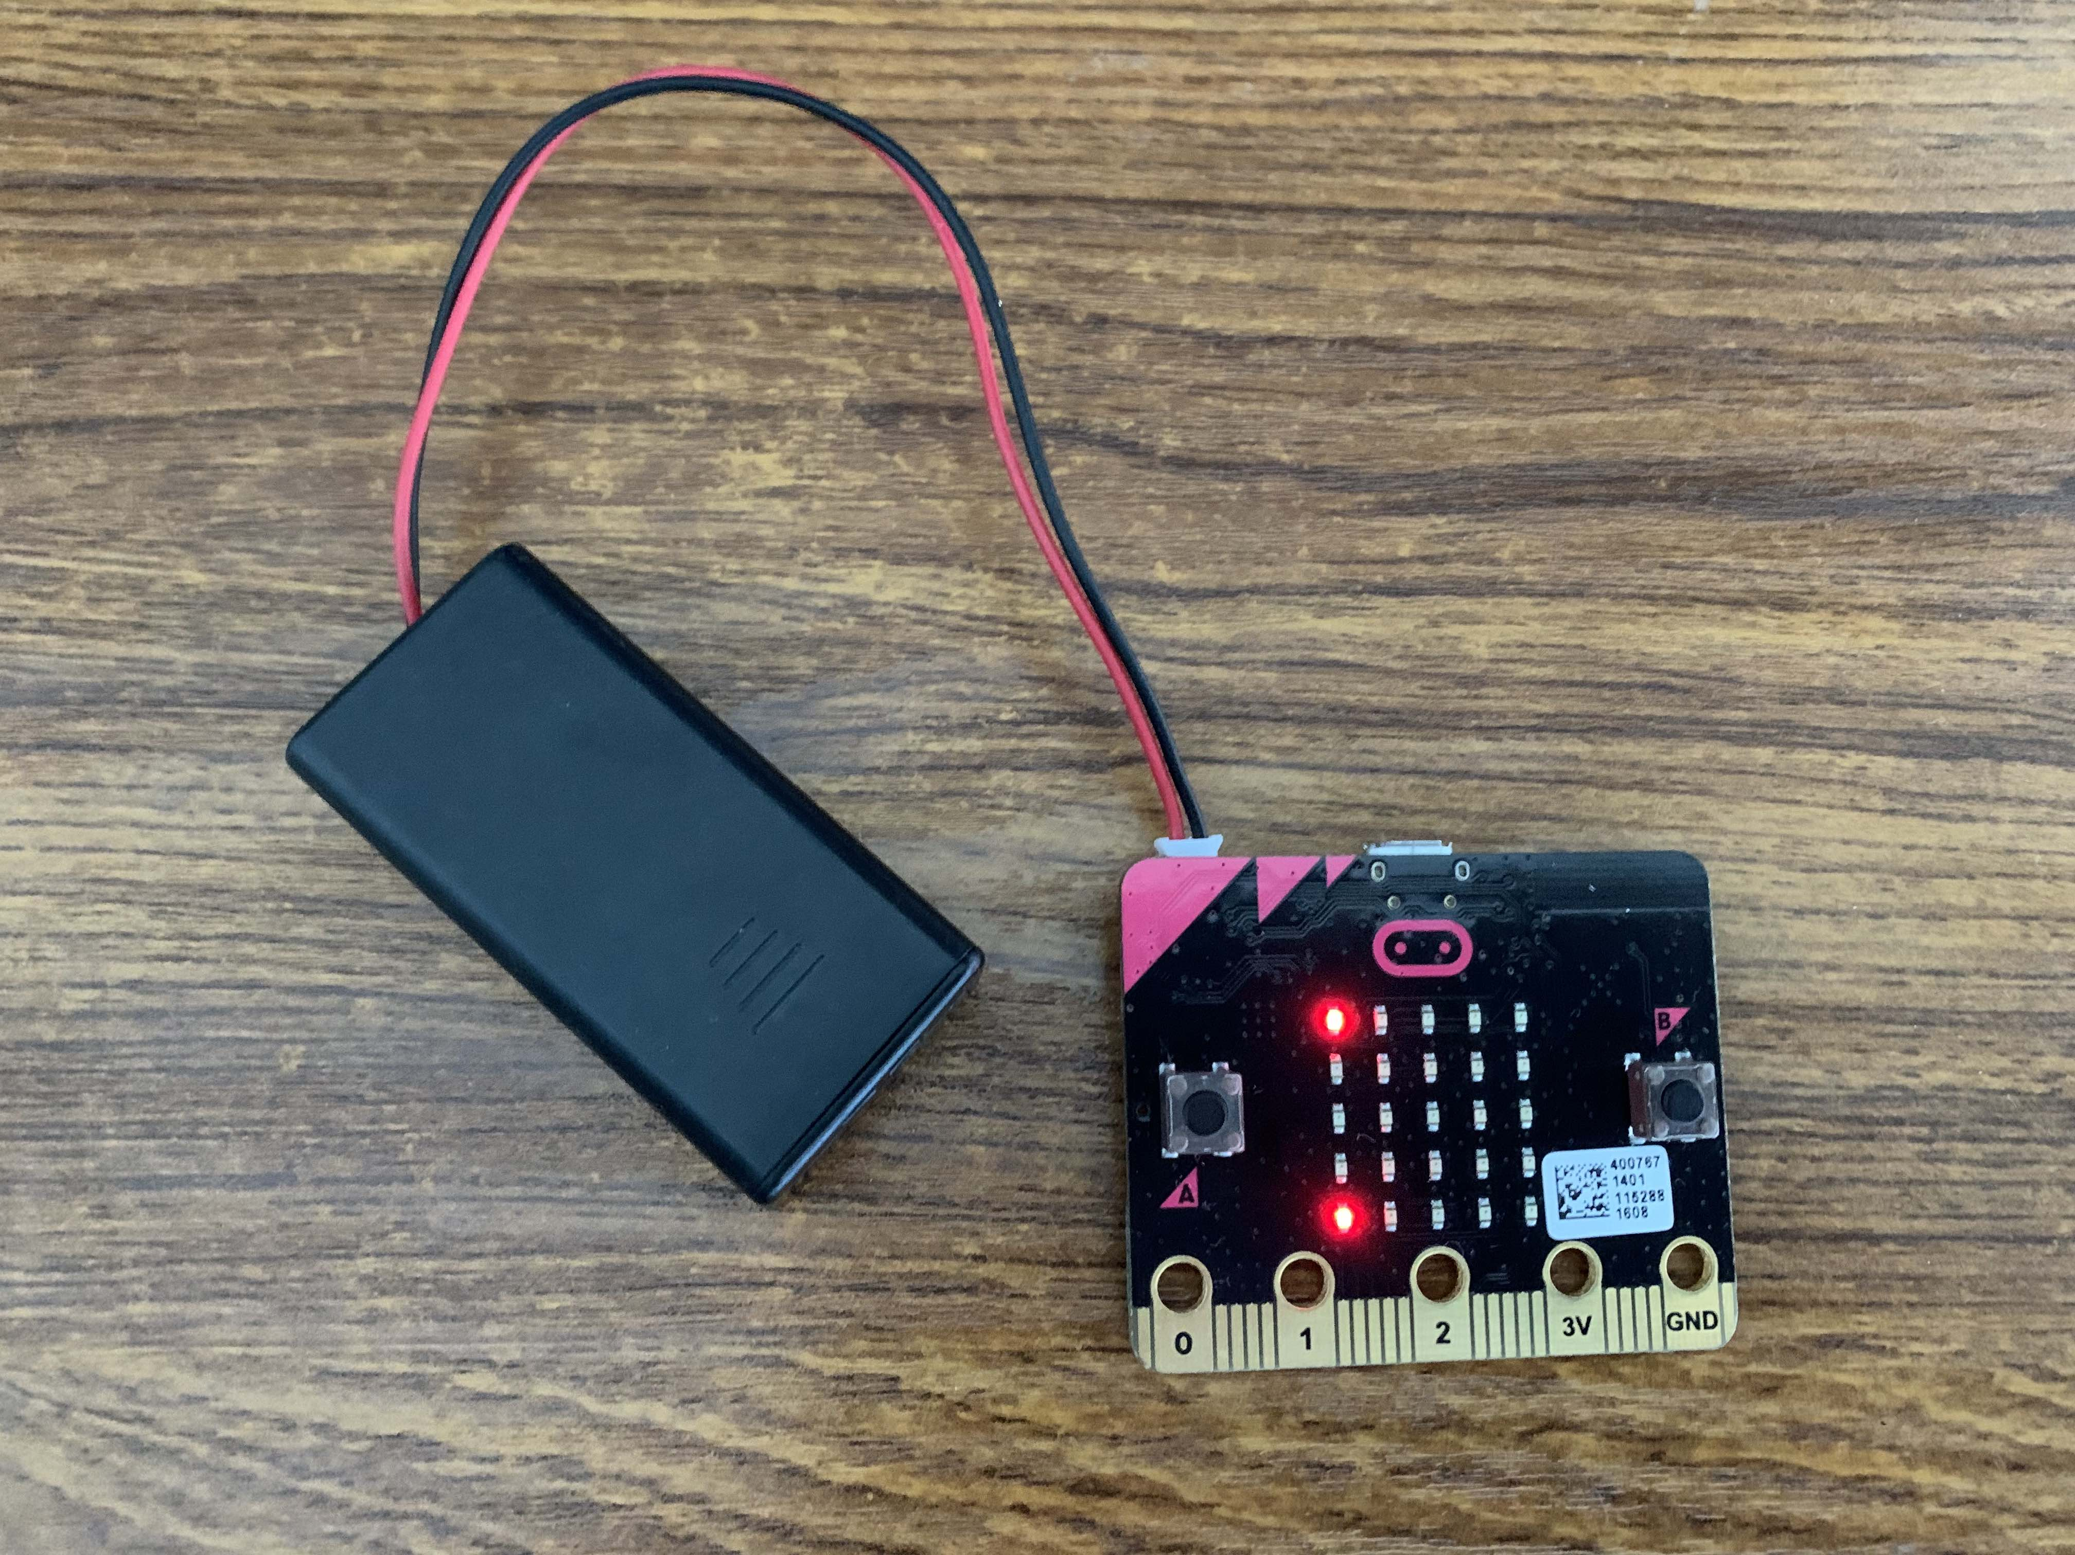
Battery pack

Slide 9
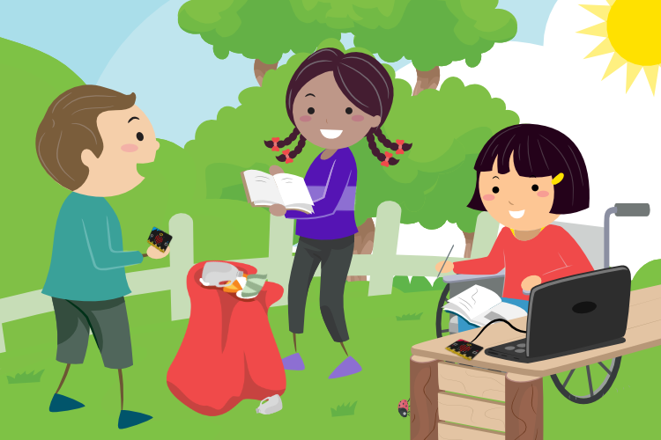
Let’s go on a litter hunt!
What materials and objects can and cannot be recycled?

Slide 10
Let’s go on a litter hunt!
What materials and objects can and cannot be recycled?
Plastic
Paper
Cardboard
Cans
Batteries
Glass
Clothes
Electronics
Wood
Metal

Slide 11
Plenary
How much of each type of litter did you find?
How might you present your findings to the environmental organisation?

