Slide 1
Sensory Classroom
Teacher lesson guide
Lesson 2

Slide 2
Learning objectives:
to use pseudocode to write an algorithm for a light pattern
to use iteration in algorithms and programs to create a repeating light pattern
to evaluate an algorithm and program to ensure they meet criteria

Slide 3
A sensory classroom
What are sensory classrooms?
What benefits do they offer learners?

Slide 4
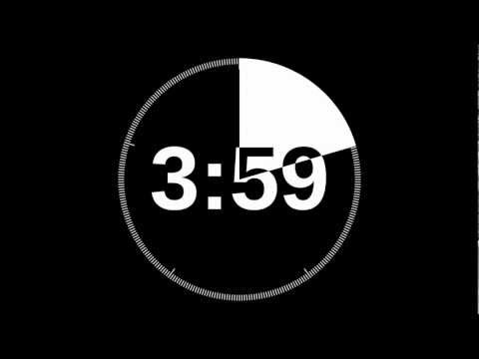
A Sensory classroom challenge
We would like to bring sensory elements into our classroom.
Sketch your ideas for how we could incorporate features from a sensory classroom.

Slide 5
Light patterns
We are going to create sensory aids that use light patterns.
What benefits could light patterns have for learners who are sensitive to visual stimuli?

Slide 6
Appropriate patterns
Which of the following images would be suitable for a sensory aid?
What do the suitable images have in common?

Slide 7
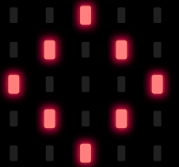
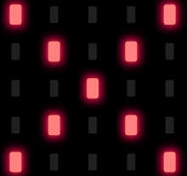
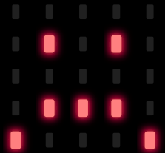
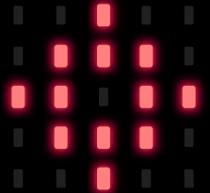
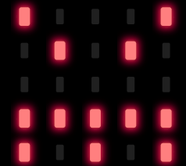
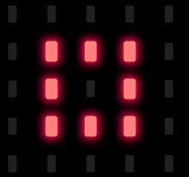
Appropriate images
text
a
b
c
d
e
f
Notes:
A, D and F are the most appropriate images as they are symmetrical and non-threatening
C and E both depict an unpleasant face
B can be associated with failure and negativity

Slide 8
Creating light patterns
How could this diagram be used to record a light pattern?

Slide 9
Sequencing a light pattern
Use the blank 5 x 5 light grids to plan each stage of your repeating pattern.
Label each image to identify its position with the sequence.

Slide 10
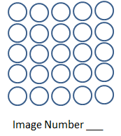
Sequencing a light pattern

Slide 11
Writing algorithms
What do you know about algorithms?
What is pseudocode and why it is useful?
Your challenge:
Write a pseudocode algorithm to create a light pattern using micro:bit

Slide 12
Algorithm criteria
Light pattern starts with an input
Images are symmetrical and non-threatening
Each image displays for 1-3 seconds
The pattern is repeated 4-8 times
No pattern is shown when the sequence has finished

Slide 13
Writing algorithms
What commands do you think our algorithm will use?
What is an input and how might we use it?
What is an output and how might we use it?
What is iteration and how might we use it?

Slide 14
Computer science concepts
Input devices
Hardware that sends data to a computer system.
Output devices
Hardware used to communicate data that has been processed.

Slide 15
Computer science concepts
Iteration
Makes algorithms and programs quicker and simpler to write.
Removes unnecessary steps
Makes programs more efficient to run

Slide 16
Sharing algorithms
How does your algorithm meet the criteria?
Light pattern starts with an input
Images are symmetrical and non-threatening
Each image displays for 1-3 seconds
The pattern is repeated 4-8 times
No pattern is shown when the sequence has finished

Slide 17
Programming micro:bit using your algorithm
How have you previously programmed using micro:bit?
Create a micro:bit program to show your repeating light pattern - remember to debug as you go.
https://makecode.microbit.org/
Notes:
https://makecode.microbit.org/

Slide 18
Paired programming
2 programmers working together to code
One types the code (driver)
One watches the driver, checks the code, makes suggestions (navigator)
work collaboratively, talking through problems
Why might this be helpful?
more accurate code written in shorter time
can collaboratively work through problems

Slide 19
Evaluating programs
Share your program with another pair
Does the program meet the criteria?
Light pattern starts with an input
Images are symmetrical and non-threatening
Each image displays for 1-3 seconds
The pattern is repeated 4-8 times
No pattern is shown when the sequence has finished
https://makecode.microbit.org/#pub:_0KU0P98eAKTE
Notes:
Output can be via the emulator or on a micro:bit

Slide 20
Sharing learning
Share the different ways that the light pattern could be started.
Share 3 things you have learnt in today’s lesson

Slide 21
Learning objectives:
to use pseudocode to write an algorithm for a light pattern
to use iteration in algorithms and programs to create a repeating light pattern
to evaluate an algorithm and program to ensure they meet criteria

Slide 22
Licensing information
Published by the Micro:bit Educational Foundation microbit.org
Licence: Attribution-ShareAlike 4.0 International (CC BY-SA 4.0)

