Slide 1
Electrical conductors
Teacher lesson guide
Lesson 4

Slide 2
Learning objectives:
To plan, write, test and debug programs.
To write programs that use selection.
To write programs that use inputs and outputs.

Slide 3
The BBC micro:bit inputs
What are inputs?
What inputs did you discover on micro:bit in the previous session?

Slide 4
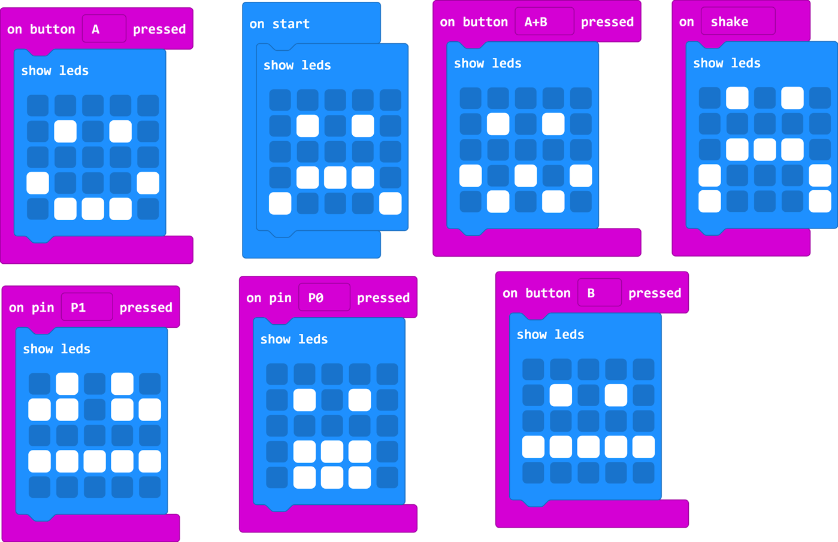
How do I show the output?
https://makecode.microbit.org/#pub:_2htEdAXKe7zD

Slide 5
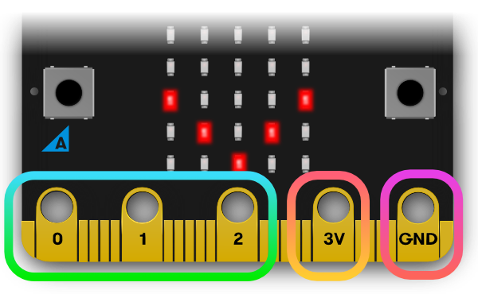
Using pins
The micro:bit has pins that can be used as inputs
By connecting crocodile clips to either pin 0, 1 or 2 and another to GND pin we can create a circuit and use the pins as an input.

Slide 6
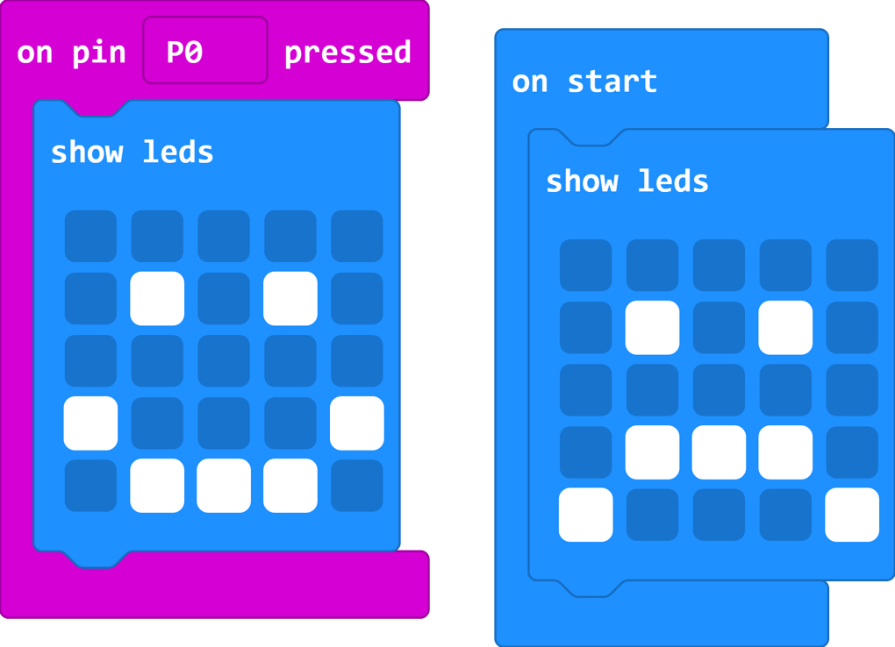
How would we change the output?
https://makecode.microbit.org/#pub:_WKpHpv0mo8e5
Notes:
Use the makecode editor (click the image) to test pupils’ ideas. Download the program and transfer it to a micro:bit. Ask pupils to explore how to get the program to output to change when using the device.

Slide 7
Testing electrical conductivity
How could we use the micro:bit as a way of testing the electrical conductivity of materials?
Use a decision box and the LED planner to plan your program.
What will the output be if the material is/isn’t a conductor?

Slide 8
Plan, program and carry out
Complete your plan
Write your program using the MakeCode editor (remember to test it before downloading)
Transfer to your micro:bit and test the materials
Record your findings in the table provided

Slide 9
Comparing conductivity tests
What ways have we tested if materials are electrical conductors?
Were the same materials identified as conductors in both methods?

Slide 10
Comparing conductivity tests
 | Pros | Cons
Electrical Circuit
BBC micro:bit
Notes:
Electrical Circuit Pros - already knew how to build circuits, Cons - a lot of equipment so it couldn’t be moved about
Micro:bit Pros - small so it can be moved around to test different objects, Cons - need to write a program to create an electrical conductor test

Slide 11
Learning objectives revisited:
To plan, write, test and debug programs.
To write programs that use selection.
To write programs that use inputs and outputs.

Slide 12
Yes
No

Slide 13
LED Planner

Slide 14
Licensing information:
Published by the Micro:bit Educational Foundation microbit.org under the following Creative Commons licence:
Attribution-ShareAlike 4.0 International (CC BY-SA 4.0) https://creativecommons.org/licenses/by-sa/4.0/

