Slide 1
Electrical conductors
Teacher lesson guide
Lesson 3

Slide 2
Learning objectives:
To review outputs.
To understand and identify inputs.
To use tinkering to find inputs on the BBC micro:bit.
To represent selection with inputs using decision boxes.

Slide 3
Outputs
What are outputs and how have we used them so far in this unit?
What outputs have you used when programming the micro:bit?
Notes:
Pupils should identify that the LEDs on micro:bit are an output

Slide 4
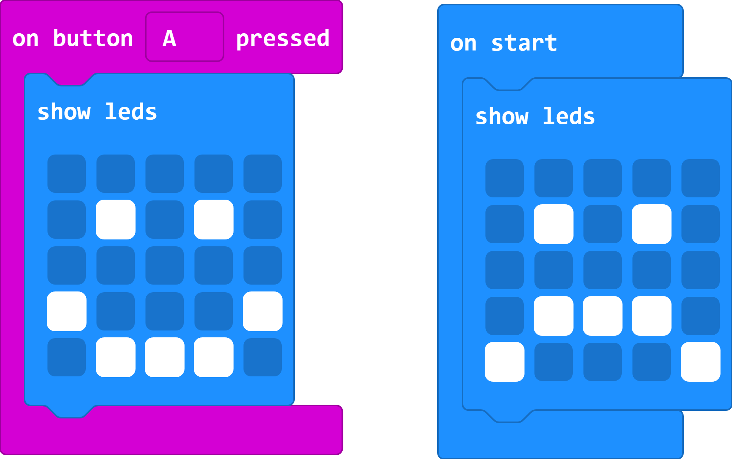
Changing faces
https://makecode.microbit.org/#pub:_03F12hWbDUEC
Notes:
Discuss which output micro:bit will show (the sad face) and how the happy face can be shown (by pressing button a). Click on the image to access the same program in the make code editor and use the simulator to test out pupils’ ideas.

Slide 5
Inputs
An input is a way of getting information into a system.
We use inputs to control and interact with electronic gadgets.
Keyboards, touchscreen devices, microphones, buttons are all inputs.
Can you think of any other examples of inputs?

Slide 6
Selection
What does the term selection mean?
What condition needed to be met to show they happy face?
What was the output when the condition wasn’t met?

Slide 7
Represent the program in this decision box
Yes
No
Notes:
Disc

Slide 8
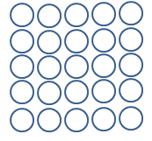
LED Planner

Slide 9
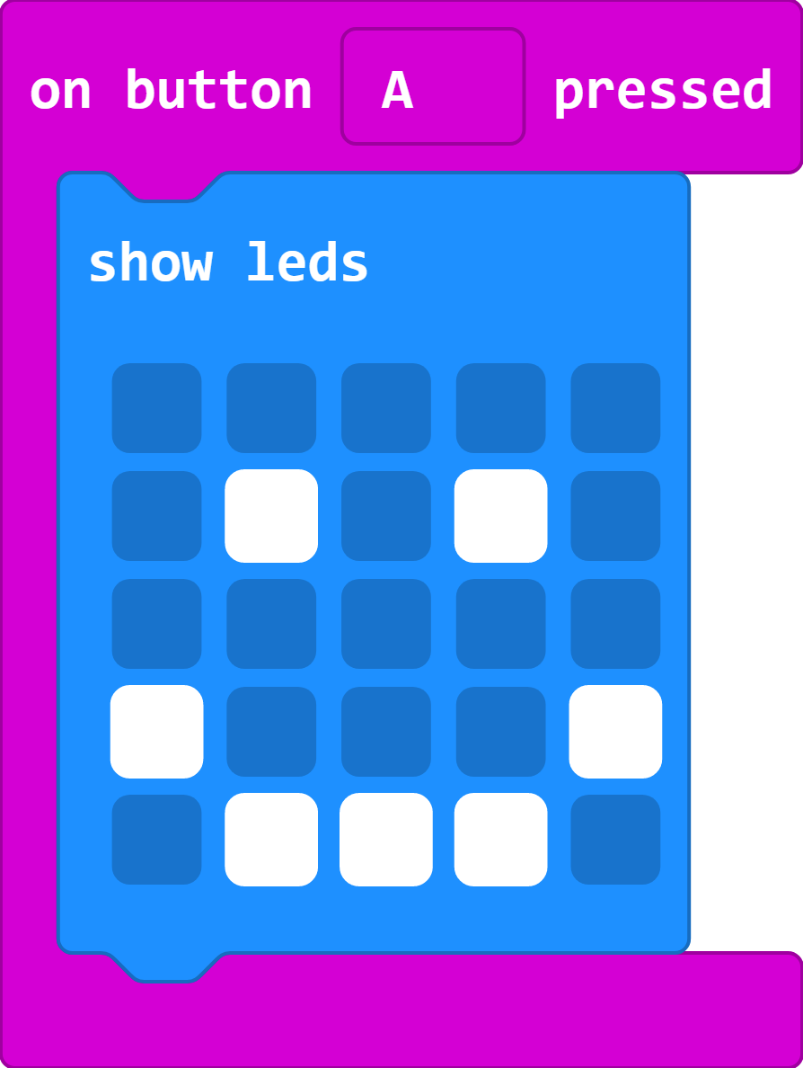
Tinkering with inputs
Button A is one of several inputs on the micro:bit
Tinker with the program to find other ways that can be used to control the micro:bit
For each input you use, create a decision box to show your findings.

Slide 10
Reviewing inputs
Which inputs did you discover through your tinkering?
Did all of these inputs work with the simulator?
Modify the program to show how your input works.

Slide 11
Learning objectives revisited:
To review outputs
To understand and identify inputs
To use tinkering to find inputs on micro:bit
To represent selection with inputs using decision boxes

Slide 12
Yes
No

Slide 13
LED Planner

Slide 14
Licensing information:
Published by the Micro:bit Educational Foundation microbit.org under the following Creative Commons licence:
Attribution-ShareAlike 4.0 International (CC BY-SA 4.0) https://creativecommons.org/licenses/by-sa/4.0/

