Slide 1
Sensory Classroom
Teacher lesson guide
Lesson 3

Slide 2
What’s in a sensory classroom?
Draw a sketch of a sensory classroom and what you might find inside.
Annotate your diagram to explain:
What are sensory classrooms?
Who can benefit from sensory classrooms and how?
What sensory aids are present?
How are the sensory aids used?

Slide 3
Learning objectives:
To create a sensory aid for a classroom that meets a given criteria
To use pseudocode to write an algorithm using inputs, outputs, iteration and selection

Slide 4
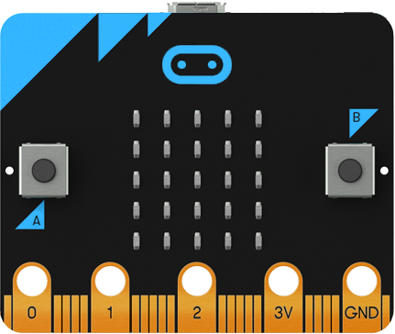
Design and build challenge
Design and build a classroom sensory aid using visual stimulus and micro:bit

Slide 5
Classroom sensory aid criteria
Provides a visual stimulus
Allows user interaction
Uses micro:bit
Conceals any wires and power-supply

Slide 6
Sensory aid planning sheet
My Design
Design Criteria
Provides a visual stimulus
Allows user interaction
Conceals wires and power-supply
My Algorithm
Materials to be used

Slide 7
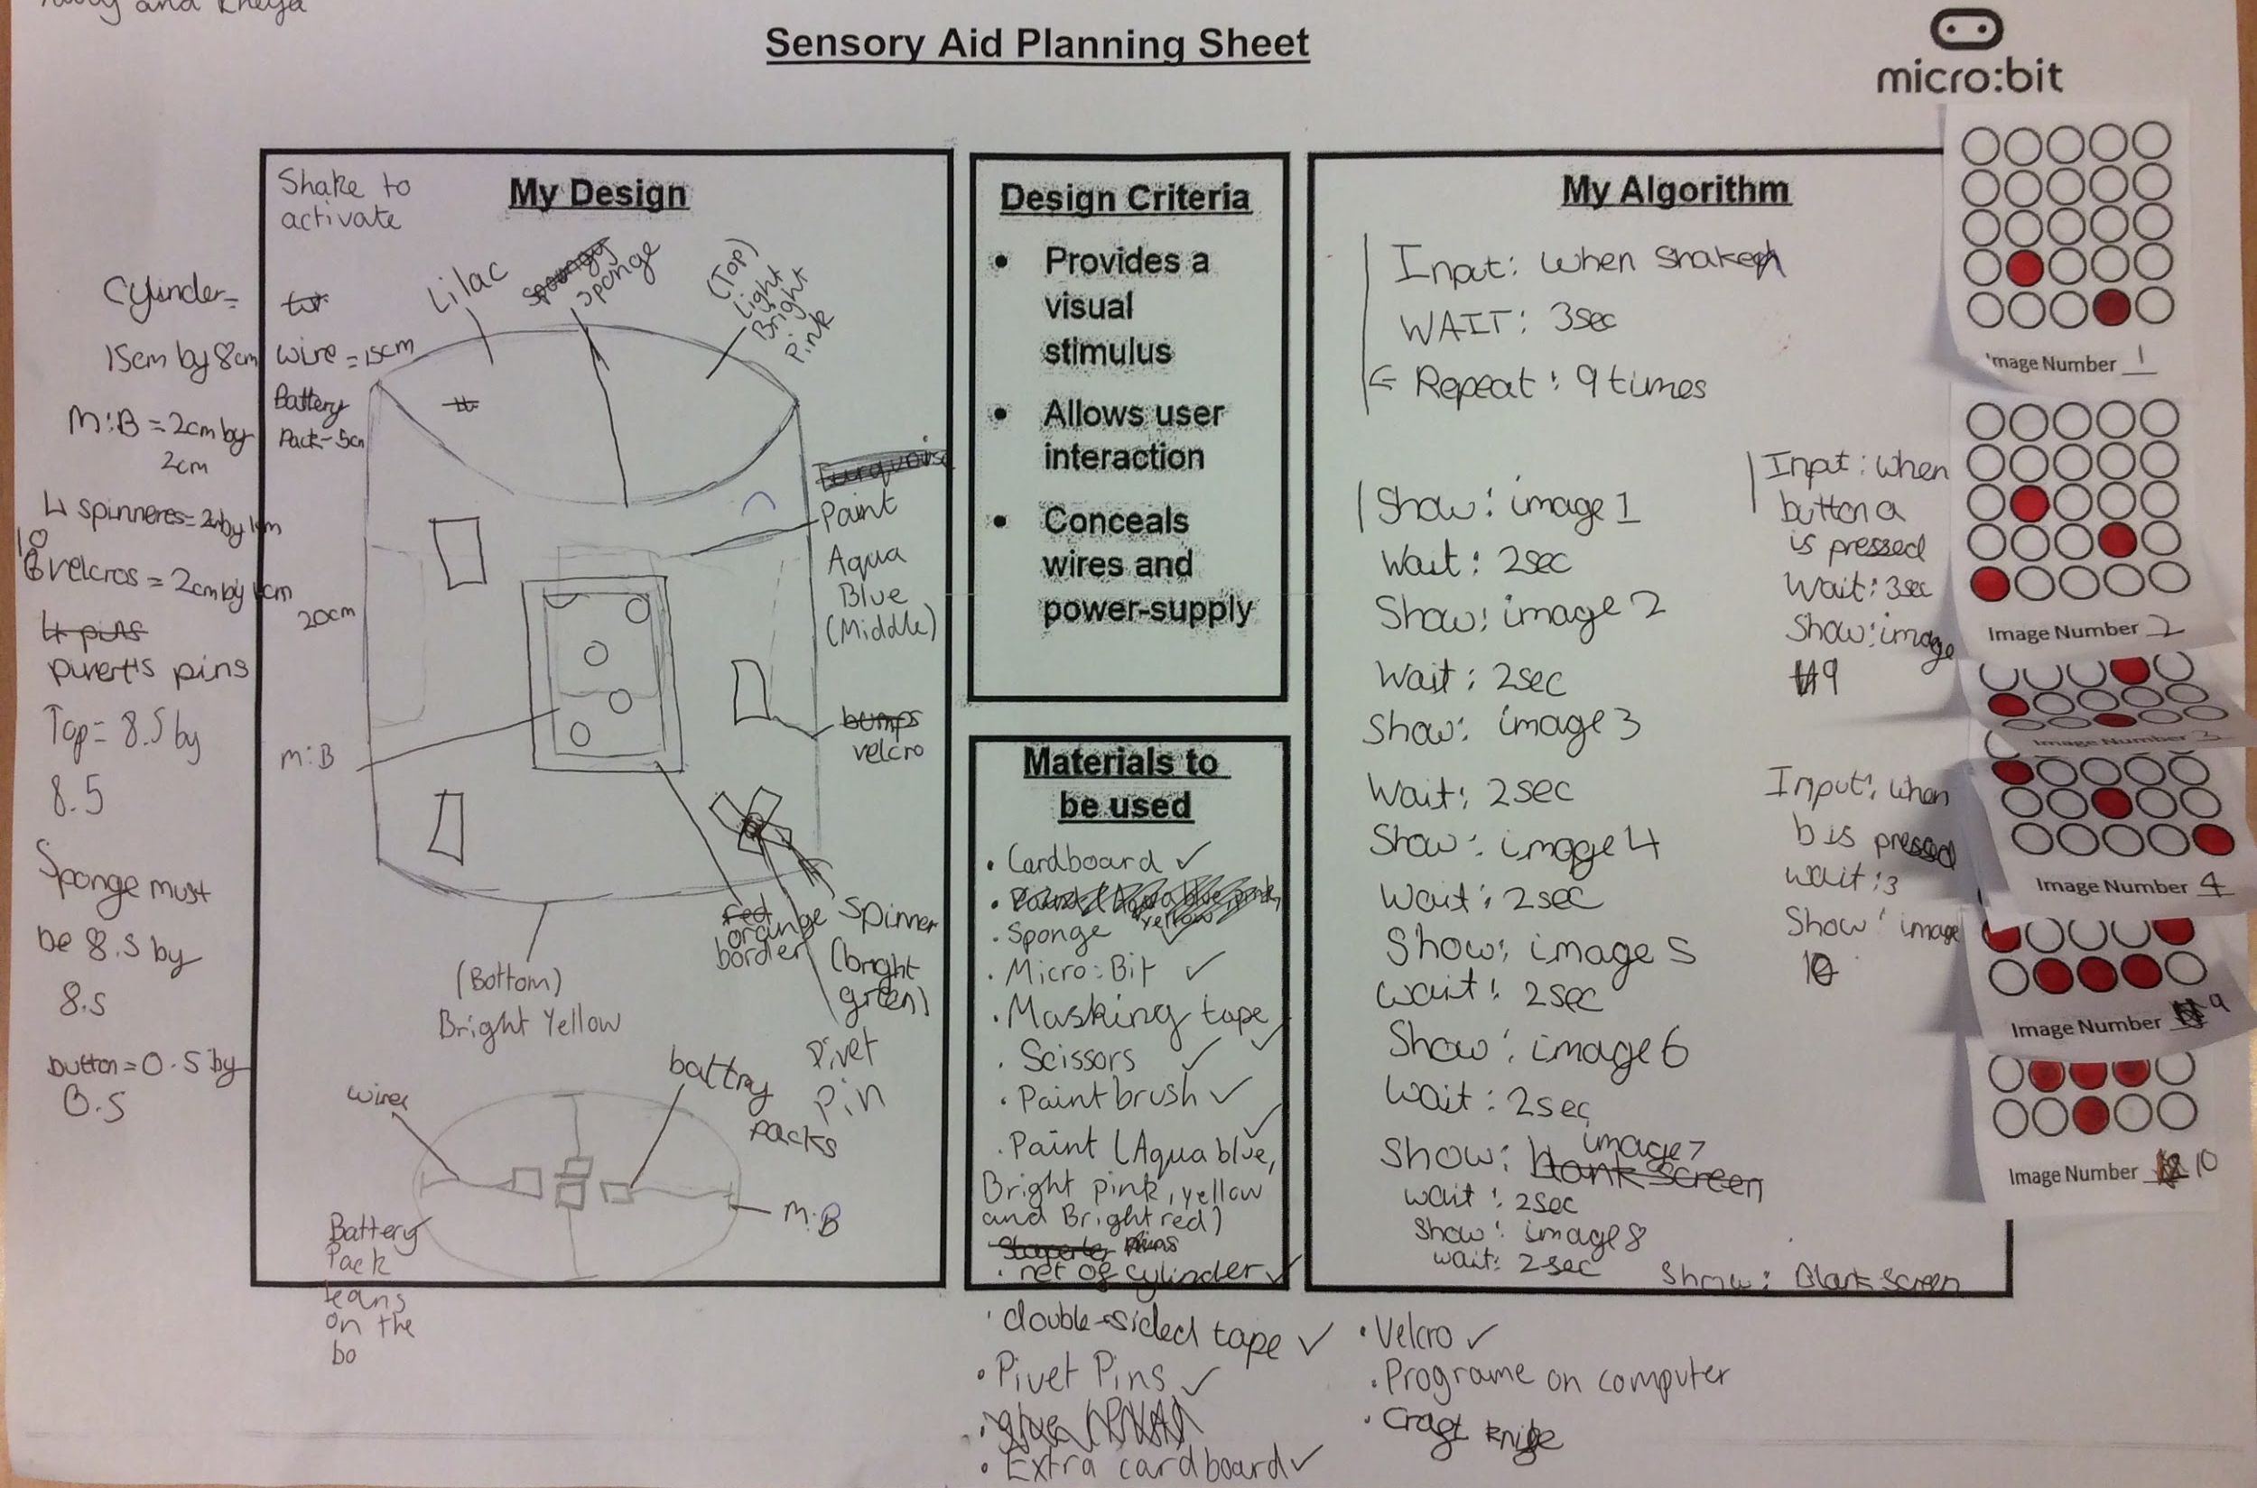
Example of completed plan
Notes:
On this plan, the students have indicated the shape of their sensory aid, the colours it will be, the position of micro:bit and the power supply (including how they will be secured) the size of the hole that needs to cut in the cupboard cylinder to make the LEDs visible, the materials and equipment they will use, the images the LED will show and an algorithm to support their programming. A copy of micro:bit file containing the program can be found in the lesson folder. The program can be viewed here https://makecode.microbit.org/_DUE5WREubb9r

Slide 8
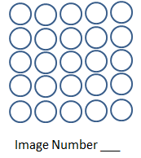
Sequencing a Light Pattern

Slide 9
Computer science concepts
Inputs and Outputs
Input devices
Hardware that sends data to a computer system.
Output devices
Hardware used to communicate data that has been processed.

Slide 10
Computer science concepts
Iteration
Makes algorithms and programs quicker and simpler to write.
Removes unnecessary steps
Makes programs more efficient to run
Selection
allows choices/decisions to be included
enables different pathways through an algorithm and program to be included

Slide 11
Classroom sensory aid criteria
Provides a visual stimulus
Allows user interaction
Uses micro:bit
Conceals any wires and power-supply

Slide 12
Example of completed plan
Notes:
On this plan, the students have indicated the shape of their sensory aid, the colours it will be, the position of micro:bit and the power supply (including how they will be secured) the size of the hole that needs to cut in the cupboard cylinder to make the LEDs visible, the materials and equipment they will use, the images the LED will show and an algorithm to support their programming. A copy of micro:bit file containing the program can be found in the lesson folder. The program can be viewed here https://makecode.microbit.org/_DUE5WREubb9r

Slide 13
Sharing designs
Share your classroom sensory aid design.
Explain how the user will benefit from using your aid and how you are intending to meet the requirements of the design criteria.
Ask questions and give constructive feedback

Slide 14
Learning objectives revisited:
To create a sensory aid for a classroom that meets a given criteria.
To use pseudocode to write an algorithm uses inputs, outputs iteration and selection

Slide 15
Licensing information
Published by the Micro:bit Educational Foundation microbit.org
Licence: Attribution-ShareAlike 4.0 International (CC BY-SA 4.0)

