Slide 1





Cryptogaphy
Teacher lesson guide
Lesson 1

Slide 2
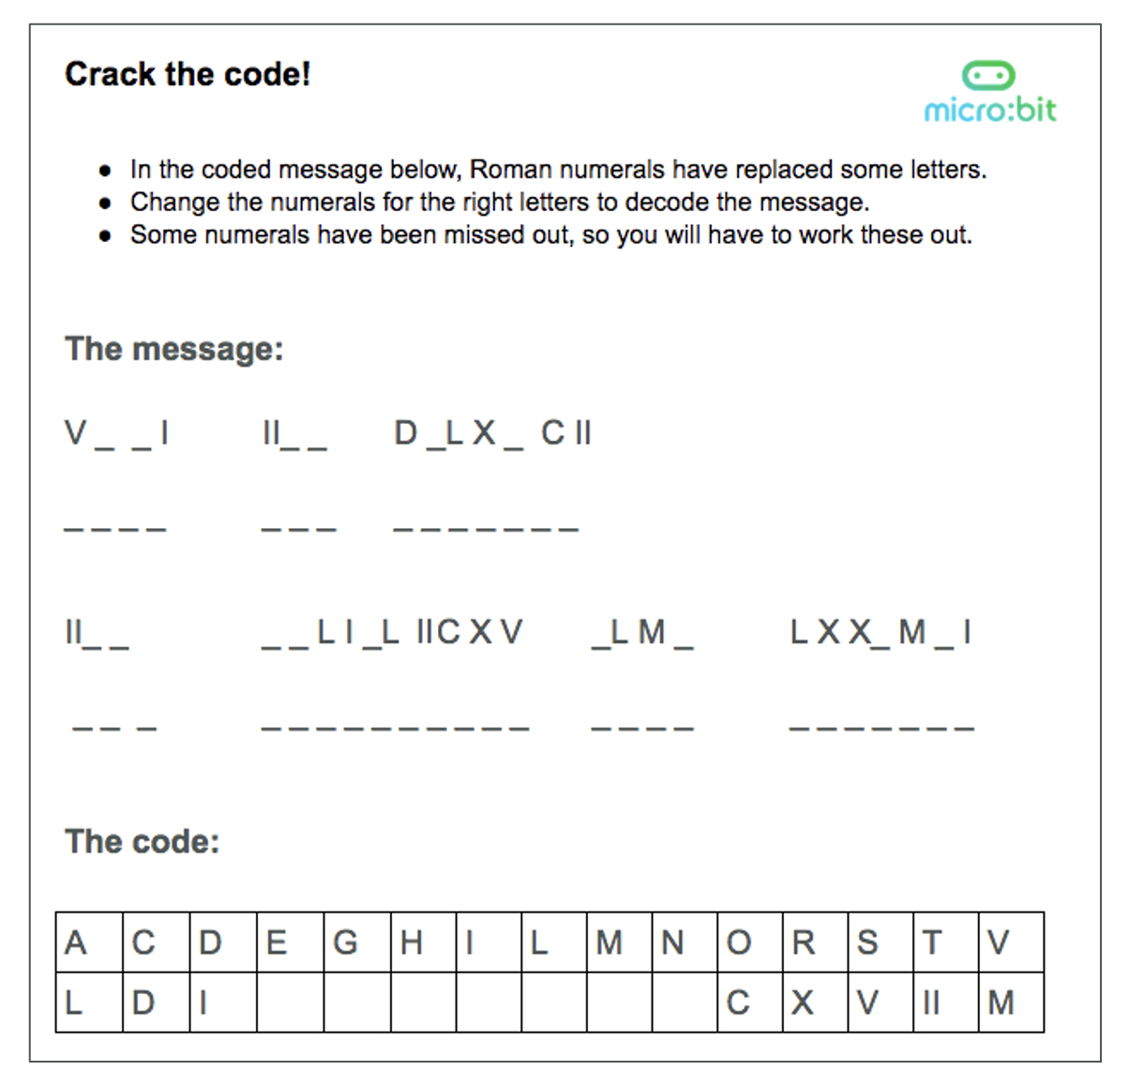
Crack the code!

Slide 3
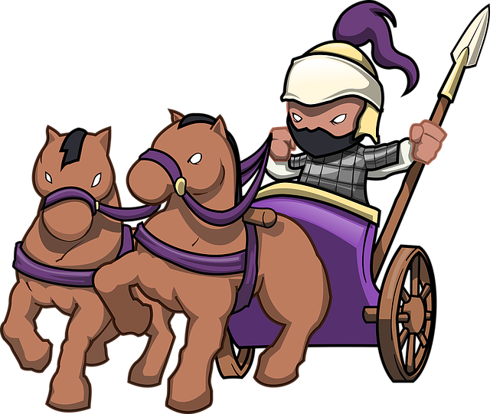
Crack the code!
Send the chariot, the gladiators have arrived!

Slide 4

Logical reasoning
Applying rules to solving problems
Using existing knowledge to make predictions
Explaining why something is the way it is
How did you use logical reasoning to crack the code?

Slide 5
Learning objectives:
To know what cryptography is and how it has been used over time to encrypt data and information.
To create and solve ciphers using logical reasoning
To appreciate the importance of code breaking in World War Two through learning about Alan Turing

Slide 6

What do you know about cryptography?
used to send messages so they can only be read by the intended recipient
used from ancient times
ciphers are used to scramble and descramble messages and information (encryption)

Slide 7
Atbash cipher (substitution)
very old cipher used with Hebrew alphabet (characters)
one of the easiest to use - very simple substitution
can you work it out using the Roman alphabet below?
the 1st letter becomes the last and so on
A | B | C | D | E | F | G | H | I | J | K | L | M | N | O | P | Q | R | S | T | U | V | W | X | Y | Z
Z | Y | X | W | V | U | T | S | R | Q | P | O | N | M | L | K | J | I | H | G | F | E | D | C | B | A

Slide 8
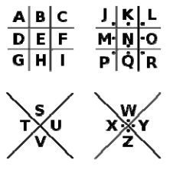
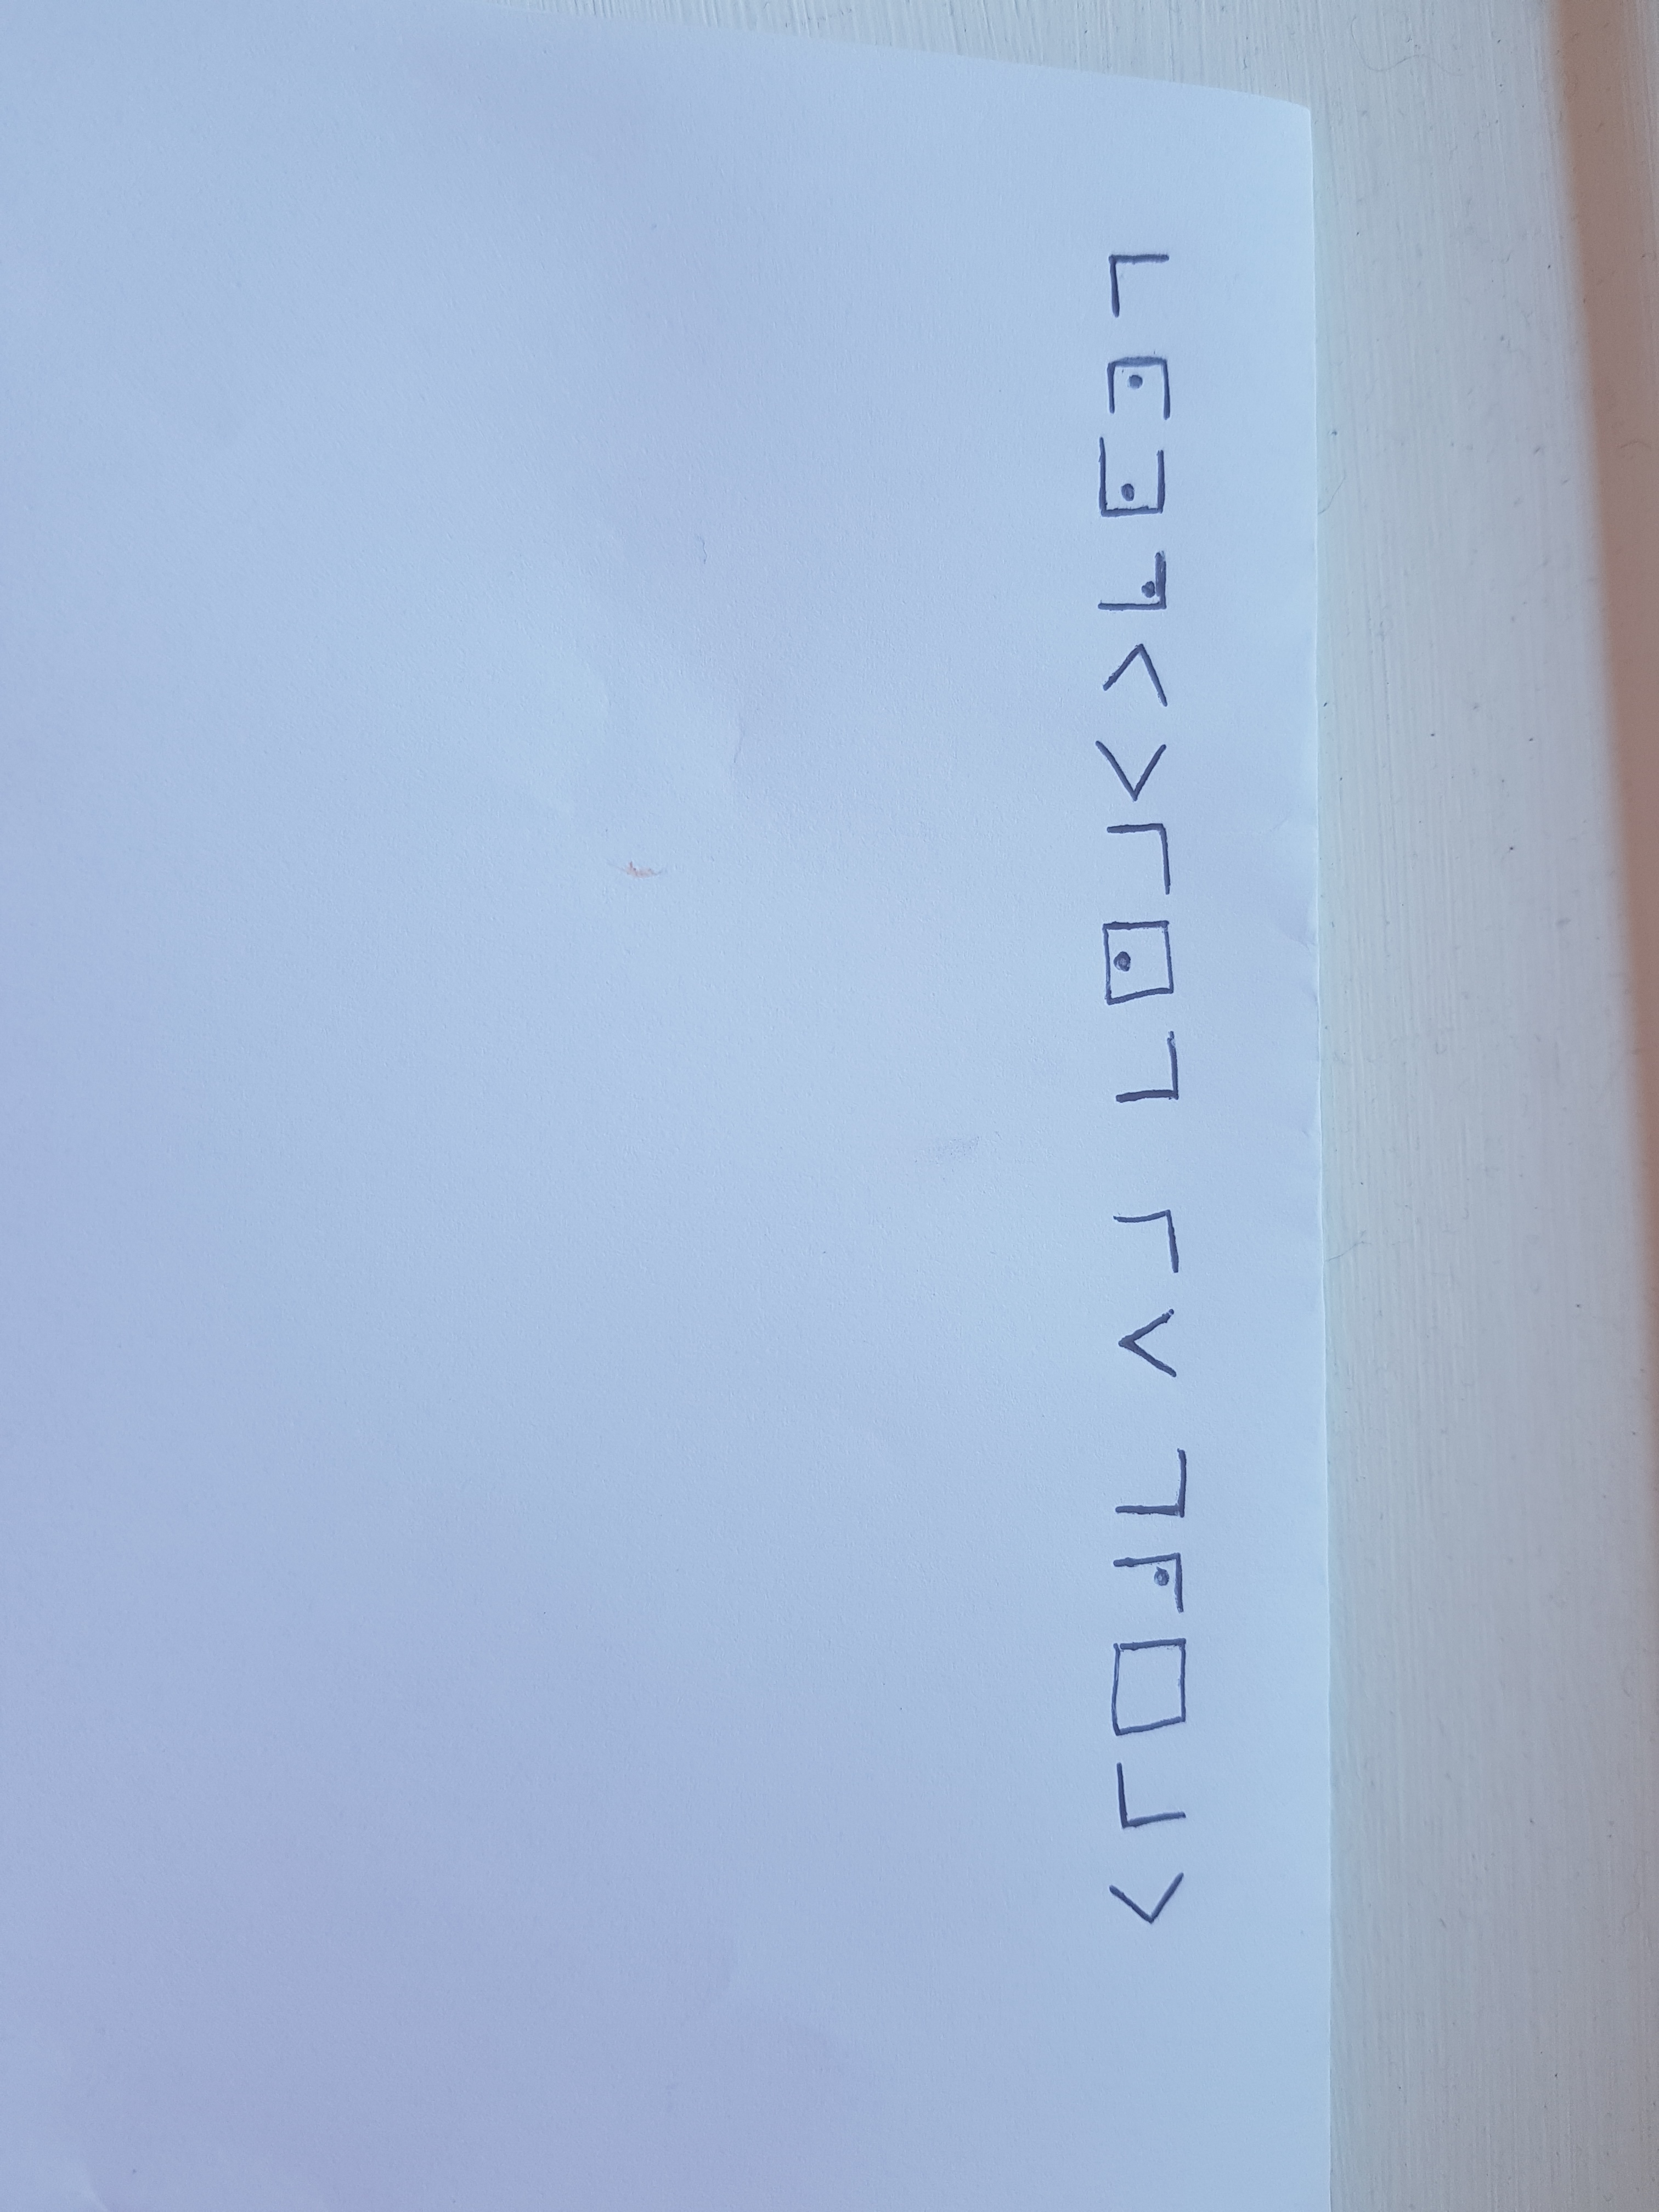
Pigpen cipher (substitution)
Symbol substitution cipher, used in 18th Century
substituted each letter of the alphabet with a symbol
can you work out what the phrase is?
Computing is great

Slide 9

The Caesar cipher (shift)
first used by Julius Caesar @ 58BC
Caesar used a cipher to ensure commands to his army appeared meaningless to enemies
is an example of a shift cipher
can you work it out?
  each letter is ‘shifted’ 3 places
A | B | C | D | E | F | G | H | I | J | K | L | M | N | O | P | Q | R | S | T | U | V | W | X | Y | Z
X | Y | Z | A | B | C | D | E | F | G | H | I | J | K | L | M | N | O | P | Q | R | S | T | U | V | W

Slide 10
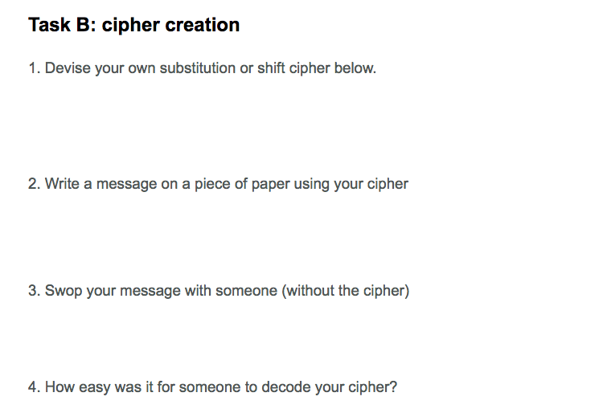
Cipher challenge

Slide 11
Logical reasoning
Applying rules to solving problems
Using existing knowledge to make predictions
Explaining why something is the way it is
How did you use logical reasoning to design and solve your ciphers?

Slide 12
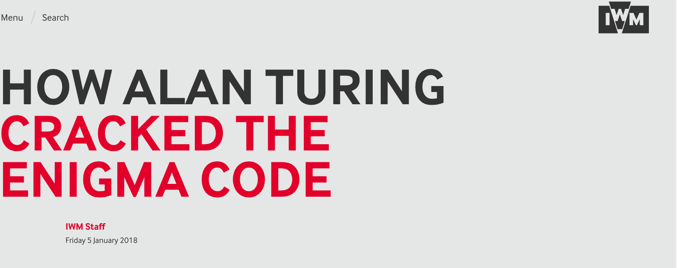
What do you know about code breaking in World War 2?
Your task:
Search for “IWM+Alan Turing”
Research & summarise the story around Turing, Enigma and Bletchley Park.
Notes:
Click on image to launch website. Web address is: https://www.iwm.org.uk/history/how-alan-turing-cracked-the-enigma-code

Slide 13

Encryption in our lives today
what types of encryption can you think of in your life?
  buying something online (https)
  logging in to online banking
  paying using your mobile phone
encryption increases security and confidentiality

Slide 14
Learning review
Discuss 3 things you have you learnt during today’s lesson?
How have you used logical reasoning?
What would you still like to learn?

Slide 15
Learning objectives revisited:
To know what cryptography is and how it has been used over time to encrypt data and information.
To create and solve ciphers using logical reasoning
To appreciate the importance of code breaking in WWII through learning about Alan Turing

Slide 16
Licensing information
Published by the Micro:bit Educational Foundation microbit.org
Licence: Attribution-ShareAlike 4.0 International (CC BY-SA 4.0)

