Slide 1
Health Tech
Teacher lesson guide
Lesson 1

Slide 2
The Health of the Nation
Top 5 causes of premature death in the UK
Focus on prevention
Public Health facts
Adolescent health problems
The costs of being unhealthy

Slide 3
Health tech
The use of technology to improve health

Slide 4
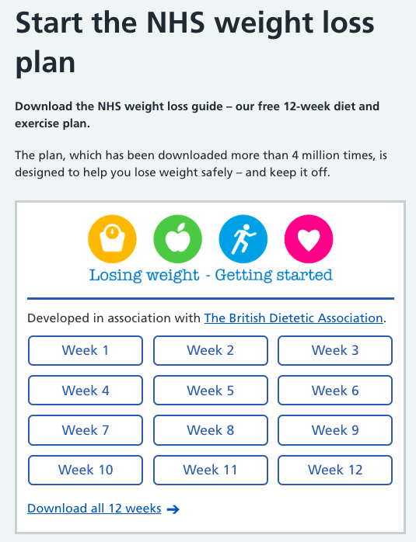
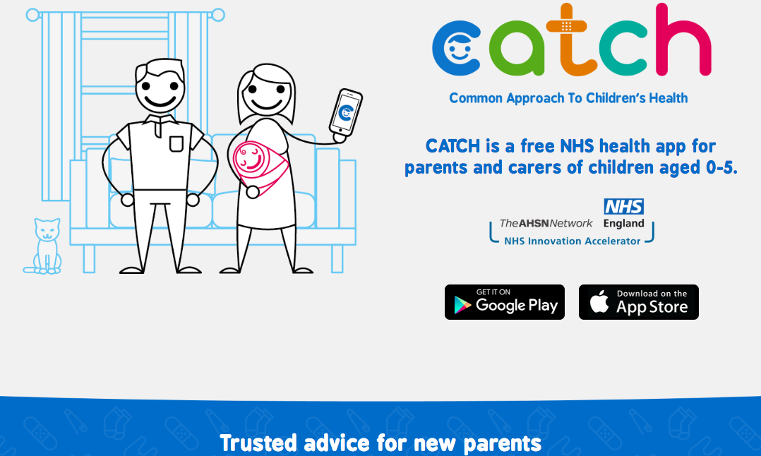
How can technology help?
access to health advice

Slide 5
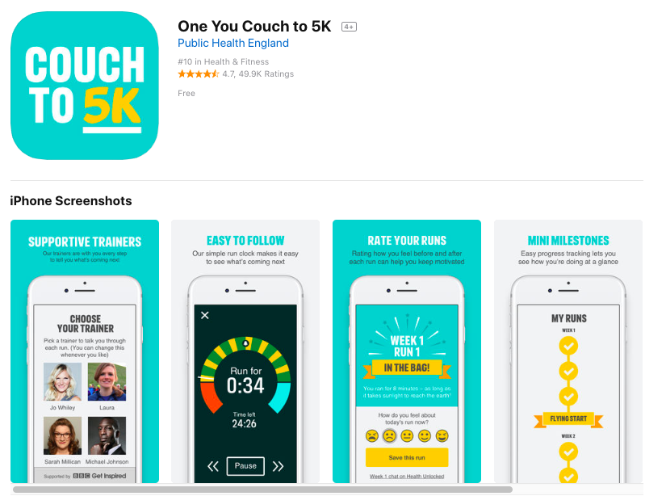
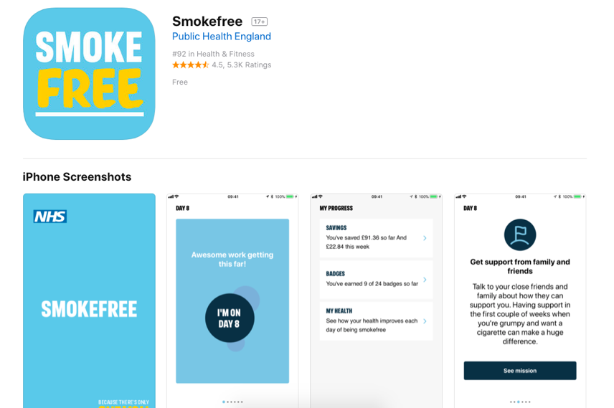
How can technology help?
offer support to help to change behaviour
step tracker

Slide 6
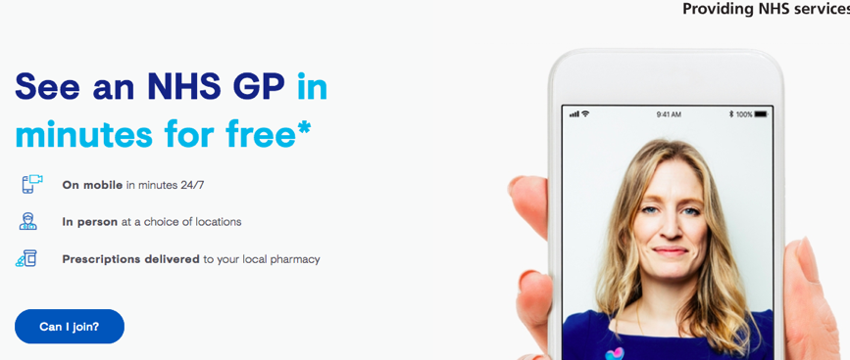
How can technology help?
improve access to doctors

Slide 7
Learning objectives:
to understand some of the UK’s biggest health challenges
to be able to explain ‘Health Tech’
to research and evaluate real-life examples of health tech being used to address health challenges

Slide 8
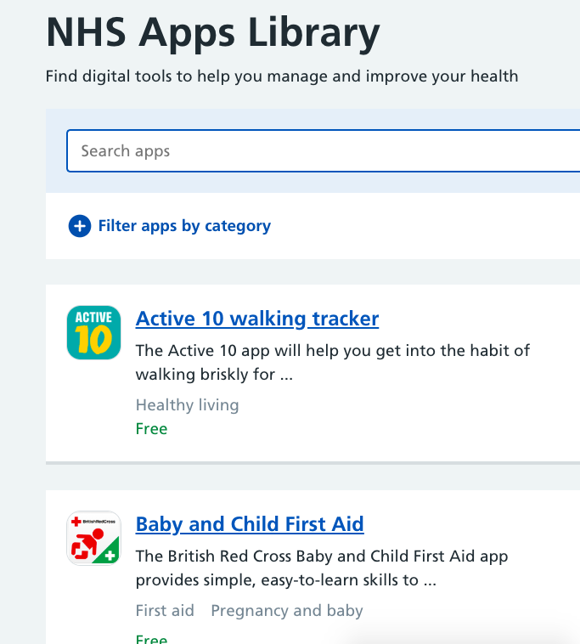
Health Tech innovations

Slide 9
Health Tech innovations
What is the innovation called?
What problem is it trying to solve?
How does it try to solve the problem?
Who are the target users?
What are the possible benefits?
What are the possible problems?

Slide 10
Lesson review
What are some of the UK’s biggest health challenges?
Using an example, explain how health tech can help address some of the UK’s big health challenges.
What do you consider are the main advantages and disadvantages of using more health tech in the UK?

Slide 11
Learning objectives revisited:
to understand some of the UK’s biggest health challenges
to be able to explain ‘Health Tech’
to research and evaluate real-life examples of health tech being used to address health challenges

Slide 12
Licensing information
Published by the Micro:bit Educational Foundation microbit.org
Licence: Attribution-ShareAlike 4.0 International (CC BY-SA 4.0)

