Slide 1
Data handling
Teacher lesson guide
Lesson 1

Slide 2
Learning objectives:
To understand what data is.
To classify data.
To identify ways that data might be used.

Slide 3
Who am I?
Select a well-known person and research information about them.
What type of information could you find out?

Slide 4
What is your person’s..?
place of birth
age
first name
number of siblings
last name
date of birth
favourite food
favourite colour
nationality

Slide 5
What is data?
Data is information collected for use elsewhere.
It is often stored in computers.
Data can be split into two parts: the name and the value: e.g. Date of birth: 23.02.1987

Slide 6
Data names and data values
Examples of data names | Examples of data values

Slide 7
Grouping data
Discuss with your partner possible ways that your data could be grouped.
Think about:
How the data is written.
If the data will always be correct.

Slide 8
Grouping data
 | Will stay the same | Will / may change
Written in words
Written in numbers

Slide 9
Who has your data?
The school has some of your data on its computer system.
What data do you think the school has on its pupils?
Why do you think the school has this data?
Which other organisations might have your data?

Slide 10
Who else has your data?
If you have loyalty cards (e.g. Game Rewards) or accounts with online retailers you will be sharing your data with them.
Why might a retailer want your data?
Notes:
Establish that by identify what they buy, the retailers can identify other similar products they may be interested in and target advertising.
Also knowing if you visit a certain shop more than others can be used to identify when and where you do your shopping.

Slide 11
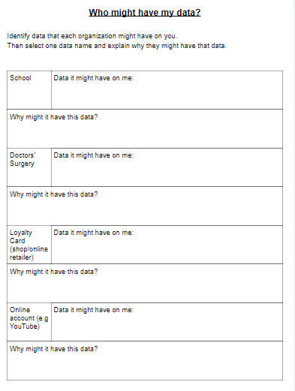
Who might have my data?
Complete the activity sheet by identifying the types of data each organisation might have about you.
Select one piece of data and give an example of how they might use this data.

Slide 12
How is your data collected?
School requests your data from your parent(s)/carer(s)
We may give organisations permission to collect our data when we accept ‘terms and conditions’ on websites or when registering a new device.

Slide 13
How is your data collected?
Many of us have internet connected device in our homes such central heating systems, smart tv, digital assistants, etc.
What data might such devices be collecting?
How might they use this data?
Notes:
We are giving information on the types of programmes we like to watch, the music we listen to, the books we read, what time of day we get up, when we are away on holiday.

Slide 14
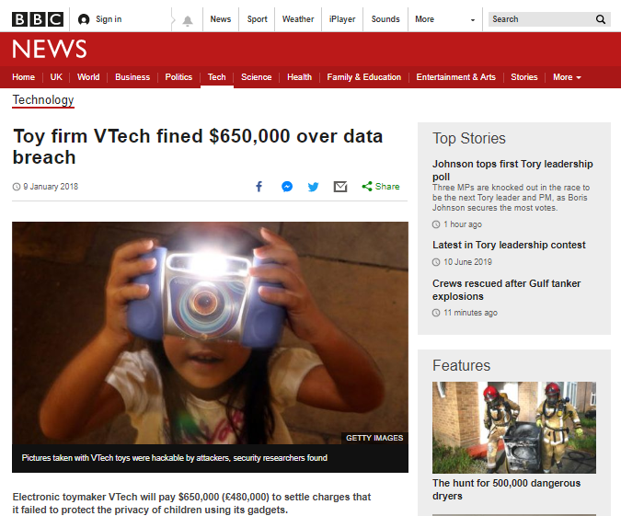
How is your data used?
Recently, there have been cases of companies who have misused people’s data or not kept it secure.

Slide 15
Learning objectives revisited:
To understand what data is.
To classify data.
To identify ways that data might be used.

Slide 16
What data can you find?

Slide 17
What data can you find?

Slide 18
What data can you find?
place of birth: London
first name: Matilda
date of birth: 08.11.2001
number of siblings: 4
last name: Ramsay
favourite emoji: cherries
age:17
home: Los Angeles
favourite colour: green

Slide 19
Licensing information:
Published by the Micro:bit Educational Foundation microbit.org under the following Creative Commons licence:
Attribution-ShareAlike 4.0 International (CC BY-SA 4.0) https://creativecommons.org/licenses/by-sa/4.0/

