Slide 1
Nature art
Teacher lesson guide
Lesson 4

Slide 2
Learning objectives:
To use logical reasoning to predict the output of programs.
To plan and write algorithms and programs to create LED nature art.
To evaluate programs.

Slide 3
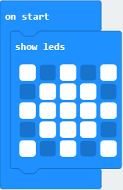
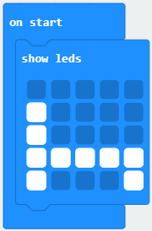
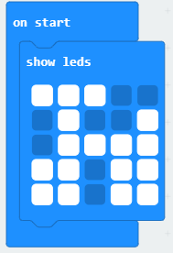
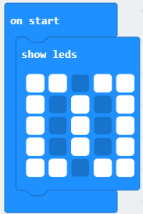
What items are these programs representing?
Program 1
Program 2
Program 3
Program 4
Notes:
Program 1 represents a star.
Program 2 represents a bed.
Program 3 represents a bicycle.
Program 4 represents a elephant. This image provides an opportunity to revisit abstraction. What detail has been included? - Ears and the trunk Is this enough detail to provide a accurate representation of an elephant?

Slide 4
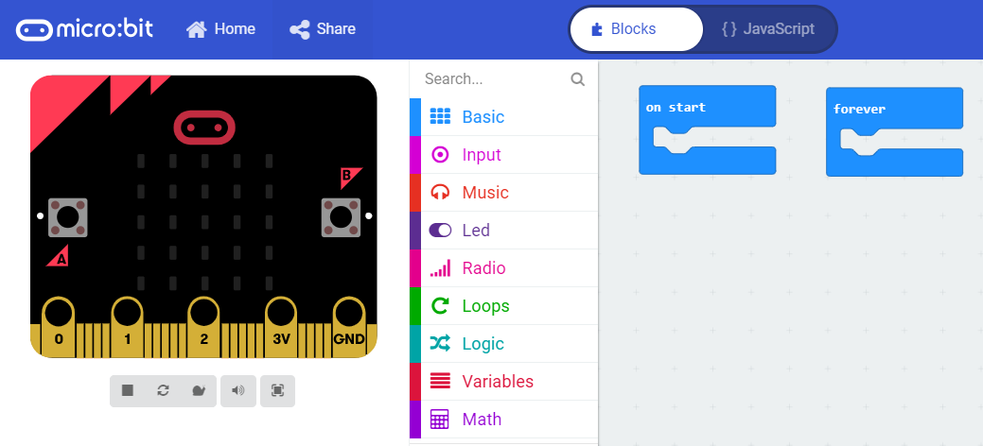
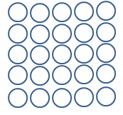
Creating LED nature art
We will create LED representations of some plants/animals we found on our nature walk.
What steps will we need to take to create our LED nature art?

Slide 5
Creating LED nature art
Select images from our nature walk.
Plan an LED representation (algorithm) of these images.
Write the program using the MakeCode editor.
Test and debug the program.

Slide 6
Evaluating our LED nature art
Which LED representations are you most happy with? Why.
Which LED representations would you like to improve? Why.
How have you made use of abstraction, algorithms, logical reasoning and debugging today?

Slide 7
Reviewing the computing concepts we have used
In this unit we have used
logical reasoning
abstraction
evaluation
algorithms
programs
debugging

Slide 8
Logical reasoning, abstraction, evaluation, algorithms, programs or debugging?
Identifying the success and the areas for improvement in our work to help improve our next piece of work.
Notes:
Evaluation

Slide 9
Logical reasoning, abstraction, evaluation, algorithms, programs or debugging?
A set of sequenced instructions, steps or rules written for humans to help solve a problem or complete a task.
Notes:
Algorithms

Slide 10
Logical reasoning, abstraction, evaluation, algorithms, programs or debugging?
Finding and fixing the errors in algorithms and programs.
Notes:
Debugging

Slide 11
Logical reasoning, abstraction, evaluation, algorithms, programs or debugging?
A set of instructions to solve a problem written in a language that a computer can follow
Notes:
Programs

Slide 12
Logical reasoning, abstraction, evaluation, algorithms, programs or debugging?
Identifying the most important details and ignoring the details that are less important.
Notes:
Abstraction

Slide 13
Logical reasoning, abstraction, evaluation, algorithms, programs or debugging?
Using evidence and clues to make predictions.
Notes:
Logical reasoning

Slide 14
Learning objectives revisited:
To use logical reasoning to predict the output of programs
To plan and write algorithms and programs to create LED nature art
To evaluate programs

Slide 15
LED planner
representation of
____________
representation of
____________
representation of
____________
representation of
____________
representation of
____________
representation of
____________
representation of
____________
representation of
____________

Slide 16
Licensing information
Published by the Micro:bit Educational Foundation microbit.org under the following Creative Commons licence: Attribution-ShareAlike 4.0 International (CC BY-SA 4.0)
https://creativecommons.org/licenses/by-sa/4.0/
Notes:
This slide must be kept.

