Slide 1
Getting active
Teacher lesson guide
Lesson 2

Slide 2
Learning objectives:
To write algorithms that use variables.
To explain how variables are used in programs.
To debug programs containing variables.

Slide 3
Ready, steady, star-jump!
In small groups, you are going to see who can do the most star-jumps in thirty seconds.
You will need variables named player, score and current leader.
What values will your variables be set to? When will the value of your variables change?

Slide 4
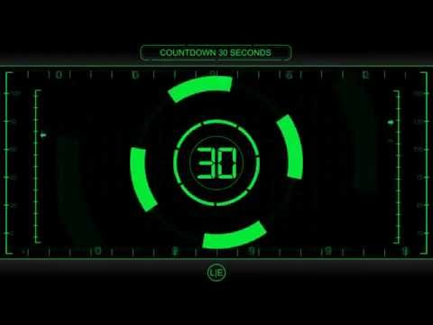
Ready, steady, star jumps

Slide 5
Reviewing variables
Think/pair/share how you made use of variables in your activity.
What value was each variable set to?
When did the value of each variable change?
How was the value in each variable used?

Slide 6
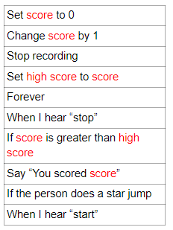
Variable algorithm to sort
Sequence these instructions to create an algorithm which shows someone how to use variables to record the number of star jumps completed in thirty seconds and who in the group recorded the most.

Slide 7
Variable algorithm
Forever
When I hear “start”
Set score to 0
If the person does a star jump
Change score by 1
When I hear “stop”
Stop recording
Say “You scored score”
If score is greater than high score
Set high score to score
Notes:
Selection in used to set the score to zero when “start” is heard, to increase the score by 1 when a star jump is completed, to stop recording and say how many jumps were completed when “stop” is heard, to change the high score if the current score is higher.

Slide 8
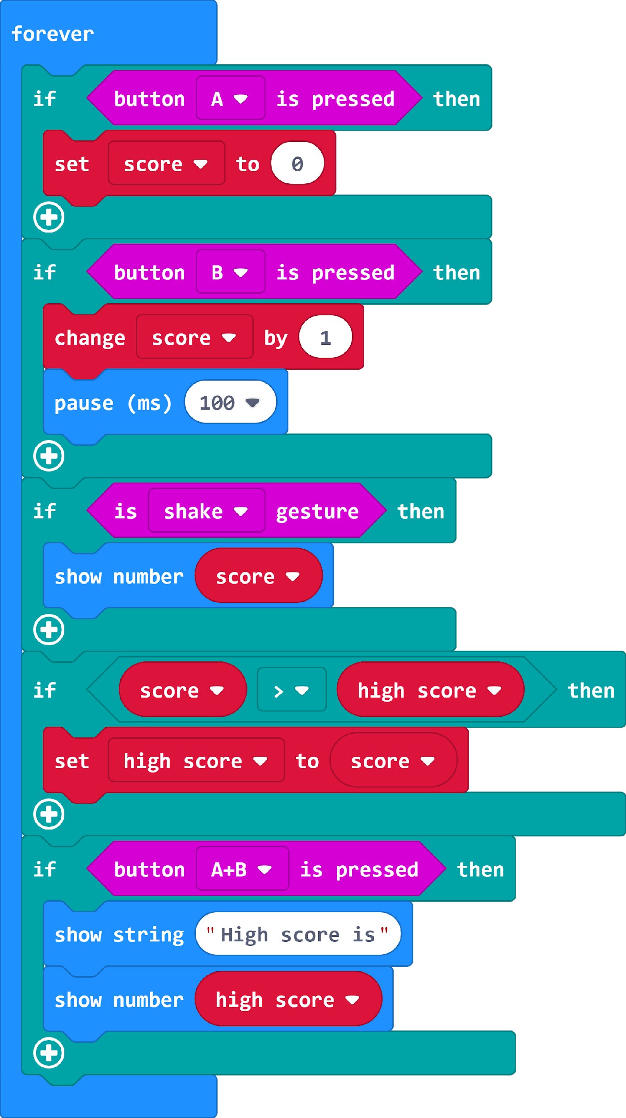
Using variables in programs
This program represents how a micro:bit could be used to record star-jumps.
Analyse the program and match the statements on your sheet with the part of the program that instructs micro:bit to do that.
https://makecode.microbit.org/#pub:_dwTUkmU2HdCM

Slide 9
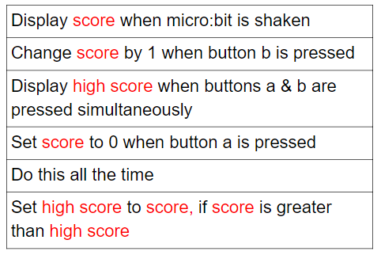
https://makecode.microbit.org/#pub:_dwTUkmU2HdCM

Slide 10
Variables in programs
Can you explain how a micro:bit would be used to record the number of star jumps that a person completes?
How would we know what the highest number of jumps completed is?
https://makecode.microbit.org/#pub:_dwTUkmU2HdCM
Notes:
The pause block is used so that micro:bit only increases the value of score once per press. If it is not used then the value can increase several times for one press as the speed of the program is faster than the human pressing the button.

Slide 11
Debugging programs with variables
What does the term debugging mean?
How can debugging help us to write efficient algorithms and programs?
Debug the program you have been given so a micro:bit can be used to record the number of star-jumps a person completes in thirty seconds and updates the high score.
https://makecode.microbit.org/#pub:_6ipg3x9f9RpD
Notes:
Give pupils access to the microbit-variable-debug hex file and ask them to work in pairs to debug the program https://makecode.microbit.org/#pub:_6ipg3x9f9RpD

Slide 12
Debugging programs with variables
What are variables and how have you made use of them in today’s lesson?
Think about the program you were given.
What variables were being used in the program?
What bugs were in the program?
How did you debug the program?

Slide 13
Learning objectives revisited:
To write algorithms that use variables
To explain how variables are used in programs
To debug programs containing variables

Slide 15
Licensing information
Published by the Micro:bit Educational Foundation microbit.org
Licence: Attribution-ShareAlike 4.0 International (CC BY-SA 4.0)

