Slide 1
Anti-poaching collar

Slide 2
The illegal wildlife trade
What is it?
Why does it exist?
What are the impacts?
What animals are endangered?

Slide 3
Poaching
What is it?
What are the biggest issues?
What is being done?
What more could be done?

Slide 4
How could technology help?
Think about:
protecting animals
why poachers poach
educating people

Slide 5
Creating a micro:bit anti-poaching collar
How could this work?
How could it help?
What issues could there be?

Slide 6
Example micro:bit anti-poaching collar
Detects if an animal stays still for longer than a certain time (suggesting it may be caught in a poaching trap).
Algorithm
IF there is no movement for more than X minutes,
Send a visual alert message over radio and sound an alarm.
ELSE, do nothing
Sample code: (collar and receiver)

Slide 7
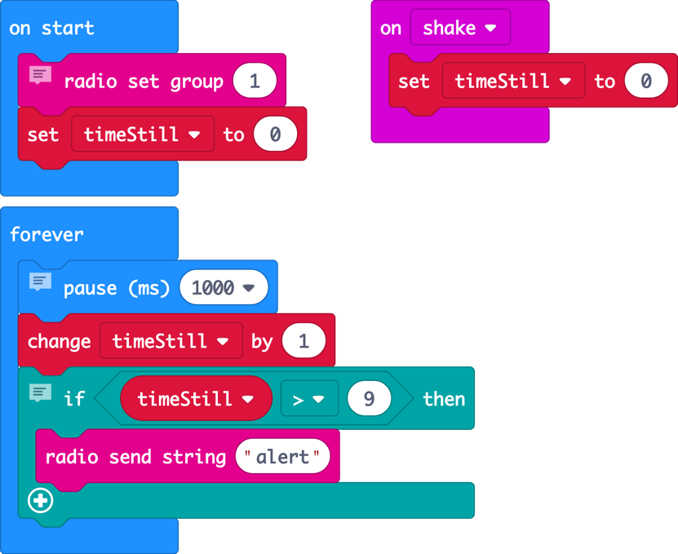
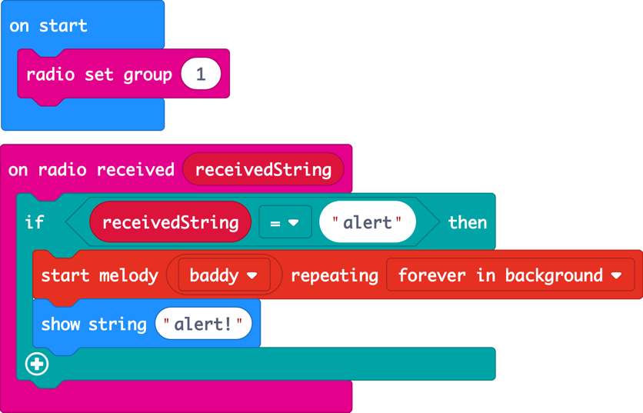
Example micro:bit anti-poaching collar
Collar (transmitter). Receiver
Notes:
This will trigger an alarm after just 9 seconds of inactivity for testing purposes.

Slide 8
Presenting your anti-poaching collar
How does your collar work?
What are you pleased with?
What needs further research and development?
What did you learn?

Slide 9
Licensing information
Published by the Micro:bit Educational Foundation microbit.org under the following Creative Commons licence:
Attribution-ShareAlike 4.0 International (CC BY-SA 4.0)
https://creativecommons.org/licenses/by-sa/4.0/
https://microbit.org/do-your-bit/

