Slide 1
Data handling
Teacher lesson guide
Lesson 3

Slide 2
Learning objectives:
To explain how repetition is used when programing sensors.
To follow design criteria to design a product.
To write algorithms that show how sensors will be used.

Slide 3
Algorithms
IF the classroom is dark,
THEN stand up and stretch your arms high above your head,
ELSE sit down.

Slide 4
Algorithms
IF the classroom is light,
THEN stand up and take a bow,
ELSE balance on one foot.

Slide 5
Algorithms
Write an algorithm using the structure below.
IF the classroom is dark
THEN
ELSE

Slide 6
Street lights
Can you use selection to explain what is happening in this video?
How could this be recorded in a decision box?

Slide 7
Yes
No

Slide 8
Yes
No
Is it dark?
Turn the street light on
Turn the street light off

Slide 9
Yes
No
Is it dark?
Turn the torch on
Turn the torch off

Slide 10
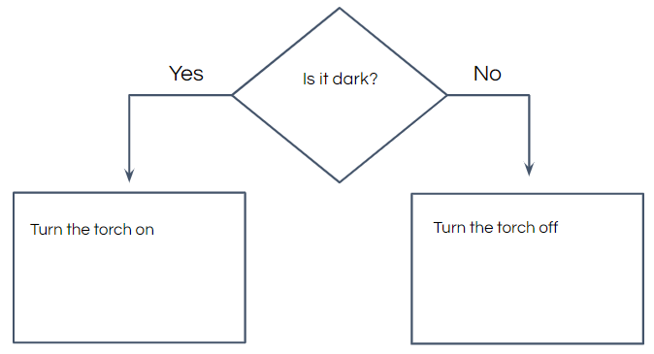
Comparing algorithms
FOREVER
IF it is dark
THEN turn the torch on
ELSE turn the torch off
What are the similarities and differences between these algorithms?
Notes:
Similarities - both use the same condition. Both instruct the same actions to be carried out if the conditions are/aren’t met. Differences - the first algorithm includes the line ‘forever’ so the light level is continually checked.

Slide 11
Has the algorithm changed?
FOREVER
IF the classroom is dark,
THEN stand up and stretch your arms high above your head,
ELSE sit down.
Notes:
A forever statement has been added so pupils continue to respond to changes in the light level.

Slide 12
Has the algorithm changed?
IF the classroom is light,
THEN stand up and take a bow,
ELSE balance on one foot.
Notes:
A forever statement hasn’t been added so the pupils should only respond to a change once.

Slide 13
Getting inventive
Design criteria:
Gadget for a 9 - 11 year old
Includes a sensor
Carries out an action when a change is sensed
The design should include an algorithm to explain how the sensor will be used.

Slide 14
Gadget with sensor planning sheet
Design criteria
Gadget for a 9 - 11 year old
Includes a sensor
Carries out an action when a change is sensed
My design
My algorithm

Slide 15
Presenting your design
Present your design to the members of your group.
Explain how you have met the design criteria.
Identify how you have used selection and repetition in your algorithm.

Slide 16
Gadget with sensor evaluation sheet
Questions |  | Yes | No
Do you think the gadget will appeal to a 9 - 11 year old?
Does the gadget include a sensor?
Does the gadget do something when a change is sensed?
Does the algorithm contain selection?
Does the algorithm use repetition?
Identify one aspect of the design you like.
Identify one aspect of the design you think could be improved.

Slide 17
Learning objectives revisited:
To explain how repetition is used when programing sensors.
To follow design criteria to design a product.
To write algorithms that show how sensors will be used.

Slide 18
Licensing information:
Published by the Micro:bit Educational Foundation microbit.org under the following Creative Commons licence:
Attribution-ShareAlike 4.0 International (CC BY-SA 4.0) https://creativecommons.org/licenses/by-sa/4.0/

