Slide 1
Digital flashcards
Teacher lesson guide
Lesson 5

Slide 2
Learning objectives:
To follow an algorithm accurately to create a digital number flashcard.
To write and debug a program.
To evaluate a program against design criteria.

Slide 3
Copy my image
What ways to control the LEDs did we find last lesson through tinkering?
Use the MakeCode editor to program the same output as shown. Have you used the most effective program?
Notes:
program 1 should use the show leds block
program 2 should use the show number block
program 3 should use the show string block

Slide 4
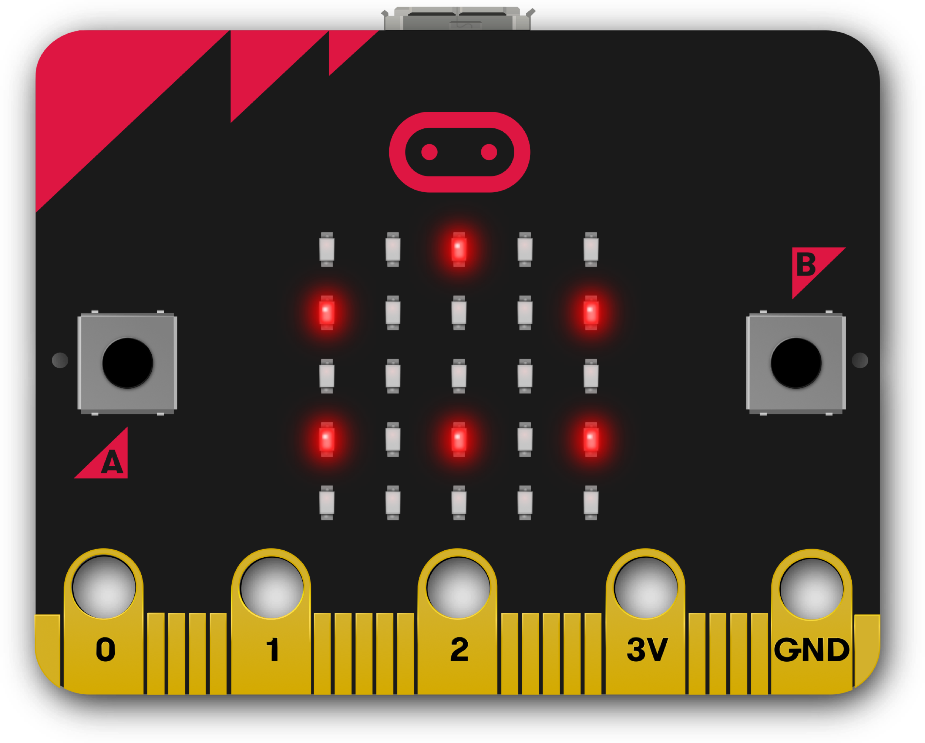
Copy my image 1
Use the MakeCode editor to program the same output as shown.
Have you used the most effective program?
CopymyImage1 project
Notes:
program 1 should use the show leds block

Slide 5
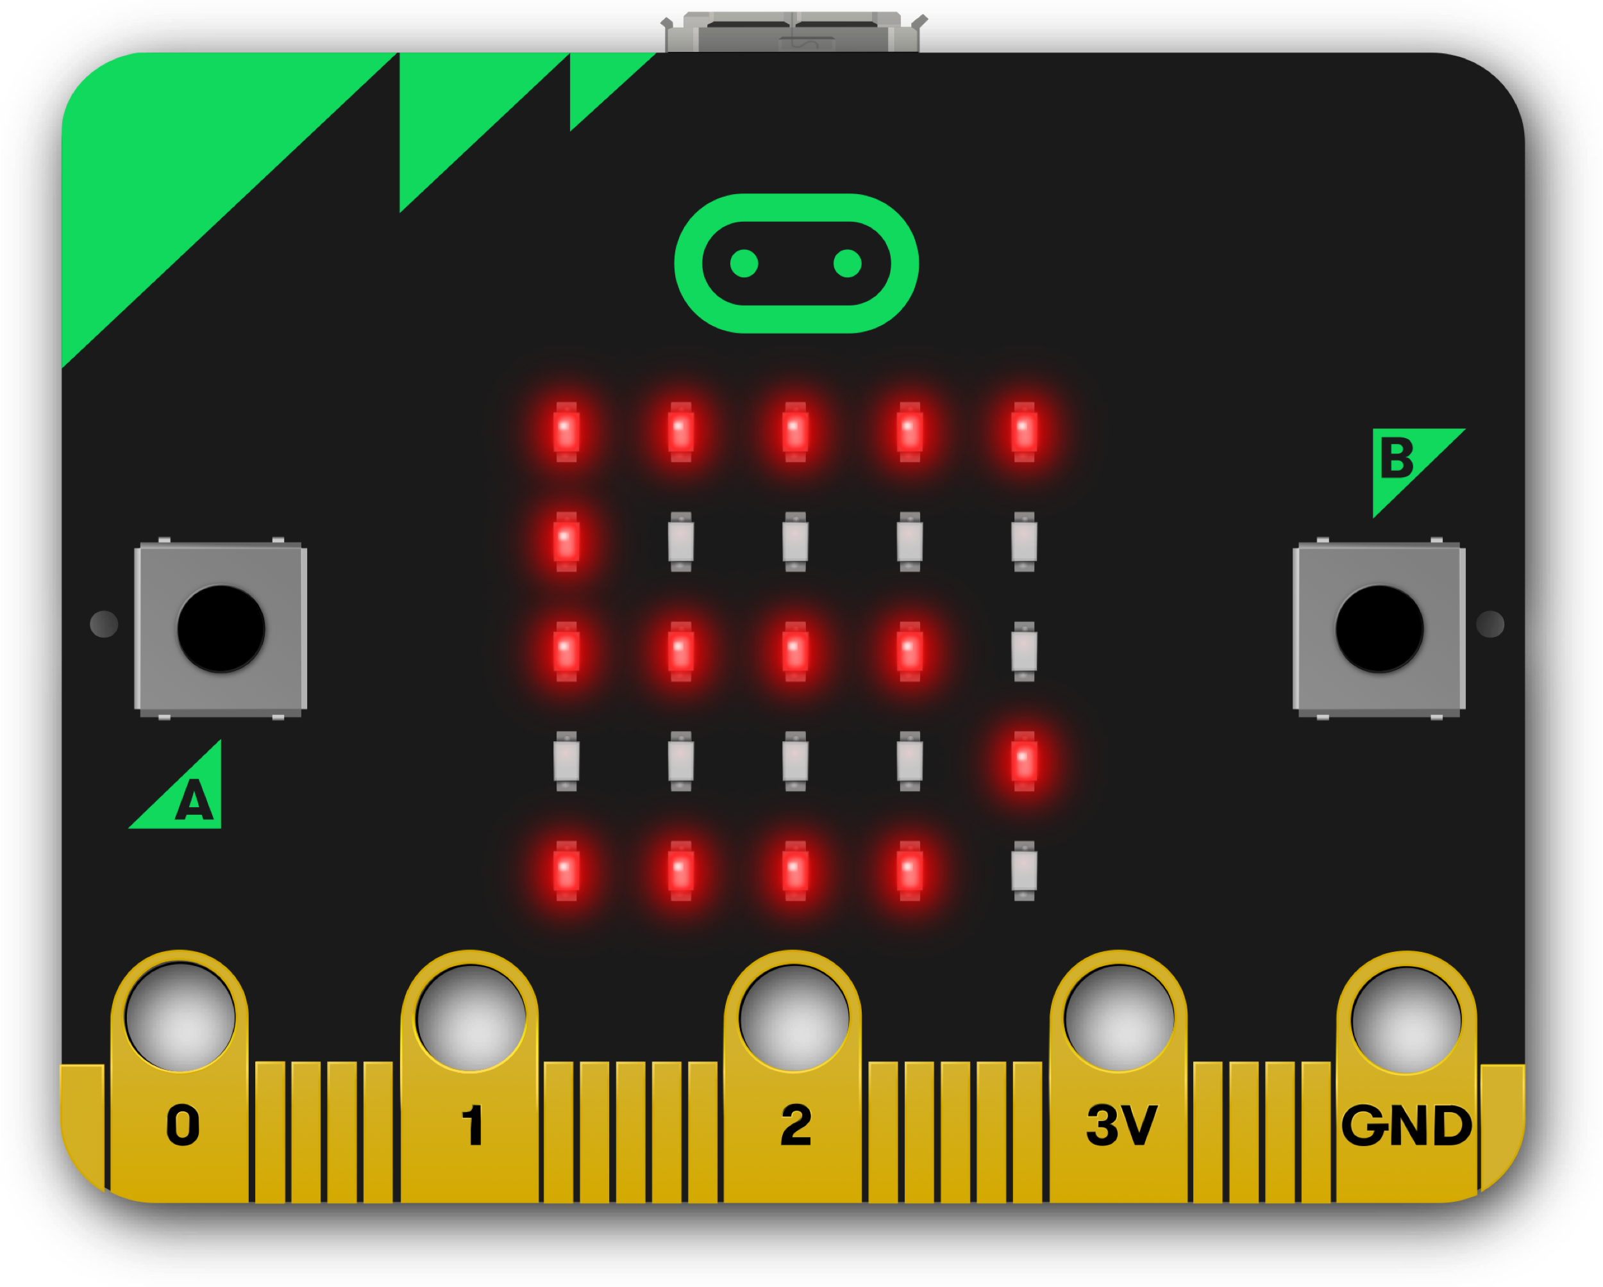
Copy my image 2
Use the MakeCode editor to program the same output as shown.
Have you used the most effective program?
CopymyImage2 project
Notes:
program 2 should use the show number block

Slide 6
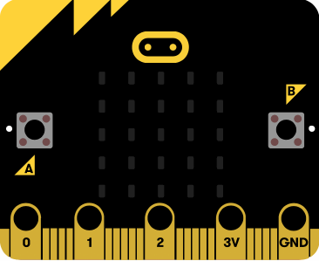
Copy my image 3
Use the MakeCode editor to program the same output as shown.
Have you used the most effective program?
CopymyImage3 project
Notes:
program 3 should use the show string block – play slideshow to show animated picture of text scrolling

Slide 7
Planning digital flashcards
Explain how we used an algorithm to plan our digital number flashcards.
Notes:
.

Slide 8
Design criteria
Represent at least four numbers between 1-10
Use word, digits and images to represent the numbers
Allow appropriate time to think and respond
Let the user know they have finished

Slide 9
Debugging
Use the simulator to test your program regularly.
If you find a problem try and fix it.
Once you are happy with your program, transfer it to your micro:bit.
Notes:
In addition to the show leds block, the pupils can also use the show number block to display a digit and show string block to scroll a word or phrase across the LEDs.

Slide 10
Evaluating against design criteria
Which parts of the design criteria did you successfully meet?
Represent at least four numbers between 1-10
Use words, digits and images to represent the numbers
Allow appropriate time to think and respond
Let the user know they have finished

Slide 11
Learning objectives revisited:
To follow an algorithm to create a digital number flashcard.
To write and debug a program.
To evaluate a program against design criteria.

Slide 12
Sequencing
What is sequencing?
How have you made use of sequence in this unit?

Slide 13
Logical reasoning
What is logical reasoning?
How have you made use of logical reasoning in this unit?

Slide 14
Patterns
What are patterns?
How have you made use of patterns in this unit?

Slide 15
Abstraction
What is abstraction?
How have you made use of abstraction in this unit?

Slide 16
Debugging
What is debugging?
How have you made use of debugging in this unit?

Slide 17
Learning objectives:
To follow an algorithm accurately to create a digital number flashcard
To write and debug a program
To evaluate a program against design criteria

Slide 18
Licensing information:
Published by the Micro:bit Educational Foundation microbit.org under the following Creative Commons licence:
Attribution-ShareAlike 4.0 International (CC BY-SA 4.0) https://creativecommons.org/licenses/by-sa/4.0/

