Slide 1

Evaluation of cross-cutting issues in Norwegian development cooperation
Presentation of final report, 6 November 2024

Slide 2
Norway’s committment to cross-cutting issues
Human rights
Gender equality and women’s rights
Environment and climate change
Anti-corruption
Do no harm
Promote

Slide 3
Evaluation questions and methodology
Mapping of expectations and commitments
Review of commitments and expectations
Managed in Norwegian development administration
Norad agreements 2018 - 2023
Human rights effects for end beneficiaries in Nepal – case studies
Barriers and opportunities in project implementation
Survey to Norad, MFA, Embassies
Document review, interviews
8 case studies
Field visits
Interviews with partners, field staff and beneficiaries
Content analysis
4 case studies
Document review
Natural language processing
Document review

Slide 4
Human rights effects in Nepal
Human rights
Right to Dignity
Right to Clean and Healthy Environment
Right to Health and Safety
Right to Non-
discrimination
Right to Education
Right to Livelihood
Right to Information
Right to Adequate Standard of Living

Slide 5
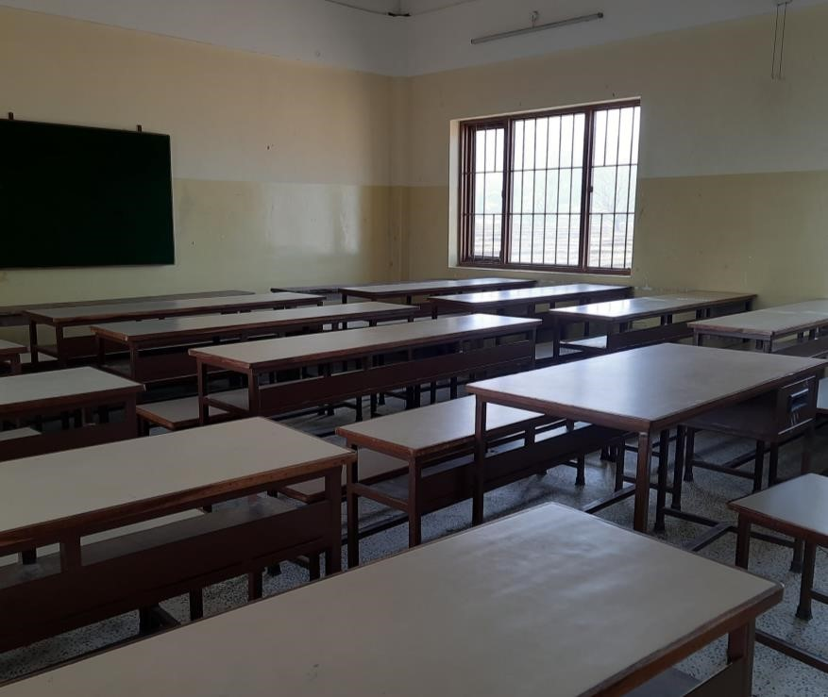
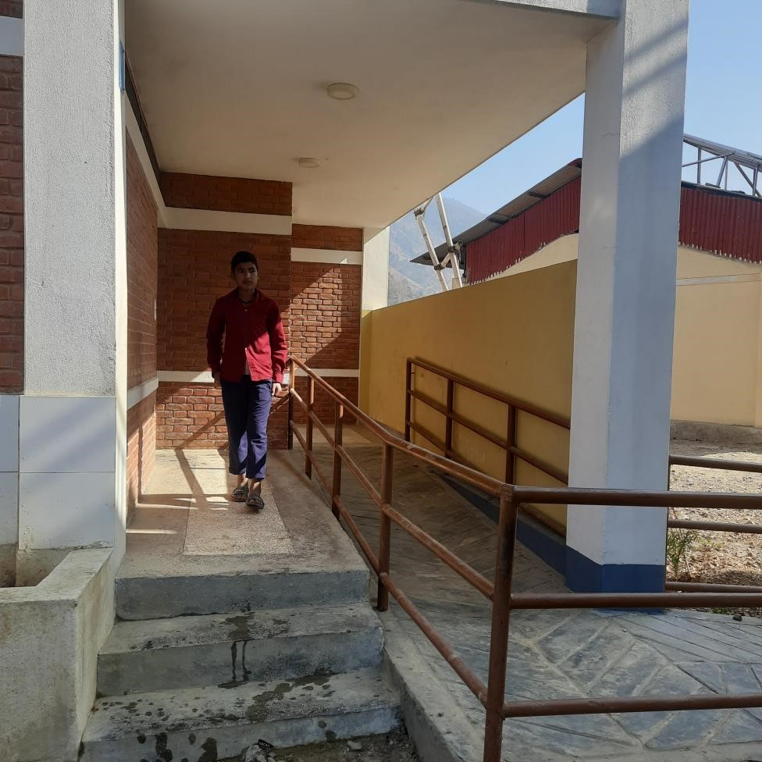
Right to education Right to non-discrimination

Slide 6
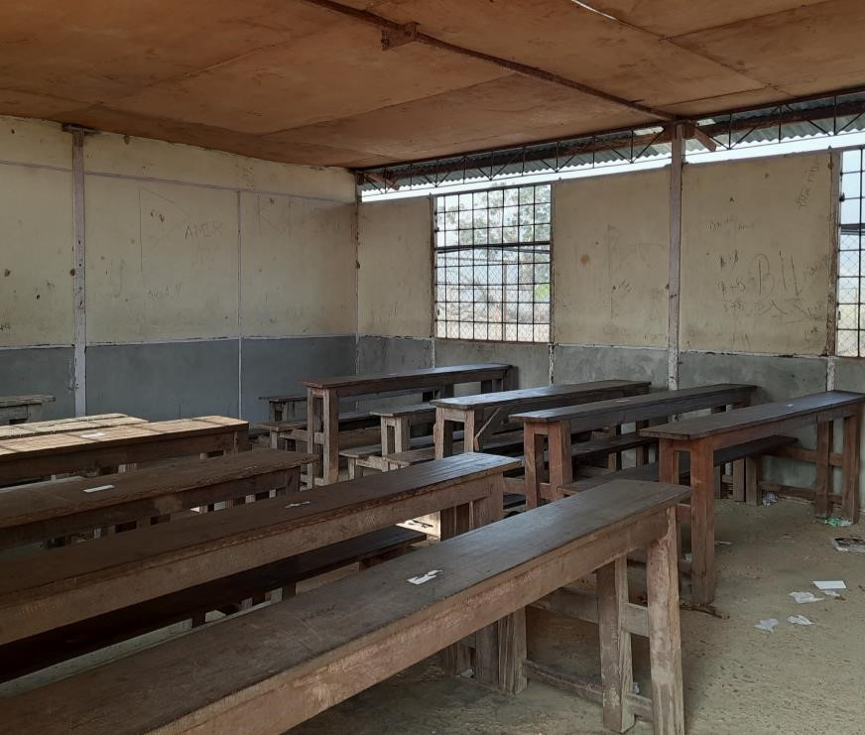
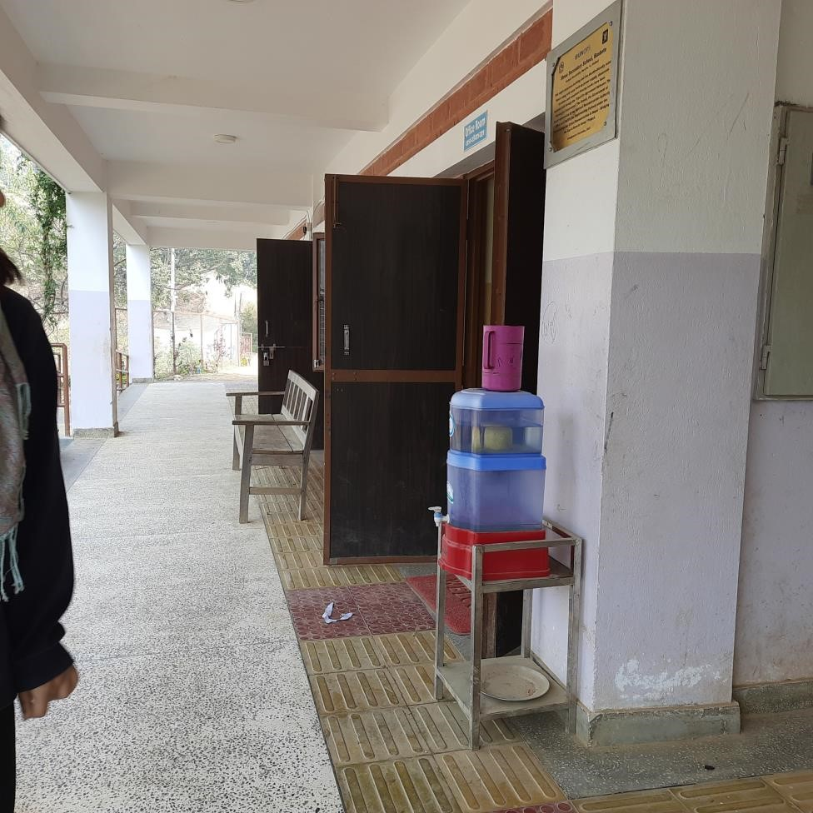
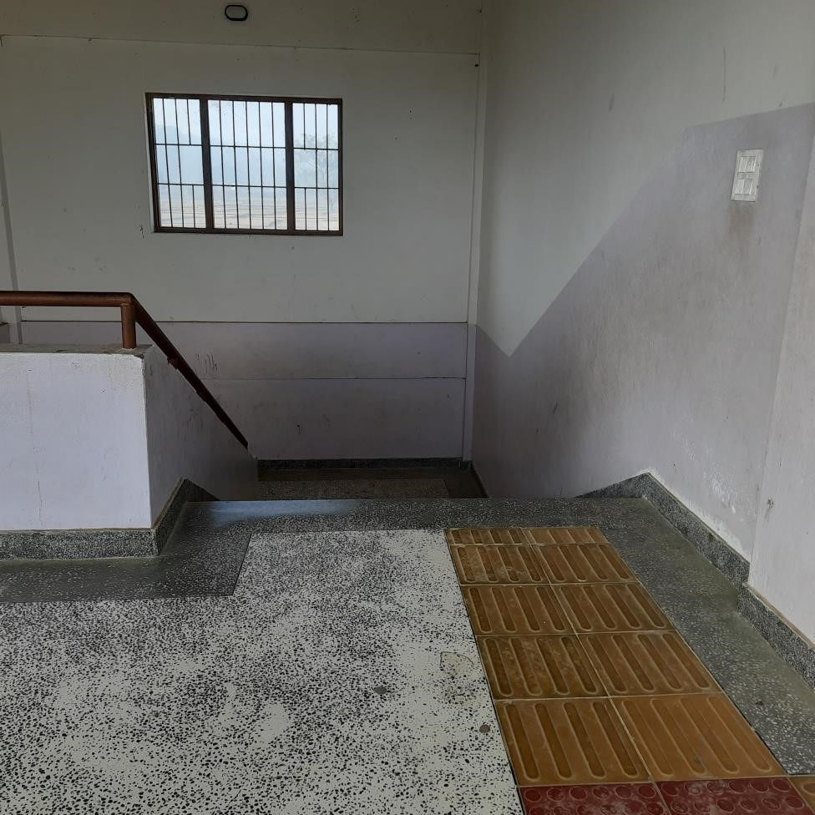
Right to education Right to non-discrimination

Slide 7
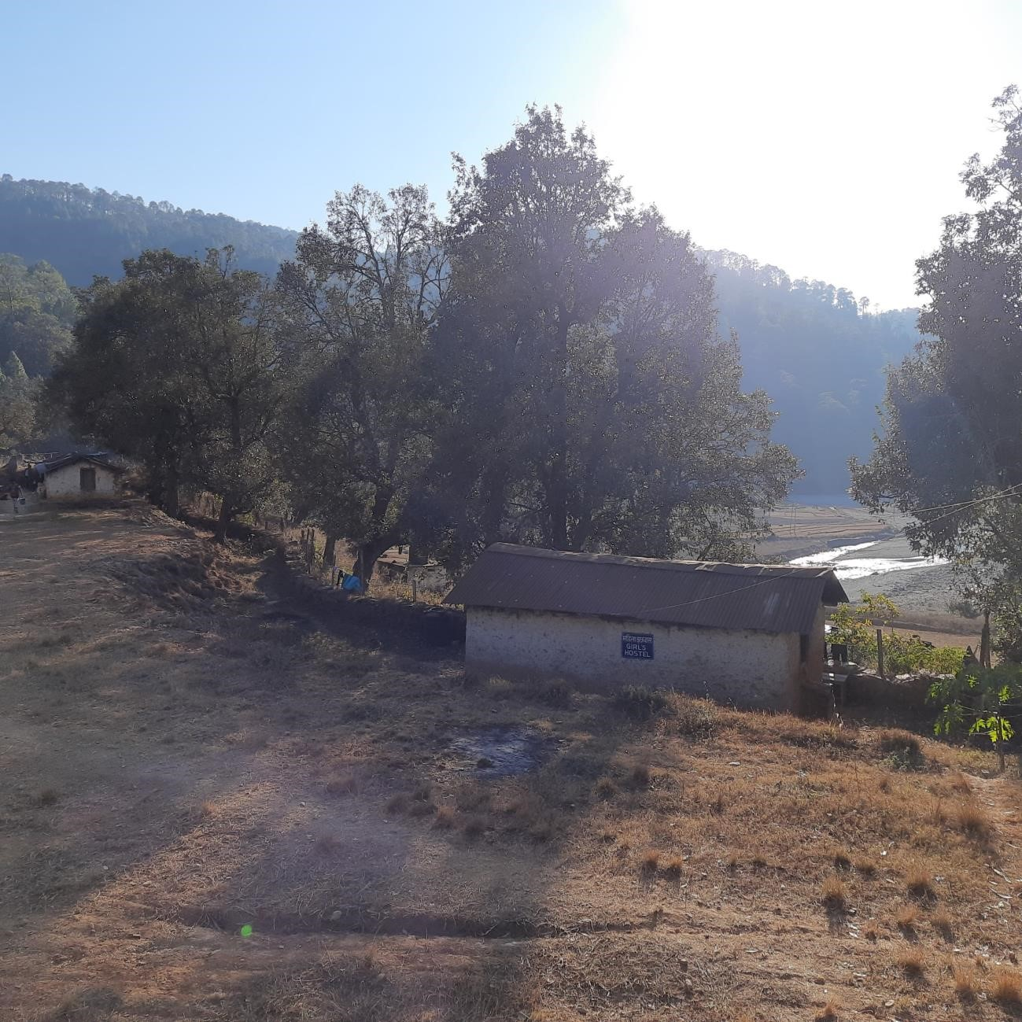
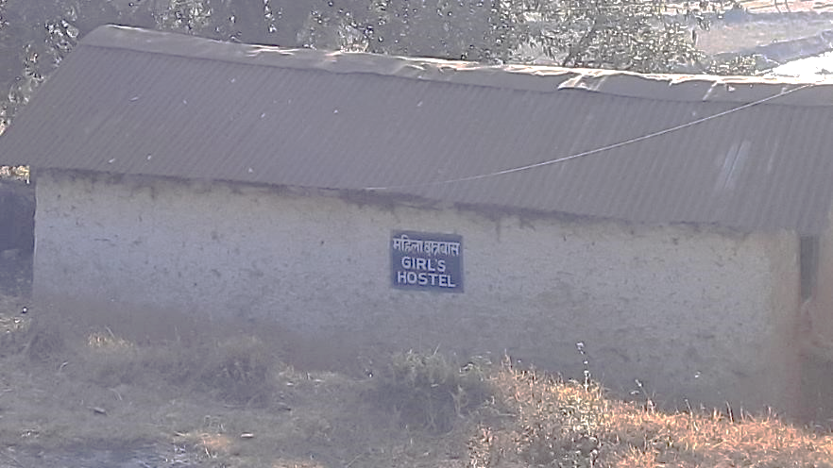
Right to education Right to protection

Slide 8
Human rights effects for end beneficiaries in Nepal
Positive human rights effects of project outcomes – not of cross-cutting considerations
Negative effects and missed opportunities
Limited application of a Human rights-based approach

Slide 9
Cross-cutting issues in Norad project documents
Promotion of cross-cutting issues
mentioned in design phase documents more than half of agreements
reported on in 12% of follow-up documents
Risks relating to cross-cutting issues not sufficiently assessed:

Slide 10
Clear commitments and expectations, translated into clear rules
Aid administration applies rules in line with commitments and expectations
Agreement partners implement cross-cutting issues as required
Implementing partners integrate cross-cutting issues in project planning and implementation
Implementation
of cross-cutting issues: assumptions

Slide 11
Barriers in aid administration
Lack of time, tools and guidance
Lack of support from leadership and colleagues
Lack of accountability and monitoring
Grant management system perceived as ‘the rule’, but
not clear
not in line with commitments
not fully understood
not fully implemented

Slide 12
Agreement partners
All referred to the requirement to report on risks to cross-cutting issues
Often more ambitious and specific on cross-cutting issues than the GMA
Different approaches:
Translated or incorporate MFA requirements into their own reporting templates and demands on partners
Adapted to other external requirements
Well-developed policies but not fully implemented in practise
Invested heavily and put cross-cutting issues at the centre of their activities

Slide 13
Implementing partners in Nepal
Responsibility for implementing cross-cutting issues
All have policies on cross-cutting issues – but not identical to Norway’s
Limited knowledge and understanding at field level of human rights as a cross-cutting issue among field staff
Risks to human rights not assessed
Mitigation strategies not identified

Slide 14
Conceptual Challenges
‘Do no harm’ and ‘Unexpected negative effects’
Assessing risks to the cross-cutting issues from project activities
Assessing risks to a cross-cutting issue that is an intended result
Expectation to take a ‘proactive approach’ to cross-cutting issues
Human rights versus HRBA
Organisational values
Gender and Rio markers
Zero tolerance for corruption - Anti-corruption as cross-cutting issue

Slide 15
Overall Conclusions
Many and often not clear commitments and expectations
Grant management rules not followed
Implementation left to agreement partners and project implementers, with little guidance, oversight or accountability
Implementation of cross-cutting issues depends on the level of ambition, knowledge and resources of agreement partners – and on their control over implementing partners
Some harm and many missed opportunities for end beneficiaries

Slide 16
Recommendations
Increase knowledge and understanding
Align and clarify commitments and instructions
Develop guidance, tools and support
Develop monitoring and accountability systems
Include cross-cutting issues in partner assessments
Mainstream cross-cutting issues in contracts
Promote sharing of good practise

Slide 17
End of presentation – slides below are for backup only
.

Slide 18
Norway’s committment to cross-cutting issues
Human rights
Gender equality and women’s rights
Environment and climate change
Anti-corruption

Slide 19
Commitments in Meld St. 24 (2016-2017)
Human rights as a cross-cutting issue shall have special focus on participation and accountability.
Women’s rights and gender equality as a cross-cutting issue shall reduce the risk that supported interventions cause unintentional discrimination of women or men.
The inclusion of climate and environment in development cooperation is a prerequisite for reaching the goal of poverty reduction. Climate- and environmental assessments, clarification of overlapping user or ownership rights and inclusive processes with local populations are particularly important.
Anti-corruption as a cross-cutting issue shall provide sufficient ensurance that interventions supported by Norway do not contribute to corrupt practices, neither in the interventions nor in society. Special focus shall be placed on increased openness and transparency, and participation of beneficiaries to achieve increased accountability.
Notes:
And support tracing of pathways within ToC and help assess their role in achieving effective implementation of CCIs.
Importance of shared understanding of what commitment and expectation is in this context. Recognise these may sit at different levels – esp in view of commitments.
In reporting – will disaggregate by CCI and subtopics, if ‘do no harm’ or will positively impact.
For part 2 of EQ2, we aim to deepen our understanding of the next level of the ToC to understand how commitments and expectations identified in part 1 are (i) reflected in a sample of partners’ documentation (focusing on policies, guidance and regulations) and (ii) are disseminated.

Slide 20
Level | Definition
Insufficiently implemented | In design documentation; the document does not contain a substantial analysis of risks to cross-cutting issues associated with the implementation of the intervention In follow up documentation; the document does not contain substantial reporting on risks to cross-cutting issues associated with project delivery
Do No Harm | In design documentation: the documentation contains a substantial analysis of risks to cross-cutting issues associated with project delivery In follow up documentation: the document contains substantial reporting on risks to cross-cutting issues associated with project delivery
Proactive | In design documentation: the document demonstrates the integration of cross-cutting issue specific objectives into a project/programme results chain In follow up documentation: the document demonstrates reporting on cross-cutting-issue specific objectives articulated in a project/programme’s results chain

Slide 21
Topics for discussion to develop recommendations
Conceptual challenges: ‘Cross-cutting issues’, ‘unexpected effects’, ‘risks from or risks to cross-cutting issues’. How to increase clarity and understanding?
Motivational challenges: Reporting on risks or mainstreaming cross-cutting issues. How to increase motivation to integrate cross-cutting issues?
Implementation at field level: How far does the Norwegian influence reach, can/should the influence of MFA/Norad be increased? How?

Slide 22
Projects included in sample
# | Number | Years | Title | Partner | Implementing partner | Description
Norad - Development Fund (DF) – Local Initiatives for Biodiversity, Research (LI-BIRD)
1 | QZA-16/0389-28 | 2018 – 2022 | Climate change adaptation for marginalised rural communities | DF | LI-BIRD | Increased food and nutrition security, income and resilience of women and marginalized families, including rebuilding after 2015 earthquake. Seed and climate policy work
Norad - Digni – United Mission Nepal (UMN) – Mission Alliance (MA)
2 | QZA-18/0159-269 | 2020 - 2022 | MA - Livelihood and education Nepal | Digni | UMN and Rural Community Development Centre (RCDC) | Livelihood project tentatively focusing on education and environment.
MCE - NICFI – CLUA
3 | KLD-NICFI-43 | 2018 - 2022 | Targeted support to Climate and Land Use Alliance (CLUA) strategy | CLUA | CLUA | Contributes to achieving emission reductions from deforestation and forest degradation. CLUA also aims to maintain and increase the role of forest carbon sinks (Natural Carbon Capture) and to contribute to a shift in protein consumption.
Norad - Malthe Winje AS
4 | RAF-16/0059 RAF-17/0031 | 2018 - 2022 | Malthe Winje AS Feasibility study Phase II small hydropower East-Africa | Malthe Winje AS | Malthe Winje AS (MW) | Feasibility study phase II of small hydropower projects in East-Africa. MW identified a project portfolio of 10 potential small hydropower projects in East Africa they want to develop on a BOT basis (build, own, operate, transfer) with local partners.
MFA – Embassy - Asian Development Bank (ADB)
5 | NPL-18/0008 | 2019 – 2022 | Power Transmission and Distribution System Strengthening Project (PTDSSP) | ADB | Nepal Electricity Authority (NEA) | South Asia Subregional Economic Cooperation (SASEC) -PTDSSP Upgrade substation capacity to allow more hydropower into the grid and to have better access to clean energy and reduce imports of coal electricity.
MFA – Embassy - UN Office for Project Services (UNOPS)
6 | NPL-18/0006 | 2018 - 2021 | UNOPS Reconstruction of schools | UNOPS | UNOPS | Reconstruction and retrofitting of schools that were damaged by the earthquake, including: access to WASH, disability accessible drinking water, book corner/library, playground facilities, classroom furniture, connection to electricity, boundary walls.
MFA - Norwegian Refugee Council (NRC)
7 | QZA-20/0048 | 2020 - 2022 | Humanitarian Response | NRC | NRC Country Office | Humanitarian Response to various countries.
MFA/Norad - Norwegian Church Aid (NCA)
8 | QZA-19/0212 | 2020 - 2022 | Governance/ Humanitarian response | NCA | NCA country offices | Humanitarian Response to various countries. As NCA has support via both Norad and MFA, an additional agreement was added to give opportunity for comparing grant management of the same organsiation in the two agencies.
9 | QZA-20/0052-8 |  | Humanitarian response | NCA | NCA country offices

Slide 23
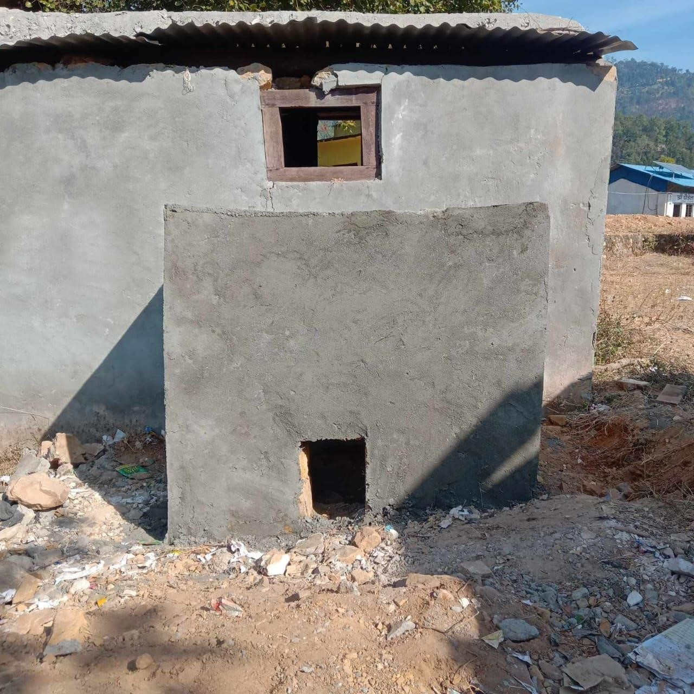
Right to education Right to health

Slide 24
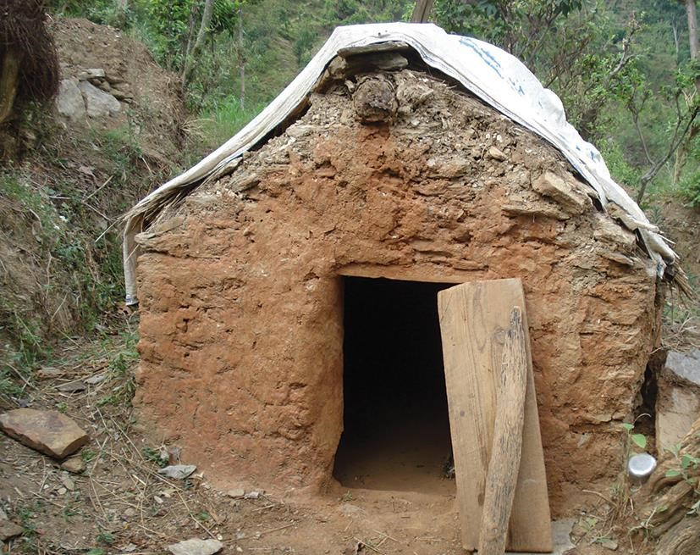
Missed opportunity to promote right to survival, right to protection, right to non-discrimination

Slide 25
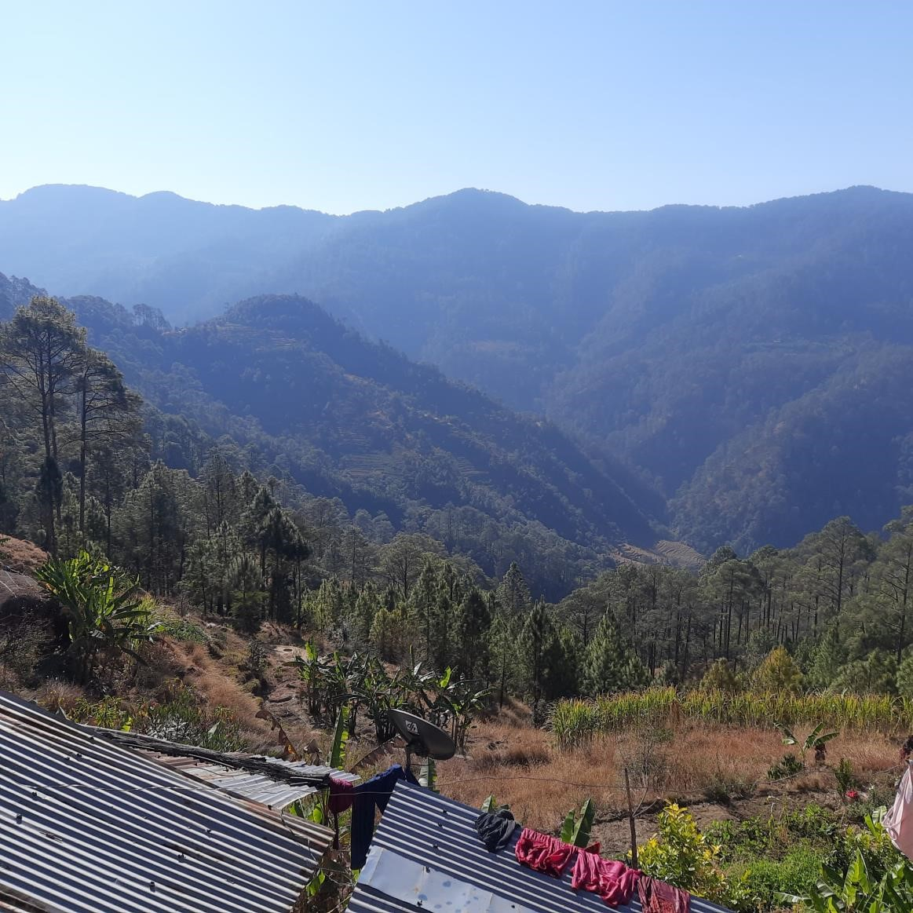
Right to clean and healthy environment

Slide 26
Agreement partners
Well developed policies
Not well integrated at field level
Well developed strategies and policies that put cross-cutting issues at the centre of activities
Incorporate cross-cutting issues as key in planning, targeting, implementation, reporting and learning
Programming must consider cross-cutting issues to be sustainable and effective
Norad/MFA requirements forwarded in their reporting templates and demands on their partners
Adapt to requirements set by other actors
All are aware of the requirement to report on cci
Different approaches applied
Demand for more support and guidance

Slide 27
Commitments in Meld St. 24 (2016-2017)
Human rights as a cross-cutting issue shall have special focus on participation and accountability.
Women’s rights and gender equality as a cross-cutting issue shall reduce the risk that supported interventions cause unintentional discrimination of women or men.
The inclusion of climate and environment in development cooperation is a prerequisite for reaching the goal of poverty reduction. Climate- and environmental assessments, clarification of overlapping user or ownership rights and inclusive processes with local populations are particularly important.
Anti-corruption as a cross-cutting issue shall provide sufficient ensurance that interventions supported by Norway do not contribute to corrupt practices, neither in the interventions nor in society. Special focus shall be placed on increased openness and transparency, and participation of beneficiaries to achieve increased accountability.
Notes:
And support tracing of pathways within ToC and help assess their role in achieving effective implementation of CCIs.
Importance of shared understanding of what commitment and expectation is in this context. Recognise these may sit at different levels – esp in view of commitments.
In reporting – will disaggregate by CCI and subtopics, if ‘do no harm’ or will positively impact.
For part 2 of EQ2, we aim to deepen our understanding of the next level of the ToC to understand how commitments and expectations identified in part 1 are (i) reflected in a sample of partners’ documentation (focusing on policies, guidance and regulations) and (ii) are disseminated.

