Slide 1

Proposed Green Ammonia Project in the Coega SEZ
Coega Green Ammonia (Pty) Ltd
Public Information-Sharing Meeting
March 2024

Slide 2



Introductions
Hive Hydrogen SA / Coega Green Ammonia
  Colin Loubser – General Manager
  Trevor Donian
SLR Consulting (South Africa) – Environmental Assessment Practitioner (EAP)
  Eloise Costandius
  Stuart Heather-Clark
  Nosipho Mbunje
NMA Effective Social Strategists – Independent Facilitator
  Nomi Muthialu – Facilitator
  Chris Fourie – Afrikaans Translator
  Andisiwe Xuma – isiXhosa Translator
  Julian Drew - Facilitator

Slide 3


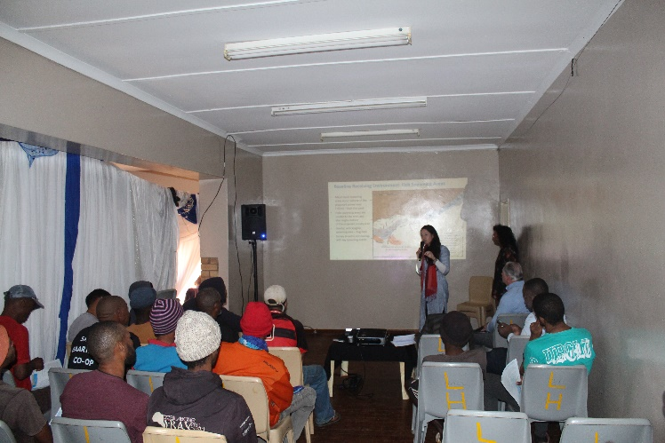
Meeting Objectives
Share information on:
  What Green Hydrogen and Ammonia is
  The Proposed Project Description
  Scoping and EIA and Public Participation Processes
  Next steps in the EIA Process
For Interested and Affected Parties to:
  Ask questions regarding the proposed project and EIA process
  Provide preliminary comments and raise issues of concern
  Make suggestions on aspects to be assessed

Slide 4
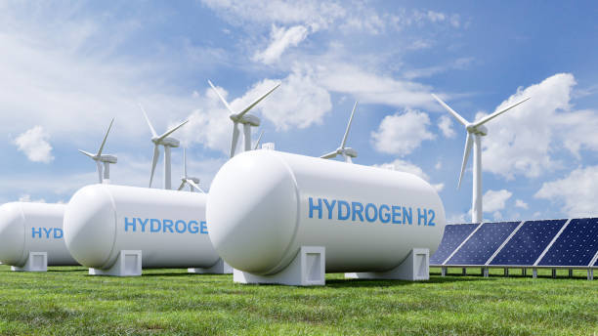
Proposed Agenda
Welcome, Introductions and Meeting Admin
Session 1:
  Project Overview – Hive
Session 2:
  Scoping and EIA Overview – SLR
Session 3:
  Discussion
  Next Steps
Source: https://www.worldwildlife.org/stories/what-is-green-hydrogen-and-how-can-it-help-tackle-the-climate-crisis

Slide 5




Meeting Protocols
We have set aside about 50 minutes for presentations and an hour for discussion
Please make notes during the presentations and reserve your questions until the discussion period
Attendance Register / POPI Act
Meeting is being recorded and photographs will be taken as evidence of the meeting
We will use the flipchart where necessary to capture questions, comments, concerns and suggestions
Language
  Presentations and responses in English with translations where required
  You are welcome to ask questions in Afrikaans or isiXhosa

Slide 6

Constructive Discussion Guidelines
Public participation is not a voting or consensus-driven process.
A process of collecting input for the purpose of helping the decision-maker to consider all issues and impacts before making a decision.
Respect / human dignity
Agree to disagree
Give everyone a fair chance to ask questions / comment
Raise your hand to comment or ask a question and work through the facilitator(s)
State your name, surname and organisation / community
Please turn your cell phones on silent

Slide 7
SESSION 1:
PROJECT OVERVIEW

Slide 8
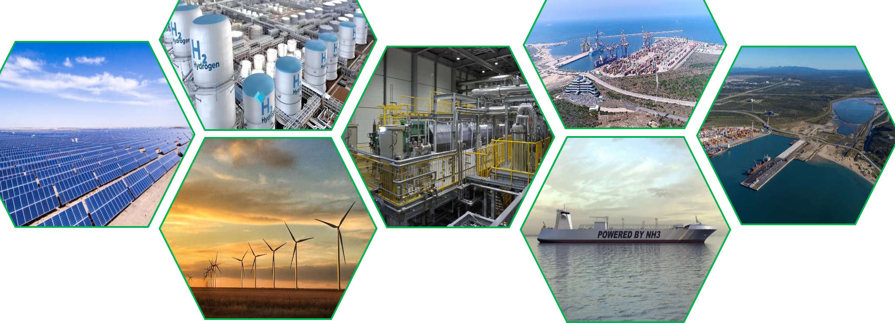


COEGA GREEN AMMONIA
Strategic Integrated Project
Targeting the lowest cost of Green Ammonia Globally
March 2024

Slide 9

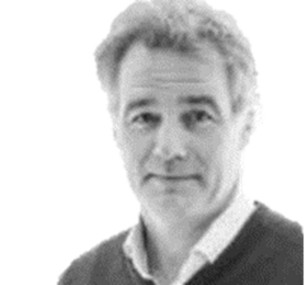





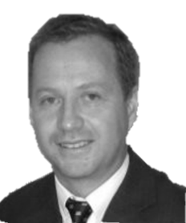

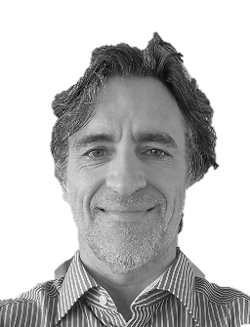

HIVE HYDROGEN
SOUTH AFRICA
Hive Hydrogen backed by Hive Energy and Built Africa has been working since September 2019 on establishing large scale Hydrogen and Ammonia plants in South Africa powered by renewable energy.
Hive Energy headquartered in Hampshire, United Kingdom, with offices in 20 countries was founded in 2010 by Giles Redpath.
Hive Energy have developed nearly 2500MW of grid connected Solar PV Plants on 50+ Solar Sites and over 40 industrial, commercial Solar Rooftop sites. Hive have further projects exceeding 24,000MW in development in 22 countries.
In 2019 Hive started its Circular Economy Business with world leading projects in eco friendly Biomass derived Activated Carbon, biogas and other critical ‘Green’ commodities.
The BuiltAfrica Group, located in Waterfall Point Office Park
in Midrand near Johannesburg was founded in 2008 by
Thulani Gcabashe, Executive Chairman to develop renewable energy projects and consult in energy efficiency.
The Group focuses on developing renewable energy projects in South Africa, having successfully participated in the South African government’s Renewable Energy Independent Power Producer Programme (REIPPP) with two large scale solar generation plants, building and operating the plants.
Thulani Gcabashe
Chairman Hive Hydrogen
Giles Redpath
CEO Hive Energy Group
Hive Hydrogen South Africa is led by Giles Redpath Founder & CEO of Hive Energy and Thulani Gcabashe, former CEO of Eskom Holdings (2000-2008) and Chairman of Standard Bank (2015-2022) and Executive Chairman of BuiltAfrica.
South Africa, due to its location, world class renewable resources, good deepwater harbours and high standard and availability of local skills and labour makes it the ideal choice to locate Hydrogen and Ammonia production plants for export to the Far East, Europe and USA.
Colin Loubser
General Manager
Benji Mothibedi
Legal Director
John Nutt
Technical Director
Trevor Donian
Programme Director
Zander van der Walt
Development Manager - Energy
Emile Ras
Project Manager
Lunga Limba
Eastern Cape Business Development Director

Slide 10
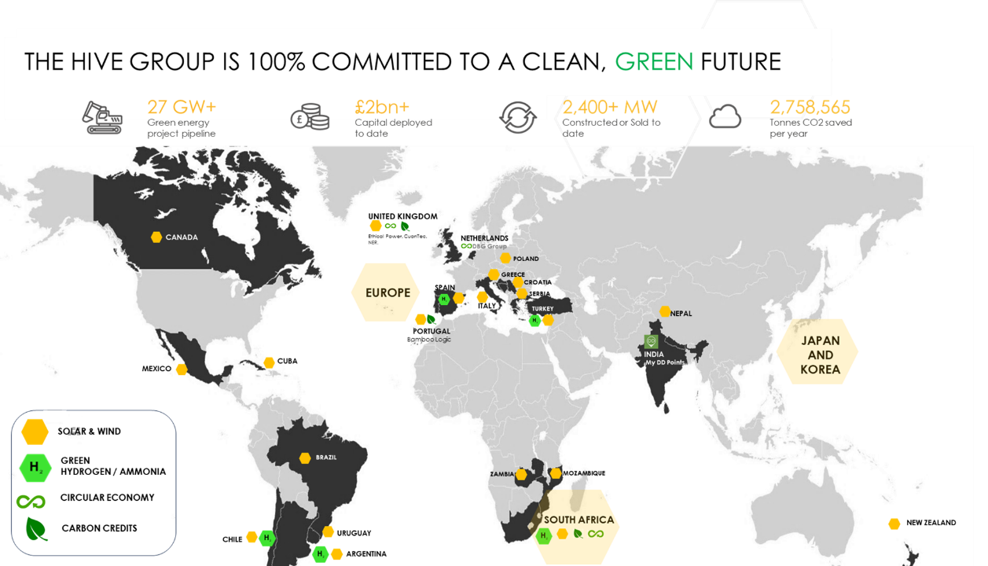

Slide 11


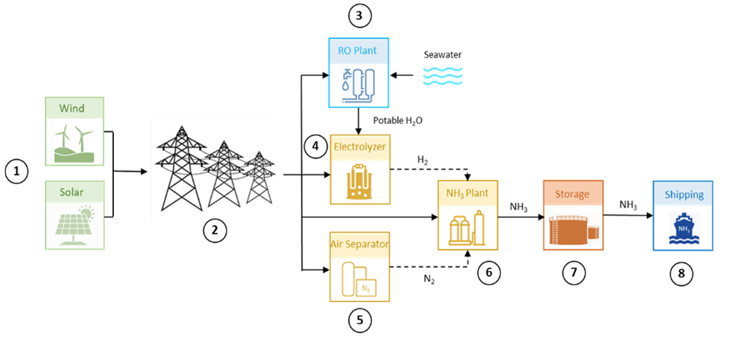
PROJECT COMPONENTS
Step 3:
Seawater is desalinated (at Cerebos) to produce potable quality water for the Electrolysis Process
KEY: GREEN HYDROGEN AND AMMONIA = HYDROGEN AND AMMONIA PRODUCED WITH RENEWABLE ENERGY SOURCES
Step 4:
Water molecules are split into Oxygen (O₂) and Hydrogen (H₂)
Renewable energy is generated from a combination of Solar PV and Wind
Step 1:
Transmission lines evacuate the energy to the Hydrogen and Ammonia Production Plant
Step 2:
Step 6:
Step 7:
Step 8:
Step 5:
H₂ and N₂ is combined under high pressure and temperature through the Haber-Bosch Process to form Ammonia (NH₃)
The NH₃ is stored as buffer for the shipping operations
The NH₃ is pumped to the waiting vessels for delivery to the Client
The Air Separation Unit extracts Nitrogen (N₂) from the air

Slide 12
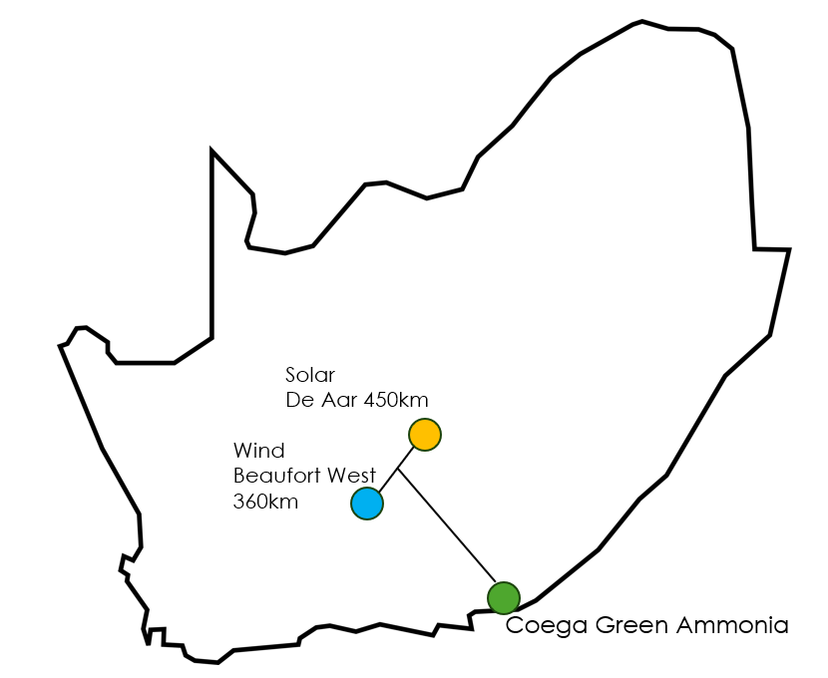

Location of Energy Sources
+/- 3,000 MW Wind Energy Assets
+/- 1,250 MW Solar PV Energy Assets

Slide 13
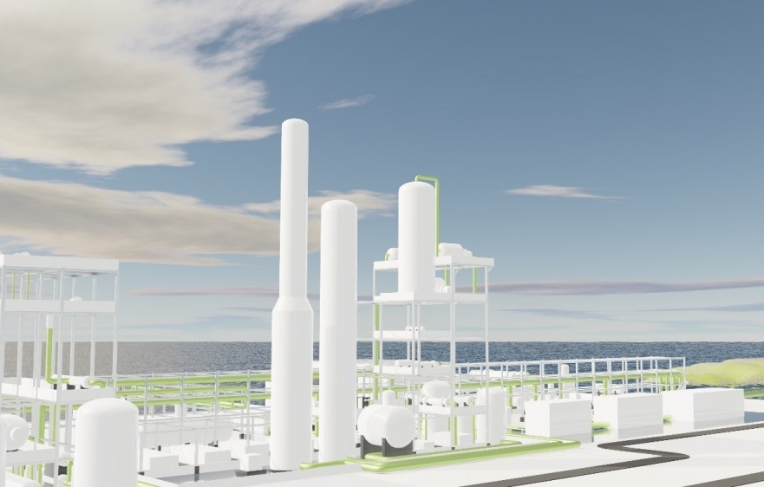





PROJECT PHASES
TOTAL INVESTMENT VALUE EXCEEDING $20BN
PHASE 1:
Green Ammonia Plant producing +/-1 million tons / year
Powered by circa 3.6 GW of renewable energy (Wind & Solar)
Investment $5.7BN (R100BN)
Offtake: East Asia and Europe
PHASE 2:
Green Ammonia Plant producing +/-1 million tons / year
Powered by circa 3.6 GW of renewable energy (Wind & Solar)
PHASE 3:
1200MW Hydrogen Electrolyser with option for Green Ammonia extension or Hydrogen Production Plant
PHASE 4:
1200MW Hydrogen Electrolyser with option for Green Ammonia extension or Hydrogen Production Plant

Slide 14
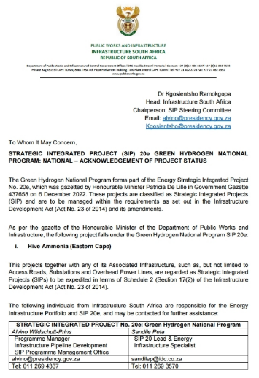
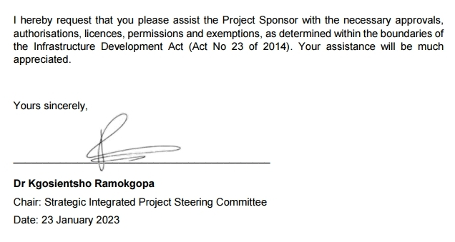
STRATEGIC INTEGRATED PROJECT STATUS
The Coega Green Ammonia Project was awarded SIP status in December 2022.
One of 9 energy projects announced by Minister of Public Works & Infrastructure Patricia de Lille, and gazette on 6 December.
Under the SIPs, the Just Energy Transition, Green Hydrogen National Plan and the Oil & Gas National Program will be fast-tracked.
To qualify for SIP status, projects need to:
be of significant economic or social importance to the Republic;
contribute substantially to any national strategy or policy relating to infrastructure development;
or be above a certain monetary value determined by the PICC
Advantages of SIP Status:
All processes relating to the implementation of SIPs, including any application for any approval, authorisation, license, permission or exemption and processes relating to any consultation and participation now run concurrently instead of the usual process which is sequential.
Implementation will be prioritised and government will assist with unblocking any snags whether technical, financial, legal or administrative that have hindered infrastructure delivery for so long.

Slide 15
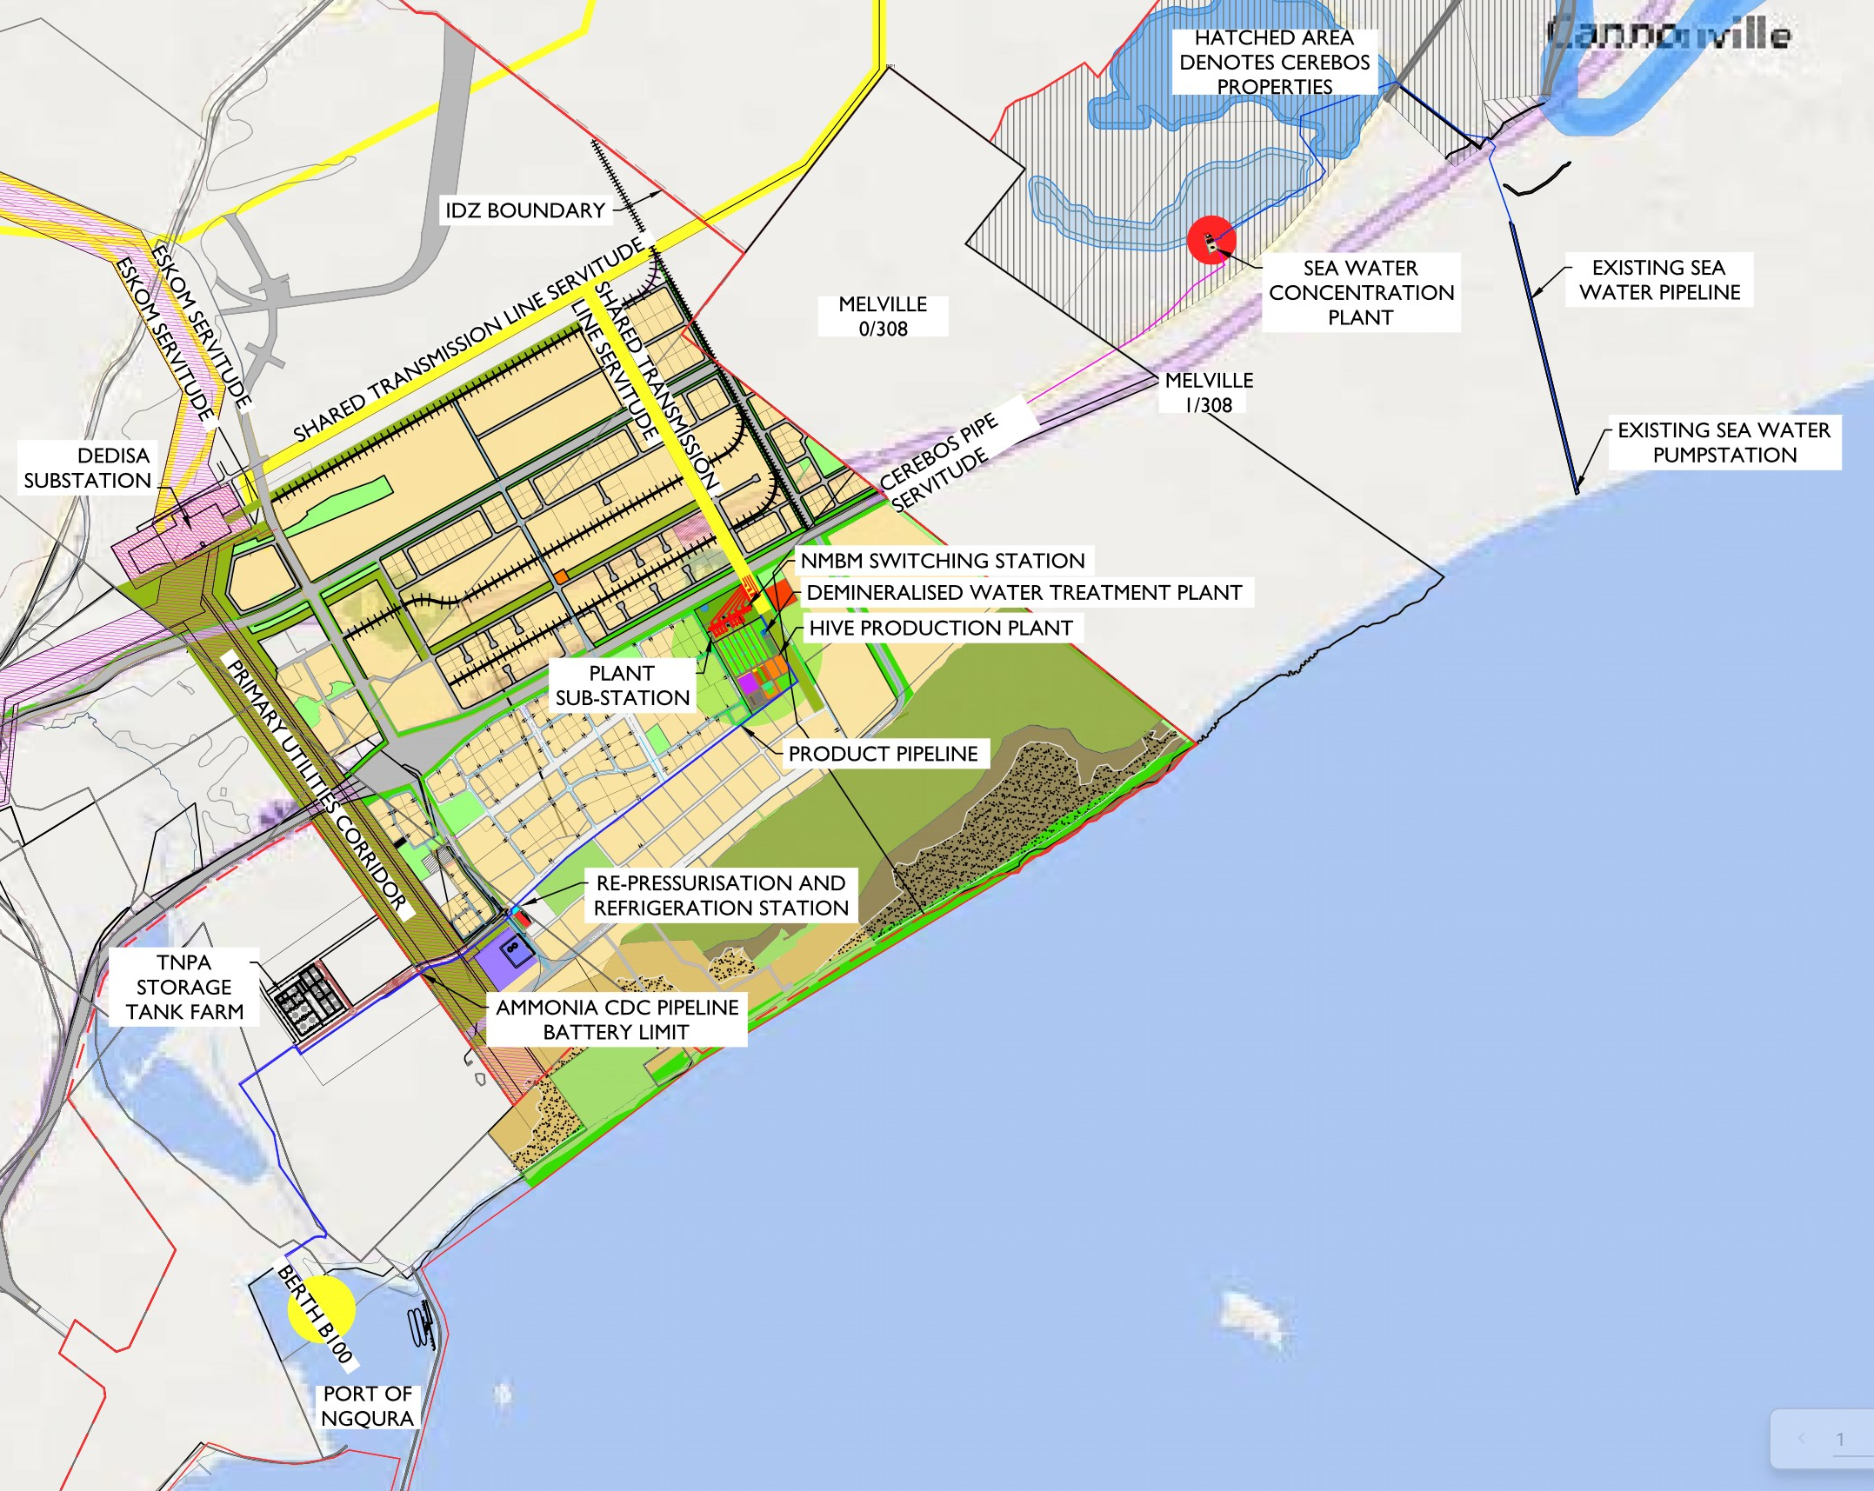
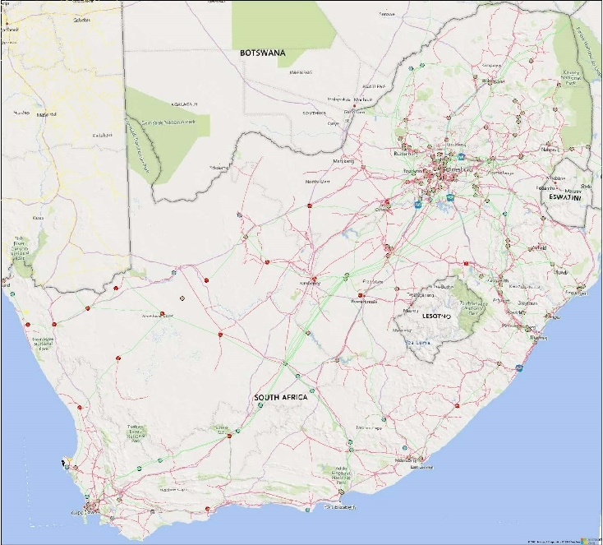
WHY COEGA?
Coega Special Economic Zone (CSEZ)
765kv
  CSEZ offering industrially zoned, permitted and serviced sites
  41 Ha CSEZ site secured for the hydrogen and ammonia production facility
  Defined and permitted servitudes
  Direct access to Ngqura Port
South Africa
Coega

Slide 16
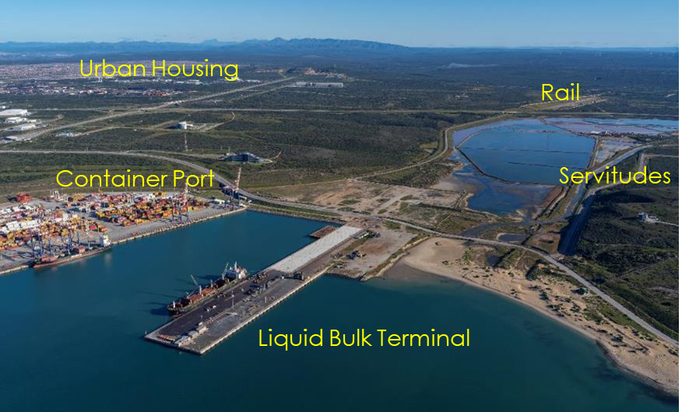
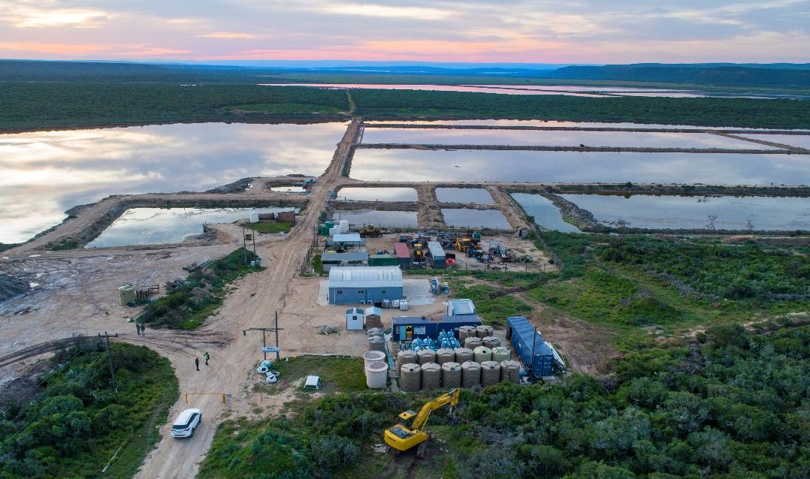
WHY COEGA?
  Ngqura Port
765kv
  TNPA confirmed berth availability in Ngqura Port
  Deep Water Harbour allows for Very Large Ammonia Carriers
  Container Terminal (40,000+ ) – Import materials & equipment
  Breakwater allows for Year-round operations - Liquid Bulk
  Defined and permitted servitudes
  Rail link
  Water Supply
  Desalinated water supply through collaboration with Cerebos
Cerebos Evaporation Ponds
  Existing servitudes and other infrastructure
New GCA Desalination Plant Site
Existing Cerebos Desalination Plant
  Active permits and licenses
  All brine collected in Cerebos evaporation ponds – no discharge

Slide 17
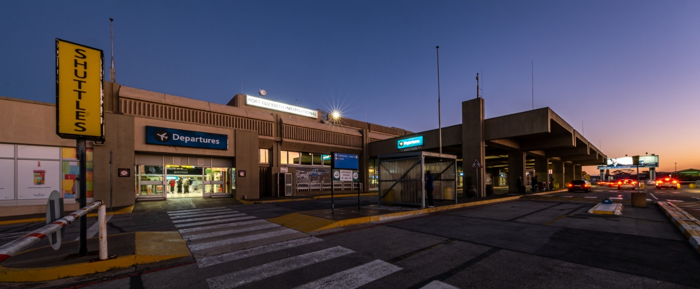
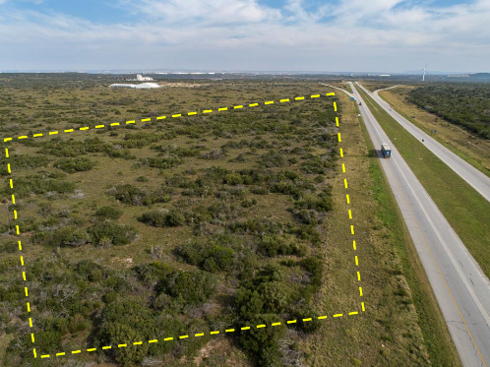
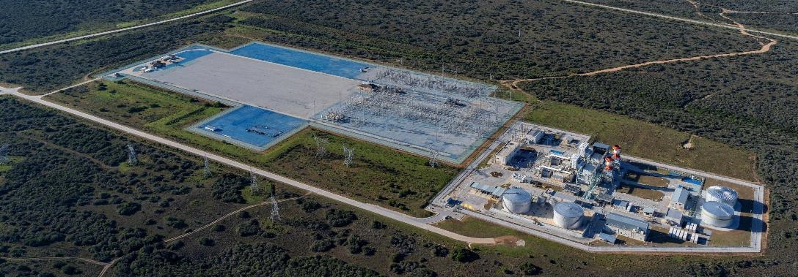
WHY COEGA?
Accessibility
1st Class Road and Rail Infrastructure
  Direct access to national road infrastructure (N2)
  Chief Dawid Stuurman Airport 30km away
  Port of Port Elizabeth 25km away
Chief Dawid Stuurman International Airport
  Electrical Load Availability
  Eskom confirmed Plant Load Availability at Dedisa Substation
  The Grid Strengthening Plan will increase load availability for Gqeberha
Coega Human Capital
Dedisa Substation
41 ha Production Plant Site

Slide 18
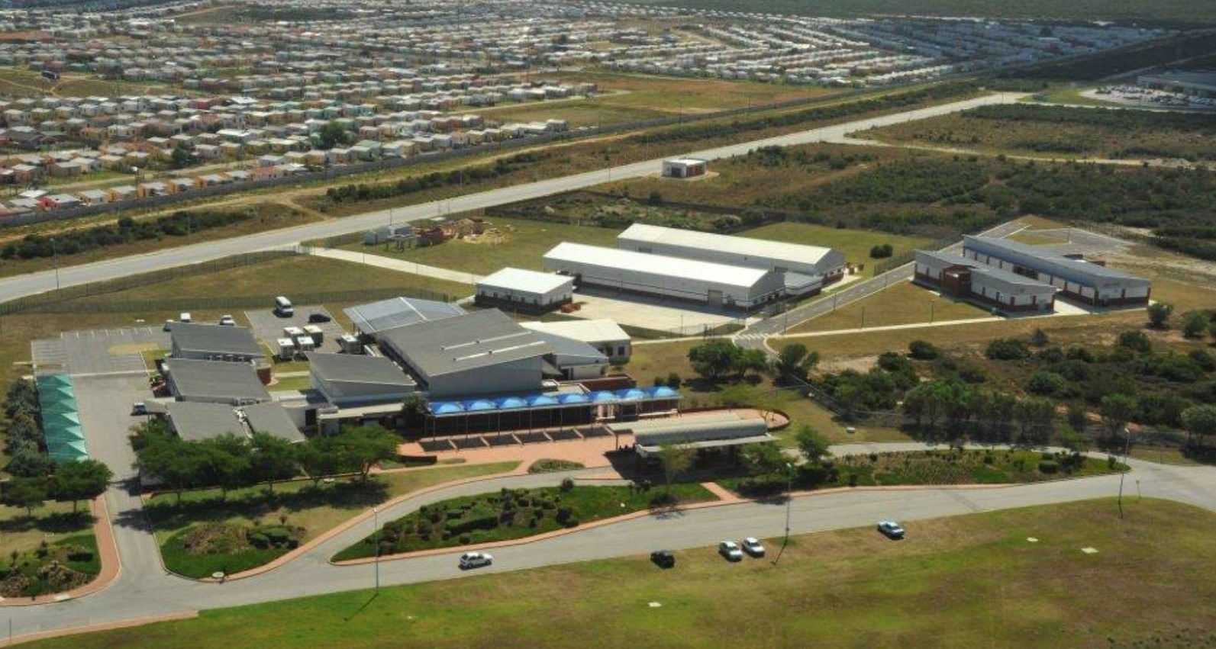
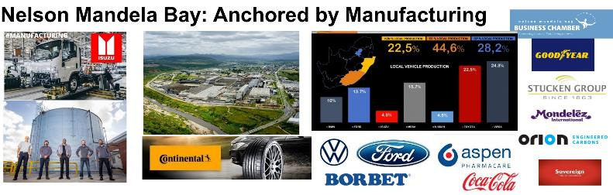
WHY COEGA?
  Socio-Economic
  Established Recruitment Centre and Clinic in CSEZ
  Large local resource of skilled, semi-skilled and unskilled labour
Skills Training Facilities at Coega Human Capital (CHC)
Large (3000+ people) housing estate with amenities at CHC
  Local Business & Industry
Coega Human Capital
Support from and collaboration with the Nelson Mandela Bay stakeholders
Large pool of manufacturing capabilities in the Metropole

Slide 19

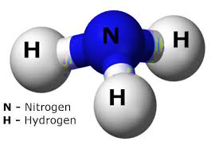
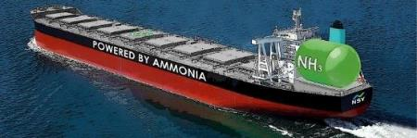
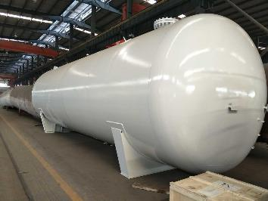


Why Green Ammonia?
Ammonia is easier to store and transport than Hydrogen and the cost is lower too...
Green Ammonia is produced by renewable energy sources
Liquid hydrogen needs to be stored at
-253 C, close to absolute zero, while ammonia needs to only be kept at -33 C.
Current Global Ammonia Production is 176 million tons/year but from fossil fuels
Changing to Green Ammonia will reduce Global Carbon Emissions by 1.8%
Ammonia has a higher energy density than liquid hydrogen (12.7 vs 8.5 MJ/L).
Zero-carbon Fuel
Fully developed global logistics infrastructure, including 120 ports with ammonia terminals.
Ideal for Coal Substitution – works with direct combustion Engine/Turbines
Changing to Green Ammonia will reduce Global Carbon Emissions by 1.8%
In PEM Fuel Cell (After cracking)
The maritime industry is set to be an early adopter, replacing the use of heavy fuel oil and diesel
with Ammonia

Slide 20


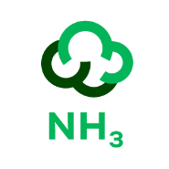




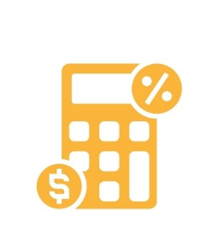
FULL PROJECT IMPACT
JUST ENERGY TRANSITION PROJECT
CLIMATE CHANGE
Funding & building transmission lines that will bring in up to 18,000 MW of Renewable capacity to the grid.
Very low environmental impact with significant net gain on reducing carbon emissions.
BLACK ECONOMIC EMPOWERMENT
ENERGY FOR INDUSTRY
Just Energy Transition focused BEE participation at minimum 25% of Equity.
Strengthening energy security in the Metro, ensuring power availability for industry.
STIMULATE MANUFACTURING INDUSTRY
JOB CREATION & SKILLS DEVELOPMENT
Catalyst for material & equipment suppliers to set up assembly and/or manufacturing plants in the Coega Special Economic Zone and the greater Metro area.
Over 20,000 direct and indirect jobs to help alleviate unemployment in phase 1 alone (15,000 construction & 5,000 operation and maintenance), including renewable energy plants.
TAX REVENUES
Tax contribution in excess of
R200 billion.

Slide 21

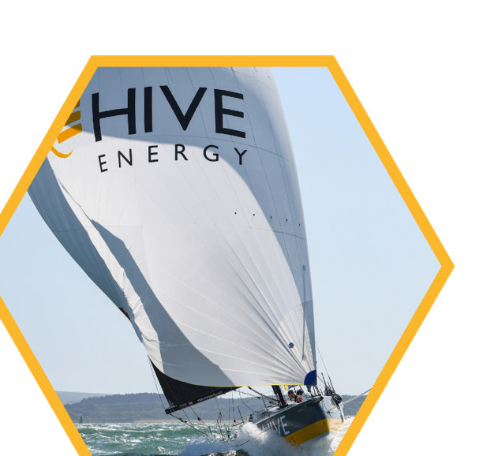
THANK YOU
COEGA GREEN AMMONIA

Slide 22
SESSION 2:
SCOPING AND EIA OVERVIEW

Slide 23

EIA Approach - Legal Requirements
  Activities listed under the National Environmental Management Act. 108 of 1998 (NEMA)
  NEMA provides for the control of certain listed activities, which are prohibited until Environmental Authorisation is obtained.
  Listing Notice 2 – activities related to vegetation removal and storage of dangerous goods are triggered » Environmental Authorisation
  As a Listing Notice 2 activity is triggered, the application for Environmental Authorisation by CGA requires a Scoping and EIA process to be undertaken in accordance with the requirements of the EIA Regulations 2014 (as amended).
Atmospheric Emissions Licence and Water Use Licence/General Authorisation
Competent Authorities
  Eastern Cape: Department of Economic Development, Environmental Affairs and Tourism – Environmental Authorisation
  Nelson Mandela Bay Municipality – Atmospheric Emissions Licence

Slide 24
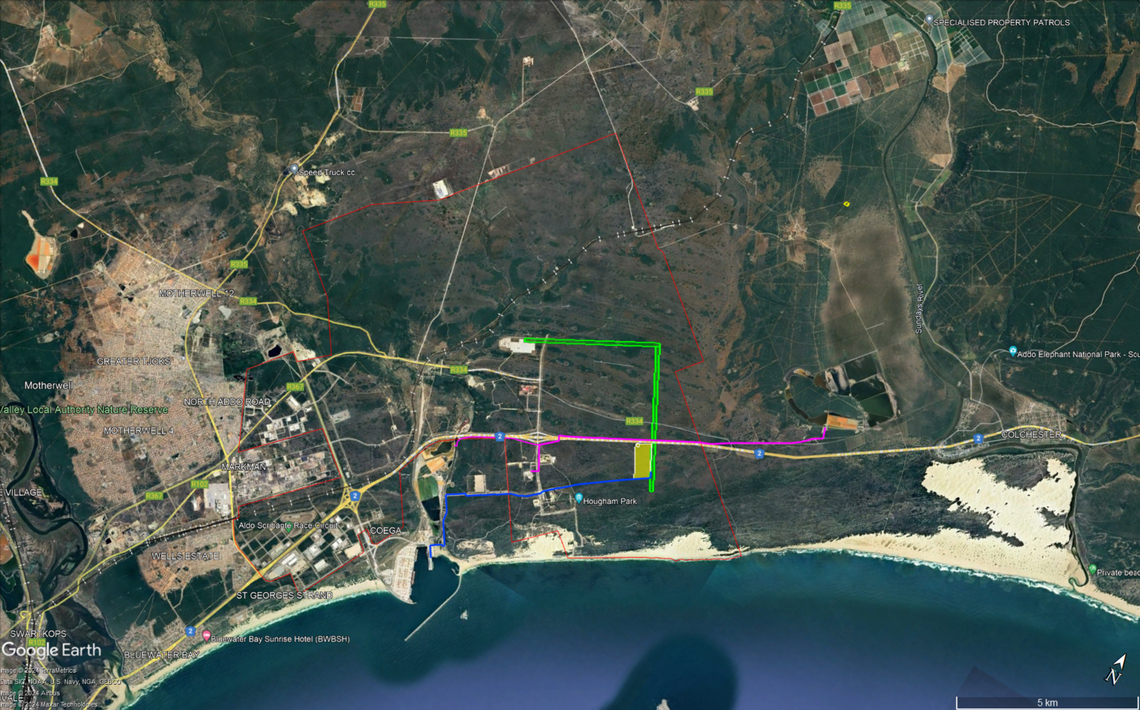
Where are we and Where is the Project?

Slide 25
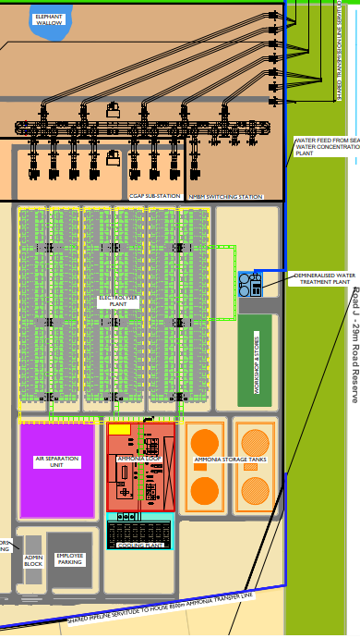
Project Components covered in the EIA Process
Hydrogen and Ammonia Production Plant on 41 ha site
in Zone 7 of Coega SEZ – Electrolyser Units and
Ammonia Production Loop
Bulk Ammonia Storage in 2 x 35 000 m³ Tanks
Ammonia Pipeline and Refrigeration Unit
Water Pipelines
On-site Substation
400 kV Transmission Line between Plant and Dedisa Substation

Slide 26
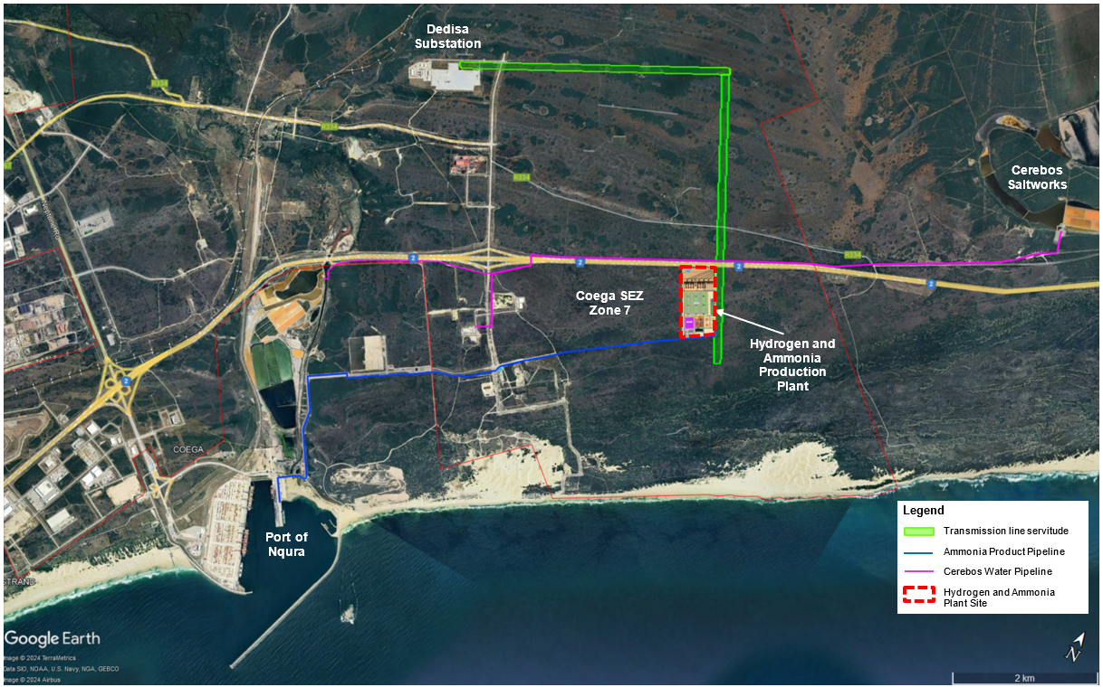
Refrigeration
Station
Berth100

Slide 27
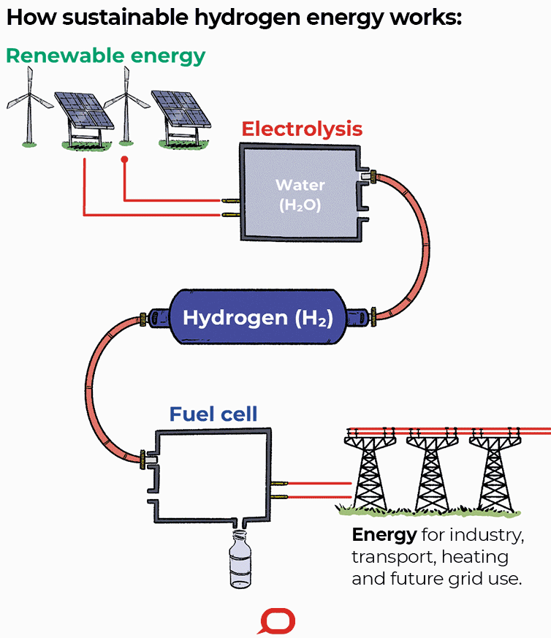

Hydrogen (H₂)
Nitrogen (N)
H₂ + N = Ammonia (NH₃)

Slide 28
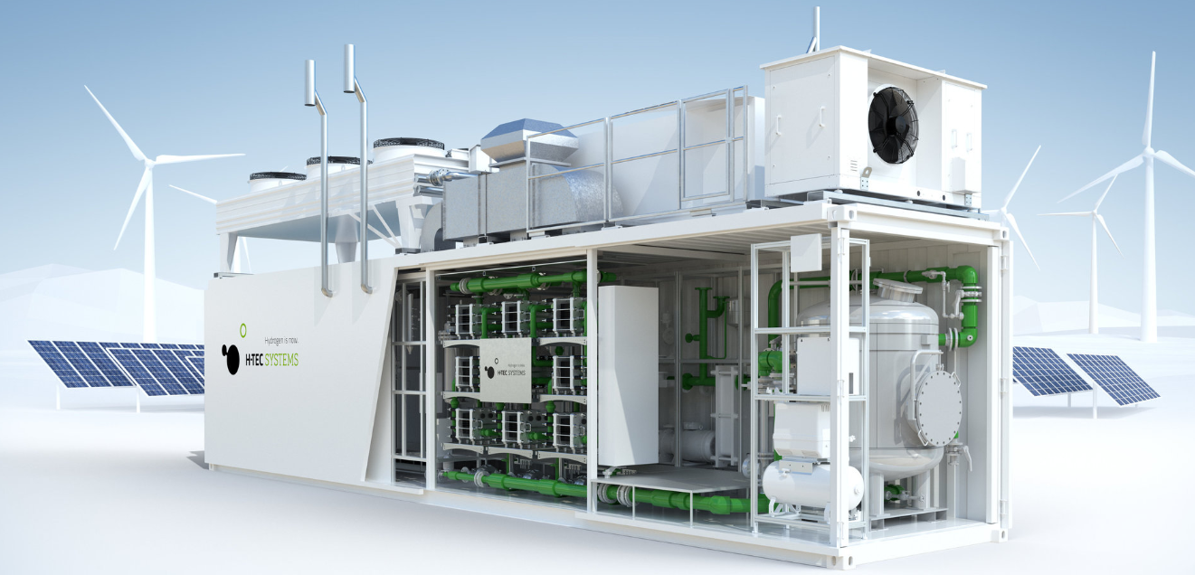
Electrolyser Unit
Berth100
https://www.h-tec.com/en/products/detail/h-tec-pem-electrolyser-me450/me450/

Slide 29
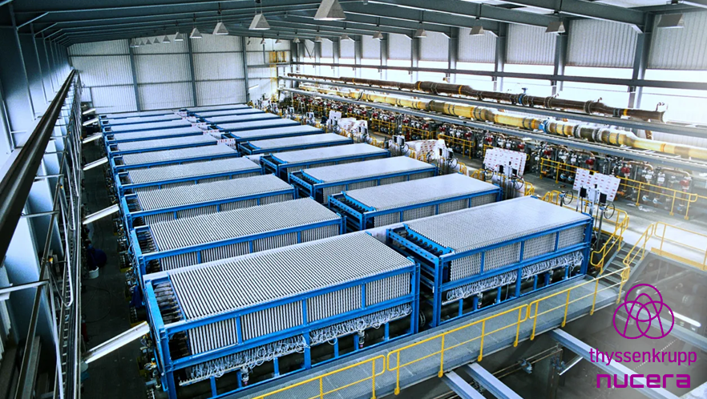
Electrolyser Units Under Roof
Berth100

Slide 30
Ammonia Plant
Berth100

Slide 31
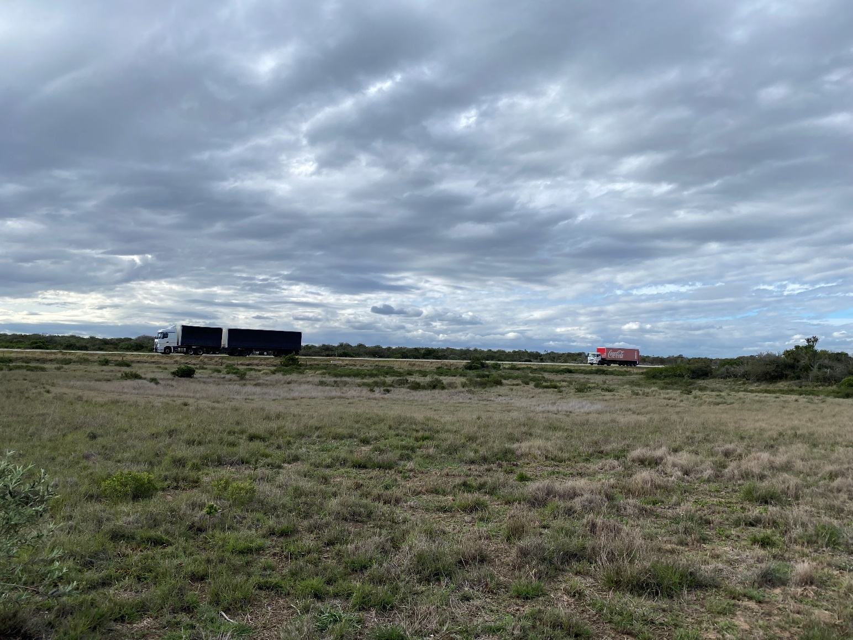
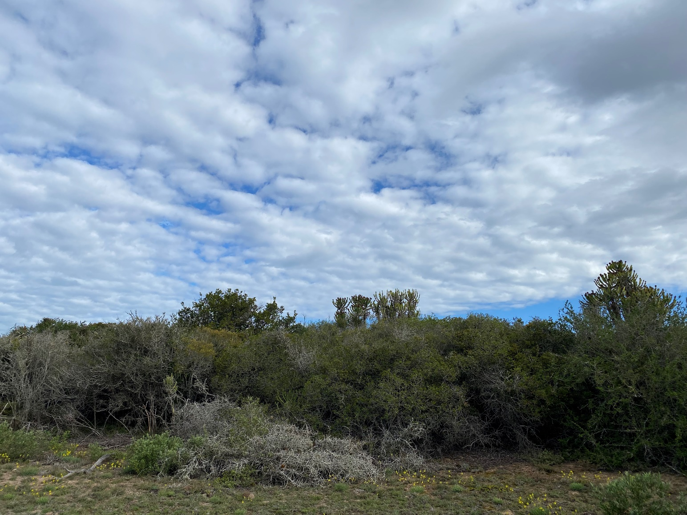
Site Photographs

Slide 32
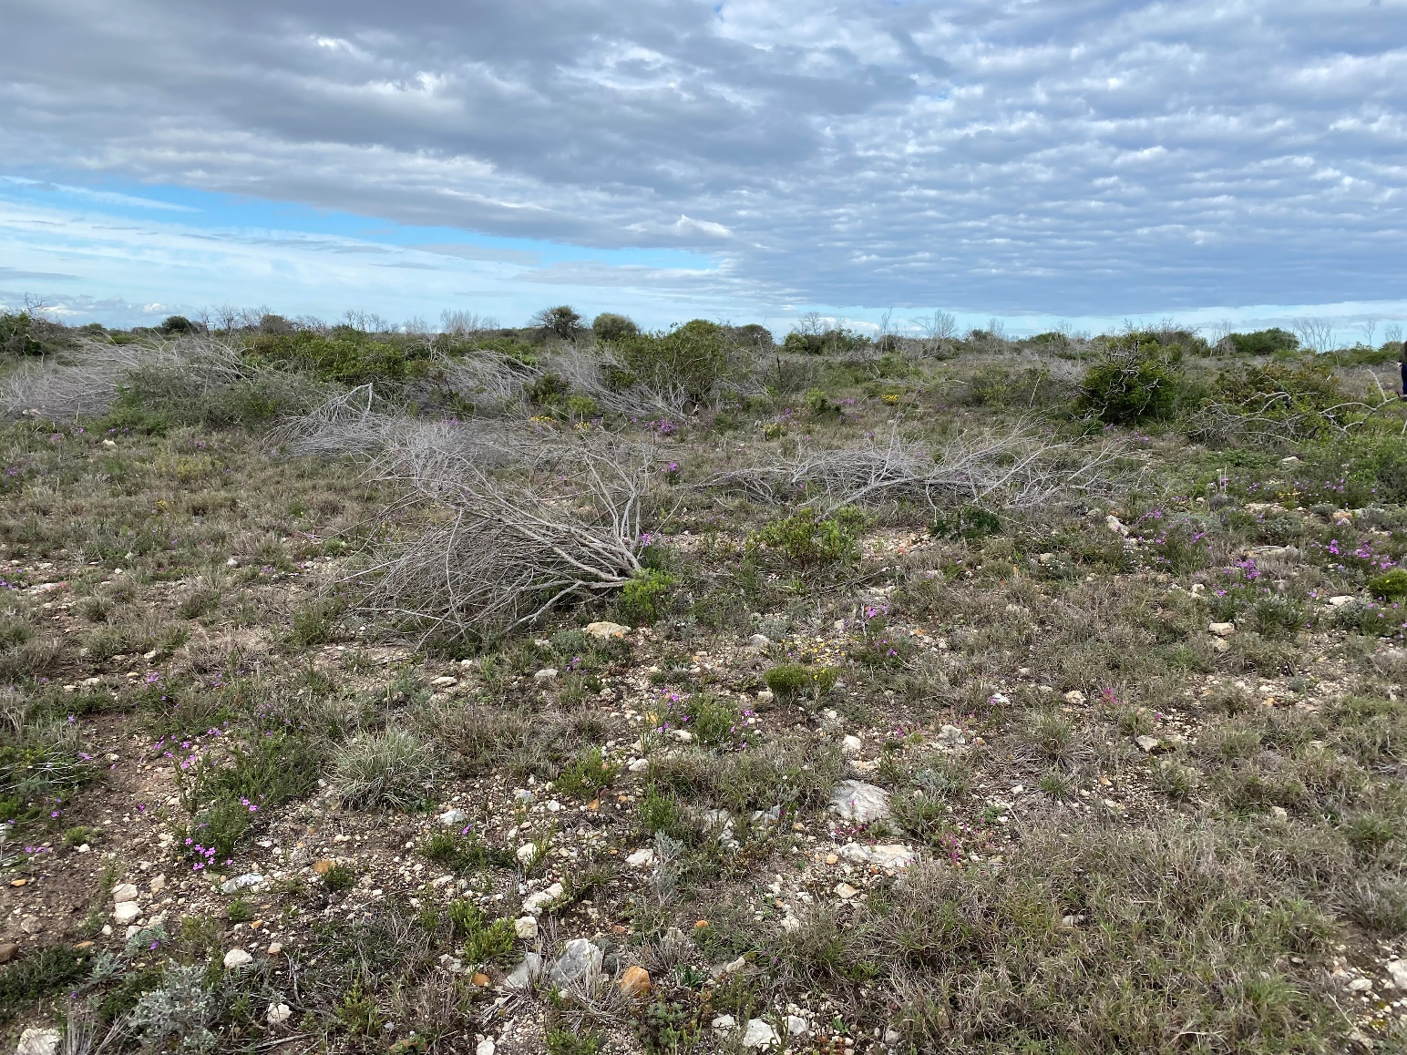
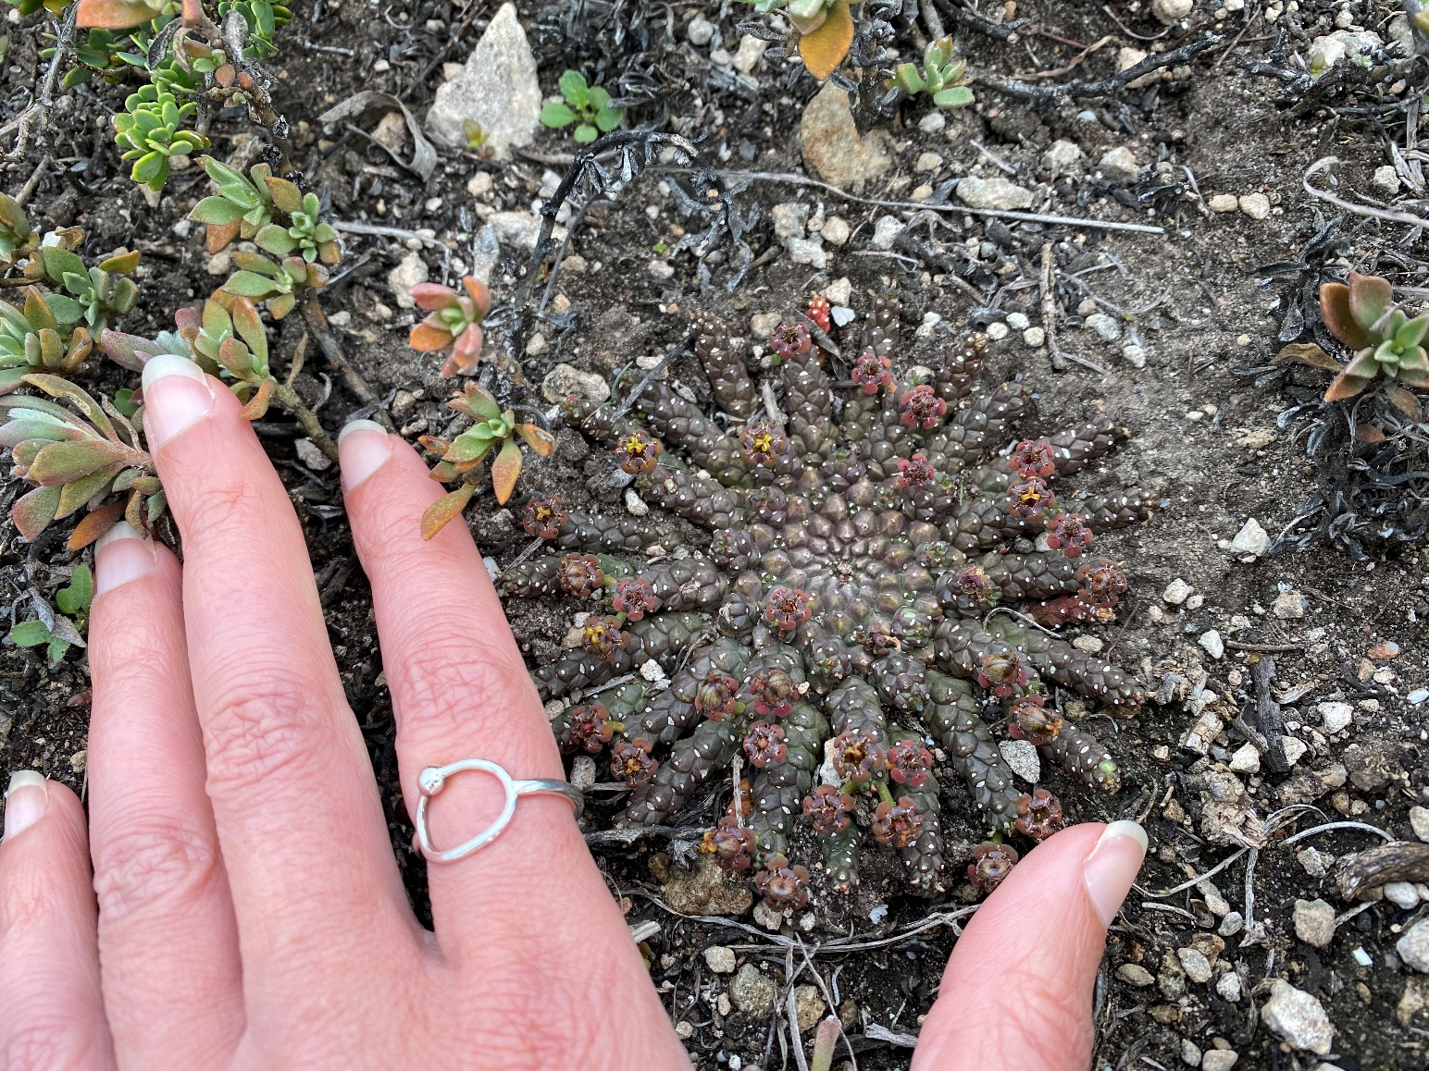
Site Photographs

Slide 33

Scoping and EIA Process
The Scoping and EIA process is undertaken to gather information to inform an authority decision on the Environmental Authorisation by:
  identifying potential risks and benefits of the proposed project through specialist input and consultation with stakeholders
  assessing the significance of potential impacts (benefits and negative impacts)
  identifying measures to prevent or mitigate impacts and promote benefits, should the project be approved.
Public Participation is a key component of an EIA process

Slide 34
EIA Approach – Process Phases
Scoping Phase
  Objectives
    To build up a stakeholder database
    To screen and identify potential impacts with input from local stakeholders
      Ecology – Vegetation, Freshwater, Birds
      Air Quality
      Health and Safety Risks
      Heritage
      Traffic
      Job Opportunities - ~5 000 construction, ~500 operations
      Local Investment
    Confirm the terms of reference for the specialist studies
  Scoping Report

Slide 35
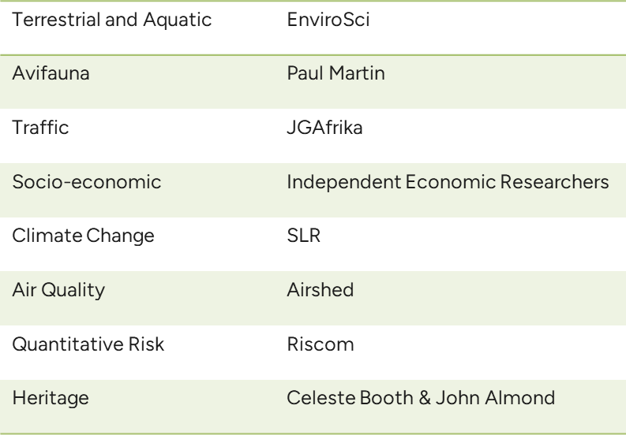
EIA Approach – Process Phases
Impact Assessment Phase
  Objectives
    Assess significance of impacts
    Identify measures to avoid, manage
    or mitigate negative impacts and
    promote benefits
  Independent Specialist Studies
  Environmental Impact Report
  Environmental Management
  Programme

Slide 36
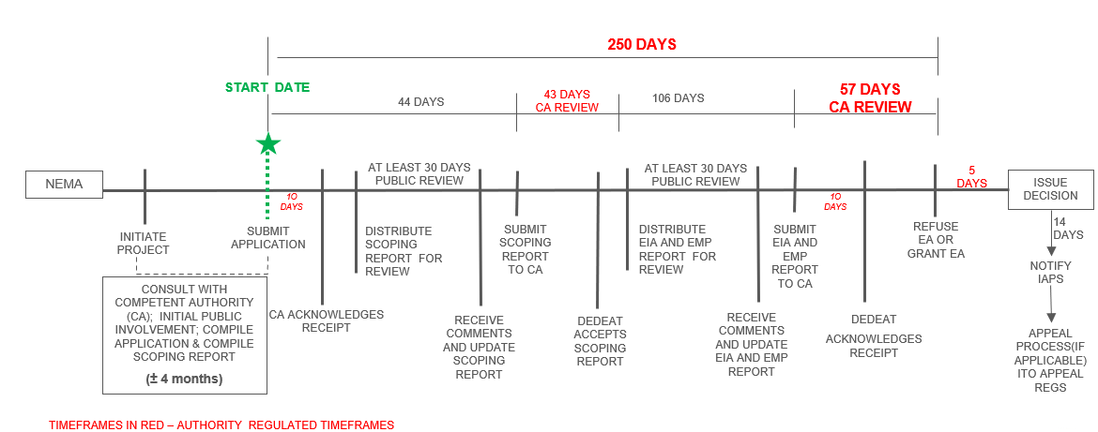
Legislated Timeframes - SIP

Slide 37
Public Participation - Opportunities to Comment
EIA Process
Pre-Application Phase:
I&AP notification and registration.
Distribution of information letter and advertising of project.
Update of project I&AP database.
Public Meetings
Scoping Phase (Q1 2024):
Submission of EA application.
Distribute Draft Scoping Report for public review and comment (30-days).
Update Scoping Report with comments received.
Submission of Scoping Report to DEDEAT.
DEDEAT accepts or rejects the Report.
Impact Assessment Phase (Q2 2024):
Distribute Draft EIA Report for public review and comment (30-days).
Public meeting.
Update EIA Report with comments received.
Submission of EIA Report to the CA.
DEDEAT reviews the EIA Report
Decision (Q3 2024):
DEDEAT grants EA or rejects the application.
Registered I&APs notified of EA decision and appeals process.
20 days to submit an appeal from date of notification.
We are here

Slide 38
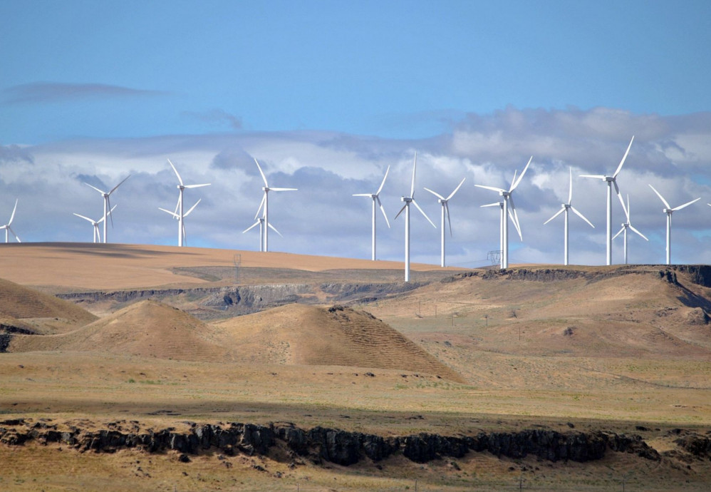
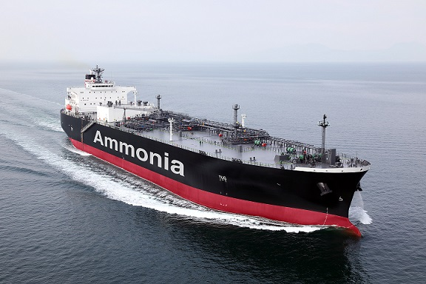
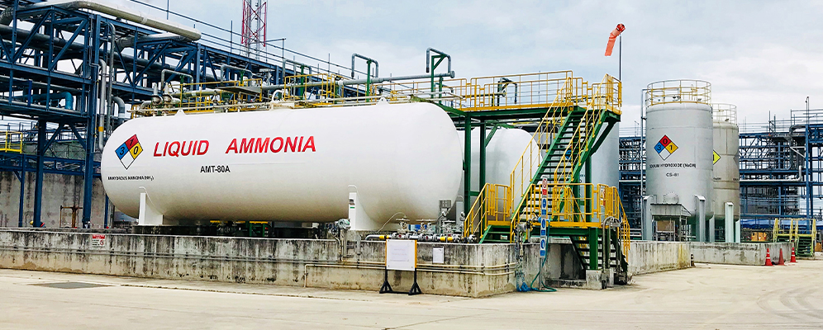
Outside of EIA Scope
NB TO NOTE: Outside of Scoping and EIA Scope
  Renewable energy sources and transmission to
  Dedisa Substation
  Any required capacity expansions at Cerebos
  Export through Port of Ngqura
https://businesstech.co.za/news/energy/93743/south-africas-biggest-wind-farms-vs-the-world/
https://www.futurebridge.com/industry/perspectives-energy/green-ammonia-for-energy-storage/
https://www.pv-magazine.com/2021/01/21/green-ammonia-breakthrough-a-potential-boon-for-solar-powered-exports/

Slide 39
Scope of the EIA
Berth100

Slide 40

Do you have any questions?

Slide 41

Constructive Discussion Guidelines
Public participation is not a voting or consensus-driven process.
A process of collecting input for the purpose of helping the decision-maker to consider all issues and impacts before making a decision.
Respect / human dignity
Agree to disagree
Give everyone a fair chance to ask questions / comment
Raise your hand to comment or ask a question and work through the facilitator(s)
State your name, surname and organisation / community
Please turn your cell phones on silent

Slide 42
NEXT STEPS
Distribution of the Draft Scoping Report for 30-day review and comment period
  Hard copies at North End Library and Coega Human Capital Solutions
  Digital copies on SLR Website and a Data Free Website link
All comments received to be responded to in a Comments Report
Final Scoping Report submission to DEDEAT for Acceptance
If accepted, the process will continue to the Impact Assessment Phase

Slide 43





Contact Details
 | Email | coega-ammonia@slrconsulting.com
 | SMS / Whatsapp | 067 380 2724
 | Telephone | 021 461 1118
 | Post | 5th Floor Letterstedt House, Newlands on Main, Newlands, Cape Town, 7700
 | Web | https://www.slrconsulting.com/public-documents/coega-ammonia/
 | Data Free | https://slrpublicdocs.datafree.co/public-documents/coega-ammonia/

