Slide 1

Skinningrove
Virtual Seafront Walk
Cleveland Ironstone Mining Museum

Slide 2
We describe the things we see as either human or physical.
Physical features are natural.
Human features are made by people.
Walk with me and spot some . . .

Slide 3
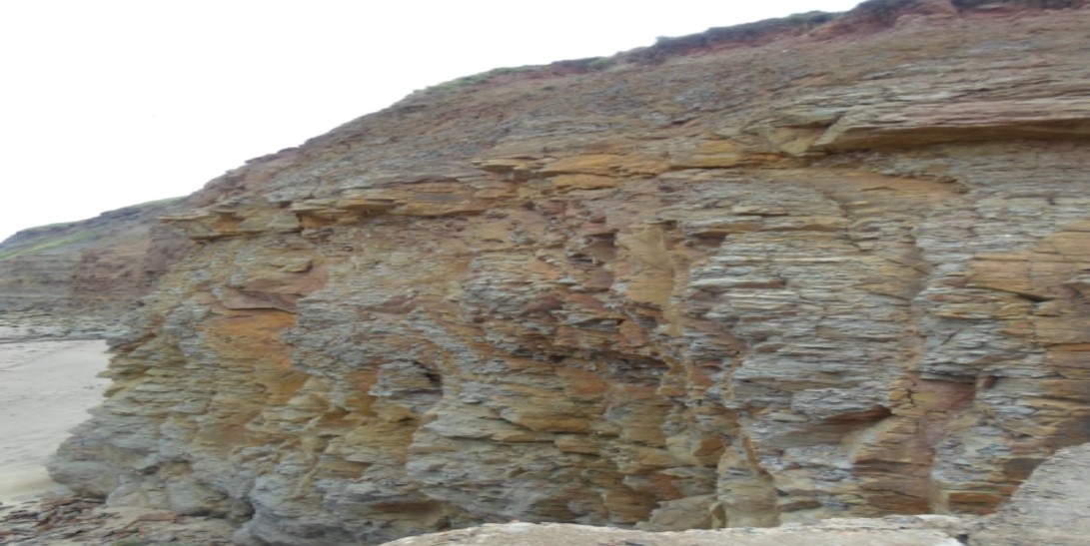
Look at these cliffs?
Are cliffs a physical or human feature?
Cliffs are natural so they are a physical feature

Slide 4
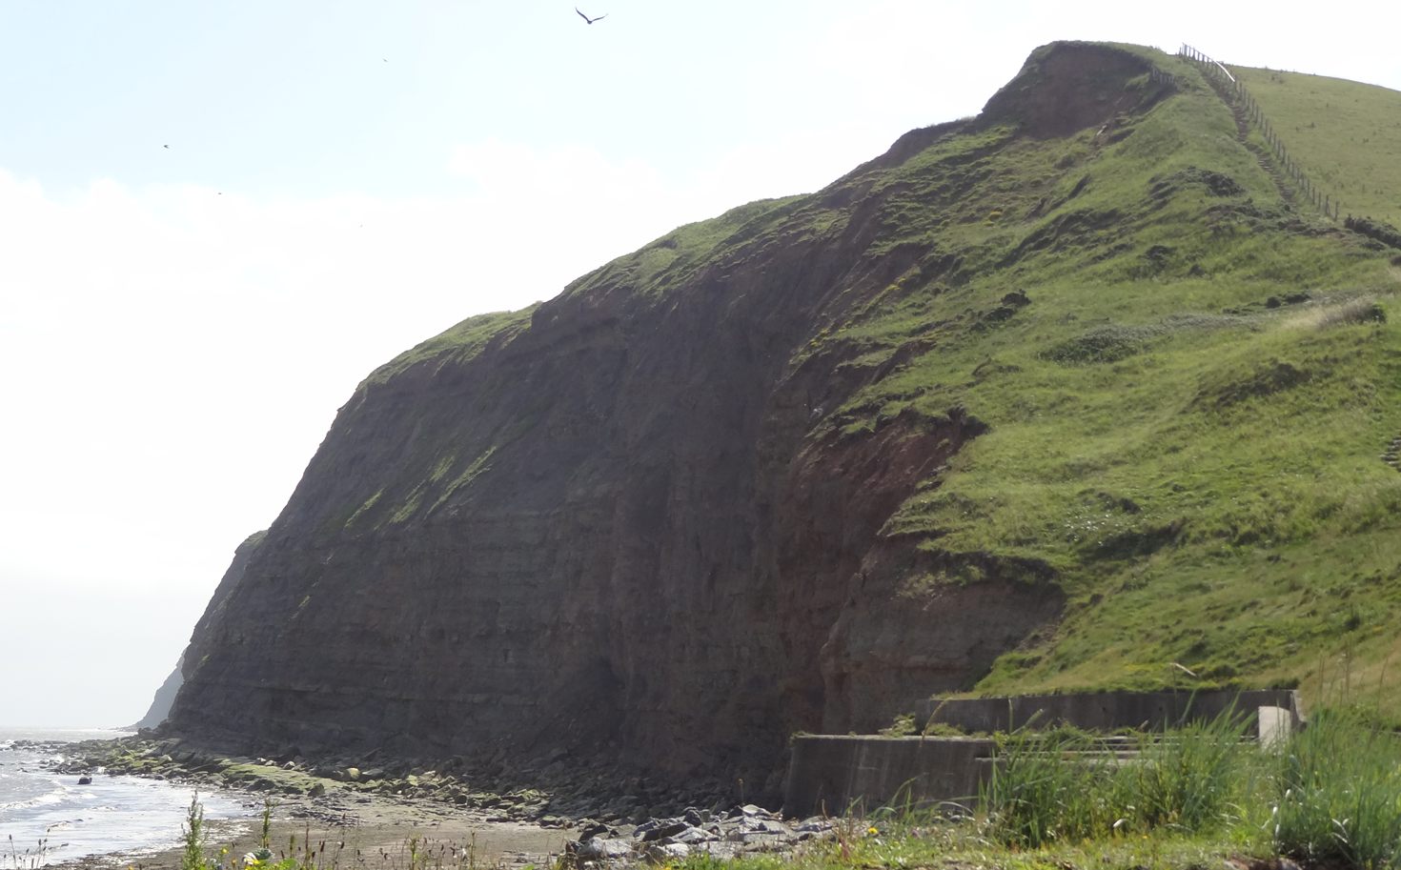
Would you like to walk the footpath to the top of these cliffs?
It is very steep so you would be tired at the top!

Slide 5
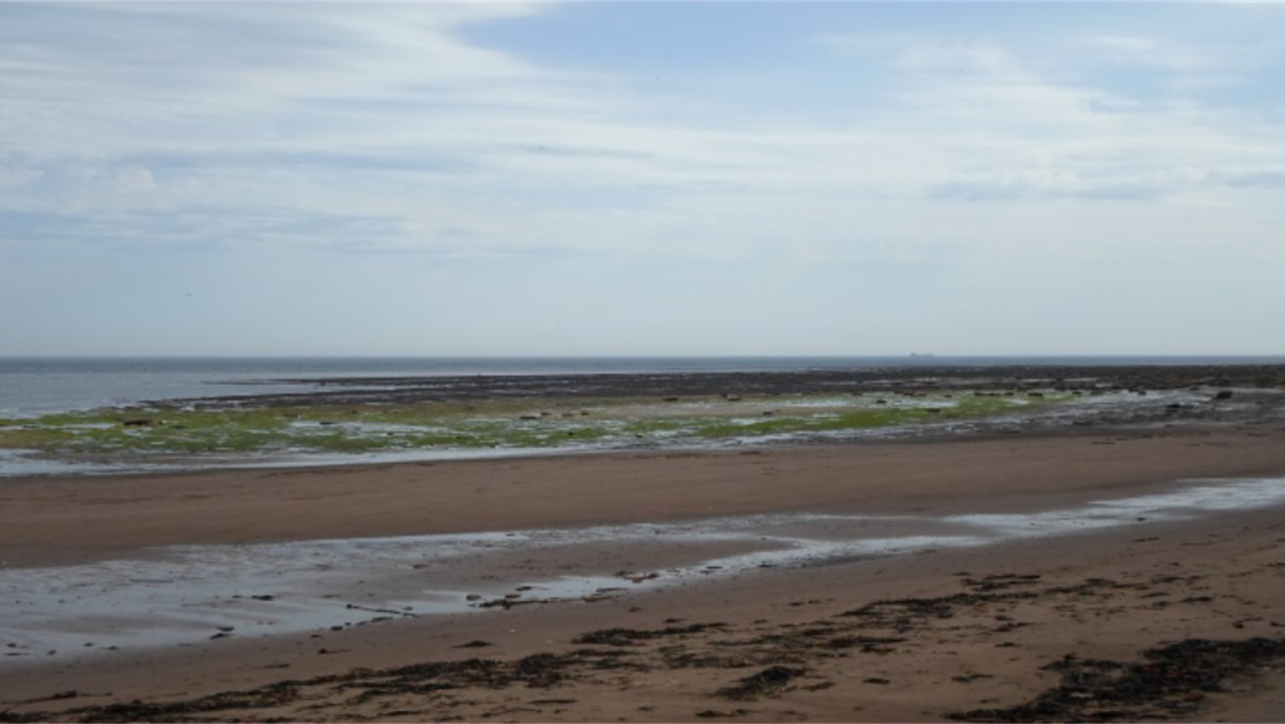
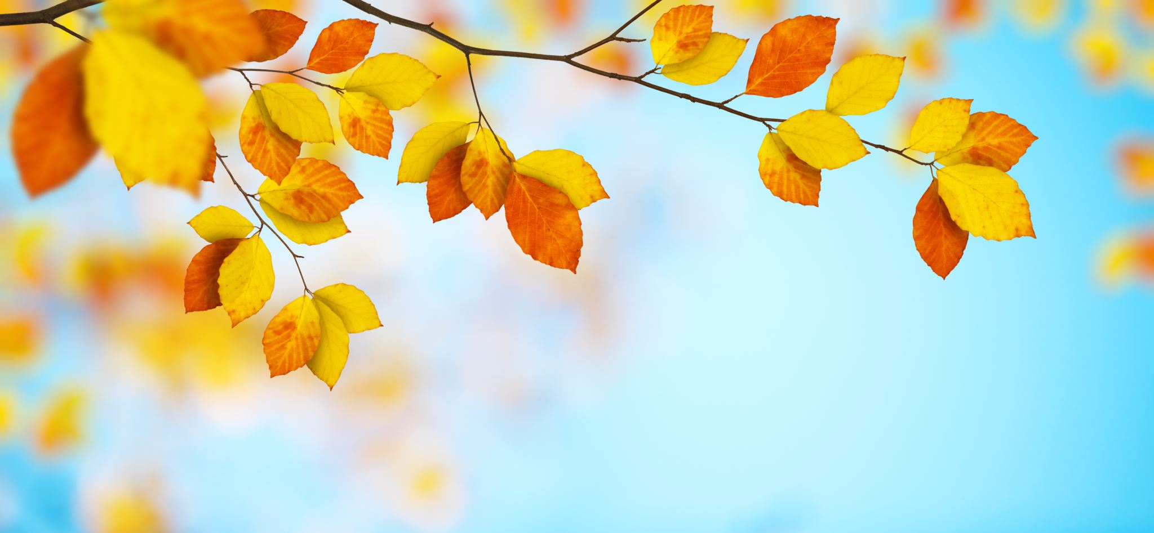
Can you see the green seaweed?
Seaweed grows in the sea. What looks like seaweed but grows on land?
Plants
Physical
Is seaweed a physical or human feature?

Slide 6
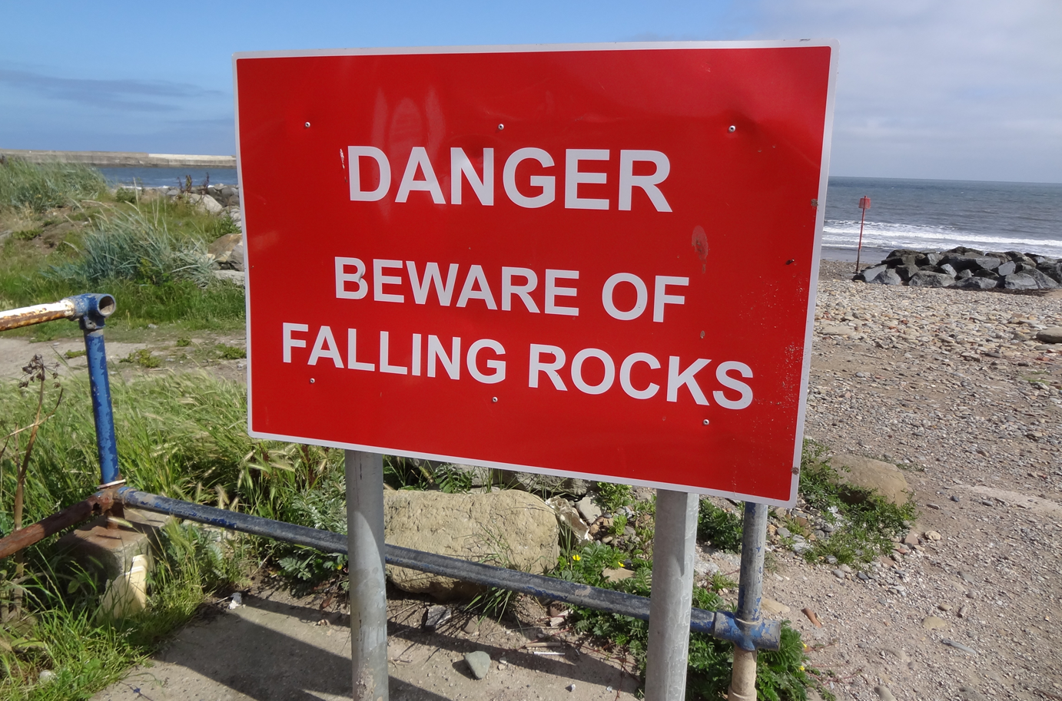
Where do you think the falling rocks would be coming from?
The cliffs
Human
Is this sign a physical or human feature?

Slide 7
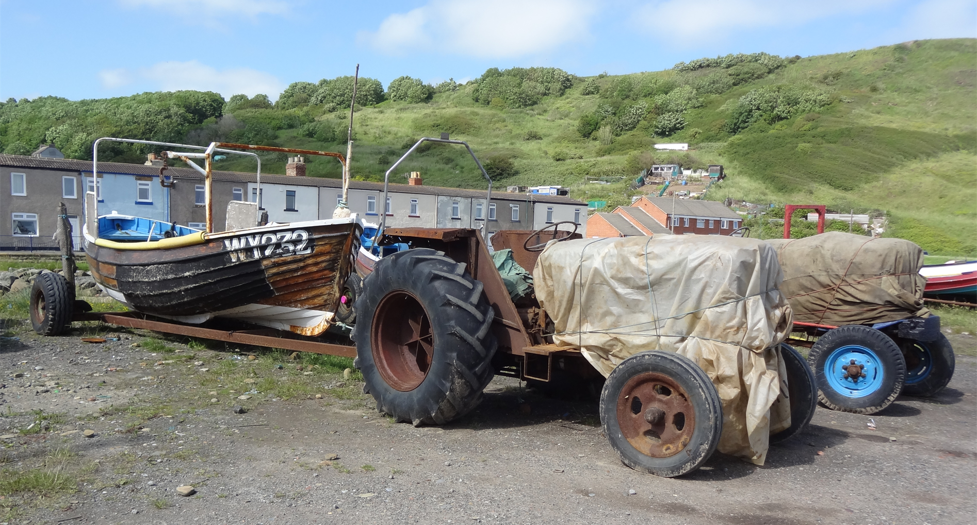
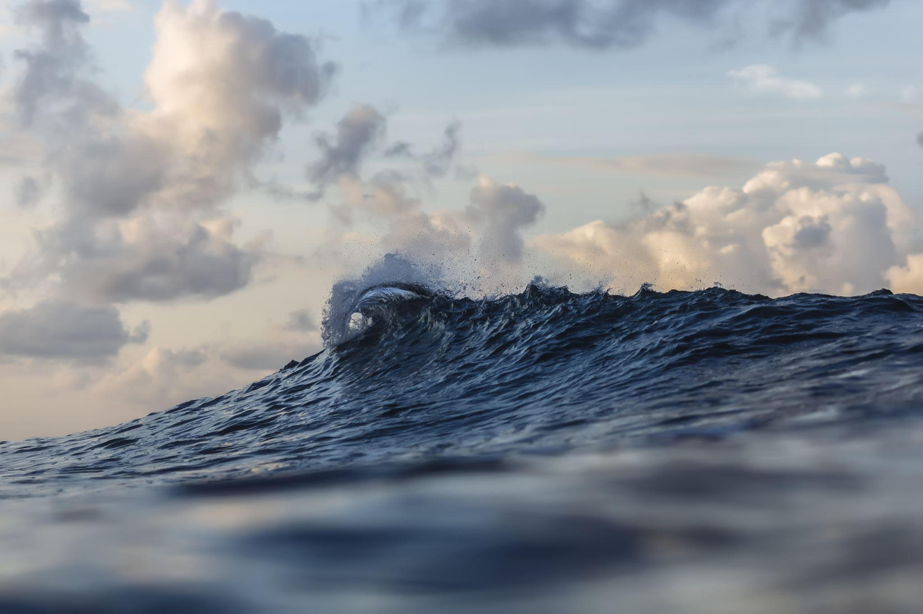
Where do think the tractor is taking the boat?
The sea
Human
Is this boat a physical or human feature?

Slide 8
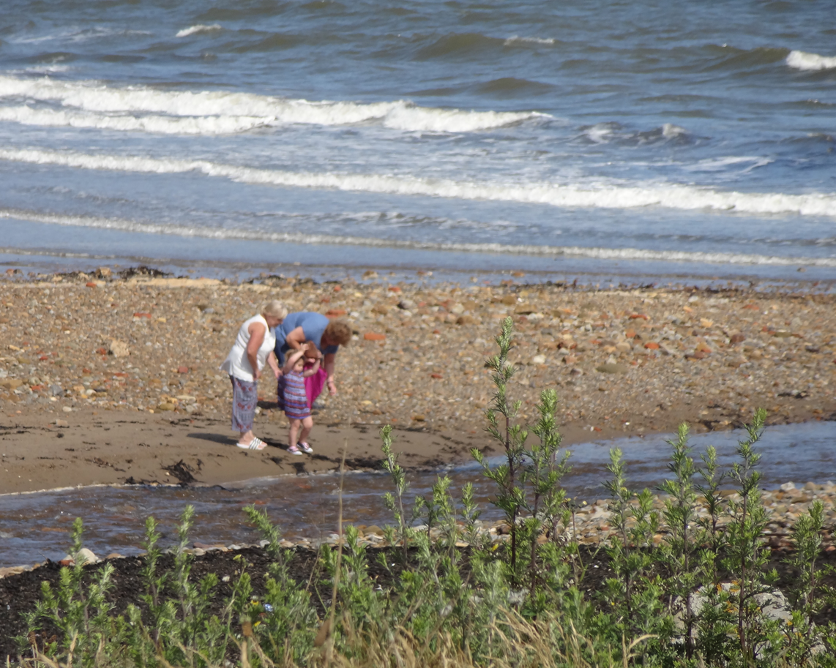
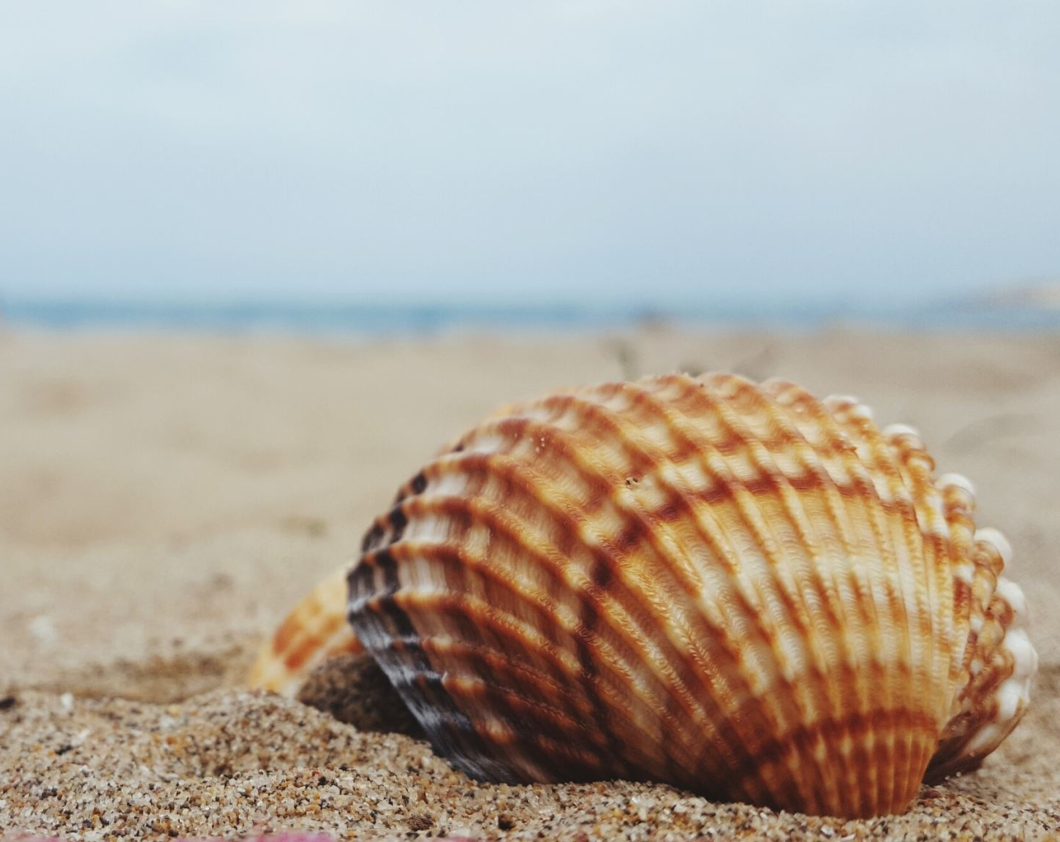
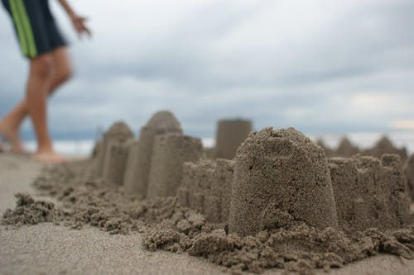
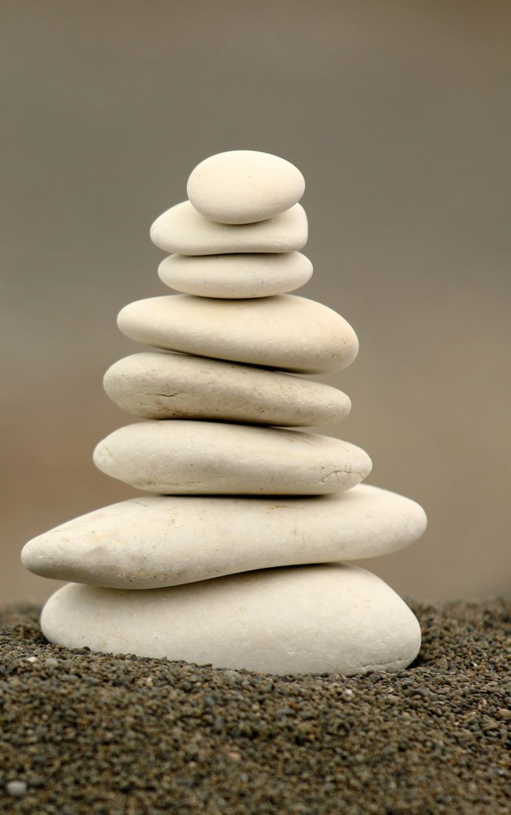
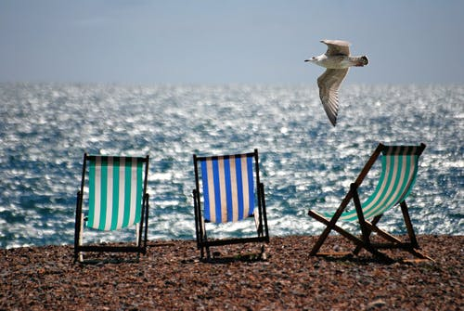
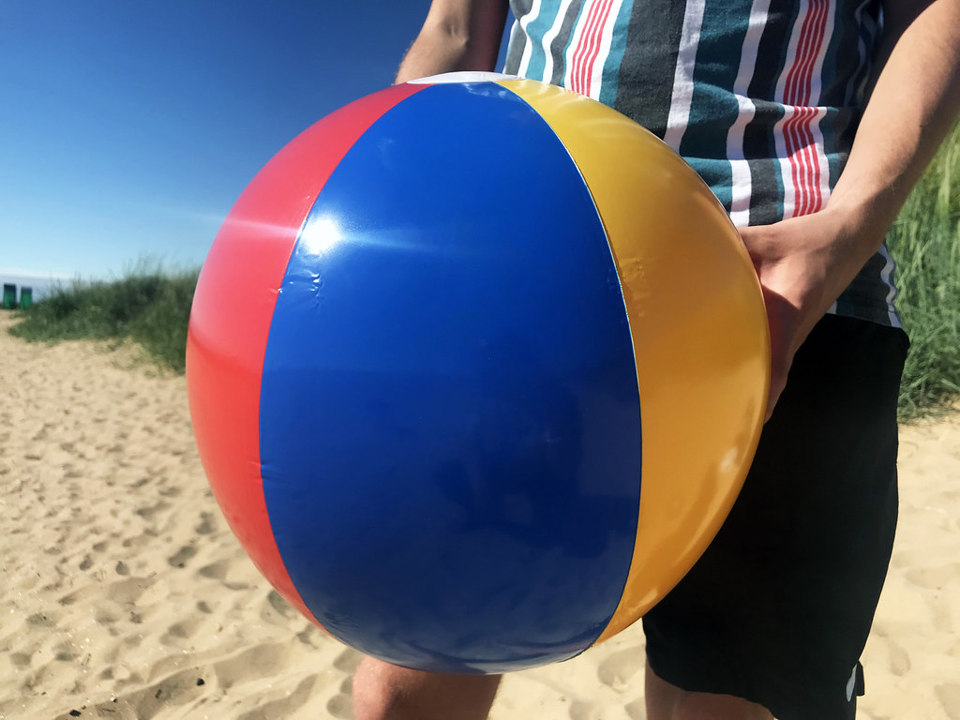
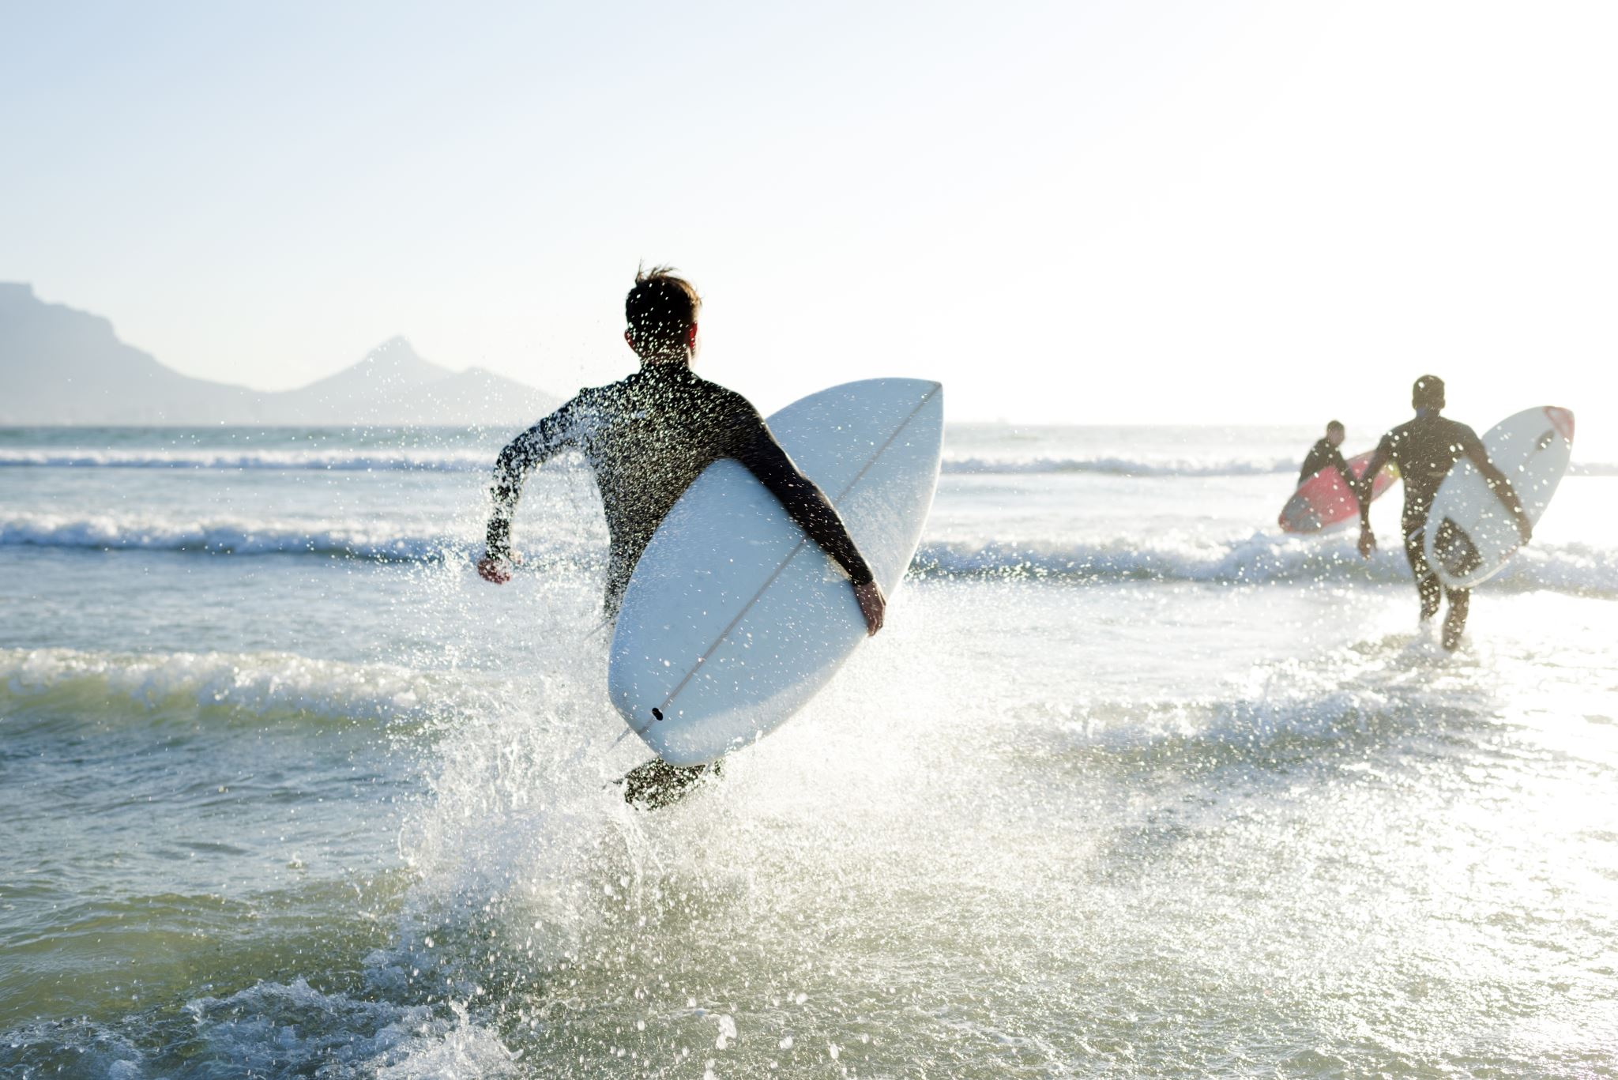
What do people enjoy doing at the beach?
Physical
Is the beach a physical or human feature?

Slide 9
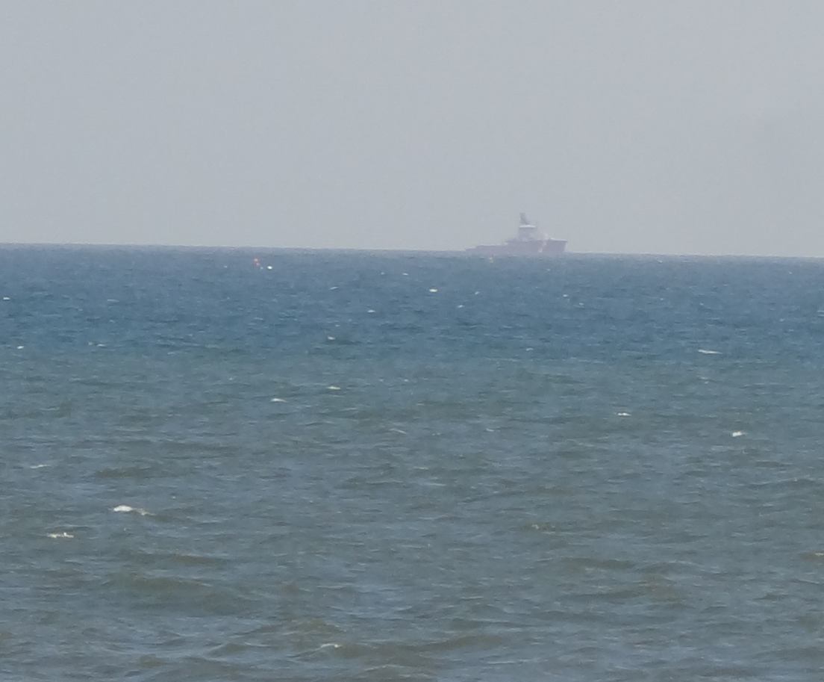
Can you see anything out at sea?
A Boat
Physical
Is the sea a physical or human feature?

Slide 10
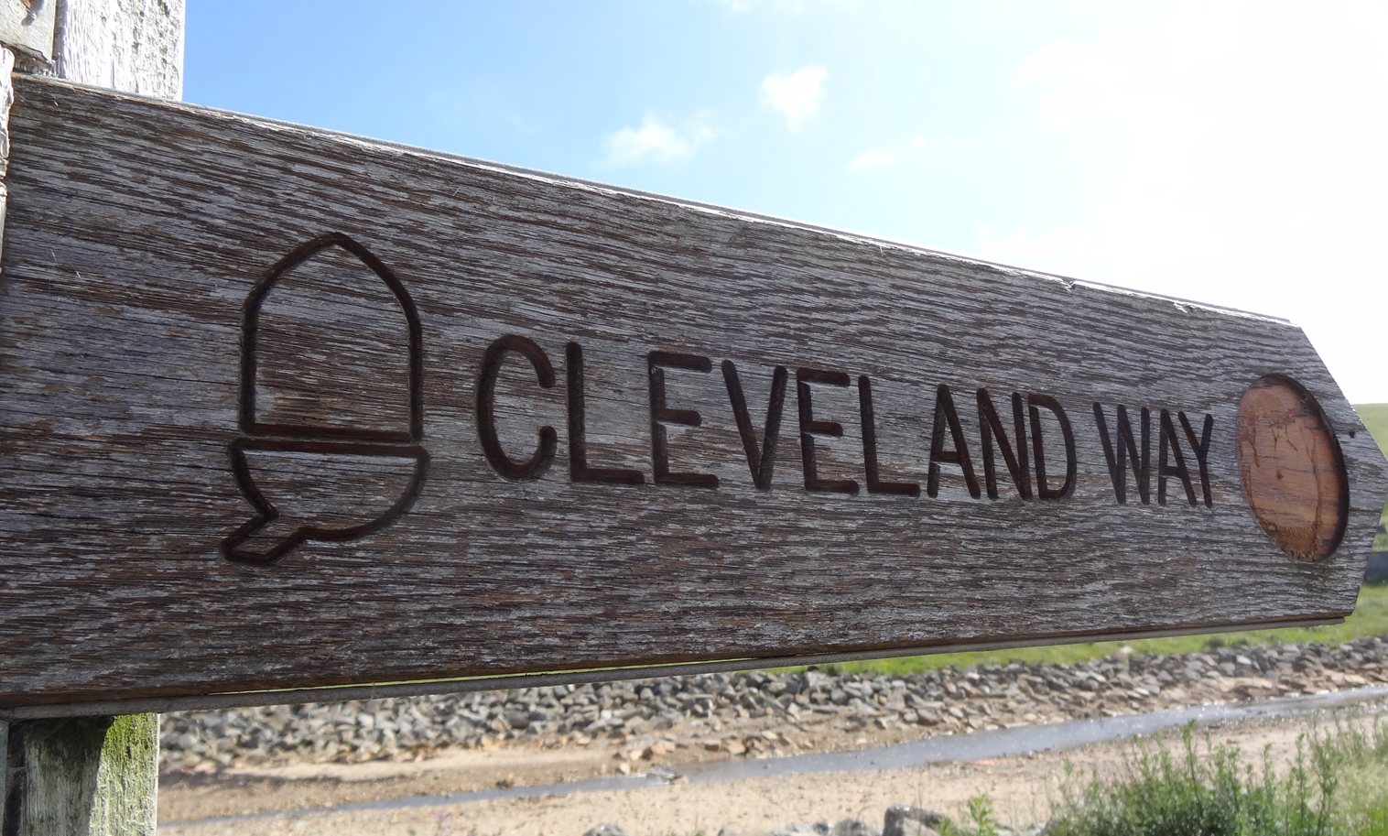
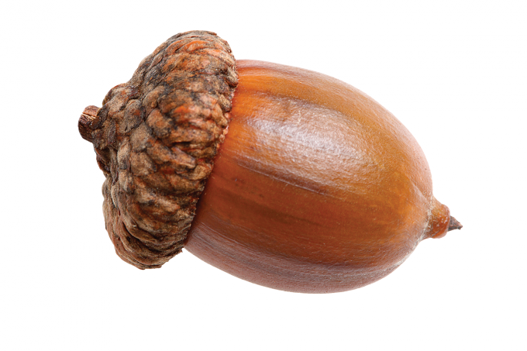
What symbol does this Cleveland Way footpath signpost
have on it?
An acorn
Human
Is the signpost a physical or human feature?

Slide 11
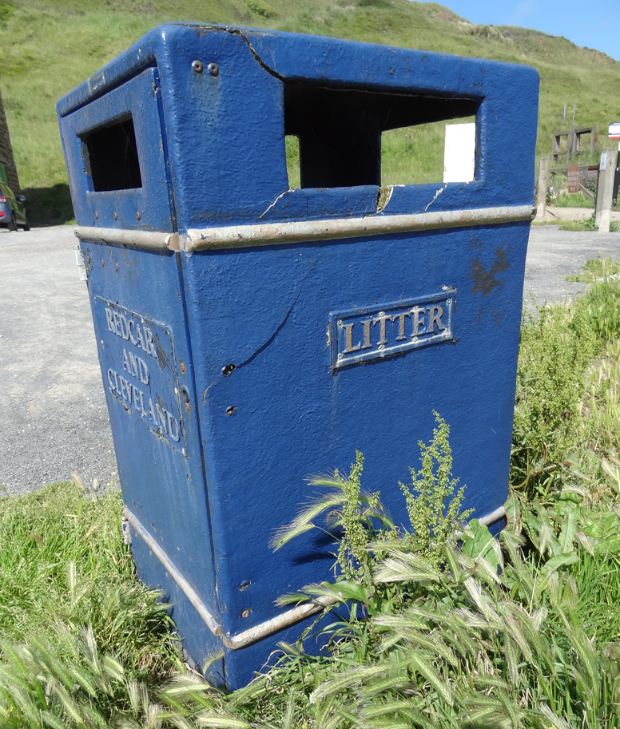
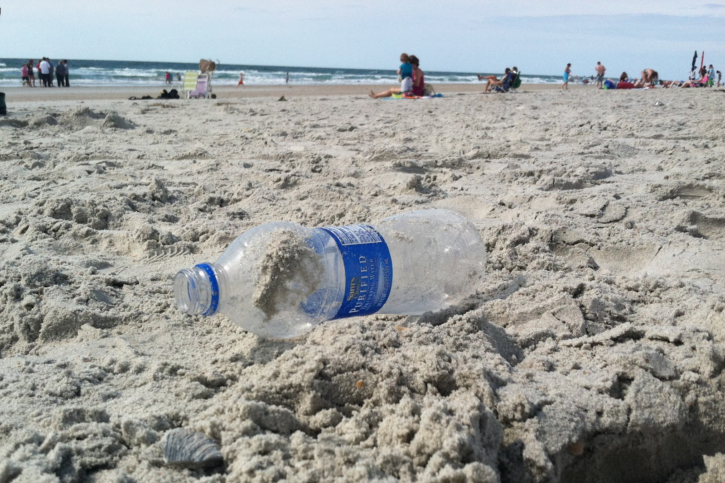
Do you always use one of these?
Why is using a litter bin important?
Rubbish can hurt animals
Human
Is the litter bin a physical or human feature?

Slide 12
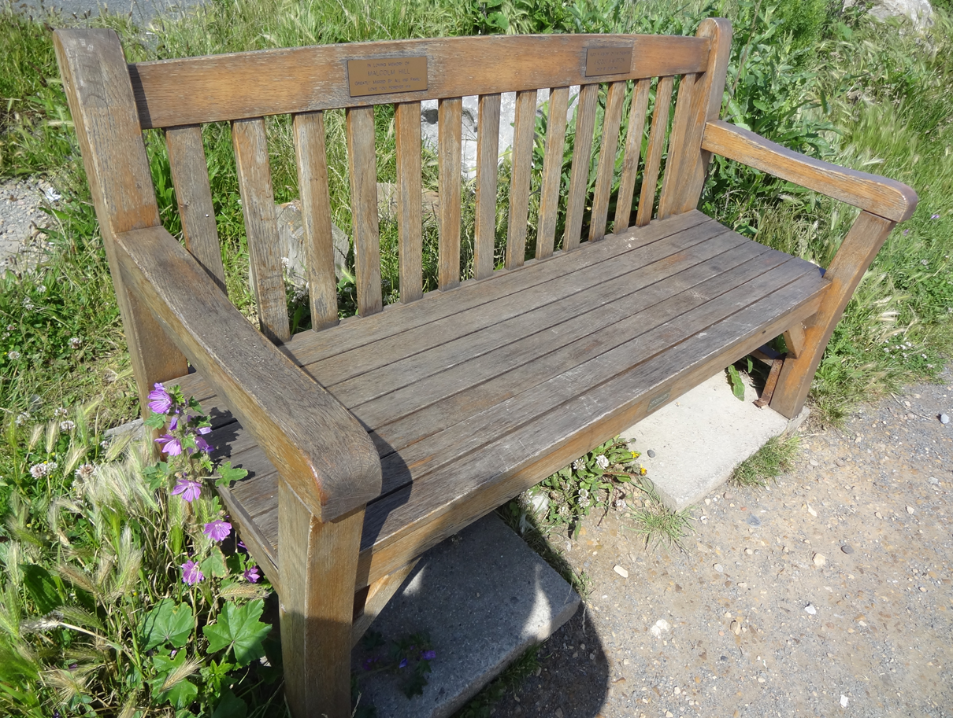
Do you like sitting on benches?
They usually have beautiful views.
Human
Is a bench a physical or human feature?

Slide 13
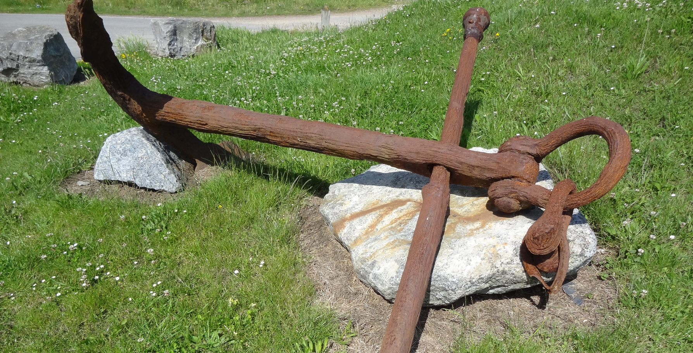
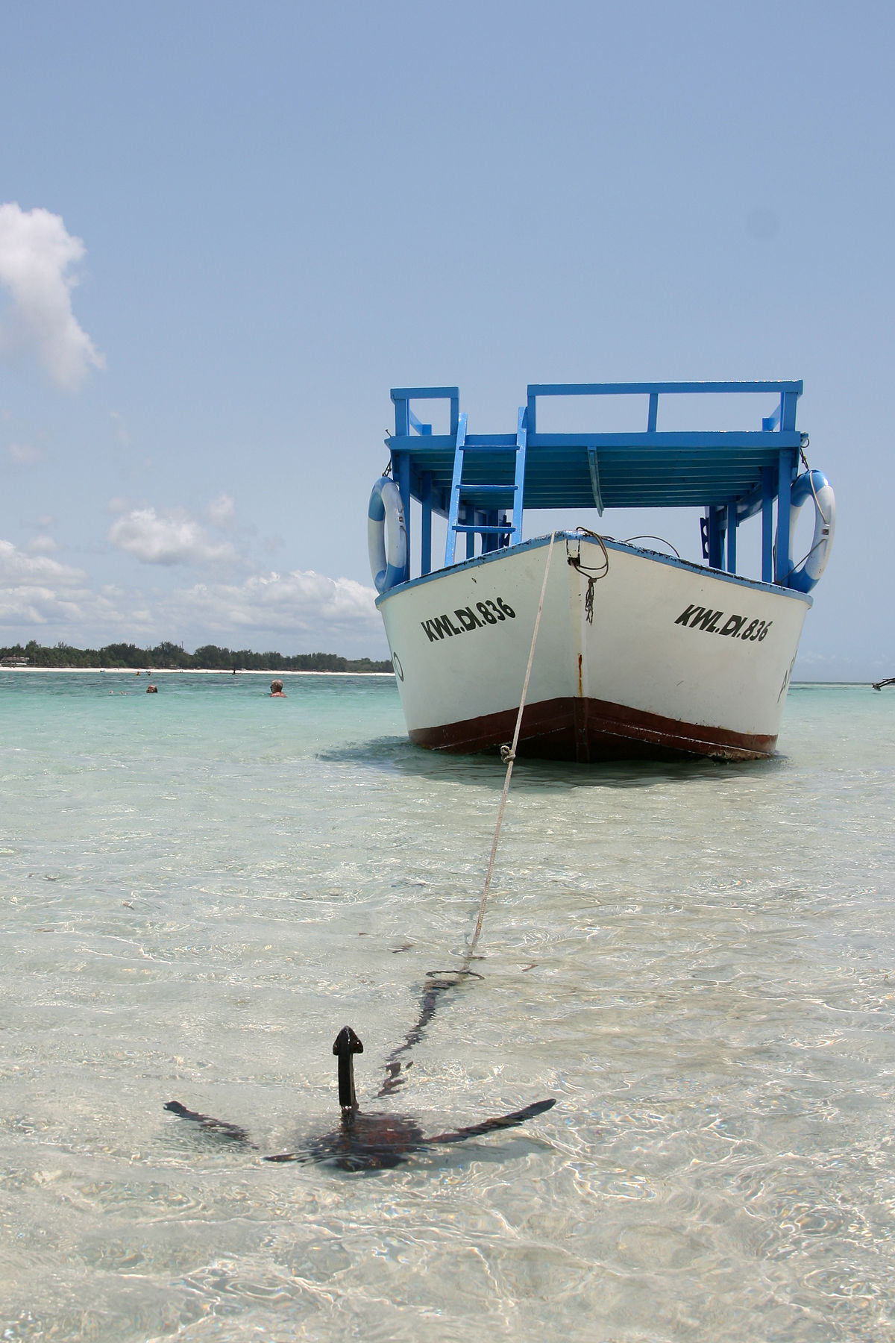
This large metal object was from a boat. What was it for?
Anchor for holding a boat still
Human
Is this object a physical or human feature?

Slide 14
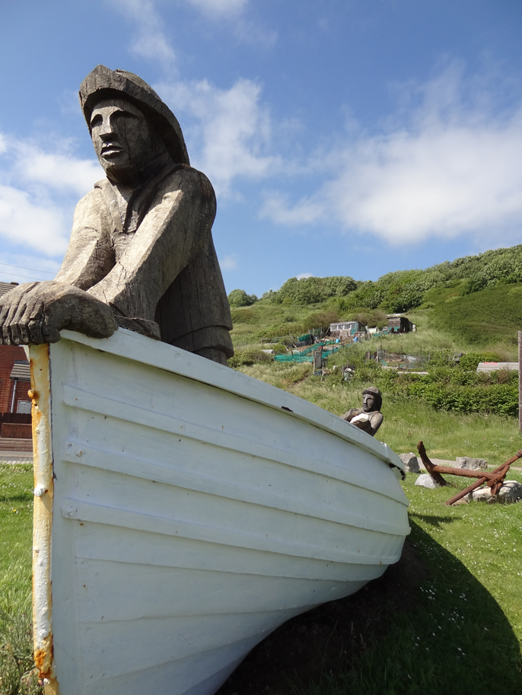
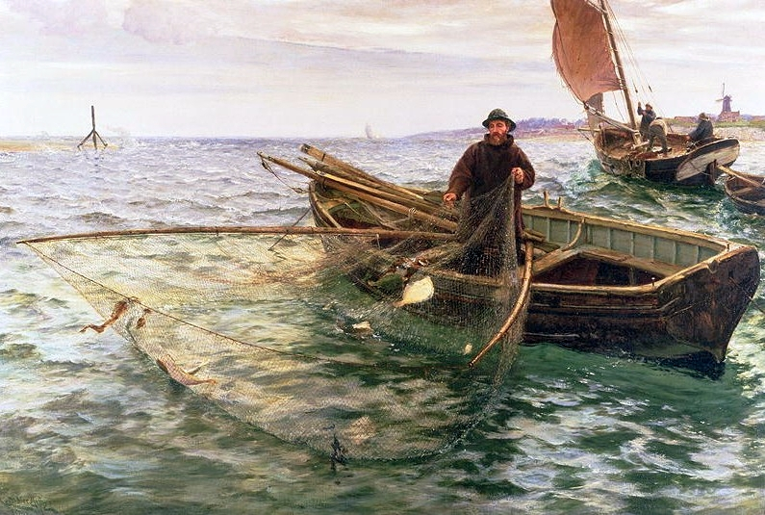
This boat is now on land. What jobs would the people who worked in it have done?
Fishing
Human
Is this boat a physical or human feature?

Slide 15
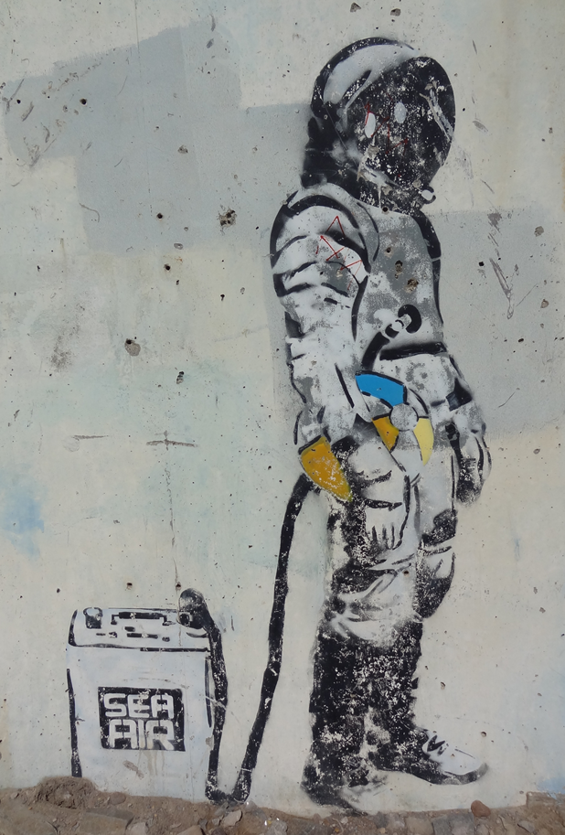
This artwork is next to the sea. What would you draw?
Human
Is art a physical or human feature?

Slide 16
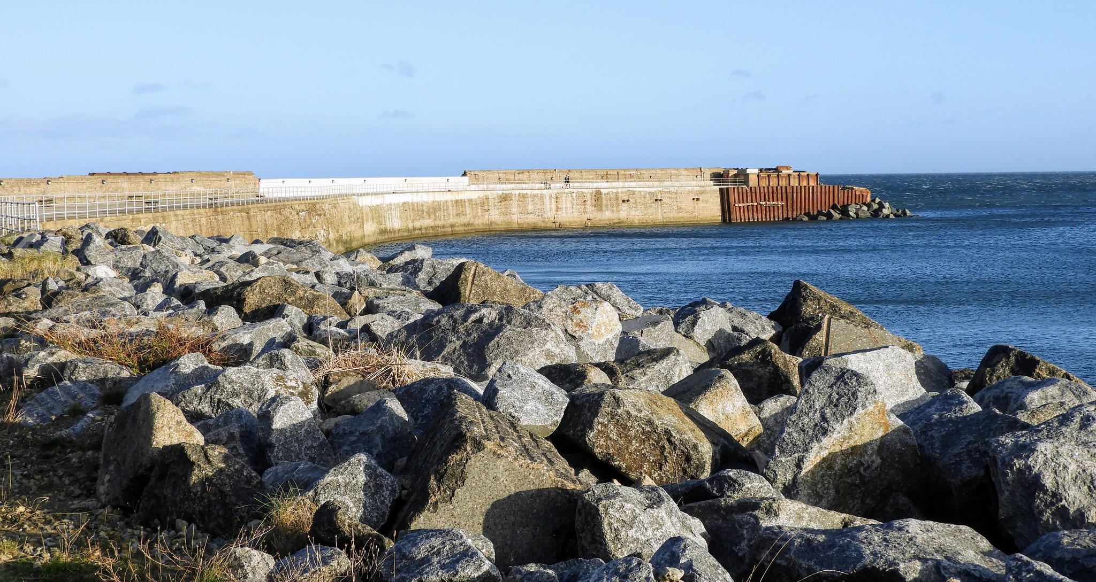
This is called a jetty, it sticks out into the sea and was where the boats parked to collect ironstone and steel
Human
Is this jetty a physical or human feature?

Slide 17
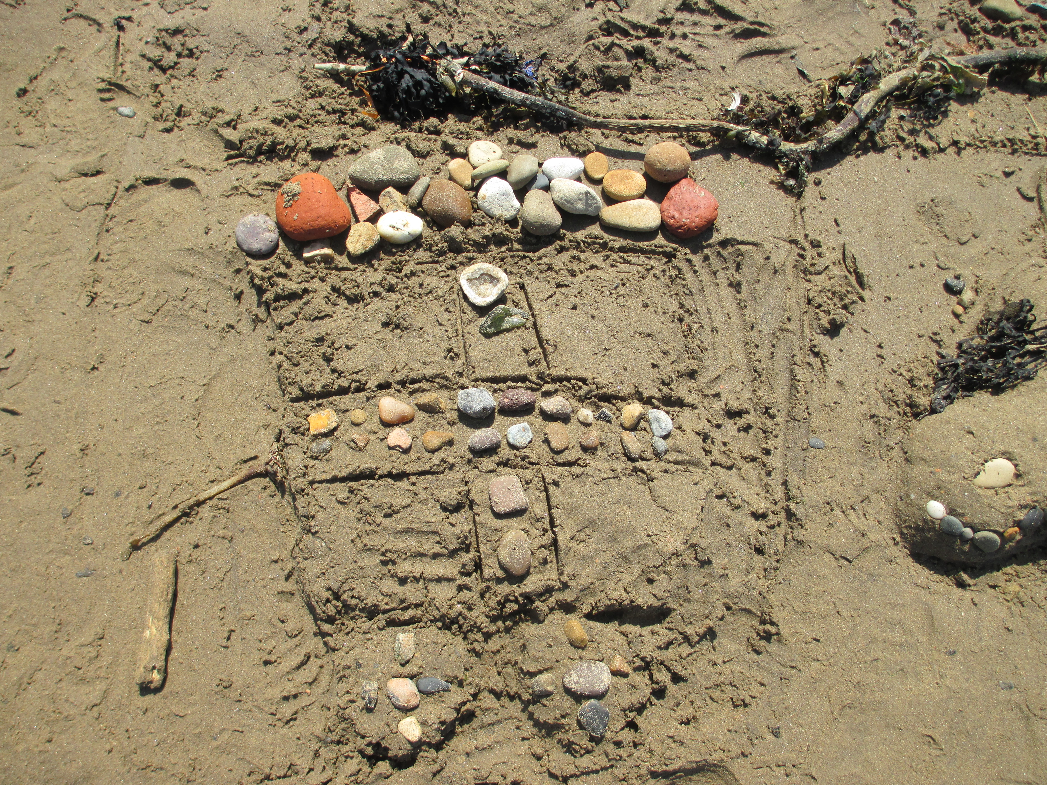
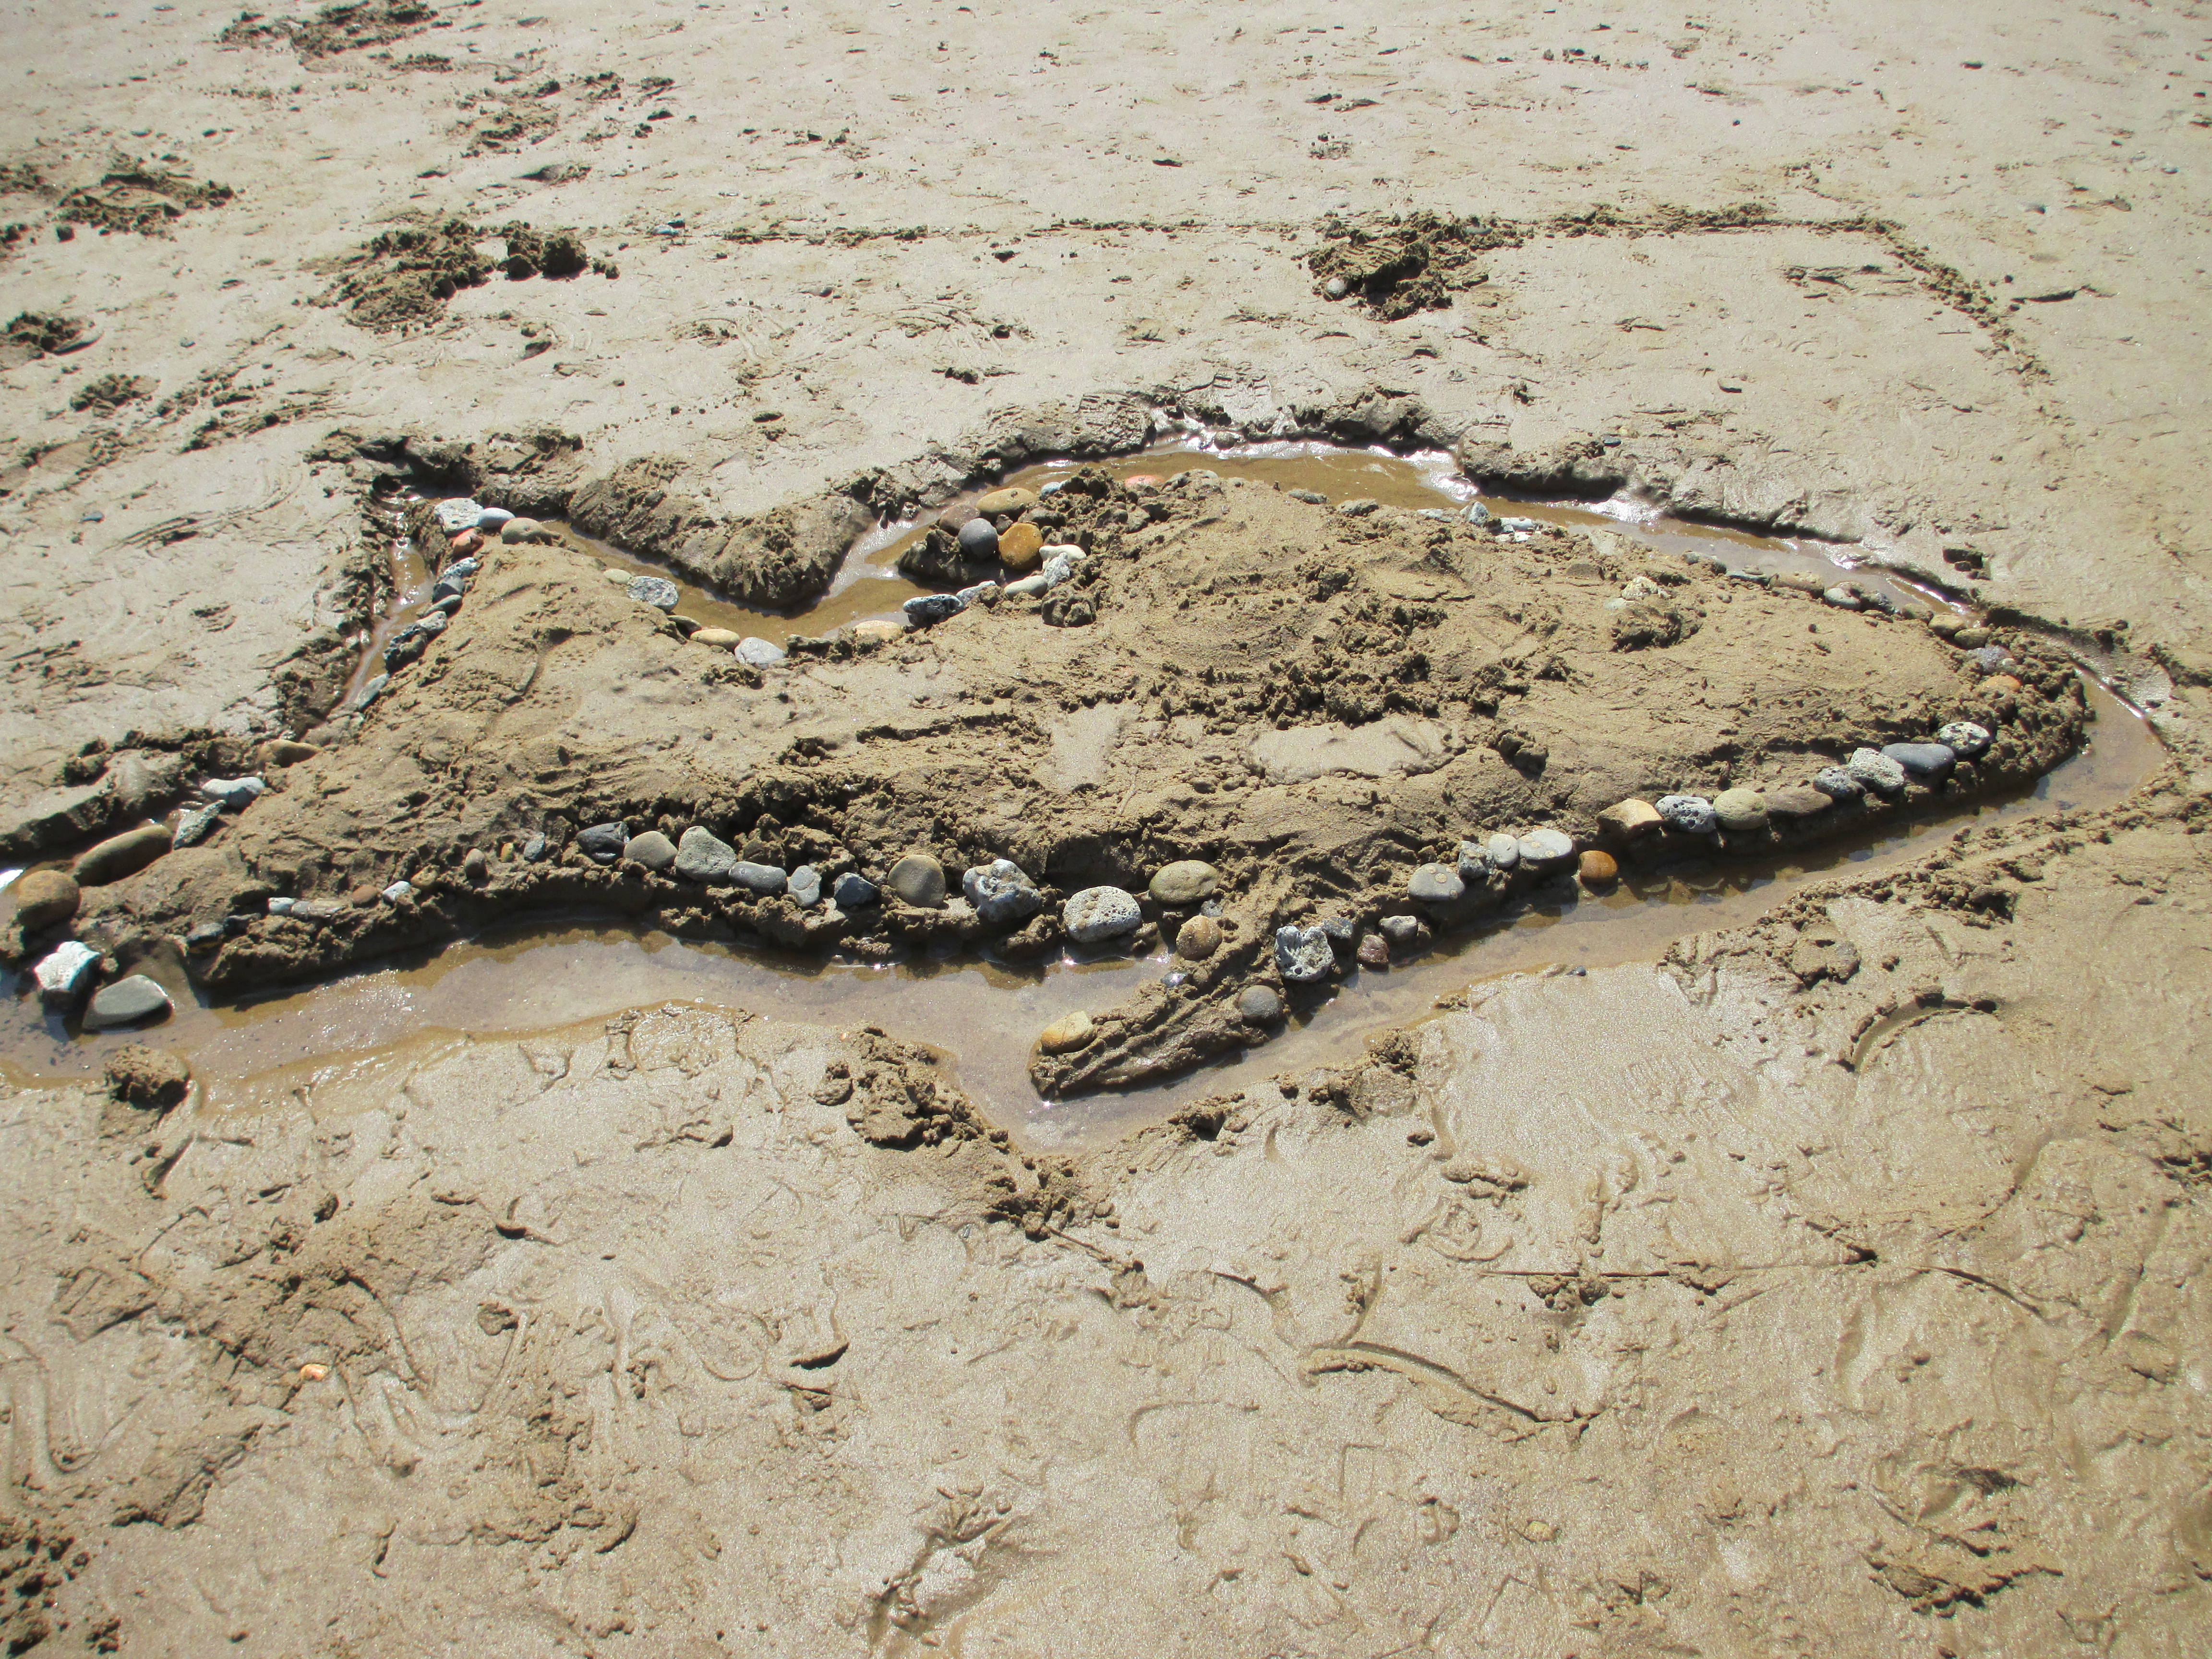
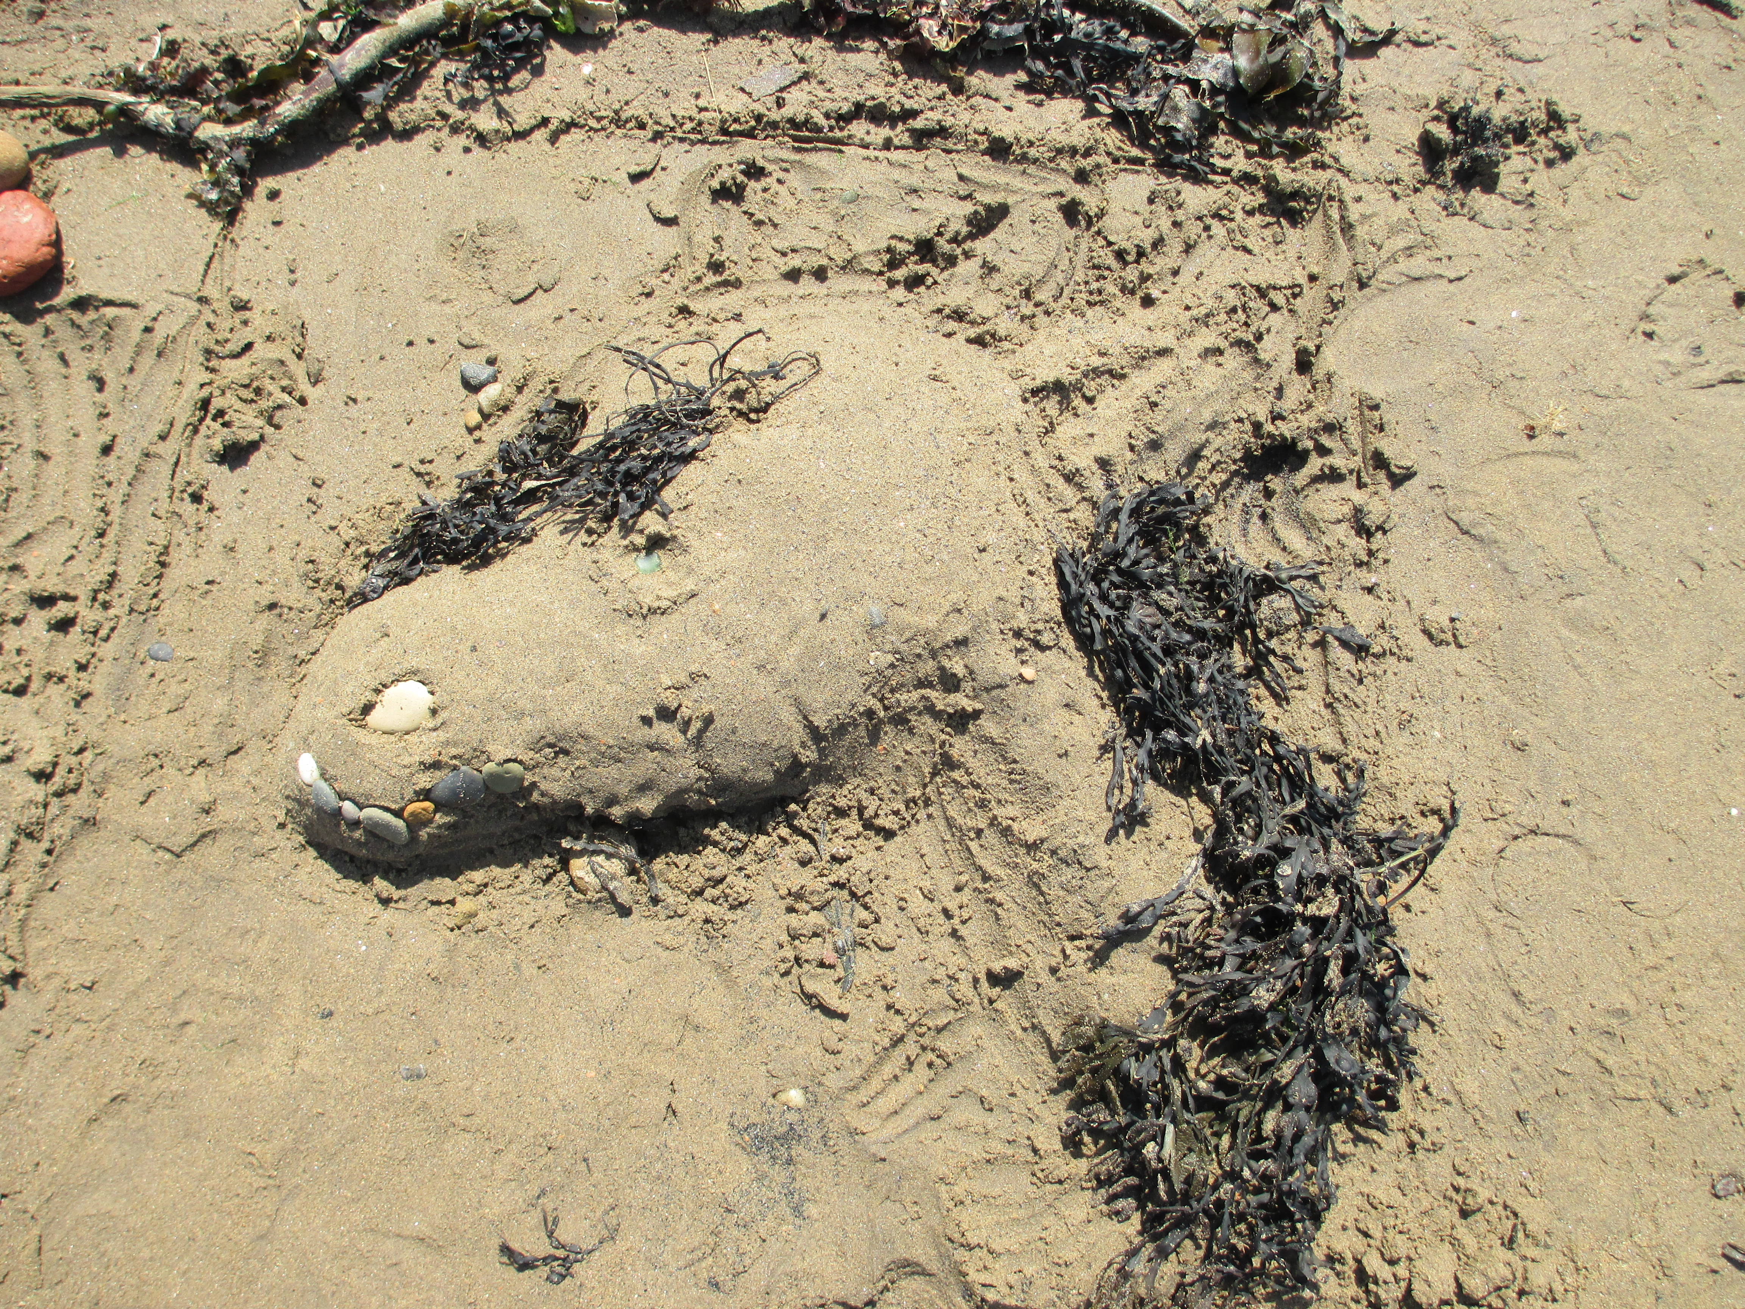
Now imagine you are on the beach, make a picture out of leaves, twigs, stones and other things in your garden or park.
Can you work out what these pictures are? Children made them to remember their day in Skinningrove. If you can please take a photo of your natural art and email it to learning@ironstonemuseum.co.uk

