Slide 1
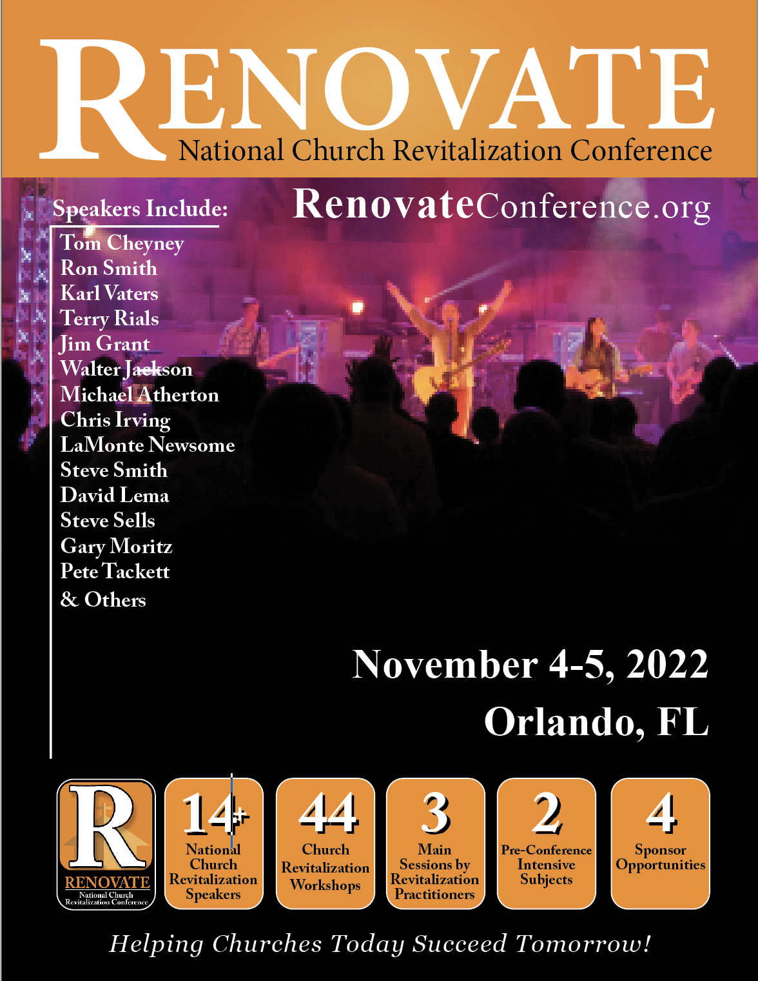
All Florida Baptist Convention
Association Mission Strategist Can attend as a Free Gift
from The Renovate Group!

