Slide 1


Slide 2
What Does the Bible Say About Deacons?
Acts 6:1-7
1. What was the presenting issue that led to the calling of the “Seven”?
2. What was the real reason for appointing these seven men?

Slide 3
How to be a “Hur” to your pastors
Verbally support them
Pray for them and with them regularly
Encourage your family to support their families
Mentor or befriend their children
Lead the church to support them financially
Be consistently positive
  In your attendance
  In your faithful giving
  In service to the church
  Seek to be a blessing, not a curse

Slide 4
What is Good Fellowship?
Eating a meal together?
Worshipping?

Slide 5
Unity vs.
Uniformity
Or Unanimity

Slide 6
Deconstructing the Onion

Slide 7
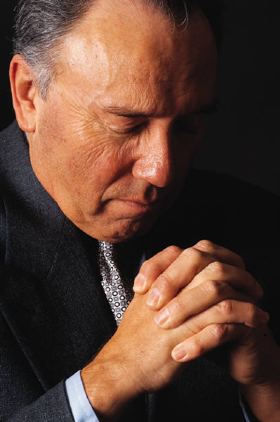
Taking the “inward” Journey
Psalm 139:23-24
John 15:1-8

Slide 8
Daily Check-up Questions
What is the most important thing I’ve done today? (this week, this month)?
How have I been an instrument of God’s love toward others?
Have I hurt anyone today? (week, month)
Have I treated anyone as a “means” to an end rather than as a person?

Slide 9

Becoming a true Deacon “Body”

Slide 10
Deacon Body Check-list
Do we truly love each other in the Lord?
Do we possess a common vision for our deacon ministry?
Are we living out our calling as deacons on a daily basis?

Slide 11
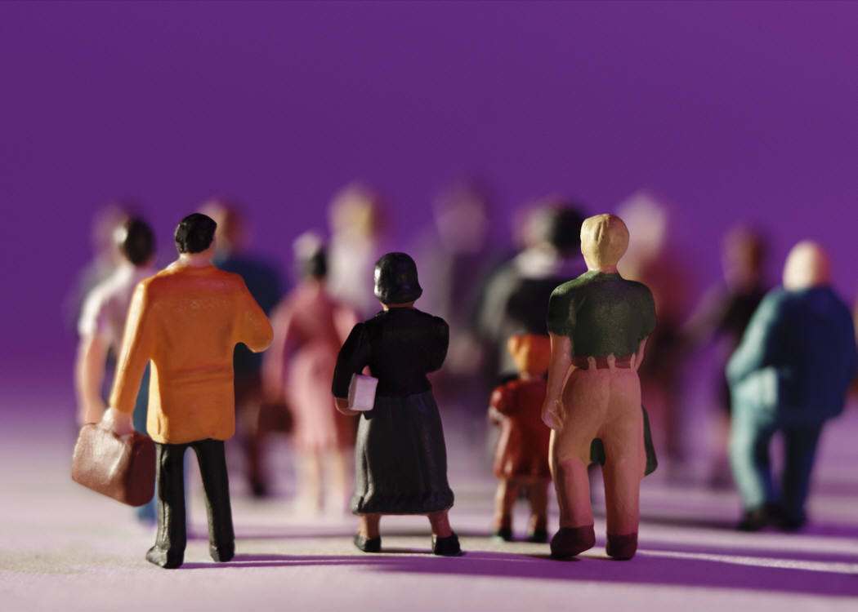
Becoming the Body of Christ

Slide 12
How will we know we are unified as a church?
What would need to be different to make our unity more evident?
What would make the “world” aware of our unity?

Slide 13

Making a Kingdom Difference

Slide 14


Funding for this presentation provided by your faithful contributions to the Cooperative Program.

