Slide 1
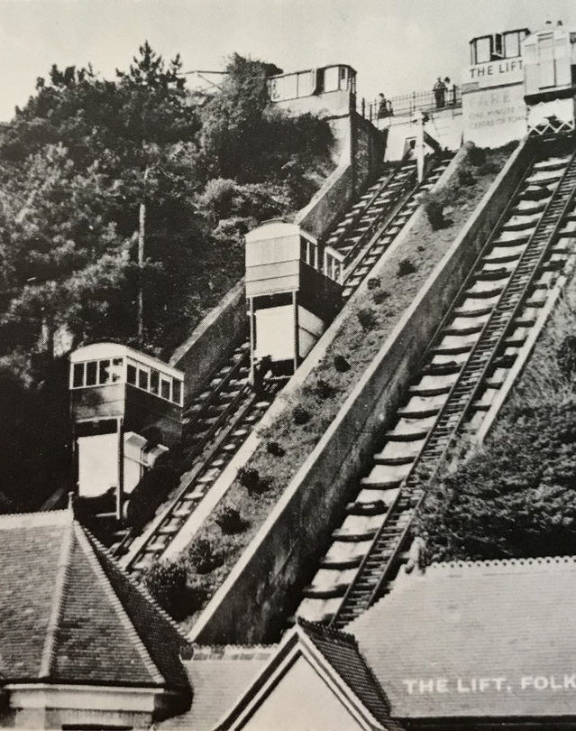
The Leas Lift
I remember going on the Leas Lift before it closed in 2017. It felt so high up. Do you like heights? Would you go on the lift when it reopens next year?
Folkestone must have looked so different back when they opened the Leas Lift. Have you always lived in nearby?
It must have so fun having lots of things to do in Folkestone. Do you like holidays by the sea? What has been your favourite holiday?

Slide 2
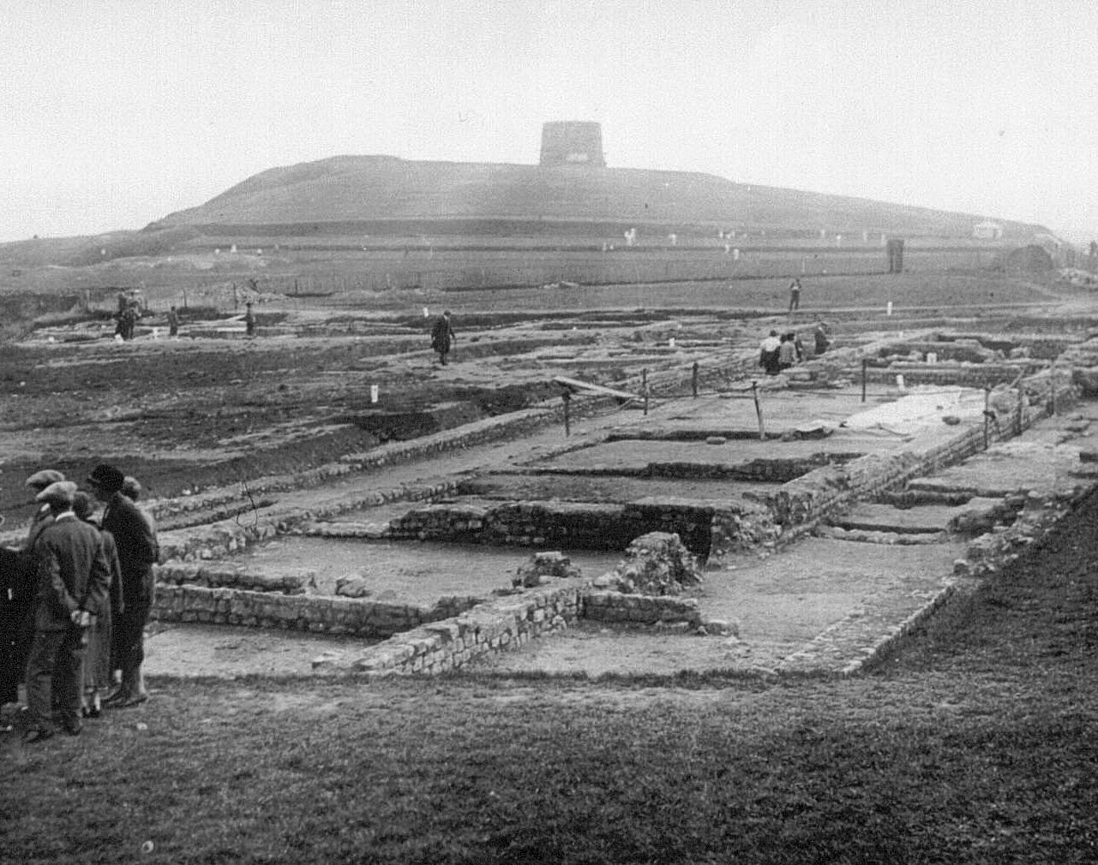
Folkestone Roman Villa
I had no idea that there was a Roman Villa up at Wear Bay Road near the Martello Tower. Did you?
Apparently, the Villa was open, and you could see all the foundation walls. Have you ever seen such a thing?
I love learning about the Romans. Did you learn about them in school? What was it like?

Slide 3
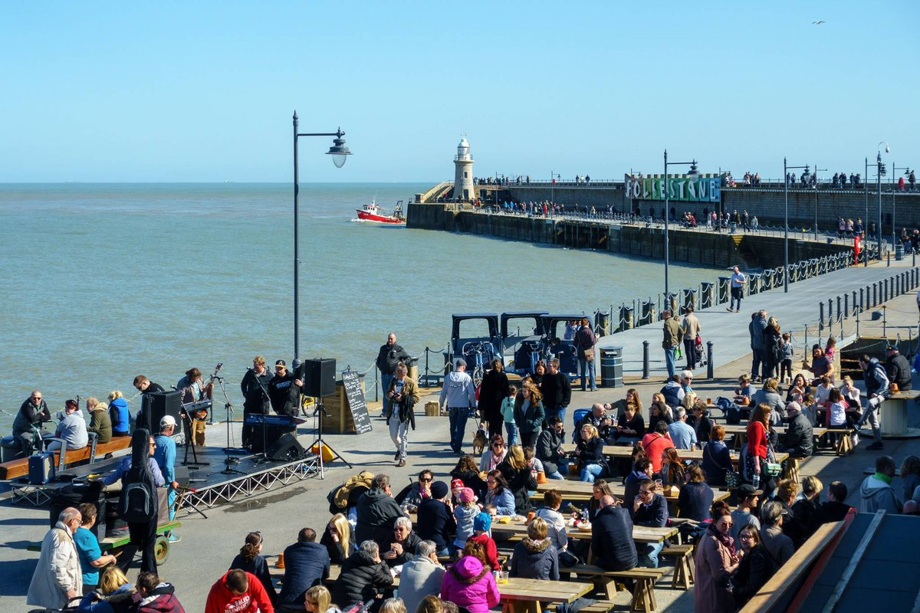
Folkestone Harbour Arm
I love being by the sea, especially on a Summer’s day. Do you like having an ice cream, or fish & chips when you are at the seaside?
There are so many different smells and sounds. Have you ever swum in the sea? It’s so cold, but I love it.
The Harbour Arm must have changed quite a lot over the years. I wonder how different it looks now.

Slide 4
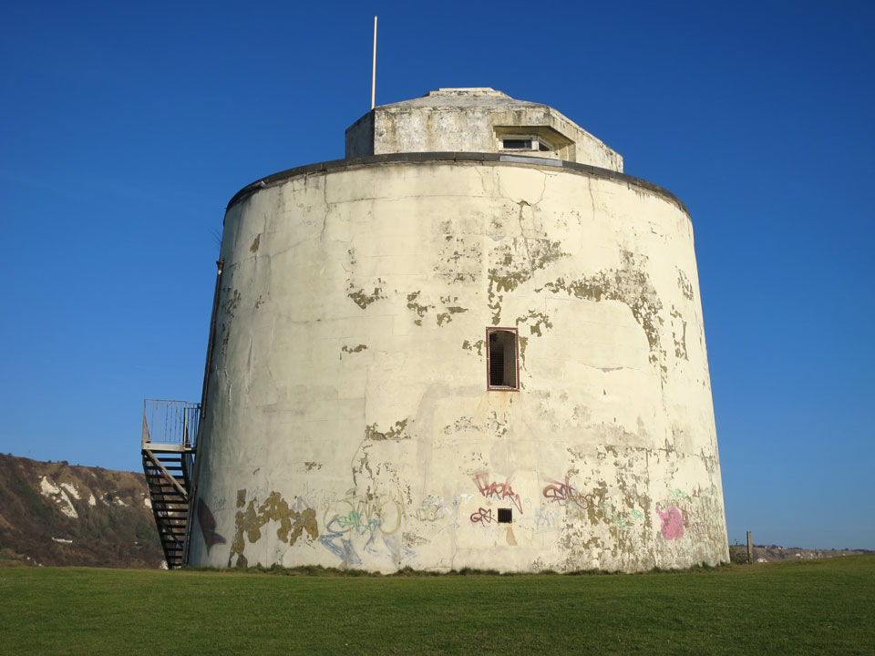
Martello Tower
The Martello Towers were built in the 1800’s and look so big and impressive on the cliff tops.
I remember seeing them when I was young and wondering what they were built for.
Some people live in them now. I wonder what they are like inside?

Slide 5
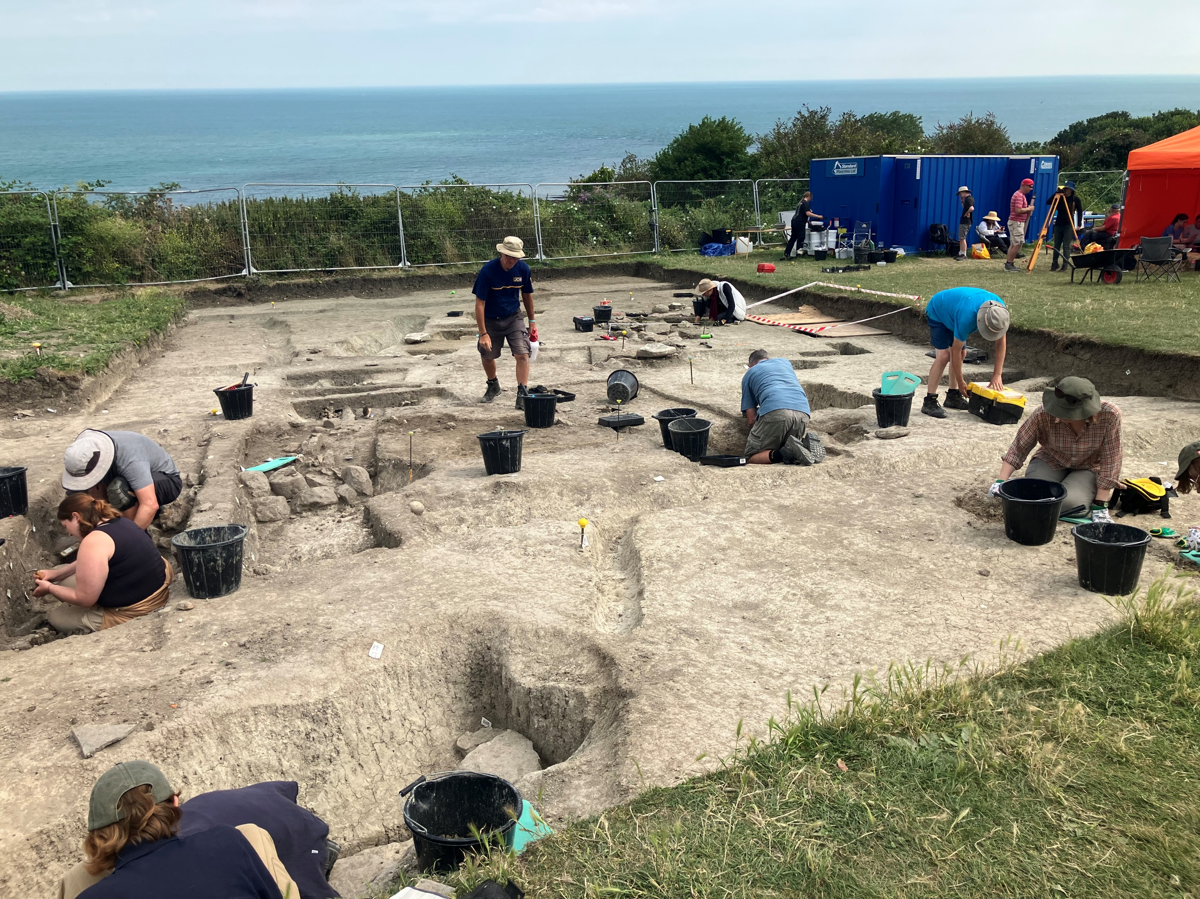
Archaeological Excavation
Being on an archaeological excavation must be so fun and exciting. Have you ever been on one?
It must be amazing unearthing things that have been hidden for hundreds and thousands of years.
Do you think it might be quite hard to dig in all different weathers though?

Slide 6
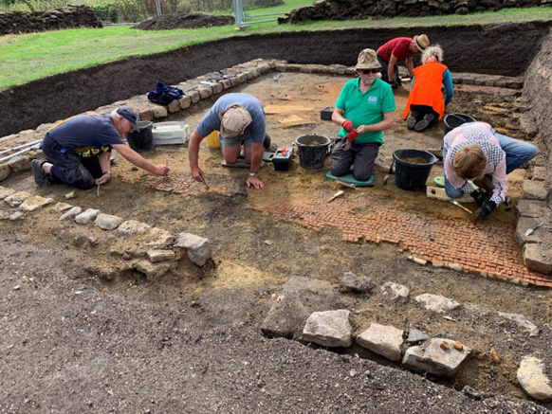
Roman Mosaics
I remember learning about Roman mosaics at school and thinking I would love to find one some day. Did you learn about them at school?
The remains of a beautiful one have been found in one of the rooms of the Roman villa in Folkestone.
Do you think they use special tools to delicately unearth it? Maybe little brushes?

Slide 7
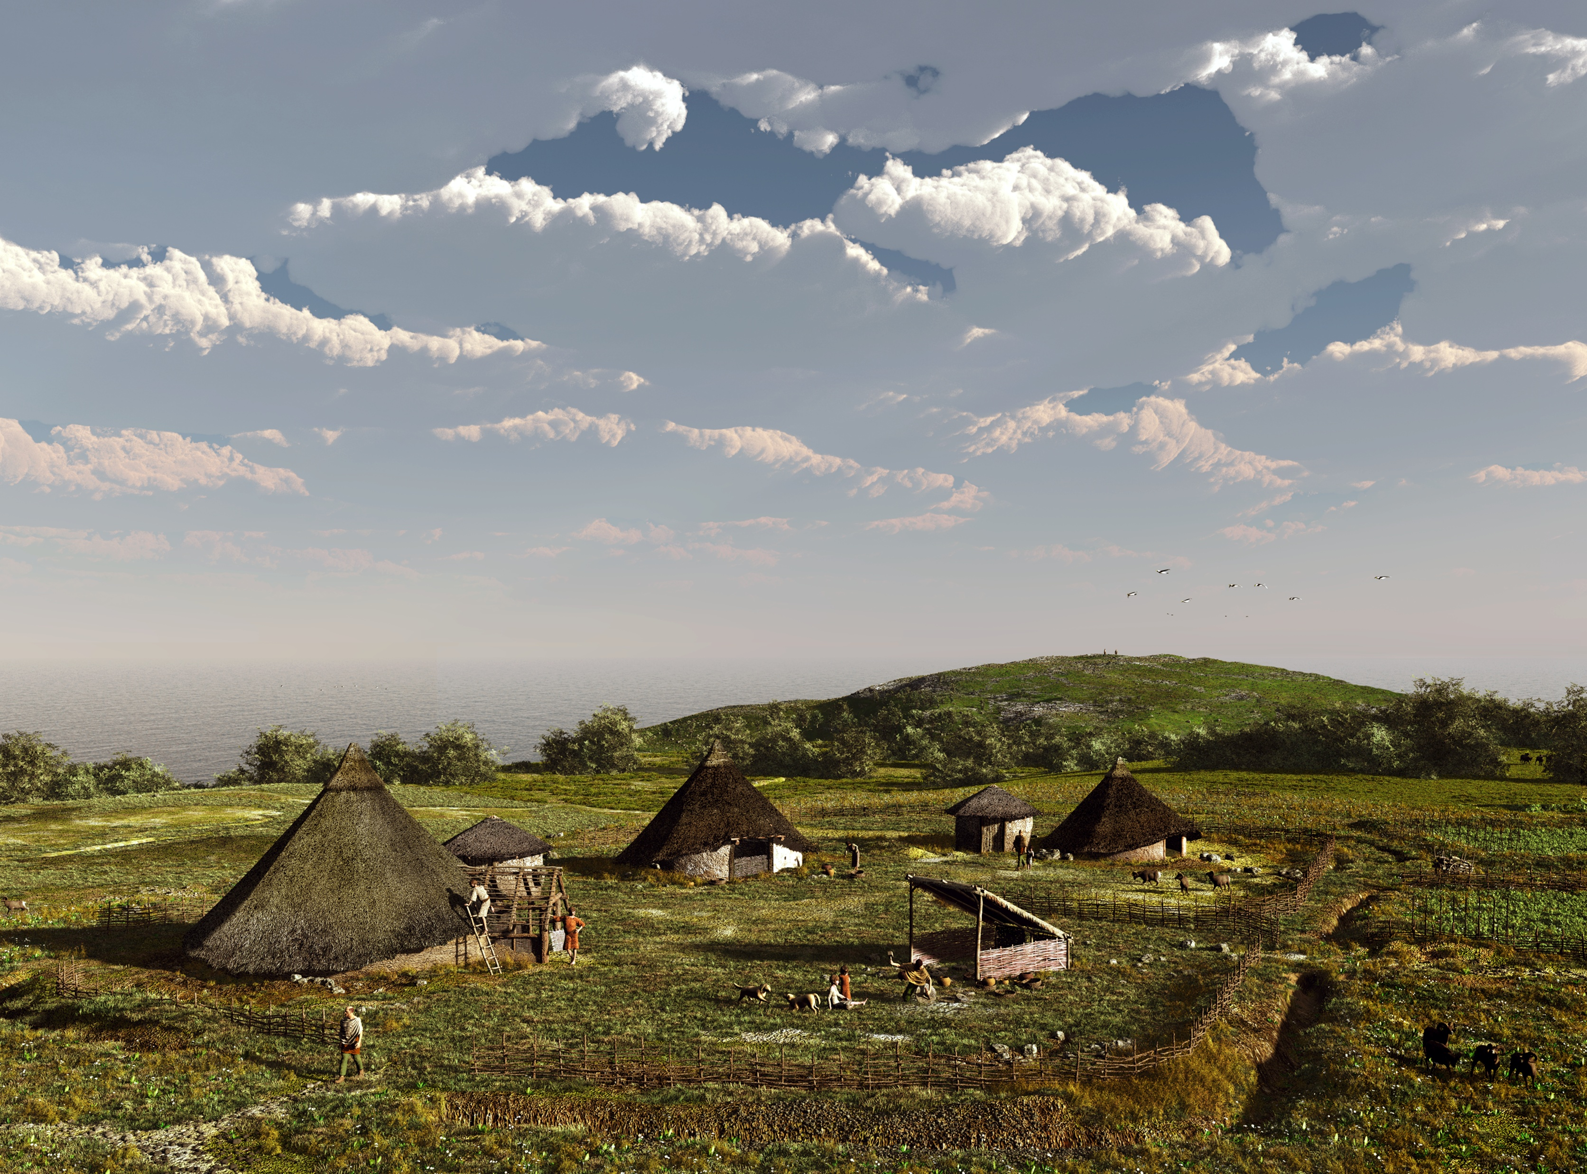
Iron Age Roundhouses
I wonder what it was like to live in an Iron Age Roundhouse?
It might have been a bit chilly and damp, but they did have a cosy fire in the middle for cooking and for keeping warm, so it might not have been that bad.
I’m always interested in what places like this would have smelt like. Very different to our nice clean houses today!

