Slide 1
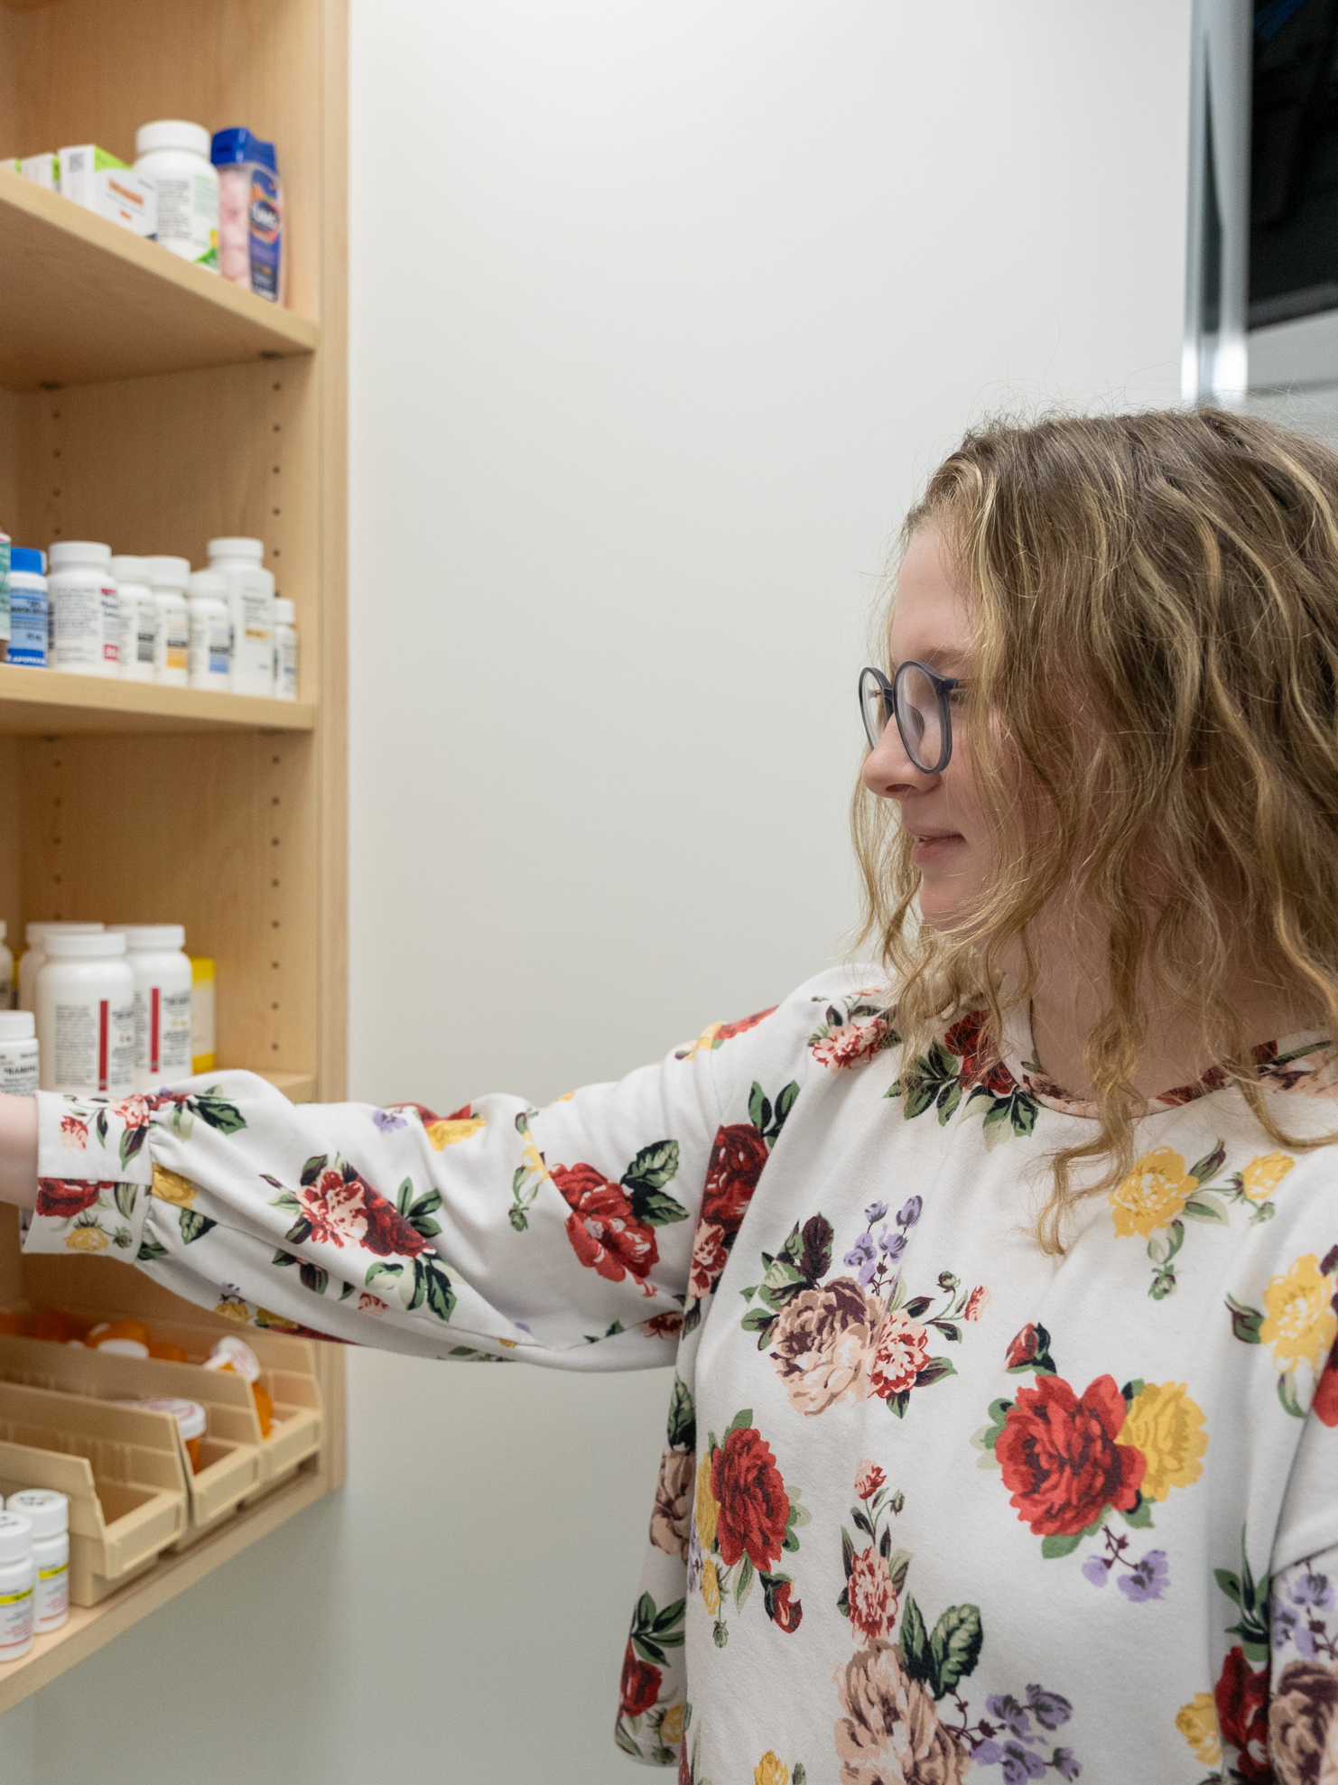

CONFEDERATION COLLEGE
Pharmacy Technician
Placement Manual
2025-2026

Slide 2
WELCOME MESSAGE
Welcome to the Pharmacy Technician Program at Confederation College! We’re thrilled to launch this new program to serve the evolving healthcare needs of Northwestern Ontario. Whether you’re a dedicated student stepping into the world of pharmacy or an experienced preceptor guiding the next generation, your involvement is vital in shaping a robust healthcare workforce for our community.
Pharmacy technicians play an essential role in patient care and healthcare support, ensuring the safe and effective handling of medications and collaborating closely with pharmacists and other professionals. This program is tailored to equip you with the knowledge and skills necessary to thrive in this dynamic field. With a curriculum focused on hands-on training and practical experience, we aim to prepare you for the unique challenges you’ll encounter in your future career.
To our students, we encourage you to embrace every opportunity for learning, from classroom discussions to real-world applications in placements. Your dedication to acquiring these skills is foundational to the excellent care you will provide.
To our preceptors, thank you for your mentorship and commitment. Your guidance enriches our students’ education, bringing classroom learning to life and providing insight that only experience can teach.
Together, we’re building a community of capable, compassionate, and knowledgeable pharmacy technicians ready to make a difference in Northwestern Ontario. Please reach out if you have questions or suggestions; your feedback is essential in helping us grow this program to best serve our students and community.
Welcome aboard, and let’s embark on this exciting journey together!

Slide 3
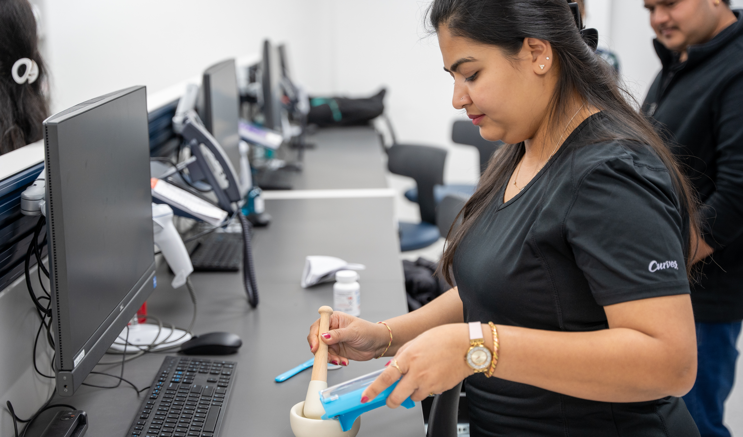
Pharmacy Technician
2024-2027 Mission, Vision, Values
Mission:
To equip students with the comprehensive knowledge and practical skills necessary for effective pharmacy practice, ensuring they can deliver safe and competent pharmaceutical services across diverse healthcare settings.
Vision:
To be a leading program in pharmacy education, recognized for producing proficient and ethical pharmacy technicians who contribute significantly to patient care and the healthcare system.
Values:
  Courage: Encouraging students to make informed decisions and take initiative in their professional roles.
  Equity: Promoting fair and just treatment, ensuring all individuals have the opportunity to achieve their full potential.
  Relationships: Fostering teamwork and collaboration among students, faculty, and the communities served.

Slide 4

MEET THE FACULTY
Shawna Larocque, RPh
Professor/Program Coordinator
Shawna.larocque@confederationcollege.ca

Slide 5
BECOMING A PRECEPTOR
Becoming a preceptor is a unique opportunity to shape the future of pharmacy by sharing your knowledge and expertise with those just entering the profession. Acting as both a mentor and a role model, you have the chance to guide students in their transition from classroom learning to hands-on practice, bringing life to what they’ve learned and helping them see its real-world application.
As a preceptor, your role is integral to developing the next generation of pharmacy technicians. It’s more than just teaching tasks or skills—it’s about fostering a supportive environment where students feel comfortable to ask questions, make observations, and build their confidence in practical settings. Through a structured approach of observation, practice, and demonstration, students can gradually build competence, learning to apply their classroom knowledge under your mentorship.
Open communication is key to a successful preceptorship. Regular check-ins and constructive feedback create a space where students can track their progress and identify areas for improvement. This ongoing dialogue not only supports their growth but also gives you valuable insights into how they’re adapting to the placement. Additionally, by being open to student feedback, you foster a two-way relationship that benefits both of you, promoting shared learning and professional development.
Remember, your mentorship is often the most memorable and influential part of a student’s training. By guiding them through real-life scenarios, helping them develop critical thinking skills, and providing the support they need to succeed, you’re helping to build a foundation of capable, knowledgeable, and compassionate pharmacy technicians.
Thank you for your dedication, patience, and commitment. Your role as a preceptor is invaluable, and it makes a lasting impact—not only on each student you guide but also on the future of pharmacy and healthcare in our community.

Slide 6
PRECEPTOR
RESOURCES
As a preceptor, you have access to a variety of resources provided by the Ontario College of Pharmacists (OCP) and other regulatory bodies to support you in delivering a high-quality learning experience for students.
Key Resources:
OCP Principles of Professionalism
This document outlines the core values and ethics expected of pharmacy professionals. It serves as a guideline for fostering a professional atmosphere in which students can learn. View Principles of Professionalism
OCP Role Definition
Familiarize yourself with the scope of practice for pharmacy technicians. This document helps clarify roles, providing you with a framework to guide students in the expectations and boundaries of the profession. View Role Definition
Model Standards of Practice for Pharmacy Technicians in Canada
These standards define the skills and knowledge expected of pharmacy technicians at entry to practice, ensuring you have a benchmark for evaluating students' performance. View Standards of Practice
Using the TAPT Tool
The Tool for Assessment of Pharmacy Technicians (TAPT) is a structured evaluation tool used to assess students’ performance in various competency areas. This tool provides guidance on assessing and documenting progress across key areas, including patient care, communication, and professionalism. TAPT Tool Guide
We encourage you to use these resources throughout the placement to foster student growth and ensure the experience aligns with professional standards. Thank you for your dedication to mentoring the next generation of pharmacy technicians!

Slide 7
PLACEMENT
REQUIREMENTS
To ensure the safety and readiness of all students, the following placement requirements must be completed prior to the start of each placement. These requirements help prepare students to meet the health and legal standards expected in the field of pharmacy.
1. Seasonal Influenza Immunization
The flu vaccine is available from October to April each year. All students are required to receive an annual influenza immunization during flu season, at least 10 days prior to the start of their placement. Students beginning placements in the fall will need to obtain this vaccination once it becomes available.
2. Standard First Aid and CPR Certification (Level C)
All pharmacy technician students must hold a current Standard First Aid certification and CPR Level C certification.
3. Police Check with Vulnerable Sector Screening
Students are required to obtain a clear police check with vulnerable sector screening, issued within six months of the placement start date. Any prior criminal record must be pardoned to meet placement eligibility.
4. N95 Mask Fit Testing
Students must complete a mask fit test to determine the appropriate size and type of N95 mask. Certification is valid for two years from the date of issue and must cover the full duration of the placement.
5. Medical Requirements and Immunizations
Before placement, students must schedule an appointment with a healthcare provider to confirm their immunizations are up to date. Required immunizations include:
  Measles, Mumps, and Rubella (MMR)
  Tuberculosis Screening (TB)
  Varicella (Chicken Pox)
  Tetanus/Diphtheria (Td)
  Pertussis
  Polio
  Hepatitis B
  COVID-19 (as required)
Please plan medical appointments in advance to allow enough time for completing and submitting all documentation to the placement administration system.

Slide 8
PROGRAM
STRUCTURE
The curriculum is structured over four semesters, each building upon the previous to develop a well-rounded understanding of pharmacy practice.
Semester 1:
  College Writing
  Community Pharmacy Management
  Pharmacy Calculations 1
  Pharmacy Dispensing Theory
  Pharmacy Dispensing Lab 1
  Pharmacotherapeutics 1
  General Elective
Semester 2:
  Professionalism and Ethics
  Pharmacy Calculations 2
  Hospital Practices and Pharmaceutics
  Pharmacy Dispensing Lab 2
  Pharmacotherapeutics 2
  Institutional Dispensing Lab 1
  General Elective
Semester 3:
  Professional Communication for Pharmacy Technicians
  Pharmacy Calculations 3
  Aseptic Compounding
  Pharmacy Dispensing Lab 3
  Pharmacotherapeutics 3
  Institutional Dispensing Lab 2
  General Elective
Semester 4:
  Professional Communication and Collaboration
  Pharmacotherapeutics 4
  Professional Practicum for Pharmacy Technicians

Slide 9
EMERGENCY
CONTACTS
Shawna Larocque
Program Coordinator/Faculty
Shawna.larocque@confederationcollege.ca
Tele: (807) 631-3093
Tania Pynn
Associate Dean
School of Health, Negahneewin, and Community Services Confederation College
Tania.pynn@confederationcollege.ca
Tele: (807) 475-6456

Slide 10
COLLEGE
POLICIES
College Policies
Students in the Pharmacy Technician program at Confederation College are expected to follow all institutional policies and procedures, ensuring a respectful and supportive learning environment.
Student Code of Conduct
Sets standards of behavior for students and procedures for complaints.
Student Code of Conduct
Student Accommodation Policies
Guidelines for accommodations, including for disabilities and religious needs.
Student Accommodation
Harassment, Discrimination, and Violence Prevention
Outlines protections against harassment and discrimination.
Harassment Prevention
Sexual Violence Policy
Provides protocols for reporting and responding to sexual violence incidents.
Sexual Violence Policy
Assessment and Evaluation Policies
Details on grading, assessment, and academic integrity.
Assessment Policy
For the full list of policies, visit the Confederation College Policies page.

Slide 11
PROFESSIONAL CONDUCT AND
STUDENT EXPECTATIONS
Students in the Pharmacy Technician program are expected to uphold the highest standards of professionalism during their placements. This includes demonstrating respect, responsibility, and integrity in all interactions.
Professional Appearance
  Follow the dress code outlined by the placement site, maintaining a clean and professional look at all times.
Confidentiality
  Adhere to strict patient confidentiality guidelines, removing any identifying information from assignments and communications. Respect the privacy of all patient, practice site, and operational information.
Communication and Use of Technology
  Limit mobile device use to breaks and lunch periods, unless required for placement activities. Check your college email regularly to stay informed of updates or important information.
Social Media
  Do not share any information about your placement site, experiences, or patients on social media platforms. All content related to the placement should remain private and professional.
Conflict of Interest
  Avoid completing a placement at a pharmacy where you or a family member is employed. Choose separate locations for different placement requirements.
These expectations are in place to help foster a professional, safe, and ethical learning environment. Students are encouraged to be mindful of these standards as they grow into their roles as future pharmacy technicians.

Slide 12
ATTENDANCE
Students are required to adhere to their scheduled placement hours and are expected to arrive 15 minutes before their shift begins. Shifts may vary, including daytime, evening, or weekend rotations, depending on the placement site’s needs.
Illness
  If you are unwell and unable to attend, notify your placement site by calling a member of the pharmacy team. Then, inform both your preceptor and faculty advisor by email. Efforts should be made to make up missed hours.
Bereavement
  In the case of a family bereavement, inform your preceptor and faculty advisor as soon as possible to discuss arrangements and determine a plan for any missed time.
College Events and Statutory Holidays
  During certain College events or statutory holidays, students may be released from placement duties. For example, specific dates are reserved for exams or college closures. If these dates affect your hours, make arrangements with your faculty advisor to make up any required time.
Attendance and punctuality reflect your professionalism and commitment. Meeting these expectations is essential for successful completion of your placement and to develop reliable habits in pharmacy practice.

Slide 13
STUDENT
RESPONSIBILITIES
Review the practicum manual, course outline, and assignment schedule.
Review the grading criteria.
Review and understand the laws and regulations related to pharmacy practice.
Complete all pre-placement online learning modules, if any.
Familiarize yourself with the pharmacy's policies and procedures.
Familiarize yourself with the pharmacy organization and the patient community it serves.
Apply patient privacy laws and maintain confidentiality when handling patient information.
Learn the layout of the pharmacy, including the location of medications, supplies, and equipment.
Practice proper medication dispensing techniques, including labeling and packaging.
Practice non-sterile and sterile compounding.
Learn how to use pharmacy software systems for data entry and patient record management.
Learn how to identify and resolve medication-related problems.
Understand the pharmacy's inventory management system and how to track and order medication.
Learn about proper storage and handling of medications to maintain their efficacy.
Understand the process for handling and disposing of expired or damaged medications.
Practice effective communication skills when interacting with patients and healthcare professionals.
Take advantage of learning opportunities provided by the pharmacy, such as in-service training.
Attend pharmacy team meetings and participate in discussions to broaden your knowledge.
Seek opportunities to observe procedures such as medication reviews or immunizations.
Keep a log of your experiences, skills acquired, and any challenges to reflect on your progress.
Communicate with your faculty advisor as needed.
Remember, this checklist may vary depending on the specific requirements and expectations of your pharmacy placement. Be sure to communicate with your preceptor or supervisor to clarify any additional tasks or responsibilities. Good luck with your placement!

Slide 14
FACULTY
RESPONSIBILITIES
Faculty play a vital role in supporting students throughout their placement experience, ensuring they have the guidance needed for a successful transition into professional practice.
Placement Preparation: Faculty are responsible for providing an orientation before placement begins, ensuring students understand expectations, requirements, and professional standards.
Clear Communication: Faculty will outline the learning modules that students must complete before starting, along with a detailed list of assignments and deadlines.
Support and Guidance: Faculty serve as a point of contact for both students and preceptors, addressing any questions, concerns, or issues that arise during the placement. For students in their final semester, faculty will conduct a mid-point check-in with both the student and preceptor to assess progress.
Evaluations: Faculty will coordinate and review all evaluation forms completed by preceptors and students to ensure alignment with program goals and standards.
Faculty are dedicated to providing ongoing support, helping students grow and succeed in their roles as pharmacy technicians.

Slide 15
COMMUNITY PHARMACY
CHECKLIST
Orientation
  Personnel introductions, roles, and responsibilities
  Review of general policies, dress code, and break times
  Emergency procedures (fire alarm, evacuation routes)
  Security measures
  Customer service policies (greeting patients, handling refunds)
  Identify preceptor, site lead, and pharmacy manager
  Computer access credentials
Telephone Procedures
  Answering the phone
  Managing calls, customers, and patients (prioritization)
  Taking verbal prescription orders (under direct supervision)
  Managing voicemail and automated renewals
Equipment and Supplies
  Familiarity with dispensing and compounding equipment
  Use of barcode scanning
Patient-Centered Care
  Building patient rapport
  Patient care management
  OTC technician triage
  Problem-solving and conflict de-escalation
Prescription Handling
  Roles of pharmacists, technicians, and assistants
  Maintaining confidentiality
  Receiving and interpreting prescriptions
  Prescription data entry and updating patient history
  Insurance adjudication, scanning, and workflow management
  Compliance packaging and final check (under supervision)
  Managing backorders, refill processing, and logged prescriptions
Compounding
  Sterile and non-sterile compounding
  Documentation and preparation
Inventory Control
  Inventory levels, cycle counts, and reconciliation
  Storage and fridge monitoring
  Handling expired medications and hazardous substances
Controlled Substances
  Patch 4 Patch process
  Reconciliation of narcotics, controlled drugs, and targeted substances

Slide 16
HOSPITAL PHARMACY
CHECKLIST
Orientation
  Personnel (introductions, roles, responsibilities)
  General policies | expectations
  Emergency procedures (fire alarm and evacuation, fire extinguishers)
  Security measures
  Identify preceptor, site lead and pharmacy manager
  Computer access credentials (if applicable)
  Student photo ID and badge access
Professionalism
  Adhere to professional dress code requirements
  Maintain professionalism throughout each rotation
  Accurately complete activities and submit by deadline
  Accurately follow instructions and procedures as assigned
  Demonstrate initiative in proceeding with rotation processes
  Display a positive attitude in all activities and interactions
  Ask questions and initiate requests for assistance/directions
  Perform tasks with minimal supervision within a reasonable time frame
  Arrive at the set rotation time and attend all assigned rotations
  Communicate professionally with pharmacy team members and all health care professionals
  Accept responsibility and accountability for one’s own actions and decisions
  Adhere to privacy/confidentiality legislation when accessing patient personal health information
Unit Dose Drug Distribution
  Demonstrate/detail processes for patient admission, discharge, and transfer
  Demonstrate "prn," "stat" and "interim" and "first" doses
  Discuss importance of error-free order entry on eMAR generation
  Apply automatic stop orders policy and calculate daily number of doses
  Detail fill list generation and demonstrate cart filling with 100% accuracy
  Detail a modified fill-list
  Exchange medication cassettes and return drugs to pharmacy stock
  Verify completed unit dose bins filled by another pharmacy technician
  Describe the process involved in dealing with discrepancies or missing doses
  Describe methods used for dealing with afterhours orders
  Demonstrate interpretation of orders and detail approved hospital abbreviations
  Define the term "extemp" in the packaging of unit dose items
  Contribute to maintenance of safe and effective drug distribution system
Controlled Substances
  Apply legislation, policies, and guidelines to controlled substances storage/distribution
  Describe processes and records used in patient administration of these substances
  Demonstrate documentation of delivery and receipt of these substances within the hospital
  Detail ordering/purchasing procedures for acquisition of these substances
  Describe security measures for storage/distribution in patient, specialty, and pharmacy areas
  Demonstrate processes to rectify controlled substance count discrepancies
  Deliver controlled substances to patient care areas obtaining signatures while adhering to security and policies and procedures
  Controlled substances destruction procedure and documentation
  Controlled substances receiving procedure and documentation

Slide 17
HOSPITAL PHARMACY
CHECKLIST
5. Ward Stock | Unit Stock
  Describe handling and distribution of ward stock items
  Detail advantages and disadvantages of Wardstock drug distribution systems
  List hospital areas to which ward stock might be supplied
  Describe differences between ward stock and other types of drug distribution systems
  Describe how drugs are chosen as ward stock
  Describe the types of records used to maintain a ward stock system
  Determine stock quantities for patient and specialty area based on quotas
  Document stock issues and credits for patient care areas
  Assess floor stock for expiration dates and quota modifications
6. Packaging | Re-packaging
  Describe the types of drugs packaged in the pharmacy
  Describe advantages and disadvantages of packaging
  Describe factors that determine the types of products packaged
  Identify equipment necessary to package drugs in a hospital pharmacy
  Identify auxiliary labels to support handling of medication and administration
  Label products according to policies, procedures, and legislation
  Document packaging processes associated with ward stock and/or unit dose products
  Ensure cleanliness, functionality, and integrity of equipment as per policies and procedures
  Assess completed packages for completeness, correct product, labeling, and dating
7. Non-Sterile Compounding
  List advantages and disadvantages of manufacturing dosage forms in a hospital
  List the types of products manufactured in the practice site pharmacy
  Identify the equipment necessary to manufacture drug products in a hospital pharmacy
  Describe compounding and control records that would be kept as part of manufacturing
  Participate in quality control and quality assurance processes
  Ensure cleanliness, functionality, and integrity of manufacturing/compounding equipment
  Adhere to safe working practices when handling chemicals and substances
8. Inventory
  Describe various types of purchasing systems used in hospital pharmacy
  List sources of supply for a hospital pharmacy
  Describe issues associated with supplying or lending of products
  Describe the procedure for ordering drug products and invoice processing
  Describe the procedures involved in receiving and checking goods
  Describe special storage requirements for a hospital pharmacy
  Discuss pricing and drug budget control
  Describe processes involved in purchase decisions and formulary additions
  Complete documentation for ordering and receipt of prescription and controlled substances
  Complete documentation of unserviceable supplies and pharmaceutical products
  Safely dispose of unserviceable products adhering to legislation, policies, and procedures

Slide 18
FEEDBACK AND EVALUATION
See the attached documents
TAPT
Student Assessments

Slide 19
FREQUENTLY ASKED QUESTIONS
What is the semester four placement structure?
  Semester four consists of a combined 320-hour placement divided into two parts: five weeks in a community pharmacy and four weeks in a hospital setting. The program secures the sites for these placements, with students on-site for 40 hours per week at each location.
Are semester four placements paid?
  Semester four placements are unpaid.
Will I need to travel far?
  Hospital capacity within Northwestern Ontario is limited, so students may need to travel. The College considers student location and preferences when assigning sites for semester four placements.
Can I fail a placement rotation?
  Yes, failing a rotation is possible. In semester four, students receive two assessments per rotation—one at the midpoint and one at the end. The midpoint assessment offers an opportunity for self-assessment and for creating an action plan with the faculty advisor if needed.
Can I still work part-time while I am on placement?
  During semester four, students will be on-site 40 hours per week for both the community and hospital placements, often with varied shifts. Part-time work during semester four is not recommended.
What if I have a medical appointment while on placement?
  Communicate with your preceptor and faculty advisor as early as possible to minimize disruptions. Any missed hours must be made up, which may include weekend and evening shifts.
Can I change my placement hours?
  Placement hours are determined by the institutions for both community and hospital settings, with students rotating through various positions during the semester four placement.

Slide 20
STUDENT PLACEMENT CHECKLIST
Pre-Placement
Connect with Preceptor: Email two weeks before start; confirm first-day details.
Travel & Parking: Test your commute; confirm parking.
Dress Code & ID: Verify attire and bring student ID.
Documentation: Complete all required medical and screening forms; bring a notepad or tablet for notes.
During Placement
Punctuality & Professionalism: Arrive 15 minutes early; check college email regularly; follow dress code and confidentiality rules.
Skills Application: Apply patient confidentiality, medication dispensing, and software skills; assist with inventory and cold chain management.
Communication: Keep a log of skills and challenges; ask questions and participate in team meetings.
Feedback & Reflection
Regular Check-Ins: Receive feedback from preceptor; note areas for improvement.
Self-Assessment: Reflect on strengths and areas to improve after each shift.
Post-Placement
Submit Documentation: Ensure all logs and evaluations are completed and submitted on time.

