Slide 1
Protecting Children Online
PowerPoint made and presented by:
Special Agent Travis Howard

Slide 2
Slang Words
Skibidi
Evil or Bad – from a viral YouTube Video

Slide 3
Slang Words
Rizz
Charisma – popularity with opposite sex

Slide 4
Slang Words
Gyatt
A large butt

Slide 5
Slang Words
Sigma
A loner male, unconcerned with popularity – Contrast to “Alpha Male”

Slide 6
Slang Words
Resources
Urbandictionary.com

Slide 7
Protecting Children Online
What we’ll discuss today
Common Social Media platforms used by children
Common ways children are abused on those platforms
Best practices to protect children from abuse online.

Slide 8
What is Technology?
Technology is a tool
Like any tool, it can be used for good and for bad

Slide 9
Social Media
There are many different social media platforms in use today.
We will cover some of the more popular but keep in mind there are many more.

Slide 10
Facebook
Largest and Oldest Social Media Platform we will discuss
Less common for Teens and Children now than in previous years.
Still heavily used and can be a hub for scams
Facebook takes steps to block nudity and report suspected child pornography.

Slide 11
Facebook
Common scam involves getting a message on Facebook Messenger from a friend.
Message will have a link to a video along with a comment of, “I think I saw you here”, or “I think you know this person”
The link is a virus and can take over your account.

Slide 12
Facebook
Facebook Messenger allows for direct chats between the user and their “friends” as well as with strangers.
Chats can be deleted but are not by default.
Should be reviewed frequently by parents/guardians

Slide 13
Facebook – Best Practices
Review child’s newsfeed to see what they are exposed to.
Read chat threads frequently
Attempt to limit use or use Messenger for Kids as an alternative

Slide 14
Instagram
Owned by Facebook, now Meta Platforms
Photo sharing platform
Has messaging feature

Slide 15
Instagram
Proven to be extremely toxic to teens, especially teen girls*
Known to cause body shaming issues*
Known to cause issues such as depression and self harm*
*per leaked internal Facebook documents

Slide 16
Instagram
Children, especially teen girls and boys, are targeted on Instagram by strangers for abuse.
Often solicit nude images which are used again as blackmail or leaked to revenge porn websites.

Slide 17
Instagram – Best Practices
Review direct messages
Review timeline
Remind children that Instagram in NOT REAL. Images there have been photoshopped and filtered.
Remind them to NEVER share nude images.

Slide 18
Reddit
Described as the “Front Page of the Internet”
Has unique ”subreddits” for almost any interest.
Does have messaging feature

Slide 19
Reddit
Has extensive NSFW subreddits
NSFW = Not Safe For Work AKA pornography
Children will often meet adults in the NSFW subreddits and then move to a different messaging platform

Slide 20
Reddit Best Practices
Review their Reddit subscriptions and history
Review messaging history
Speak honestly with children about the hazards of meeting people that they met online

Slide 21
Snapchat
Messaging and social media platform
Messages go away by default
Has a hidden folder titled, “My Eyes Only” which is protected by a 4 digit passcode

Slide 22
Snapchat – My Eyes Only

Slide 23
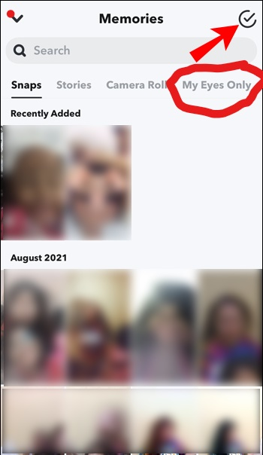
Snapchat – My Eyes Only

Slide 24
Snapchat – My Eyes Only

Slide 25
Snapchat
Nude images frequently shared
Frequently targeted for scams
Child Predators specifically talk to children on Snapchat because the messages disappear by default
Some messages are recoverable by Law Enforcement but it is difficult.

Slide 26
Snapchat
Nearly every case I have worked on where a child was physically abused by an adult, they communicated on Snapchat.
Child Predators frequently insist on speaking with children on Snapchat as opposed to other messaging platforms.

Slide 27
Snapchat Scams
There is a common scam that involves sharing passwords.
You get a message from a contact asking for your login info to keep a streak going.
Once the login info is shared, the account is logged into and the password changed.
The account is then held hostage and sensitive photos from “My Eyes Only” are taken

Slide 28
Snapchat Scams
Those photos are then used to blackmail the account holder.
Photos will be released to other contacts or posted to revenge porn sites.
Scammer then uses that account to perpetuate the scam.

Slide 29
Snapchat Best Practices
Don’t let children have Snapchat
Use parental controls and/or parental monitoring software
Speak to children about not taking or sharing nude images
Remind children to never share passwords or login information

Slide 30
TikTok
Previously known as Music.ly
Video Sharing Platform
Has a direct messaging feature
Filled with Child Sex Predators

Slide 31
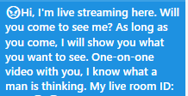
TikTok
This message came in to an 11 year old’s TikTok account after following an account.

Slide 32
TikTok
Predators will often pose as children and teens
Will attempt to gain trust by liking and commenting on shared videos
Will encourage less clothing in future videos

Slide 33
TikTok
Will often manipulate young girls with two main phrases
“You’re Pretty”
”You’re mature for your age”

Slide 34
TikTok
Will often manipulate teen boys with requests to exchange nude images
Boys – STRANGERS ON THE INTERNET DO NOT WANT TO SEE YOU NAKED
THEY WANT TO SCAM YOU

Slide 35
TikTok
Newer scam targeting teen boys
Boy gets a message from an attractive girl on TikTok
Asked to send nude images on either TikTok or on another platform
That image then used to blackmail the teen boy

Slide 36
TikTok Best Practices
Don’t let children have TikTok

Slide 37
Kik
Messaging Application
Preferred messaging platform for child sex predators
Has groups that exist specifically to share child pornography
Children that meet people of TikTok/Reddit are frequently asked to move to Kik

Slide 38
Kik
Historically was not cooperative with US Law Enforcement, which lead to its abuse
Previously based out of Canada
Now based out of California and is more cooperative with US Law Enforcement

Slide 39
Kik Best Practices
If your child has Kik on their phone….
BURN THE PHONE!

Slide 40
Telegram
Encrypted Chat Platform
Channels exist for selling drugs
Channels exist for sharing Child Sexual Abuse Material
Emerging as the new preferred platform of the Child Abuse Community, replacing Kik.

Slide 41
Telegram
Telegram is based out of British Virgin Islands
Founded by Russian brothers Nikolai and Pavel Durov
Would NOT turn over records to Law Enforcement until…

Slide 42
Telegram

Slide 43
Telegram
French Authorities arrested Pavel Durov for suspicion of aiding criminal enterprises.
French law allows for arrests of persons while a crime is investigated.
Telegram will now honor Law Enforcement Search Warrant Requests.

Slide 44
Telegram
As this new policy has become known, some members are switching to other platforms, but it is still heavily used.
Yet to be determined if Telegram will begin reporting child abuse material to National Center for Missing and Exploited Children.

Slide 45
Telegram – Best Practices
Do NOT allow children to use Telegram!

Slide 46
Tinder
Dating Application
Uses location of user’s phone to find people close by
Users “Swipe Right” on profiles they would like to match with and “Swipe Left” on profiles they don’t want to match with.
18+

Slide 47
Tinder
NOT designed for children to use
Minimum age to sign up is 18
PEOPLE ARE TREATED AS ADULTS

Slide 48
Tinder - Issues
Children will be exposed to adult conversations
Adults assume that they’re speaking with another adult
Often try to move to other platforms such as Snapchat for more intimate conversations.

Slide 49
Tinder
NEVER allow children to have a Tinder account
Violates Tinder’s policies
Prosecution unlikely based on the assumption that people are of legal age

Slide 50
Grindr
Dating application for geared towards gay men
Location based service – will match with other users in same area.
Minimum age is 18 to have an account
Conversations can go to extremes immediately.

Slide 51
Grindr
Adults will assume that people on this platform are consenting adults
Children on this application will be exposed to extreme content
Children should NEVER have Grindr

Slide 52
Revenge Porn
Virginia has 2 laws that deal with Revenge Porn
18.2-386.2 – Unlawful Dissemination of Images of Another – Criminal
8.01-40.4 – Civil Action for Dissemination of Images of Another - Civil

Slide 53
Revenge Porn
New law covers AI generated and altered images
Common in schools now for nude images to be shared that were generated from non nude images

Slide 54
Revenge Porn
The criminal and civil laws cover images sent voluntarily and images that were secretly recorded.
The law additionally covers Images that have been created through editing/AI/Photoshop

Slide 55
Revenge Porn
Tennessee law § 39-17-318
“A person commits unlawful exposure who, with the intent to cause emotional distress, distributes an image of the intimate part or parts of another identifiable person”

Slide 56
Revenge Porn
(1) The image was photographed or recorded under circumstances where the parties agreed or understood that the image would remain private; and
(2) The person depicted in the image suffers emotional distress.

Slide 57
Revenge Porn Websites
Multiple Exist
Usually “based” from a foreign country
Very rarely can be taken down by US Law Enforcement
Some underage images may be taken down on a case by case basis

Slide 58
Parental Controls
Numerous options exist for parental controls phones.

Slide 59
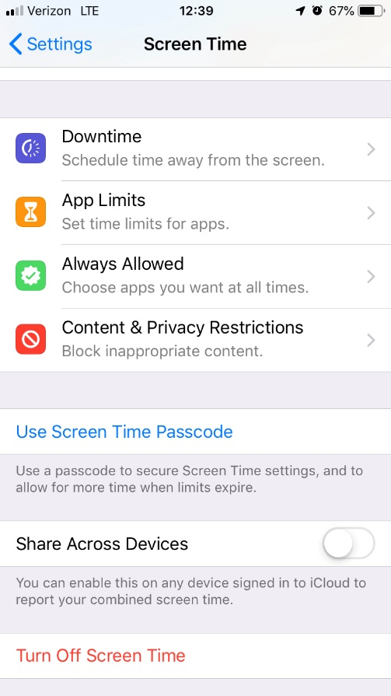
iPhone Screen Time

Slide 60
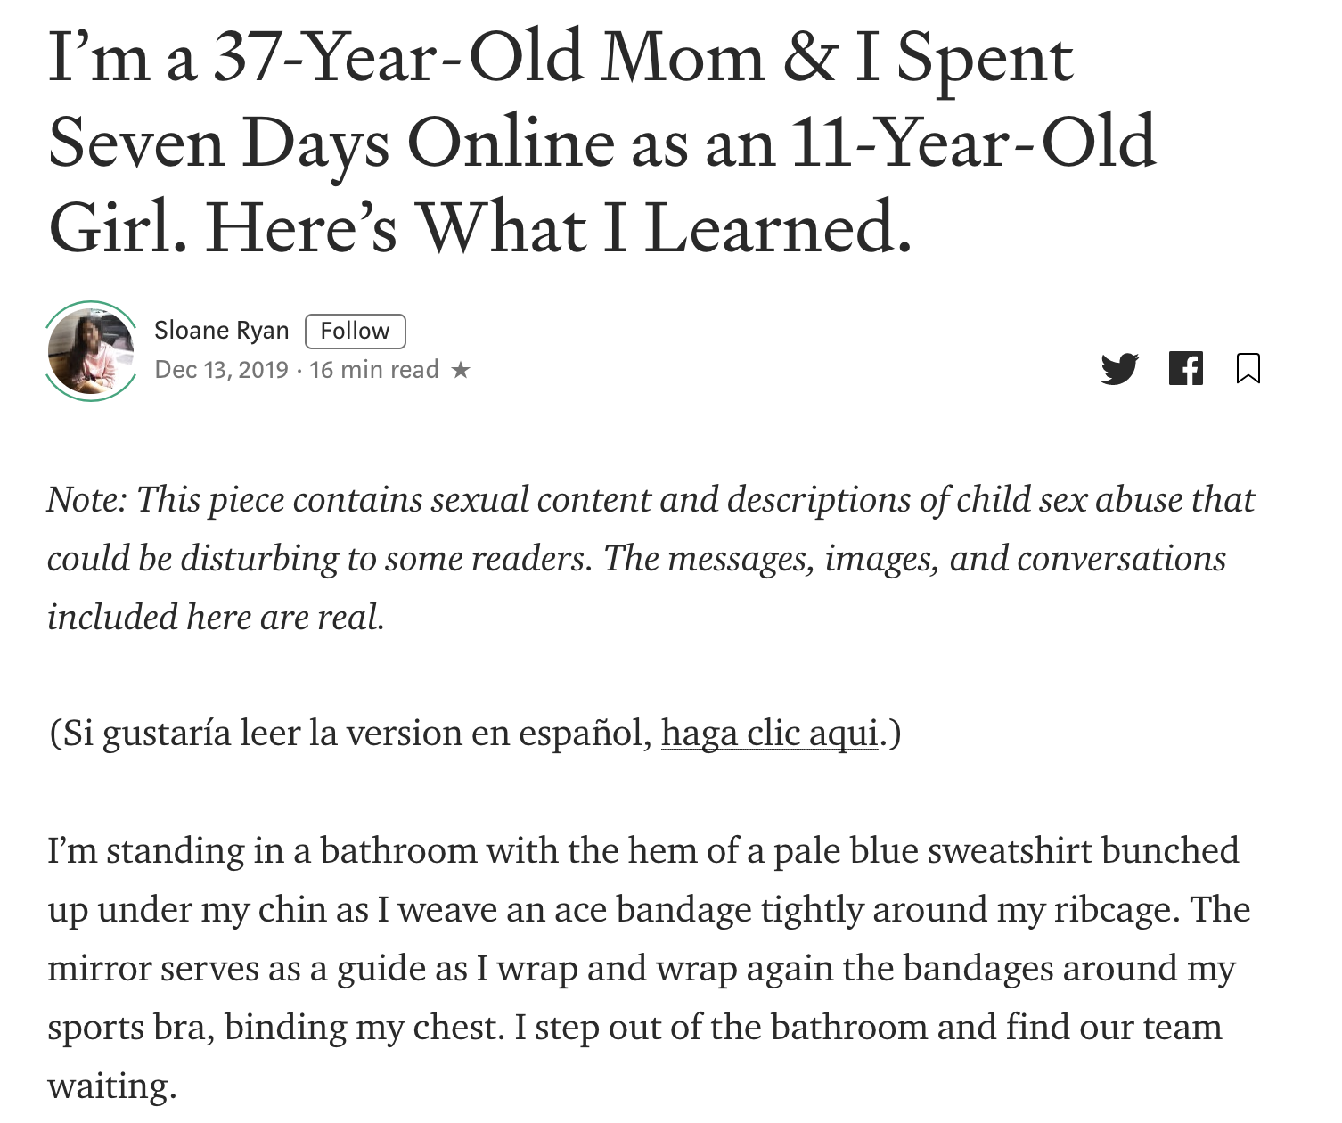

Slide 61
