Slide 1


NJCEP Proposed Fiscal Year 2025 True-Up Budget, Revised Budget and Program Changes
March 26, 2025
10:00 am

Slide 2
Agenda
Welcome and Introduction
Meeting Logistics
Overview of True-Up Budget Process
Changes in Compliance Filings and Other Documents
Process & Schedule

Slide 3
Meeting Logistics
Meeting will be recorded.
Meeting recording and PowerPoint will be available on the BPU and DCE website.
Meeting participants on Mute
Questions and Comments

Slide 4
Documents for Review
Proposed FY25 True-Up Budget
Compliance Filings
› DCE
› Charge Up New Jersey
› Comfort Partners
Comprehensive Resource Analysis
BPU/DPMC Designated Project List

Slide 5
Background
The Fiscal Year 2025 (“FY25”) New Jersey’s Clean Energy Program (“NJCEP”) budget was:
Approved through a June 27, 2024, Board Order.
This was based upon an estimate of expenses and commitments
expected to be incurred during Fiscal Year 2024.
Once actual expenses and commitments are known, the Board typically does a true-up of the differences between the estimated and actual amounts.

Slide 6
Staff Recommendations
Reallocations based upon program needs and changes in original projections.
Program revisions to continue to provide an equitable, transparent, and efficient use of funding.
Build upon successful decarbonization efforts by exploring innovative programs and supporting ongoing work by the Board.
Maintain progress towards the State’s clean energy
goals, including providing additional financial relief to qualified ratepayers through energy bill assistance.

Slide 7

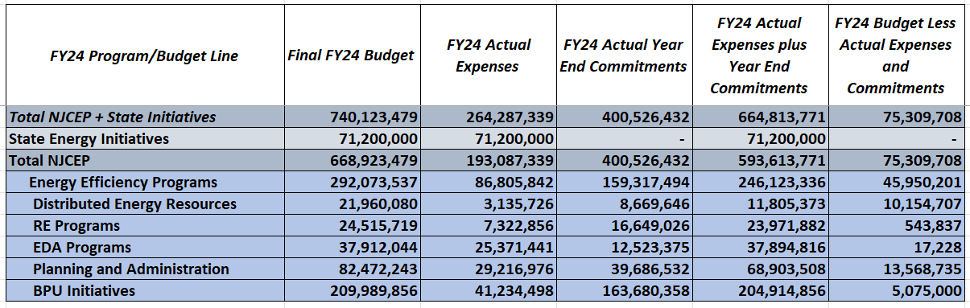
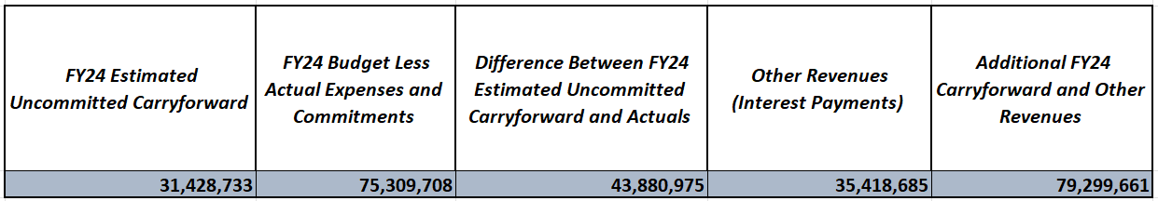


True-Up Calculations (Derivation of Additional Carryforward) (In $)
**Numbers presented in the above two tables may not add up precisely to totals provided due to rounding.

Slide 8
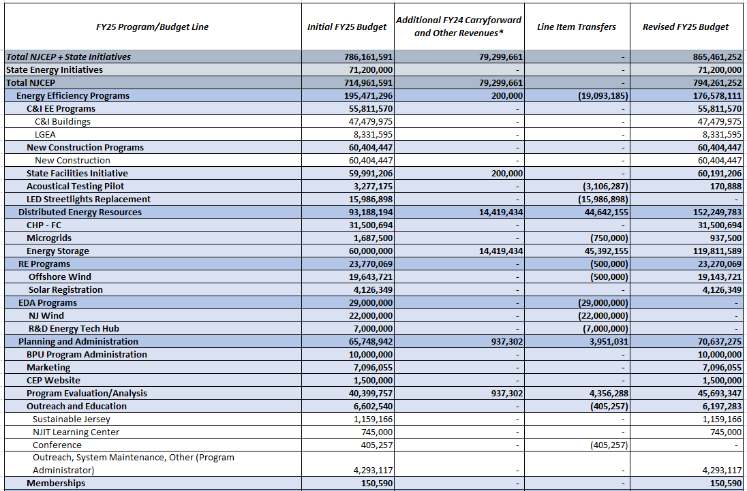
Proposed FY25 True-Up Budget (In $)

Slide 9
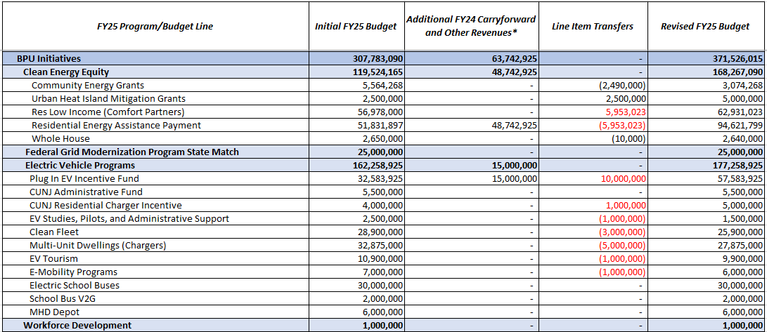
Proposed FY25 True-Up Budget (Cont.)
*Other revenue includes interest earnings from the Clean Energy Fund
**Numbers presented in the above table may not add up precisely to totals provided due to rounding
***Due to the time-sensitive nature of these changes as they relate to program continuity, the figures in red text are authorized Staff-approved changes that will occur before the True Up budget is approved

Slide 10
Reallocations and Rationale
Proposed Increases
Program | Reason(s) | Amount in $
State Facilities Initiative | Additional support for upgrades to state facilities | 200,000
Energy Storage | Additional funding has been allocated to reflect an anticipated need to award incentive payments as part of Phase 1 solicitations as part of the implementation of the New Jersey Storage Incentive Program | ‘ 59,811,589
Program Evaluation/Analysis | Supports contract modifications for Grid Modernization and EMP Update Consultant, and the addition of a storage administrator | 5,293,590
Urban Heat Island Mitigation Grants (previously Heat Island) | Establishes a statewide program to reduce the heat island effect by prioritizing funding for interventions in overburdened municipalities, including the expansion of energy-efficient public cooling infrastructure and community resilience efforts | 2,500,000
Residential Energy Assistance Payment | Provide a second round of energy bill assistance for LMI accounts | 42,789,902
Plug In EV Incentive Fund | Budget adjusted to reflect updated forecast of participation levels | 25,000,000
CUNJ Residential Charger Incentive | Budget adjusted to reflect updated forecast of participation levels | 1,000,000

Slide 11
Reallocations and Rationale
Proposed Deductions
Program | Reason(s) | Amount in $
Acoustical Testing Pilot | Some funding will not be needed and can be reallocated to other programs/initiatives | 3,106,287
LED Streetlights Replacement | This funding was anticipated to be utilized in FY25 but will not be spent this year | 15,986,898
Microgrids | Some funding will not be needed and can be reallocated to other programs/initiatives | 750,000
Offshore Wind | Some funding will not be needed and can be reallocated to other programs/initiatives | 500,000
NJ Wind | This funding was anticipated to be utilized in FY25 but will not be spent this year | 22,000,000
R&D Energy Tech Hub | This funding was anticipated to be utilized in FY25 but will not be spent this year | 7,000,000
Conference | This funding was anticipated to be utilized in FY25 but will not be spent this year | 405,257
Community Energy Grants | Some funding will not be needed and can be reallocated to other programs/initiatives | 2,490,000
Whole House | Some funding will not be needed and can be reallocated to other programs/initiatives | 10,000

Slide 12
Reallocations and Rationale
Proposed Deductions (Cont.)
Program | Reason(s) | Amount in $
EV Studies, Pilots, and Administrative Support | Budget adjusted to reflect updated forecast of participation levels | 1,000,000
Clean Fleet | Budget adjusted to reflect updated forecast of participation levels | 3,000,000
Multi-Unit Dwellings (Chargers) | Budget adjusted to reflect updated forecast of participation levels | 5,000,000
EV Tourism | Budget adjusted to reflect updated forecast of participation levels | 1,000,000
E-Mobility Programs | Budget adjusted to reflect updated forecast of participation levels | 1,000,000

Slide 13
DCE Compliance Filing
In addition to the budget reallocations, the DCE Compliance Filing has been
updated to reflect developments in the following key program areas:
› Offshore Wind:
» Fourth solicitation updates
› Solar:
» Latest developments in CSI Program solicitations and Community Solar Energy Program
» Updated to reflect the status of the Dual-Use Solar Pilot
› Energy Storage:
» Latest developments in Phase 1 of the New Jersey Storage Incentive Program

Slide 14
DCE Compliance Filing (cont.)
› Program Evaluation:
» Latest developments in Grid Modernization and other Clean Energy procurements
› Electric Vehicle Program:
» Proposed EV Tourism corridor program
› Clean Energy Equity:
» Updates on Community Energy Plan Grants and Residential Energy Assistance Payment

Slide 15
Charge Up New Jersey Compliance Filing
No major program changes. Some minor updates made regarding Charge Up+ and incentive eligibility.

Slide 16
Comfort Partners Compliance Filing
Compliance filing reflects the budget increase and funds shifted between cost categories to align with expected need in these service areas.

Slide 17
Comprehensive Resource Analysis
The Comprehensive Resource Analysis has been adjusted to reflect program
updates and previously approved Board actions.

Slide 18
BPU and DPMC Designated Project List
Due to updated timelines and cost projections, $500,000 has been reallocated between previously approved projects in the DPMC and BPU Designated Project List. An additional increase of $200,000 was added to support energy efficiency upgrades at the State Library and Roebling building. $2 million in RGGI funds will supplement SBC funds for the DEP Parks Upgrade.

Slide 19
Process & Schedule
Staff requests comments on the Proposal prior to presenting it to the Board for
consideration.
Commenters are encouraged to file their comments directly to the specific docket, Docket No. QO24040224, using the “Post Comments” button on the Board’s Public Document Search tool.
Comments may also be submitted electronically to Board.Secretary@bpu.nj.gov, under the subject heading “Requests for Comments –Proposed NJCEP Fiscal Year 2025 True-Up Budget, etc.”
Please note that these comments are considered “public documents” for purposes of the State’s Open Public Records Act. Commenters may identify information that they seek to keep confidential by submitting them in accordance with the confidentiality procedures set forth in
N.J.A.C. 14:1-12.3.
Comments will be accepted through 5:00 p.m. on March 28, 2025.

Slide 20
THANK YOU

