Slide 1


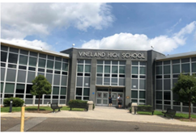
MONROE TOWNSHIP BOARD OF EDUCATION
Monroe Township, NJ
Project Date: January 10, 2025
Project Type: ESCO Model- Honeywell
Project Overview:
Generated $14,165,153 in annual energy savings
Reduction of 1,705 MTE of CO₂ emissions
Projected Saving: $18,559,314 total annual savings /20-year term
Financing Profile:
Energy Conservation Measures (ECMs) Installed:
Project Cost : $12,294,803
Project Term/Payback : 20 years
LED Lighting Retrofit
Type of Financing: Refunding Bond
Building Envelope Weatherization
Applied Incentives : $ 594,494
HVAC Upgrades/Replacements
Overall Savings: $ 18,559,314
Energy Management System Replacement
Building Profile:
Performance Metrics:
Number of Buildings: 10
5,422,532 kWh saved.
Square Footage: 965,032 sq ft
4,848,769 pounds of greenhouse gas emissions reduced.
17,455 therms saved.
Public Entity Contact Information :
Energy Service Company Contact Information:
Facilities Director: John Tague
Project Manager: Caroline Jackson
Caroline.Jackson@Honeywell.com
ESIP PROJECT BRIEF

