Slide 1
NJCEP Proposed Fiscal Year 2023 True-Up Budget, Revised Budget and Program Changes
March 3, 2023
1:00 pm

Slide 2
Agenda
Welcome and Introduction
  Meeting Logistics
Overview of True-Up Budget Process
Changes in Compliance Filings and Other Documents
Process & Schedule

Slide 3
Meeting Logistics
Meeting will be recorded.
Meeting recording and PowerPoint will be available on the website.
Meeting participants on Mute
Questions and Comments

Slide 4
Documents for Review
Proposed FY23 True-Up Budget
Compliance Filings
  DCE
  TRC
  Comfort Partners
  Charge Up NJ
DPMC Designated Project List

Slide 5
Background
The Fiscal Year 2023 (“FY23”) New Jersey’s Clean Energy Program (“NJCEP”) budget was:
Approved through a June 29, 2022 Board Order.
This was based upon an estimate of expenses and commitments expected to be incurred during Fiscal Year 2022.
Once actual expenses and commitments are known, the Board typically does a true-up of the differences between the estimated and actual amounts.

Slide 6
Staff Recommendations
Reallocations based upon program needs and changes in original projections.
Program revisions to continue to provide an equitable, transparent, and efficient use of funding.
Build upon successful decarbonization efforts by exploring innovative pilot programs and supporting ongoing work by the Board.
Maintain progress towards the State’s clean energy goals.

Slide 7
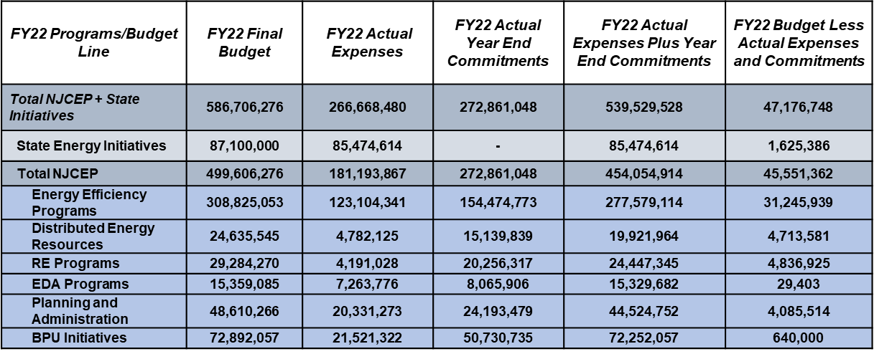
True-Up Calculations (Derivation of Additional Carryforward) (In $)
**Numbers presented in the above two tables may not add up precisely to totals provided due to rounding.

Slide 8
Proposed FY23 True-Up Budget (In $)
FY23 Program/Budget Line | Initial FY23 Budget | Additional FY22 Carryforward and Other Revenues* | Line Item Transfers | Revised FY23 Budget
Total NJCEP + State Initiatives | 610,751,520 | 46,396,198 | 0 | 657,147,718
State Energy Initiatives | 92,674,000 | 0 | 0 | 92,674,000
Total NJCEP | 518,077,520 | 46,396,198 | 0 | 564,473,718
Energy Efficiency Programs | 256,373,502 | 42,464,898 | 0 | 298,838,400
Res Low Income (Comfort Partners) | 54,500,000 | 2,478,000 | 0 | 56,978,000
C&I EE Programs | 78,264,244 | 17,000,000 | 0 | 95,264,244
C&I Buildings | 67,187,357 | 15,000,000 | 0 | 82,187,357
LGEA | 3,981,302 | 1,500,000 | 0 | 5,481,302
DI | 7,095,585 | 500,000 | 0 | 7,595,585
New Construction Programs | 30,316,692 | 14,000,000 | 0 | 44,316,692
New Construction | 30,316,692 | 14,000,000 | 0 | 44,316,692
Energy Efficiency Transition | 23,340,494 | 0 | 0 | 23,340,494
State Facilities Initiative | 56,670,192 | 3,000,000 | 0 | 59,670,192
Acoustical Testing Pilot | 3,281,880 | 0 | 0 | 3,281,880
LED Streetlights Replacement | 10,000,000 | 5,986,898 | 0 | 15,986,898
Distributed Energy Resources | 23,771,608 | 0 | 0 | 23,771,608
CHP - FC | 22,084,108 | 0 | 0 | 22,084,108
Microgrids | 1,687,500 | 0 | 0 | 1,687,500
RE Programs | 31,962,396 | 3,501,300 | 0 | 35,463,696
Offshore Wind | 28,928,500 | 3,126,300 | 0 | 32,054,800
Solar Registration | 3,033,896 | 375,000 | 0 | 3,408,896

Slide 9
Proposed FY23 True-Up Budget (Cont.)

Slide 10
Reallocations and Rationale
Proposed Increases
Program | Reason(s) | Amount in $
Res. Low Income (Comfort Partners) | Budget adjusted to reflect additional support to ensure all service areas can maximize the number of energy efficiency projects | 2,478,000
C&I Buildings | Support a potential pilot program related to the Large Energy Users Program | 15,000,000
LGEA | Budget adjusted to cover additional costs associated with auditing of State buildings | 1,500,000
DI | Budget adjusted to reflected updated forecast of existing commitments | 500,000
New Construction | Budget adjusted to reflect updated forecast of participation levels and to support a potential pilot program | 14,000,000
State Facilities Initiative | Support HVAC replacement at the Department of Education’s Katzenbach School for the Deaf | 3,000,000
LED Streetlights Replacement | Budget adjusted to reflect additional need from municipalities to assist with offsetting the costs of conversion | 5,986,898
Offshore Wind | Support additional contractual work being undertaken by transmission consultant to assist Staff with the ongoing State Agreement Approach. Also, funding has been allocated to support the Board’s commitment to become a public sponsor of the National Offshore Wind Research and Development Consortium | 3,126,300

Slide 11
Reallocations and Rationale
Proposed Increases (Cont.)
Program | Reason(s) | Amount in $
Solar Registration | Budget adjusted to ensure sufficient funding is available to cover additional ADI/CSI training and to establish the new CSI portal | 375,000
Clean Energy Manufacturing Fund | Additional funding needed to cover the remaining FY23 EDA administrative costs associated with this program | 30,000
Program Evaluation/Analysis | Support an MOU between BPU and the DEP for a multi-agency light detection and ranging data collection project of six counties in northeast region of New Jersey | 50,000
Outreach, Website, Other | Provide additional support to BPU program focused events | 300,000
Memberships | Additional funding is needed to support existing membership dues | 50,000
Multi-Unit Dwellings (Chargers) | Budget adjusted to reflect updated forecast of participation levels | 2,000,000
EV Tourism | Budget adjusted to reflect updated forecast of participation levels | 1,000,000

Slide 12
Reallocations and Rationale
Proposed Decreases
Program | Reason(s) | Amount in $
State Vehicle Fleet | Budget adjusted to reflect updated forecast of participation levels | 2,000,000
Local Clean Fleet | Budget adjusted to reflect updated forecast of participation levels | 1,000,000

Slide 13
DCE Compliance Filing
In addition to the budget reallocations, the DCE Compliance Filing has been updated to reflect developments in the following key program areas:
  Offshore Wind:
    Award of transmission projects as part of the State Agreement Approach
    Development of the third solicitation
    New MOU with EDA to further support the Wind Institute
  Solar: Launch of the Competitive Solar Incentive (“CSI”) Program and details regarding the first solicitation.
  Energy Storage:
    Release of the Straw Proposal for the New Jersey Storage Incentive Program (“SIP”)
    Funding committed to a pilot program to improve resiliency at State facilities
  LED Streetlights Replacement: Funding for Atlantic City to complete conversion.

Slide 14
DCE Compliance Filing (cont.)
  Program Evaluation:
    Consideration of an MOU between BPU and DEP to provide funding for a multi-agency regional light detection and ranging (“LiDAR”) data collection project
    Grid Modernization – Work on changes to interconnection rules based upon final report recommendations.
  Clean Energy Conference: Held first successful conference in October 2022 in Atlantic City.

Slide 15
TRC Compliance Filing
Detailed budget was updated to reflect previously discussed true-up reallocations.
Provide flexibility to Staff to raise the cap on State entities for the Local Government Energy Audit Program.

Slide 16
Comfort Partners Compliance Filing
Revised narrative to explain how additional funding will be used to support EE work across the service areas.
Updated detailed budget to ensure the new funding is spread amongst the EDCs for the remainder of FY23 in order to:
  Better reflect actual participation rates in certain service areas.
  Maximize existing funding.
  Estimate the need moving forward.

Slide 17
Charge Up NJ Compliance Filing
Updated the criteria for eligible chargers for all EV programs to include the requirement that they be “Energy Star certified.”

Slide 18
BPU and DPMC Designated Project List
Due to updated timelines and cost projections, Staff is proposing a reallocation of approximately $200k between previously approved projects to better align with current project status.
Updated to reflect the additional $3 million to support HVAC work at the Department of Education’s Katzenbach School.

Slide 19
Process & Schedule
Staff requests comments on the Proposal prior to presenting it to the Board for
consideration.
Commenters are encouraged to file their comments directly to the specific docket, Docket No. QO22020113, using the “Post Comments” button on the Board’s Public Document Search tool.
Comments may also be submitted electronically to Board.Secretary@bpu.nj.gov, under the subject heading “Requests for Comments –Proposed NJCEP Fiscal Year 2023 True-Up Budget, etc.”
Please note that these comments are considered “public documents” for purposes of the State’s Open Public Records Act. Commenters may identify information that they seek to keep confidential by submitting them in accordance with the confidentiality procedures set forth in N.J.A.C. 14:1-12.3.
Comments will be accepted through 5:00 p.m. on March 10, 2023.

Slide 20
THANK YOU

