Slide 1
Notes:
PLEASE READ BEFORE PRESENTING
Use this PowerPoint to help you deliver a Movember assembly in your school. It’s designed to help students understand why there are fundraising and what they can do to help change the face of men’s health.
You may wish to delete some slides or videos if you don’t have much assembly time.
You can also add any of the individual videos that Movember has made for you here: (https://movember.box.com/s/o5s3lfpxor888gdz70ei2wp2btfhr4tv) or play the whole 20min video: (https://movember.box.com/s/mrj5e0vfxwbc7oqc4eghpwr1kw4bv1y5) instead of presenting (please note this video was created for general audiences so you may want to assess if it appropriate for the age group you are presenting to)
These slides may contain sensitive information of which some students may have direct experience. Consider any sensitivities or known experiences before delivery. You may also wish to brief students before introducing the content and invite discussion ahead of the assembly if they wish.

Slide 2


Slide 3

Notes:
Movember is the world’s leading men’s health charity
Since 2003, we funded over 1,250 men’s health programmes to
change the face of men’s health
We’re working towards a world where men live happier, healthier
and longer lives

Slide 4
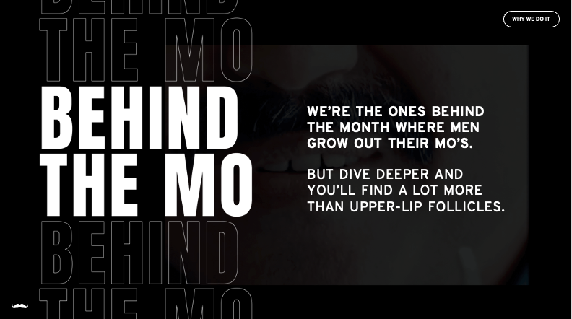

Slide 5
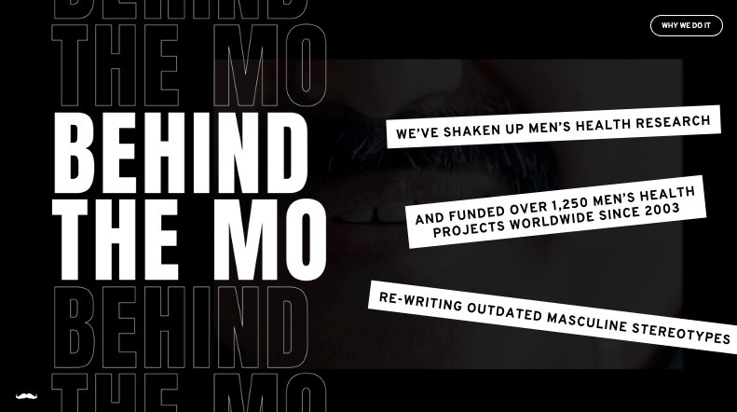

Slide 6
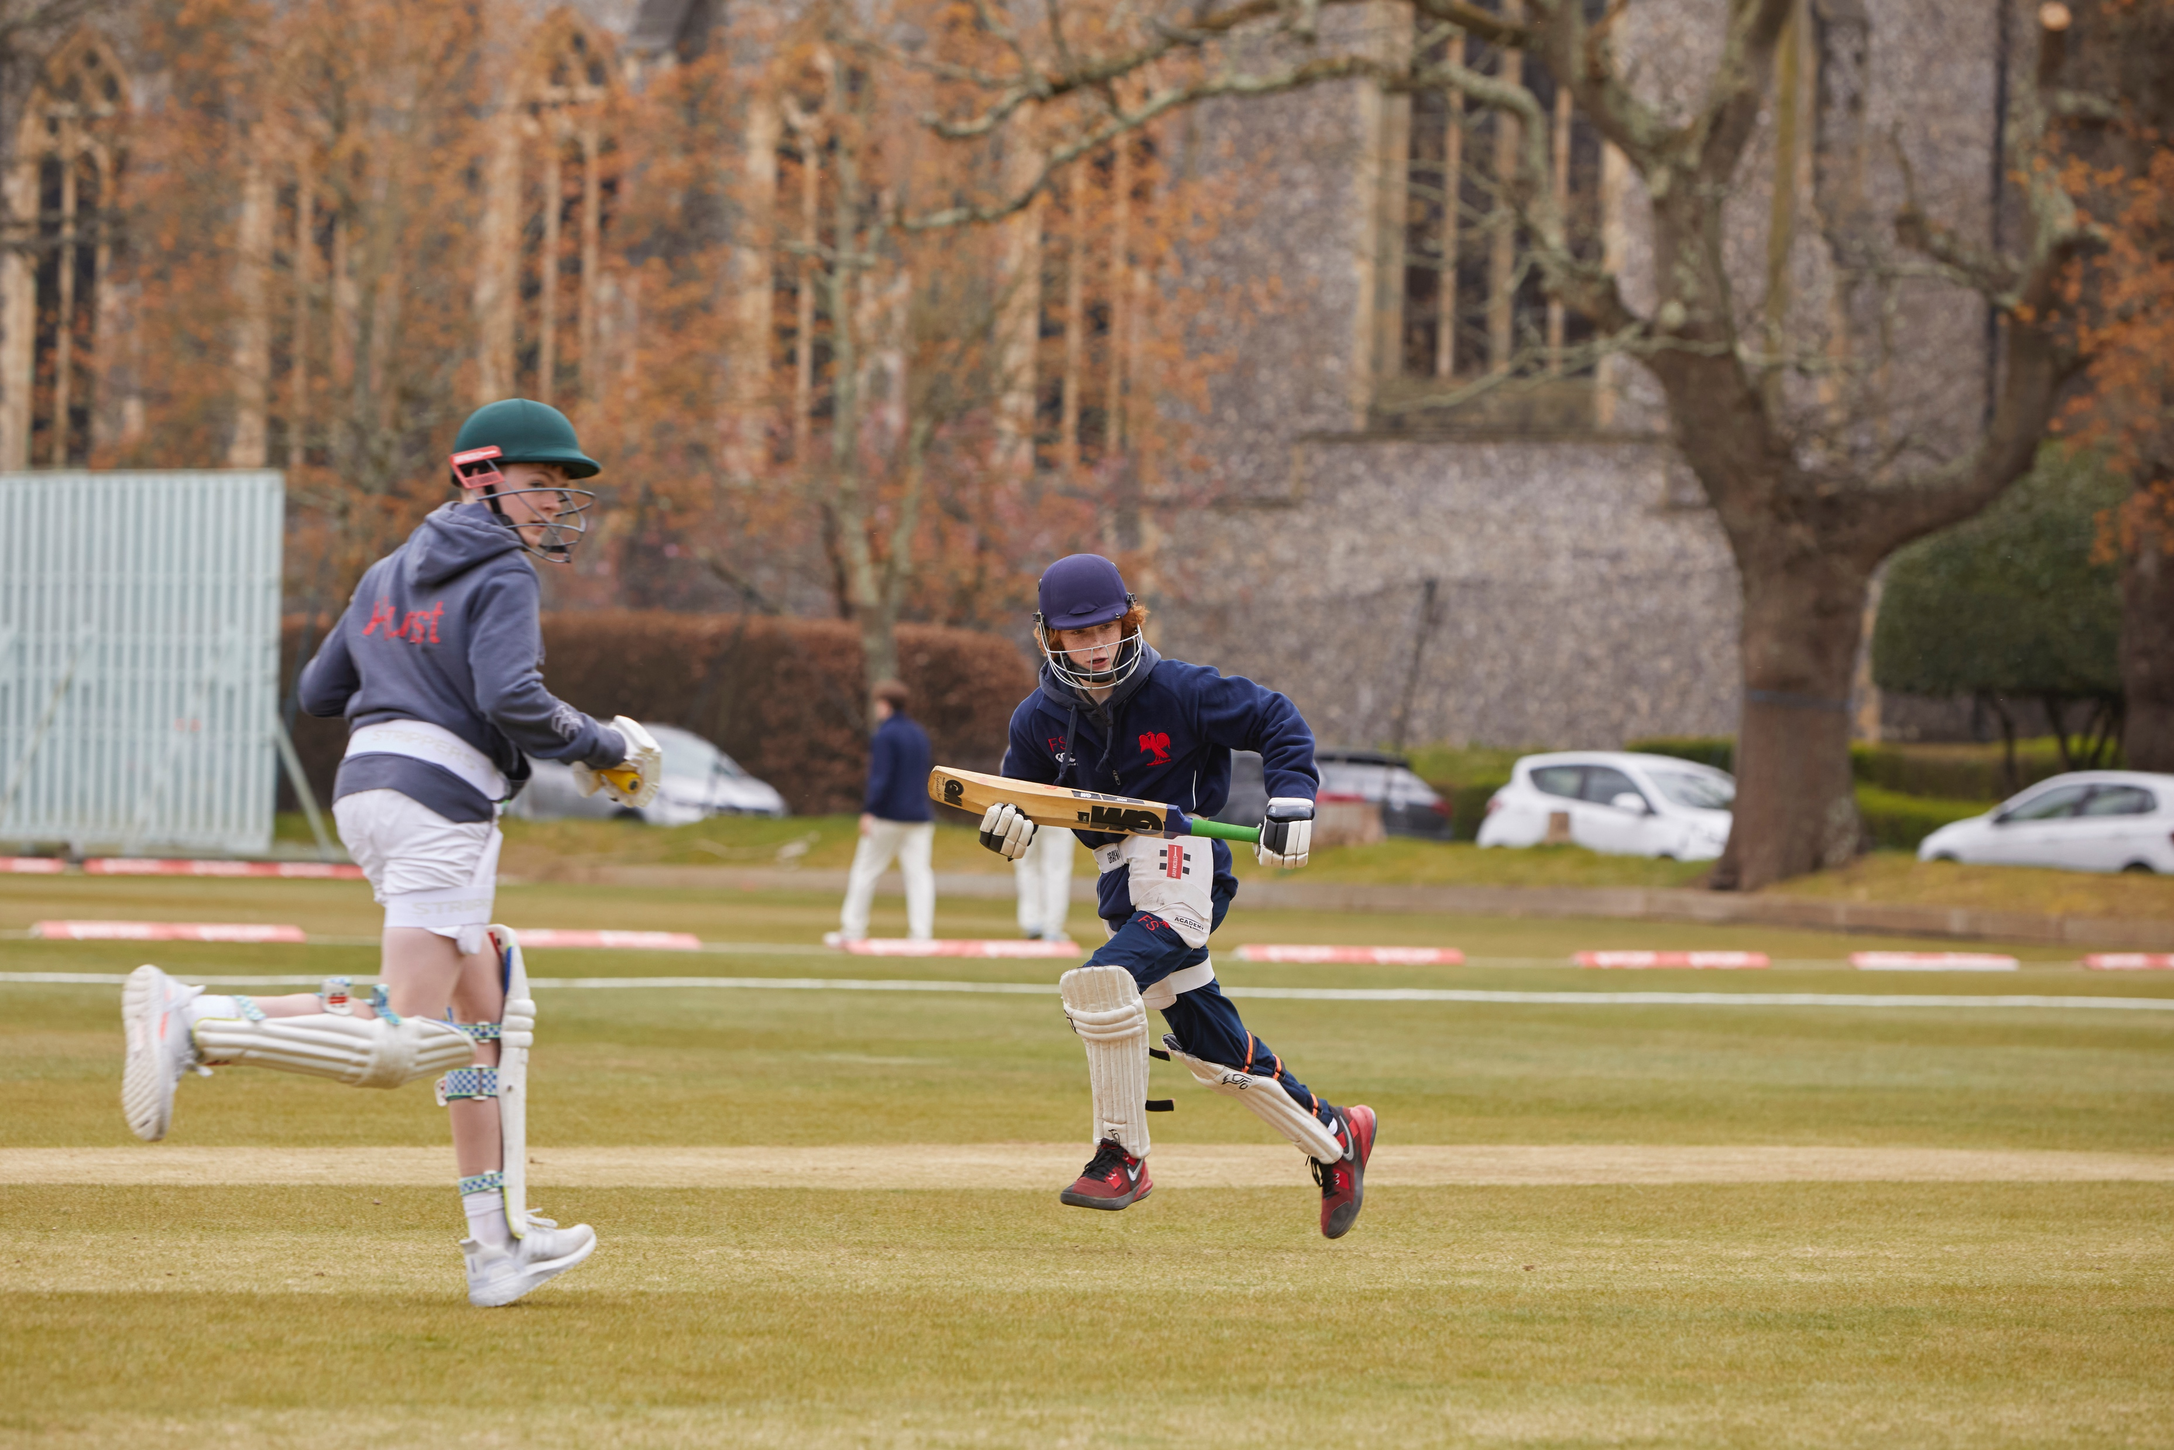
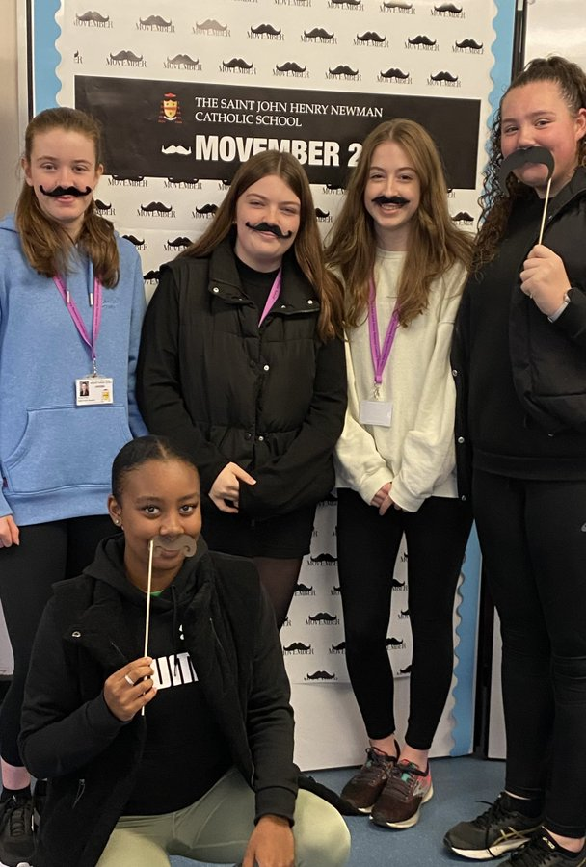
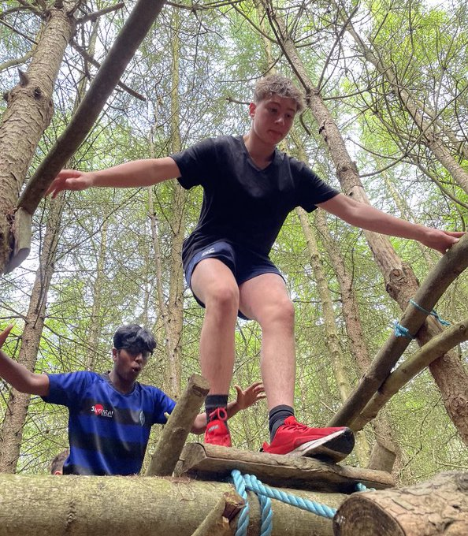
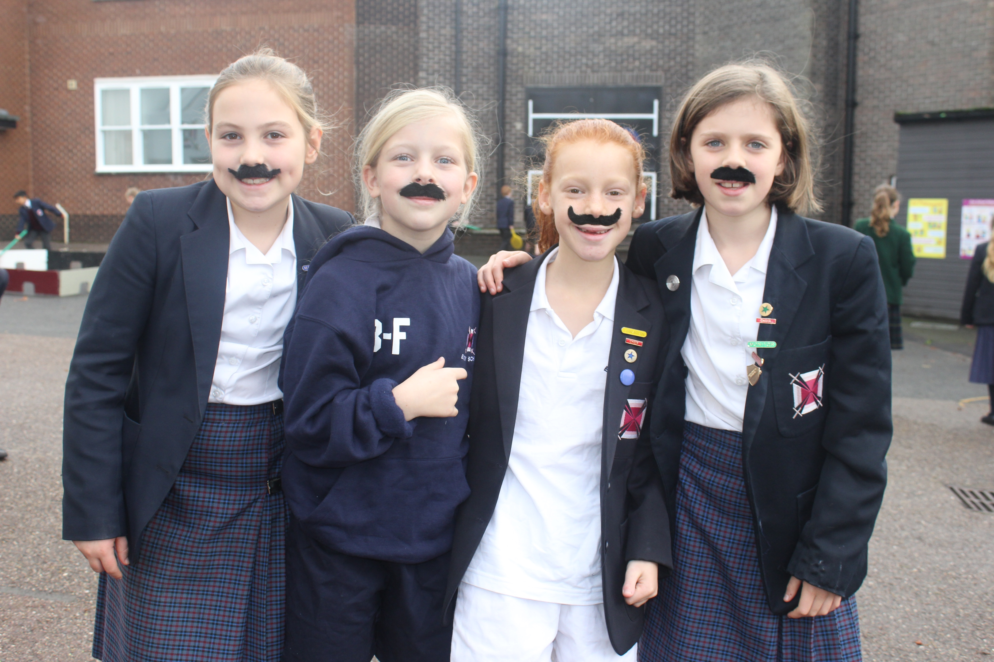
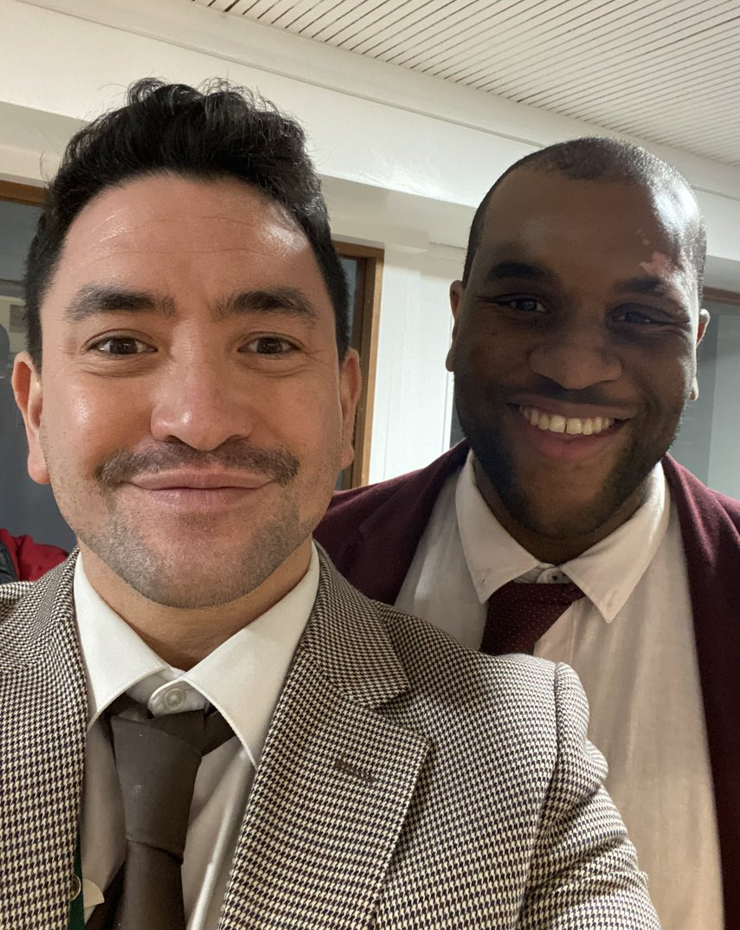
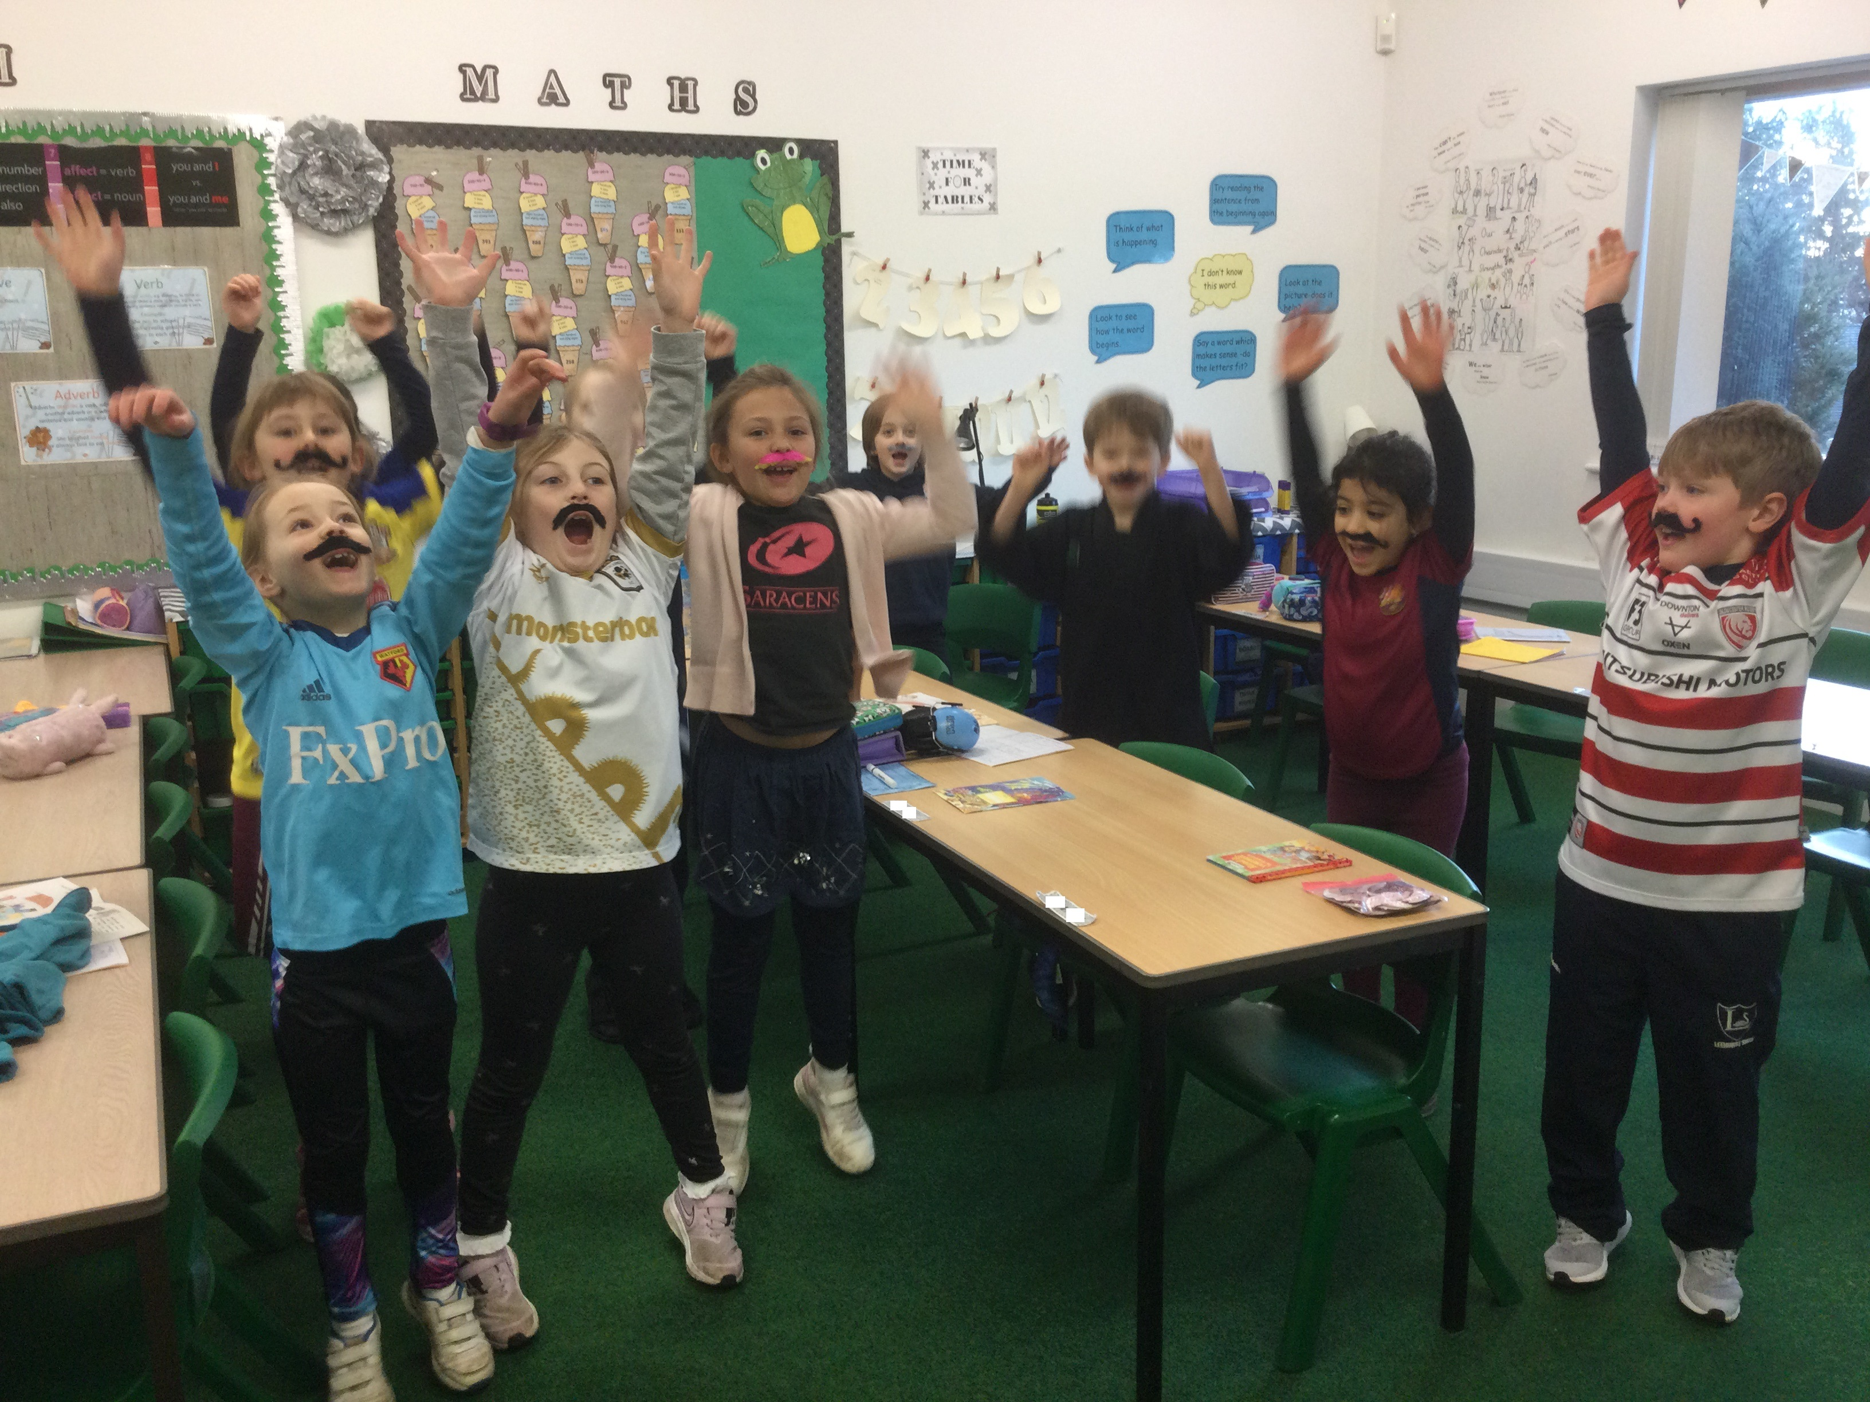
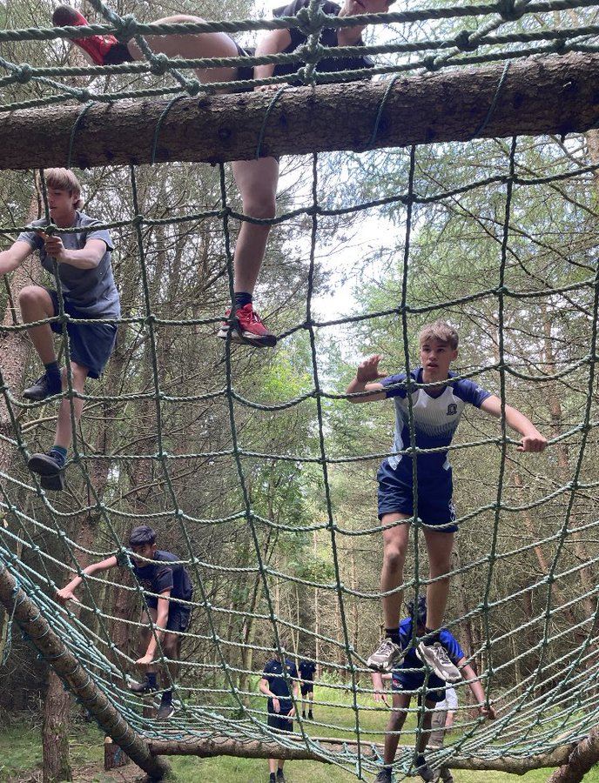
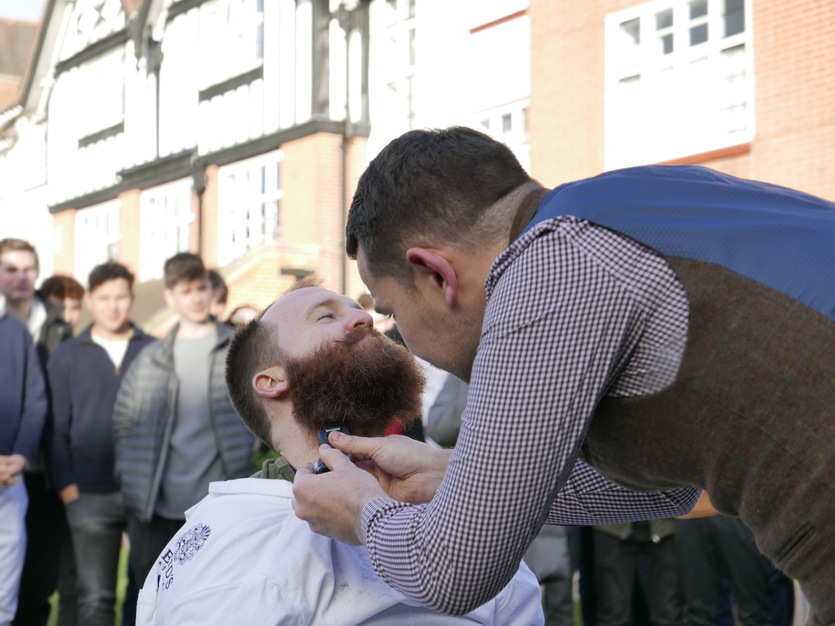
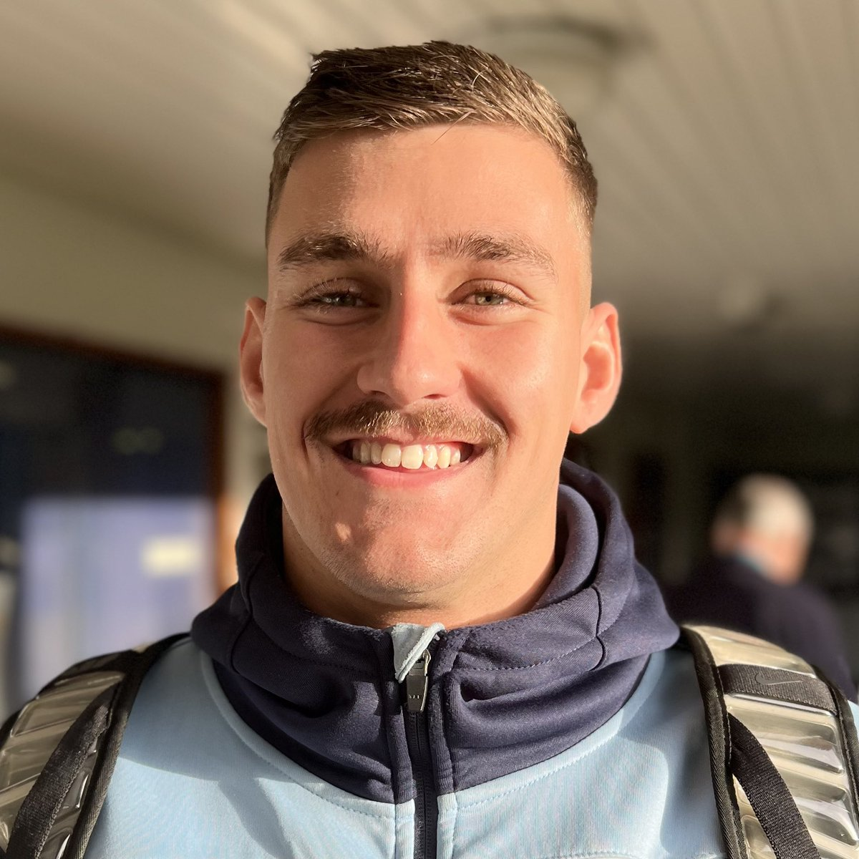
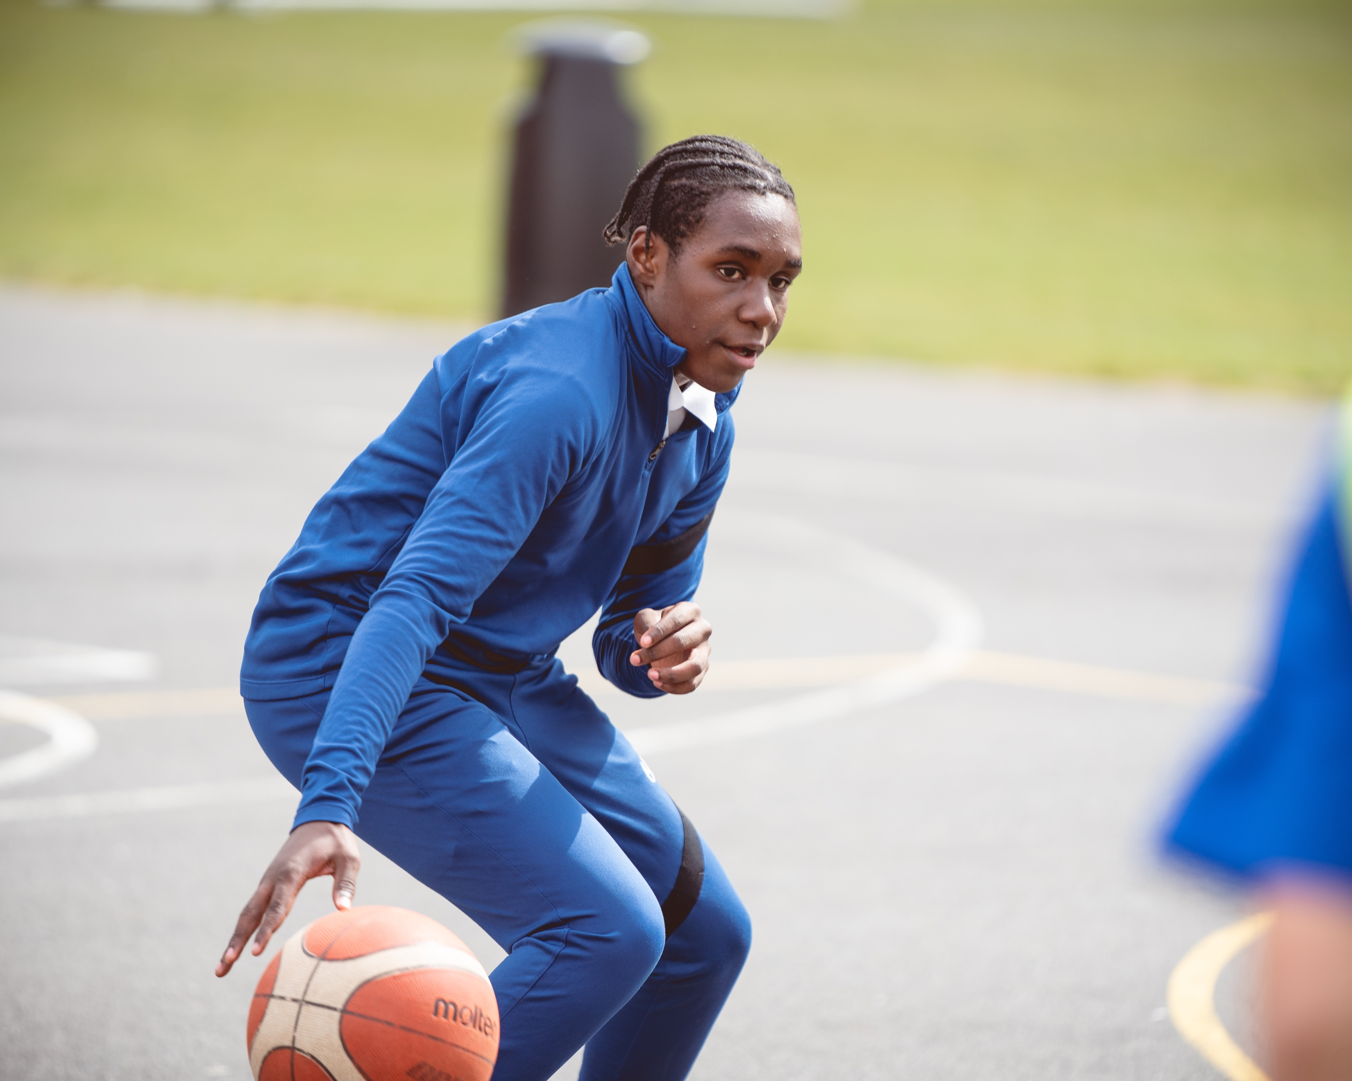
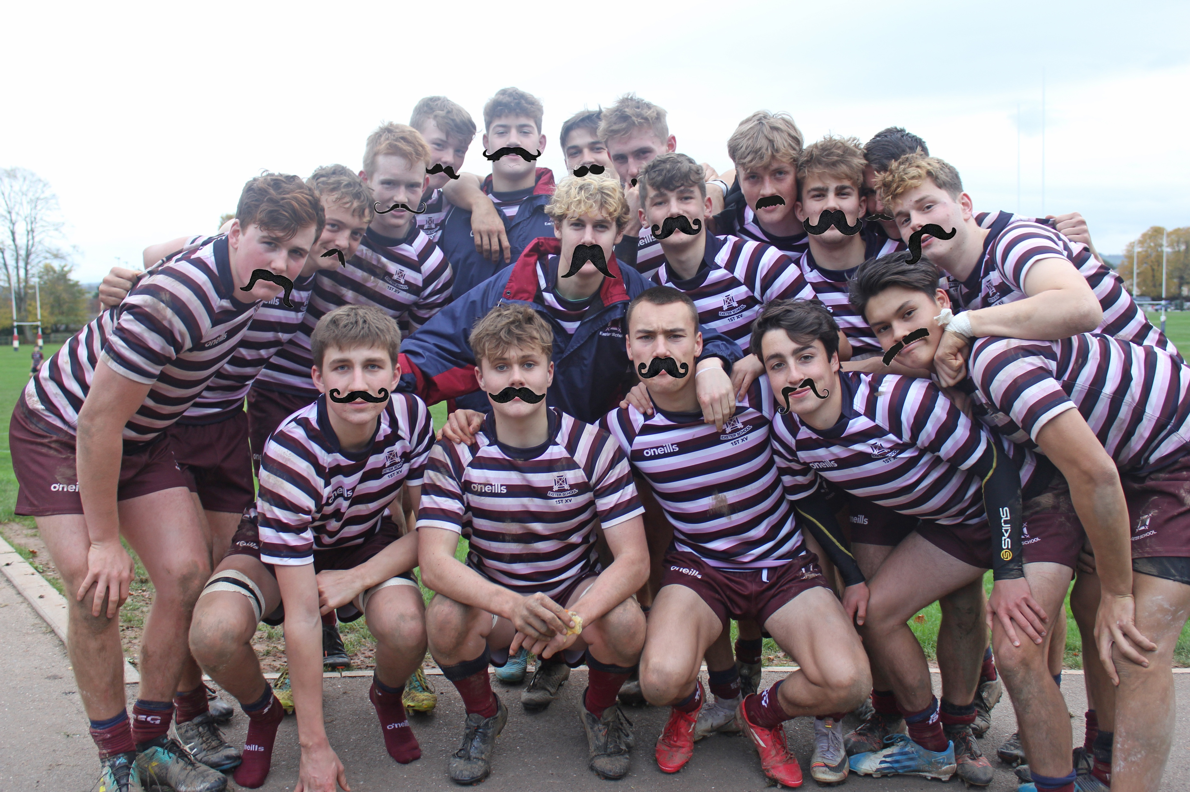
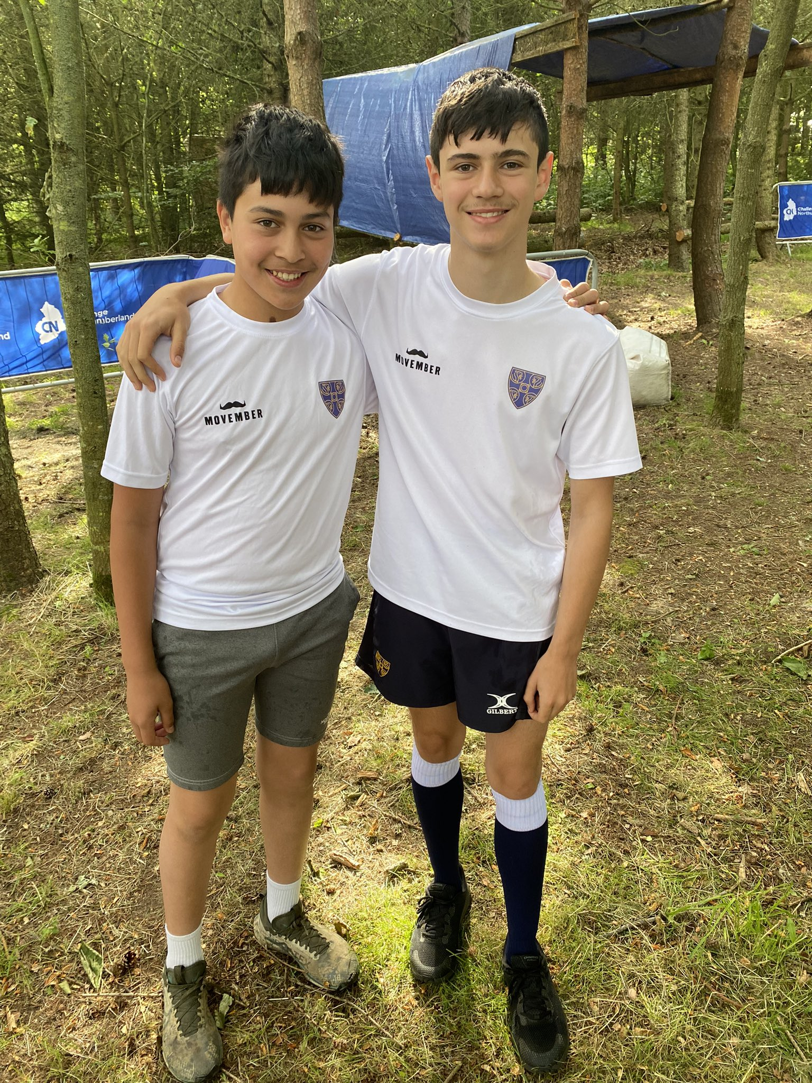
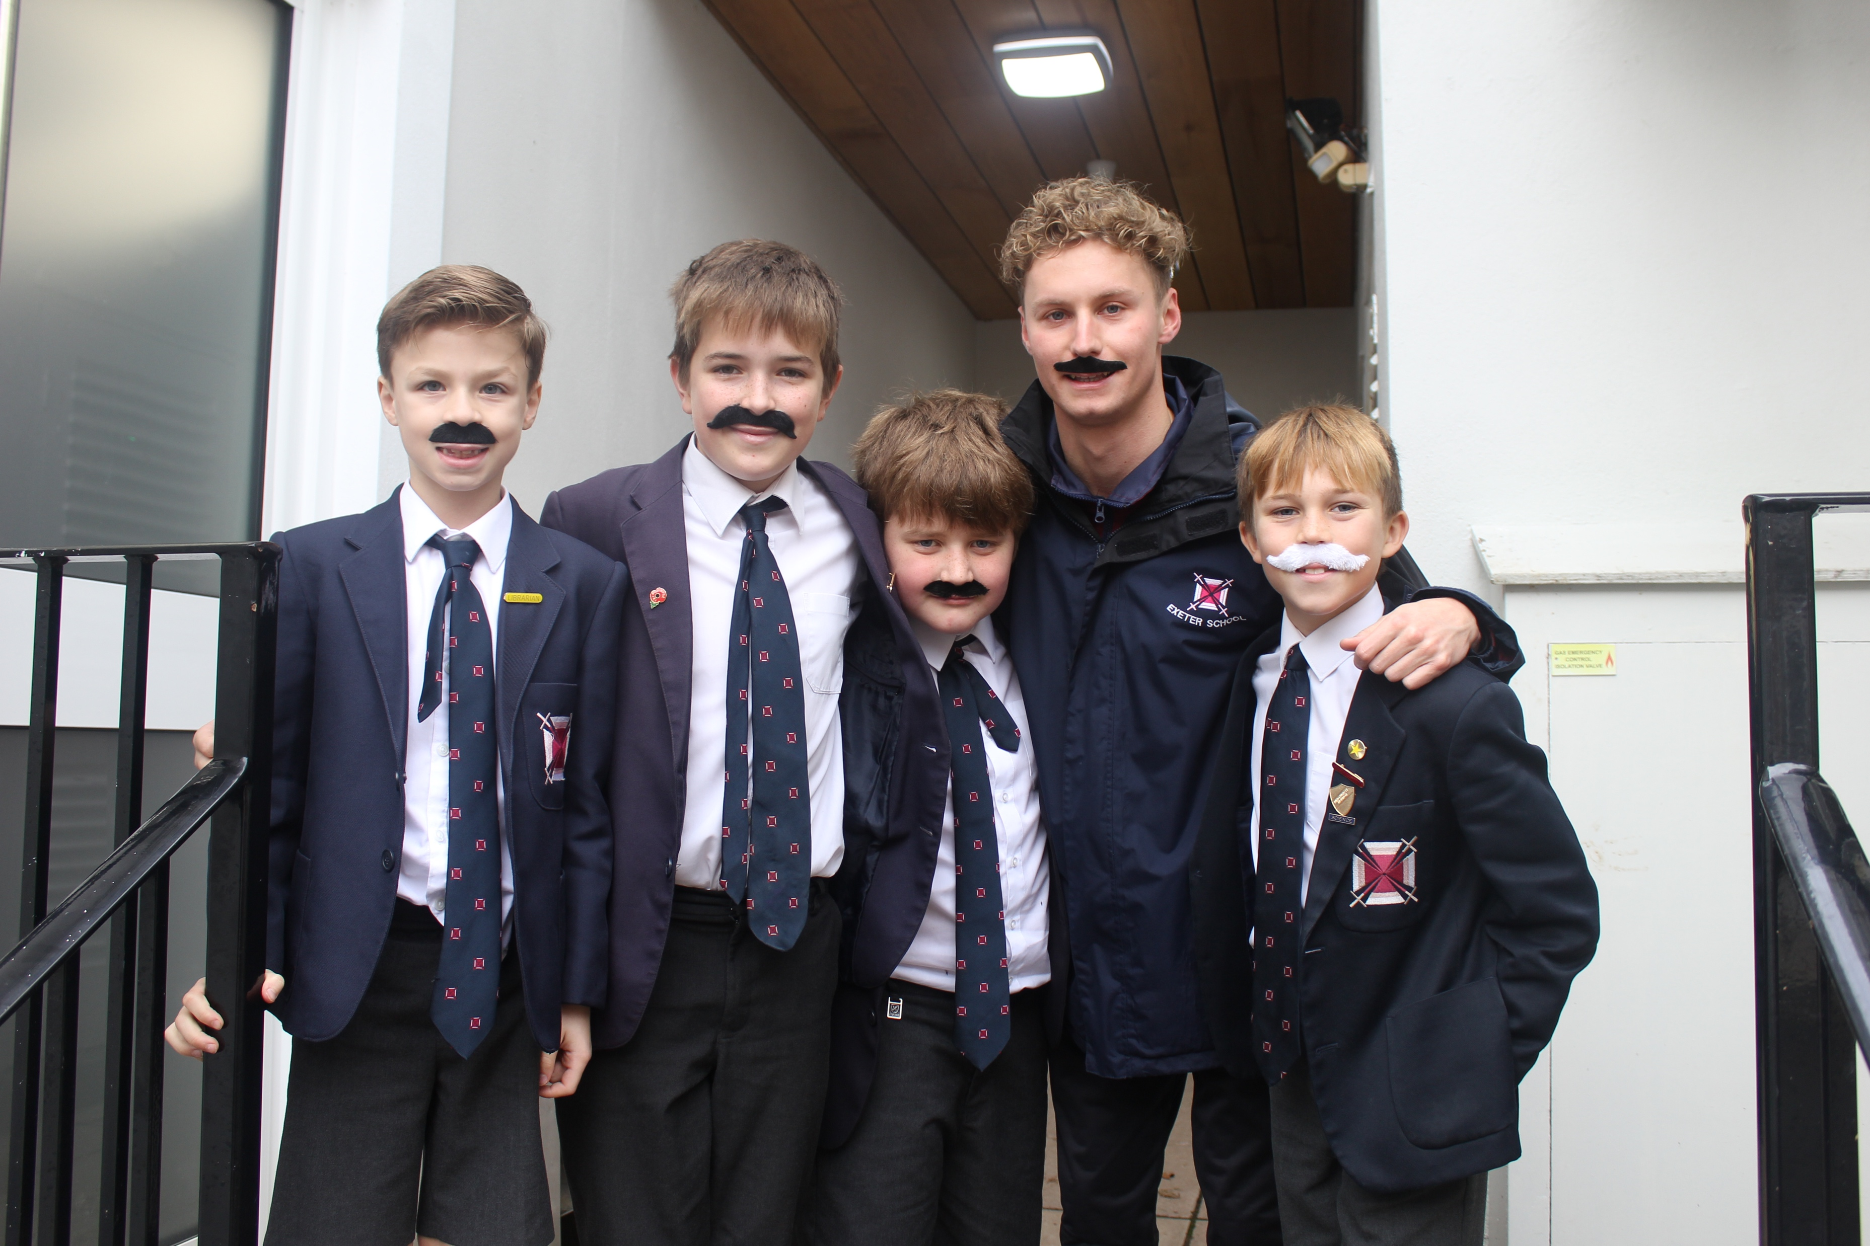
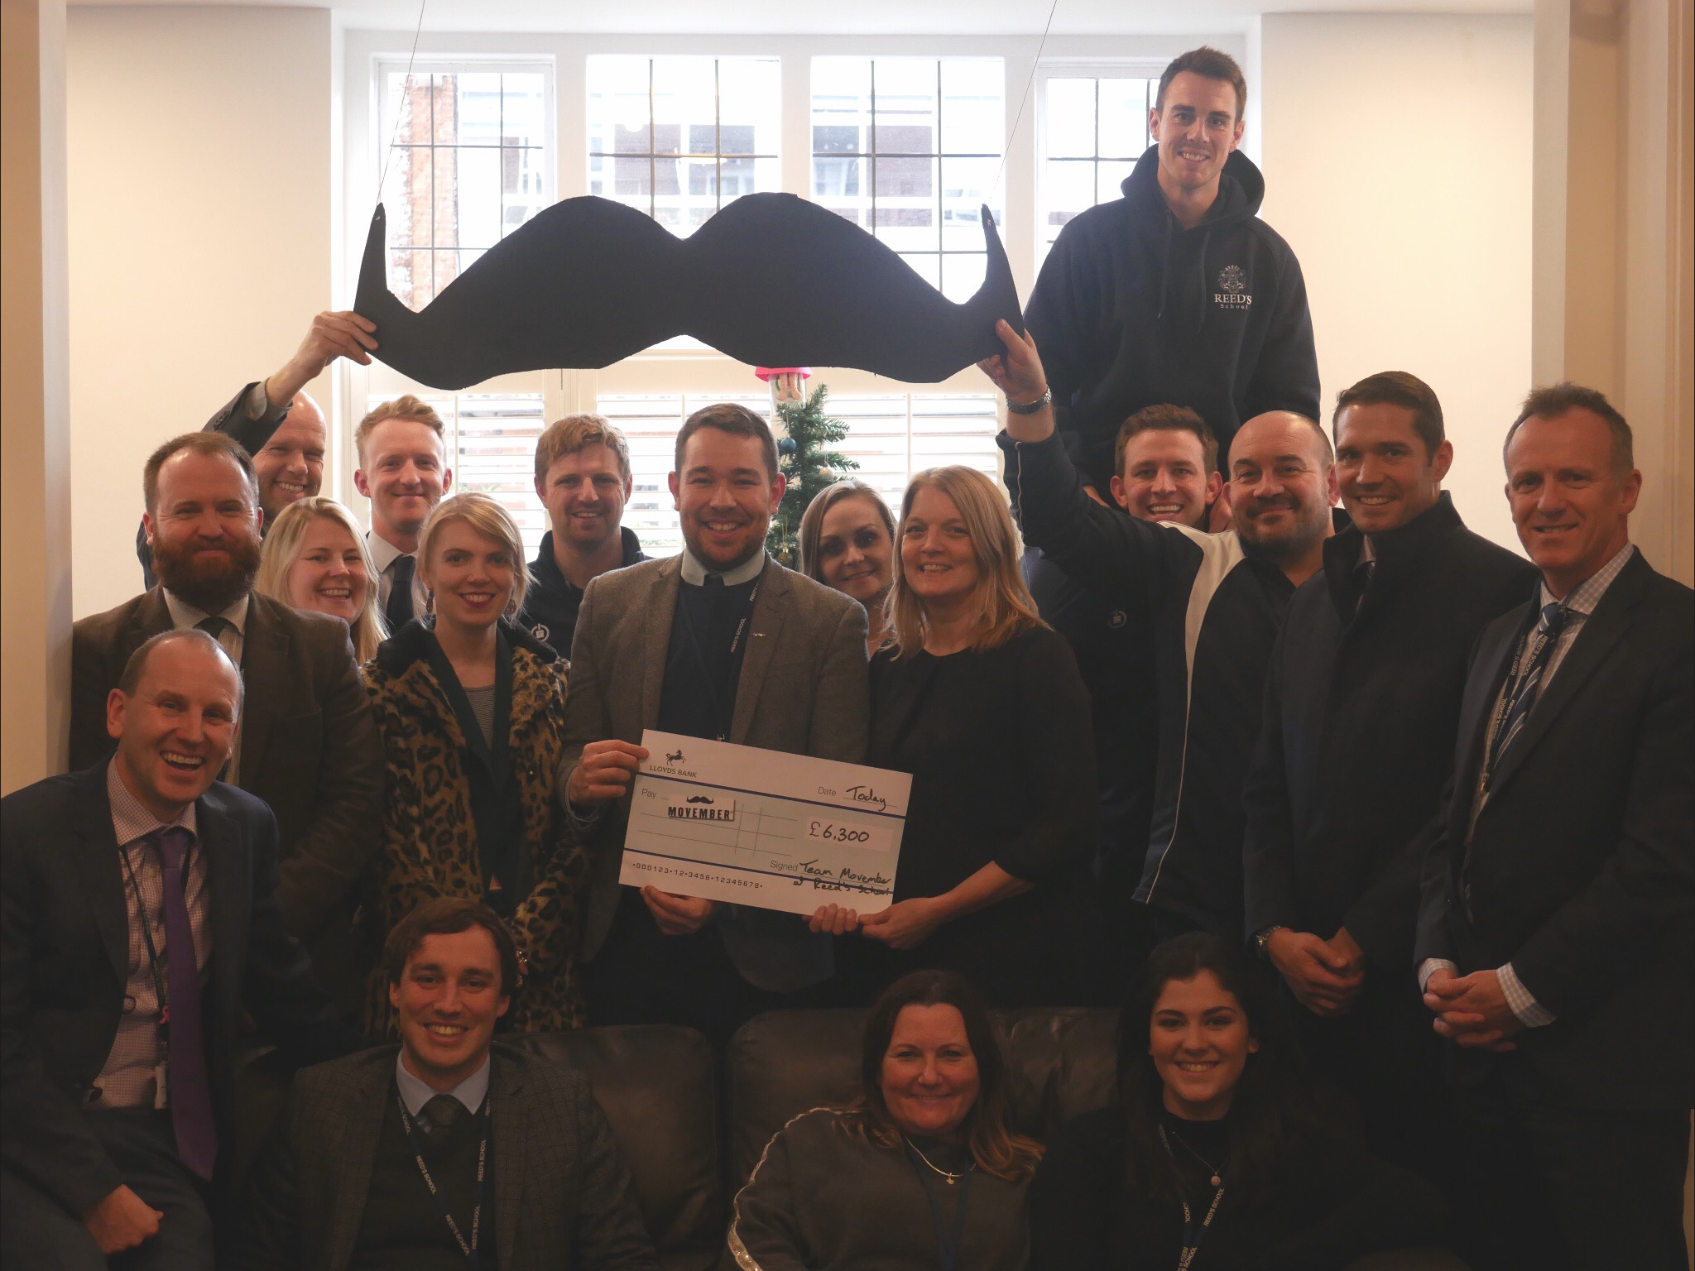


WHY WE DO IT

Slide 7

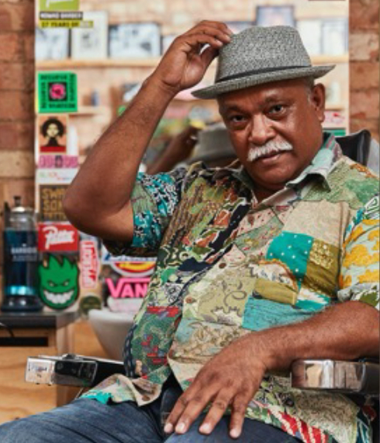
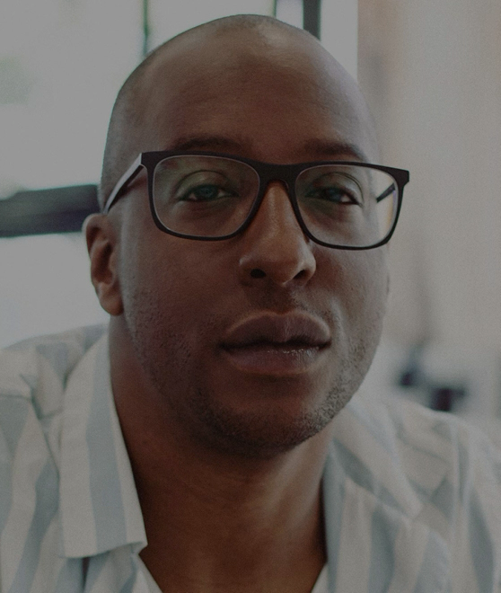
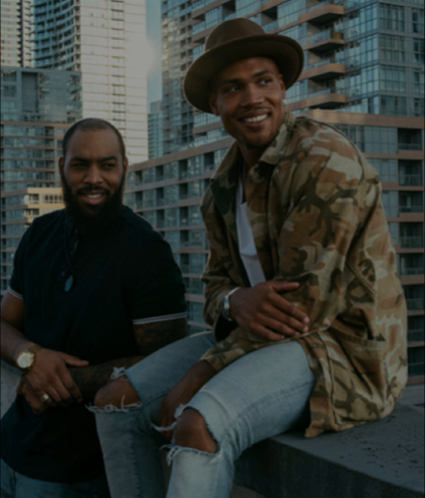
PROBLEM
WHY WE DO IT
ON AVERAGE, MEN
DIE 5
YEARS
EARLIER
1/8 MEN
WILL BE DIAGNOSED WITH PROSTATE CANCER
THAN WOMEN FOR PREVENTABLE REASONS
TESTICULAR CANCER
ONE MAN GLOBALLY
DIES BY SUICIDE EVERY MINUTE
IS THE MOST COMMON CANCER AMONG YOUNG MEN
Notes:
Why men’s health? Why Movember?
Gender is one of the strongest and most consistent predictors of health and life expectancy.
Globally men die an average of 4.5 years earlier than women and biology is only a small part of this. Most of it is down to things that are preventable - these are complex, but not unsolvable.
Men are often slow to act when they experience a health problem, and when they do it’s often too late.
There’s a men’s health crisis that isn’t being talked out.
Our fathers, brothers, partners and friends are dying too young, and we can’t afford to stay silent

Slide 8
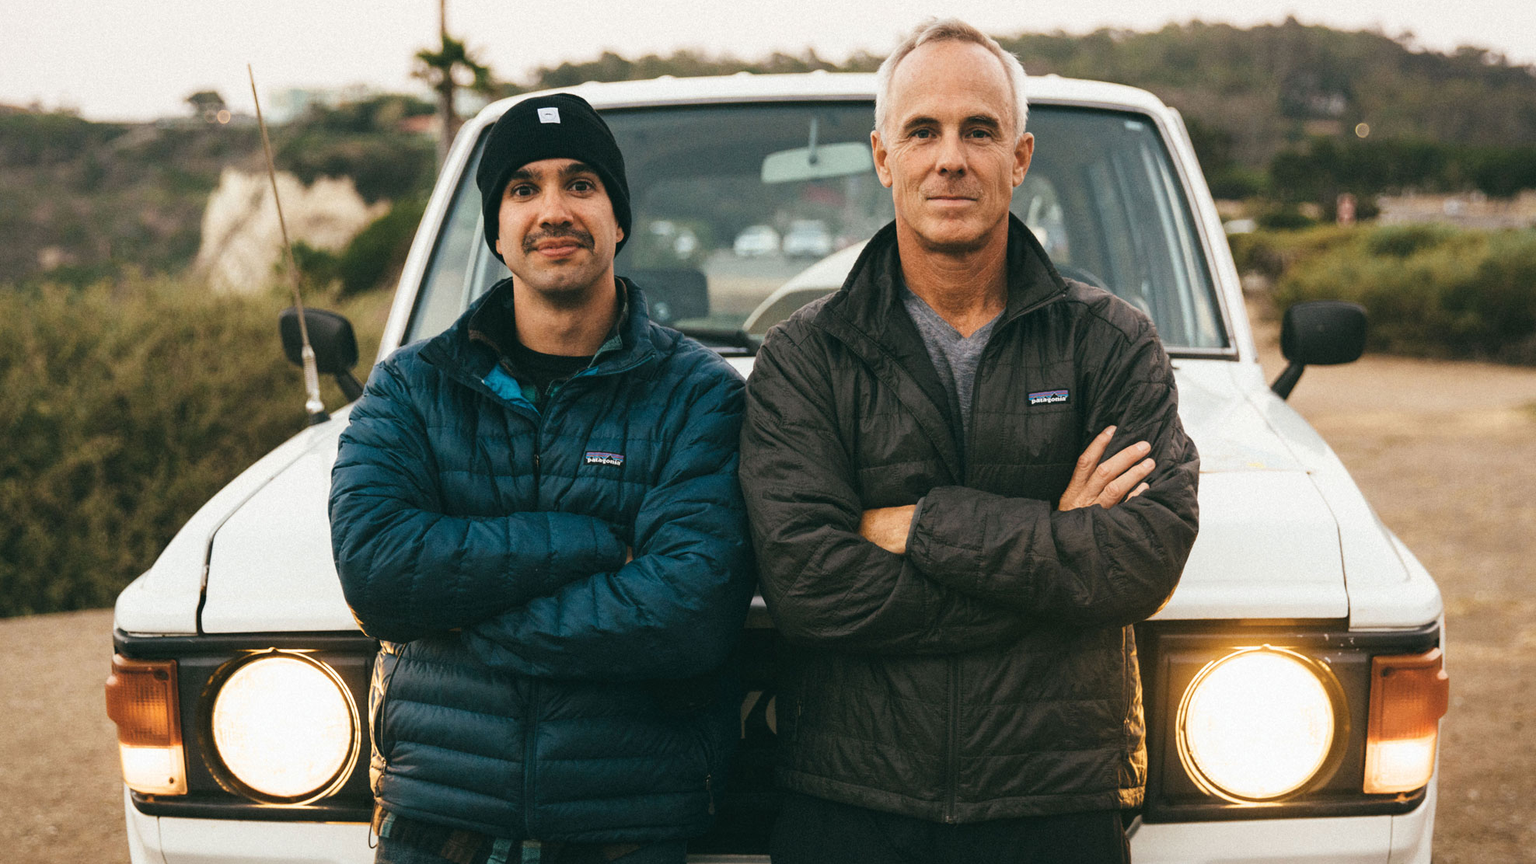
It’s why Movember exists and, together, something we can fight.
WHY WE DO IT

Slide 9


Slide 10

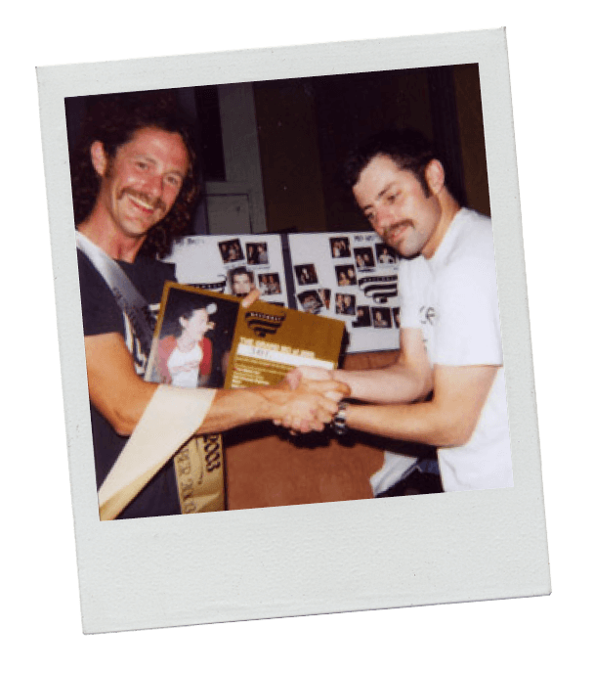
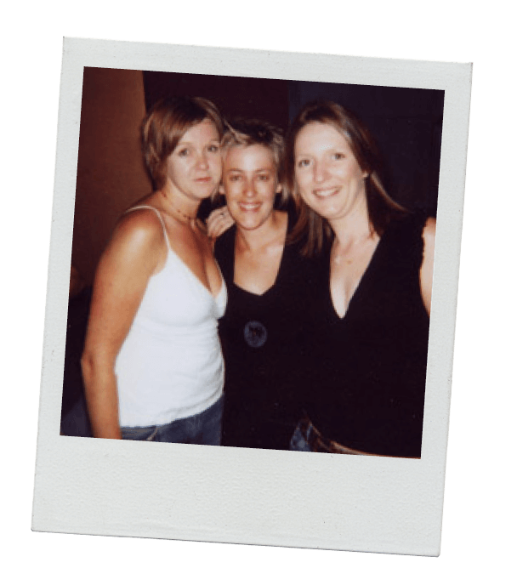
HOW WE STARTED
2003
IT STARTED WITH A CHAT
MATES HAVING A CHAT AND SEEING WHERE IT GOES. THAT’S A PROPER GOOD CHAT.
AND THAT’S HOW MOVEMBER STARTED.
TWO FRIENDS CATCHING UP OVER DRINKS, THINKING, WHAT WOULD HAPPEN IF THE
MOUSTACHE MADE A COMEBACK.
Notes:
What started between two mates as a chat about long-forgotten fashion trends quickly turned into a hairy challenge: after decades of hibernation, could the moustache make a comeback?
Could they, with a ragtag rabble of friends, bring it back into fashion?
Thirty guys threw their top lips in the ring, kicking off the first unofficial Movember.
And, well, the rest is history.

Slide 11

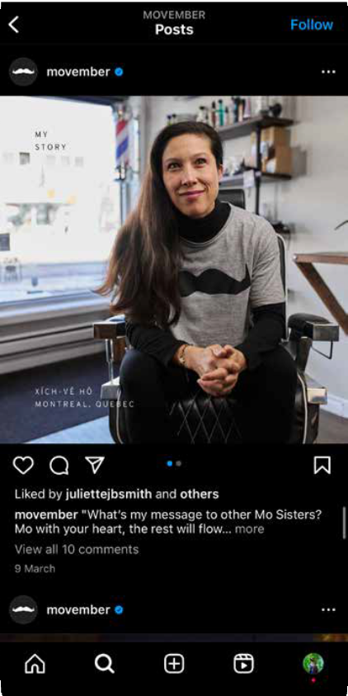
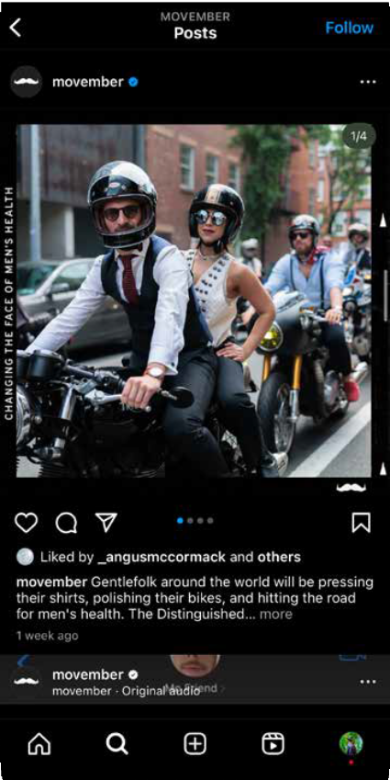

HOW WE STARTED
2023
TWO DECADES LATER:
GIF HERE
IT’S CREATED A VITAL COMMUNITY WORLDWIDE THAT’S HELPED RAISE AUD $1 BILLION FOR MEN’S HEALTH GLOBALLY
1 BILLION
Notes:
Over 20 years in we’re still going from strength to strength
Huge sums of money raised already, but work still to do
It’s now time for a new and future-proofed approach to ensure we’re making maximum impact on men’s health

Slide 12


Slide 13


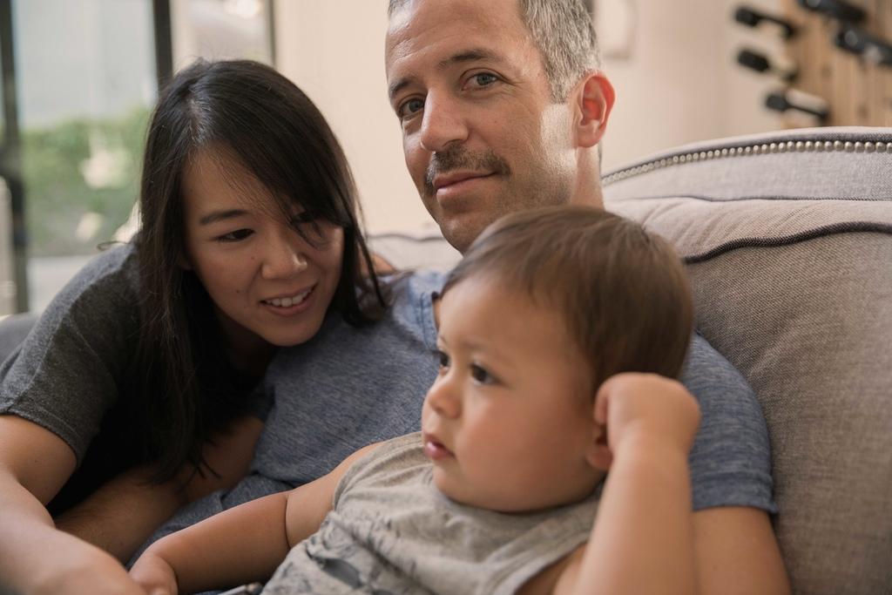

WHY WE DO IT
MENTAL HEALTH AND SUICIDE PREVENTION
TESTICULAR CANCER
PROSTATE CANCER
IT’S THE NUMBER 1 CANCER AMONG YOUNG GUYS
1 IN 8 MEN WILL GET IT. WE’RE WORKING TOWARDS A WORLD
WHERE NO MAN DIES FROM IT
EVERY MINUTE OF EVERY DAY ONE MAN DIES GLOBALLY BY SUICIDE
Notes:
Globally, one man dies by suicide every single minute
1 in 8 men will be diagnosed with prostate cancer in their lifetime
Testicular cancer is the most common cancer amongst young men

Slide 14


Slide 15
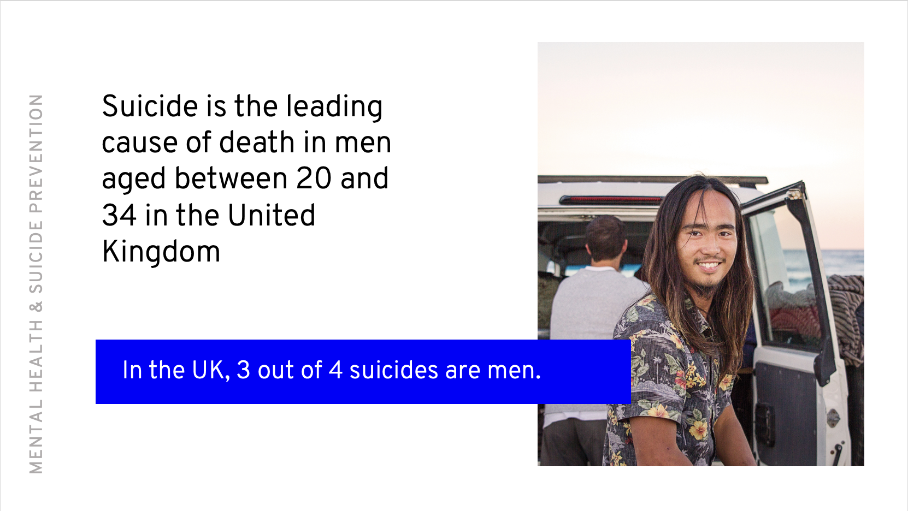
Notes:
Mental health. It’s a topic that is often misunderstood and comes with a lot of stigma attached.
Mental health is your mood, how you’re feeling, how you’re able to cope with your day-to-day and life events.
And, just as your life and circumstances continually change, so too do your moods and thoughts, and your sense of wellbeing or self-worth.
We want ALL men and boys feeling mentally healthy and taking appropriate action during tough times, backed and understood by their friends, family and community.
Globally, the rate of suicide is alarmingly high: one man dies every minute somewhere in the world.
In the UK suicide is the leading cause of death in men aged 20-32 and ¾ of mental health conditions start before the age of 14, this is why it’s so important to start these discussions now
Too many ‘tough it out’ and struggle alone.
We have to take action to improve mental health and reduce the rate of male suicide.
We want to raise awareness around this issue.

Slide 16

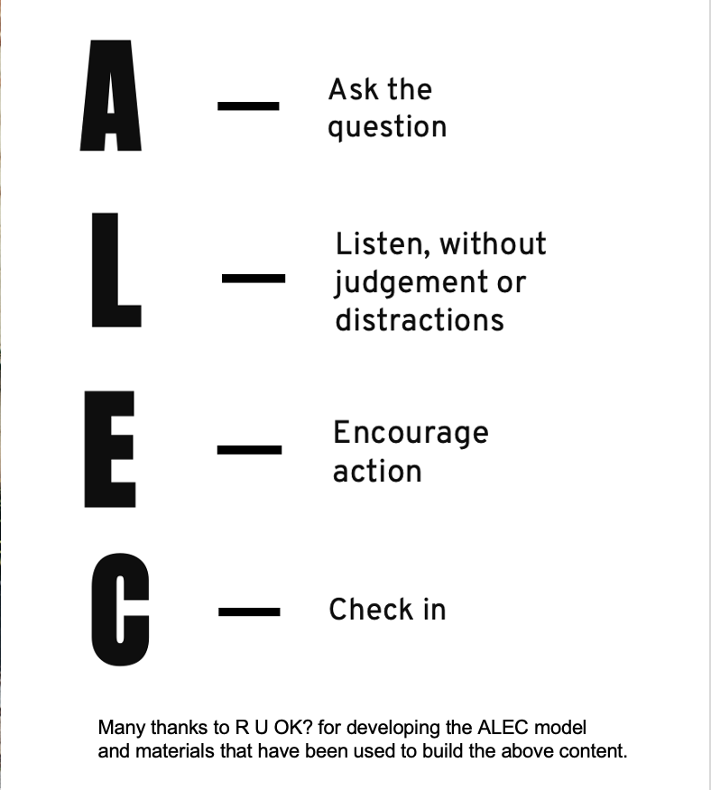
ALEC

Slide 17
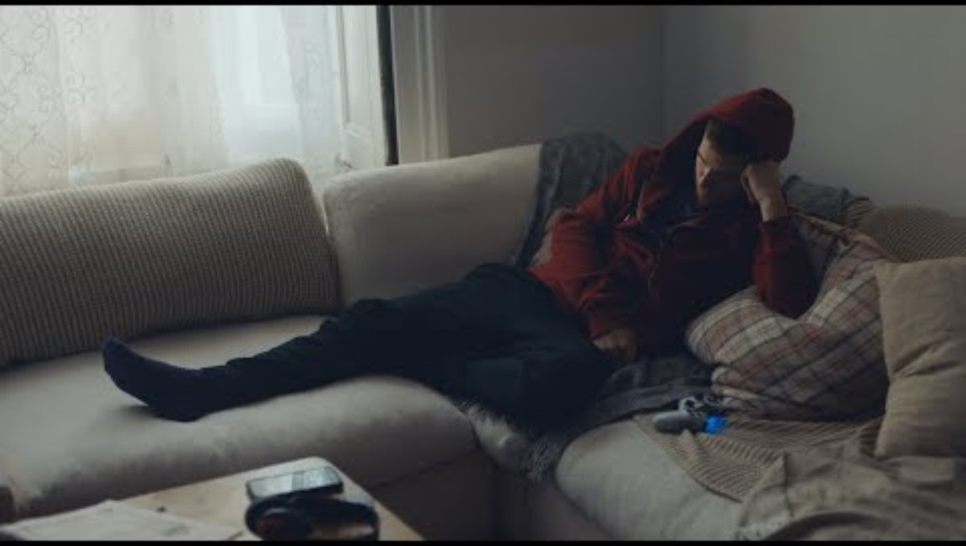
Notes:
Spot the signs video
A change in behaviour or becoming withdrawn could be a sign that someone is struggling, don’t ignore it and have a conversation
PLAY: https://youtu.be/z85nNubbt4o

Slide 18


Slide 19
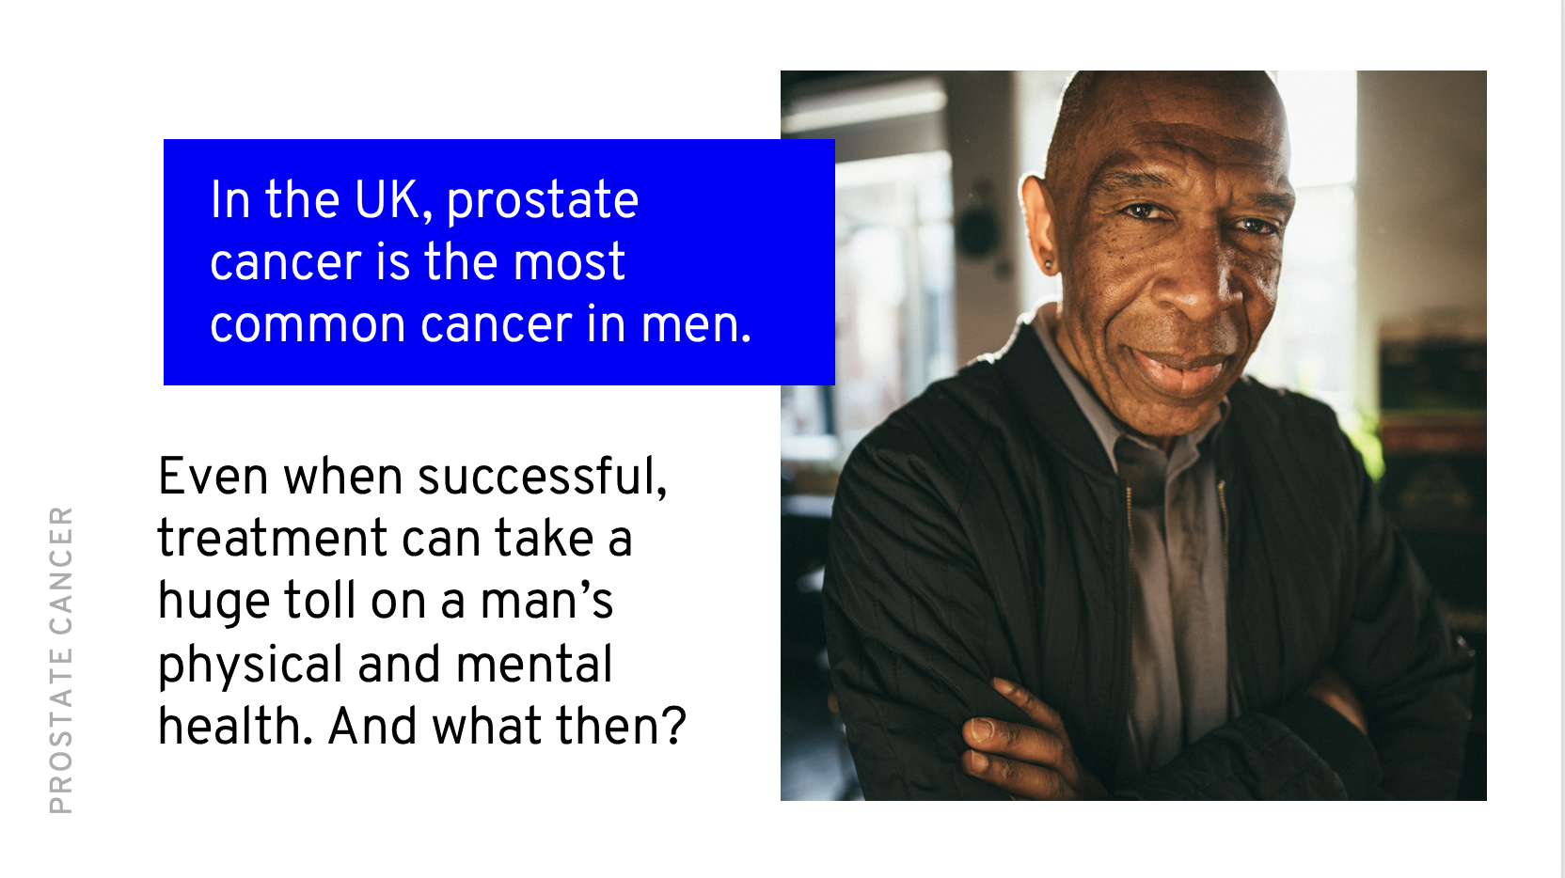
Notes:
Prostate Cancer is as sizeable an issue for men as breast cancer is for women – yet until recently it has received far less attention.
15 years ago general awareness of prostate cancer was low, and research to understand the disease was underfunded.
Prostate cancer research and treatment has come a long way in the past two decades. Survival rates have increased dramatically.
But it’s still the most commonly diagnosed cancer among men in the UK.

Slide 20
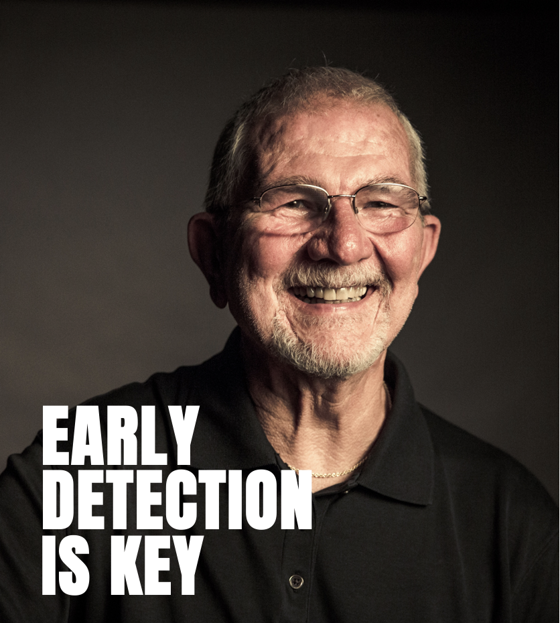
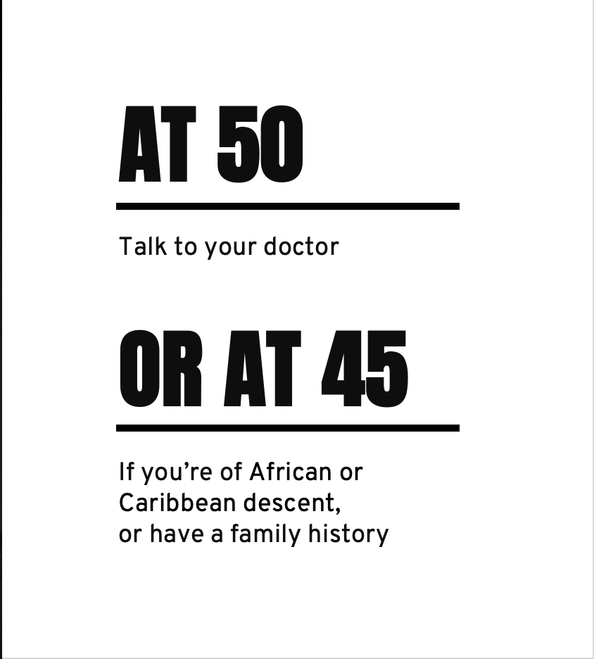
Notes:
And if there is one thing to remember about prostate cancer it is that “EARLY DETECTION IS KEY”
Early detection (when cancer is isolated to prostate) leads to 98% survival rate; whereas later detection (when cancer has moved outside the prostate, usually to bones) survival rate drops drastically to 26%.
Know what you need to do, and when. If you’re 50, you should be talking to your doctor about PSA testing. If you’re of African or Caribbean descent ­– or if you have a brother or father with prostate cancer in their history – you need to have that conversation at 45.
The great news is that more men are surviving prostate cancer, but treatment can take a huge toll on a man's physical and mental health, so that is why Movember have invested in programmes to help improve quality of life for these men, and their partners and/or caregivers.

Slide 21


Slide 22
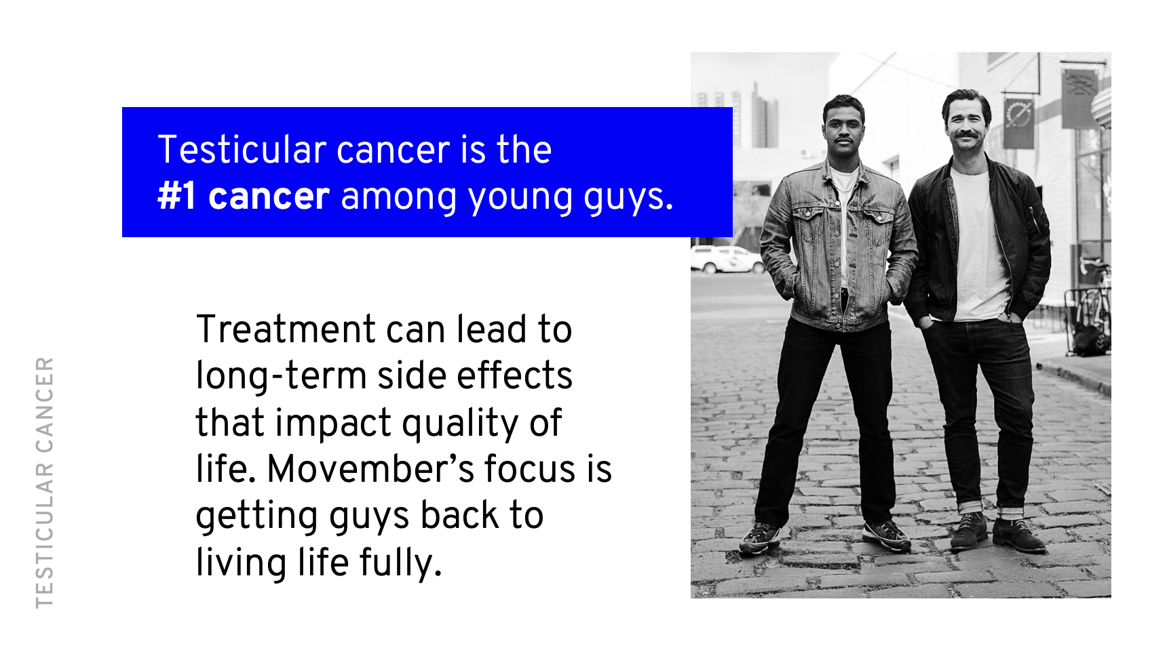
Notes:
Why testicular cancer?
Many people don’t realise that testicular cancer is the most commonly diagnosed cancer in young men.
And while survival rates are better than good for most men, treatment can lead to long-term side effects that can have a huge impact on a man’s quality of life.
Movember’s focus is to get these guys back to living life fully.

Slide 23
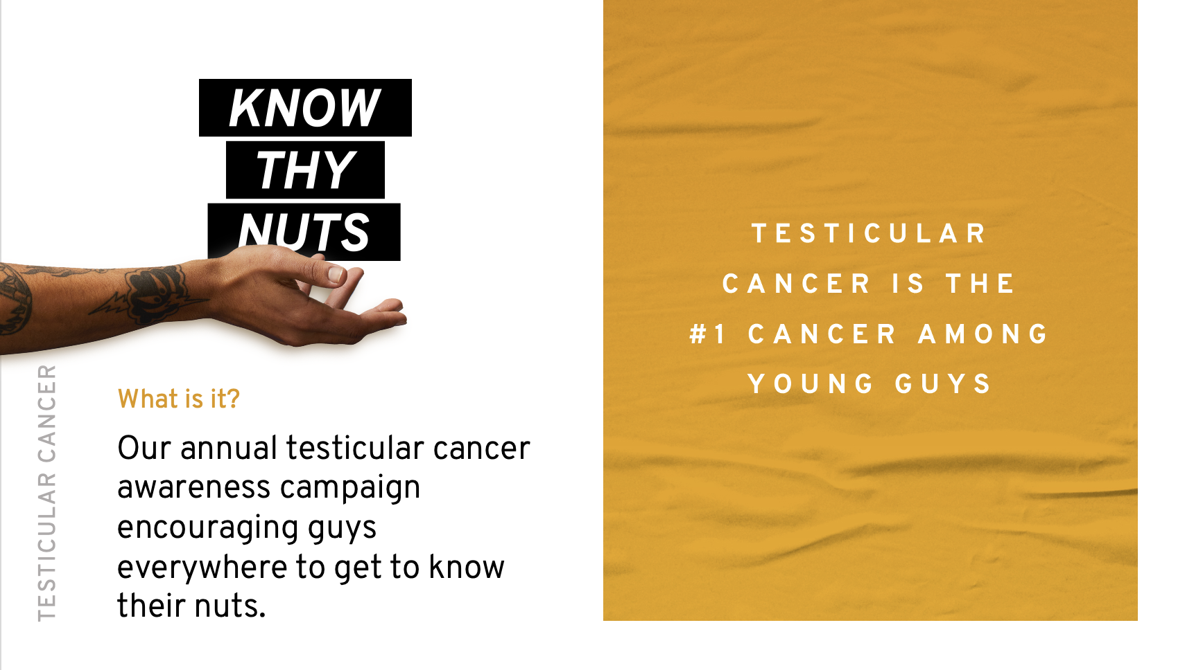
Notes:
Whilst testicular cancer has a high survival rate (95-98%), it is important to catch it early.
So, Movember want to educate men and boys on what to look out for and when to see a doctor, this when the Know Thy Nuts campaign steps in.
What is it?
Know Thy Nuts is Movember’s annual testicular cancer awareness campaign in April.
Know Thy Nuts is about men and boys getting to know what’s normal for their nuts and what’s not, learning how to check them and how often.

Slide 24
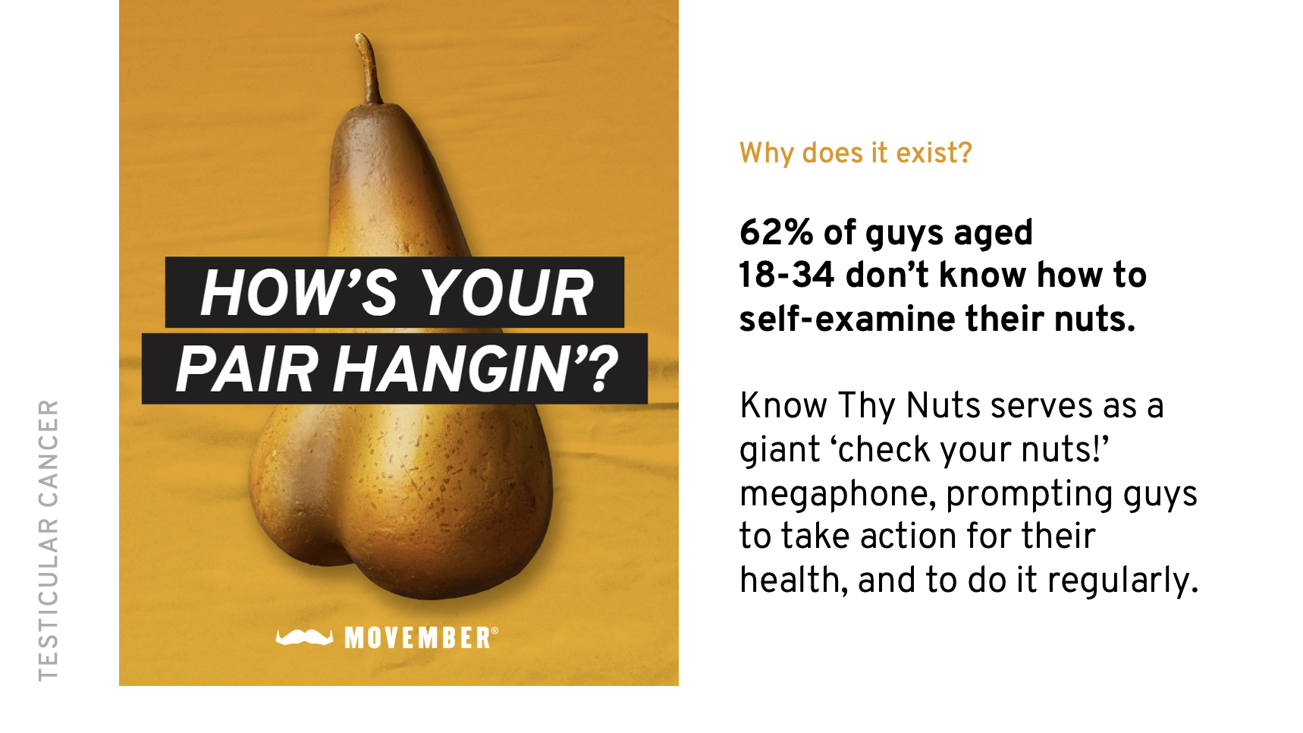
Notes:
Why does it exist?
A recent global study found that 62% of guys aged 18-34 (testicular cancer’s most at-risk group) didn’t know how to self-examine their nuts.
Know Thy Nuts aims to serve as a giant ‘check your nuts’ megaphone, prompting guys to take action for their health regularly.

Slide 25


Slide 26

IMPACT
Notes:
This video highlights just a few youth programmes that Movember is proud to fund

Slide 27


Slide 28

FUNDRAISING
Notes:
Here is a video showcasing what was made possible in 2024!

Slide 29
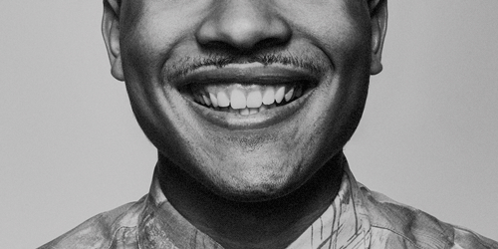
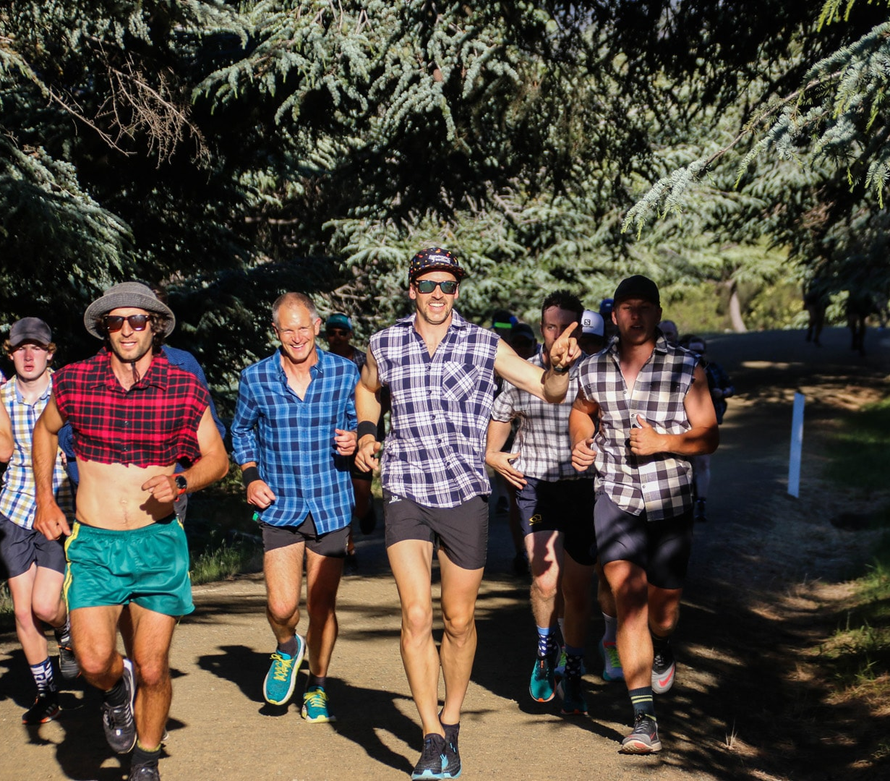
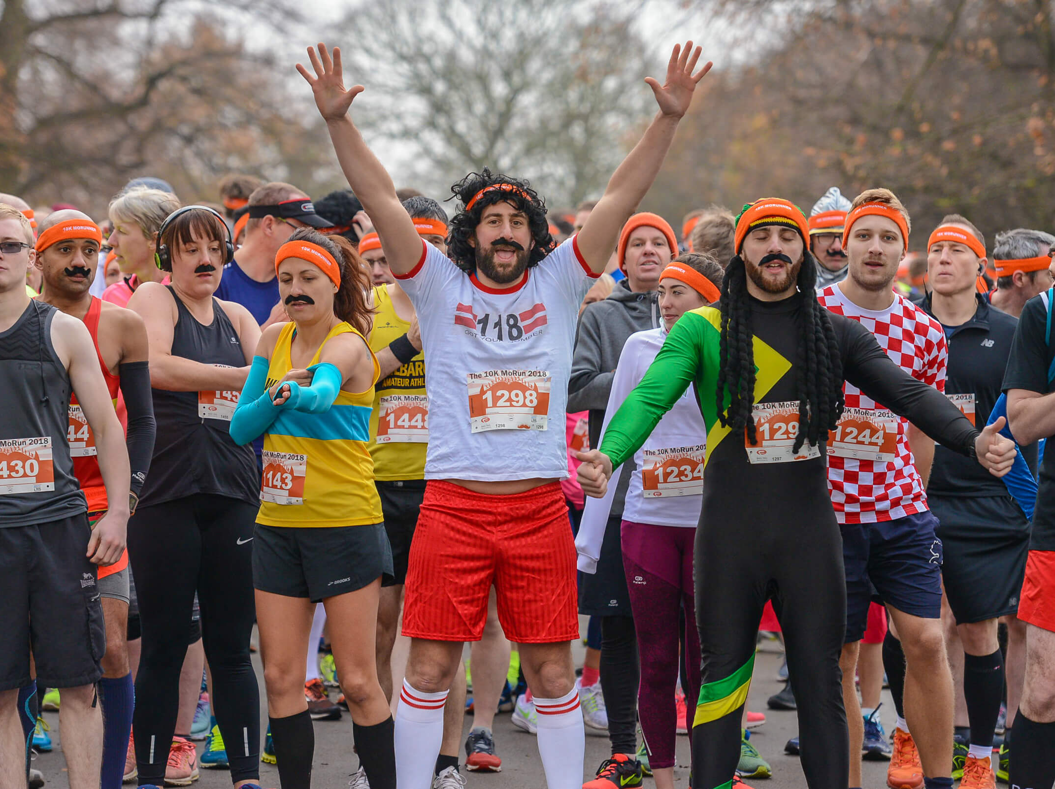
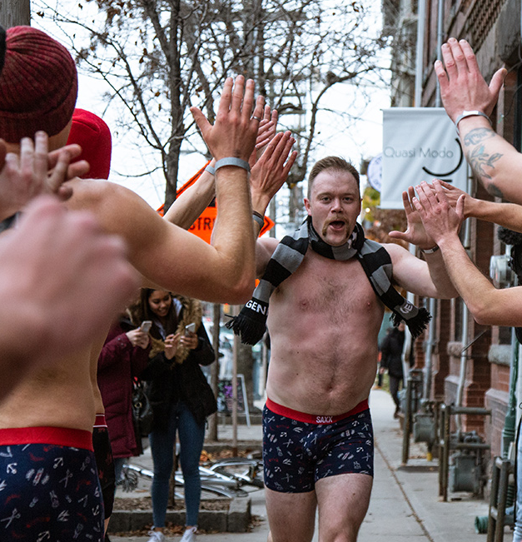
FUNDRAISING PRODUCTS
GROW
MOVE
GROW
GROW
MOVE
MOVE
THE MOST IMPORTANT MO
YOU’LL EVER GROW
RUN OR WALK 60KM FOR THE
60 MEN LOST TO SUICIDE EACH
HOUR WORLDWIDE.
Notes:
TIPS TO HELP YOU GROW
BE PREPARED Choose the moustache that will grace your face. Trucker, regent, connoisseur or wisp? Check out the options at movember.com
BE BRAVE The first few days, even weeks, can be uncomfortable as your Mo takes shape. Ride it out to encourage donations.
IGNORE THE ITCHING Remind yourself that men have endured worse in the past. You can stand a little face tickle.
SHAPE YOUR MOUSTACHE Get across all the proper grooming techniques. A great Mo comes down to great grooming.
NURTURE IT AND KEEP IT CLEAN Look after your Mo, and your Mo will look after you.
Drive donations
The highest donor on your Mo Space gets to choose what shape you grow.
Post your daily progress on FB to encourage donations and let people know how you’re getting on.
Have a non-uniform day where everyone comes as their favourite moustachioed character.
Use our Mo activity sheet to decorate and cut out your own Mo to wear for a day
HERE’S HOW:
SIGN UP AT MOVEMBER.COM Choose to Grow this Movember.
START GROWING Start clean-shaven, then let your Mo take the spotlight and start conversations.
MAKE IT COUNT Ask friends, colleagues and family to back your Mo by donating. Together, we can stop men dying too young.
MOVE
Get some friendly competition going and see who can reach their 60km targets first – teachers or students?
Give rewards at the end of the month for whoever covered the most kilometres throughout the month
Kick things off at the beginning of the month with an inter class 100m dash race – with all kilometres going towards your school total
HERE’S HOW:
SIGN UP AT MOVEMBER.COM And choose to Move for men’s health.
CHIP AWAY YOUR WAY Hit it fast. Take it slow. Run solo. Join a team. Go outside. Or jump on the treadmill.
MAKE IT COUNT Call on friends, colleagues and family to back you with a donation, and change the face of men’s health.

Slide 30
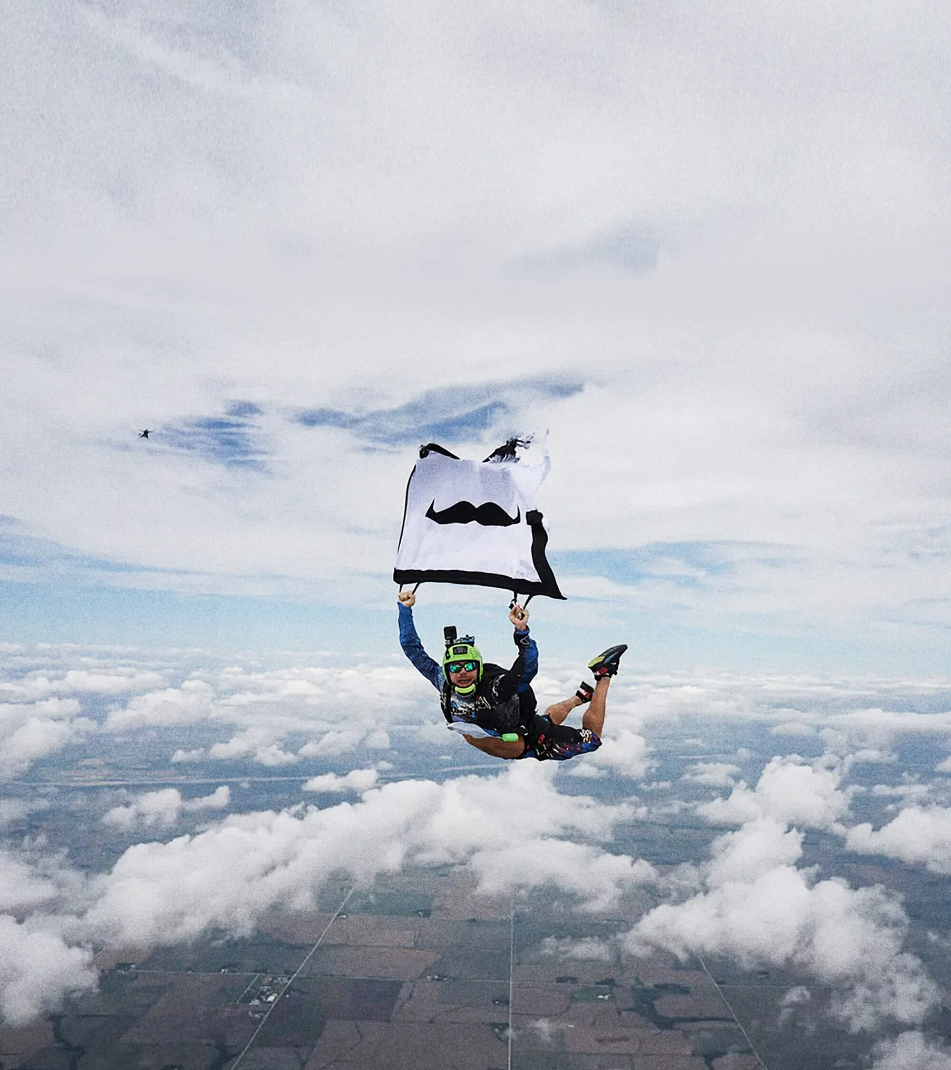
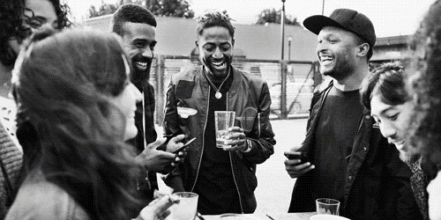
FUNDRAISING
HOST
HOST
HOST
MO YOUR
OWN WAY
IT’S ALL ABOUT
HAVING A GOOD TIME
FOR A GOOD CAUSE.
CHOOSE YOUR OWN ADVENTURE. THEN SEE HOW FAR YOU CAN
TAKE IT.
Notes:
Hosting is the perfect chance to come together as a school and raise much-needed funds for men’s health.
Everybody loves a Quiz (don’t they?). You could book your school dining room or hall for a night of quizzing in the name of Movember. Or host a virtual quiz over zoom or google hangouts, and invite all parents to text their knowledge. Charge a fee for teams to enter.
Bake sales are a sure-fire way to bring in some cash and add a little sweetness to the day to day. Or host a bake off where parents and friends donate to who they think should win.
Release your inner Mo Farah, with a house sports competition. Pay to enter and be in it to win it for your house colours
MO-MENTS
WORTH HOSTING
Talent Show
Quiz night – staff v students
Gaming tournament
Mo Olympics
Sports matches
HERE’S HOW:
SIGN UP AT MOVEMBER.COM And choose to Host for men’s health.
CHIP AWAY YOUR WAY Hit it fast. Take it slow. Run solo. Join a team. Go outside. Or jump on the treadmill.
MAKE IT COUNT Call on friends, colleagues and family to back you with a donation, and change the face of men’s health.
MO YOUR OWN WAY
Our ‘catch-all’ product for the marathon runners, the mountain climbers and the baked-bean-bathers
Over the years our community truly have gone above and beyond - Mo Your Own Way is for those who are fundraising in their own special way
Can your school make it ‘Round the World’ in 30 days during the month of Movember? ‘Round the World’ is 40,075 km. 668 (approx.) x 60 Km. Can you hit this target as a school?
How about a steps challenge? 60km is 78,740 steps. Go slow (er) with 20,000 a week or get those running shoes out. Whatever you do, get those sponsors lined up. If you have rowing machines/bikes put on a 24-hour marathon
Which class is the fittest? Put on a bleep test tournament to find out
Perhaps give up something for the month, get sponsored to break that coffee habit
There are just some examples, but Mo Your Own Way is about supporting Movember in whatever way you want – the wackier the better. So feel free create a personalised challenge just for your school.
HERE’S HOW:
SIGN UP AT MOVEMBER.COM And choose to Mo Your Own Way for men’s health.
CHIP AWAY YOUR WAY Hit it fast. Take it slow. Run solo. Join a team. Go outside. Or jump on the treadmill.
MAKE IT COUNT Call on friends, colleagues and family to back you with a donation, and change the face of men’s health.

Slide 31
United we mo.
Notes:
Thanks for listening.
Now it’s up to you, does anyone have any good ideas for ways to get involved with Movember?
Movember Europe, registered charity in England and Wales (no. 1137948) and Scotland (no. SC041981)

