Slide 1
LEARNING TO USE EMAIL
Learning objectives:
Being able to log off and on an email account
Being able to send, receive and reply to emails
Notes:
In this course, we will learn how to use Outlook.
Many email services upgrade their services regularly. Because of this, it is possible that what you see when you are creating an account, logging in and using other functions may not look exactly like in the illustrations shown in this presentation. So try to create a user account yourself and to send and receive email with Outlook before teaching the course. If you see any changes, you should update the presentation in order to make it easier for the course participants to follow.
Go through the learning objectives with the course participants before you begin teaching. This will make it easier for them to focus on and remember the most important information.

Slide 2
Part 1
Creating an email address

Slide 3
Creating an email address
1
Notes:
In order to send and receive email, you need an email address. You get one by creating an account with an email service. This process might be a little complicated, but luckily it’s something you only have to do once. You’ll need to concentrate, but don’t worry too much about trying to memorise this part of the course.
There are a lot of email services out there. It’s possible to have more than one email address with more than one email service.
In this course, we will learn about Live Mail. Live Mail, which is owned by Microsoft, is a very popular email service.
To send and receive email, you first need to create an email address.
To create an email address, open your web browser and type in the web address of the email service.

Slide 4
Creating an email address
1
www.live.com
Notes:
The address is www.live.com.
Ask everyone to go to this address.

Slide 5
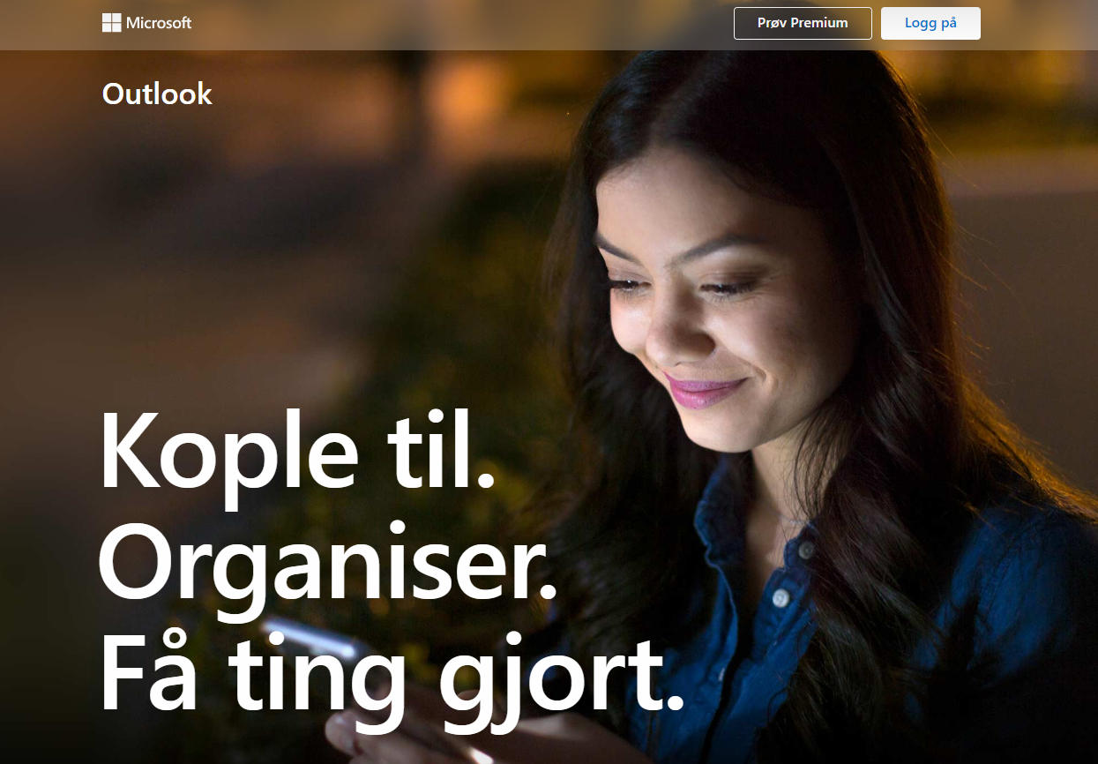
Creating an email address
1
Notes:
If you have typed in the correct address, one of these images should appear on your screen.
Make sure everyone has reached the sign-in screen before you go on.
This is the page you’ll see whenever you use your new email address, but since we don’t have email addresses yet, first we need to create accounts and sign up with the service.

Slide 6
Creating an email address
1
Notes:
Click on the link to register and create an account.

Slide 7
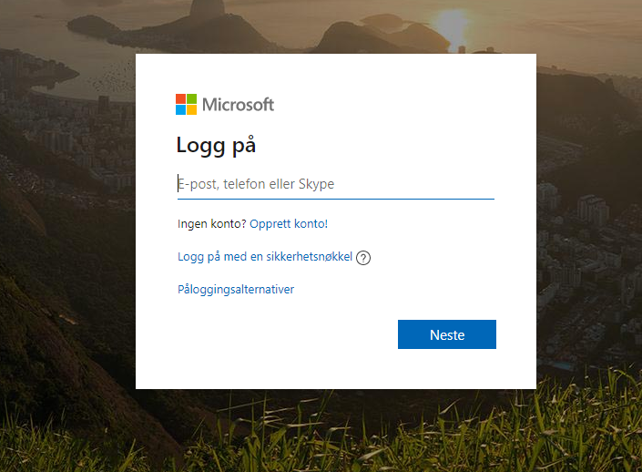
Creating an email address
1
Notes:
We have to fill in these forms to get a user account and an email address. We will go through them step by step and fill them in.

Slide 8
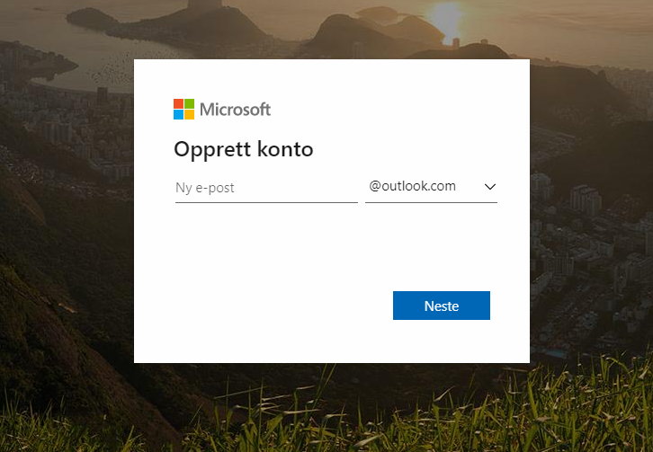
Creating an email address
1
Notes:
In the next field, we create a username. Your username is what distinguishes your email address from all other email addresses. Your username can be whatever you want it to be, but it’s a good idea to have a username that is a bit similar to your real name. That will make it easier for you and others to remember your username and your email address.

Slide 9
Creating an email address
1
æ => ae
ø => o
å => aa
navn.etternavn
Notes:
Your username cannot contain spaces or the Norwegian letters ‘æ’, ‘ø’ or ‘å’. If you want a username consisting of your first and last names, you need to replace any such letters with for instance ‘aa’ or ‘o’, and instead of a space between your first and last names, it’s common to use a full stop.

Slide 10
Creating an email address
1
Notes:
Ask everyone to try to enter a username they want to use.
When you have entered a username, press ‘Enter’ or ‘Next’ on the keyboard. The service will then check if anyone else is already using that username or if you can use it the way you have written it.

Slide 11
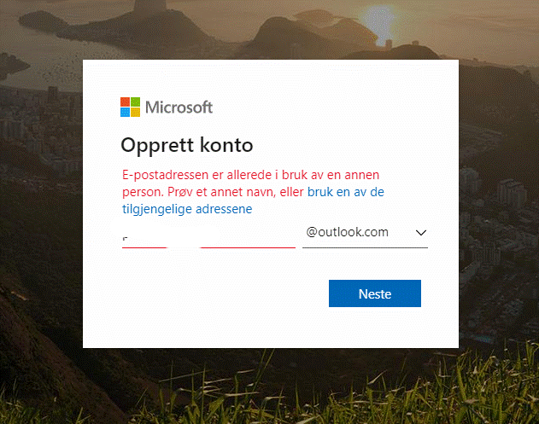
Creating an email address
1
Notes:
If someone is already using the name you have entered, a message telling you this will appear in red underneath the username field.

Slide 12
Creating an email address
1
navn.i.etternavn
navn.etternavn123
Notes:
If someone is already using this name as their username, you’ll have to change it a bit. A lot of people choose to add an initial or some numbers at the end of the name. Try until you find a name that no one else is using.
Wait for everyone to find an available username before you move on. Take the time to help anyone who has trouble finding a good username.
Now that everyone has a username, it can be a good idea to write it down so that we don’t forget it.

Slide 13
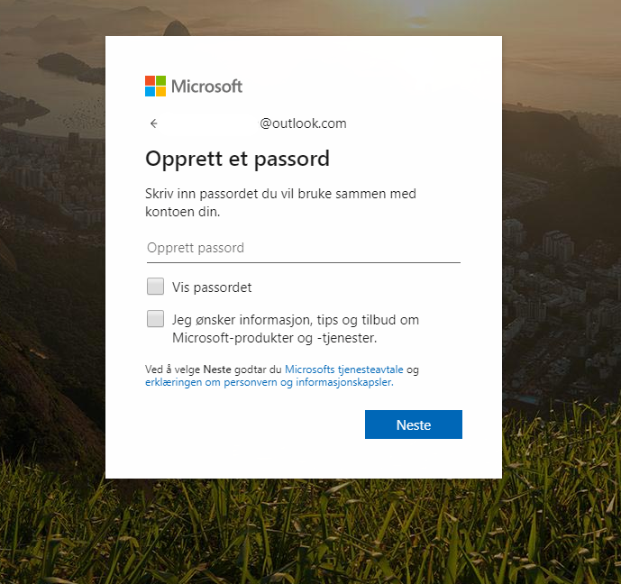
Creating an email address
1
Notes:
To create a password, tap or click on the next field.

Slide 14
Creating an email address
1
Minimum 8 tegn
Minimum 2 av disse:
STORE BOKSTAVER
små bokstaver
tall
symboler
Notes:
A password must consist of at least eight characters. A password must also contain at least two different types of characters. You password should be easy for you to remember and difficult for others to guess.
A password can be changed later, and it is possible to have a new password sent to you if you should forget yours, but the best and quickest solution is to have a password you are sure that you’ll remember.
Just like the PIN for your debit card, your password is private.
Enter the password you’d like to use. The characters in your password will not be shown on the screen as you type. Instead, you will see one black dot for each character you type in the password field. This is to prevent others from seeing your password.
When you are done, press ‘Enter’ or ‘Next’ on your keyboard.

Slide 15
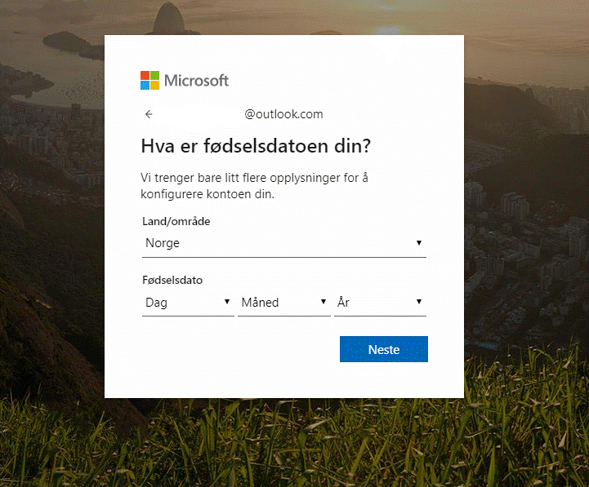
Creating an email address
1
Notes:
In the next field, we need to enter our birth month. Use the drop-down list.

Slide 16
Creating an email address
1
Notes:
Then we select the year field. Use the drop-down list.

Slide 17
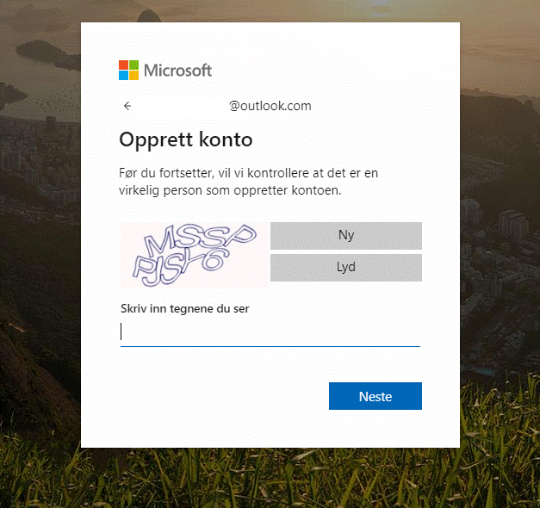
Creating an email address
1
mssppjsy6
Notes:
Further down the page, you’ll see some strange letters or a picture of some numbers. To prove to the email service that you are a real person and not a computer program, you need to type in the letters and numbers you see in the field below. Then press ‘Enter’ or ‘Next’ on your keyboard. If you have made a typing error, you’ll need to try again.
Some participants might find it difficult to read the characters shown. Take the time to help them to get it right before you go on.

Slide 18
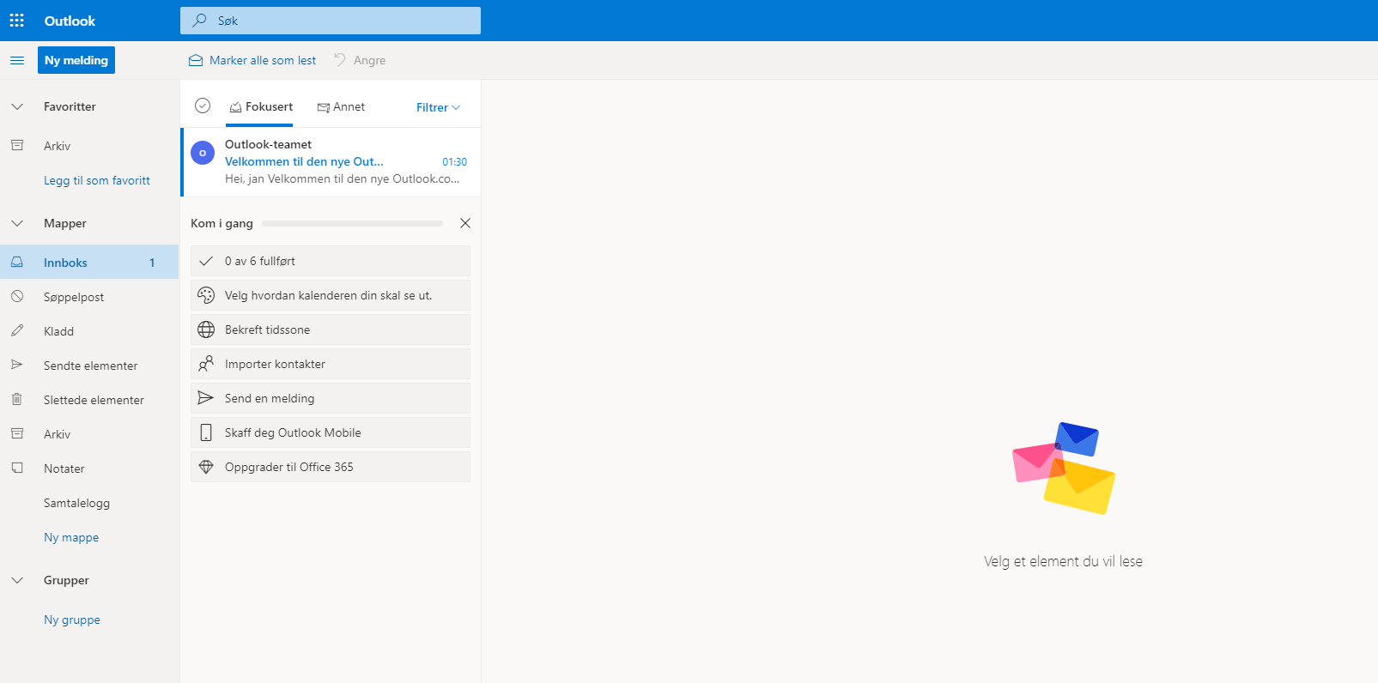
Creating an email address
1
1
Gratulerer med brukerkonto og e-postadresse!
Notes:
Congratulations! You now all have a user account and an email address.

Slide 19
Creating an email address
1
brukernavn
Notes:
Your email address is as follows:
The first part is your username.

Slide 20
Creating an email address
1
brukernavn@
Notes:
After the username comes an at sign (@). All email addresses contain this sign. This is how we distinguish an email address from a website address.

Slide 21
Creating an email address
1
brukernavn@Outlook.com
Notes:
After the at sign comes the name of the email service you’re using (in our case, Outlook or Live), followed by a full stop and the letters c-o-m.

Slide 22
Part 2
Logging in and out

Slide 23
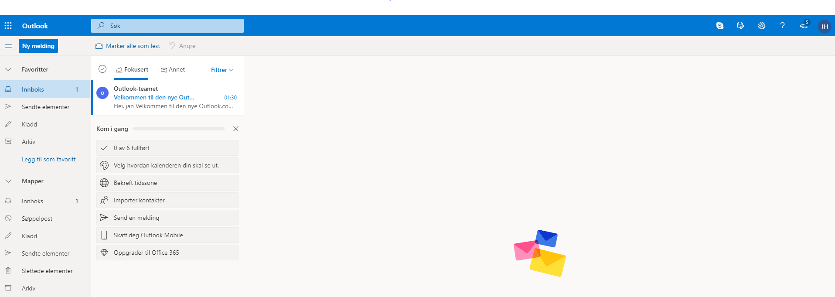
Logging in and out
2
Notes:
You are now looking at your Inbox. Different email services look a bit different, but the main features are the same. I am using a simplified version to make it easier for you to see what to do.
The inbox is where the emails people send to you end up. This is also where you can find what you need to send emails. We’ll look at that a bit later. Now, we are going to log out.
In the top right-hand corner of your Inbox you’ll see your name or email address. Click on it once.

Slide 24
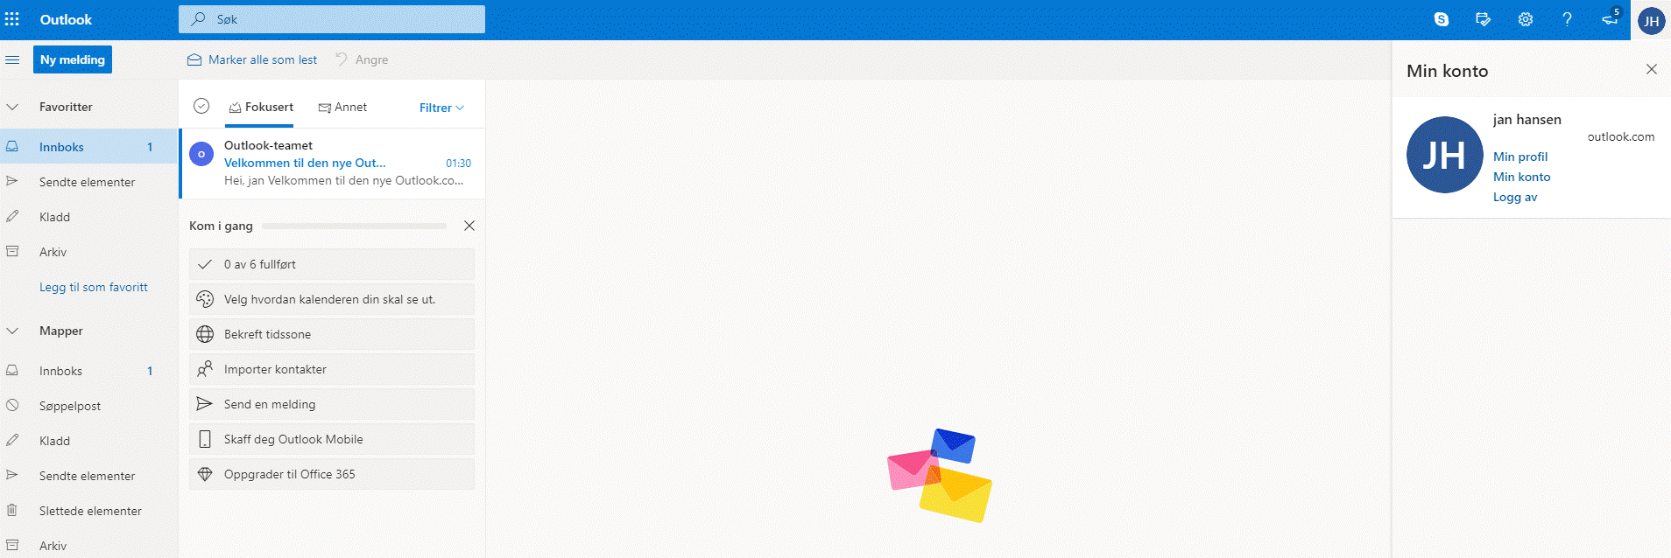
Logging in and out
2
Notes:
A menu will appear. On this menu, you’ll find an item called ‘Log out’ or ‘Sign out’. Click on that menu item to log out.

Slide 25
Logging in and out
2
www.live.com
Notes:
In this course, you are learning to log in to and use your email account in a web browser. To do this, first you have to open the web browser, then you type in the web address for the email service you use. We did this at the beginning of Part 1 of this course.
Some of you may have a program on your computer or an app on your tablet or smartphone that you can use to check your email. This is often a convenient solution. When you’ve entered your user account and password in this type of program or app once, you won’t have to enter this information each time you go in to check your email. This is a convenient solution, but it only works when you are using your own computer, smartphone or your own tablet. If you don’t have your device with you, you need to go to the web address and log in from there. This might take a bit longer to do, but the advantage is that you can then check your email on other people’s devices. Remember to sign out when you’re done so that others can’t read and send email from your account.
In this course, we learn how to use email in a web browser because this way, it makes no difference whether you use devices that belong to family members, the course facilities or others.

Slide 26
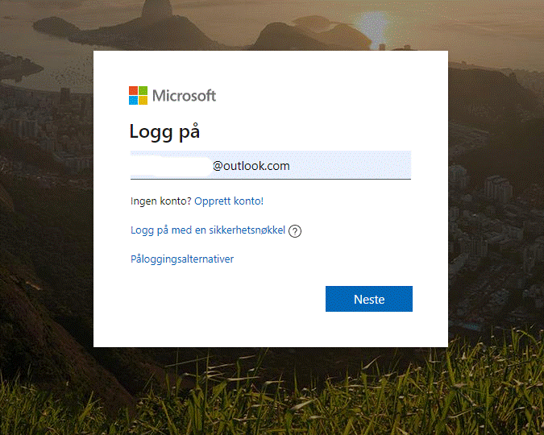
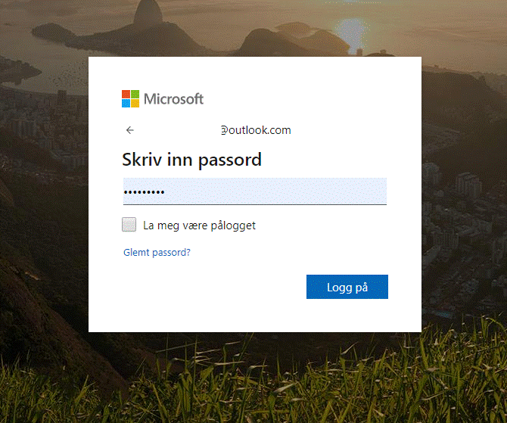
Logging in and out
2
E-postadressen
Passord
Notes:
We are now going to log out of our email accounts again.
Enter your email address in the first field and your password in the next one.

Slide 27
Logging in and out
2
Notes:
Click on the blue ‘Sign in’ button to log in.
The Inbox will now reappear.
Ask everyone to practise logging off and back in a couple of times.

Slide 28
Part 3
Sending emails

Slide 29
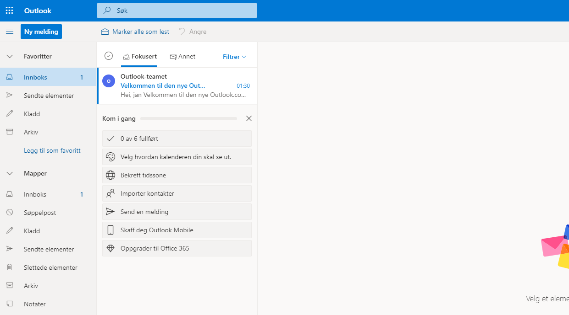
Sending emails
3
Notes:
Make sure everyone has successfully signed in.
All email services have a button you can click to begin writing a new email.
In this service, the button is located at the top of the screen, on the left.

Slide 30
Sending emails
3
Notes:
Outlook uses a blue button with a plus sign and the words ‘New email’.
Ask everyone to find and click on this button.

Slide 31
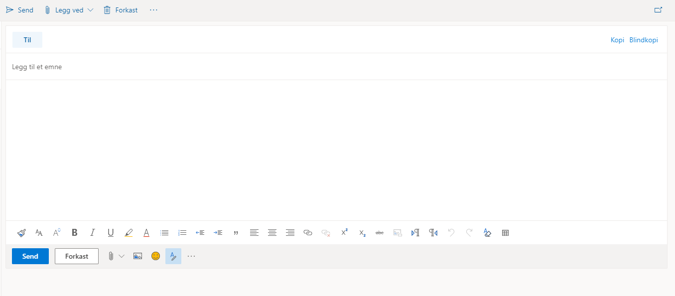
Sending emails
3
Notes:
A window will now appear in which you can write your email.

Slide 32
Sending emails
3
Notes:
This simplified window will show you all the most important features for sending an email.

Slide 33
Sending emails
3
Mottagers e-postadresse
Notes:
A ‘To’ field where you type in the email address of the recipient.

Slide 34
Sending emails
3
Mottagers e-postadresse
Hva handler e-posten om
Notes:
A ‘Subject’ field where you can write a heading for your email.

Slide 35
Sending emails
3
3
Mottagers e-postadresse
Hva handler e-posten om
I dette feltet skrives det man ønsker som en beskjed eller
som et brev, fra «Hei» til «Hilsen
Notes:
The largest section of the window is the part where you write your message or letter.

Slide 36
3
Sende e-post
Mottagers e-postadresse
Hva handler e-posten om
I dette feltet skrives det man ønsker som en beskjed eller
som et brev, fra «Hei» til «Hilsen
Notes:
Finally, there is a button to click when you want to send the email to the recipient.
To help you send your first email, we will go through and fill in all the fields step by step.

Slide 37
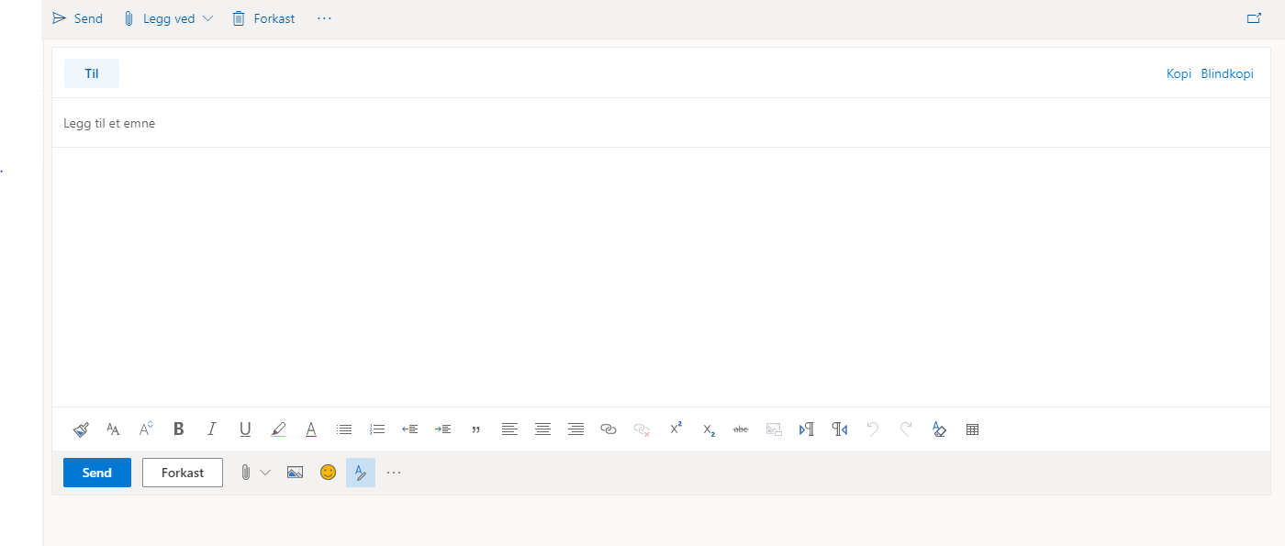
Sending emails
3
Notes:
Now you will all send an email to me.
We’ll start by filling in the email address.
Find the ‘To’ field and click in it.
My email address is: give your own email address or an email address you have created for this course. Before the course, you may want to add a slide with your email address on it to the presentation or write it on the board to make sure everyone writes it correctly.
Wait for everyone to fill in the email address before you go on.

Slide 38
Sending emails
3
Notes:
Now we can add a subject.
Find the ‘Subject’ field and click in it.
It is always a good idea to write something in the subject field. This will make it easier for the recipient to understand the purpose of the email and to find it again later.
Since you are just testing things out, you can type ‘Test’ in the subject field for this email. Type ‘Test’ in the subject field.
Make sure everyone has typed a subject in the field before you go on.

Slide 39
Sending emails
3
Notes:
We can now start writing the actual content of the email.
Click in the large blank field.
Now, please type a short message or greeting to me. Just like when you write a letter, it is polite to start with ‘Hi’ and to finish with ‘Regards’.

Slide 40
Sending emails
3
3
Notes:
When you are done writing to me, you need to click the ‘Send’ button to send the email so I can see what you have written.
The ‘Send’ button is located at the bottom left corner of the window.
Click on the ‘Send’ button.
Wait for everyone to send the email before you go on.

Slide 41
Part 4
Opening emails
Notes:
Send en e-post til alle på kurset.

Slide 42
Opening emails
4
4
Notes:
Make sure everyone has their Inbox open.
On the left side of the screen you’ll see an overview of all the folders in your email account. The most important one is the Inbox.
When you have unread emails in your Inbox, a number will appear behind where it says Inbox in the overview. If there is no number there, it means you don’t have any new emails waiting for you.

Slide 43
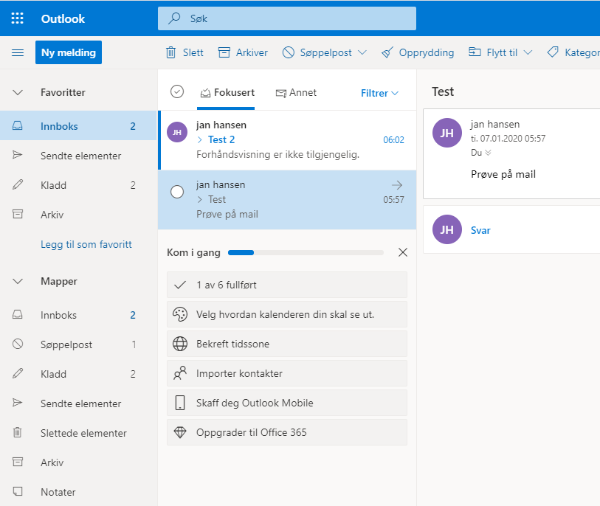
Opening emails
4
Notes:
The main part of the screen contains a list of all the emails you have received. The most recent emails will be at the top of the list. The oldest ones will be at the bottom.
Each email contains the name or email address of the sender as well as the title of the email (what the sender has written in the subject field).
Unopened emails will be displayed in bold font.
To open an email and read the contents, click once on either the name of the sender or the heading.

Slide 44
Opening emails
4
Notes:
To open an email, click on the name of the sender or the heading.
Ask everyone to click on one of the emails in their Inbox.

Slide 45
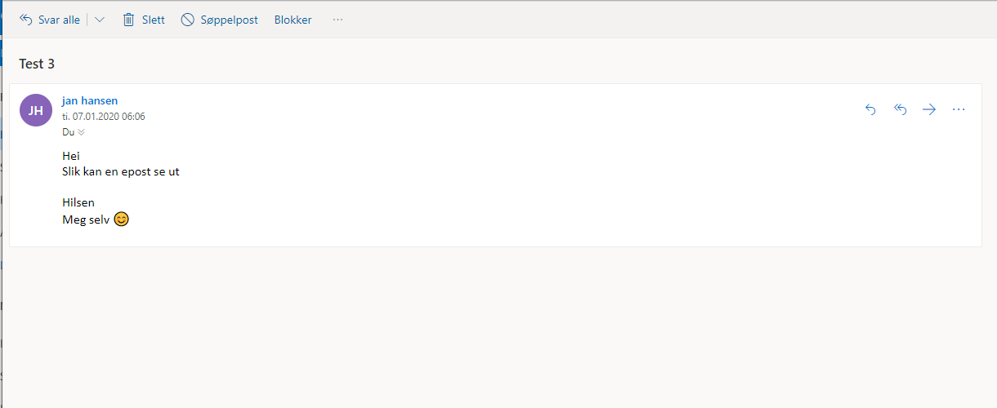
Opening emails
4
Notes:
A typical email in Outlook looks like this.

Slide 46
Opening emails
4
Tittel
Notes:
The heading of the email is on top.

Slide 47
Opening emails
4
Avsender
Notes:
Then you see the name and/or email address of the person who sent you the email.

Slide 48
Opening emails
4
Beskjeden fra avsender
Notes:
Below that, you’ll see the message from the sender.

Slide 49
Opening emails
4
Notes:
To return to the Inbox and the list of all your emails, click ‘Inbox’ in the menu to the left on your screen.
Make sure everyone is back in their Inbox before you go on.

Slide 50
Opening emails
4
Notes:
You will also see that the email you have opened is no longer shown in bold font.

Slide 51
Part 5
Replying to emails
Notes:
Send en e-post til alle på kurset.

Slide 52
Replying to emails
5
Notes:
To reply to an email, select it from the list in your Inbox.
You should all have received an email from me in reply to the email you sent me earlier. Some of you might have looked at it already.
Find it in the list in your Inbox, and click on it.

Slide 53
Replying to emails
5
Notes:
To send me a reply, Gmail users will need to click in the blank field at the bottom of the window where it says ‘Click here to reply or forward’.

Slide 54
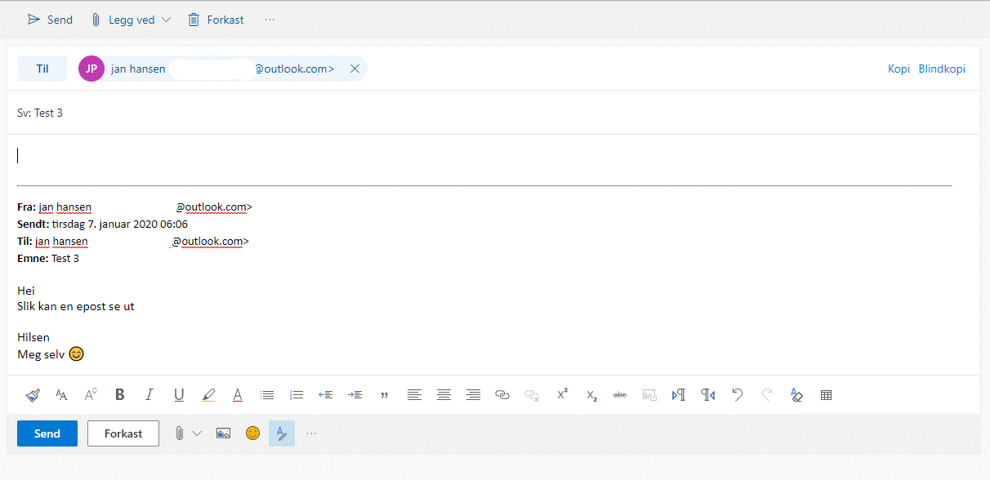
Replying to emails
5
5
brukernavn@e.post.no
Re: Tema
Notes:
A reply email is like a new email, except that the ‘To’ and ‘Subject’ fields are already filled in.

Slide 55
5
Svare på e-post
Notes:
Also, the text from the email you’re replying to will be visible above or below the field where you will write your reply.

Slide 56
Replying to emails
5
Notes:
All you have to do is write your reply.

Slide 57
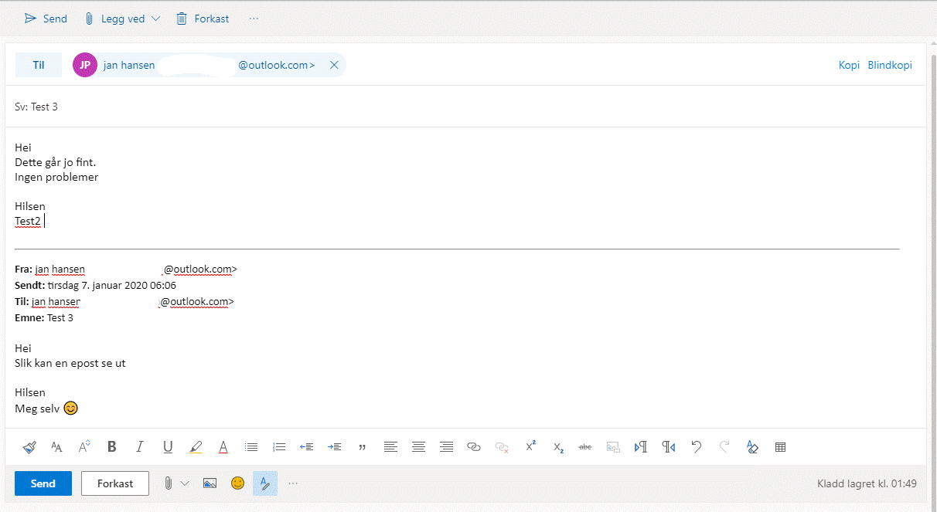
Replying to emails
5
Notes:
This is what it typically looks like in Outlook.

Slide 58
Replying to emails
5
Notes:
This is the text from the sender.

Slide 59
Replying to emails
5
Notes:
And this is where you write your reply.

Slide 60
Replying to emails
5
Notes:
When you are done writing your reply, hit the ‘Send’ button.

Slide 61
Ferdig – godt jobba alle sammen!
Nå kan dere øve på:
Be om e-postadressen til sidemannen din slik at dere kan øve på å sende e-post til hverandre, åpne og svare på hverandres e-poster
Logg av og på e-postkontoen din
Lukk nettleseren helt, åpne den igjen, skriv inn adressen til e-posttjenesten og logg den inn på nytt
Øv hjemme:
Finn noen å øve med som du kan sende og motta e-post fra
Notes:
THAT'S IT!

