Slide 1
LEARNING TO USE EMAIL
Learning objectives:
Being able to log off and on an email account
Being able to send, receive and reply to emails
Notes:
In this course, we will learn how to use Gmail.
Many email services upgrade their services regularly. Because of this, it is possible that what you see when you are creating an account, logging in and using other functions may not look exactly like in the illustrations shown in this presentation. For this reason, you should try to create a user account yourself and to send and receive email via Gmail before teaching the course. If you see any changes, you should update the presentation in order to make it easier for the course participants to follow.
Go through the learning objectives with the course participants before you begin teaching. This will make it easier for them to focus on and remember the most important information.

Slide 2
Part 1
Creating an e-mail address

Slide 3
Creating an e-mail address
1
Notes:
In order to send and receive email, you need an email address. You get one by creating an account with an email service. This process might be a little complicated, but luckily it’s something you only have to do once. You’ll need to concentrate, but don’t worry too much about trying to memorise this part of the course.
There are a lot of email services out there. It’s possible to have more than one email address with more than one email service.
In this course, we will learn about Gmail. Gmail, which is owned by Google, is a very popular email service.
To send and receive email, you first need to create an email address.
To create an email address, open your web browser and type in the web address of the email service.

Slide 4
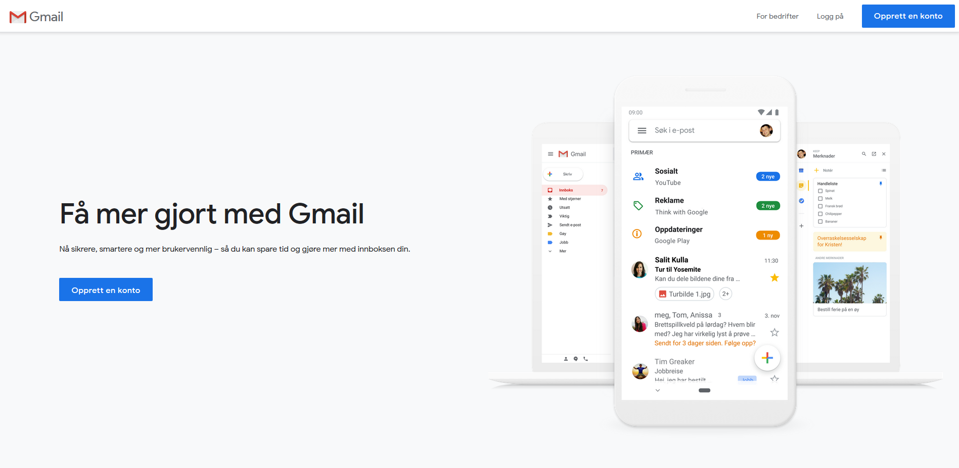
Creating an e-mail address
1
Notes:
Gmail’s address is www.gmail.com.
Ask everyone to go to this address.

Slide 5
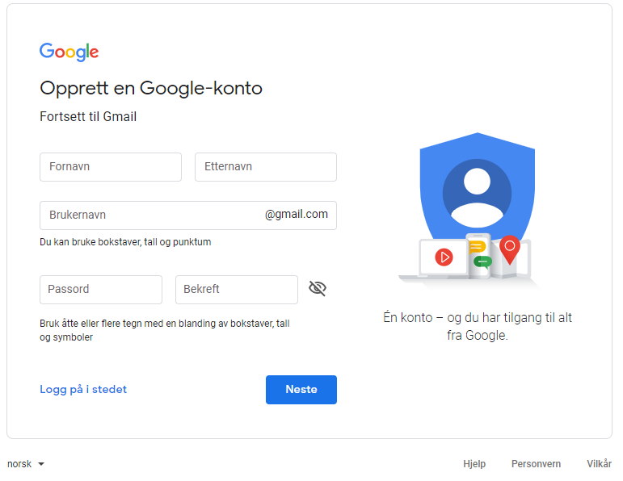
Creating an e-mail address
1
Notes:
If you have typed in the correct address, one of these images should appear on your screen.
Make sure everyone has reached the sign-in screen before you go on.
This is the page you’ll see whenever you use your new email address, but since we don’t have email addresses yet, first we need to create accounts and sign up with the service.

Slide 6
Creating an e-mail address
1
Notes:
To type in a field, first you have to tap or click on it. Tap or click on the field at the top. Write your first name here.

Slide 7
Creating an e-mail address
1
Notes:
Click on or tap the ‘last name’ field, and enter your last name.

Slide 8
Creating an e-mail address
1
Notes:
In the next field, we create a username. Your username is what distinguishes your email address from all other email addresses. Your username can be whatever you want it to be, but it’s a good idea to have a username that is a bit similar to your real name. That will make it easier for you and others to remember your username and your email address.

Slide 9
Creating an e-mail address
1
æ => ae
ø => o
å => aa
navn.etternavn
Notes:
Your username cannot contain spaces or the Norwegian letters ‘æ’, ‘ø’ or ‘å’. If you want a username consisting of your first and last names, you need to replace any such letters with for instance ‘aa’ or ‘o’, and instead of a space between your first and last names, it’s common to use a full stop.

Slide 10
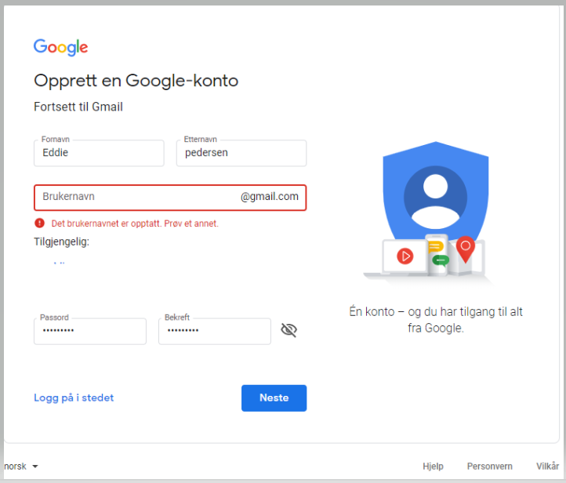
Creating an e-mail address
1
Notes:
If someone is already using the name you have entered, a message telling you this will appear in red underneath the username field.

Slide 11
Creating an e-mail address
1
navn.i.etternavn
navn.etternavn123
Notes:
If someone is already using this name as their username, you’ll have to change it a bit. A lot of people choose to add an initial or some numbers at the end of the name. Try until you find a name that no one else is using.
Wait for everyone to find an available username before you move on. Take the time to help anyone who has trouble finding a good username.
Now that everyone has a username, it can be a good idea to write it down so that we don’t forget it.

Slide 12
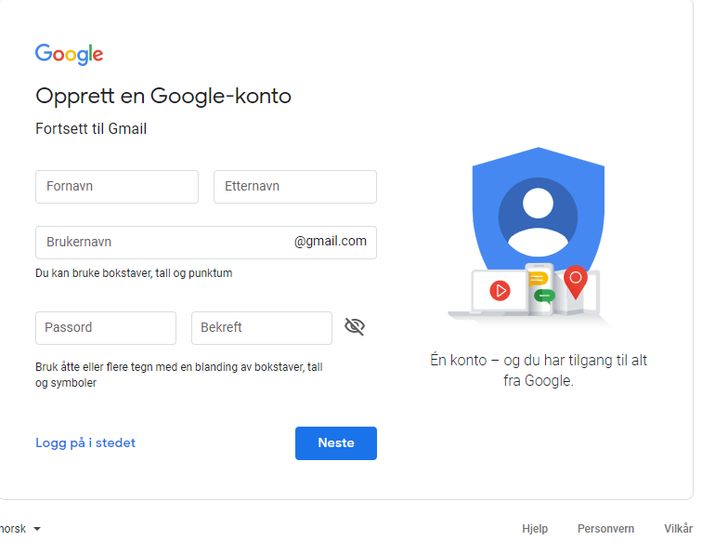
Creating an e-mail address
1
Notes:
To create a password, tap or click on the next field.

Slide 13
Creating an e-mail address
1
Minimum 8 tegn
Minimum 2 av disse:
STORE BOKSTAVER
små bokstaver
tall
symboler
Notes:
A password must consist of at least eight characters. A password must also contain at least two different types of characters. You password should be easy for you to remember and difficult for others to guess.
A password can be changed later, and it is possible to have a new password sent to you if you should forget yours, but the best and quickest solution is to have a password you are sure that you’ll remember.
Just like the PIN for your debit card, your password is private.
Enter the password you’d like to use. The characters in your password will not be shown on the screen as you type. Instead, you will see one black dot for each character you type in the password field. This is to prevent others from seeing your password.
When you are done, press ‘Enter’ or ‘Next’ on your keyboard.

Slide 14
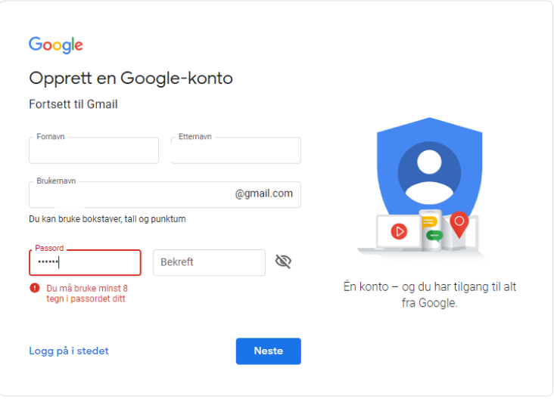
Creating an e-mail address
1
Notes:
If your password isn’t long enough or doesn’t contain enough different characters, you will see this message. If this happens, try again.

Slide 15
Creating an e-mail address
1
Minimum 8 tegn
Minimum 2 av disse:
STORE BOKSTAVER
små bokstaver
tall
symboler
Notes:
Remember to stick to the rules. Wait for everyone to type in a valid password before you go on.

Slide 16
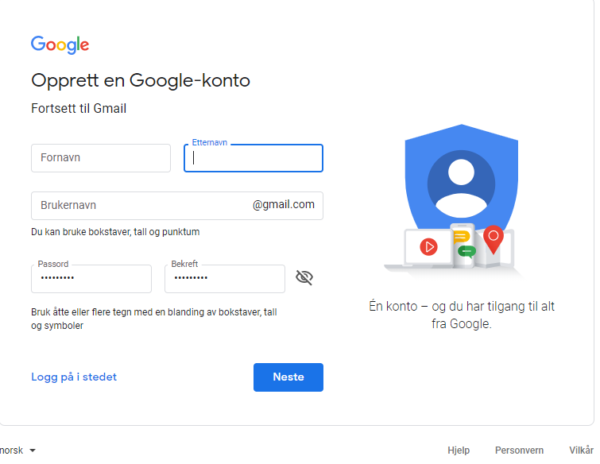
Creating an e-mail address
1
Notes:
In the next field, enter in your password again. This is how the service makes sure you didn’t make a mistake the first time you typed it.

Slide 17
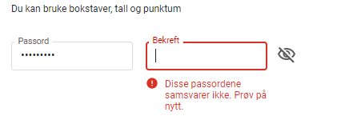
Creating an e-mail address
1
Notes:
If your password isn’t long enough or doesn’t contain enough different characters, you will see this message. If this happens, try again.
If you still get a message saying that the passwords don’t match, there is probably a typo in the first password field. Go back and type your password in the first field once more before you try again.
Help anyone struggling to create or confirm their password before you move on with the course.

Slide 18
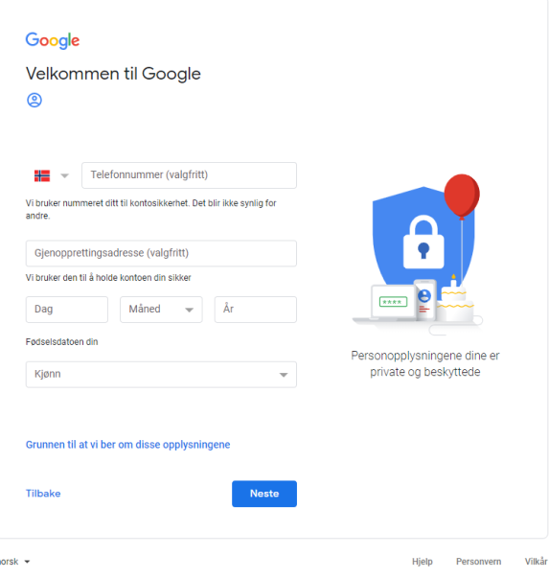
Creating an e-mail address
1
Notes:
In the next field, we need to enter our birth month. A drop-down list will appear.

Slide 19
Creating an e-mail address
1
Notes:
In the next field, you need to enter the day of the month you were born.

Slide 20
Creating an e-mail address
1
Notes:
Then we select the year field. Gmail users will click on the field and enter the full year.

Slide 21
Creating an e-mail address
1
Notes:
In the next field, you have to enter your gender. To do this, click on the arrow on the right side of the field. A drop-down list will appear. Point at or click on an option to choose it.

Slide 22
Creating an e-mail address
1
Notes:
Find the field where it says ‘Mobile phone’. The service will already have filled in the country code for Norway (+47). Enter your phone number, preferably a mobile phone number.

Slide 23
Creating an e-mail address
1
?
Notes:
Anyone who already has another email address, can enter it in the next field. This is not a requirement for creating a user account, but it can be a good idea to include it in case you forget your password. That way, Gmail can send a new password to your other email address.

Slide 24
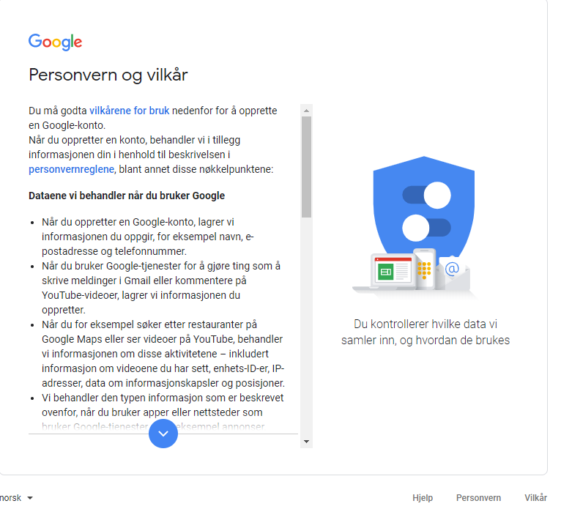
Creating an e-mail address
1
Notes:
A window containing Google’s terms and conditions for use will appear. To agree to them, you need to scroll to the bottom of the window.

Slide 25
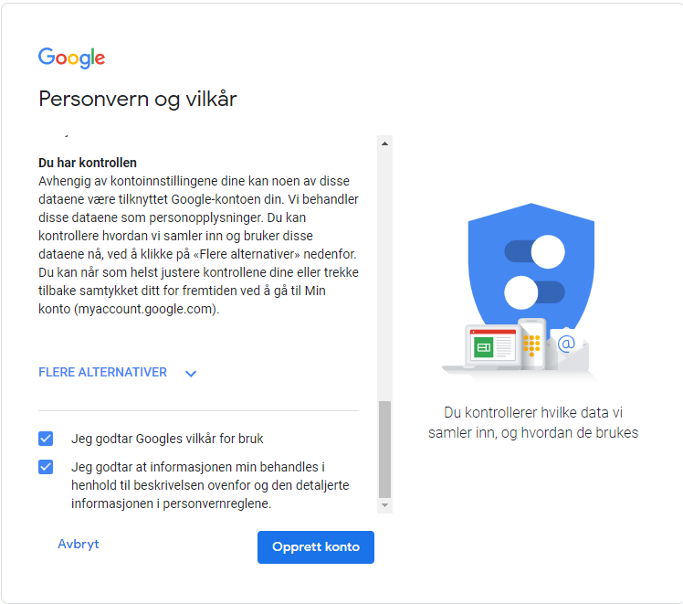
Creating an e-mail address
1
Notes:
The ‘I Agree’ button is now blue. Click on it.

Slide 26
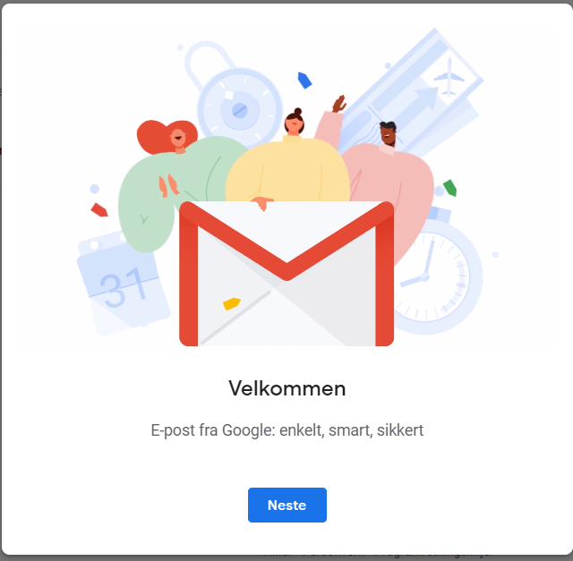
Creating an e-mail address
1
Notes:
A welcome message will appear. Click on the blue button.

Slide 27
Creating an e-mail address
1
Gratulerer med brukerkonto og e-postadresse!
Notes:
Congratulations! You now all have a user account and an email address.

Slide 28
Creating an e-mail address
1
brukernavn
Notes:
Your email address is as follows:
The first part is your username.

Slide 29
Creating an e-mail address
1
brukernavn@
Notes:
After the username comes an at sign (@). All email addresses contain this sign. This is how we distinguish an email address from a website address.

Slide 30
Creating an e-mail address
1
brukernavn@gmail.com
Notes:
After the at sign comes the name of the email service you’re using (in our case, Gmail), followed by a full stop and the letters c-o-m.

Slide 31
Part 2
Logging in and out

Slide 32
Logging in and out
2
Notes:
You are now looking at your Inbox. Different email services look a bit different, but the main features are the same. I am using a simplified version to make it easier for you to see what to do.
The inbox is where the emails people send to you end up. This is also where you can find what you need to send emails. We’ll look at that a bit later. Now, we are going to log out.
In the top right-hand corner of your Inbox you’ll see your name or email address. Click on it once.

Slide 33
Logging in and out
2
Notes:
A menu will appear. On this menu, you’ll find an item called ‘Log out’ or ‘Sign out’. Click on that menu item to log out.

Slide 34
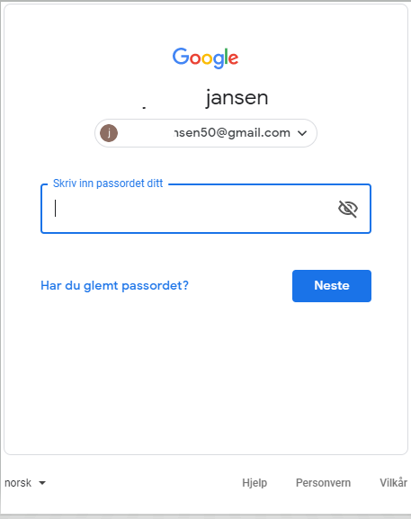
Logging in and out
2
Notes:
The image appearing now should look like the image we saw before we created our email accounts. We will use this page to log back in to our email accounts, but first let’s talk about the different ways it’s possible to log in to our accounts.

Slide 35
Logging in and out
2
www.gmail.com
Notes:
In this course, you are learning to log in to and use your email account in a web browser. To do this, first you have to open the web browser, then you type in the web address for the email service you use. We did this at the beginning of Part 1 of this course.
Some of you may have a program on your computer or an app on your tablet or smartphone that you can use to check your email. This is often a convenient solution. When you’ve entered your user account and password in this type of program or app once, you won’t have to enter this information each time you go in to check your email. This is a convenient solution, but it only works when you are using your own computer, smartphone or tablet. If you don’t have your device with you, you need to go to the web address and log in from there. This might take a bit longer to do, but the advantage is that you can then check your email on other people’s devices. Remember to sign out when you’re done so that others can’t read and send email from your account.
In this course, we learn how to use email in a web browser because this way, it makes no difference whether you use devices that belong to family members, the course facilities or others.

Slide 36
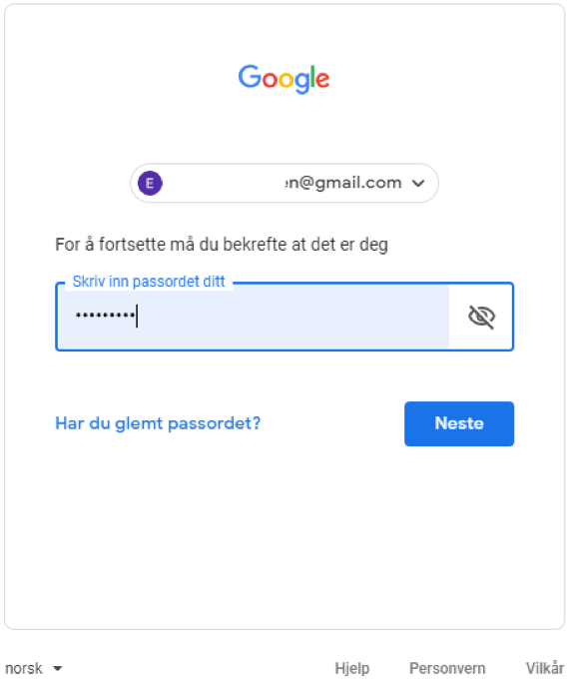
Logging in and out
2
E-postadressen
Passord
Notes:
We are now going to log out of our email accounts again.
Many Gmail users will see that their email address has already been filled in by the service. They will then only have to type in their password.

Slide 37
Logging in and out
2
Notes:
Click on the blue ‘Sign in’ button to log in.
The Inbox will now reappear.
Ask everyone to practise logging off and back in a couple of times.

Slide 38
Part 3
Sending emails

Slide 39
Sending emails
3
Notes:
Make sure everyone has successfully signed in.
All email services have a button you can click to begin writing a new email.
The button is located at the top of the screen, on the left.

Slide 40
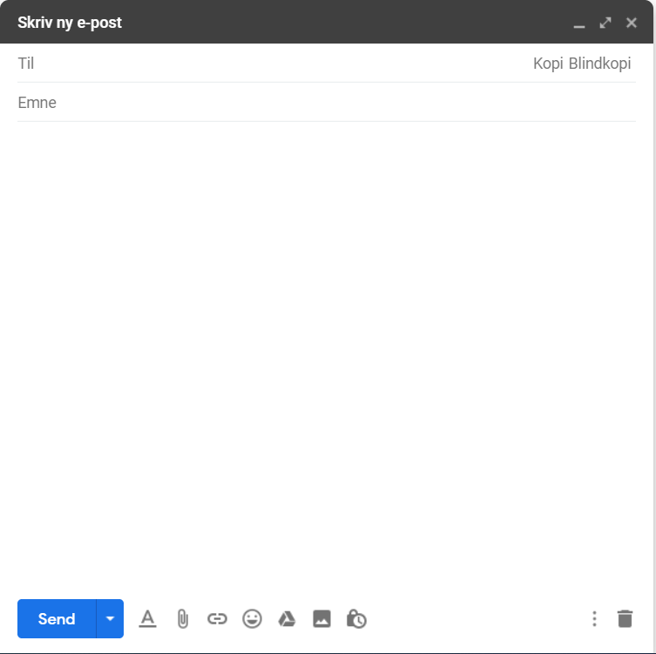
Sending emails
3
Notes:
A window will now appear in which you can write your email.

Slide 41
Sending emails
3
Notes:
For some Gmail users, this window will be a bit small. You can click on the two-way arrow at the top right of the window to enlarge it. If you think the size of the window is OK, you don’t need to do anything.

Slide 42
Sending emails
3
Notes:
This simplified window will show you all the most important features for sending an email.

Slide 43
Sending emails
3
Mottagers e-postadresse
Notes:
A ‘To’ field where you type in the email address of the recipient.

Slide 44
Sending emails
3
Mottagers e-postadresse
Hva handler e-posten om
Notes:
A ‘Subject’ field where you can write a heading for your email.

Slide 45
Sending emails
3
Mottagers e-postadresse
Hva handler e-posten om
I dette feltet skrives beskjeden eller brevet du ønsker å sende, fra "Hei" til "Hilsen"
Notes:
The largest section of the window is the part where you write your message or letter.

Slide 46
Sending emails
3
Mottagers e-postadresse
Hva handler e-posten om
I dette feltet skrives beskjeden eller brevet du ønsker å sende, fra "Hei" til "Hilsen"
Notes:
Finally, there is a button to click when you want to send the email to the recipient.
To help you to send your first email, we will go through and fill in all the fields step by step.

Slide 47
Sending emails
3
Notes:
Now you will all send an email to me.
We’ll start by filling in the email address.
Find the ‘To’ field and click in it.
My email address is: give your own email address or an email address you have created for this course. Before the course, you may want to add a slide with your email address on it to the presentation or write it on the board to make sure everyone writes it correctly.
Wait for everyone to fill in the email address before you go on.

Slide 48
Sending emails
3
Notes:
Now we can add a subject.
Find the ‘Subject’ field and click in it.
It is always a good idea to write something in the subject field. This will make it easier for the recipient to understand the purpose of the email and to find it again later.
Since you are just testing things out, you can type ‘Test’ in the subject field for this email. Type ‘Test’ in the subject field.
Make sure everyone has typed a subject in the field before you go on.

Slide 49
Sending emails
3
Notes:
We can now start writing the actual content of the email.
Click in the large blank field.
Now, please type a short message or greeting to me. Just like when you write a letter, it is polite to start with ‘Hi’ and to finish with ‘Regards’.

Slide 50
Sending emails
3
Notes:
When you are done writing to me, you have to click on the ‘Send’ button to send the email so that I can see what you have written.
The ‘Send’ button is located at the bottom left corner of the window.
Click on the ‘Send’ button.
Wait for everyone to send the email before you go on.

Slide 51
Sending emails
3
Notes:
You are now back in your Inbox again.
Try to send me another email.
Start by finding the button labelled ‘New email’ or ‘Compose’.

Slide 52
Sending emails
3
Mottagers e-postadresse
Hva handler e-posten om
I dette feltet skrives beskjeden eller brevet du ønsker å sende, fra "Hei" til "Hilsen"
Notes:
I will leave this on the screen to make it easier for you to remember what to do.
While you’re sending emails to me, I will try to reply to the email you just sent me, and then we can learn to open and reply to emails.
Take a moment to send a quick reply to the ‘Test’ emails you have received from the participants. Suggested text:
‘Hi,
I have received the email you sent me.
Well done!
Regards, your course instructor’
When you have replied to everyone and everyone has sent you at least one email, you can move on with the course.

Slide 53
Part 4
Opening emails
Notes:
Send en e-post til alle på kurset.

Slide 54
Opening emails
4
Notes:
Make sure everyone has their Inbox open.
On the left side of the screen you’ll see an overview of all the folders in your email account. The most important one is the Inbox.
When there are unread emails in your Inbox, a number will appear after ‘Inbox’ in the overview. If there is no number there, it means that you don’t have any new emails waiting for you.

Slide 55
Opening emails
4
Notes:
The main part of the screen contains a list of all the emails you have received. The most recent emails will be at the top of the list. The oldest ones will be at the bottom.
For each email, the list shows the name or email address of the sender as well as the heading (what the sender has written in the subject field).
Unopened emails will be displayed in bold font.
To open an email and read the contents, click once on either the name of the sender or the heading.

Slide 56
Opening emails
4
Notes:
To open an email, click on the name of the sender or the heading.
Ask everyone to click on one of the emails in their Inbox.

Slide 57
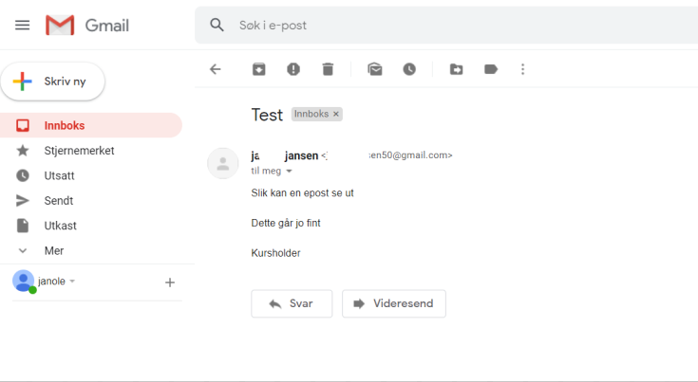
Opening emails
4
Notes:
A typical email in Google looks like this.

Slide 58
Opening emails
4
Tittel
Notes:
The heading of the email is on top.

Slide 59
Opening emails
4
Avsender
Notes:
Then you see the name and/or email address of the person who sent you the email.

Slide 60
Opening emails
4
Beskjeden fra avsender
Notes:
Below that, you’ll see the message from the sender.

Slide 61
Opening emails
4
Notes:
To return to the Inbox and the list of all your received emails, click ‘Inbox’ in the menu to the left on your screen.
Make sure everyone is back in their Inbox before you go on.

Slide 62
Opening emails
4
Notes:
You will now see that the number by ‘Inbox’ in your overview will be lower.

Slide 63
Opening emails
4
Notes:
You will also see that the email you have opened is no longer shown in bold font.

Slide 64
Part 5
Replying to emails
Notes:
Send en e-post til alle på kurset.

Slide 65
Replying to emails
5
Notes:
To reply to an email, select it from the list in your Inbox.
You should all have received an email from me in reply to the email you sent me earlier. Some of you might have looked at it already.
Find it in the list in your Inbox, and click on it.

Slide 66
Replying to emails
5
Notes:
To send me a reply, Gmail users will need to click in the blank field at the bottom of the window where it says ‘Click here to reply or forward’.

Slide 67
Replying to emails
5
brukernavn@e.post.no
Notes:
Replying to an email is a lot like writing a new email, except that the ‘To’ field are already filled in.

Slide 68
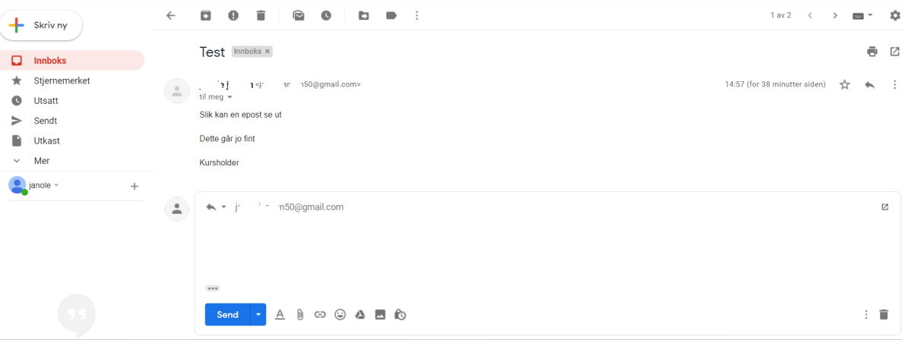
Replying to emails
5
Notes:
Also, the text from the email you’re replying to will be visible above or below the field where you will write your reply.

Slide 69
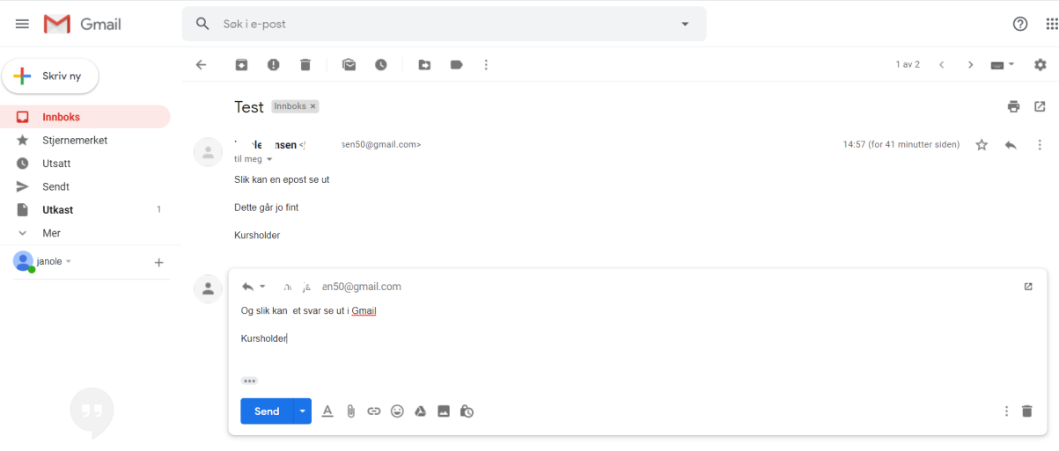
Replying to emails
5
Notes:
This is what it typically looks like in Gmail.

Slide 70
Replying to emails
5
Notes:
This is the text from the sender.

Slide 71
Replying to emails
5
Notes:
And this is where you write your reply.

Slide 72
Replying to emails
5
Notes:
When you are done writing your reply, hit the ‘Send’ button.

Slide 73
Ferdig – godt jobba alle sammen!
Nå kan dere øve på:
Be om e-postadressen til sidemannen din slik at dere kan øve på å sende e-post til hverandre, åpne og svare på hverandres e-poster
Logg av og på e-postkontoen din
Lukk nettleseren helt, åpne den igjen, skriv inn adressen til e-posttjenesten og logg den inn på nytt
Øv hjemme:
Finn noen å øve med som du kan sende og motta e-post fra
Notes:
THAT'S IT!

