Slide 1
LEARNING TO USE A TABLET
Learning objectives:
Being able to turn on and off the tablet
Being able to navigate the desktop
Being able to open an app
To be able to return to the desktop from another screen
Notes:
Go through the learning objectives with the course participants before you begin teaching. This will make it easier for them to focus on and remember the most important information.

Slide 2
Part 1
Switching on your tablet and familiarising yourself with the desktop

Slide 3
Switching on your tablet
1
Notes:
To use the tablet, first you have to switch it on. You will find the ‘On’ button along the edge of the tablet. It may be blank or have a circle with a line through it on or next to it. There might be more than one button along the edge of your tablet. If you’re unsure which of them is the ‘On’ button, just try the different buttons. Press and hold the button for a couple of seconds to switch on the tablet.
Ask everyone to switch on their tablets.

Slide 4
Familiarising yourself with the desktop
1
Skyv for å låse opp
Notes:
Some will be asked to enter a PIN, while others will be asked to ‘swipe to unlock’. That means to touch the screen with your finger and move it to the right. How you unlock a tablet can vary slightly between different tablets. Follow the instructions on your screen.
Make sure everyone has successfully switched on their tablet.
If the screen goes black (enters sleep mode) when you haven’t used the tablet for a while, you can press the ‘On’ button quickly to switch it on again. Some may have to enter their PIN again at this point or swipe their fingertip across the screen to unlock it.

Slide 5
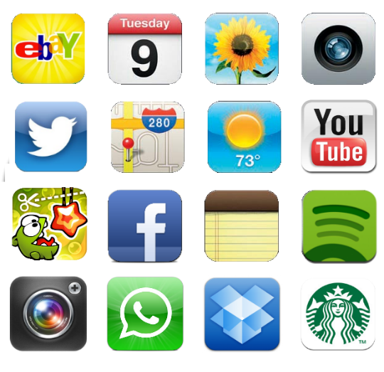
Familiarising yourself with the desktop
1
Notes:
The image that appears on your screen at this point is your ‘desktop’. Each little picture icon is a program or an app on your tablet. To see more apps, touch the screen with your finger and pull it to the right or left.
Ask everyone to try this.

Slide 6
Familiarising yourself with the desktop
1
Notes:
At the very top of the screen you will see a thin line with some symbols on it. It can be useful to have a look at this line from time to time.

Slide 7
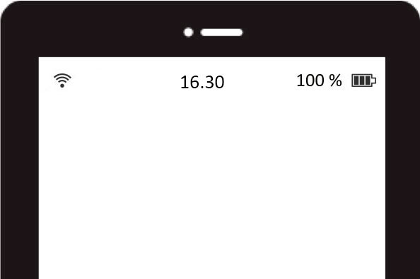
Familiarising yourself with the desktop
1
Notes:
Somewhere along this line you’ll see a battery icon. The battery shows how much power is left on your tablet. Some will have a number next to the battery symbol showing how much power is left. When the battery is nearly empty, it’s a good idea to plug the tablet into the charger. If your tablet won't switch on, it’s possible that the battery is empty. Plug it into the charger and try again in a couple of minutes. But let’s get back to the line. Most people will have a clock on their line. And if the tablet is connected to the internet, you’ll see a symbol that looks like a hand-held fan. The order in which these symbols appear may differ depending on the type of tablet you use.
Help anyone who can’t find the symbols.

Slide 8
Part 2
Opening an app and returning to the desktop

Slide 9
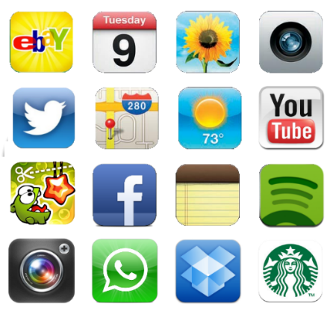
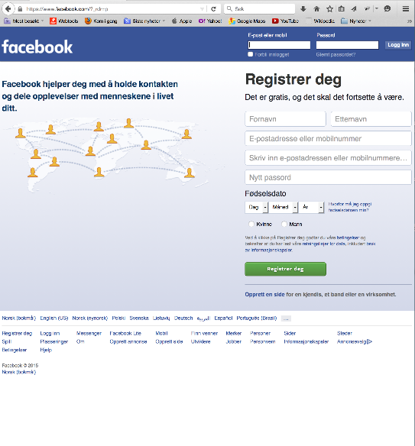
Opening an app and returning to the desktop
2
Notes:
To open an app, click on one of the icons. It doesn’t matter which app you open.
Ask everyone to click on an app to open it.
When it opens, the app will fill the screen.

Slide 10
Opening an app and returning to the desktop
2
Notes:
Press/click on the ‘Home’ button to return to the desktop so you can choose a different app. On some tablets, this is a physical button on the front of the tablet on one of its short sides. For others, the ‘Home’ button is a house icon at the bottom of the screen. This type of ‘Home’ button will move depending on which way you hold the tablet, but it will always look the same.
Ask everyone to press/click the ‘Home’ button so they can return to the desktop.
No matter which app you have opened and no matter what your tablet screen is filled with, you can always press/click the ‘Home’ button to return to the image you’re looking at now. Don’t be afraid to use it!

Slide 11
Part 3
Switching off your tablet

Slide 12
Switching off your tablet
3
Notes:
To switch off the tablet, press and hold the ‘On’ button for a couple of seconds until something happens on the screen.
Ask everyone to press and hold the ‘On’ button for a couple of seconds.

Slide 13
Switching off your tablet
3
Slå av
Notes:
Some people will now see a menu where ‘Switch off’ is listed as an option. Tap ‘Switch off’.
Others will see a message to ‘swipe to switch off’. Touch that button and swipe it to the side.
The tablet will now switch off.

Slide 14
Ferdig – godt jobba alle sammen!
Nå kan dere øve på:
Skru av og på nettbrettet
Bla bortover skrivebordet
Åpne apper og returnere til skrivebordet
Notes:
THAT'S IT!

