Slide 1
FACEBOOK – opprett en profil og bli kjent med tjenesten
Learning objectives:
Being able to log on and off Facebook
Knowing privacy and security settings and how to change these
Knowing what a timeline is
Know the features and icons on the menu bar
Searching for friends, groups and the like
Being able to add friends to your friends list
Being able to follow groups, businesses and the like
Like, comment and share articles and photos
Chat with other users
Notes:
Go through the learning objectives with the course participants before you begin teaching.
This will make it easier for them to learn and to remember what they have learned.

Slide 2
Part 1
What is Facebook?

Slide 3

What is Facebook?
1
Notes:
Facebook is a social networking service. This means that it is an online community that people can use to communicate with others.
You need a profile to use Facebook. When you have a profile, you can contact other people and share photos, videos, news stories, thoughts and other things with others who also have a Facebook profile. Some pages on Facebook can also be viewed without having your own profile, but you can’t leave comments, share or do other things which we will learn about in this course.
Some people use Facebook to keep in touch with old friends and family. Many interest groups, clubs and associations use Facebook to organise their activities and send messages to members, and many businesses and organisations use Facebook to communicate with their customers and users.
It is entirely up to you how you chose to use Facebook and for what purpose. You can choose to share a lot or nothing at all. It is NOT necessary to post photos and text on Facebook if you don’t want to. Many people have a profile just to stay up to date on what’s going on, and that’s fine.
Facebook also has settings that let you decide who you want to connect with, who can see what you write and the photos and videos you post, as well as how much personal information others can read about you.
If you ever decide that you don’t want to be on Facebook anymore, it is also possible to delete your profile. We will talk about this and about privacy and security settings later.
Just like with an e-mail account, you can choose to use Facebook in your web browser or download an app/program if you have a smartphone or tablet. Both work equally well, and in this course it makes no difference what you choose. However, it is often easiest to use the app if you are using a smartphone or tablet. The steps and explanations we go through here apply no matter which technical device you use, but sometimes the screen may look a little different. Feel free to ask if you are unsure of what to do or where to click. Where there is little difference between what you see in a web browser and in an app, the image I show on the screen will be from a web browser on a computer.

Slide 4
Part 2
Create a profile
Notes:
Creating a Facebook profile or user is something you only have to do once, so it's not a problem if you don’t remember everything from this first part of the course afterwards. What’s important is that you follow the instructions that are displayed on your screen as we go along, and that you ask if you have any questions. Don’t worry if what you see on your screen isn’t always identical to what I show in this presentation. Facebook and other online services change their appearance all the time, but the main features remain the same. That’s the important thing, and you will learn these features as you become a more experienced user.
Before you continue, make sure that all participants have turned on their computer or tablet and have opened their web browser or app store.

Slide 5
Create a profile
2
www.facebook.no
Notes:
To create a Facebook profile, start by going to www.facebook.no or downloading the Facebook app from your app store (this only works for tablet and smartphone users).
Ask all the participants to type the address into the address field and go to the page, or to download the app.

Slide 6
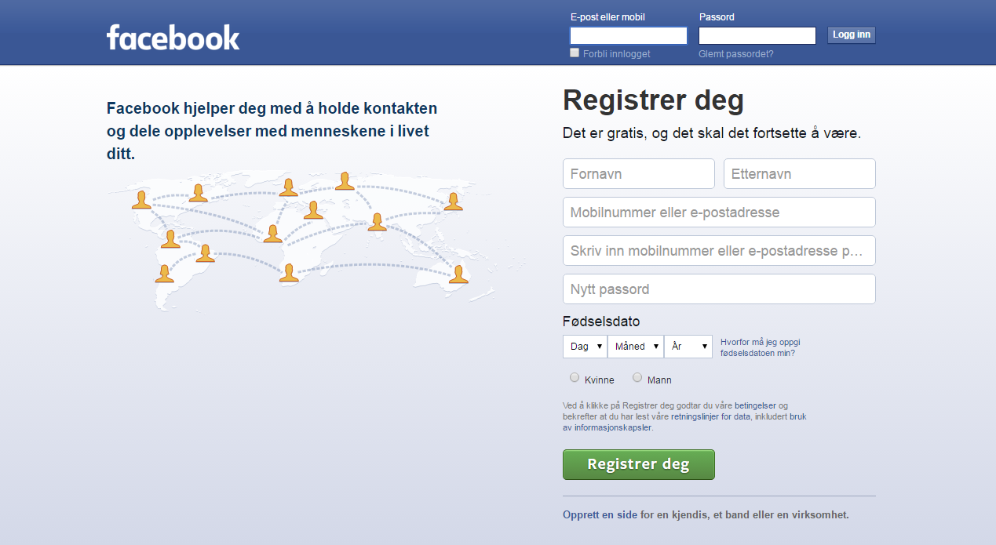
Create a profile
2
Notes:
If you have typed the address correctly, you will reach this page. If you downloaded the app, you have to find it on your phone and open it.

Slide 7


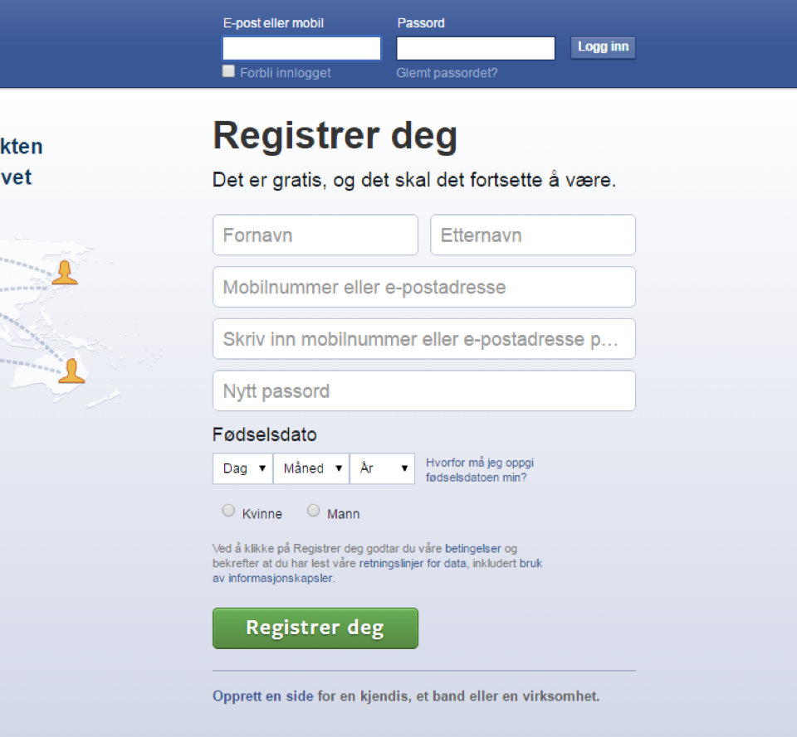
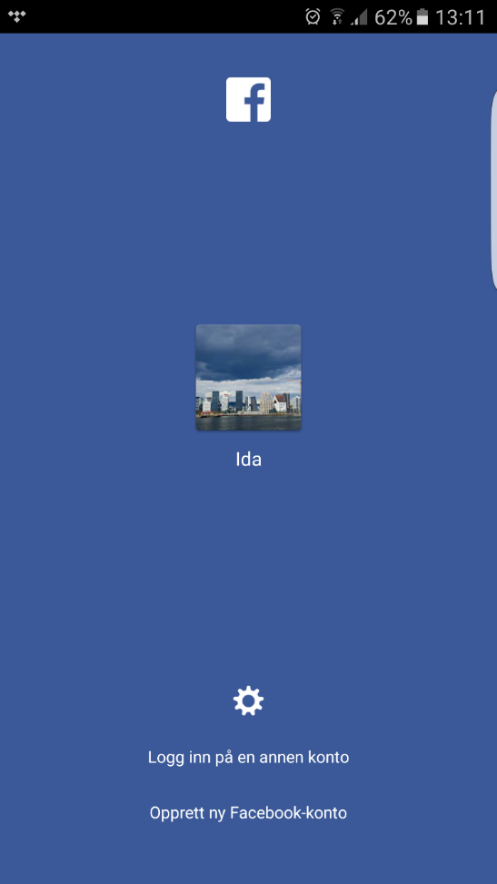
Create a profile
2
Notes:
You only have to create a Facebook account ONCE. Try to follow each step as we go through the process. Don’t worry if you don’t think you’ll be able to remember everything. If you’re unsure or if there’s something you can’t figure out, just let me know straight away and I will help you.
Make sure everyone is on the right page or has downloaded the app.

Slide 8
Create a profile
2
Notes:
Those participants who are using a web browser will need to fill in the information requested under ‘Sign Up’.
Those using the app must tap where it says ‘Create a new account’ and follow the instructions displayed.
Wait for everyone to fill in the required information before you move on.

Slide 9
Create a profile
2
Notes:
When you have entered all the information, click on the ‘Sign Up’ button.

Slide 10
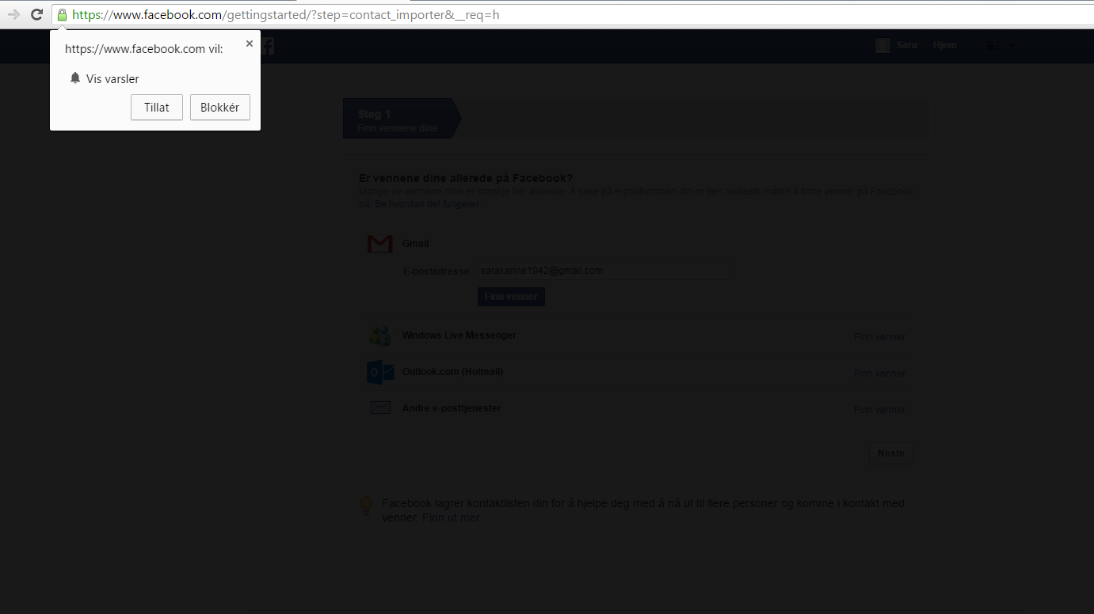
Create a profile
2
Notes:
For some people, the page will now go dark, and a little information pane will appear where Facebook asks if they can send you notifications. This means that you will hear a little ‘ping’ or see a message on your screen whenever anything happens on your Facebook account.

Slide 11
Create a profile
2
Notes:
If you would like to receive such notifications, click ‘Allow’. If you’d rather not, click ‘Block’. If you’re still not sure what you want to do, you can click on the X in the top right-hand corner and make this decision later, when you are a more experienced Facebook user.
Ask everyone who has received this message to choose an alternative, then continue to the next slide.

Slide 12
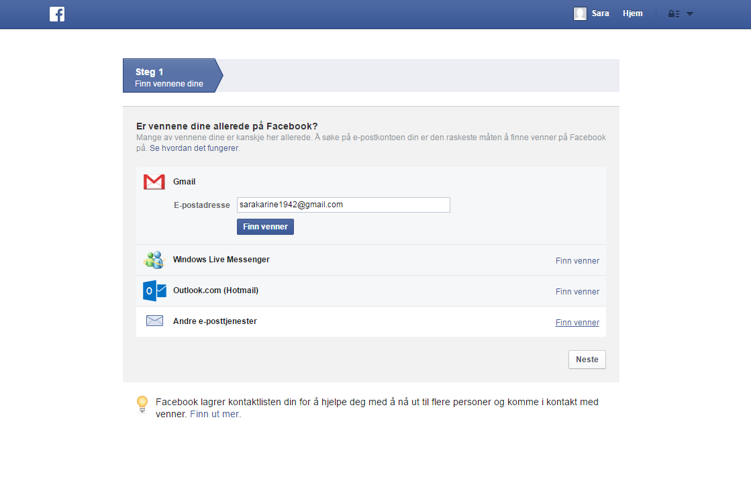
Create a profile
2
Notes:
Facebook will now offer to help you to find your friends by going through your email contacts, but you can also search for people you’d like to connect with.

Slide 13
Create a profile
2
Notes:
Therefore, we’ll skip this step and click 'Next' at the bottom right instead.

Slide 14
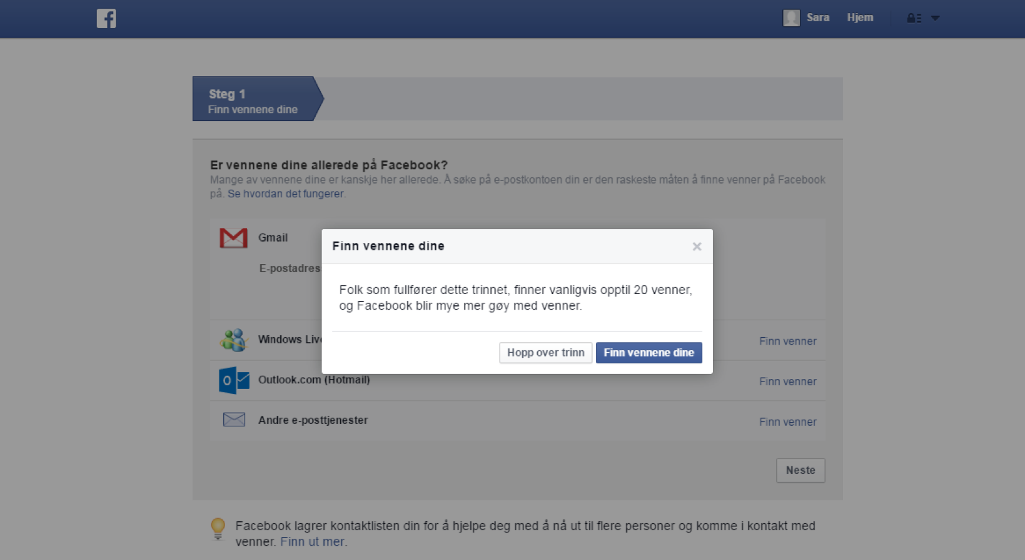
Create a profile
2
Notes:
Then click ‘Skip this step’.

Slide 15
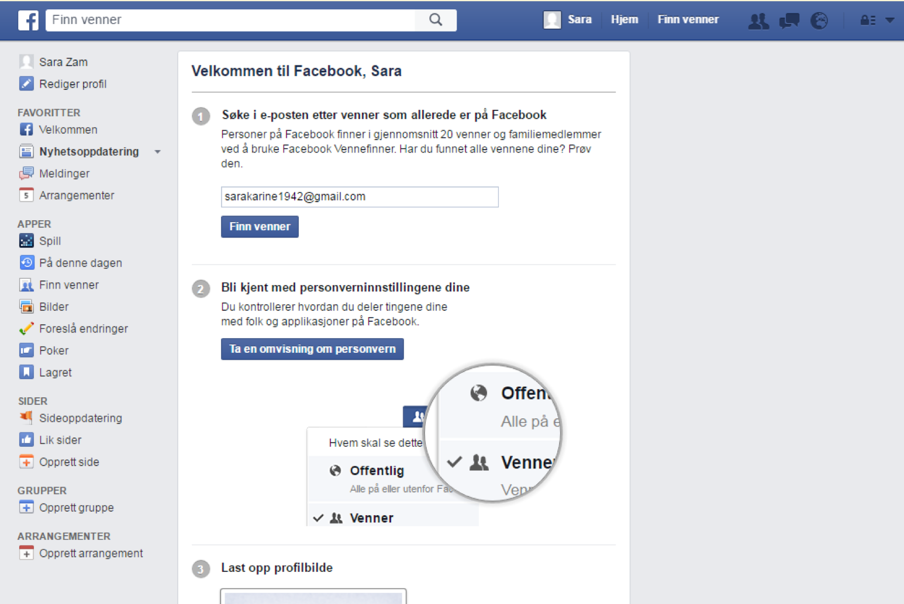
Create a profile
2
Notes:
This page will appear.
To complete your registration, you must now log on to go to your email account.
Facebook will have sent you an email to confirm that you actually are who you say you are.
The email will be sent to the email address you entered a few minutes ago when you signed up.
Ask everyone to go to their email account and see if they have received an email from Facebook.

Slide 16
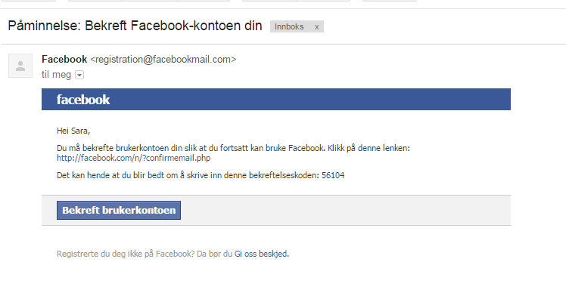
Create a profile
2
Notes:
Help those who can’t find the email from Facebook on their email account.
It may have ended up in the spam/junk folder.
The message from Facebook will look something like this.

Slide 17
Create a profile
2
Notes:
Click the button where it says ‘Confirm user account’.

Slide 18
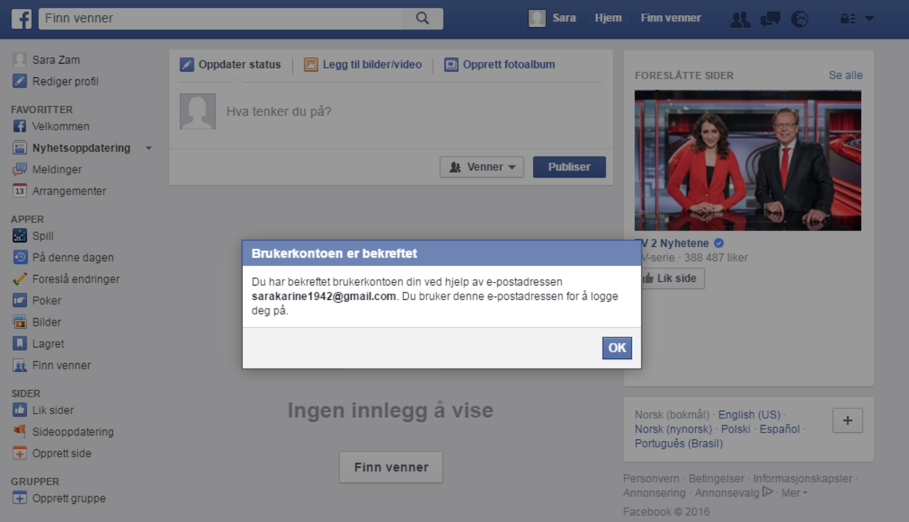
Create a profile
2
Notes:
This page and this message should then appear on your screen.

Slide 19
Create a profile
2
Notes:
Click 'OK'.

Slide 20
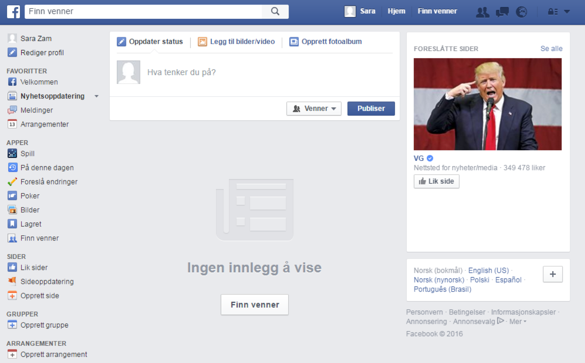
Create a profile
2
Notes:
If a page appears that looks something like this, that means that you have now created a Facebook account.
It might look a little empty compared to other Facebook pages you have seen, but that’s because your page is brand new and hasn't been filled with content yet. But that’ll come. Before we get that far, though, we have to talk about privacy and security.

Slide 21
Part 3
Privacy and security

Slide 22

Privacy and security
3
Notes:
On Facebook, you can choose what you’d like to share with others, who to be friends with and who can see that you have a Facebook profile. Some people choose to have a very open profile and share most of their content, while others decide to go for the middle option and only share some things.
You can change your mind later if you’d like to make your profile more or less private.

Slide 23
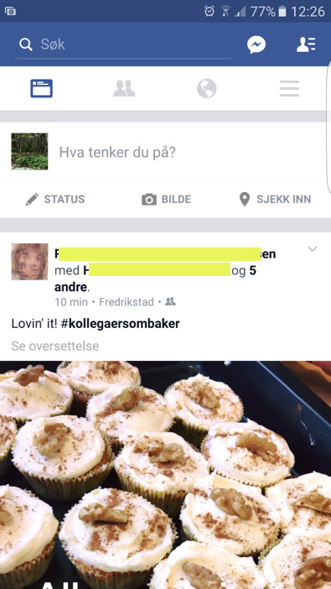
Privacy and security
3
Notes:
This page should still be up on your screens.

Slide 24
Privacy and security
3
Notes:
You’ll see the Facebook menu bar at the top of the page. If you’re using the app, the toolbar may be partly at the top and partly at the bottom of the screen.

Slide 25
Privacy and security
3
Notes:
If you’re using a web browser, you’ll see a small padlock symbol with some lines next to it at the far right of the menu bar.
Click on this symbol.
Those who are using a tablet will have a menu button that consists of three horizontal lines somewhere on their screen. Find this button and click on it.

Slide 26
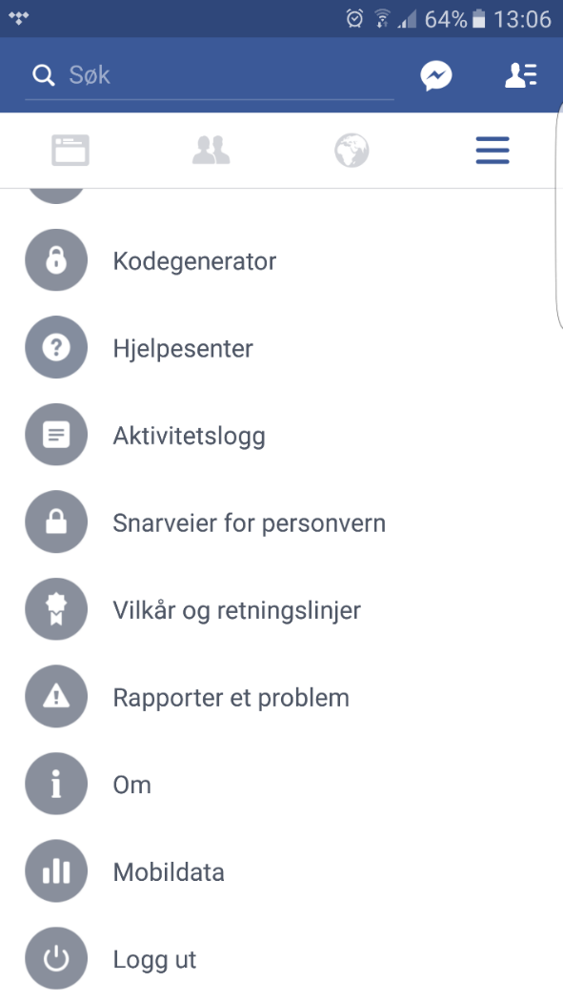
Privacy and security
3
Notes:
App users will see a long list of menu choices. Scroll almost all the way to the bottom of this list and find the option called ‘Privacy shortcuts’. Click to select this option.

Slide 27
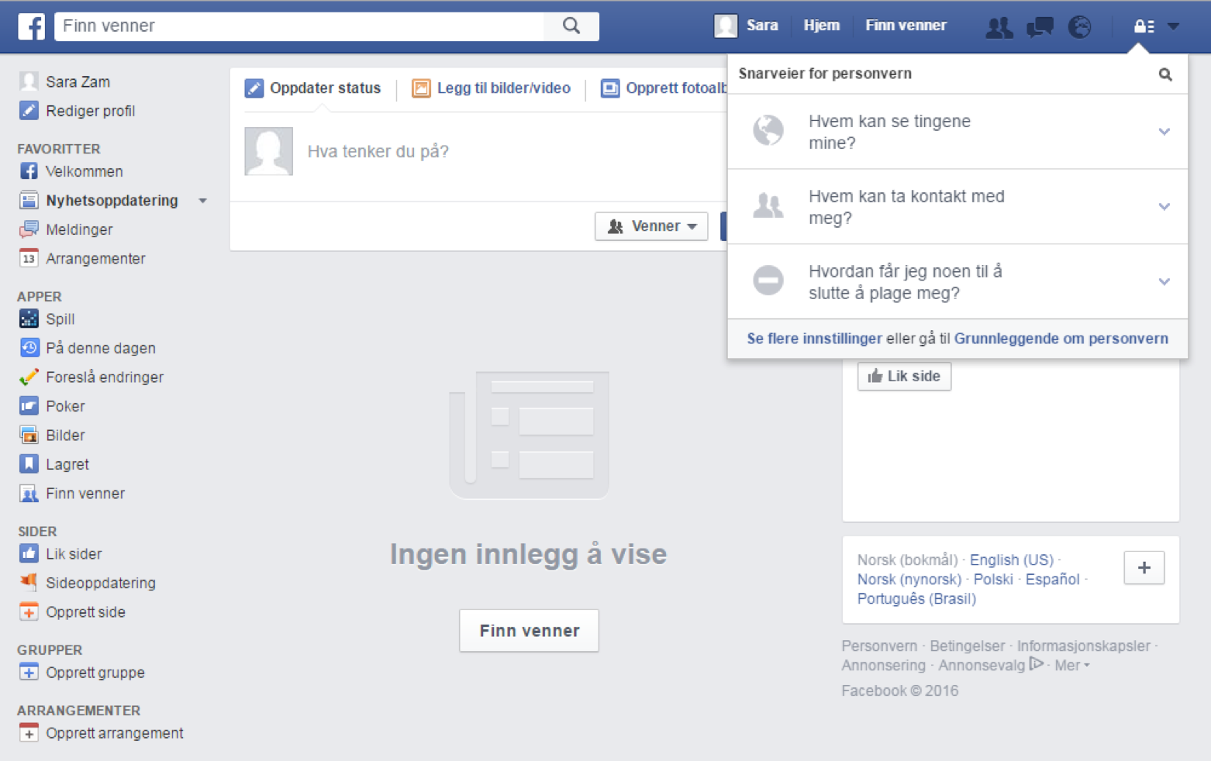
Privacy and security
3
Notes:
A little menu will now appear.
Check that everyone can see the menu.

Slide 28
Privacy and security
3
Notes:
The first choice that comes up is called ‘Who can see my stuff?’ To see more, click on the downward arrow.

Slide 29
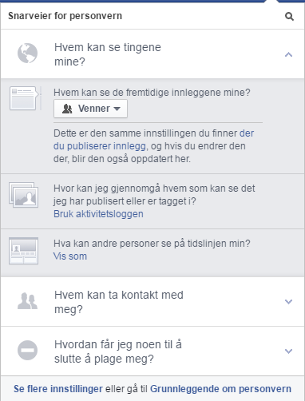
Privacy and security
3
Notes:
The submenu will now appear. At the top it says ‘Who can see your future posts?’ and the button below it says ‘Friends’.

Slide 30
Privacy and security
3
Notes:
On Facebook, ‘friends’ means people you have agreed to be connected to. Either you have found them and sent them a friend request which they have accepted (we’ll learn more about that later), or else they have found you and sent you a friend request which you have accepted.
You haven’t added any friends on Facebook yet, but if you leave your settings as they are now, your future friends will be able to see any photos, comments, news stories and other things you decide to share on Facebook.
If you click on the ‘Friends’ button, several choices will appear. ‘Public’ means that everyone on Facebook can see what you share, and ‘Only me’ means that you’re the only one who will see be able to it. To switch to any of these settings, just click on the one you want. The most common setting is to share with friends, but you are free to choose a different setting if you like. If you want to, you can go back and change your security and privacy settings later.

Slide 31
Privacy and security
3
Notes:
Click on the arrow again to close this part of the menu.

Slide 32
Privacy and security
3
Notes:
The next section is titled ‘How people can find and contact you’. Click on the arrow to the right of the heading to see the menu.

Slide 33
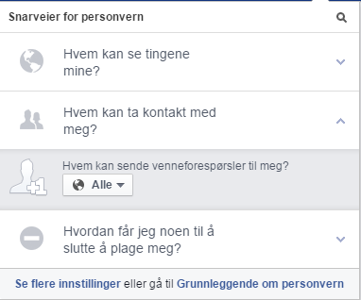
Privacy and security
3
Notes:
It says here that everyone using Facebook can send you a friend request if they want to. This is the most common setting. It doesn’t mean that you’ll be getting friend requests from all the millions of people who are on Facebook. It just means that anyone who searches for your name on Facebook will see that you are on Facebook and can send you a friend request. This will usually be people you know already. If you get a friend request from someone you don’t want to accept, simply click ‘Ignore’ when it appears. The person who sent you the friend request will not be notified if you choose to ignore their friend request.
If you don’t want everyone to be able to contact you, the alternative is that only friends of friends will be able to. This means that only people who are already a Facebook friend of someone you are Facebook friends with will be allowed to send you a friend request. If you’d like to apply this setting, click on the button marked ‘Public’ and click on the other option that appears on the list.

Slide 34
Privacy and security
3
Notes:
Click on the arrow again to hide this part of the menu.

Slide 35
Privacy and security
3
Notes:
The last section is titled ‘How do I stop someone from bothering me?’
If you should ever be bothered on Facebook by someone you don’t want contact with, it’s good to be aware of this section. You probably won’t need it.
Click on the arrow.

Slide 36
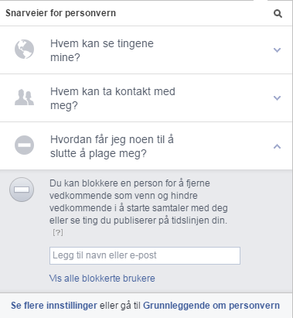
Privacy and security
3
Notes:
In this field, you can type the name or email address of someone you don’t want further contact with. This is called ‘blocking’ the person. But again, most likely you’ll never have to do this.

Slide 37
Part 4
Searching for and adding friends

Slide 38
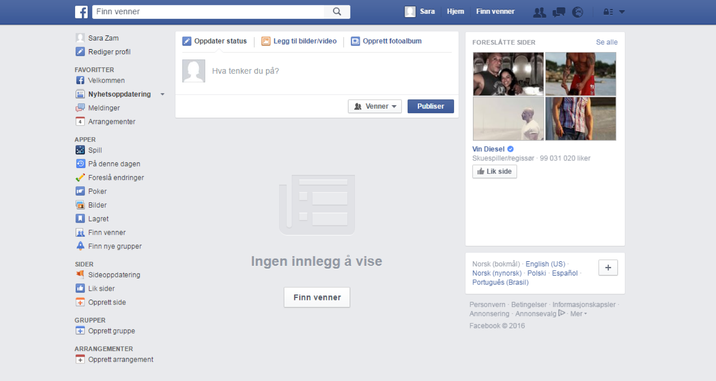
Searching for and adding friends
4
Notes:
Most people use Facebook to keep in touch and share photos, news stories and other things with friends and acquaintances. To be connected to a person, you have to add them to your friends list.

Slide 39
Searching for and adding friends
4
Notes:
To find your friends on Facebook, you have to search for them. Most people use their real name and a profile picture that’s easily recognisable. The search field is at the top of the page or app, indicated by a small magnifying glass. Click on the search field and start typing the name of the person you’re looking for.

Slide 40
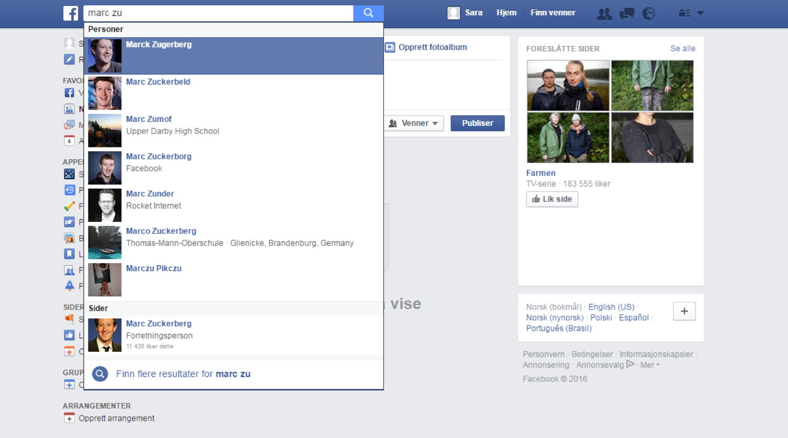
Searching for and adding friends
4
Notes:
Facebook will give you suggestions for who you’re looking for. These suggestions will appear in a list below the field you’re typing in. You won't be able to find friends who don't have a Facebook account.
When you see the right person in the list, click on the name.

Slide 41
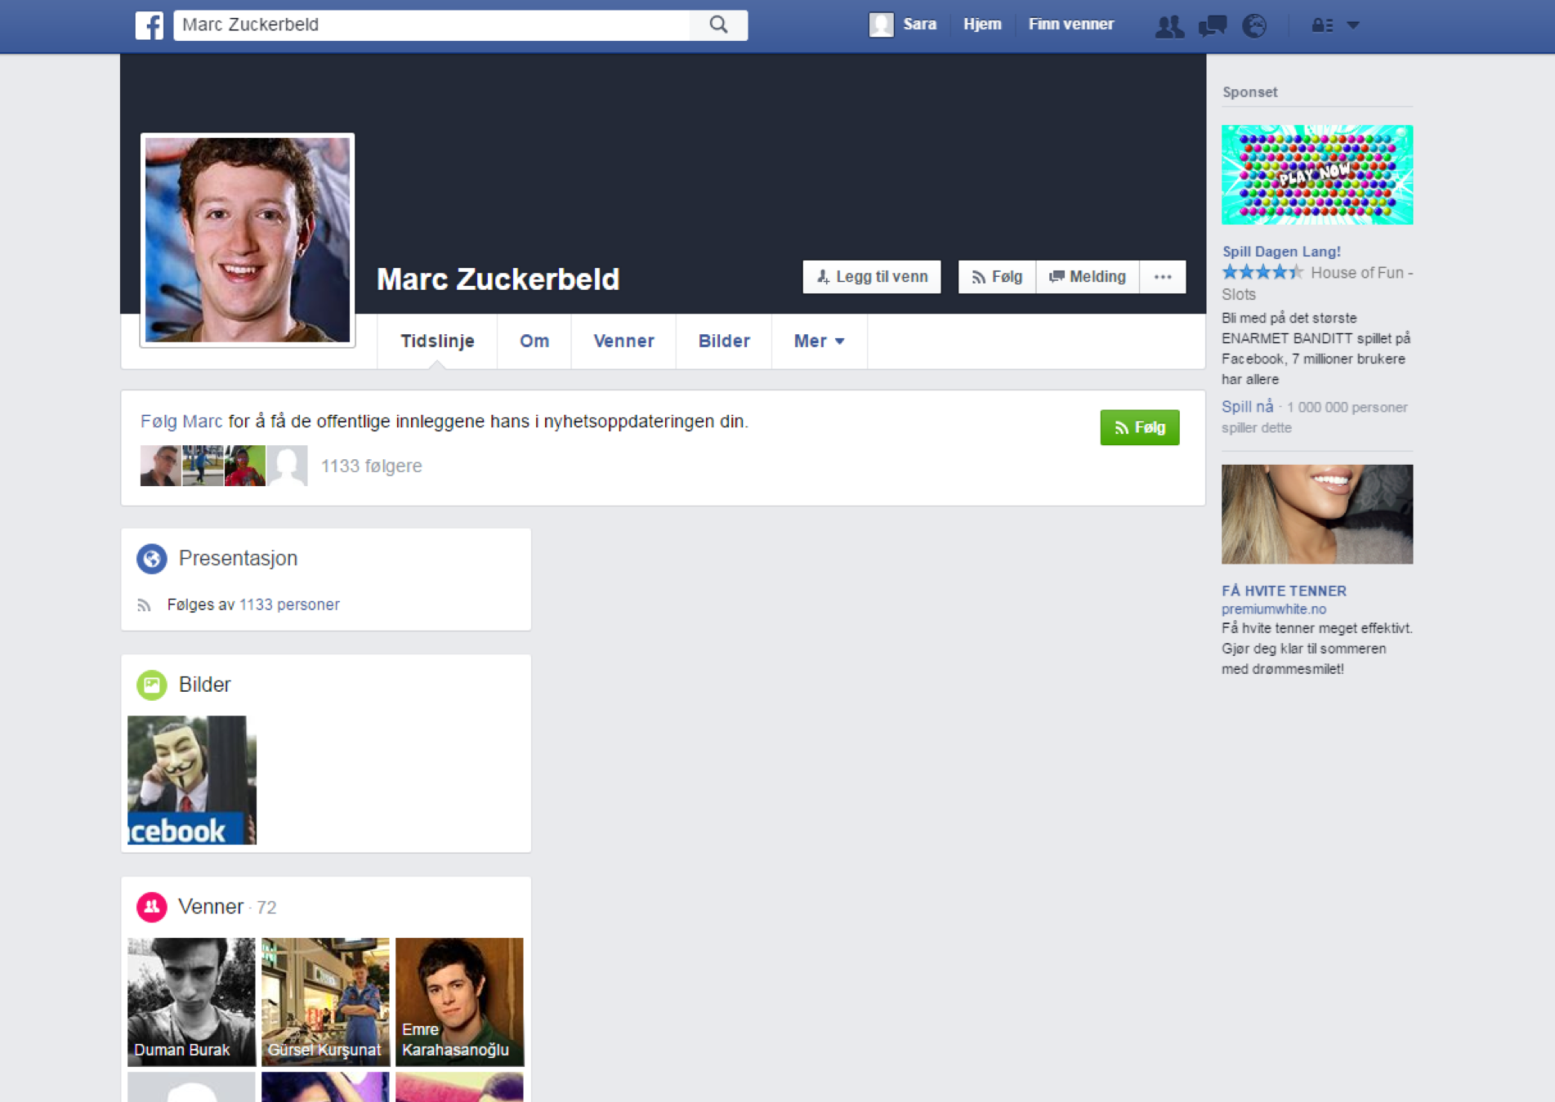
Searching for and adding friends
4
Notes:
That will take you to his or her Facebook page, or their ‘profile’. This profile is often called a ‘wall’ or a ‘timeline’. Later we’ll talk about what a timeline is and how it can be used.

Slide 42
Searching for and adding friends
4
Notes:
To add the person to your friends list, click on the ‘Add friend’ button.
This button is often found towards the top of the page. It has a small symbol of a person and a plus sign.

Slide 43
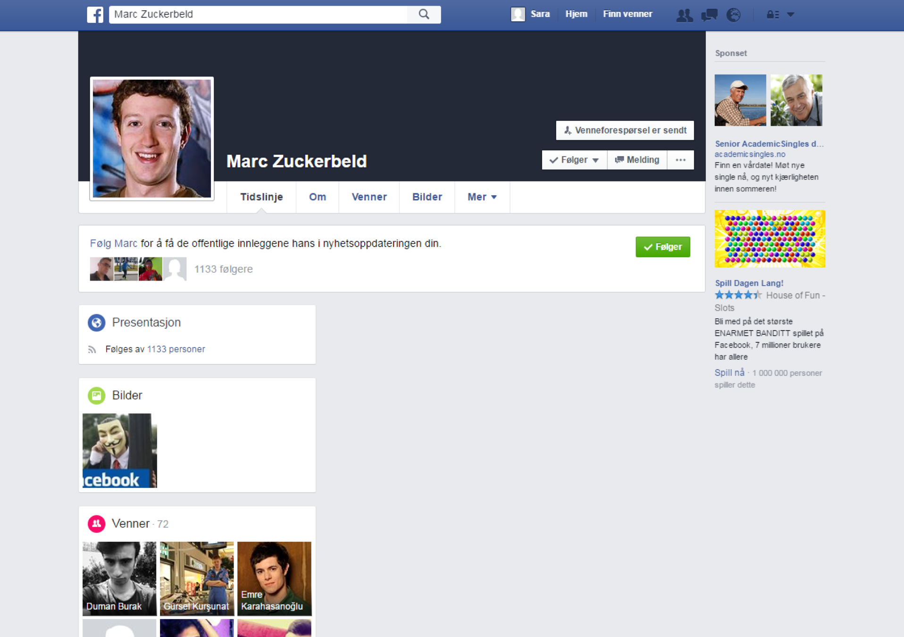
Searching for and adding friends
4
Notes:
A friend request will then be sent to the person, who can choose to accept or ignore your request. Others can also send you such requests.
You can always choose whether you want to connect with someone or not. Later we’ll look at where these friend requests appear.

Slide 44
Searching for and adding friends
4
Notes:
You can also search for companies, businesses, institutions, clubs, associations and a lot more on Facebook. You do this the same way as when you search for friends.
Start typing the name of the entity you’re looking for in the search field.

Slide 45
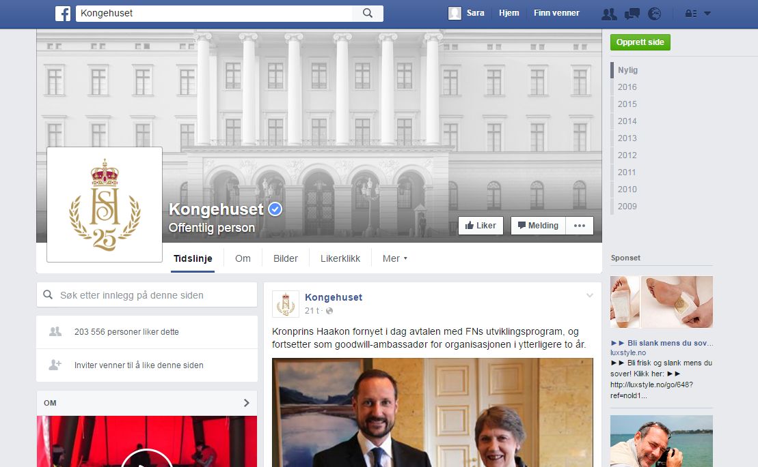
Searching for and adding friends
4
Notes:
It is often not possible to be friends with institutions, but you can choose to ‘like’ them.
You do this by clicking on the button where it says ‘Like’ next to a thumbs-up symbol.

Slide 46
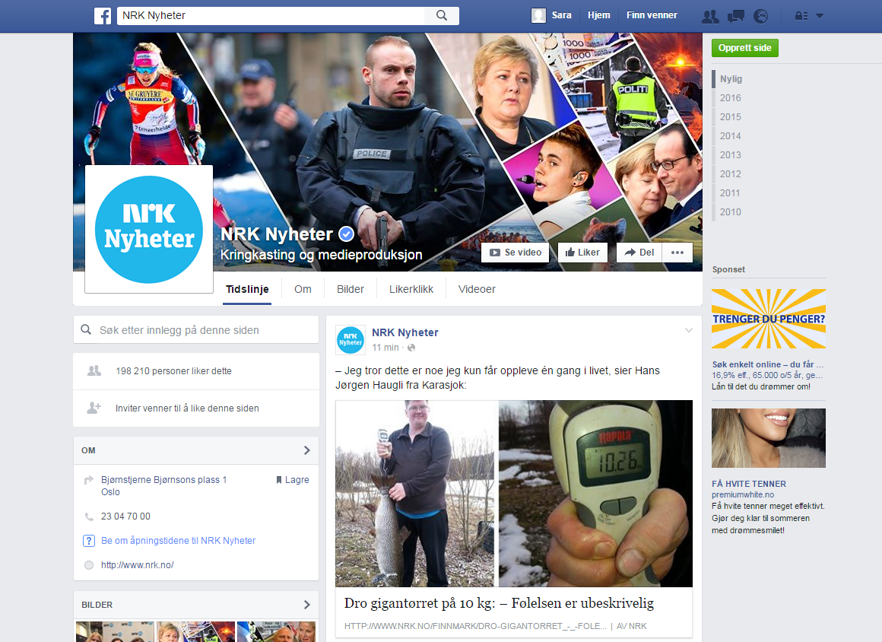
Searching for and adding friends
4
Notes:
You can like a lot of different organisations and people. When you like them, you’ll see what they post, for instance news stories, photos, video clips etc. You can have as many such connections as you like on Facebook. Some people have a lot of friends and ‘like’ a lot of things, while others might just be connected to their close family or co-workers.
Ask all the participants to find at least one friend, a family member or something else by searching for them in the search field and then try to send a friend request to or like them. This might take some time.
Make sure that everyone gets the help they need. It is a good idea to let the participants help each other. Go through this part of the course one more time while the participants follow you step by step. Suggest that they search for the municipality’s page, their local library or something similar.

Slide 47
Part 5
What is a timeline?

Slide 48
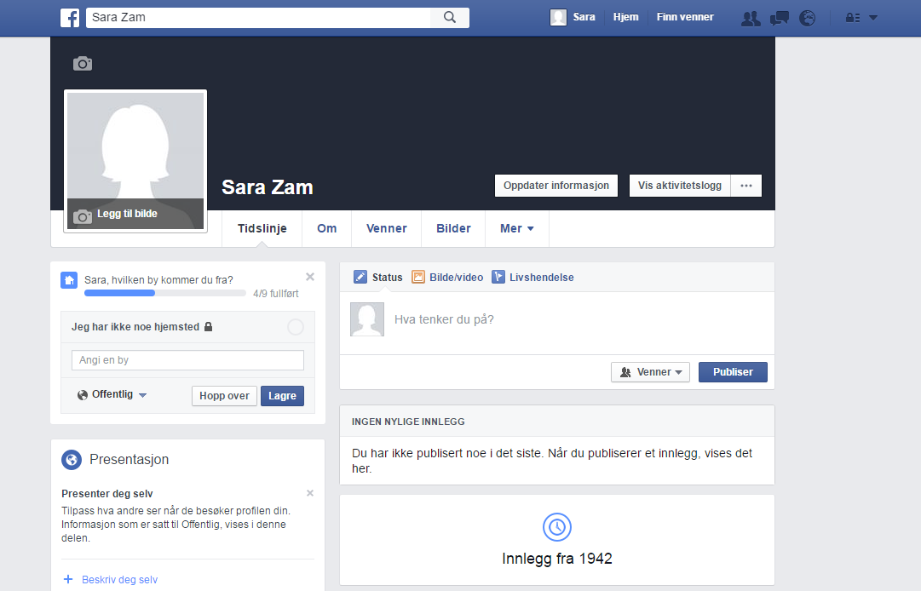
What is a timeline?
5
Notes:
All individuals, companies and other Facebook users have a timeline. The timeline works like a profile for the person or organisation it belongs to. It provides some information about the person or institution, and you can see what they decide to share with others on Facebook. How much you can see depends on whether you are friends with them or not and on their privacy settings. Some choose to share a lot, others only a little.

Slide 49

What is a timeline?
5
Notes:
Click on your name on the menu bar to see your timeline. If you didn’t have a Facebook profile already, there won’t be much on there yet, but you can post photos, links to interesting stories or funny videos here if you like. You can also add more information and a picture of yourself if you want to.
If you’re using the app, you’ll have to tap the menu icon again. You’ll see your name at the top of the list that appears. Tap it to get to your timeline.

Slide 50
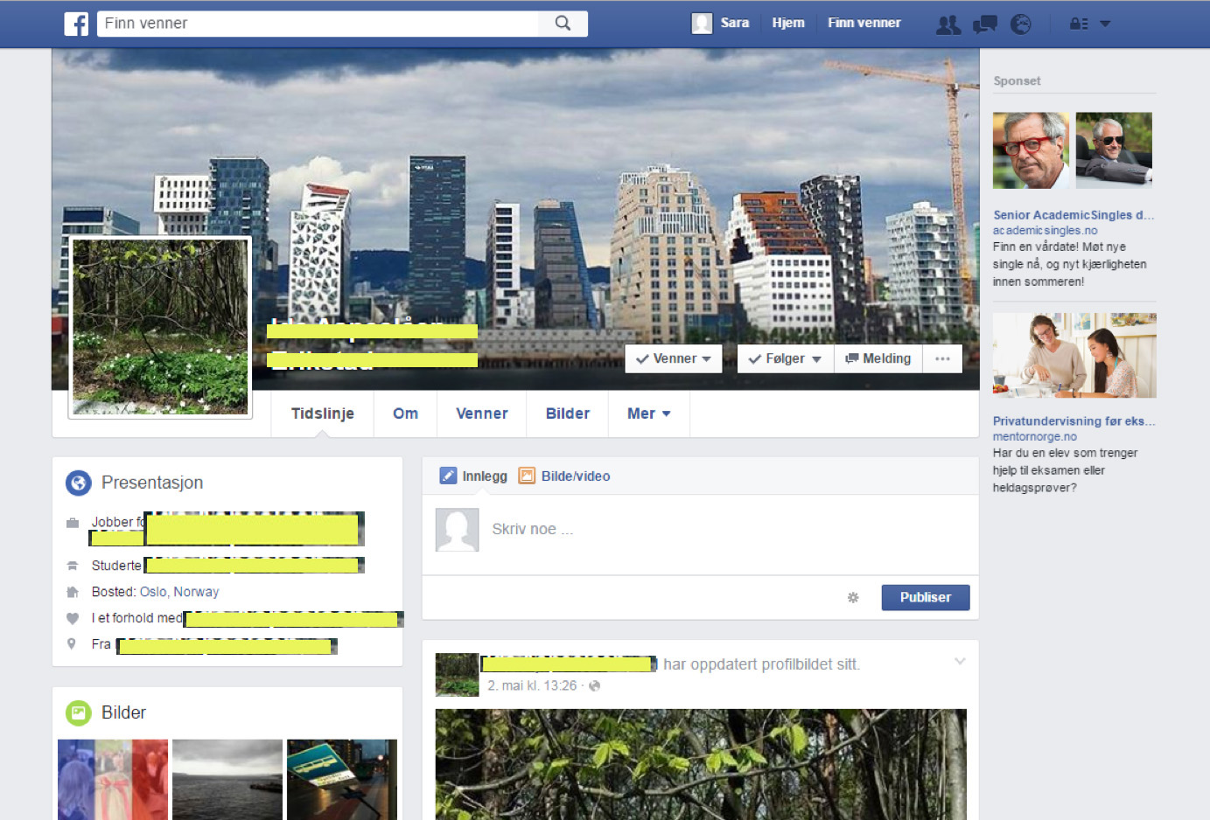
What is a timeline?
5
Notes:
If you go to the timeline of someone you have added as a friend or ‘liked’, you can see what they have posted on their timeline. In the search field, search for the person or organisation whose timeline you want to see, and click on the name. Scroll down the timeline to see more.

Slide 51
What is a timeline?
5
Notes:
You can also write something on other users’ timelines if you want to. To do this, use the field where it says ‘Write something...’, but remember that everything you write on a timeline can be seen by other people who are connected to that person. This is NOT the place for private messages. If you’d like to send a message or something else for only ONE of your friends to see, you need to open a ‘chat’.

Slide 52
Part 6
Chatting using Messenger

Slide 53
Chatting using Messenger
6
Notes:
To send a message to one specific Facebook friend, you need to chat with them. Chatting is almost like sending a text message on your phone, and gives you a lot more control over who can see the message than you have if you choose to write on their timeline.
To chat with a friend, go to their Facebook timeline and find the button where it says ‘Message’ next to a speech bubble symbol. Click on the button to start the chat.
If you’re using the Facebook app on a smartphone or tablet and haven’t chatted before, you’ll receive a message saying that you have to download an app called ‘Messenger’. You’ll need this app in order to chat on Facebook using a smartphone or tablet.
Wait until everyone who needs to download Messenger has done so before you go on.

Slide 54
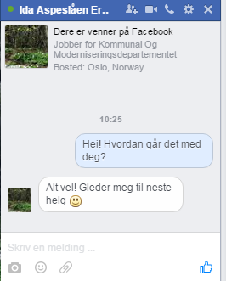
Chatting using Messenger
6
Notes:
If you’re using a web browser, the chat will appear in a small window at the bottom right-hand corner.
If you’re using the app, the chat will appear in another app called Messenger.
This happens automatically, and the window will cover the entire screen.

Slide 55
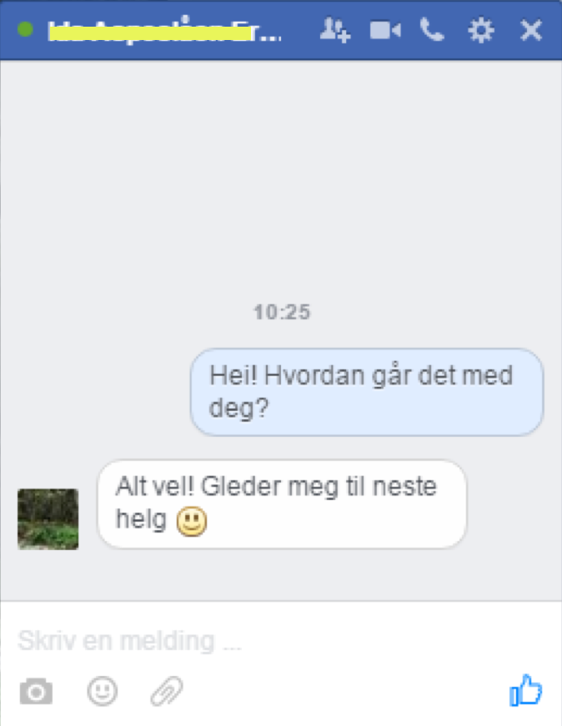
Chatting using Messenger
6
Notes:
The chat will show all the messages back and forth between you and the person you're chatting with. What you send to them will show up on the right-hand side, and what they send to you will show up on the left.
To write a message, click on the white field at the bottom of the chat where it says ‘Write a message...’

Slide 56
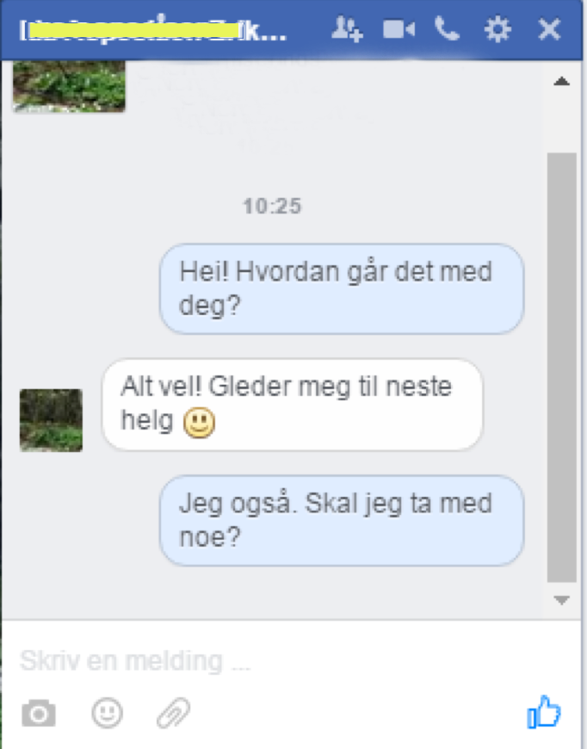


Chatting using Messenger
6
Enter
Notes:
When you have written what you want to say, press 'Enter' on the keyboard to send the message.

Slide 57

Chatting using Messenger
6
Notes:
If you’re using the app, you’ll see an arrow or a small paper aeroplane symbol next to what you have written.

Slide 58
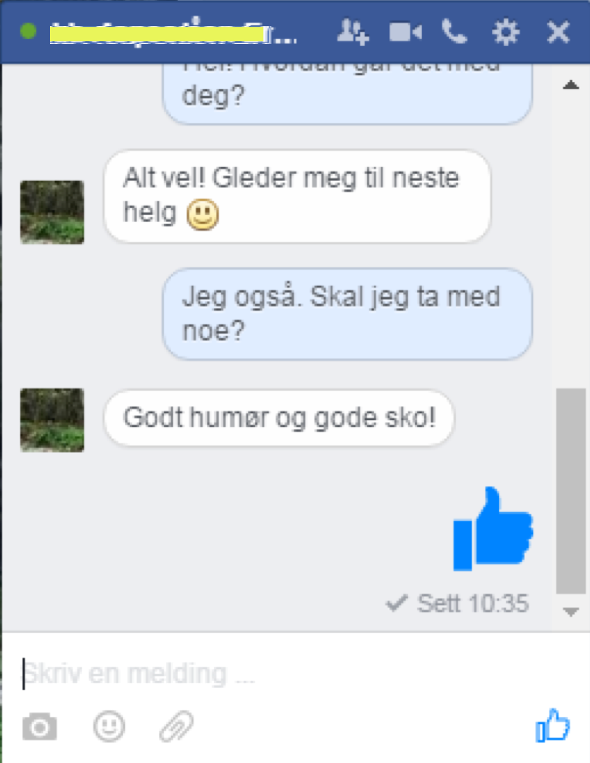
Chatting using Messenger
6
Notes:
Thumbs-up or ‘like’ is a symbol that’s used a lot on Facebook, and it may mean that you like something, that you agree with something or that you’ve understood what the person has written. You can also use this symbol when you chat. You’ll find it in the bottom right-hand corner.

Slide 59
Chatting using Messenger
6
Notes:
You can also try to add photos, emojis (smileys) or documents in your chats, but we won’t be covering that in this course. Try it out with someone you know who’s a bit more familiar with Facebook, or practise with another course participant.

Slide 60
Chatting using Messenger
6
Notes:
It might also be useful to know that you can add more than one person to a chat, open a video chat, use the chat to make voice calls etc. Explore the possibilities by using the symbols you see here. Those using tablets and smartphones also have all these symbols, and they look exactly the same, but might not be located in the same place in the window.

Slide 61
Part 7
Liking, commenting and sharing

Slide 62
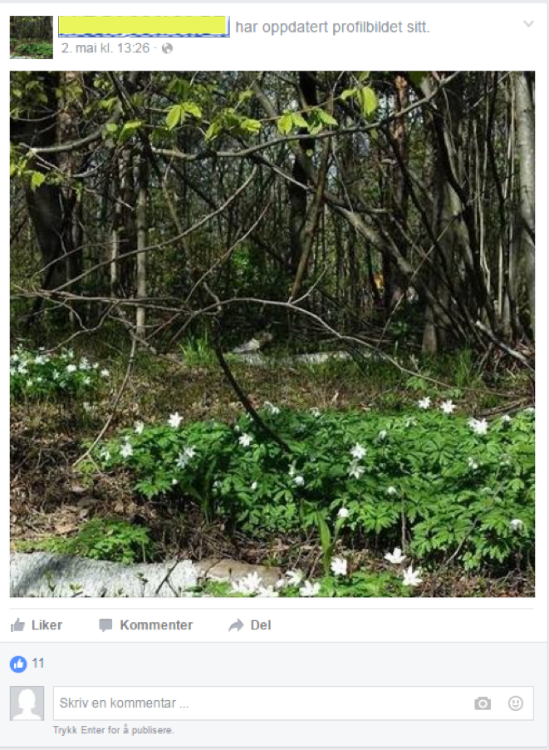
Liking, commenting and sharing
7
Notes:
Facebook also makes it possible for you to respond to and share photos, comments, articles and other things that your friends, companies, commercial enterprises and others have posted on Facebook.

Slide 63
Liking, commenting and sharing
7
Notes:
You’ll find these features under or sometimes next to the photo, comment or article. They are called ‘Like’, ‘Comment’ and ‘Share’, and have easily recognisable symbols. You can choose to use one or more of these features when you see something you want to respond to so that other users can see it.

Slide 64
Liking, commenting and sharing
7
Notes:
The ‘like’ function is a quick way of responding. It always appears as a thumbs-up symbol.

Slide 65
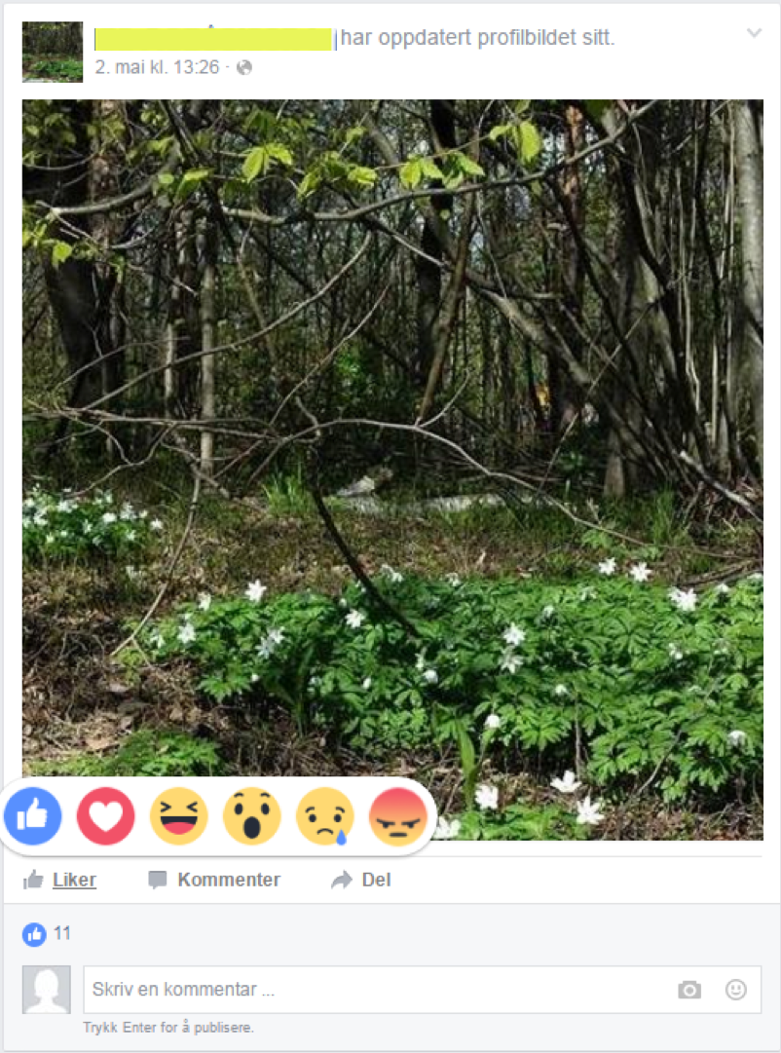
Liking, commenting and sharing
7
Notes:
If you’re using a computer, a number of different icons will appear if you hover the cursor over the 'Like' button. On tablets and smartphones, touch the Like button with your finger and press it until the icons appear.
Then point at or tap the symbol that expresses the reaction you want to show to what has been shared. You can choose between ‘thumbs-up’, 'heart', ‘laugh’, ‘surprise/shock’, ‘sad’ or ‘angry/offended’.
The most common reaction for most people is the thumbs-up. Using these icons is called ‘liking’ the photo, article or comment.

Slide 66
Liking, commenting and sharing
7
Notes:
You can also write your own comments to photos and other Facebook posts.
To comment, either click on the button where it says ‘Comment’, or...

Slide 67
Liking, commenting and sharing
7
Notes:
... click on the field where it says ‘Write a comment’.

Slide 68
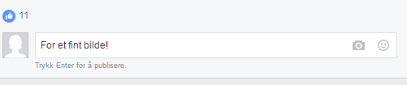

Liking, commenting and sharing
7
Enter
Go
Return
Notes:
Write your comment. If you’re using a desktop computer or a laptop, press 'Enter' to finish and publish your comment. It will then appear below the photo or post you chose to comment on.

Slide 69
Liking, commenting and sharing
7
Notes:
If you’re using a tablet or smartphone, tap the icon that looks like an arrow or a little paper aeroplane to publish your comment (this symbol is the same as the one you use when you’re chatting).

Slide 70
Liking, commenting and sharing
7
Notes:
You may also choose to share a photo or other post that others have published. To do this, click on the ‘Share’ button.

Slide 71
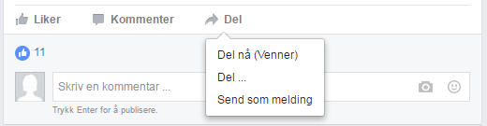
Liking, commenting and sharing
7
Notes:
Three options will then appear, and we’ll go through each of them.

Slide 72
Liking, commenting and sharing
7
Notes:
If you choose the option ‘Share now (Friends)’, the photo or post will appear on your Facebook timeline so that your friends can see it there.

Slide 73
Liking, commenting and sharing
7
Notes:
If you select option 2, ‘Share...’, a new window will appear.

Slide 74
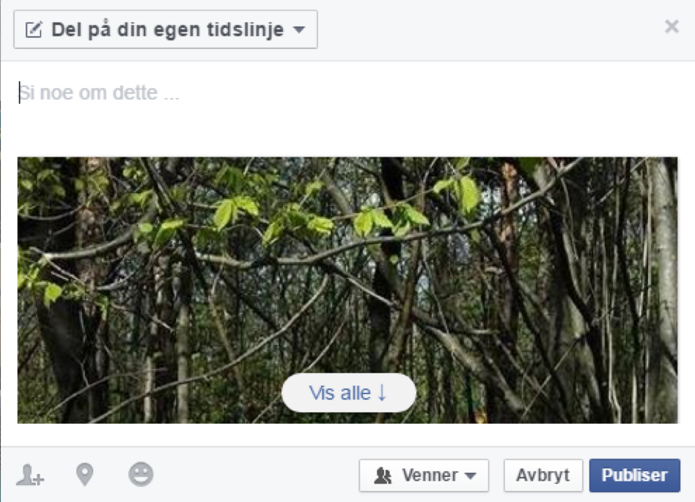
Liking, commenting and sharing
7
Notes:
It will give you the option to write something in the field where it says ‘Say something about this...’.

Slide 75
Liking, commenting and sharing
7
Notes:
If you then click on the ‘Publish’ button, the post and the comment you have just written will appear on your Facebook timeline.

Slide 76
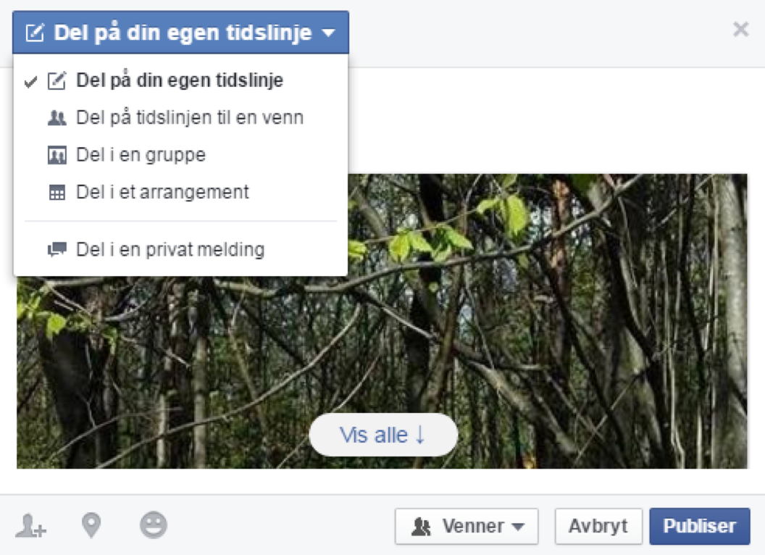
Liking, commenting and sharing
7
Notes:
If you want to publish the photo or post on a page other than your own, you can do this by clicking on the drop-down menu at the top of the window where it says ‘Share on your own timeline’. You will then see several sharing options.

Slide 77
Liking, commenting and sharing
7
Notes:
You can choose to share on a friend’s timeline (wall), in a group or in an event. Click on the option you want. In this example, we are choosing to share the post on a friend’s timeline.

Slide 78
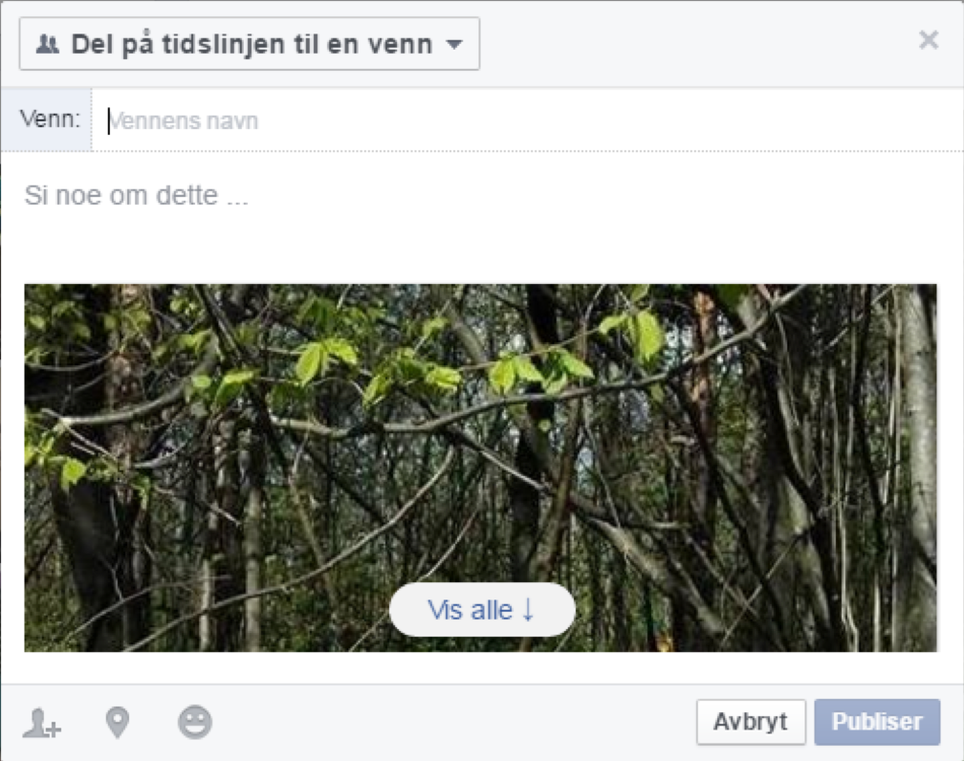
Liking, commenting and sharing
7
Notes:
The window that appears will look almost identical no matter which option you choose.
First, you will be asked to enter the name of the friend, group or event you want to share the post to. Type it in the name field. You can also enter more than one name if you wish.

Slide 79
Liking, commenting and sharing
7
Notes:
You can also choose to write in a little message or comment before you share here too.

Slide 80
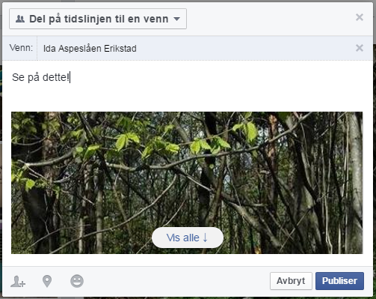
Liking, commenting and sharing
7
Notes:
When you have added all the recipients you want and written any comment you want to include, click ‘Publish’.

Slide 81
Liking, commenting and sharing
7
Notes:
The final option you can choose is ‘Send as message’. If you click on this, a window will appear that looks like the one that appears when you share on a timeline, group etc. When you click ‘Publish’, the message, post or photo will appear in a chat window (just like in a normal chat). The content will only be displayed to the person or persons you choose to share it with. They can then send you a response to what you have shared, and you can continue your conversation as a normal chat.

Slide 82
Part 8
Getting to know the menu bar

Slide 83
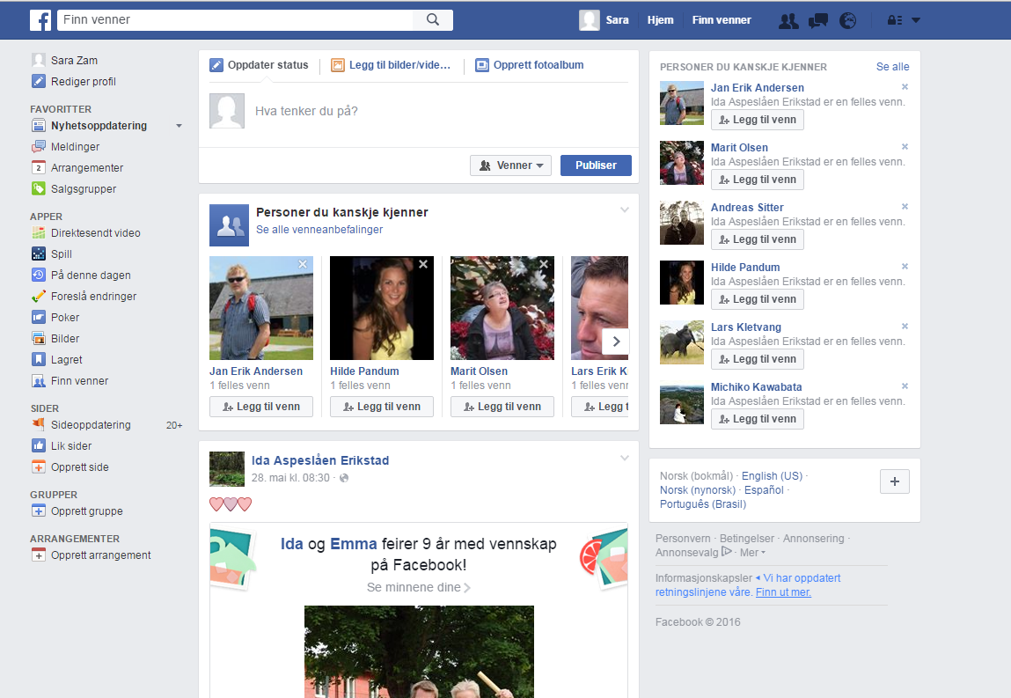
Getting to know the menu bar
8
Notes:
The Facebook menu bar is the line across the top of the screen. This line is blue when you use Facebook on a computer, but it can look a bit different when you use the Facebook app on a tablet or smartphone.

Slide 84
Getting to know the menu bar
8
Notes:
Sometimes, the menu will be split so that some of the features are displayed at the top and some at the bottom of the screen. Most of the functions, including the most important ones, are available regardless of whether you’re using a web browser or an app, though you do have slightly fewer options when using the app.

Slide 85
Getting to know the menu bar
8
Notes:
We already know the search field, where you can search for friends, groups, events etc.

Slide 86
Getting to know the menu bar
8
Notes:
The menu bar visible to computer users has three menu options on the right-hand side.
We’ll have a closer look at these options and see where you can find them in the app.

Slide 87


Getting to know the menu bar
8
Notes:
The first menu option shows your profile picture and your name. If you click on this, you’ll get to your wall/timeline straight away.

Slide 88
Getting to know the menu bar
8
Notes:
To find this menu option in the app, tap the menu symbol (three horizontal lines). A long list will then appear showing much of what is always visible when you are using Facebook on a web browser, but which is hidden to save space when using the app on a smartphone or tablet.

Slide 89
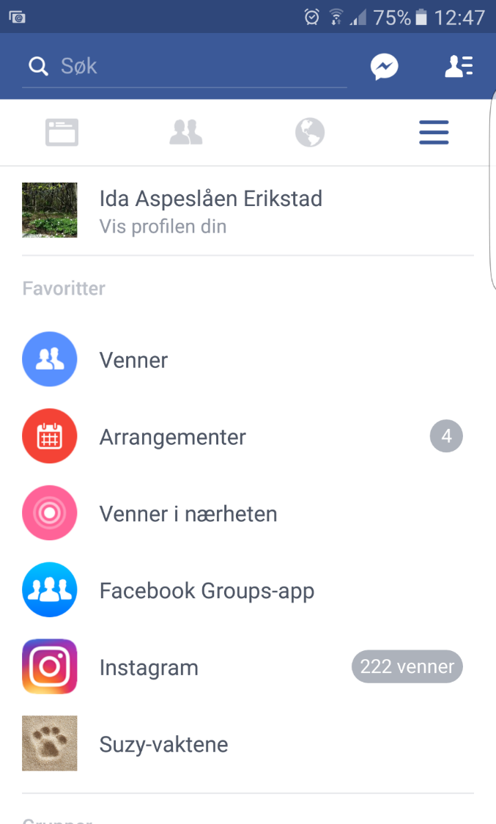
Getting to know the menu bar
8
Notes:
A long list will then appear showing much of what is always visible when you are using Facebook on a web browser, but which is hidden to save space when using the app on a smartphone or tablet.

Slide 90
Getting to know the menu bar
8
Notes:
Your profile picture and name is shown at the top of the menu bar. Tap it to get to your timeline.

Slide 91
Getting to know the menu bar
8
Notes:
Back to the web browser.
Clicking on ‘Home’ will take you back to the news feed. This is the same feed that shows up when you first sign in to Facebook, and it changes constantly to show you what your friends, associations and organisations are sharing and commenting, what news they are publishing etc.
In the app, this feature has a special icon: a small symbol of a screen. Tapping this symbol will take you back to the news feed.

Slide 92
Getting to know the menu bar
8
Notes:
The ‘Find Friends’ function is only available in the web browser. If you click here, you’ll see a list of users that Facebook thinks you may know. If you like, you can add people from this list as Facebook friends. You don’t have to use this feature. Searching for friends in the search field and adding them that way works just as well. The ‘Find Friends’ function is not available in the Facebook app, so you will have to search for people manually if you're using the app.

Slide 93
Getting to know the menu bar
8
Notes:
The next three menu options we will look at are: ‘Friend requests’, ‘Messages’ and ‘Notifications’.

Slide 94

Getting to know the menu bar
8
Notes:
These features are indicated by icons only. When using a web browser, the icons are located side by side on the menu bar and are dark blue in colour. In the app, the icons are the same, but whether they are located at the top or bottom of the screen depends on whether you’re using a smartphone or tablet.
A special feature of these three things is that a little number will appear in a red square next to the icon each time something new has happened in that category. Often you’ll also hear a sound, just like when you receive a text message on your phone.

Slide 95
Getting to know the menu bar
8
Notes:
The first category we will look at is ‘Friend requests’. When someone asks to be friends with you or a friend request you have sent to someone else is accepted, a number in a red square will appear here.

Slide 96

Getting to know the menu bar
8
Notes:
When someone asks to be friends with you or a friend request you have sent to someone else is accepted, a number in a red square will appear here. If you click on the icon, you will see a list that shows you what has happened and allows you to accept or decline the friend request.

Slide 97
Getting to know the menu bar
8
Notes:
The next category is ‘Messages’.

Slide 98

Getting to know the menu bar
8
Notes:
Here you’ll also see a red square with a number in it if anything new has happened since the last time you checked.

Slide 99
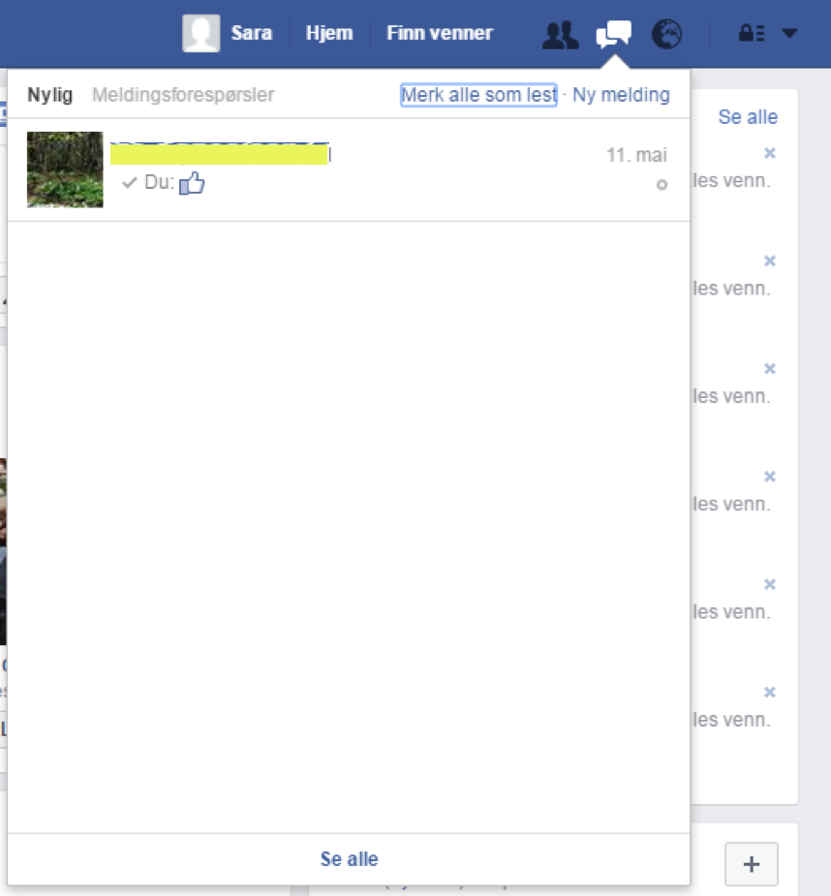
Getting to know the menu bar
8
Notes:
Clicking on this icon will show a list of the conversations you have had, and the most recent ones will always appear at the top. Click on one of the conversations in this list to continue it, and a chat window will open.

Slide 100
Getting to know the menu bar
8
Notes:
The last icon is ‘Notifications’. This reports other things happening on Facebook that concern you. This might be an invitation to attend an event or to join a group, a message saying that someone has posted, commented on or liked something on your timeline, or a message saying that someone you know has a birthday, or many other things.

Slide 101

Getting to know the menu bar
8
Notes:
Just like for the two other categories, a number will appear in a red square when you have new notifications.

Slide 102
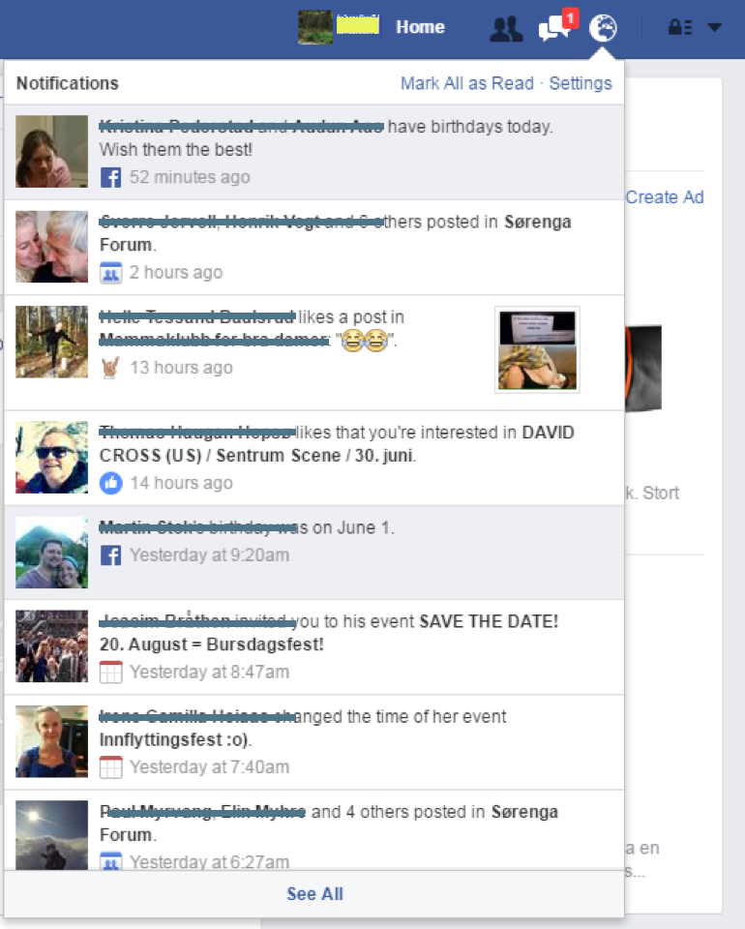
Getting to know the menu bar
8
Notes:
Click on the icon to see a list of what has happened. If you click on any of the items in the list, you’ll be redirected to the page where something has happened.

Slide 103
Getting to know the menu bar
8
Notes:
The final icon on the menu bar is an arrow when using Facebook on a web browser and is accessed via the menu symbol of three horizontal lines in the app.

Slide 104
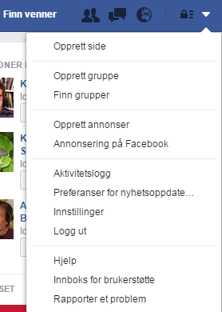
Getting to know the menu bar
8
Notes:
If you click on it, you’ll see a long list of other activities you can do on Facebook. There are many options to explore as you become a more experienced user, but in this course we will only be talking about the ones called ‘Help’ and ‘Log Out’.

Slide 105
Getting to know the menu bar
8
Notes:
Some way down the list you’ll find the menu option ‘Help’. If you click on this, you’ll reach Facebook’s Help Centre, where you can learn more about all the functions, services, settings and reporting options available. This may be a good place to start if you encounter issues and situations where you are unsure about what to do.

Slide 106
Part 9
Logging in and out

Slide 107


Logging in and out
9
Notes:
Some way down the list you’ll find the menu option ‘Log Out’. Those using the app on a smartphone or tablet will need to scroll all the way to the bottom of the list.
Clicking on this option will log you out of Facebook, and you will not receive messages and notifications until you log in again. If you’re normally the only person using the computer, tablet or smartphone you’re using now, it’s not common to log out of Facebook each time you have used it.
Most people find it convenient to receive a notification on their screen as soon as something important happens, and not to have to log in again to check. If you’re using a computer, tablet or smartphone that’s used by several different people, it’s important that you remember to log out so no one else can use your Facebook account and pretend to be you, change your password etc. This is especially important if you’re using a computer in a library or other public place.
To log out, click ‘Log Out’.

Slide 108


Logging in and out
9
Notes:
When you are logged out, these images will appear on your screens. You probably remember them from when we created our profiles earlier.

Slide 109

Logging in and out
9
Notes:
If you’d like to log in again, you’ll have to type your email address or mobile phone number and password in the web browser before clicking the ‘Log On’ button at the top of the page.
If you’re using the app, you just tap your name or photo in the middle of the screen.

Slide 110
Logging in and out
9
Notes:
If the name or photo that appears is not yours, you need to tap ‘Log in to another account’ and fill in your details just like you would if you were using a web browser.
When you have done this, you are back on Facebook again.

Slide 111
Ferdig – godt jobba alle sammen!
Nå kan dere øve på:
Logge på og av Facebook
Søke etter venner grupper og liknende
Å like grupper og selskap du liker, slik at du får oppdateringen om hva de foretar seg
Be om å få legge til noen i vennelisten din
Like, kommentere og dele artikler og bilder
Chatte med andre brukere
Bruke menylinjen
Notes:
THAT'S IT!

