Slide 1
LEARNING TO DOWNLOAD APPS
Learning objectives:
Being able to find and open the app store
Being able to search and buy apps
To delete apps
Notes:
Go through the learning objectives with the course participants before you begin teaching. This will make it easier for them to focus on and remember the most important information.

Slide 2
Part 1
About different phones and tablets

Slide 3
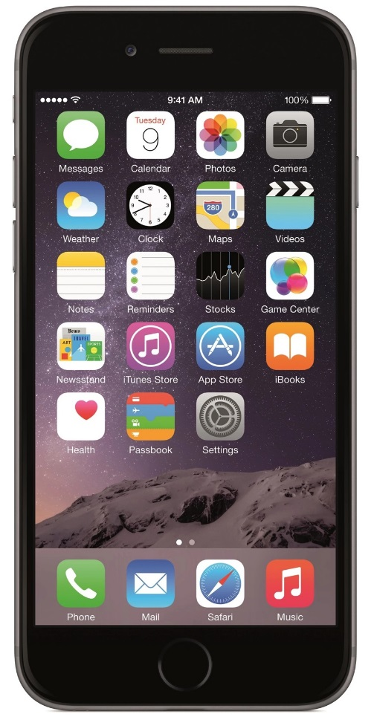
About different phones and tablets
1
iPad/iPhone
Notes:
There are three main types of smartphones and tablets in use in Norway.
A lot of people have an iPad or iPhone.

Slide 4
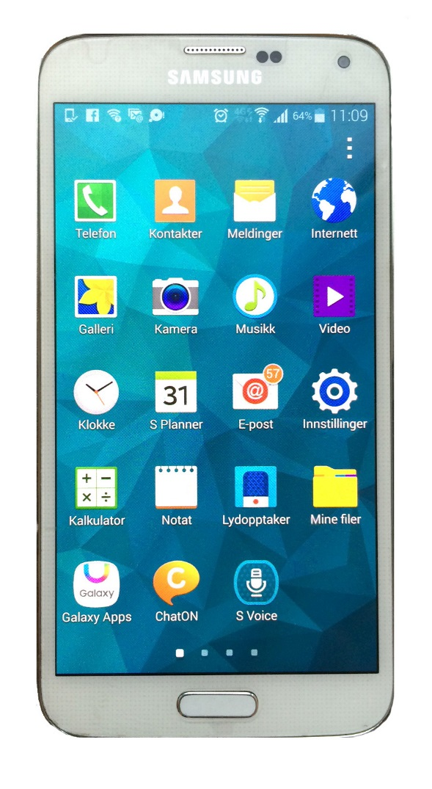
About different phones and tablets
1
iPad/iPhone
Android
Notes:
Android phones and tablets are also popular.

Slide 5
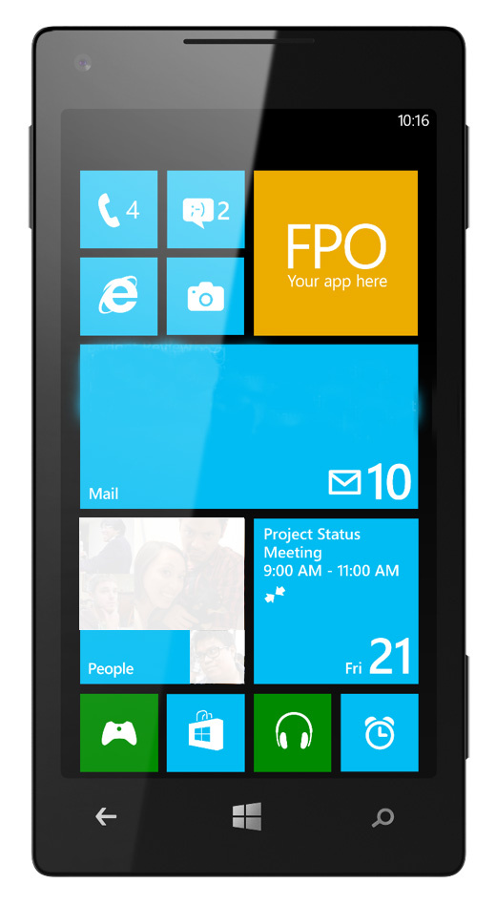
About different phones and tablets
1
iPad/iPhone
Android
Windows
Notes:
Some people use Windows phones and tablets.
A smartphone often has more functions than a tablet, and although tablets and phones from different manufacturers are not identical, they are quite similar and can mostly do the same things.
In this course, we will learn to download apps to tablets and phones. Pictures and explanations will be adapted to cover all the most common smartphones and tablets.

Slide 6
Part 2
Find your username

Slide 7
Find your username
2
iPad/iPhone
Android
Windows
Notes:
If this is your first time using the app store, you need to sign in with a username and password. Most people already have a user account. One is often created when you buy a tablet or phone and switch it on for the first time. To find out whether you have an account, go to ‘Settings’ on your phone.
The ‘Settings’ icon looks like this.

Slide 8
Find your username
2
iPad/iPhone
Android
Windows
Notes:
Tap the icon to open ‘Settings’.

Slide 9
Find your username
2
iPad/iPhone
Android
Windows
Innstillinger
iTunes og Appstore
Innstillinger
Kontoer
Innstillinger
E-post
Notes:
You are now in the ‘Settings’ menu. You will see a long menu with many items on the screen.
iPad and iPhone users need to tap the menu item called ‘iTunes and App Store’.
Android users need to tap the ‘Accounts’ button.
Those using Windows tap the item ‘Email’.

Slide 10
Find your username
2
iPad/iPhone
Android
Windows
Innstillinger
iTunes og Appstore
Apple-ID
Innstillinger
Kontoer
Google
Innstillinger
E-post
Kontoer
Notes:
iPad and iPhone users will find their username under ‘Apple ID’.
Android users will find their username under the item ‘Google’, often with a lower-case ‘g’ symbol next to it.
Windows users will find their username under ‘Accounts’.
Many people will have an email address they recognise as their user account/ID.
Make a round of the classroom to check that everyone has found the email address they need to sign in with.
If you find the username difficult to memorise, you can write it down so you’ll remember it for later.

Slide 11
Find your username
2
iPad/iPhone
Android
Windows
Innstillinger
iTunes og Appstore
Apple-ID
Innstillinger
Kontoer
Google
Innstillinger
E-post
Kontoer
Notes:
Those who don’t have an account to sign in with need to create one. It is almost like creating an email address, and you only have to do it once.
Help anyone who does not have a user account to create one.

Slide 12
Part 3
Logging in to your app store

Slide 13
Logging in to your app store
3
iPad/iPhone
Android
Windows
Notes:
When you are back on the home screen of your phone or tablet, it’s time to find your app store.
You’ll see the symbol of your app store above.
To use the app store, you must be connected to the internet.
Make sure that everyone has found their app store before you go on.

Slide 14
Logging in to your app store
3
iPad/iPhone
Android
Windows
Notes:
Open the app store by tapping it. Choose ‘Sign in’ and follow the instructions.
Type in your email address in the email address field (use the address we found in ‘Settings’ earlier).
Enter your password in the password field.
If you have used the app store previously, you might already be logged in.
Make sure everyone is logged in before you go on.

Slide 15
Part 4
Searching for an app

Slide 16
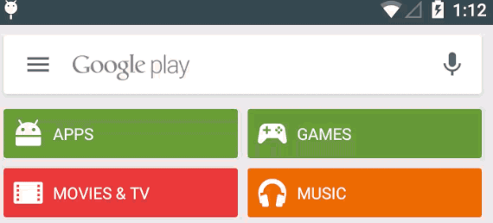
Searching for an app
4
iPad/iPhone
Android
Windows
Notes:
There are many apps out there. You will see some of the most popular ones as soon as you open the app store. To see more, just scroll down the page. Often, you will be looking for a specific app. To find the app you’re looking for, you have to search for it.
iPad/iPhone or Windows users need to tap the magnifying glass icon to search. This will make a search field appear on the screen.
Android users will find a search field at the top of the screen and need to tap it to start a search.

Slide 17
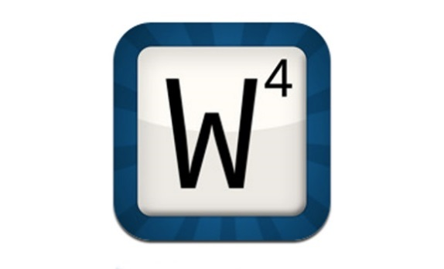
Searching for an app
4
Vipps fra DNB
Facebook
NRK Radio
Wordfeud
VG-TV
Notes:
There are a lot of apps that you can download. An app is a program that makes it easy for you to use digital services on a smartphone or tablet.
Apps can help you to access news, entertainment, games, banking services, social media and many, many other things. If you have a particular app in mind that you’d like to download to your phone or tablet, go ahead and search for it. If not, you can download one of these apps.
At the end of this course, you will learn how to remove apps from phones and tablets, so don’t worry too much about what you decide to download now.

Slide 18
Part 5
Downloading an app

Slide 19
Downloading an app
5
Wordfeud
Notes:
We’ll start by finding an app we would like to download. I’ll use Wordfeud as an example. This is a game similar to Scrabble that was very popular a few years ago.

Slide 20
Downloading an app
5
iPad/iPhone
Android
Windows
Notes:
I start by searching for Wordfeud in my app store.

Slide 21
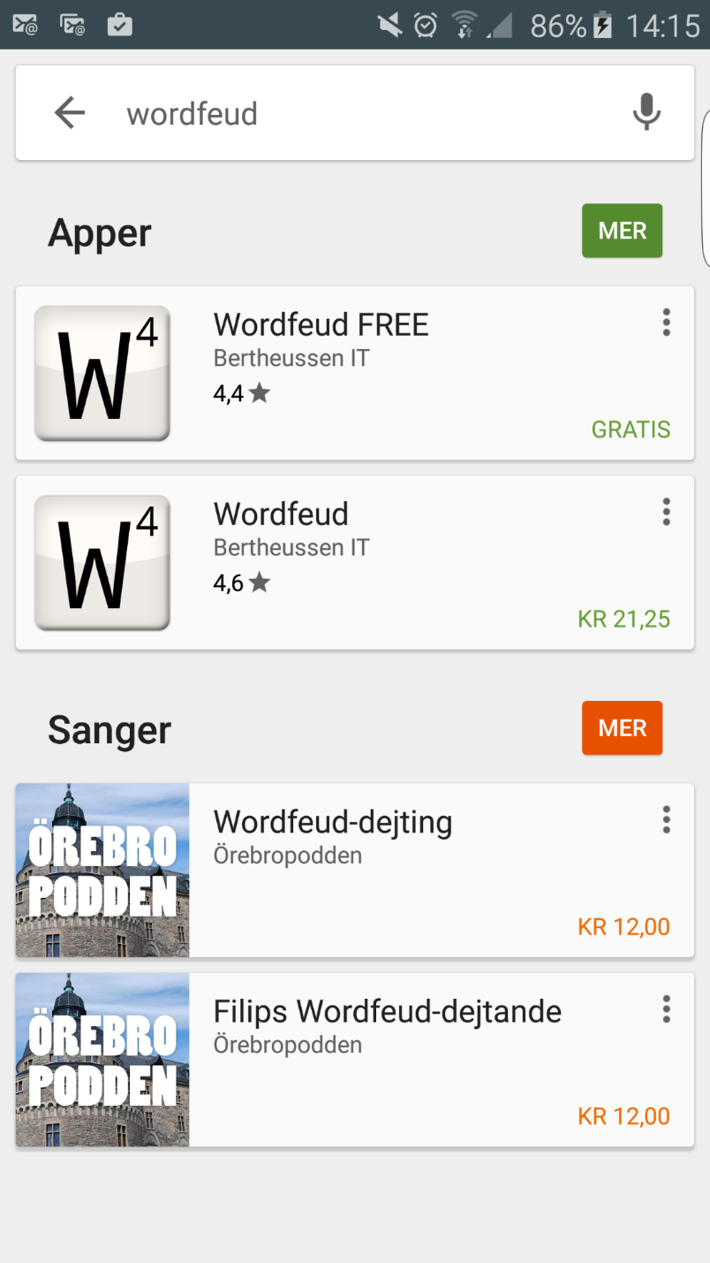
Downloading an app
5
Notes:
A list of the apps that fit my search will now appear.
I can see that the top two results are the ones I am interested in.

Slide 22
Downloading an app
5
Notes:
If you look more closely, you’ll see that one version of Wordfeud is FREE,

Slide 23
Downloading an app
5
Notes:
... while the other version costs money. When this happens, it is often because one of the versions, the free one, contains advertising, while the one that costs money has no ads. If you can, it’s a good idea to try out the free version first and then decide whether you think it’s worth spending money on the paid app.
Some apps are only available as free versions (this doesn’t necessarily mean that they contain ads), while others can only be downloaded if you pay for them.
To read more about an app before I download it, I can tap it once.

Slide 24
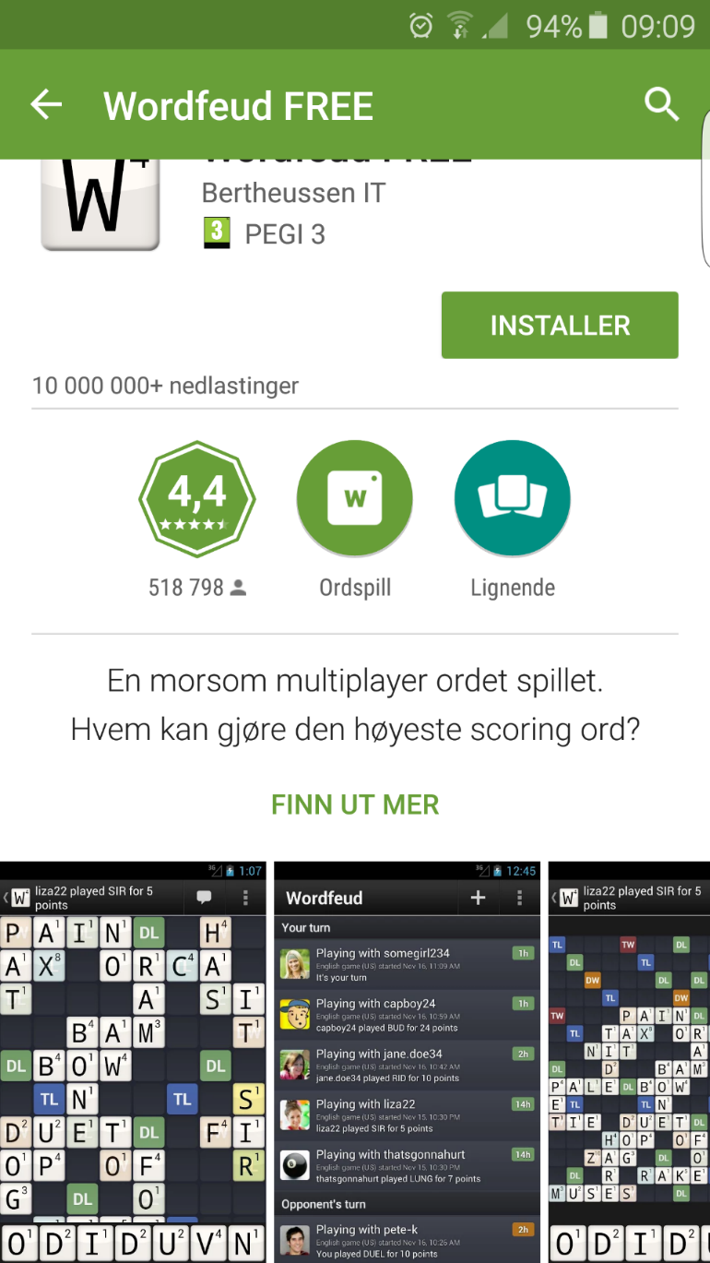
Downloading an app
5
Notes:
An information and download page for an app might look like this. The appearance depends on which app store and what type of tablet or smartphone you are using.
This screen provides information about the free version of Wordfeud.

Slide 25
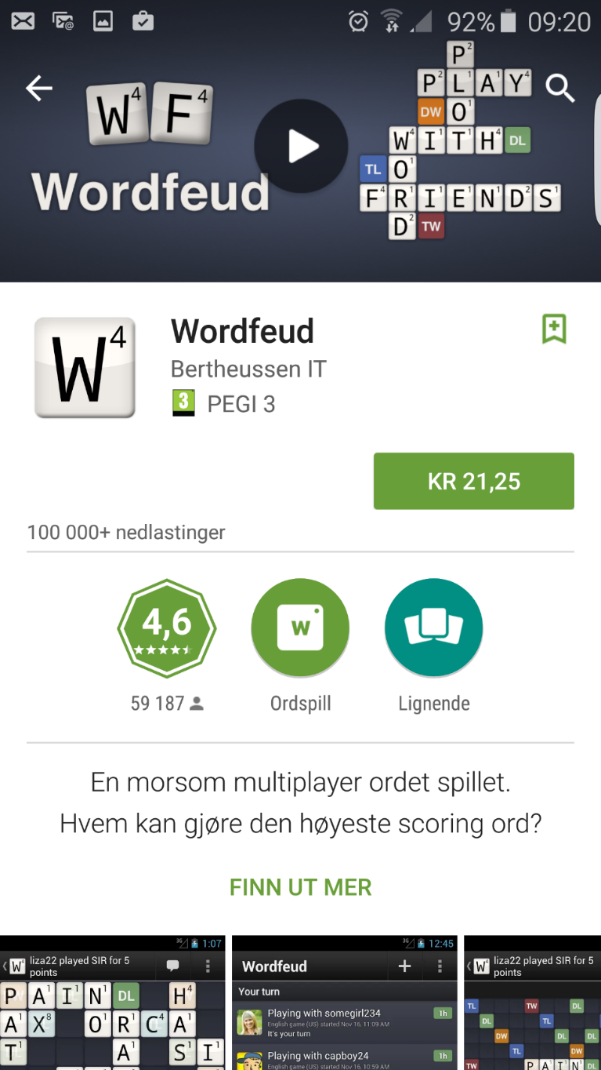
Downloading an app
5
Notes:
Here we can see what the paid version looks like.

Slide 26
Downloading an app
5
Notes:
To download the app, you need to tap a button that’s located towards the top of the page, often right by the app icon.
The exact text on the button depends on which app store you’re using.

Slide 27
Downloading an app
5
iPad/iPhone
HENT
eller
19,00 kr
Notes:
iPad/iPhone users will see ‘Get’ or the price of the app.

Slide 28
Downloading an app
5
iPad/iPhone
HENT
eller
19,00 kr
INSTALLER
eller
KJØP
Notes:
If you tap ‘Get’ once, it’ll say ‘Install’. If the app costs money, tap the price, and then it’ll say ‘Buy App’.

Slide 29
Downloading an app
5
iPad/iPhone
HENT
eller
19,00 kr
INSTALLER
eller
KJØP
Notes:
Tap once more to download or buy the app.

Slide 30
Downloading an app
5
Android
Windows
INSTALLER
INSTALLER
eller
eller
19,00 kr
19,00 kr
Notes:
On Android and Windows phones, you can tap ‘Install’ or the price button once.
Some of you might be instructed to enter your payment card details. If you get such a message, just follow the instructions on the screen. You usually only need to do this once. The app store will remember your card details for you, and it will not charge your card without your approval.

Slide 31
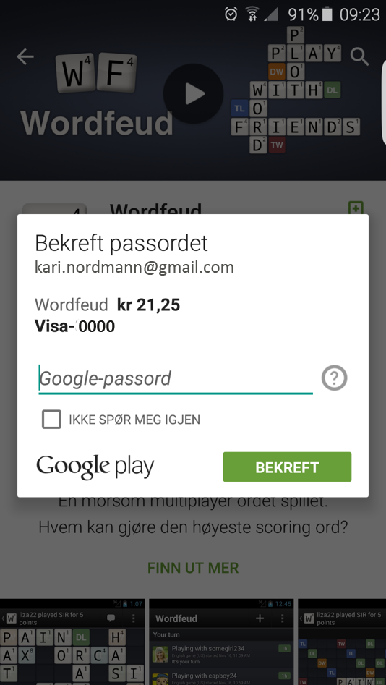
Downloading an app
5
Notes:
Some will be asked to enter a password to download the app. Type in the password and tap ‘Confirm’ or ‘Accept’.
Some will be asked to use their fingerprint to download the app.

Slide 32
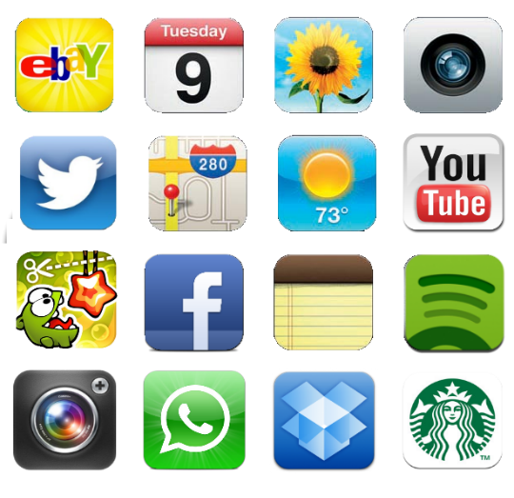
Downloading an app
5
Notes:
When the download is completed, the app can be found among the other apps on your phone or tablet. To find it, browse through your apps until you find the icon for your new app.

Slide 33
Downloading an app
5
Notes:
You can now tap the icon to open the app, just as you do with all the other apps you have opened on your phone already.
Make sure that everyone has succeeded in downloading an app and finding it on their device before you go on.

Slide 34
Part 6
Deleting apps

Slide 35
Deleting apps
6
00:00:01
Notes:
Sometimes you’ll want to remove an app from your smartphone or tablet. Some apps can’t be removed because they came with the tablet or phone, but all the apps you have downloaded yourself can be removed.
First, find the app you want to remove.
Next, touch it with your finger and hold for at least one second, and something will happen on the screen.

Slide 36
Deleting apps
6
iPad/iPhone
Android
Windows
AVINSTALLER
Notes:
iPad/iPhone users will see that all the icons on their screen will start to wiggle and will have an X in their left corner.
Android users will see a line with a recycle bin appear at the top of the screen. If you let go of the app with your finger, the screen will return to normal.
Windows users will get the option ‘Uninstall’ on their screen.

Slide 37
Deleting apps
6
iPad/iPhone
Android
Windows
AVINSTALLER
Notes:
To uninstall an app on an iPad/iPhone, tap the X.
Then you can tap the ‘Home’ button to make the icons stop wiggling.

Slide 38
Deleting apps
6
iPad/iPhone
Android
Windows
AVINSTALLER
Notes:
Android users can use their finger on the screen to drag the app up to...

Slide 39
Deleting apps
6
iPad/iPhone
Android
Windows
AVINSTALLER
Notes:
...the recycle bin and...

Slide 40
Deleting apps
6
iPad/iPhone
Android
Windows
AVINSTALLER
Notes:
...drop it.

Slide 41
Deleting apps
6
iPad/iPhone
Android
Windows
AVINSTALLER
Notes:
Windows users can tap ‘Uninstall’.

Slide 42
Deleting apps
6
iPad/iPhone
Android
Windows
AVINSTALLER
Notes:
If you are then asked for confirmation, just tap ‘Yes’ or ‘Uninstall’.
The app should now be deleted from your tablet or phone.

Slide 43
Ferdig – godt jobba alle sammen!
Nå kan dere øve på:
Søke fram apper
Laste ned apper
Slette apper fra smarttelefonen
Notes:
THAT'S IT!

