Slide 1

Studiebarometeret 2026
The national student survey on the educational quality in higher vocational education (HVE)

Slide 2
The Student Survey (Studiebarometeret)
A national survey which asks students about different aspects of quality related to their education
The Directorate for Higher Education and Skills (HK-dir) conducts the survey on behalf of the Ministry of Higher Education and Research
The survey is sent to all HVE students who
are enrolled in programmes of more than 30 credits, who have completed their first semester
Students enrolled in study programmes of exactly 30 credits
The results are published at hkdir.no/studiebarometeret

Slide 3
Topics covered in the survey include:
Learning activities
Information
Practical matters
Exams and other assessments
The study environment

Slide 4
How students complete the survey
A personal link to the survey will be sent to eligible students by email on 8 April
Students who have not completed the survey will be followed up by email and text message
All information is treated confidentially. Data which may be used to identify respondents will never be made public

Slide 5
Why Studiebarometeret?
Students are an important voice in the ongoing work to improve the quality of higher education!
Gives institutions useful information about students’ perception of the quality of higher education
Makes it possible to compare your study programme to corresponding study programmes at other Norwegian institutions

Slide 6
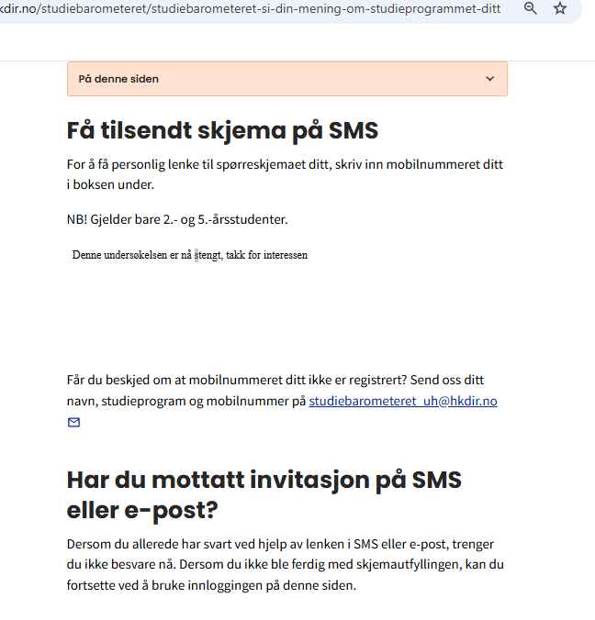
What should a student do if they do not receive the initial email?
Scan the QR code that is visible on all campaign material or go to https://hkdir.no/onsker-du-a-si-din-mening-om-utdanningen-din
Write your telephone number in the box and submit
Are you told your number is not found? Then fill in information by pressing the link.
After processing, you will receive a survey link.
send
Fyll inn kontaktinfo her: lenke
Note: Students who do not have their information registered in the public contact information register will not receive an invitation. This is often the case for international students. They need to submit the online form to receive a survey link

Slide 7
Studiebarometeret as a useful tool
Use it as a tool for quality development and strategic planning at your institution!
Institutions get:
Anonymous raw data
Data at the institutional and study field level
Reports for each educational programme
Studiebarometeret can complement your own surveys/analyses

Slide 8
Hkdir.no
Detailed view of data
Number of responses, response distribution, standard deviation
Norwegian and English versions

Slide 9
A high response rate is important!
So that the institutions receive correct information on educational quality
HK-dir needs the support of the institution – what can you do?
Take a shared responsibility for the survey across the institution
Set internal goals for response rate
Make a plan for disseminating information about the survey
Institutions may follow the response rate in real time online – you will receive a link for this

Slide 10
Tips for increasing the response rate
Create a competitive environment at the institution!
e.g. between programmes or locations
or by doing a raffle among responding students. We are happy to help you draw winners.
Information to all programme coordinators and academic staff
Set aside 15 minutes during class for students to complete the survey
Spread information via internal information channels and notice boards. Use HK-dir’s posters
Close cooperation between student representatives and staff on spreading information increases the response rate!

Slide 12
More information?
Read more about the survey at: https://hkdir.no/studiebarometeret
Results from previous years: : https://www.nokut.no/studiebarometeret/analyser
Any other questions? Do not hesitate to contact HK-dir at: studiebarometeret_fagskole@hkdir.no

