Slide 1


Slide 2

What is the student survey (Studiebarometeret)?
The only national survey examining students’ perception of the quality of their education
You are invited to participate if:
  you are enrolled in a programme of more than 30 credits and have completed your first semester, or
  you are enrolled in a programme of exactly 30 credits
Your answers will be anonymised so that nobody, including your institution, will be able to identify you

Slide 3
Why should you participate?
Your experiences and feedback are important!
Let your school know what it is doing well and what it should get better at
Your feedback helps your school improve their education – benefitting you or students who enroll after you.
🎉 3 winners
💰 5 000 kr
🎉 10 winners
💰 1 000 kr
Fill out and win!

Slide 4
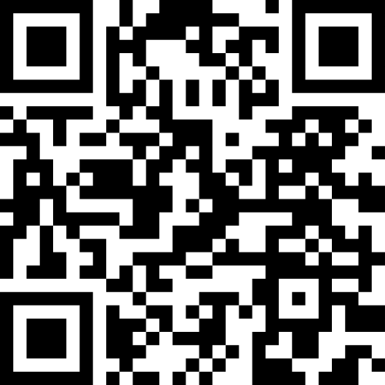
How to fill out the survey
Press the link that was sent to you by email
Or scan this QR code:

Slide 5

Studiebarometeret:
Voice your opinion about your study program!
The national student survey on educational quality

