Slide 1
Guidelines and tools for responsible international cooperation
A short introduction to regulations and resources

Slide 2
Background for the development of guidelines
National threat assessments point to the knowledge sector as a target for foreign intelligence and influence
International concern in the fields of research and higher education regarding reciprocity, integrity, research integrity, and academic freedom
In 2022 the Ministry of Education gave HK-dir and the RCN the task of developing guidelines for responsible international cooperation
The development of guidelines for responsible international cooperation is based on similar work in the EU and OECD, Sweden, the Netherlands, Denmark, and others
Notes:
National threat assessments: For several years, it has been pointed out that the Norwegian knowledge sector has increasingly become a target for foreign intelligence. The northern areas and the Norwegian research community in marine technology are particularly vulnerable. Additionally, the national threat assessments highlight Russia, China, Iran, and Pakistan as countries of concern. China is considered a very important partner country in research and higher education, and it is a country with which the Norwegian knowledge sector has largely sought to collaborate.
International concern: Over several years, there has been growing concern about knowledge collaboration, particularly with China but also with other countries, in terms of reciprocity and integrity. In response to this concern, many countries have been working to increase awareness around security and ethics in international cooperation.
Mandate from the Ministry of Education: HK-dir and the Research Council of Norway were tasked with developing guidelines for responsible international cooperation. The guidelines were developed in close collaboration with the knowledge sector and relevant authorities in the field, including security authorities.
Guidelines from other countries: We are not alone in this effort and have benefited from the work of the Swedes, the Dutch, and the Danes in this area. Guidelines and tools for responsible international knowledge cooperation have been developed with a particular focus on the EU's toolkit; 'Tackling R&I Foreign interference.' One of the directives from the Ministry of Education to the Research Council of Norway and HK-dir was that the guidelines should be aligned with the EU framework to avoid creating unnecessary obstacles for Norwegian knowledge institutions.

Slide 3
Defining «responsibility»
"‘(...) taking into account academic values and national interests, including security interests, when entering into international cooperation.’ (Responsibility in the Panorama strategy)
Academic values refer to the autonomy of universities and colleges, academic freedom, and research ethics.
National security interests concern the country's sovereignty, territorial integrity, and democratic form of government."
Notes:
"The guidelines base their definition of responsibility on current Norwegian legislation and a principle of responsibility as defined in the Panorama Strategy, which is the government's strategy for knowledge cooperation with strategic partner countries outside Europe. Responsibility in the Panorama Strategy is defined along two axes: academic values on one side and national interests/security interests on the other.

Slide 4
Basic structure
The guidelines are:
Thematically organized
Target group-oriented (Management/administration and faculty)
Web portal and report
In Norwegian and English
Notes:
Retningslinjene er:
The guidelines are:
Thematically oriented and structured according to the activities involved in international cooperation, such as planning research and educational collaborations, student exchanges, visiting researchers, digital collaboration, and export control for knowledge transfer.
Target audiences: The guidelines are designed with the understanding that professional environments and management/administration have different tasks and responsibilities. Therefore, each area provides two different sets of recommendations for management/administration and the professional environment.
Web portal and report: The guidelines are available in two formats: as a report and as a web portal. The difference between the two is that the web portal is based on the report but features a condensed format. The web portal will be updated with links and new resources over time.
Language: Both the report and the website are available in Norwegian and English to ensure accessibility for English-speaking staff and international collaborators.

Slide 5
How can the guidelines be used?
Gain an overview of laws, regulations, and institutional obligations
Increase awareness of risks and threats in international cooperation
Enhance internal procedures and support functions for international collaboration and recruitment
Improve planning and implementation of international knowledge cooperation

Slide 6
The guidelines
Are country-agnostic and independent of disciplines
Provide an overview of laws and national and international regulations relevant to the knowledge sector
Describe the responsibilities of the knowledge sector
Outline known challenges in the thematic areas
Include recommendations for assessments and procedures in various thematic areas for management/administration and researchers/professional environments
Make available guides, reports, checklists, and templates
Notes:
The guidelines are general with respect to country and discipline considerations. They are aimed at developing robust systems that ensure academic values and security within knowledge institutions. They have been developed to assist the sector in navigating its international collaborations in a heightened geopolitical climate, which requires better planning, mapping, and diligence for the knowledge sector to meet its obligations and manage its responsibilities.
The guidelines are structured as follows for each thematic area:
Describe laws, regulations, and guidelines and what these entail in terms of responsibility
Outline known challenges in the thematic field
Provide a list of assessments and suggestions for procedures for management/administration and researchers/professional environments
Compile relevant existing guides, both national and international
Key points – it is recommended to build upon existing systems for security management and risk management. The principle of proportionality in the developed framework is important, and this depends on the forms of collaboration institutions engage in and their scope. Risk is never zero, but it is important to have an overview of the institution's values, combinations of risk sources in collaboration, and to plan for how risk can be managed or mitigated.

Slide 7
Digital tour
Notes:
On the website, you will see that the first two tabs gather a set of overarching recommendations for management and administration on one side, and for the professional environment on the other. This is a summary of the key advice provided by the guidelines and tools.
Additionally, there are dedicated thematic sections on:
International research and innovation collaboration
International higher education collaboration
Risk and security management at knowledge institutions
Academic values and research ethics
Each of these pages has subpages with resources – for example, the section on international research and innovation collaboration includes resources on partnerships, research collaboration agreements, export control, open research and sharing, information security and privacy, and the invitation and management of visiting researchers.
The pages conclude with a bullet-point list of suggested assessments and procedures. This list can be used as guidance for the evaluations that should be made concerning academic values, ethics, and security in international collaboration.

Slide 8
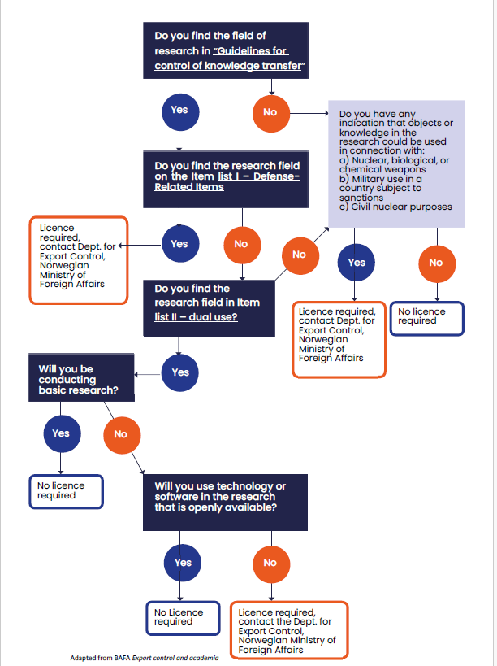
Want to learn more?
Subscribe to the newsletters from the Research Council and HK-dir. They announce webinars on responsible international knowledge collaboration (in Norwegian)
You can find recordings of previous webinars at the bottom of the website (in Norwegian):
Guidelines and tools for responsible international knowledge cooperation

