Slide 1

Studiebarometeret: Voice your opinion about your education!
The national student survey on the educational quality

Slide 3
What is the Student Survey (Studiebarometeret)
The only national survey examining students’ perception of the quality of their educational programme
The survey is sent to all students who are either
enrolled in programmes of more than 30 credits, who have completed their first semester
or enrolled in study programmes of exactly 30 credits
Norwegian Directorate for Higher Education and Skills (HK-dir) conducts the survey on behalf of the Ministry of Education and Research
The results are published at hkdir.no. Each school receives additional data

Slide 4
We want to know what students think about:
Learning activities
Information
Practical matters
Exams and similar assessments
The study environment
… and other aspects about their programmes

Slide 5
How do students fill out the survey?
A personal link to the survey is sent to all eligible students on 8 April
Students who do not complete the survey will receive reminders by text message or email
All information is treated confidentially. Data which may be used to identify respondents will never be made public

Slide 6
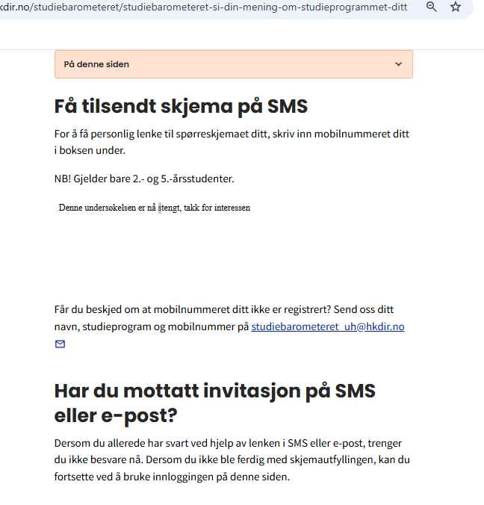
What should a student do if they do not receive the initial email?
Scan the QR code that is visible on all campaign material or go to https://hkdir.no/onsker-du-a-si-din-mening-om-utdanningen-din
Write your telephone number in the box and submit
Are you told your number is not found? Then fill in information by pressing the link.
After processing, you will receive a survey link.
send
Fyll inn kontaktinfo her: lenke
Note: Students who do not have their information registered in the public contact information register will not receive an invitation. This is often the case for international students. They need to submit the online form to receive a survey link

Slide 7
Why should students bother to fill out the survey?
It provides students a platform to express their opinions about their programmes
It gives students an opportunity to influence their own study programme
It informs wider society about the state of higher vocational education

Slide 8
…. And it could pay off
🎉 3 winners
💰 5 000 kr
🎉 10 winners
💰 1 000 kr

Slide 9
A high response rate is important!
To ensure that your programme is displayed in the web portal
To get a data quality that is sufficiently good

Slide 10
Tips for increasing the response rate
Inform the students about the survey during class! – and ask teachers to set aside 15 minutes for students to fill it out
Spread information via internal information channels and notice boards
Create a competitive environment at the institution!
E.g. cake award to programmes that acheive the highest response rate

Slide 11
More information?
Read more about the survey at: Studiebarometeret | HK-dir
Results from previous surveys: https://www.nokut.no/studiebarometeret/analyser
Any other questions? Feel free to contact HK-dir at: studiebarometeret_fagskole@hkdir.no

