Slide 1
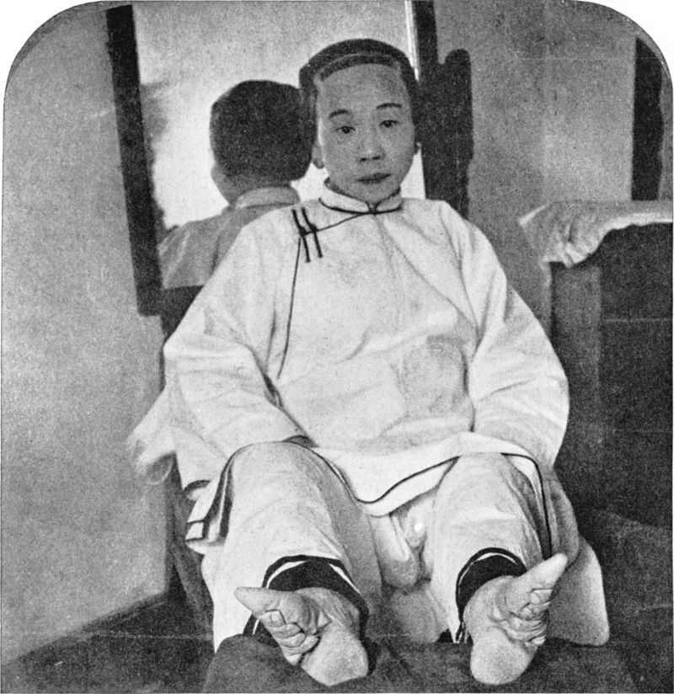

Slide 2
Foto: Fearlontach (flickr)

Slide 3
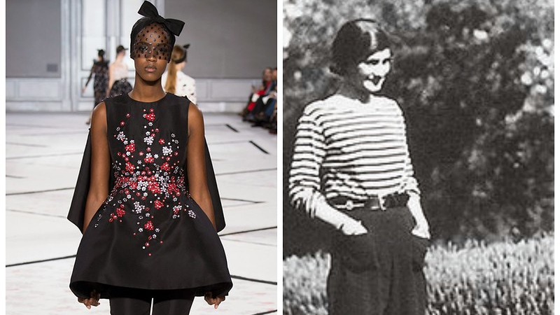
Foto: Carolina Franco (flickr)

Slide 4
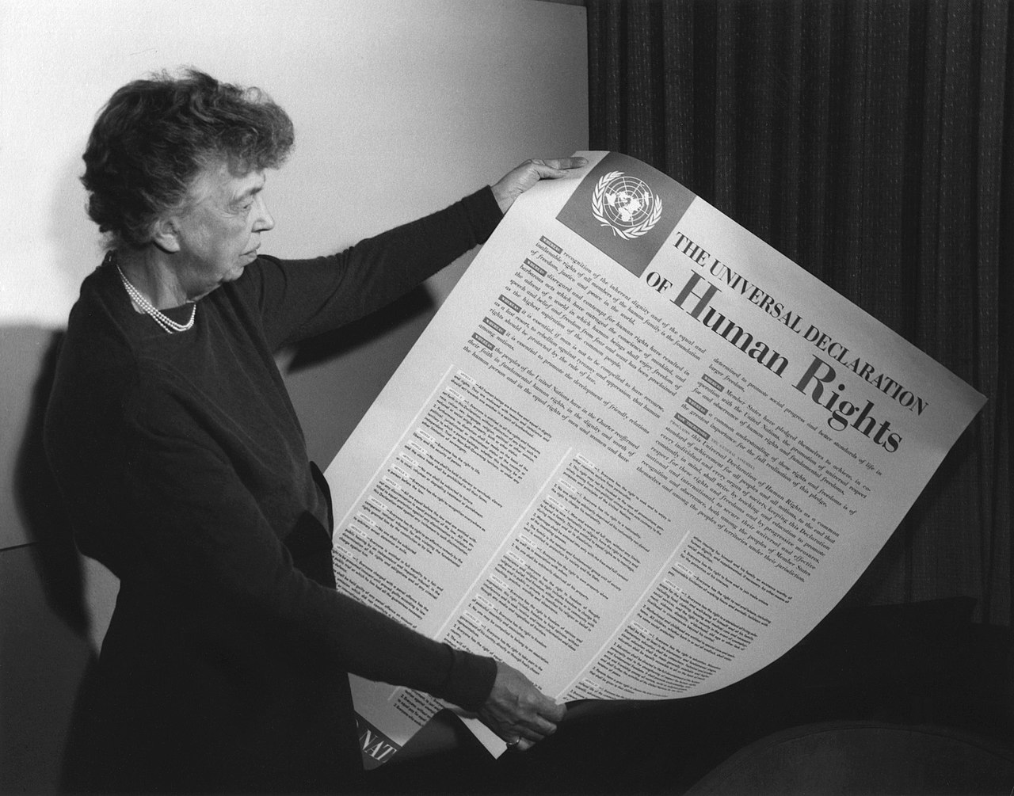

Slide 6
Foto: Olaf (flickr)

Slide 7
Foto: Gabriela Sanda (pixabay)

Slide 8
Foto: Castorly Stock(pexels)

Slide 9
Foto: Ruth Archer (pexels)

Slide 10
Foto: Quang Nguyen Vinh (pexels)

Slide 11
Image by master1305 on Freepik

Slide 12
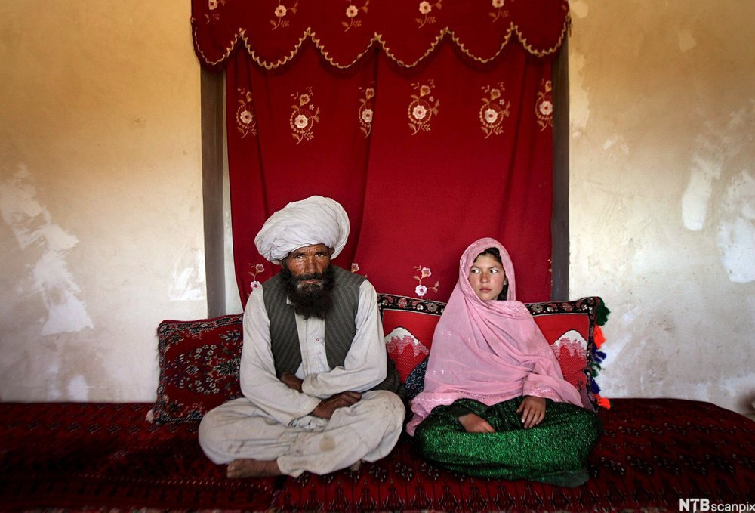
Tvangsbryllup i Afghanistan, av (UNICEF), S. S., EPA, NTB scanpix. (https://ndla.no/article/36176). CC BY-NC-ND 4.0.

Slide 13
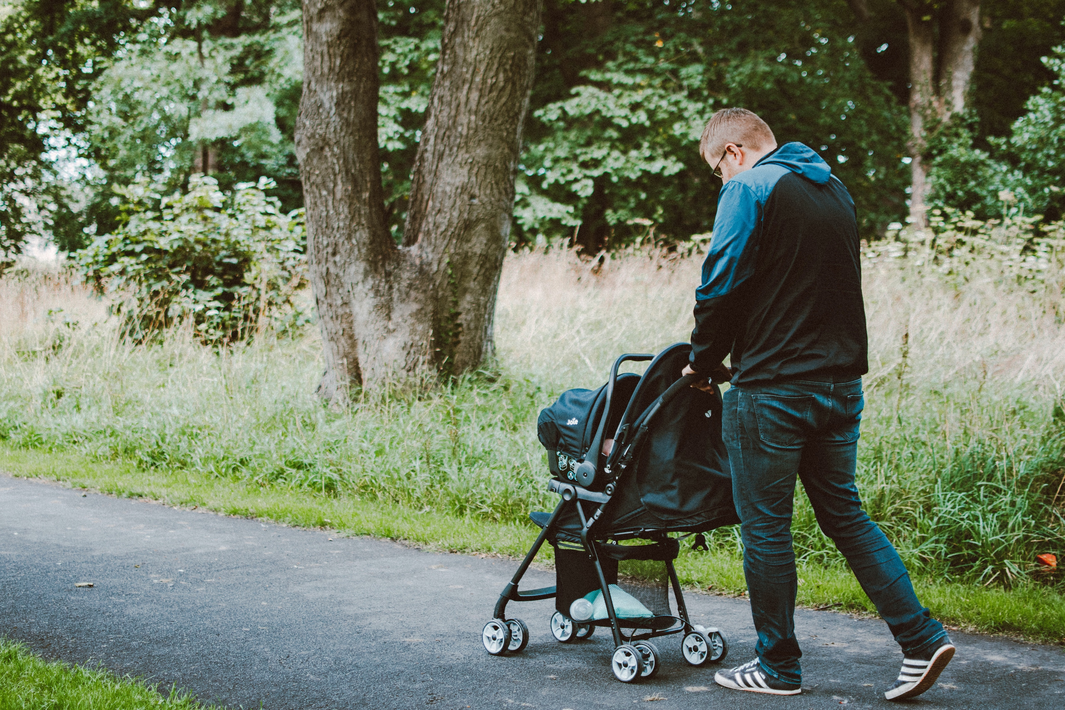
Bilde av Lisa Fotios (pexels)

Slide 14
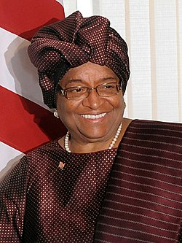
Attribution 3.0 Brazil (CC BY 3.0 BR)

Slide 15
Foto: Russell Watkins/Departement
for International Development (flickr)

Slide 16
Foto: Amnon s (Amnon Shavit)https://creativecommons.org/licenses/by-sa/3.0

Slide 17
Foto: Davey D Cook (flickr)

