Slide 1
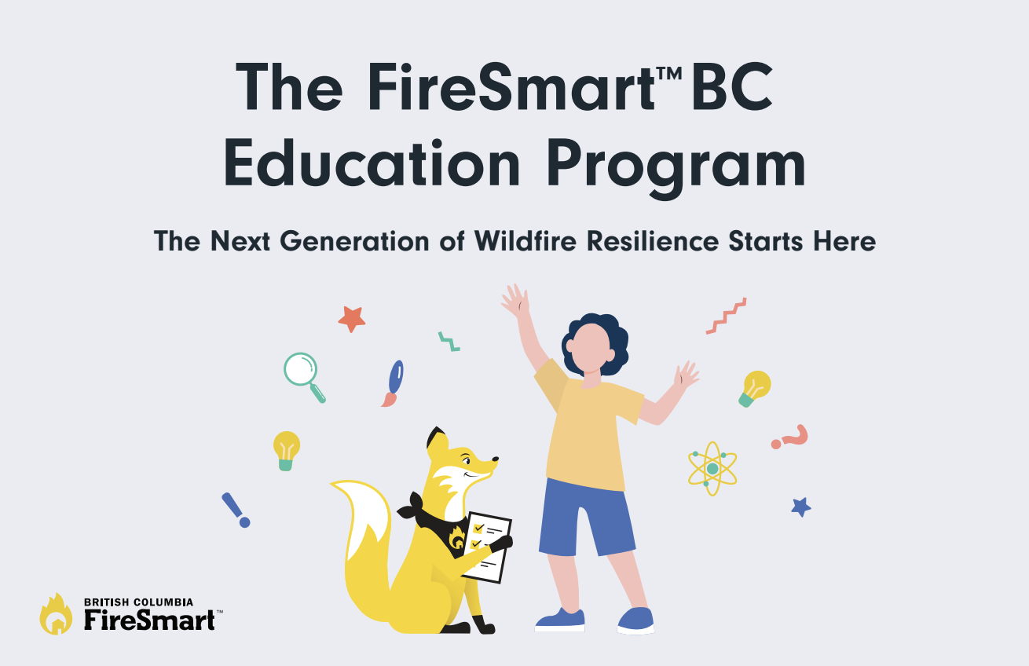
FireSmart, Intelli-feu and other associated Marks are trademarks of the Canadian Interagency Forest Fire Centre.
Notes:
Elementary School Presentation - 30 Minutes
(consider bringing Ember mascot, small value prizes, and colouring sheets/Kids Home Assessments)
Use “hands up” if students have questions. Respect teachers discipline efforts and abide by their rules to keep structure within the students.

Slide 2
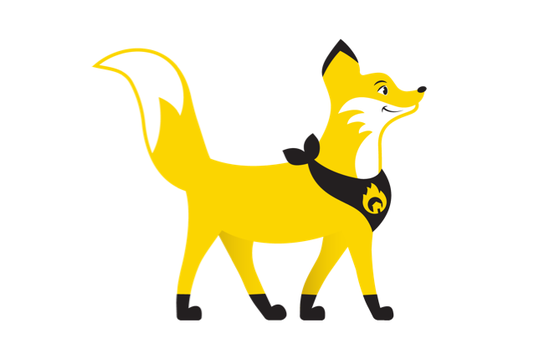
Who We Are
Notes:
Introductions and Land Acknowledgement
Give a land acknowledgement, encourage the group to reflect on which land they are on. If you are unsure of the territory you reside on, visit Native-land.ca to learn more (or ask your teacher).
Show of hands, who has seen firefighters before? (Introduce yourself - consider adding photos of yourself to the slide)
Show of hands, who has seen Ember the FireSmart Fox before?
Ember is the mascot for the FireSmart program. You may have seen her around on tv ads or on billboards if you’ve driven to other towns! She is the perfect mascot because of her unique characteristics, which include alertness, adaptability, intelligence and community mindedness.

Slide 3
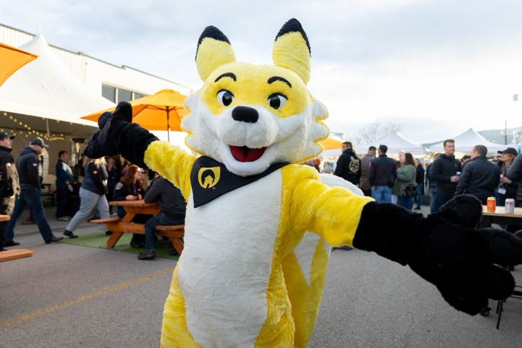
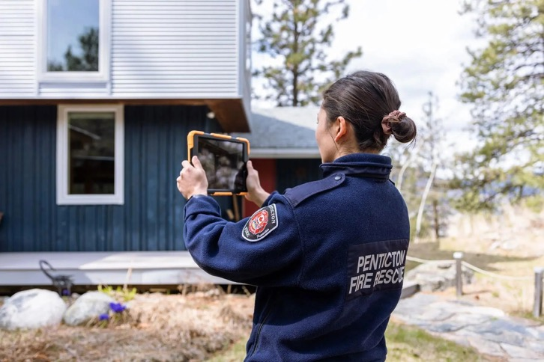
What We Do
Notes:
We support different communities across British Columbia to help keep them safe from wildfire. This can be helping people remove items from around their home that could catch on fire, or helping them understand what they could do to in case of a fire, and sometimes, we even work when a fire is nearby.
We help the people of (insert the community you are in) learn how to make their homes safe from wildfire.
We also attend all kinds of events throughout our community and talk to as many people as possible about what FireSmart is and what they can do to make our community safer.

Slide 4
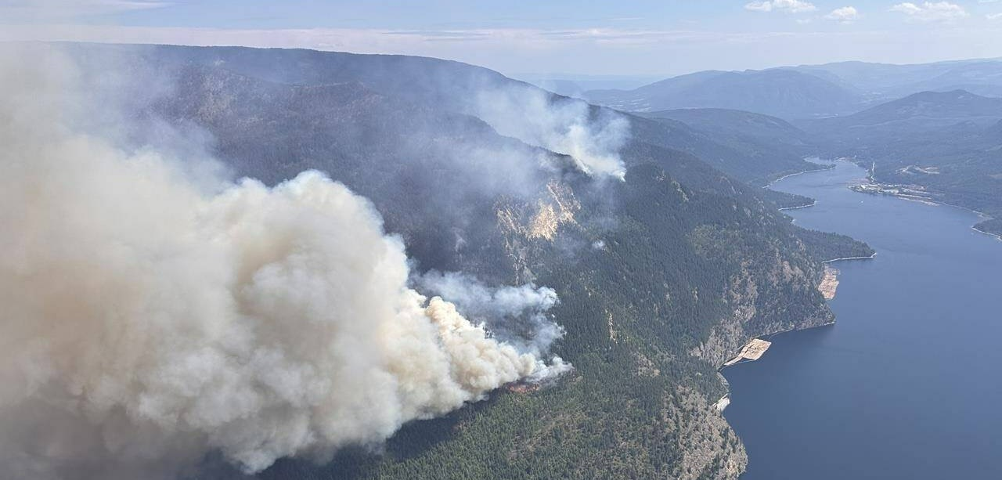
Who has seen a wildfire?
Notes:
Show of hands, how many of you have seen a wildfire? Have you seen big plumes of smoke like the one in this picture? Have you seen an orange glow in the mountains at night? Maybe some of you have seen open flames on a hillside? Have you noticed the smoke in the summers? Or seen fires on the news?
British Columbia sees many wildfires throughout the summer season.
Our big forested areas, large mountains and hot dry summers are exactly what a wildfire needs to start and grow.
So the next question is: What is a wildfire? To answer that, let’s start with what is a fire.

Slide 5
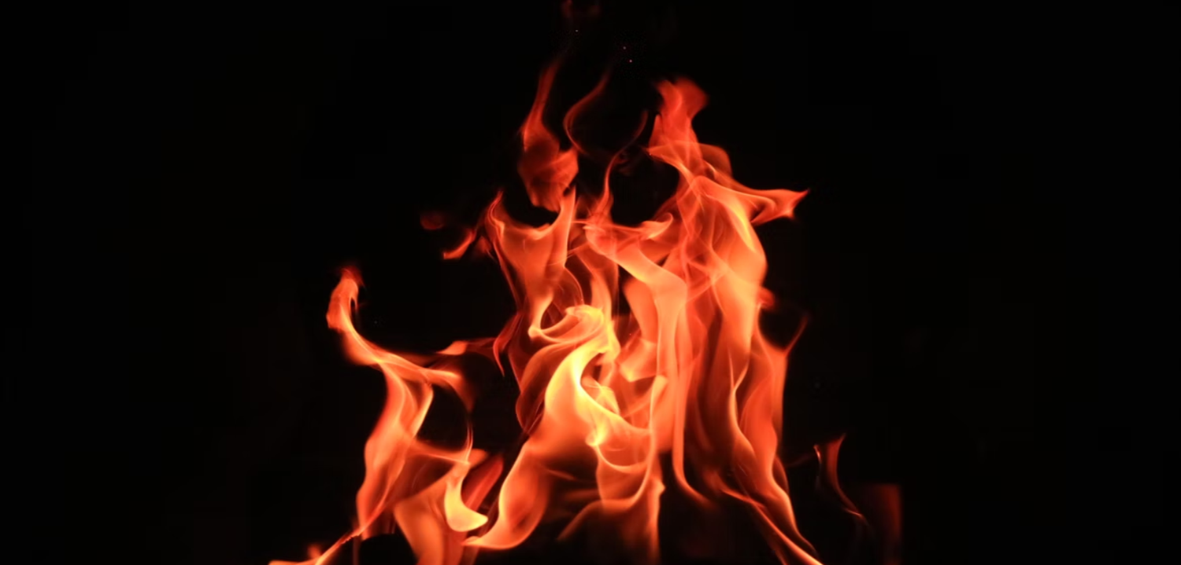
What is fire?
What is a wildfire?
Notes:
A good place to start learning about wildfire is by learning what fire is.
Fire happens when something gets hot enough to burn. When it burns, it gives off heat, light, and smoke.
Fire needs three things to keep burning:
Heat to start it,
Oxygen from the air,
Fuel, which is something that can burn.
Ask a group question: Hands up if you think rocks could burn? Hands up if you think wood could burn?
For a wildfire, the fuel is usually things like trees, grass, leaves, branches, and other plants.

Slide 6
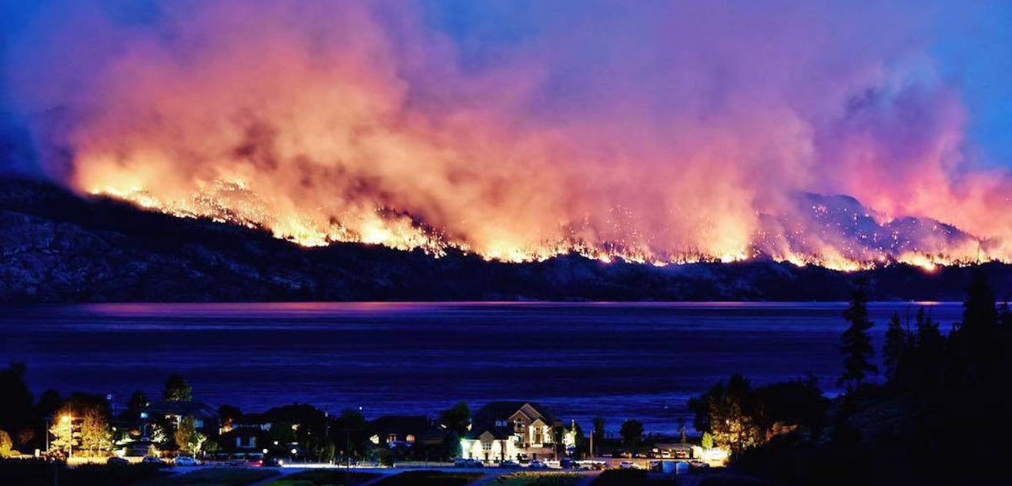
What is a wildfire?
What is a wildfire?
Notes:
Knowing what we now know about fire, what do we think a wildfire is now?
A wildfire is an uncontrolled fire that happens outside in a forest or on a grassy hillside. Just like a regular fire (like a campfire or a birthday candle), a wildfire needs heat, fuel, and oxygen to start and keep burning.
Let’s watch a short video to help clear some things up.

Slide 7
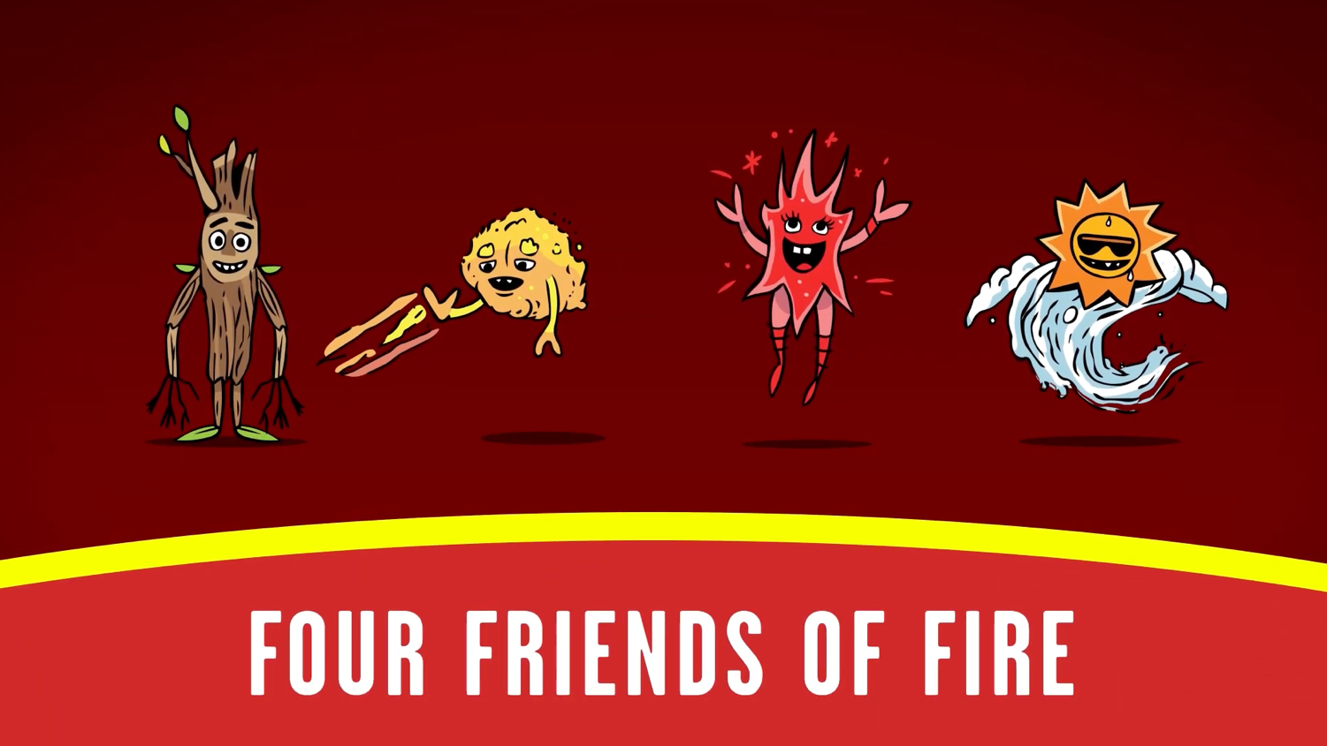
Notes:
https://www.youtube.com/watch?v=yo1DsSarYdE
Our friends in Australia have put together this video that helps explain what a wildfire is. One thing to note before we start the video is that in Australia, “Wildfires” are called “Bushfires”

Slide 8
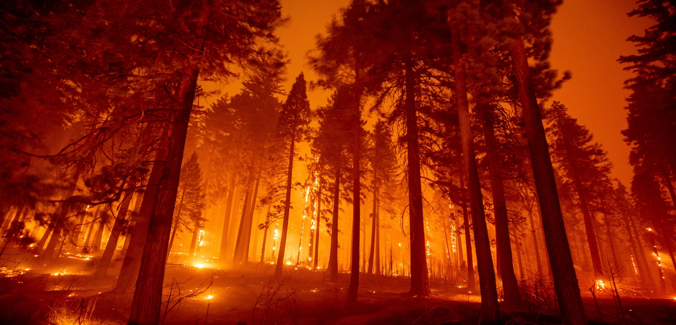
Is wildfire good or bad?
Notes:
Show of hands: How many people think that wildfire is bad? Show of hands: How many people think that wildfire is good?
Wildfire (or bushfire like in the video) is a general term which includes forest fires, grassland fires, and any other vegetation fire in the natural environment.
Now we all know that fires can be very dangerous. A fire that gets out of control can cause serious harm and damage.
But did you know that wildfire is a natural phenomenon?
A natural phenomenon means that it’s part of nature. That means that natural landscapes and plant life that surround us, all over British Columbia, were shaped by fire.
Wildfire has been around on the planet for a very long time. In fact, it's been around much much longer than we humans have. It’s actually older than dinosaurs!
And wildfire is something that is needed for a healthy forest to grow. It’s as much a part of nature as sunshine or wind or rain.
Historically and currently, Indigenous people in BC have used fire to increase forest health, protect themselves from ticks, create more food for themselves and for animals.

Slide 9
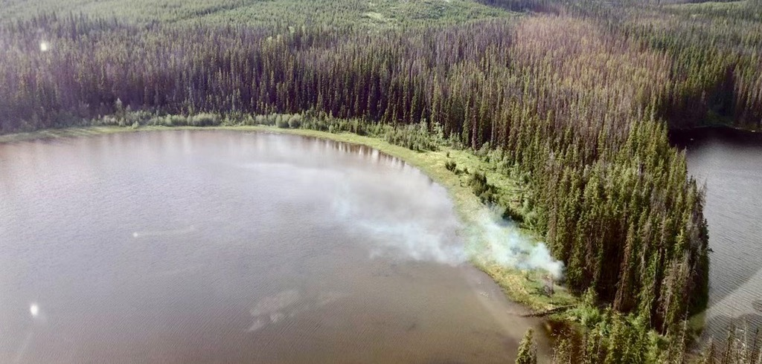
How many wildfires are there each year in BC?
Notes:
Now that we know what a wildfire is, how many do you think there are? (Get the students to guess)
On average: 1600 wildfires per year.
In 2024, there were 1,697 fires.
In 2025, there were 1,370 fires.

Slide 10
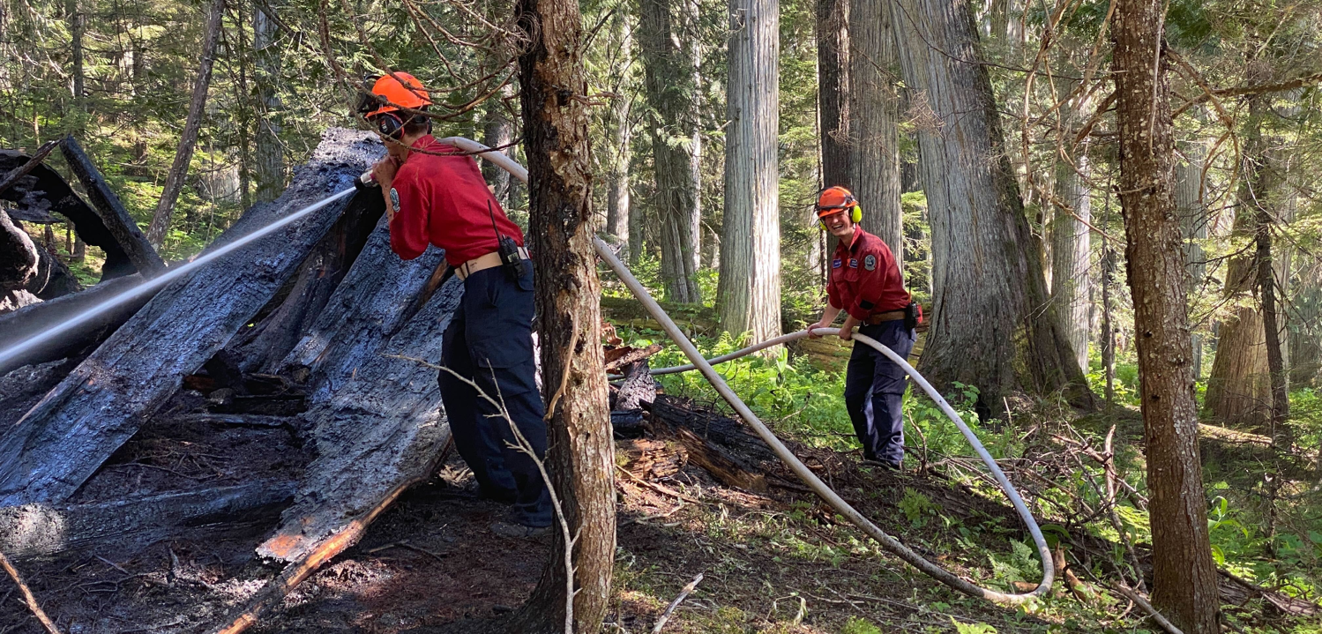
Why do we fight wildfire?
Notes:
So now we know that wildfire is an important part of the natural life cycle of an ecosystem.
You may be asking yourself, if wildfires are natural, why do we fight them?
Hands up: Why do we fight fires? (Take one answer)
These days, people live in forests or places with trees. Our homes, businesses, and schools are built in areas where wildfires used to burn freely. If a wildfire gets out of control, it can be very dangerous and cause harm to people and their homes.
You and your family may have to leave your home for your safety if a wildfire is close by. That is called an evacuation. Homes, schools, and other important buildings may be damaged if they are not prepared.

Slide 11
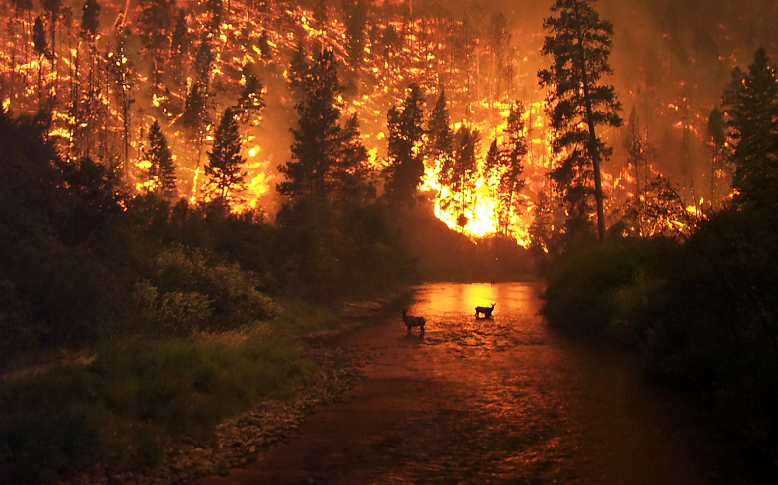
What do we see?
Notes:
Wildfire has actually been around for so long that different plants and animals have adapted to learn to live with it.
What do you see in this picture? (take some answers)
Notice the elk in the river!
Why do you think they are in the river? (take some answers)
Most animals that live in areas that have wildfires have an instinct for avoiding wildfire.
Some species instinctively head down slope away from fires which typically burn uphill.
Others will go towards their water source, out of harm's way.
Some trees have grown bark that is so thick that fire can’t burn the tree.
So if animals have learned how to live with fire, it’s about time humans learn to live with fire too.

Slide 12
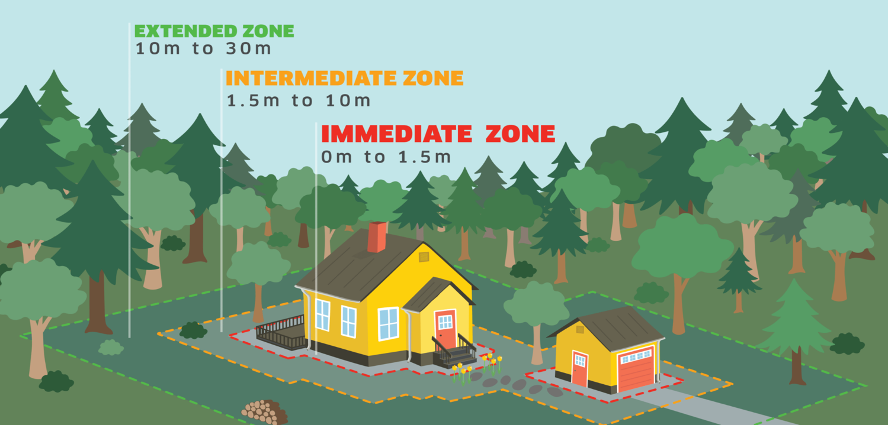
What is FireSmart?
Notes:
Does anyone live close to a forest? What about close to a park? Do you have trees or bushes around your home? Many of us do, so it’s important to understand how wildfires spread.
Wildfires throw off bits of burning wood called embers (just like in a campfire). Those embers can collect around buildings and start new fires in towns.
Having our homes and community prepared for wildfires like this is called being FireSmart. What exactly is FireSmart?
Just like how we wear helmets when we ride our bikes or wear sunscreen to protect our skin from the sun, Firesmart is a set of actions we can take to protect ourselves and our homes and the environment from the danger of wildfires. When we FireSmart our home, we make it hard for embers to collect and start new fires.
What are some actions we can do around our home to make them safer? (Take 2-3 answers)
We are now going to watch a short video where our friend, Ember, will show us some actions we can take to make our homes safer.

Slide 13
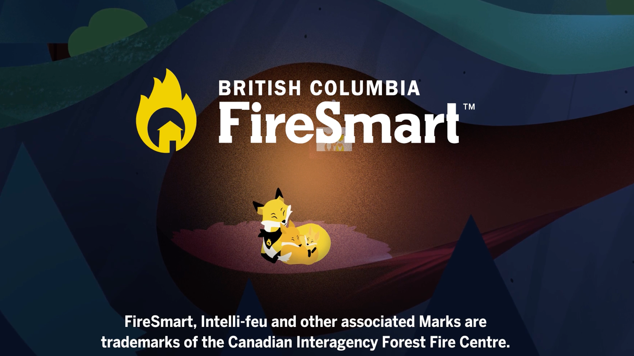
Notes:
https://vimeo.com/531039180?fl=pl&fe=vl
Pay attention, because there might be some questions at the end.
We can’t stop wildfires from ever happening again because they are actually good for the forest. And we don’t know when a wildfire will happen near our home or community. So, just like the animals have learned how to live with wildfire, so will we. We need start doing FireSmart work on our homes to prevent them from catching on fire from a nearby wildfire.
Let’s watch a quick video of how Ember can help your neighbourhood to be FireSmart.

Slide 14
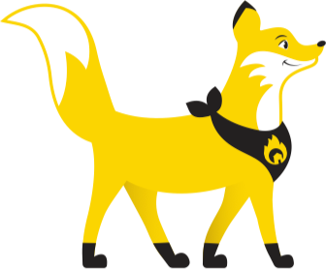
What are some reasons that wildfires might start?
What type of materials did Ember help remove from the home to make it more FireSmart?
What helpful actions did Ember do?
Notes:
Answers:
Lightning, human-caused
Firewood, branches, leaves, debris
Cleaned off a roof, picked up wood on the ground, educated her neighbours
(It can be nice to have stickers/tattoos/Ember pins as prizes)

Slide 15
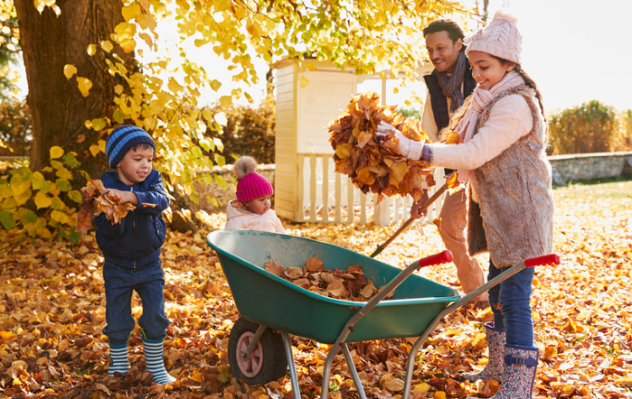
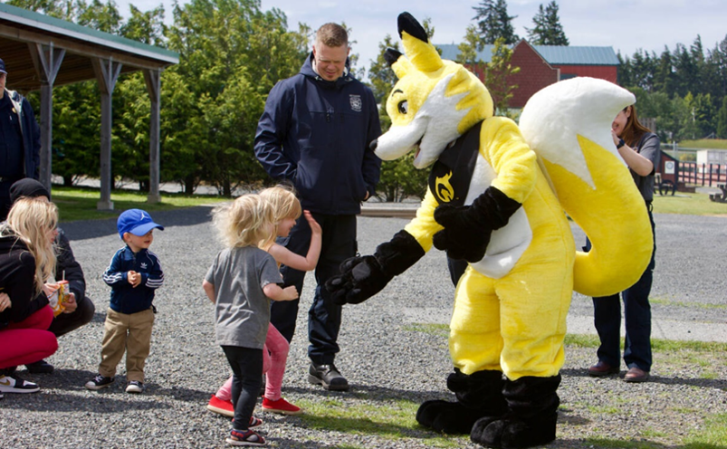

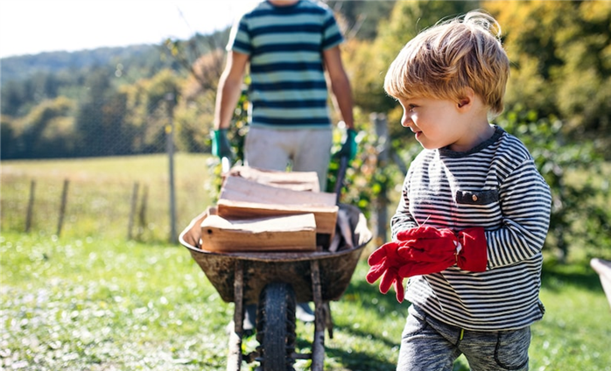
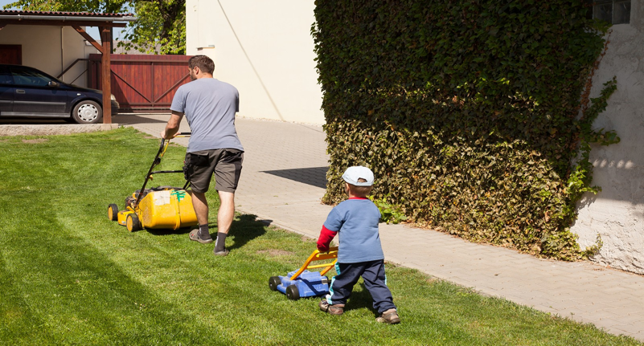
Notes:
It's important to remember that even though fires can be scary, there are things we can do to protect ourselves and our homes.
So after watching that video, let’s brainstorm some ideas that might make a house safer from a wildfire.
Moving toys and bikes away from the house
Picking up branches on the ground
Keeping dry leaves, pine needles, and branches away from our homes
Making sure that there are no materials that can burn near our homes like propane tanks, firewood, or patio cushions.
Cleaning out gutters regularly so tree needles and leaves can’t pile up in them
Keeping our lawns short and green
Teaching our grownups, our family, friends and neighbours about FireSmart
When we do these things, we are making our homes and our environment safer from fires.

Slide 16
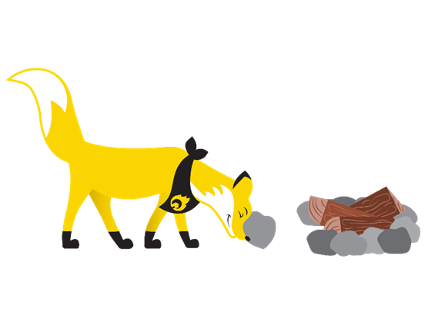
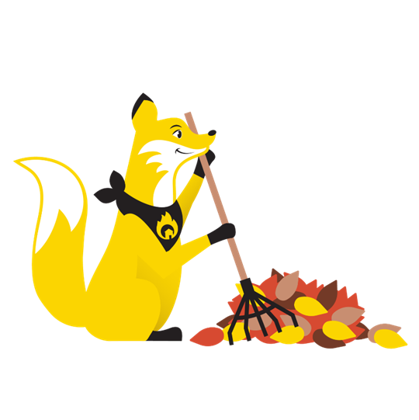
What You Can Do to Help?
Notes:
We want you to help us prevent and prepare for wildfires this summer!
Be smart with fire this summer - Enjoy time with friends and family outside, but make sure to follow the current fire bans and ensure that your fire is out cold before you leave.
Go home and talk to your grown-ups about FireSmart. The handout we are sharing with your teachers has a few links to help teach your grown-ups about FireSmart, as well as some fun activities.

Slide 17
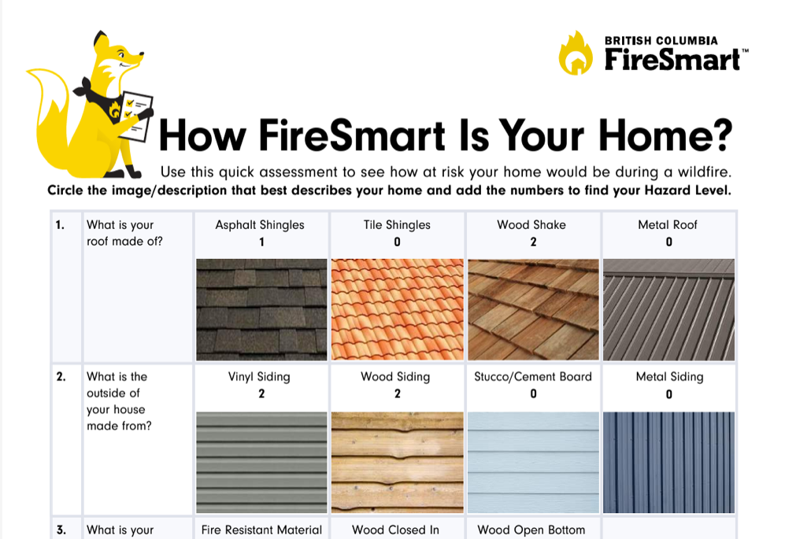
Home Assessment
Notes:
**If you’ve done so**
We have given your teachers a handout/colouring page for you to bring home with some links to the FireSmart BC pages so you and your grown-ups can learn all about the program.

Slide 18
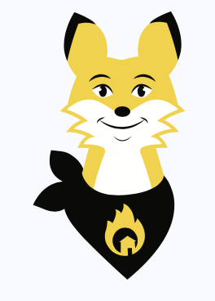
Shhhhh….
Let’s try and call Ember out of her den.
Notes:
(Ask students to be quiet. Once silent, they can quietly call Ember’s name to come out of her den and make an appearance. Potential photo opportunity for each class or Ember can stand at the door as the classes leave the assembly.)
(If Ember isn't present, show this photo and take questions directly)
Ember is happy to answer any questions you might have. Put your hand up and ask your question. Ember will whisper the answer to us.

Slide 19

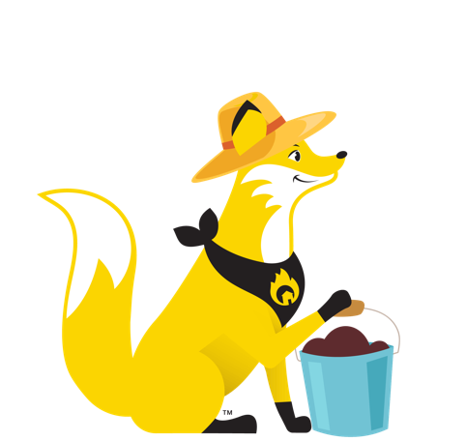
Thank you for listening!

