Slide 1
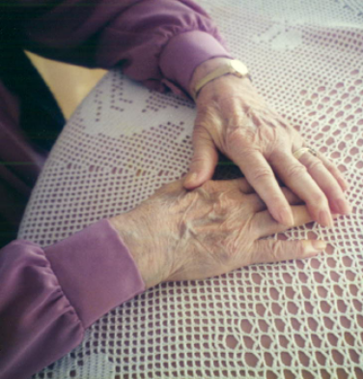
Training for:
Delirium prevention program
for seniors with cognitive impairment
in nursing homes
CYCLE 3
March 2012
LPN PAB orderly
Notes:
Hello. My name is XXX. I am XXX.
Im here today to tell you about the Delirium Prevention Program.
We know you have a very busy and demanding schedule and so are very grateful for the time you have set aside for this training. We are even more appreciative because of the major role you play in delirium prevention.
This program aims to reduce the number of residents who will develop delirium. This program was developed after extensive testing in Montreal and Quebec residences. The program has been adapted and improved thanks to the valuable comments and suggestions of nursing staff who participated in the testing of the program – their input and experience helped make this program relevant and feasible for nursing staff.

Slide 2
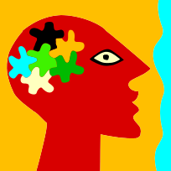




Context
Scientific research
  Researchers from several universities and clinical settings (see the inside cover of the guidebook) worked on this program.
Research funded by
  Alzheimer Society of Canada
  The Canadian Nurses’ Foundation
  CIHR’s Institute of Aging
Program tested at
  The Donald Berman Maimonides Geriatric Centre (Montreal)
  Centre d’hébergement Sacré-Cœur, CSSS de la Vieille-Capitale
  Nursing staff from these centres provided valuable input to improve the final program.
Notes:
This program was developed as a result of several years of research.

Slide 3
What is delirium?
Delirium is a mental disorder, with a rapid onset, fluctuating, which affects consciousness, cognition and behaviour (Cole, 2004).
≠
Delirium
Cognitive impairment
Notes:
Delirium is a mental disruption, which fluctuates, and alters cognition and consciousness. One observes a sudden change in the usual mental state of the resident. Here are some examples of possible manifestations of delirium: very distracted; lacking attention; increased sensitivity to surroundings or, on the contrary, disconnected from his/her surroundings; incoherent speech, hallucinations (sees or hears things); agitation, irritability; disturbed sleep-wake cycle. These manifestations tend to fluctuate during the course of a single day. As opposed to Alzheimer’s which has a very progressive onset, delirium appears very rapidly.
It is important to know that delirium may appear in individuals who already have some form of cognitive impairment like Alzheimer's. In fact, individuals who have cognitive impairment may be at higher risk of developing delirium. This is why we are particularly interested in this group of residents: because they are already at higher risk.

Slide 4
Why prevention ?
Incidence of delirium…
About 25% of seniors in nursing homes are affected by delirium.
Consequences of delirium…
    Reduced functional autonomy and alteration of cognitive abilities.
    10% to 30% increased mortality
    Increased work load for nursing and medical staff
Notes:
Delirium is very frequent. According to previous studies, 1 in 4 residents will be affected.
The consequences of delirium are very important for residents, their families and for the nursing home staff: Delirium implies reduced functional autonomy and cognitive abilities, increased mortality.
The inattention, and disruptive and agitated behaviour that come with delirium also mean an increased work load for nursing staff. Residents are less collaborative, staff must repeat indications... It is in everyone’s best interest to try to prevent delirium

Slide 5
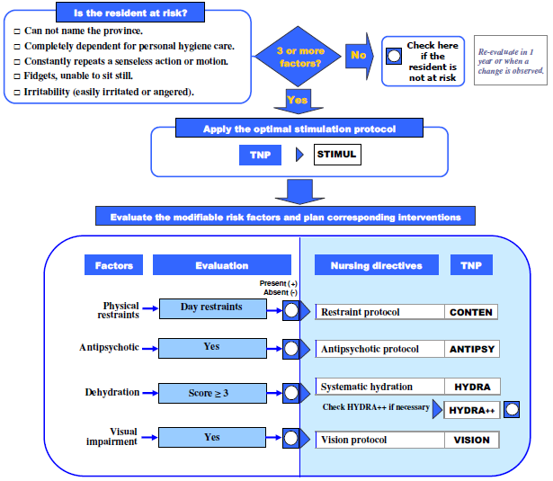
The decision tree, briefly…
Notes:
This is what we refer to as the Decision Tree. It is the tool that represents the back bone of the prevention project. Even though it is the nurse that is responsible for completing it, I will show it to you so that you may get a global perspective of the prevention program and understand where you will have a important role to play.
First, the nurse will identify the residents that are most at risk of developing delirium. This means about 8 residents on the floor, so not very many. This may be a bit more or a bit less; we will know the exact number once the program starts.
For the residents that are identified as being at risk of delirium, you will be asked to apply what we are calling an optimal stimulation protocol. I will explain to you what this is in a minute. How will you know when you have to apply this protocol? The nurse will write this down on your work sheet.
After this, the nurse will evaluate if there are specific factors that could set off an episode of delirium in the residents at risk, like for example a dehydration problem. If the nurse observes such a problem, she will then put in place the specific interventions that address the identified problem. So, once again, you will possibly have to apply the protocols or interventions that will have been put in your work sheet as a result of a risk identified by the nurse. However, be assured that in many cases, you are already carrying out these interventions and so the next slides will serve as a reminder.

Slide 6



Surveil:
  Wearing of hearing or visual aids.
  Lighting.
  Set-up of the room/organisation of space
The Optimal Stimulation Protocol (STIMUL)
Notes:
The optimal stimulation protocol (referred to as STIMUL) is applied to residents who have been identified as being at risk of delirium. As I mentioned previously, this does not mean all residents on the floor, only the 6-8 that you identified as being at risk, and for who you wrote STIMUL in the TNP.
The protocol can be summarized in 3 words: Surveil, Orient, and Stimulate (think of SOS).
Upon entering the room of a resident, you should surveil:
1st: Whether the resident is wearing his/her hearing aids or glasses. If you know the resident owns a pair of glasses, or a hearing aid, make sure that he/she is using them. Studies have shown that a large percentage of residents in nursing homes do not wear their hearing/visual aids for all kinds of reasons. It is also important to determine whether it is relevant to offer technical aids, like a magnifying glass, a telephone with large buttons, or a portable voice amplifier.
2nd: Lighting. As you know, it is important to ensure that there is sufficient lighting (for example, keep curtains open during the day, consider using a night light at night). Also, it is important to ensure that the resident is not exposed to glare or sudden flashes of light (for example, when the sun is too bright or if there is a light that is too bright in the room, this may “blind” the resident; a newly waxed floor on which bright light is reflected may also be “blinding”; transitioning from a dark to a bright space, like for example turning on a bright light when changing a resident late at night may cause flashes and be blinding... Try to create conditions so that the resident has time to adjust to light changes).
3rd: Keep an eye on the organisation of objects in the residents living environment (click for next slide with example)

Slide 7
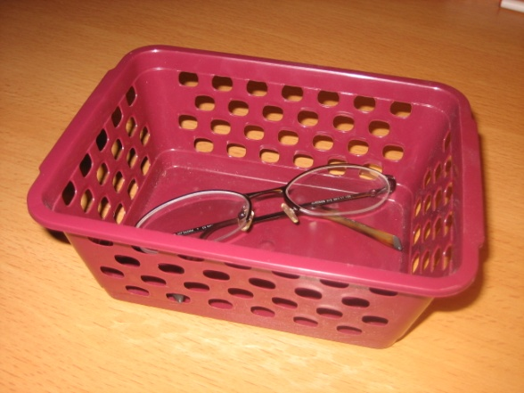
The Optimal Stimulation Protocol (STIMUL)
Make seeing glasses easily accessible
Notes:
What do we mean by set-up of the room?
This could mean for example making the resident’s reading glasses easily accessible by placing them in a plastic box in the drawer by the resident’s bedside. Plastic boxes are available in the toolbox (show toolbox) which will be placed in the nursing station.

Slide 8
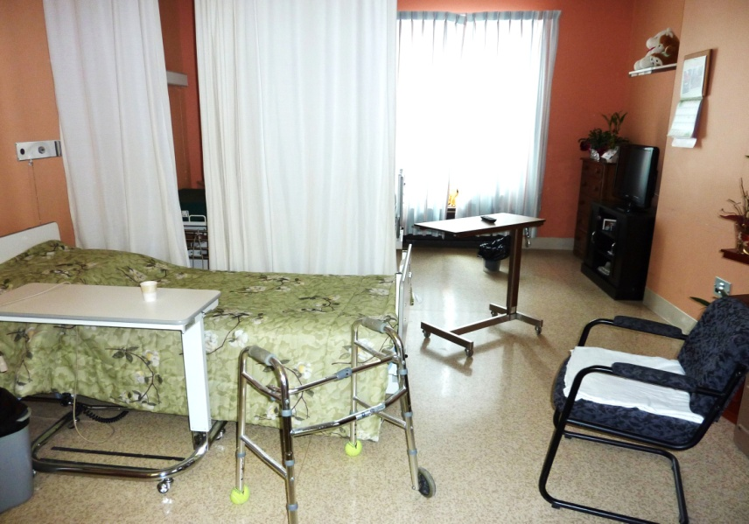
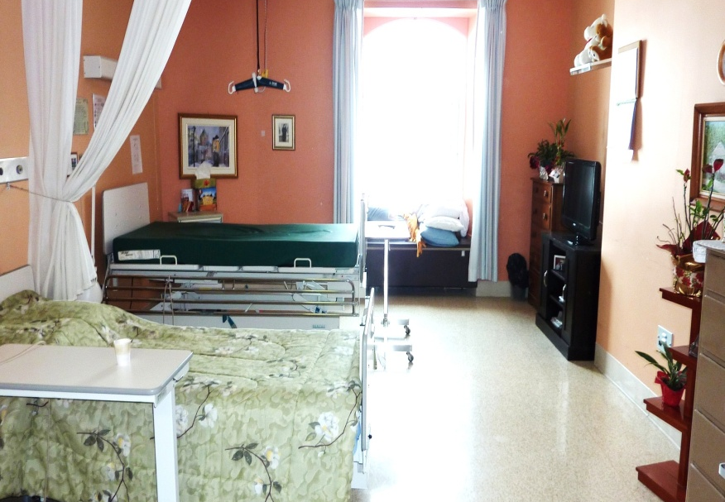
The Optimal Stimulation Protocol (STIMUL)
3. Set-up of the room (continued)
Avoid any obstructions and any objects that could create illusions for the resident.
✗
Notes:
By set-up of the room or organization of space, we also mean that we should avoid any obstructions and any objects that could create illusions for the resident. (For example, a coat rack in a corner could become a menacing object when lighting is reduced.)
So, to recap, when you enter the resident’s room, SURVEIL the surroundings to ensure that:
the resident is using his/her visual or hearing aids (if applicable),
that lighting is sufficient and comfortable and
to ensure that set-up of the room is appropriate.
This doesn’t take any time; it is more a question of getting into the habit of doing it and remembering that it is extra important for residents at risk of delirium.

Slide 9


Orient:
Each time you enter the room:
  Person
  Time (season, month, day…)
  Space (city, province, residence…)
The Optimal Stimulation Protocol (STIMUL)
Notes:
The second component of the STIMUL protocol is ORIENTATION:
Each time you enter the resident’s room, address the person by their last name, let them know the reason of your visit. It is also important to use a short phase to orient the resident in time and space. Obviously, you should adjust yourself to the cognitive abilities of the resident. For example, it may not be helpful to tell a resident in advanced stages of Alzheimer’s that today is the XX of March, but rather give him/her indications as to the season and the temperature outside (for example, say something like “Hi Mrs. Tremblay. Wow, it was cold outside this morning! You can really tell it is winter today!”)

Slide 10
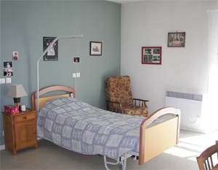
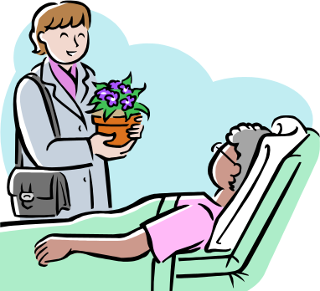
Stimulate:
Every day:
Use objects that are familiar to the resident to engage in reminiscing exercises.
Encourage family members, friends or volunteers to be present regularly
The Optimal Stimulation Protocol (STIMUL)
Notes:
Finally, the 3rd component of the STIMUL protocol is Stimulation:
For people that are at risk of delirium, it is important to put a lot of emphasis on cognitive stimulation – this means we need to stimulate their minds!
Use objects that are familiar to the resident, that are available in the room to not only stimulate their memory, but also to give them a chance to speak and tell their story. Start with a photo in a frame... The nature of the conversation is not that important, the idea is just to get them talking. You could ask questions about photos, drawings or other objects they’ve placed in their room.
The presence of company is very important. A good way of making visitors of residents feel welcome is letting them feel that we are happy to see them. If you see a visiting family member and you know that particular resident is at risk, go and say hello. Letting them know that you notice their visit will encourage them to come regularly.

Slide 11


Stimulate :
Avoid over-stimulating the resident (too many activities, tiresome or noisy activities).
Program activities that are adapted to the abilities and interests of the resident.
The Optimal Stimulation Protocol (STIMUL)
Notes:
3) While stimulation is important, be careful not to over-stimulate. For example, if you enter into the room of a resident and you notice that the TV and the radio are playing at the same time, and that there is a lot of noise in the hallway, this could be enough to bring on an episode of delirium in a vulnerable resident.
4) There are already many activities offered to nursing home residents. If you have a resident that is at risk of delirium that for some reason is unable to participate in group activities and that is often alone in his/her room, it is possible for the nurse to program alternate activities for this resident. It could be for example that the nurse will prescribe a stimulation activity like for example putting on 30 minutes of music that the resident likes. You should therefore not be surprised if the nurse indicates a specific activity for this at-risk resident in your work plan.

Slide 12
The Optimal Stimulation Protocol (STIMUL)
Use a portable voice-amplifier if relevant and available.
Notes:
For some residents that are particularly hard of hearing, it could be worthwhile to use a portable voice amplification system to facilitate communication. It is much more effective than raising your voice. And you do not need to use it each time, but if you have important information to pass along to the resident, or if you really need him/her to cooperate (for example when drawing blood, or during wound care) – it could be a useful aid. The project is providing a portable voice amplifier that will be available on the unit. The resident wears the earphones, and you speak into a little microphone (demonstrate: make sure to show that nurses should check the volume by listening themselves before giving the headphones to a resident). It is easy to use.

Slide 13
The decision tree, briefly…
Notes:
So we have just reviewed the STIMUL protocol which is applied to all residents who have been identified as being at risk of delirium.
As mentioned at the beginning of the presentation, the nurse is also responsible for evaluating if, in the resident that is at risk of delirium, there are certain factors present that could “set off” an episode of delirium. If, when doing her evaluation, the nurse notices that the resident is showing signs of dehydration, she will then add interventions specific to the problems identified. These interventions will be indicated in your work sheet. It is very important to understand that not all residents will need these interventions. For example, while there may be 8 residents at risk on the floor, perhaps only 2 of them will have the dehydration problem.

Slide 14

Restraints intervention
(CONTEN)
  Remove restraints during care of hands and feet.
  Remove restraints during washing.
  Remove restraints during meal times.
  Remove restraints when the family is visiting.
Notes:
The first protocol has to do with physical restraints. The use of physical restraints can trigger an episode of delirium. If the resident is at risk of delirium and he/she is also physically restrained, the nurse will reevaluate whether the restraints are needed. The nurse may modify the duration that the resident is in restraints, or modify the restaints in specific circumstances.

Slide 15
The decision tree, briefly…
Notes:
So we have just reviewed the STIMUL protocol which is applied to all residents who have been identified as being at risk of delirium.
As mentioned at the beginning of the presentation, the nurse is also responsible for evaluating if, in the resident that is at risk of delirium, there are certain factors present that could “set off” an episode of delirium. If, when doing her evaluation, the nurse notices that the resident is showing signs of dehydration, she will then add interventions specific to the problems identified. These interventions will be indicated in your work sheet. It is very important to understand that not all residents will need these interventions. For example, while there may be 8 residents at risk on the floor, perhaps only 2 of them will have the dehydration problem.

Slide 16



Systematic hydration
(HYDRA)
  Place a pitcher of cool, fresh water by the resident’s bedside.
  Encourage drinking.
  Offer liquids the resident likes.
Source: http://www.vestibularuniville.com.br/?tag=estudar
Source: http://www.finna.com.br/receitas/
Notes:
So what does the hydration protocol consist of exactly? (We use the term HYDRA to refer to this protocol):
If the resident is dehydrated, you must ensure that there is a pitcher like this one (show pitcher) placed by his/her bedside. These are dishwasher-safe so you do not need to worry about washing them yourself. Just remember to place them on the cart at the end of the day so that they are sent to the kitchen and washed, and remember to place a new pitcher by the resident’s bedside. Pitchers are identified with the floor number so that they will be returned to this floor after washing. It is important to fill these with fresh, cool water.
The key word for the hydration protocol is encouragement. “Ok Mr. Simco, take a little sip please, you’ll see it will be really refreshing and will do you good!” Previous research has shown that encouraging residents to drink effectively increases hydration amongst residents. Even in residents that have memory loss.
It is also important to offer liquids that the resident enjoys. Even though residents with cognitive impairment may find it more difficult to express which liquids they prefer, the care provider can notice through observation which liquids the resident prefers to consume.
16

Slide 17
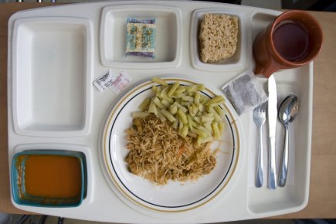
Systematic hydration
(HYDRA)
  Offer a glass of liquids…
      With each meal
      After morning care routine
      In the middle of the afternoon
  Offer 60-180 ml of liquids with medications.
Source:: http://www.cyberpresse.ca
Notes:
Read the slide.
60ml is really not very much at all... It will not take the resident any time to take this liquid. (As an example, show the small transparent glass inside the pitcher to give an idea of what 60ml represents.)
17

Slide 18
Hydration plus
(HYDRA ++)
For residents who are hesitant to drink…
  Offer 60 ml of liquid each time upon entering the resident’s room.
Notes:
In general, the hydration interventions which I have just presented (those we refer to as HYDRA) are sufficient to rehydrate the resident.
However, if this is not the case, you may have to add an additional element for residents that are more hesitant to drink. In these cases, 60ml of liquids should be offered each time you enter the room. This hydration plus protocol is identified as HYDRA++.
18

Slide 19
Concrètement….
  How do I know if a resident is at risk?
    His name will be on the board of residents who are at risk (posted in the nursing station)
    Specific directives will be written in your work sheet.
Notes:
Read the slide
19

Slide 20
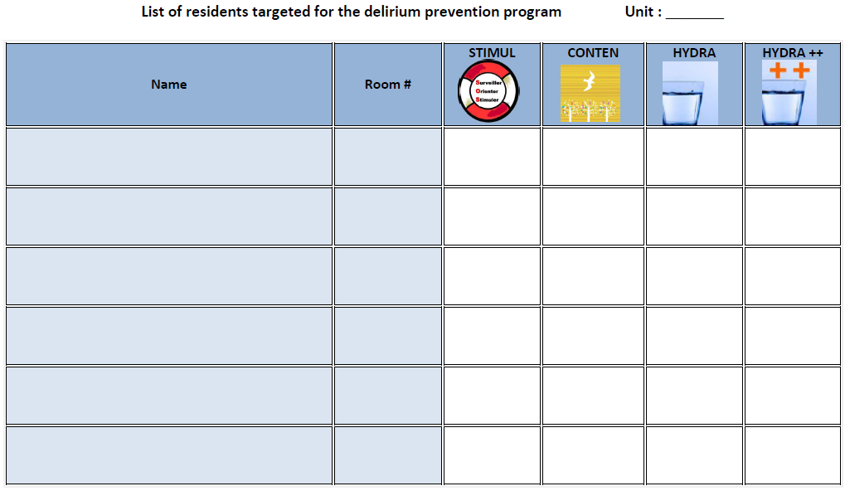
The reminder board
Sylvie Richard 404A  
Marie-Claude Fortin 401B 
Notes:
Here is the reminder board that will be posted in the nursing station that you will complete.
For example, we notice here that there are 2 residents at risk of delirium on the floor. The STIMUL protocol will automatically be applied to them, because as I’d mentioned before, all residents at risk of delirium will receive the STIMUL protocol (SOS: Surveil, orient and stimulate).
We also notice that the first resident is only receiving the hydration protocol (HYDRA) while the other is only receiving STIMUL.
The antipsychotics and vision protocols are not on the table because they do not concern LPNs, PABs, and orderlies. At Maimonides, the CONTEN protocol never applies – it is only applicable in nursing homes that use restraints.
20

Slide 21

Concretely…
  What should I do for a resident that is identified as being at-risk?
  I automatically apply the STIMUL protocol.
  I look at the work sheet to find out which interventions to apply. The interventions in place are also written on the board of at risk residents that I can see in the nursing station.
Notes:
Read the slide
21

Slide 22
Concretely….
  I have an at-risk resident and have to apply the HYDRA protocol, but I don’t remember the details of this intervention… What do I do?
  I look at the poster, or at the reminder card which summarize the interventions.
  I follow the specific instructions in my work plan.
Notes:
Read the slide
22

Slide 23
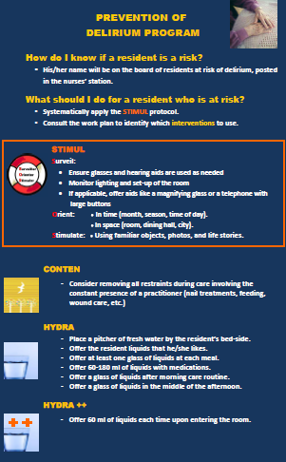
Notes:
This is what the poster that will be placed on the unit will look like. We will also provide you will a reminder card that contains this information so that you can have that with you at all times.
23

Slide 24
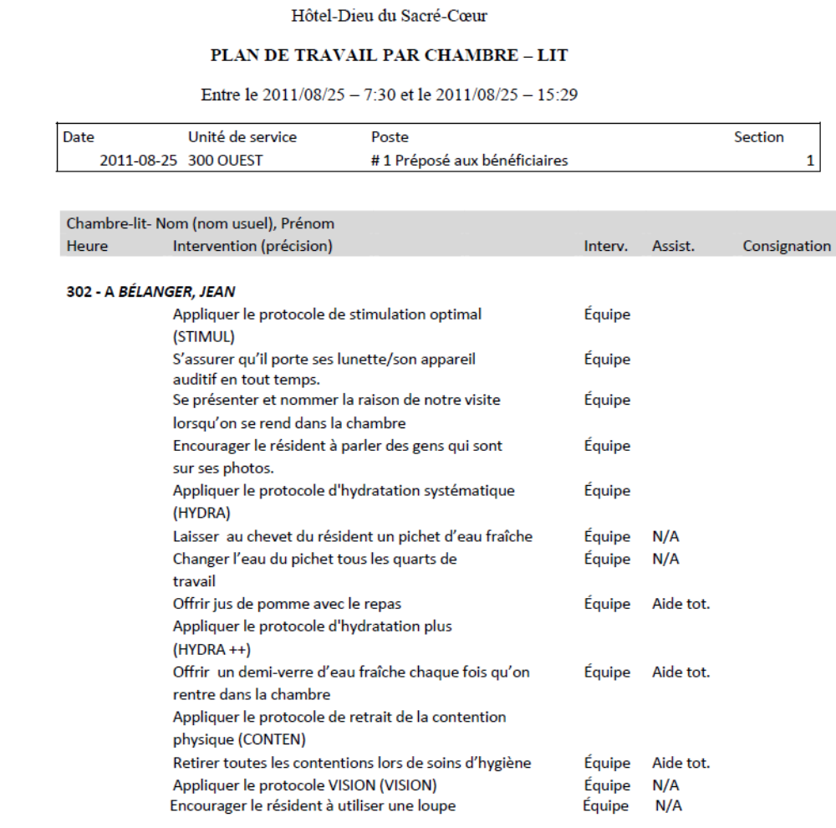
Concretely….
Notes:
Here is an example of a work sheet in which we have included all possible interventions linked to the delirium prevention program. It is only to show you what this could look like in a work plan. So far, a resident has never needed all interventions at the same time. If we rely on information from the first two implementation cycles, you can expect about 1-2 interventions (excluding the STIMUL) per resident.

Slide 25
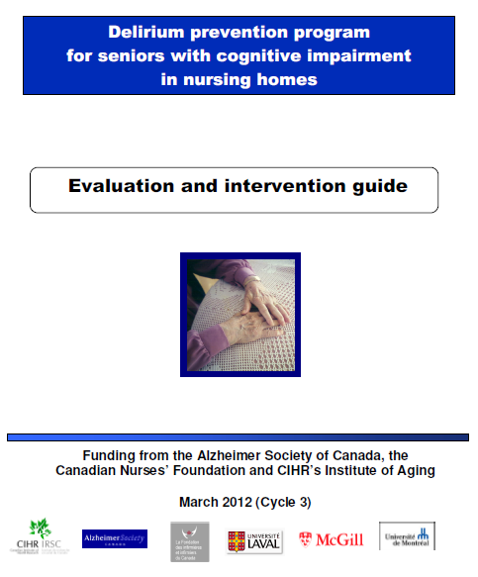
The guidebook…
Notes:
If at any time you wish to review some of the points we’ve discussed today, a guidebook will be available on the unit. It explains all the protocols we have presented to you today.

Slide 26

Thank you!
Questions?

