Slide 1

Health & Safety Transport Induction Package

Slide 2
Transport Induction
Contents Covered
Bookings – Delivery/Pick Ups
Driver Qualifications
Mandatory Personal Protective Equipment (PPE)
Drugs & Alcohol
Passengers, Animals and Children
Arriving on site
Signage
Area Restrictions
Signing In and Out
No stopping areas/Map
Operating Damar Plant or Equipment
Load Restraint
Loading/Unloading
Designated Safe zone
Tanker Deliveries
Site Hazards
Facilities
Evacuation/Site Evacuation Map
Hazardous Substances
Incidents, Hazards and Near Miss Reporting
Failure to Follow Damar Rules
Induction

Slide 3
Transport Induction
1. Bookings – Delivery/Pick Ups
All transport drivers coming into the transit depot area are restricted to the Canopy and Warehouse Office areas only.
Booking in for deliveries/pickups is a requirement. In the event of a delay, where you will exceed your time frame by 15 minutes you are required to contact Raw Materials/Logistics and advise when you will be on site. Failure to meet this requirement may result in delays for the driver or the driver being turned away.
Any damage sustained to product, packaging or pallets must be reported to the Warehouse Administrator or Warehouse Manager prior to departing the site.
All drivers must be inducted prior to arriving on site. Persons not inducted prior will be allowed entry to
the site however they must report to the Warehouse office and complete the induction
2. Driver Qualifications
Transport drivers must hold, carry with them and provide at the time of induction to place on our files:
  Their current New Zealand Driver’s License for the class of vehicle they are driving, and
  A current Dangerous Goods “D” Endorsement on their Driver’s Licence
Transport drivers must confirm on the sign in sheet that they have Emergency Response Information in their vehicle and ensure this information is relevant for the load being carried *
  * As Damar are the Consignor, we have to ensure that:
  The driver has this information in their vehicle, and
  We can prove that we have asked the driver if he has ERI in their vehicle
  (Should the driver be stopped for a compliance check, the company could be liable for significant fines if this check has not been carried out)

Slide 4






Transport Induction
3. Mandatory Personal Protective Equipment (PPE)
High Visibility Cotton Clothing to be worn at all times. Must be in good condition – vests zipped up
Wear Safety Footwear
Safety Glasses. Must be worn whenever you are outside of your vehicle
4. Drugs & Alcohol
Damar does not tolerate Drugs or Alcohol in the work place
You are prohibited from being on site if you are under the influence of drugs or alcohol
In the event of an Accident/Incident you may be required to provide a post incident drug and alcohol test if requested
In the event you are suspected of being under the influence of Drugs or Alcohol, your employer will be advised and you will be removed from the site
5. Passengers, animals and children
No animals are permitted on site – This is a MPI requirement for transitional facilities
No children are permitted in any operational area on site
Passengers are only permitted, provided they have completed the induction and if they have met the following criteria:
  Are trainer or trainee drivers
  Are authorised personnel such as a Safety Officer
  Mobile plant operators have been advised of the presence of a trainee or other authorised personnel
  The passenger remains with the driver at all times
  Both driver and passenger must remain in a ‘Safe Zone’ while loading/unloading is taking place

Slide 5
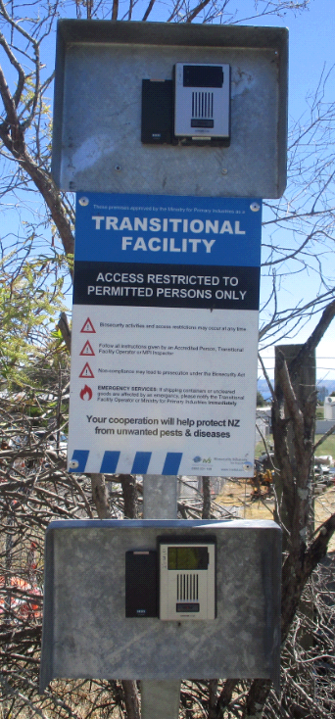
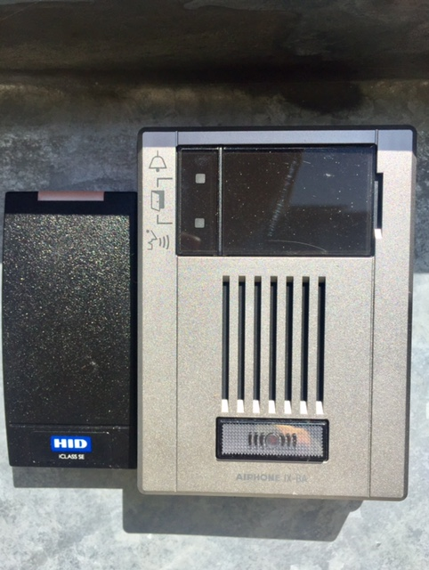
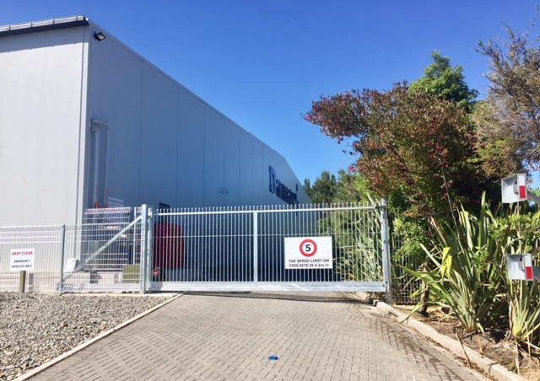
Transport Induction
6. Arriving on site
All vehicles/drivers will need to gain access to site by pushing the car or truck intercom at the entrance gate
A Damar operator will ask for your name and company, then check the system to see that you have completed this induction and that it is current. They will also ask if there are any passengers in the vehicle
If loading/unloading is underway in the transit depot, the Damar operator will advise you at this time
If behind another vehicle at the gate, DO NOT pass through when the gate opens for them to enter – Wait until the gate has closed and you have spoken to a staff member on the intercom
Vehicles must remain in line when in the Transit depot and behind the cones that are placed to indicate an exclusion zone is in effect
Vehicles that require access through the area (Tanker Deliveries, Courier Vans) must wait until the forklift
operator responsible or administrator has stopped all forklift and pedestrian traffic in the exclusion zones in
place, and signaled the driver that they may now
proceed
Persons not inducted prior will be allowed entry to
the site however they must report to the Warehouse
office and complete the induction
Push intercom and wait for Damar operator to answer

Slide 6




Transport Induction
7. Signage
You must abide by all site signage
You must drive within the site’s 5 km speed limit and to the conditions. This applies to the
entire site
8. Area Restrictions
Using a Mobile Phone
You may only use your mobile phone when you are in your cab AND the vehicle is stationary
Your mobile phone must remain in your cab at all times
Mobile Phone use is not permitted when your vehicle is moving
These rules also apply to hands free operations while on site and no use of mobile phones when driving up to the gates (sensors are affected at exit gate)
RT or CB use is permitted only when the vehicle is stationary
Smoking/Vaping
Smoking/vaping is not permitted in the Canopy, Warehouse Office areas
Smoking/vaping is not permitted in your vehicle anywhere on Damar site
No Ignition Sources
Mobile phones and other electronic devices including ear-pieces (hearing aids are exempt) must remain in your cab
Cigarette lighters and matches must remain in your cab

Slide 7
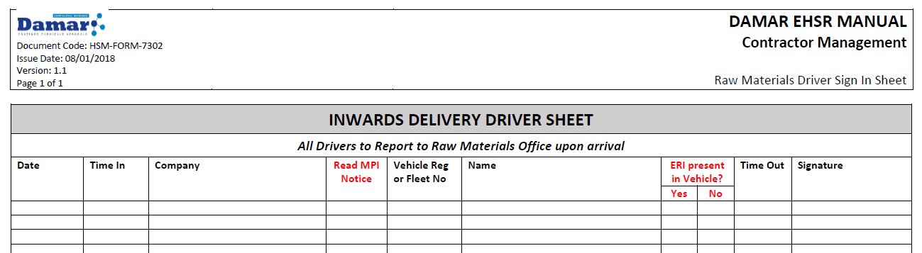
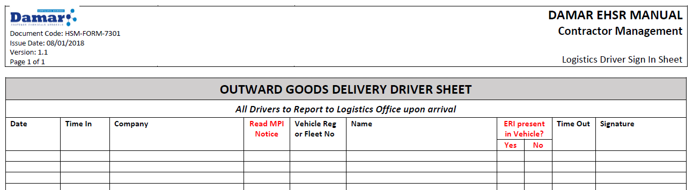
Transport Induction
9. Signing In and Out
Transport drivers must:
Read the Ministry of Primary Industries (MPI) Transitional Facility notice posted in the sign in register areas and acknowledge acceptance by ticking the indicated column of the Sign In Sheet (red circle)
Acknowledge they have Emergency Response Information (ERI) by ticking the ‘Yes’ box
If they tick the ‘No’ box, they must be given a copy before leaving site and the sign in sheet is to be initialed by the person who provided it (purple circle)
Once you have reached the transit depot and switched your vehicle off:
All drivers picking up or delivering goods must sign in and then sign out before leaving the site at the Inwards desk situated in canopy next to WH3 roller door
10. No stopping areas:
No stopping on the Ring Road unless in a designated loading area and have prior permission to stop
Vehicles are not to park around the LPG tank farm fence line *
No vehicle should park beyond the canopy roof
* The LPG and Bulk Solvent tanker trucks have an exemption during delivery process
If the area under the canopy is full, the Damar operator will inform the driver on arrival and the vehicle will be held at the gate until space becomes available

Slide 8
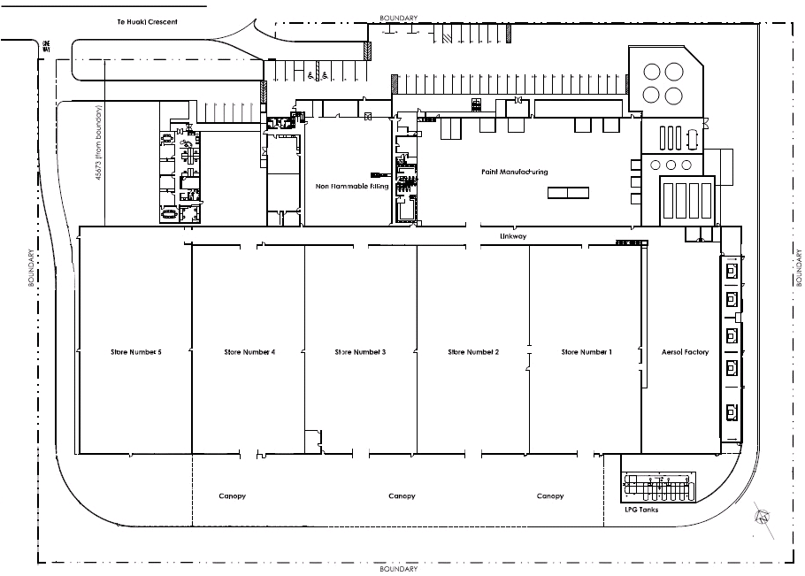
Transport Induction
10. No stopping area map:
Warehouse Office
Driver Safe Zone Area
Bulk Solvent Tanker
No Stopping on ring road
(red line) except when under the Canopy
LPG Tanker

Slide 9
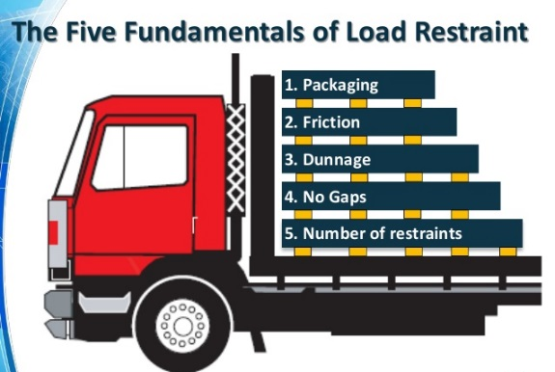
Transport Induction
11. Operating Damar or Others Plant/Equipment
You are not permitted to operate any Damar plant/equipment unless you have written authorisation from Damar HSQE Manager to do so i.e. been issued with a MHF-FORM-6923 Authorised Transport Forklift Operator Certificate
Transport drivers requesting to operate a Forklift on site must provide copies of their current:
  Drivers Licence (both sides)
  Forklift OSH Certification for the type of equipment they will be using
  ‘D’ Endorsement
  They will also need to complete MHF-HSMS-6923 Transport Drivers Safe Forklift Operation and have this document signed off by a Damar designate.
  You are not permitted to move any vehicle other than your own whilst under the canopy unless you have authorization from the driver of that vehicle.
12. Load Restraint
All drivers must be trained and are responsible for the correct restraining
of their loads.
All loads must be restrained to at least the legal requirement, prior to
moving the vehicle.
Any site specific requirements related to product quality must also be
adhered to.

Slide 10
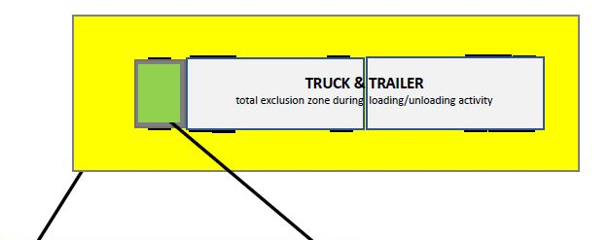
Transport Induction
13. Loading/Unloading
Report to the Warehouse Office and proceed to the safe zone area directed by Damar staff.
The forklift operator and transport company driver must discuss what needs to be loaded or unloaded and plan the order and placement of pallets before loading or unloading begins.
The transport company driver must ensure the forklift operator is informed prior to loading or unloading commencing, of any need the driver may have to enter the exclusion zone during the loading/unloading process e.g. to move curtains.
The forklift operator will set out the exclusion zone by placing traffic cones 2m out from each corner of the vehicle.
An exclusion zone has been established at a distance of 2 metres around all areas of the truck and cab.
The transport company driver must remain in the designated safe zones while the forklift operator is loading or unloading.
Inwards sign in desk (outside exclusion zone)
The transport company driver must not approach either side of the trailer, until the forklift operator has given the all clear & the forklift is in the stationary position.
All unloading must stop if the driver or pedestrian needs to enter the exclusion zone.
The forklift operator and transport company driver must discuss what needs to be loaded or unloaded and plan the order and placement of pallets before loading or unloading begins.
If the transport company driver is self-loading or unloading – the exclusion zone applies to all personnel in the area.
No forklift or other vehicle is permitted to
enter the exclusion zone while the driver is preparing his vehicle for loading/unloading or leaving site.
The forklift operator will not commence loading/unloading until the driver is in the safe zone. Once the driver is there, the exclusion zone becomes available to the forklift operator and no pedestrians or other traffic may enter.

Slide 11
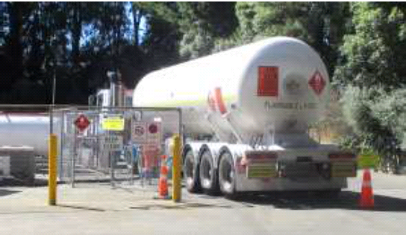
Transport Induction
14. Designated Safe Zone
The safe zone area on site –
  Inwards sign in desk (outside exclusion zone) under canopy next to WH3 doorway
The Driver must not move from this area unless:
  a prior arrangement has been made for them to enter into the exclusion zone during the loading/unloading process by the loader/unloader, and
  they have received positive acknowledgement from the Loader/Unloader who has exited the zone and has the forklift in a stationary position.
15. Tanker Deliveries
At times, you may encounter an LPG tanker unloading gas in the LPG tank farm at the far end of the canopy.
It is permissible to drive past unloading road tankers in order to exit the site, you do not have to wait for them to finish the filling process (unless ‘no entry’ signs are out).

Slide 12

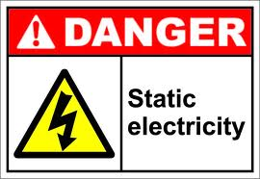



Transport Induction
16. Site Hazards
Pedestrians | Chemicals
Static Electricity | Mobile Plant
Liquid Petroleum Gas | Fire
17. Facilities
We are a Major Hazard Facility and as such, we require all transport drivers remain in the Driver Safe Zone
If a driver needs to use the washroom/toilet facilities on site they must:
  Report to the Warehouse Office and request an escort to the facilities
  Wait for an escort to be arranged and accompany the escort to the facilities and back to the office where the request was made
  Inform the Office that they are back in the Driver Safe Zone
Under NO circumstances can a driver leave the restricted area unaccompanied

Slide 13
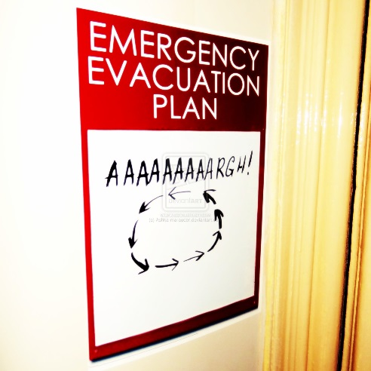
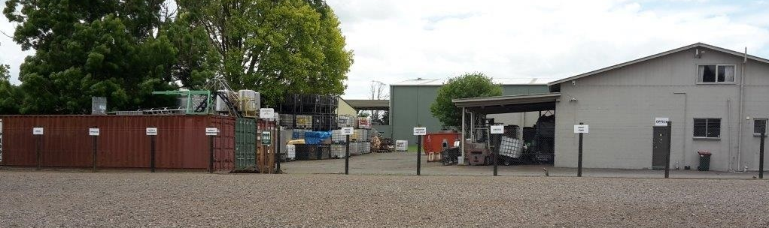
Transport Induction
18. Evacuation
If alarm sounds, move steadily to the nearest exit and assemble at the Site Evacuation Point.
The Evacuation Point is located in the staff carpark across the road
Do not drive your vehicle offsite. Vehicles may only be moved when directed by the Head/Deputy Warden, to allow access to emergency response services.
Once at the evacuation point, report to the Warehouse Fire Warden and ensure your name is checked off
Do not leave the evacuation point
Do not smoke at the evacuation point
Do not re-enter the site or building until cleared to do so by the Head Warden
Mobile phones is not permitted during an evacuation (unless directed by the Head/Deputy Warden).
Vaping or smoking is not permitted during an evacuation
NB: All security gates will automatically open

Slide 14
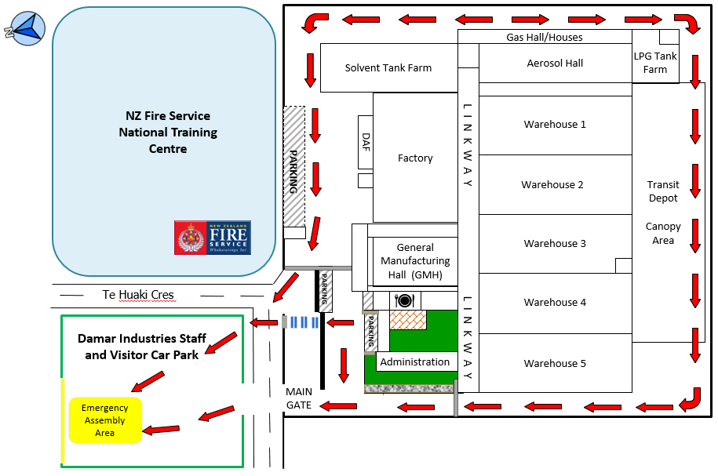
Transport Induction
Site Evacuation Map
Follow the direction of the red arrows to reach the evacuation assembly area

Slide 15
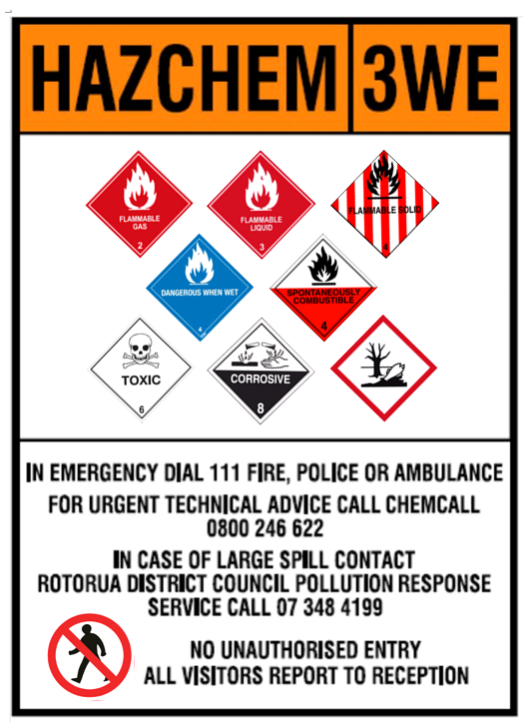
Transport Induction
19. Hazardous Substances
Chemical classes held on site include:
Class 2 Flammable Gas
Class 3 Flammable Liquid
Class 4 Flammable Solids
Class 5 Oxidisers
Class 6 Toxic
Class 8 Corrosives
Class 9 Ecotoxic
Chemical Classes not held on site:
Class 1 Explosives
Class 7 Radioactives

Slide 16

Transport Induction
Incidents, Hazards and Near Miss Reporting
All hazards, accidents, incidents and near misses must be documented and reported to any one of the Warehouse Administrators – this includes plant or property damage.
An Accident / Near miss Form must be completed BEFORE leaving the site, the Warehouse Administrators will provide the form and assist in it’s completion.
Where requested, you may be required to assist in an investigation.
The accident/incident scene must remain undisturbed unless the movement of vehicles, objects, etc. is necessary to administer first aid, save life, prevent further injury, allow access for emergency services or prevent serious property damage.
Advise your Dispatch personnel.

Slide 17

Transport Induction
21. Failure to Follow Damar Rules
Subject to investigation, a driver may be removed from site, or may be stood down for a period.
Cancellation of the driver’s site induction and/or refusal to allow the driver back on site may be an additional consequence of not abiding by site rules.
Any incidents of failing to adhere to Damar rules will be formally communicated to the Damar business partner the driver represents.
22. Induction
On completion of your Induction, your name will be placed on our Damar Inducted Contractor list, which will remain valid for a period of 12 months from the initial date of Induction.
You will be required to follow the sign in process when entering the Damar site each visit.
All drivers are at ALL times required to complete the Induction paperwork prior
to gain access onto the Damar Rotorua site. Completion of the induction process
does not guarantee access. We reserve the right to deny site access at our
discretion, regardless of induction status.

