Slide 1

45 PO Invoice Creation
Creating Invoices Against a 45 PO
Notes:
Slide layouts have been created for a number of different slide styles in the template. Choosing ‘New Slide’ from the ‘Home’ ribbon displays two full sets of these slide layouts. The first set includes a subtitle under the content slide titles, the second set has only the title on the content slides. Different slide layouts can be applied by ‘right-clicking’ a slide and choosing ‘Layout…’ – this will display the same palette of slide layouts for selection.
For more detailed information on working with slide layouts, go to Microsoft PowerPoint Help and enter ‘slide layout’ in the search field.
This slide uses slide layout: Title Slide
Preset type sizes
The presentation headline and presentation title type size and style has been preset in the template. The subtitle information needs to manually applied.
Images
Title images can be replaced but need to have sufficient contrast for the headline to be legible. When working with images, it may be necessary to arrange elements of the content differently (i.e., ‘Send to back’) in order to be able to select and edit them.

Slide 2
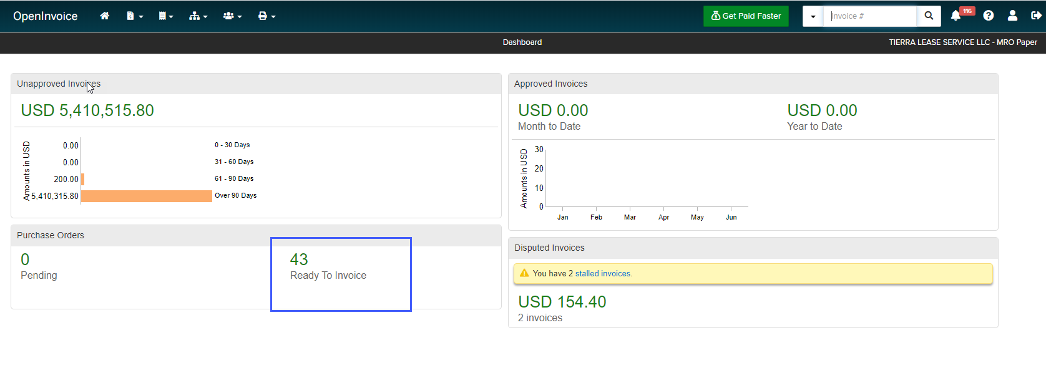
Creating Invoices Against a 45 PO
Step 1
  Click on Green # under Purchase Order
Notes:
This slide uses slide layout: Title and Two Content
Images
Images on text slides can be replaced – they should be sized according to the gridlines in the template.

Slide 3
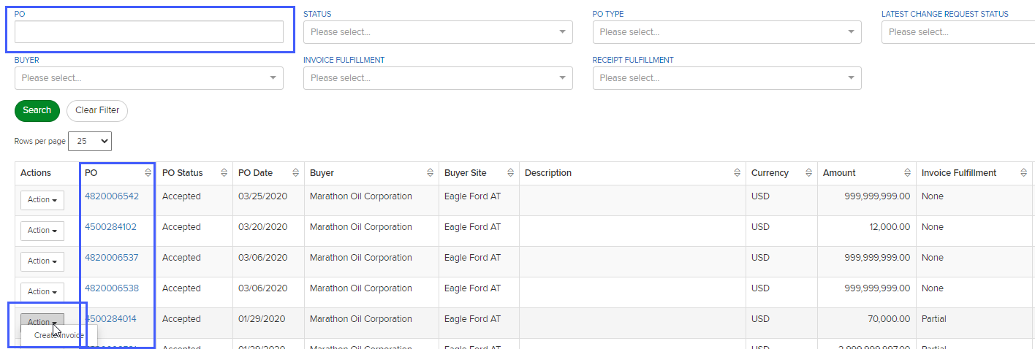
Creating Invoices Against a 45 PO
Step 2
  Enter Po # in PO field or find PO in the list
  Click Action
  Create Invoice
Notes:
This slide uses slide layout: Title and Two Content
Images
Images on text slides can be replaced – they should be sized according to the gridlines in the template.

Slide 4
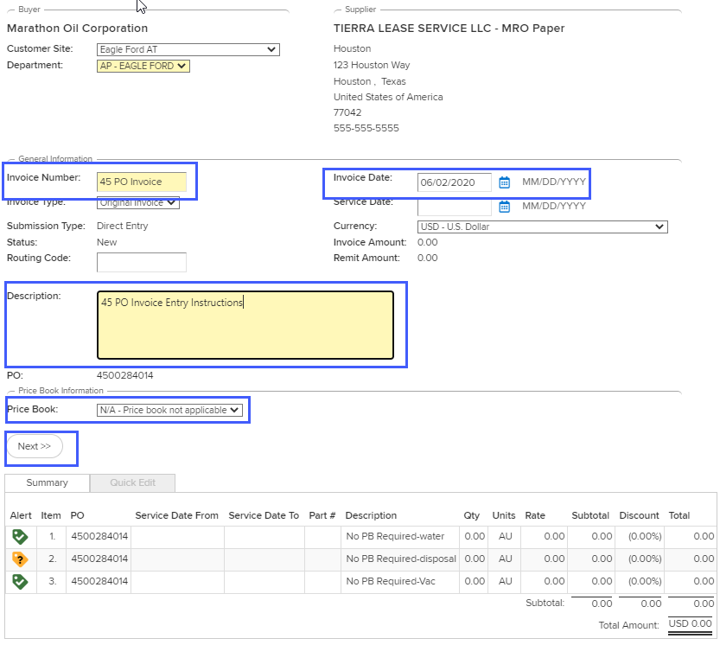
Creating Invoices Against a 45 PO
Step 3
  Enter Invoice #
  Enter brief description of work performed
  Select PriceBook N/A in the PriceBook field
  Click Next
Notes:
This slide uses slide layout: Title and Two Content
Images
Images on text slides can be replaced – they should be sized according to the gridlines in the template.

Slide 5
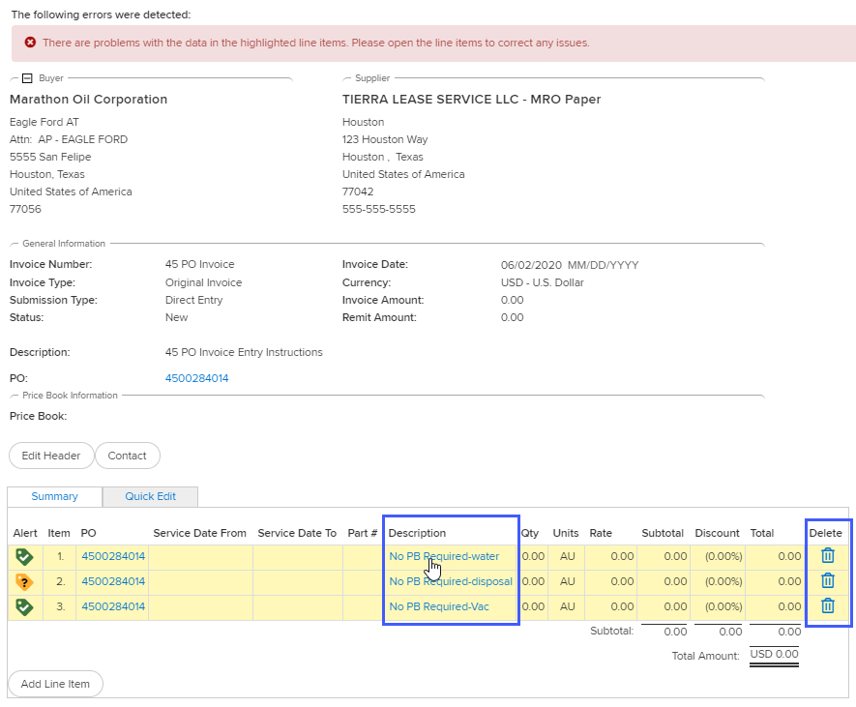
Creating Invoices Against a 45 PO
Step 4
  Ignore the red error message at the top of the page
  Click on the blue hyperlinked description for the PO line you need to bill
  **If you need to bill all PO lines you will need to do them 1 at a time.
Notes:
This slide uses slide layout: Title and Two Content
Images
Images on text slides can be replaced – they should be sized according to the gridlines in the template.

Slide 6
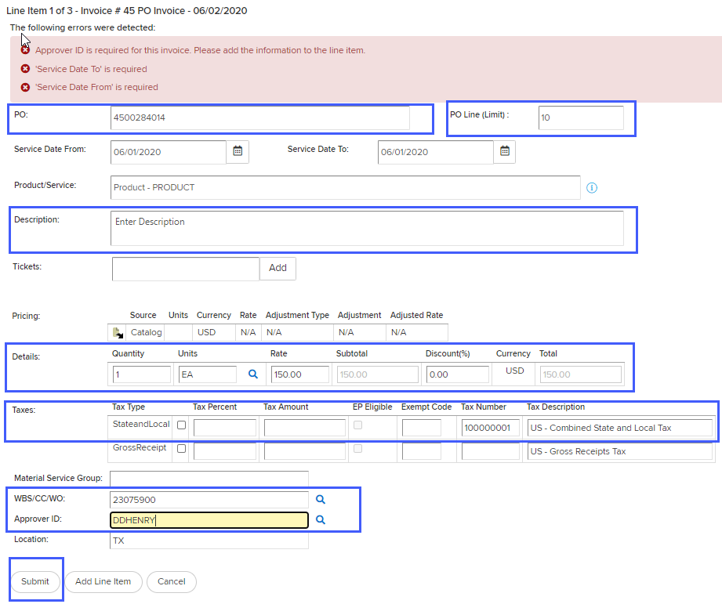
Creating Invoices Against a 45 PO
Step 5
  Verify PO Line is correct
  Enter the service dates
  Verify description matches the item you are billing, if not you can edit.
  Enter/verify quantity, unit of measure, and rate
  Enter taxes if necessary
  Enter WBS/CC/WBS if not pre-populated (see next if missing)
  Enter Approver ID (see next if missing)
  Click Submit
Notes:
This slide uses slide layout: Title and Two Content
Images
Images on text slides can be replaced – they should be sized according to the gridlines in the template.

Slide 7
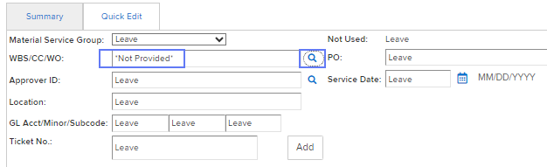
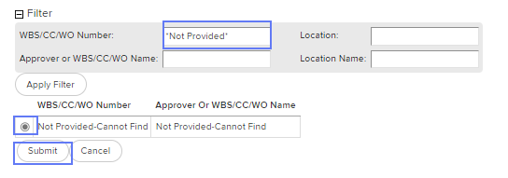
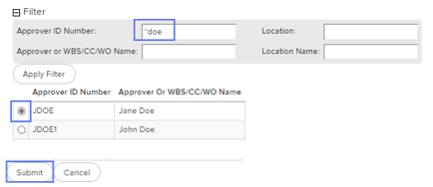
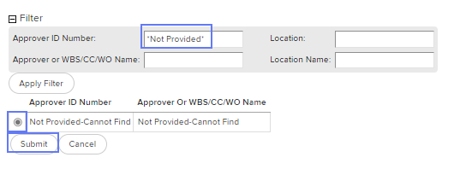
Creating Invoices Against a 45 PO
Step 5-continue *Missing Information for WBS/CC/WO or Approver?
  WBS information missing - the WBS/CC/WO field is required. If you cannot find this information or were not provided this information, the following steps will help you proceed in entering your invoice without it. Note: Please do not guess for this field!
  Enter *Not Provided* in the WBS/CC/WO field on the invoice and click Apply Filter, click radial button, and click Submit.
  Approver ID unknown/not found - If the approvers ID is not auto-populated, enter *last name (i.e. *doe) and click the magnifying glass to display a list of IDs available in the Approver ID Number field.
  If not found, use Approver ID Not Provided-Cannot Find

Slide 8
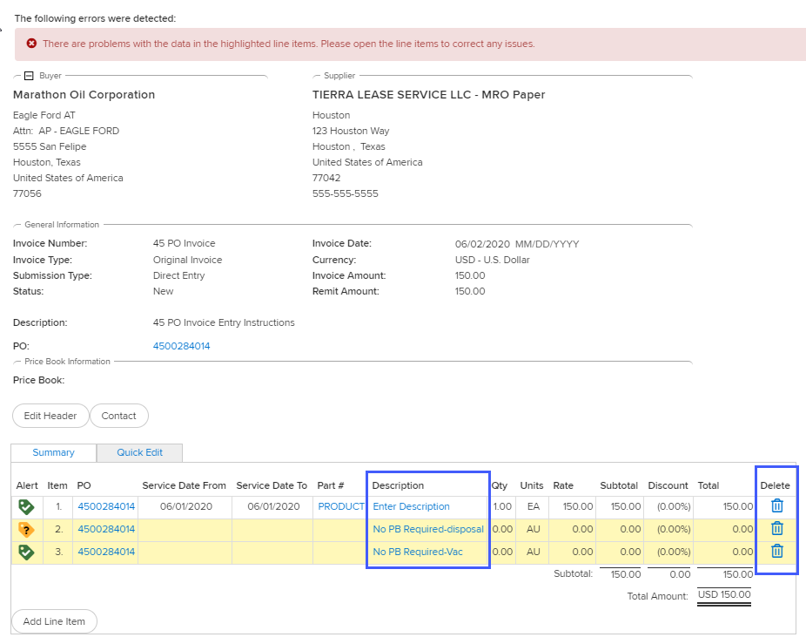
Creating Invoices Against a 45 PO
Step 6
  After clicking submit you will return to the invoice header screen.
  Click the blue hyperlinked description for the next line item, if you have more to bill
  Delete extra lines by clicking the trash can, if you don’t need to bill the additional lines
Notes:
This slide uses slide layout: Title and Two Content
Images
Images on text slides can be replaced – they should be sized according to the gridlines in the template.

Slide 9
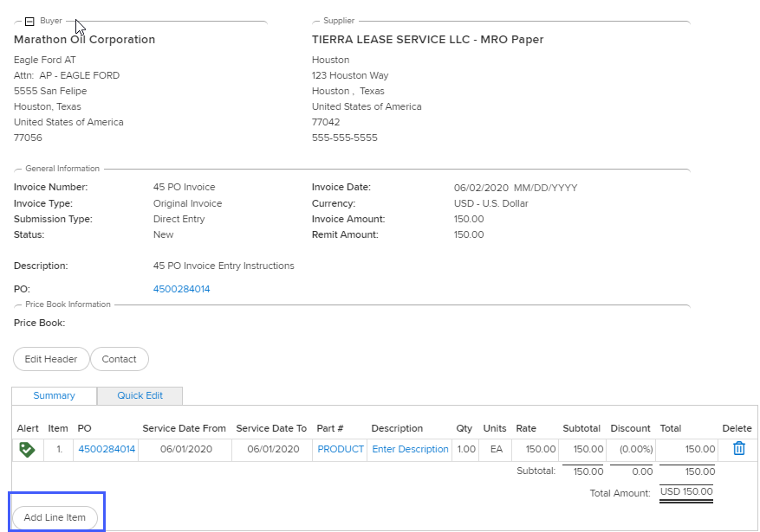
Creating Invoices Against a 45 PO
Adding FREIGHT to an invoice
  If you need to bill a FREIGHT line, follow the below steps.
  Click Add Line Item
Notes:
This slide uses slide layout: Title and Two Content
Images
Images on text slides can be replaced – they should be sized according to the gridlines in the template.

Slide 10
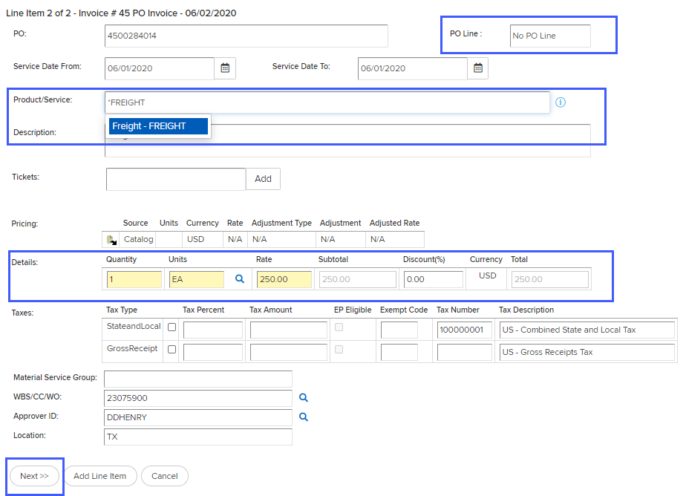
Creating Invoices Against a 45 PO
Adding FREIGHT continue
  Update PO line to No PO Line
  Place *FREIGHT in Product/Service field
  Select FREIGHT from the dropdown
  Enter quantity, unit of measure, and rate
  Click Next
Notes:
This slide uses slide layout: Title and Two Content
Images
Images on text slides can be replaced – they should be sized according to the gridlines in the template.

Slide 11
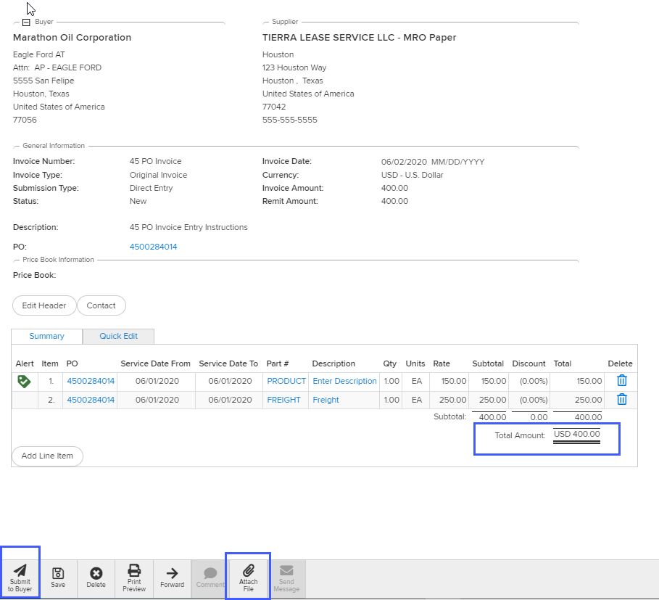
Creating Invoices Against a 45 PO
Step 7
  Verify your total matches the total of your invoice.
  Attach your supporting documentation
  Click submit to buyer
Notes:
This slide uses slide layout: Title and Two Content
Images
Images on text slides can be replaced – they should be sized according to the gridlines in the template.

Slide 12

20pt page title
14pt subtitle, Arial
Thank you
Notes:
This slide uses slide layout: Section Divider (Image)
Images
End slide images can be replaced but need to have sufficient contrast for the type elements to be legible. When working with images, it may be necessary to arrange elements of the content differently (i.e., ‘Send to back’) in order to be able to select and edit them.

