Slide 1

Creating Invoices
Pricebook not required Pricebook required vs
Creating Invoices Using PriceBooks
Pricebook Not Required vs. PriceBook Required
Notes:
Slide layouts have been created for a number of different slide styles in the template. Choosing ‘New Slide’ from the ‘Home’ ribbon displays two full sets of these slide layouts. The first set includes a subtitle under the content slide titles, the second set has only the title on the content slides. Different slide layouts can be applied by ‘right-clicking’ a slide and choosing ‘Layout…’ – this will display the same palette of slide layouts for selection.
For more detailed information on working with slide layouts, go to Microsoft PowerPoint Help and enter ‘slide layout’ in the search field.
This slide uses slide layout: Title Slide
Preset type sizes
The presentation headline and presentation title type size and style has been preset in the template. The subtitle information needs to manually applied.
Images
Title images can be replaced but need to have sufficient contrast for the headline to be legible. When working with images, it may be necessary to arrange elements of the content differently (i.e., ‘Send to back’) in order to be able to select and edit them.

Slide 2
Pricebook Not Required
Notes:
This slide uses slide layout: Section Divider (Color)
Other background colors should not be used.

Slide 3
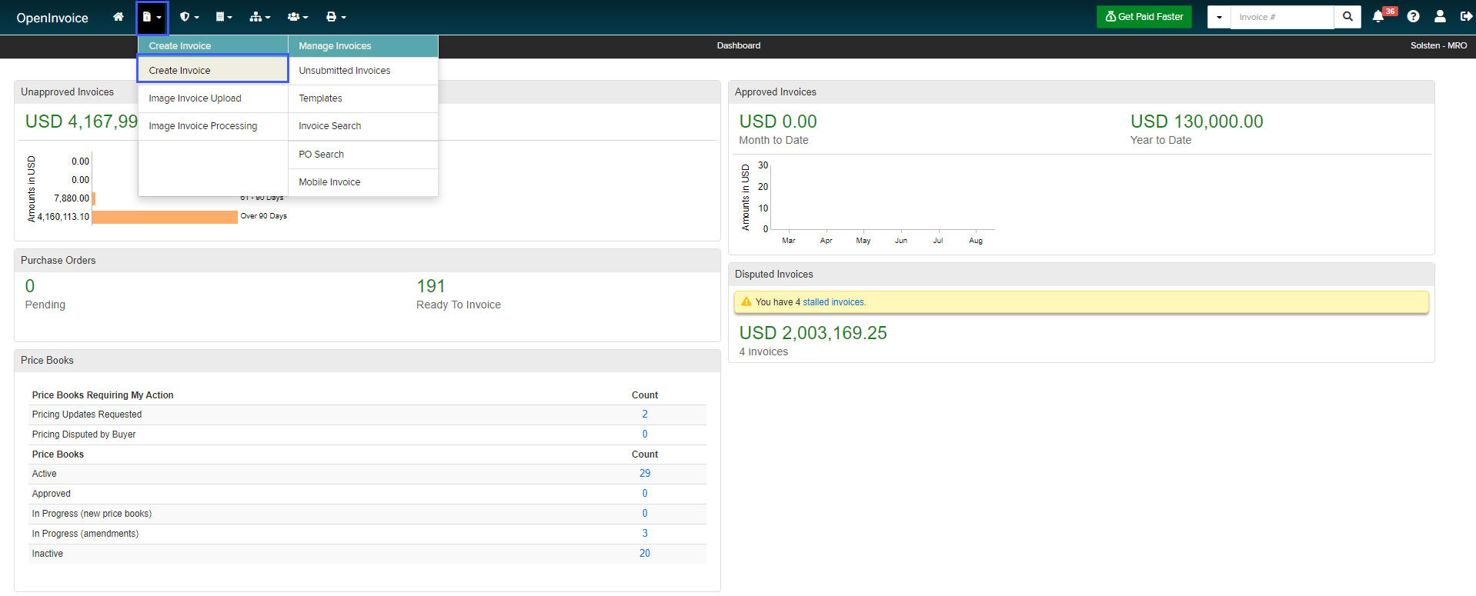
PriceBook Not Required
How to create invoices for PriceBook Not Required
From your dashboard select:
    Invoice Icon
    Create Invoice
Notes:
This slide uses slide layout: Title and Two Content
Images
Images on text slides can be replaced – they should be sized according to the gridlines in the template.

Slide 4
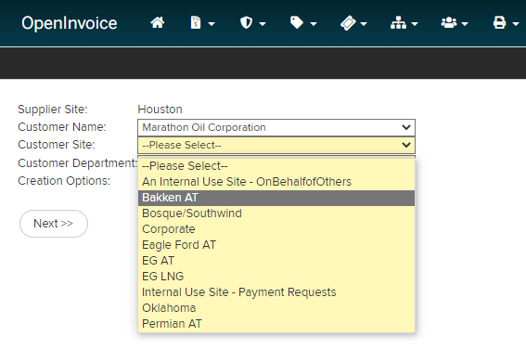
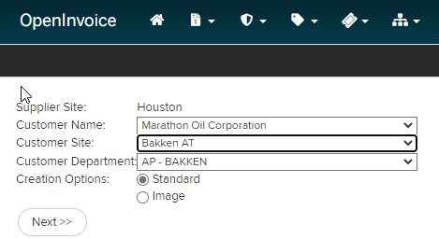
PriceBook Not Required
How to create invoices for PriceBook Not Required
Enter the appropriate values in the following fields:
    Customer Name: Marathon Oil
    Customer Site: Select the customer site that matches the asset you performed work in
    Customer Department: Will auto select – no action needed
    Click Next
Notes:
This slide uses slide layout: Title and Two Content
Images
Images on text slides can be replaced – they should be sized according to the gridlines in the template.

Slide 5
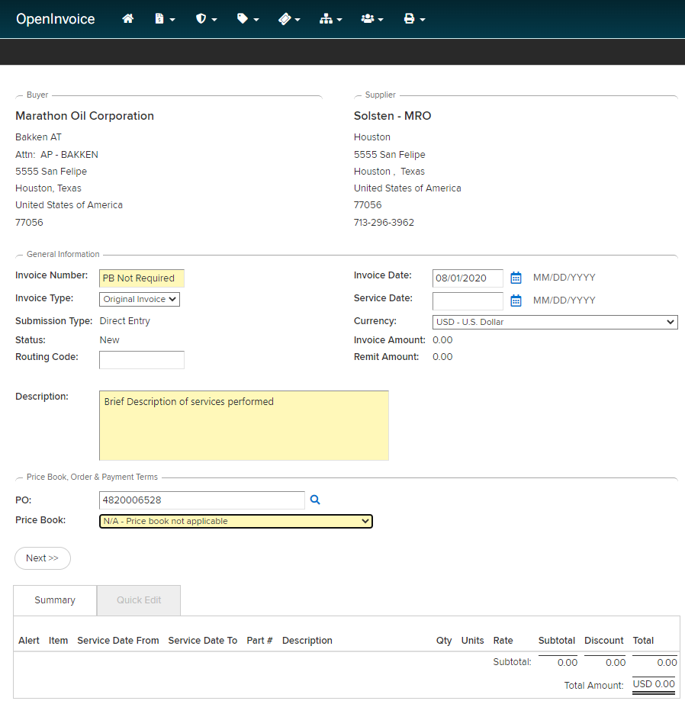
PriceBook Not Required
How to create invoices for PriceBook Not Required
Enter the appropriate values in the following fields:
    Invoice Number: Should match your supporting documentation
    Invoice Date: Should match your supporting documentation
    Description: Brief description of the work performed
    Pricebook: Select the N/A – PriceBook not applicable per the screenshot
    Click Next
    Review header info to ensure accuracy
Notes:
This slide uses slide layout: Title and Two Content
Images
Images on text slides can be replaced – they should be sized according to the gridlines in the template.

Slide 6
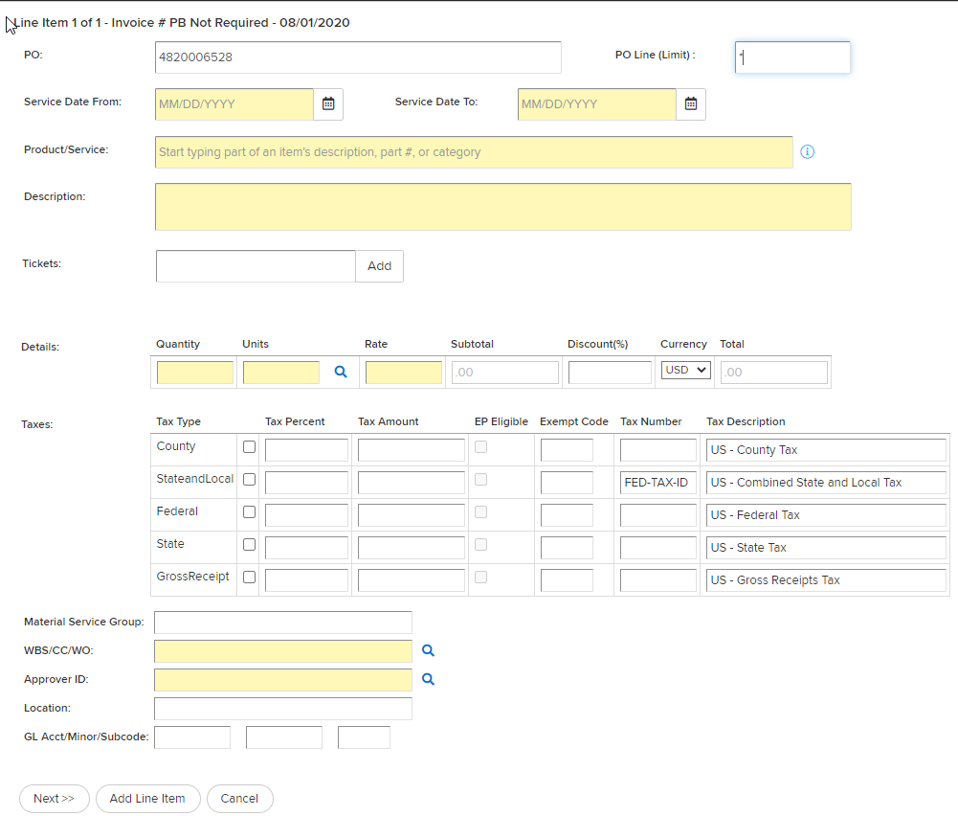
PriceBook Not Required
How to create invoices for PriceBook Not Required
Enter the appropriate values in the following fields:
    Purchase Order Number: Po line will be populated with number entered in the header.
    PO Line: Place an * in the PO line field and select the PO line that best fits the services you are providing
PO number will be populated with the number entered on header.
Select the correct PO line for the service performed.
Notes:
This slide uses slide layout: Title and Two Content
Images
Images on text slides can be replaced – they should be sized according to the gridlines in the template.

Slide 7
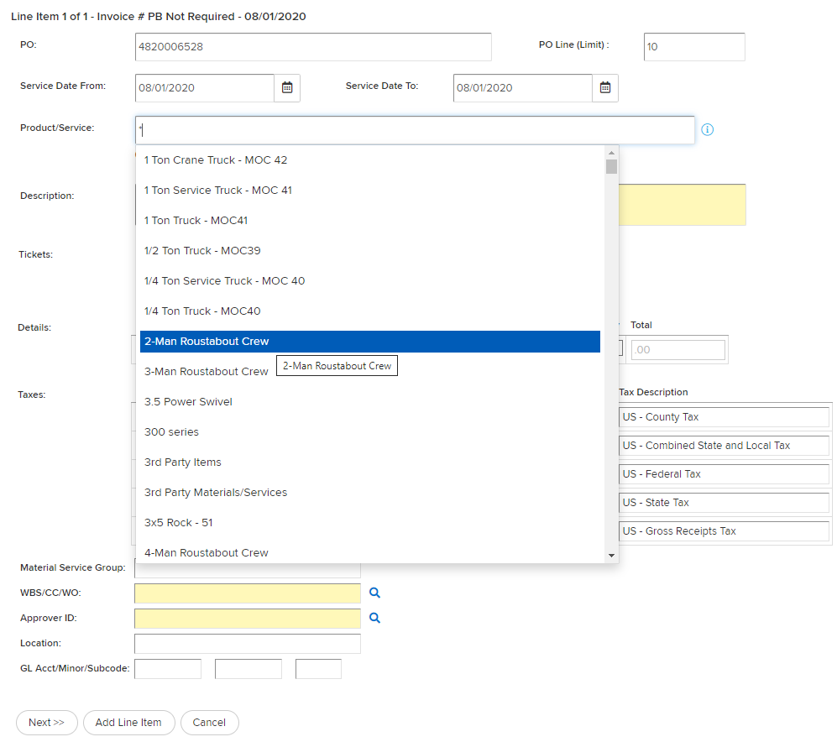
PriceBook Not Required
How to create invoices for PriceBook Not Required
Enter the appropriate values in the following fields:
    Service Dates: Enter the service dates that match your supporting documentation
    Product/Service: Place an * in this field and select the catalog item that matches your supporting documentation
**If that item is not available, choose PRODUCT, be sure to update description to match supporting documentation**
Notes:
This slide uses slide layout: Title and Two Content
Images
Images on text slides can be replaced – they should be sized according to the gridlines in the template.

Slide 8
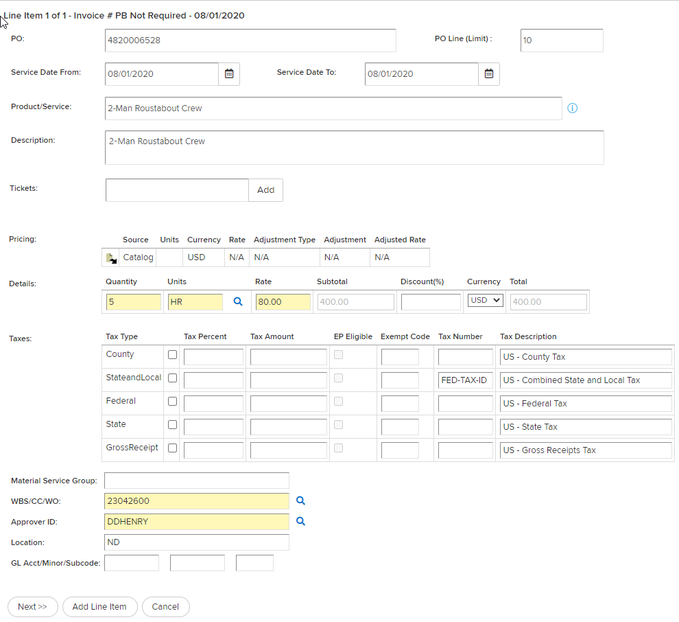
PriceBook Not Required
How to create invoices for PriceBook Not Required
Enter the appropriate values in the following fields:
    Details: Enter quantity, unit of measure (units), and rate
    Taxes: Enter taxable amount as state and local tax IF APPLICABLE
    WBS/CC/WO: Enter WBS/CC/WO – search by entering any portion of coding surrounded by * and click magnifying glass.
    Approver ID: Enter Approver ID - search by entering any portion of approvers name surrounded by * and click magnifying glass
  Complete invoice entry by selecting add a line item to enter more lines or Next to finish invoice
  **Ensure you attach all your support documentation
    Submit to buyer
Notes:
This slide uses slide layout: Title and Two Content
Images
Images on text slides can be replaced – they should be sized according to the gridlines in the template.

Slide 9
PriceBook Required
Notes:
This slide uses slide layout: Section Divider (Color)
Other background colors should not be used.

Slide 10
PriceBook Required
How to create invoices for PriceBook Required
From your dashboard select:
    Invoice Icon
    Create Invoice
Notes:
This slide uses slide layout: Title and Two Content
Images
Images on text slides can be replaced – they should be sized according to the gridlines in the template.

Slide 11
PriceBook Required
How to create invoices for PriceBook Required
Enter the appropriate values in the following fields:
    Customer Name: Marathon Oil Corporation
    Customer Site: Select the customer site that matches the asset you performed work in
    Customer Department: Will auto select – no action needed
    Click Next
Notes:
This slide uses slide layout: Title and Two Content
Images
Images on text slides can be replaced – they should be sized according to the gridlines in the template.

Slide 12
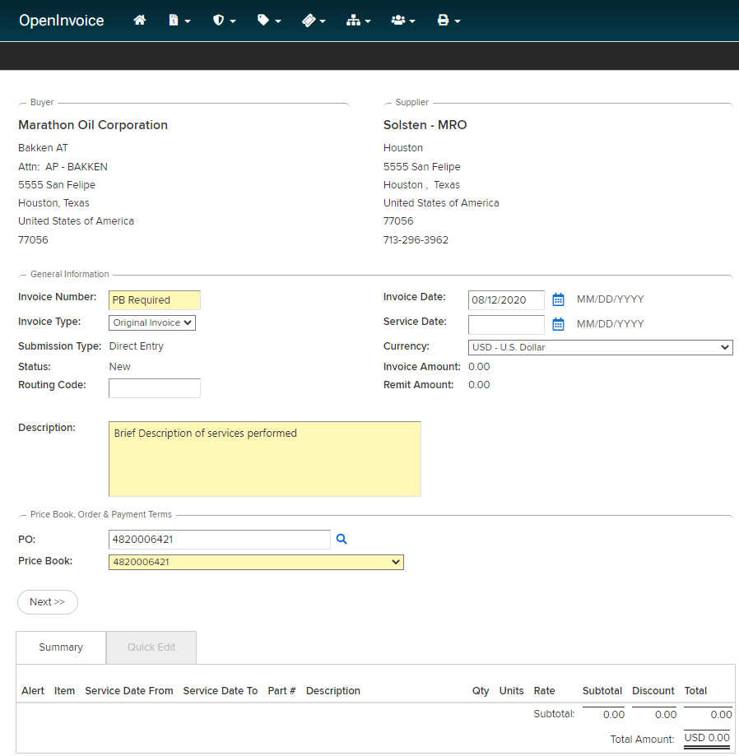
PriceBook Required
How to create invoices for PriceBook Required
Enter the appropriate values in the following fields:
    Invoice Number: Should match your supporting documentation
    Invoice Date: Should match your supporting documentation
    Description: Brief description of the work performed
    PO: Enter the 10 digit PO number.
    PriceBook: Will auto populate if there is a PriceBook linked to the PO
    Click Next
    Review header info to ensure accuracy
Enter your 10 digit PO number. If applicable, the Price Book will auto populate.
Notes:
This slide uses slide layout: Title and Two Content
Images
Images on text slides can be replaced – they should be sized according to the gridlines in the template.

Slide 13
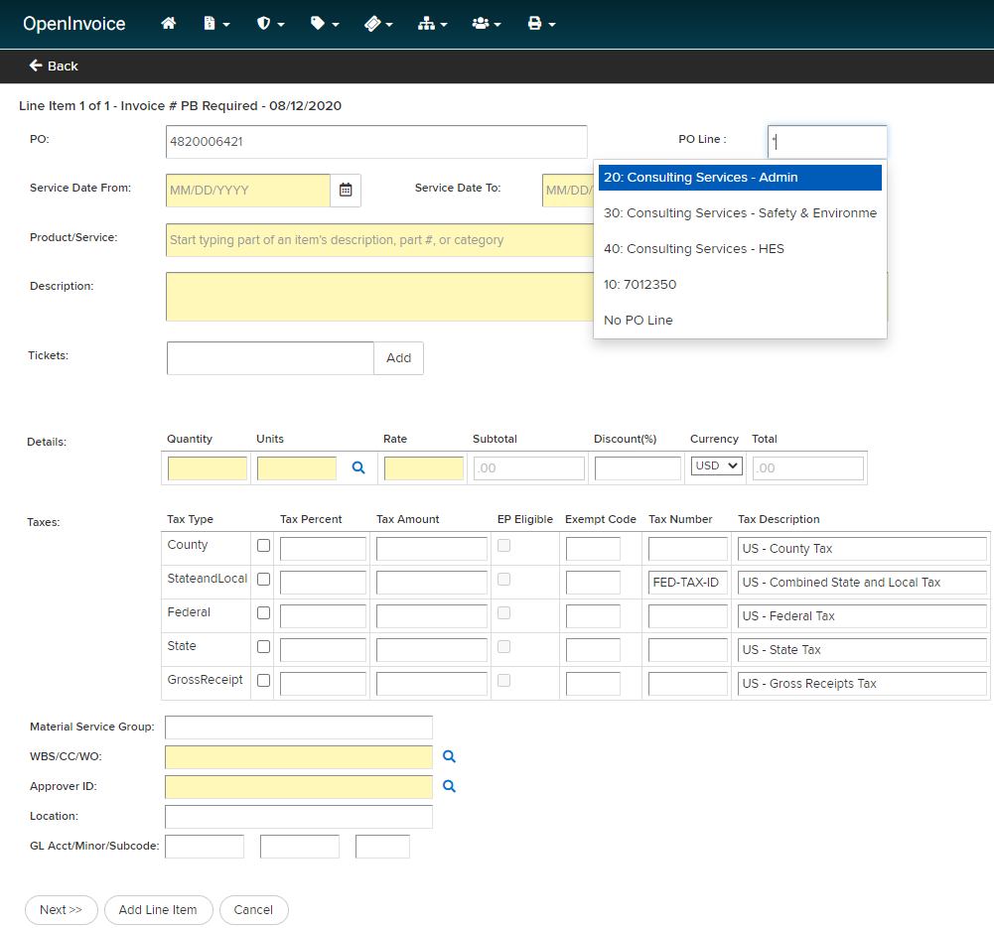
PriceBook Required
How to create invoices for PriceBook Required
Enter the appropriate values in the following fields:
    Purchase Order Number: Po line will be populated with number entered in the header.
    PO Line: Place an * in the PO line field and select the PO line that best fits the services you are providing
PO number will be populated with the number entered on header.
Select the correct PO line for the service performed.
Notes:
This slide uses slide layout: Title and Two Content
Images
Images on text slides can be replaced – they should be sized according to the gridlines in the template.

Slide 14
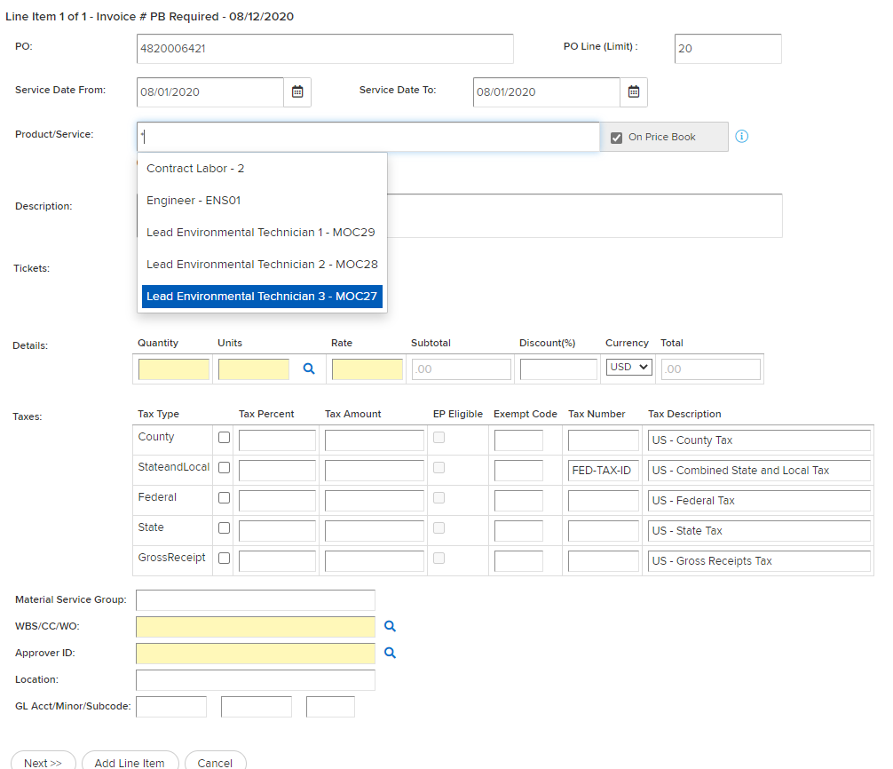
PriceBook Required
How to create invoices for PriceBook Required
Enter the appropriate values in the following fields:
    Service Dates: Enter the service dates that match your supporting documentation
    Product/Service: Place an * in this field and select the PriceBook item that matches your supporting documentation
    Off Contract Items: See slide 16
Notes:
This slide uses slide layout: Title and Two Content
Images
Images on text slides can be replaced – they should be sized according to the gridlines in the template.

Slide 15
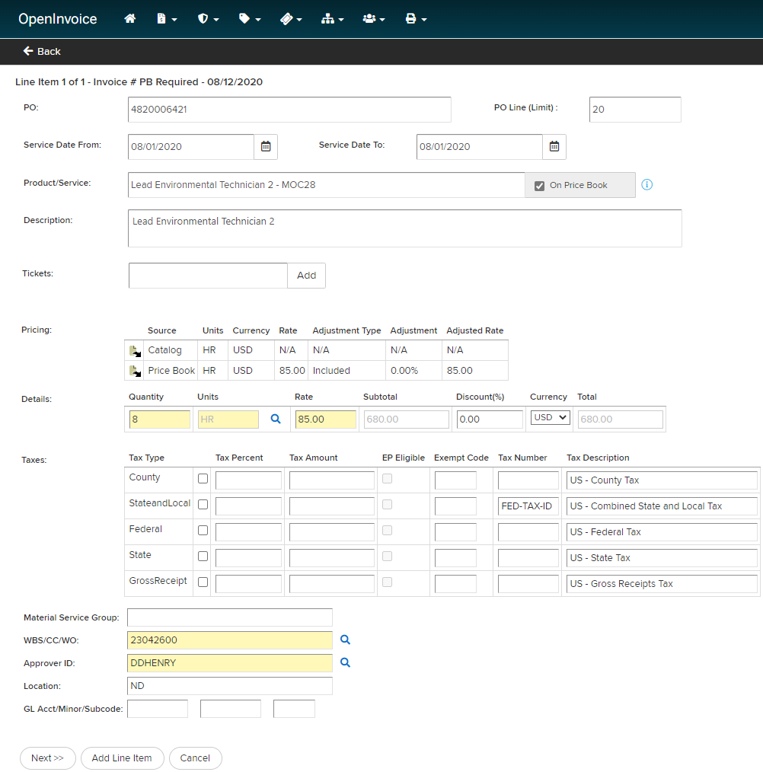
PriceBook Required
How to create invoices for PriceBook Required
Enter the appropriate values in the following fields:
    Details: Enter quantity, unit of measure (units), and rate
    Taxes: Enter taxable amount as state and local tax IF APPLICABLE
    WBS/CC/WO: Enter WBS/CC/WO – search by entering any portion of coding surrounded by * and click magnifying glass.
    Approver ID: Enter Approver ID - search by entering any portion of approvers name surrounded by * and click magnifying glass
  Complete invoice entry by selecting add a line item to enter more lines or Next to finish invoice
  **Ensure you attach all your support documentation
    Submit to buyer
Notes:
This slide uses slide layout: Title and Two Content
Images
Images on text slides can be replaced – they should be sized according to the gridlines in the template.

Slide 16
Off Contract Items
Notes:
This slide uses slide layout: Section Divider (Color)
Other background colors should not be used.

Slide 17
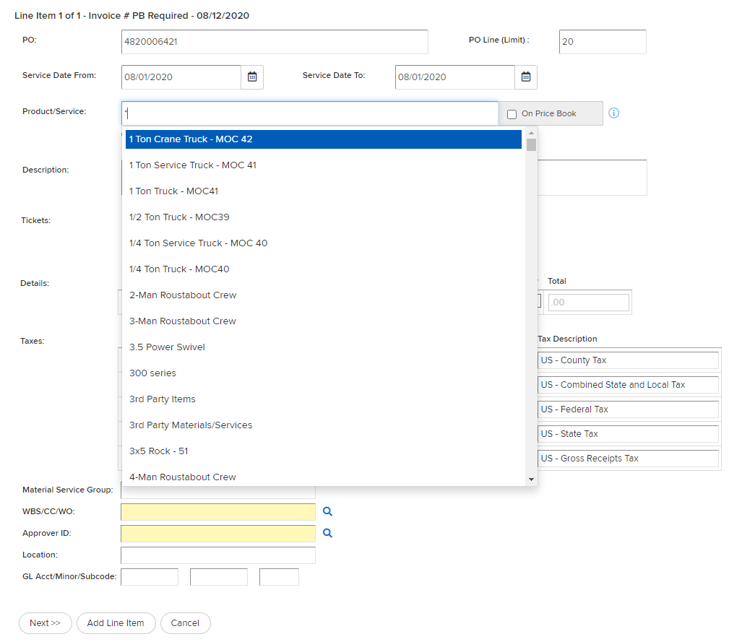
Off Contract Item Billing
How to bill off contract items
Billing Off Contract Items
PriceBooks will only include items that are in the mutually agreed upon contract. Items not included in the Job Order are considered Off Contract.
Uncheck the “on Pricebook” box in the Product/Service section.
Search for a specific item by description/part # in the product service field.
Placing an * in this field will allow you to see all catalog items where you can choose the correct item.
If the correct item does not exist in your catalog, please save your invoice, add item to your catalog before continue billing.
Update description, quantity, rate and units.
**Refer to next slide or contact Enverus Support for assistance with adding items to your catalog**
** All items billed off contract will be reviewed internally and could result in invoice dispute **
Notes:
This slide uses slide layout: Title and Two Content
Images
Images on text slides can be replaced – they should be sized according to the gridlines in the template.

Slide 18
Off Contract Item Billing
Add off contract items to your catalog:
Add off contract items to your catalog:
Click on the Corporate menu (Org Chart Icon)
Select Product/Service Catalog
Here you will see all items in your supplier catalog.
  You can make changes by clicking on each item
  Add new items by clicking add item.
  You can download the catalog to excel and them make changes and reimport. You will not be able to delete items in buyers pricebooks.
If you need further assistance with catalog maintenace refer to the resource center (question mark icon) or contact Enverus Support openinvoicesupport@enverus or 1-866-627-3287.
Then you will be able to select the items from your catalog to bill as off contract.
Ensure the Pricebook # is selected on the header screen of the invoice.
Uncheck the “on Pricebook” box in the Product/Service section.
Search for a specific item by description/part # in the product service field.
  Placing an * in this field will allow you to see all catalog items where you can choose the correct item.
Update quantity, rate and units.

Slide 19

Additional Assistance Needed?
Contact Marathon’s call center
Openinvoicesupport@marathonoil.com or 866-323-1836
Thank you
Notes:
This slide uses slide layout: Section Divider (Image)
Images
End slide images can be replaced but need to have sufficient contrast for the type elements to be legible. When working with images, it may be necessary to arrange elements of the content differently (i.e., ‘Send to back’) in order to be able to select and edit them.

