Slide 1
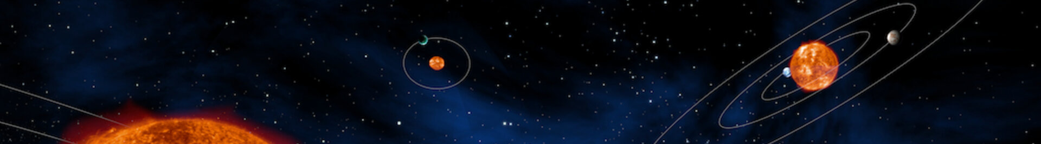
Learning Objectives
Learn about planets outside of our solar system
Use scientific methods to investigate what conditions are needed for a planet to have clouds
Explain how clouds are formed
Notes:
It is suggested that you prepare the materials (including the hot water) for the demonstration in activity 2 before the lesson begins in order to save time during the lesson.

Slide 2
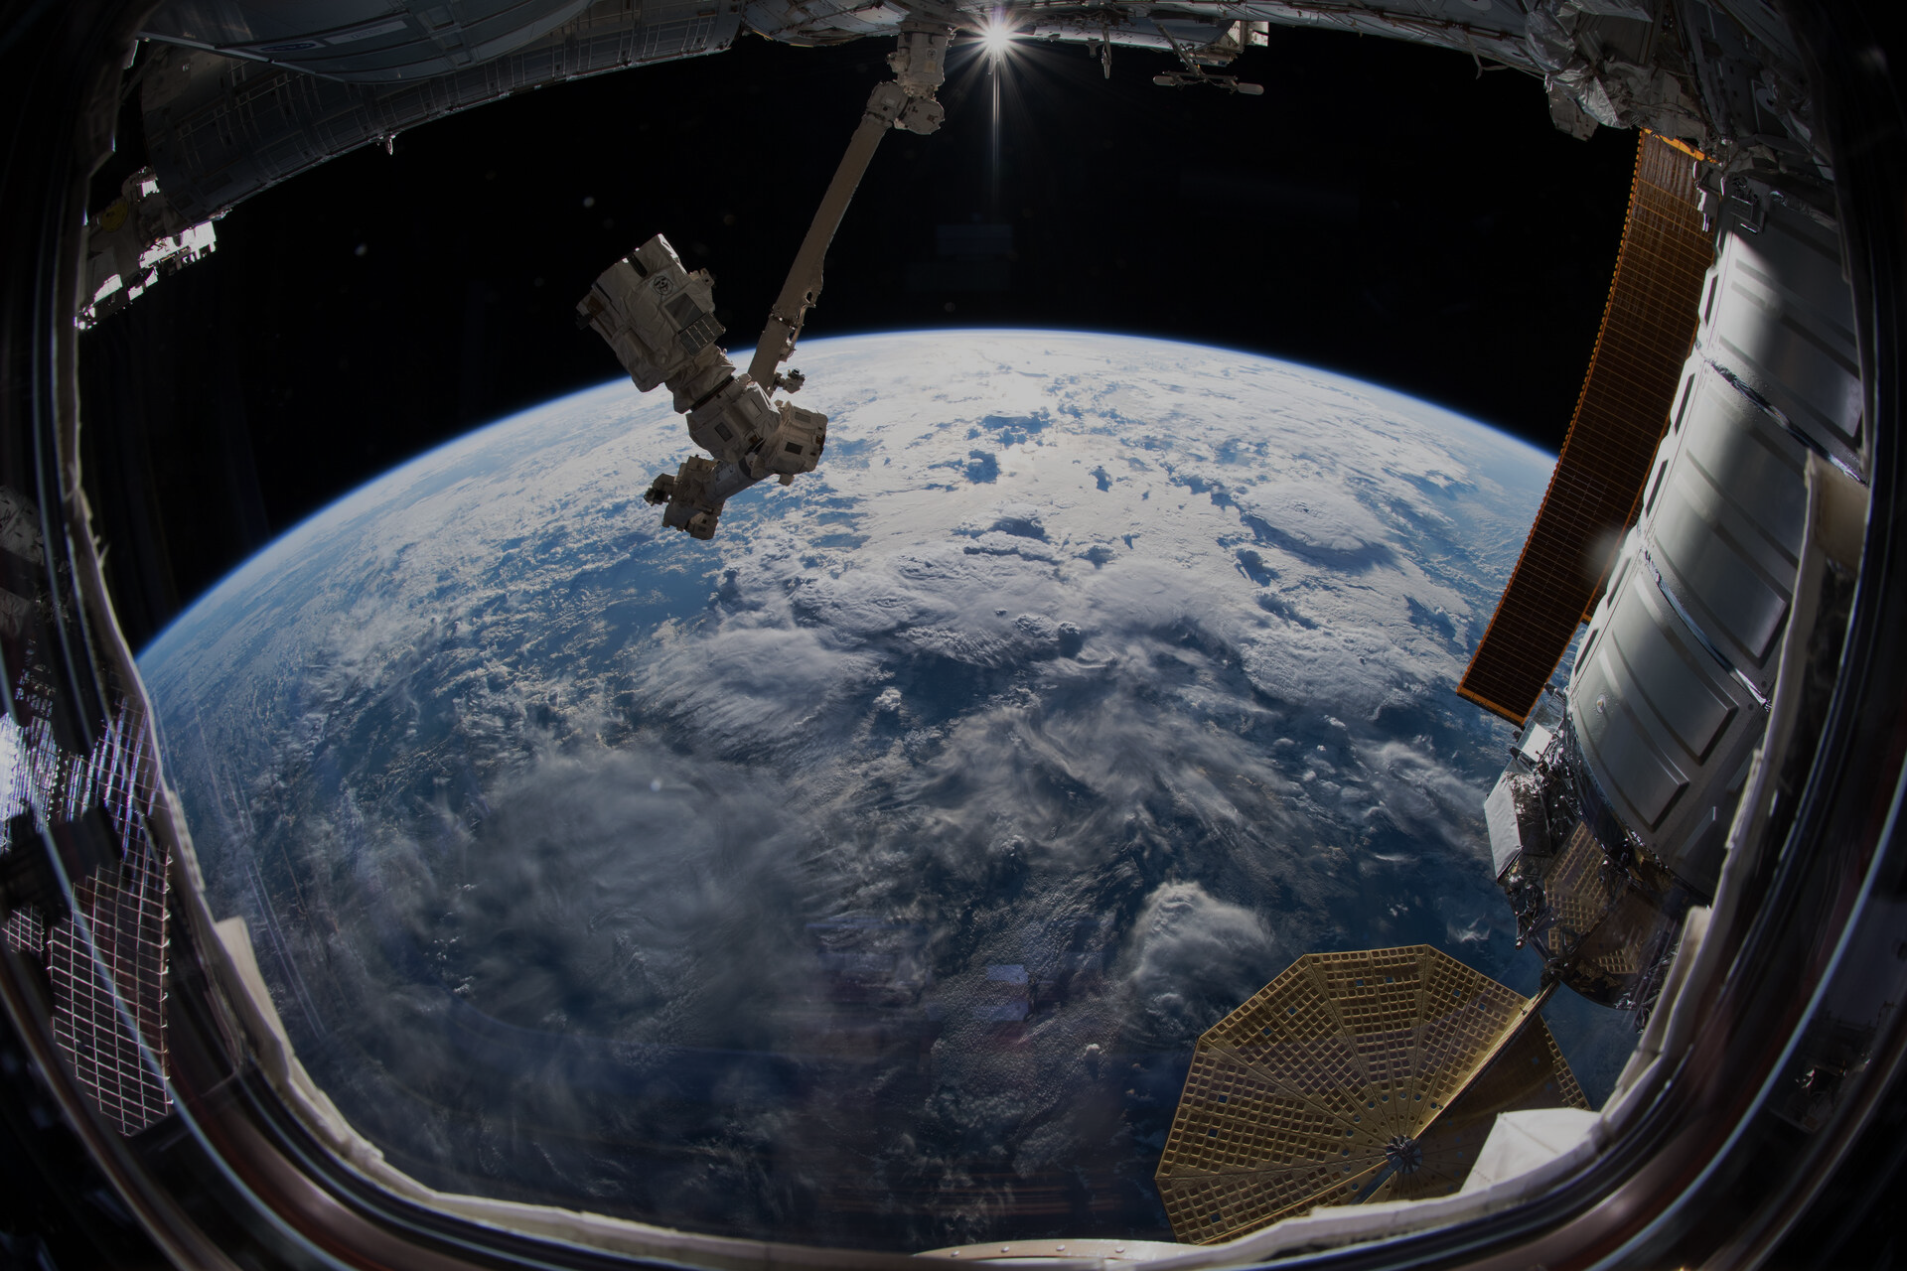
Clouds In Space
ESA astronaut Alexander Gerst captured this image of Earth from the International Space Station on 21 June 2018.
Notes:
Activity 1: Introductory ‘quiz’ – the aim of this is to introduce the students to exoplanets, and to gauge their knowledge on the topic of exoplanets and cloud formation.

Slide 3
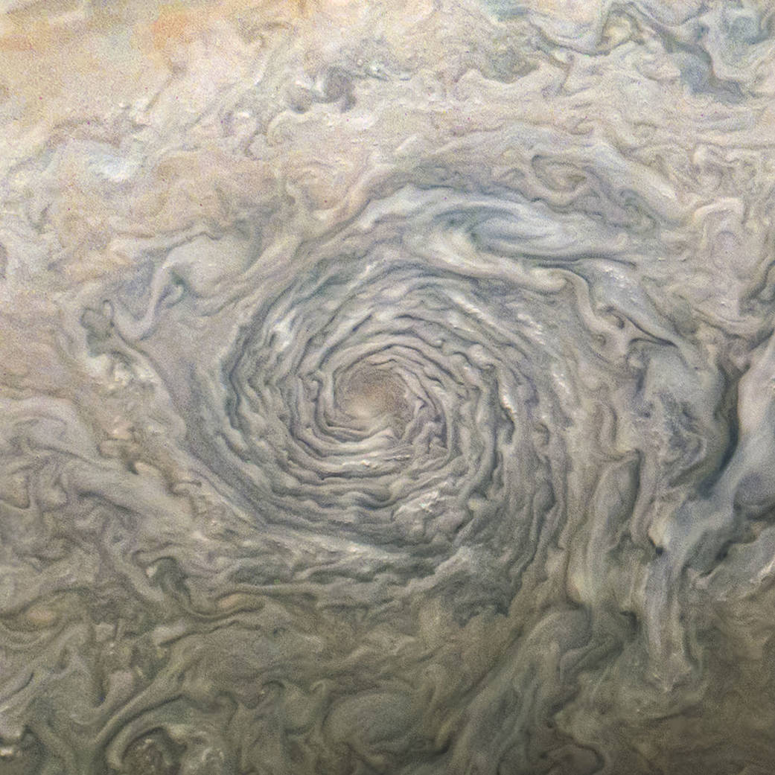
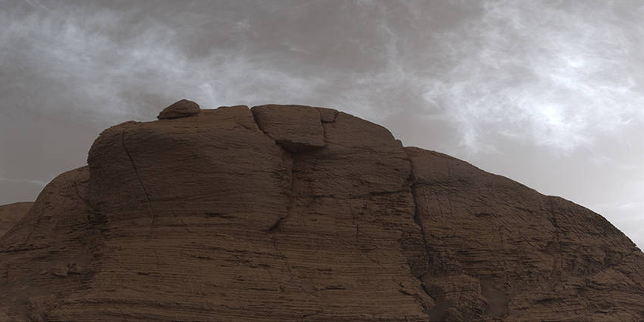
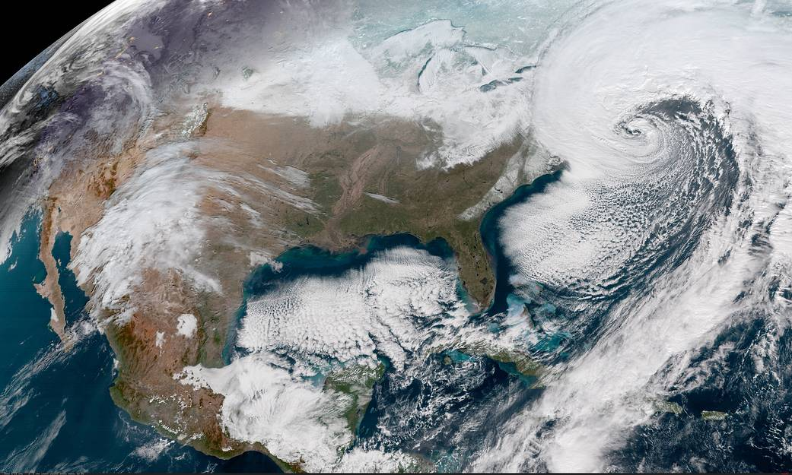
Where do you think these clouds can be found?
Notes:
Ask students to identify where these photos of clouds are from.
The answers will be shown on the next slide. Correct answers are: Jupiter, Mars and Earth. You may provide guidance to students to get to the correct answers.

Slide 4
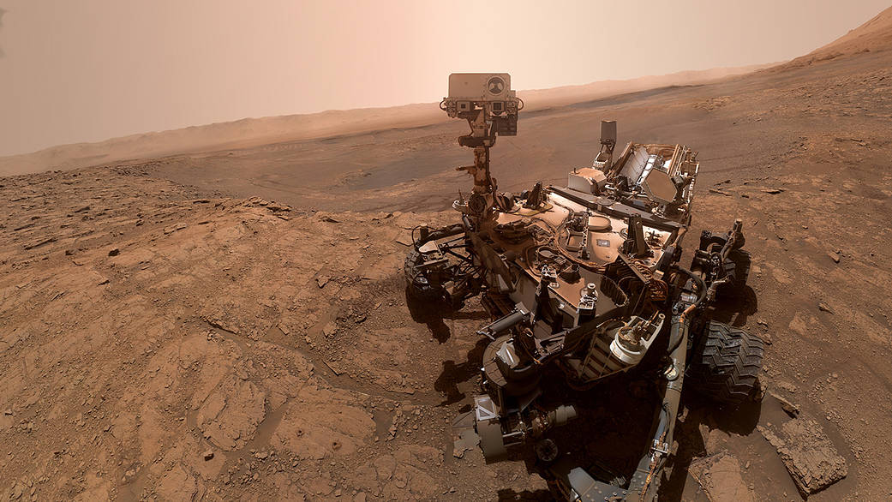
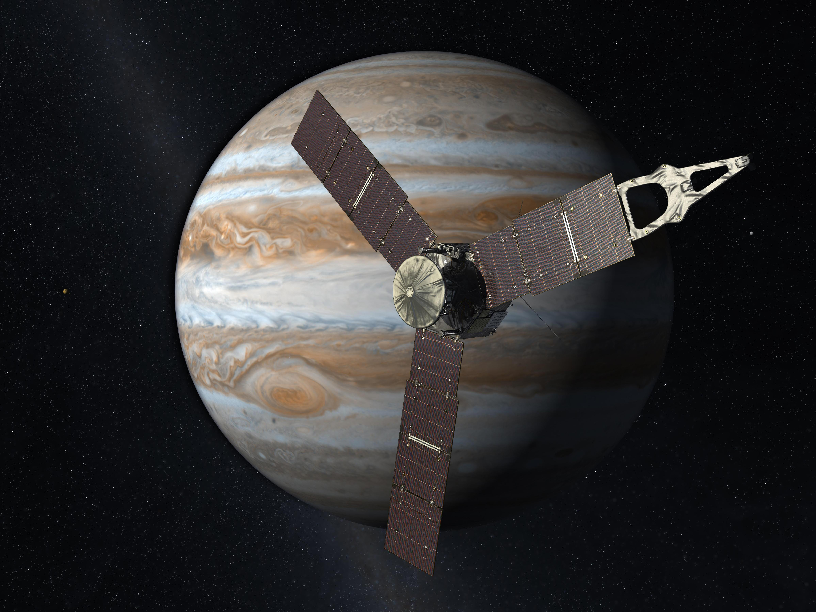
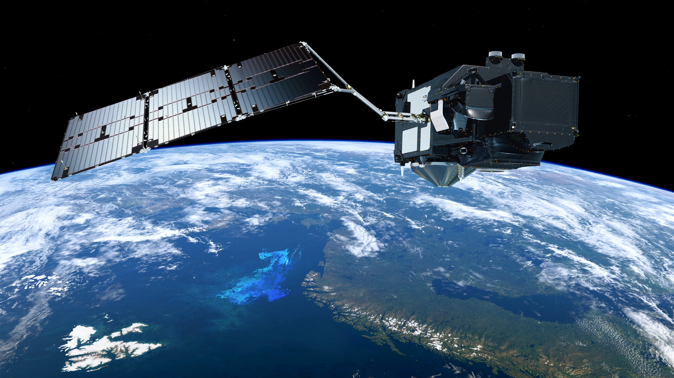
Where do you think these clouds can be found?
Mars
Jupiter
Earth
NASA’s Juno Spacecraft, NASA.gov
NASA’s Mars Curiosity rover 2021, NASA.gov
ESA’s Copernicus Sentinel-3 Mission www.ESA.int
Notes:
Mention to the class the similarity in patterns of clouds between planets.
This is because the same physics dictates cloud formation regardless of which planet you are on.
The images from mars were taken by the Mars Curiosity rover, the images of Jupiter were taken by the Juno Spacecraft.
We are starting by looking at clouds on planets within our solar system as these are the ones we can most easily observe and learn from.

Slide 5
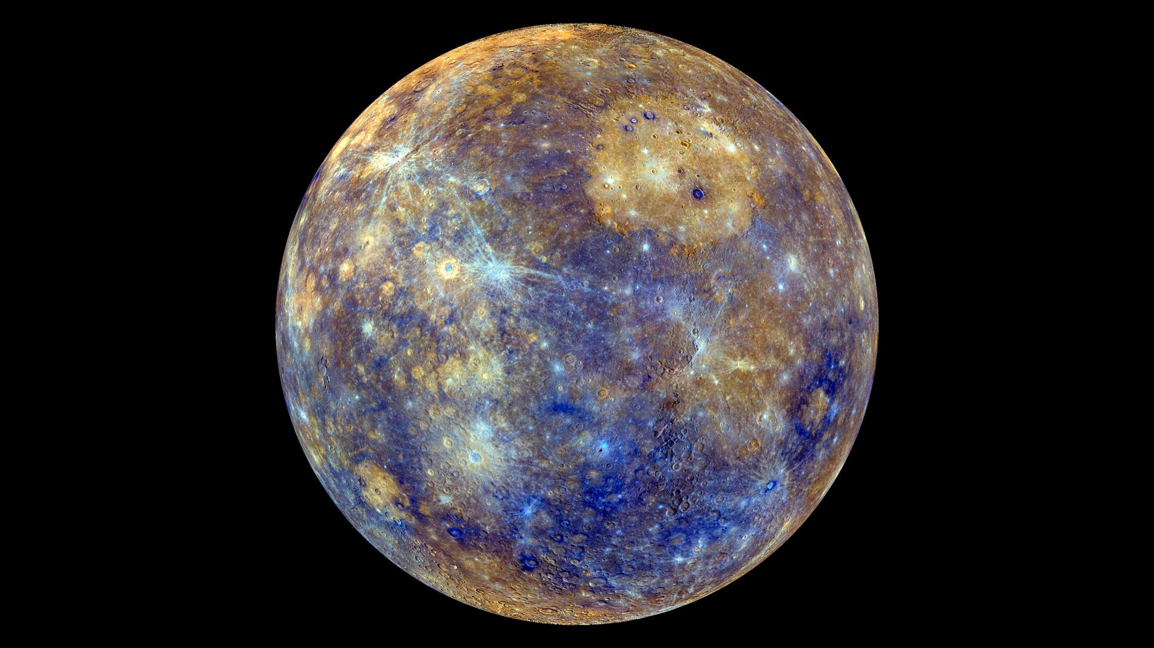
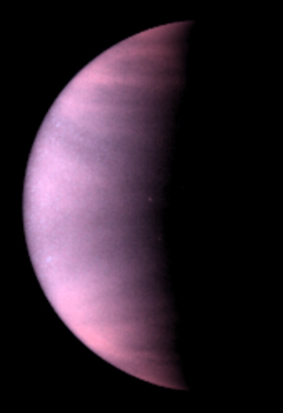
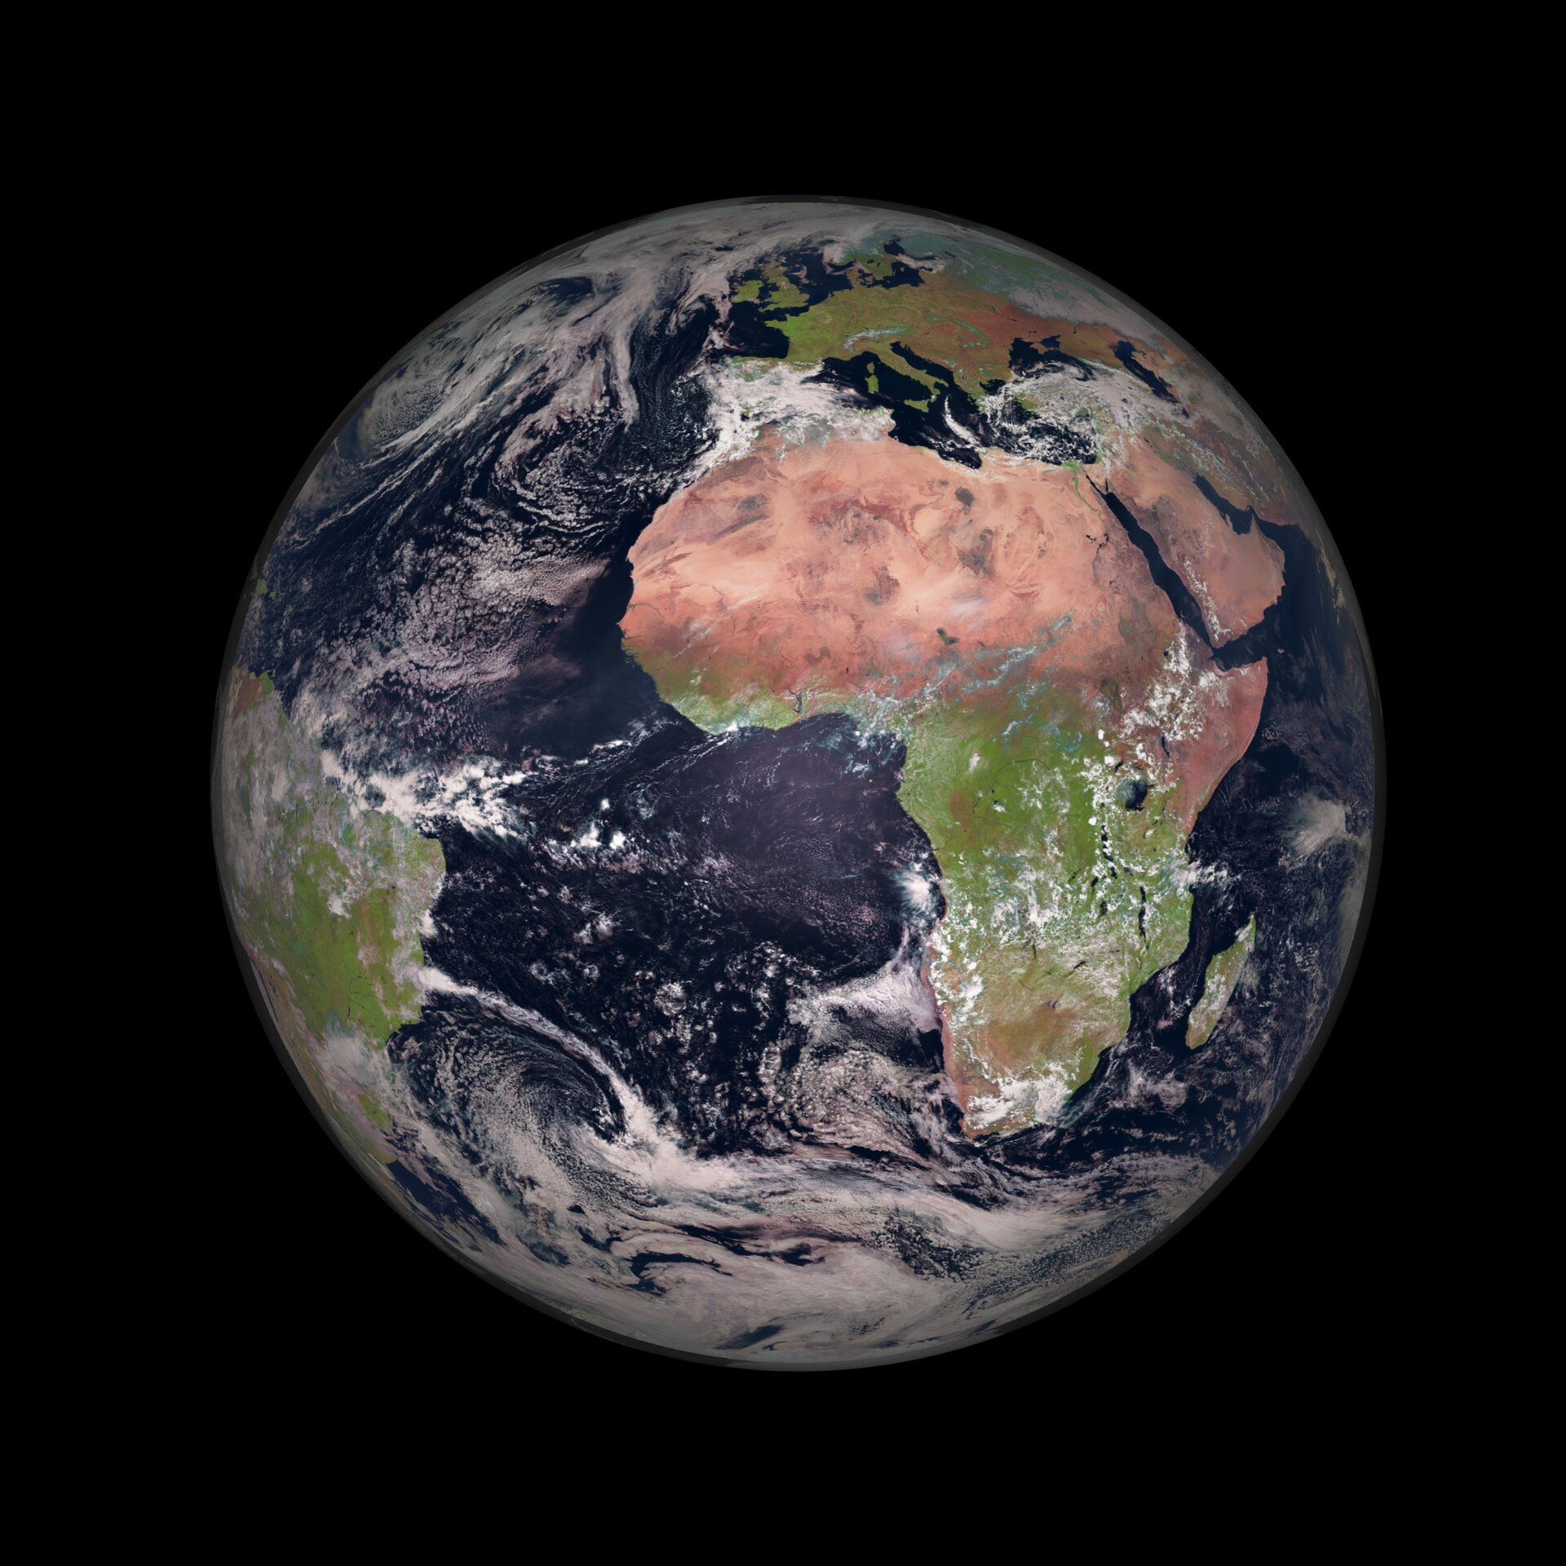
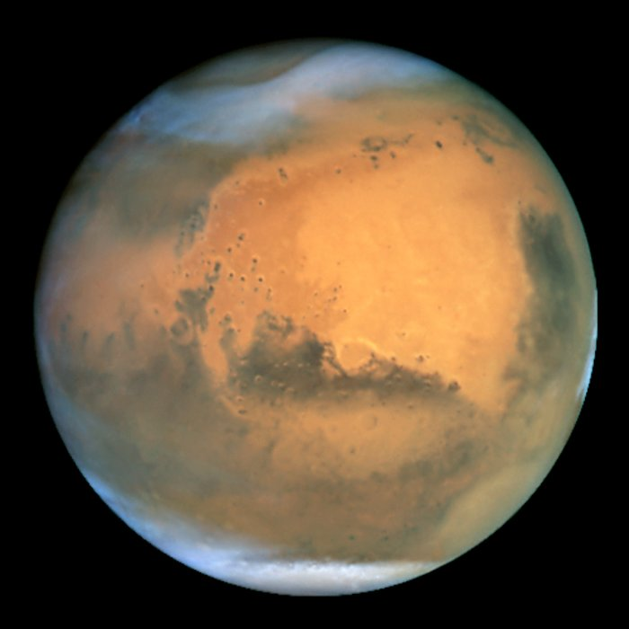
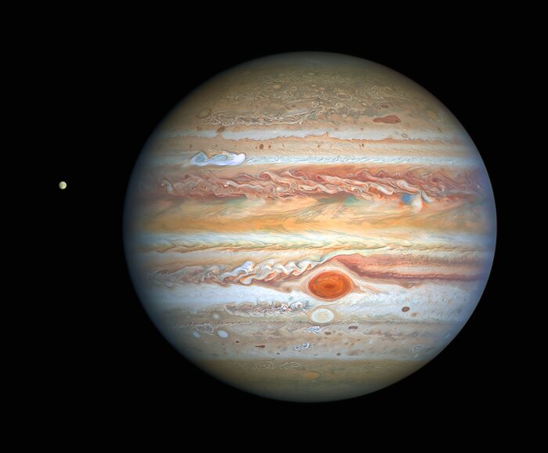
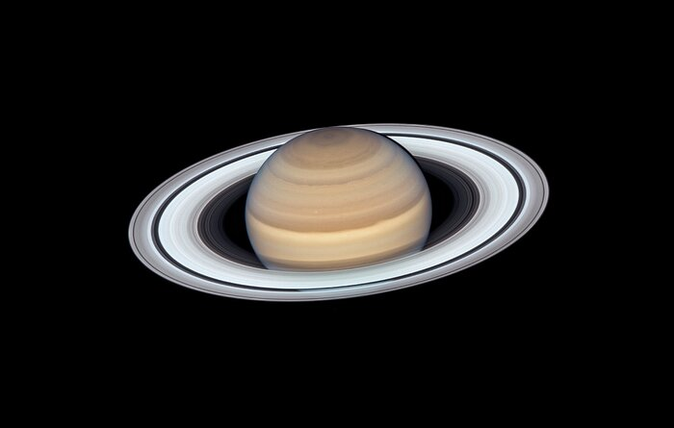
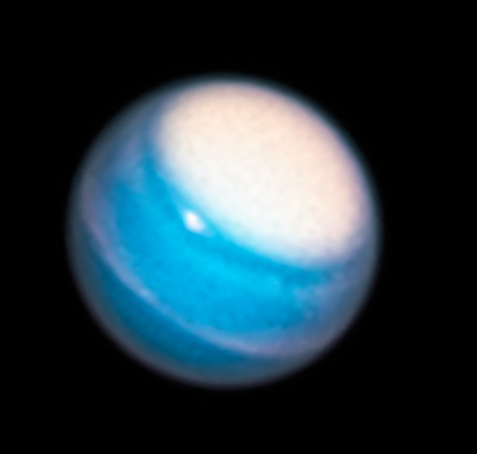
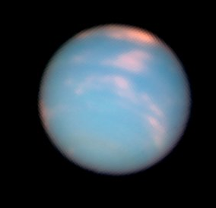
Which of the planets in our solar system do you think have clouds?
Mercury
Venus
Earth
Mars
Jupiter
Saturn
Uranus
Neptune
Mercury: NASA Messenger https://solarsystem.nasa.gov/, Earth image ESA Meteosat http://esa.int,
All other images from the Hubble Space Telescope https://esahubble.org/images/
Notes:
The class has seen in the previous slide that Earth, Jupiter and Mars all have clouds.
You may prompt students to think about why a planet may or may not have clouds.

Slide 6

Which of the planets in our solar system do you think have clouds?
Mercury
Venus
Earth
Mars
Jupiter
Saturn
Uranus
Neptune
Mercury: NASA Messenger https://solarsystem.nasa.gov/, Earth image ESA Meteosat http://esa.int,
All other images from the Hubble Space Telescope https://esahubble.org/images/
Notes:
Mercury doesn’t have an atmosphere, so clouds can not form on it.
Mercury doesn’t have an atmosphere for two main reasons: 1) it is quite a small planet so the gravity is not large enough to hold the atmosphere. 2) it is very close to the sun, so much of the atmosphere was blasted away by the energy from the sun
If the majority of planets within our solar system have clouds, it seem reasonable to expect that clouds on planets must be quite a common phenomena.

Slide 7
Which of these planets do you think have clouds made of water?
Mercury
Venus
Earth
Mars
Jupiter
Saturn
Uranus
Neptune
Mercury: NASA Messenger https://solarsystem.nasa.gov/, Earth image ESA Meteosat http://esa.int,
All other images from the Hubble Space Telescope https://esahubble.org/images/
Notes:
We know that clouds on earth are made of water, what about on other planets?
Is there a reason why clouds on earth are made of water? Is there a reason why other planets would not have clouds made of water?

Slide 8

Which of these planets do you think have clouds made of water?
Mercury
Venus
Earth
Mars
Sulfuric acid
Water
Water ice and some frozen carbon dioxide
Jupiter
Saturn
Uranus
Neptune
Ammonia ice, ammonium hydrosulfide crystals, possibly water ice and vapour
Hydrogen-sulfide ice
Methane ice
Mercury: NASA Messenger https://solarsystem.nasa.gov/, Earth image ESA Meteosat http://esa.int,
All other images from the Hubble Space Telescope https://esahubble.org/images/
Notes:
Science does not always have all of the answers. Using the observations and knowledge that we have, we believe that Jupiter and Saturn are likely to have water ice clouds below their surface layers, however scientists do not know for certain yet. Research is still being done on this topic.
The chemicals composition of clouds depends on the pressure and temperature of the planets atmosphere, so different planets can have clouds made of different chemicals.

Slide 9
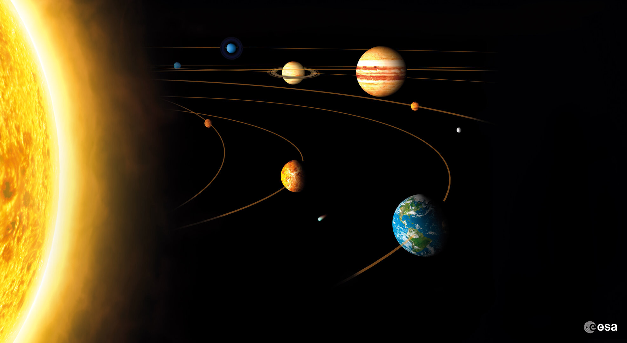
Where do you think we could find clouds outside of our solar system?
Notes:
There are multiple correct answers for this, such as giant interstellar clouds of gas and dust in space called ‘nebulas’. The answer that we will focus on in this lesson is ‘on planets outside of our solar system’ (exoplanets).
In this lesson we will focus on how clouds form on exoplanets.

Slide 10
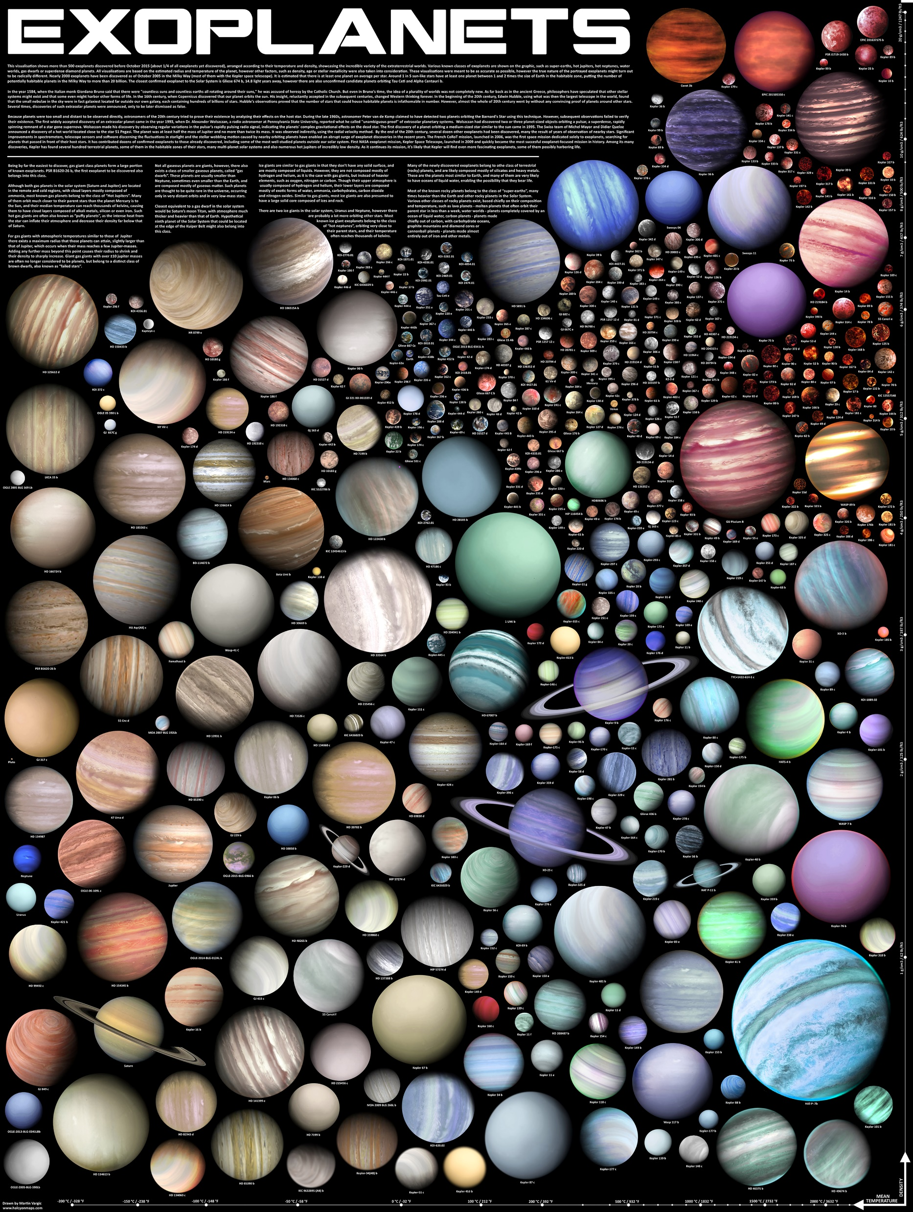
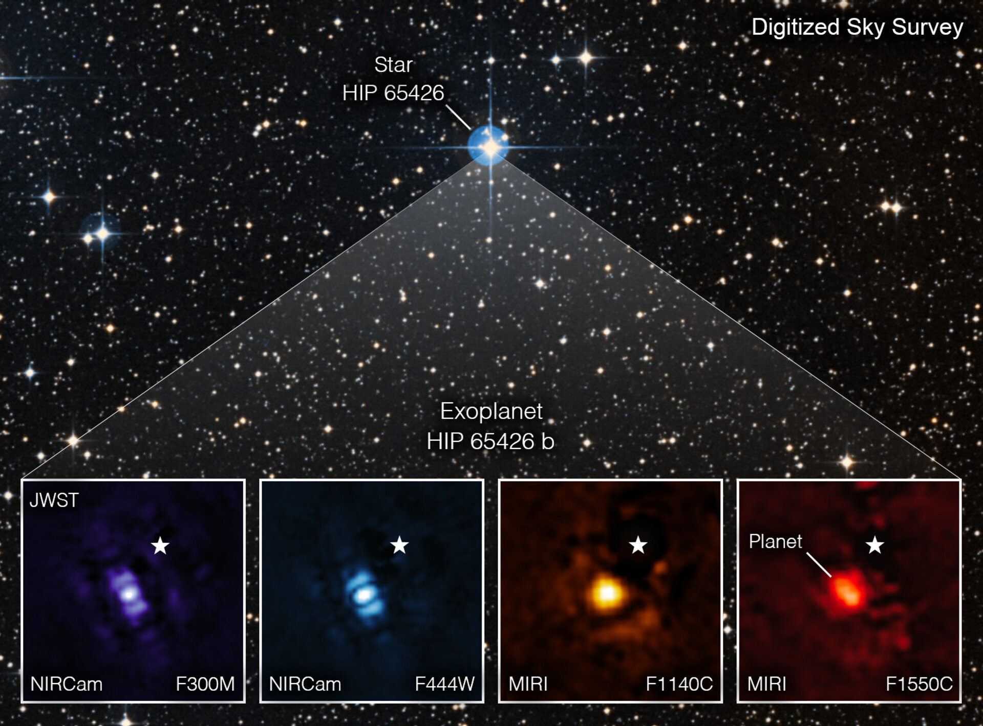
https://www.esa.int/ESA_Multimedia/Images/2022/08/Webb_takes_its_first_exoplanet_image
Martin Vargic https://www.halcyonmaps.com/exoplanets
Notes:
Planets that orbit stars other than our sun are called exoplanets
As of 2022 scientists have have discovered over five thousand exoplanets, and this number is still growing!
Because it is difficult to see thought the clouds we have here on earth, many of the telescopes that we use to look for exoplanets are out in space.
On the left is a poster showing 500 different types of exoplanets, these are artist impressions of the planets, not images. On the right are images taken by the James Webb space telescope of an exoplanet in four different wavelengths of light. As you can see, the direct photos of exoplanets we have do not have a lot of detail!
It is very challenging to observe exoplanets because they are small compared to their host star, and they do not emit their own light.
Using a combination of observations and computational models, it is predicted that many of the exoplanets we have detected will have clouds on them!

Slide 11
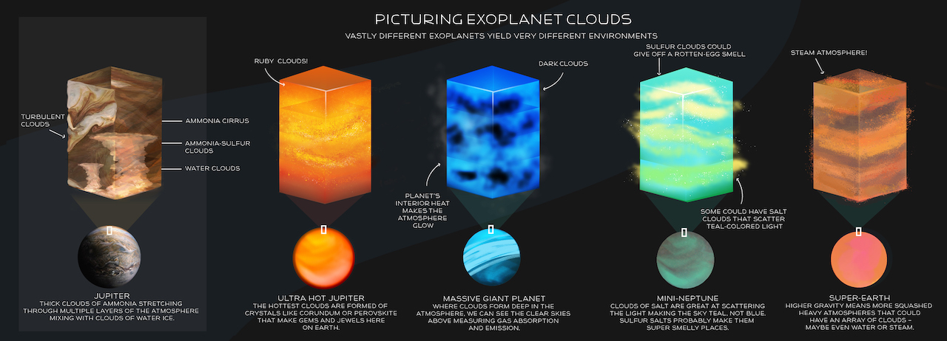
https://exoplanets.nasa.gov/news/1709/exoplanet-clouds-jewels-of-new-knowledge/
Notes:
The clouds on exoplanets can look very different to clouds in our solar system.
Exoplanets come in a huge variety of sizes, temperatures, orbital periods and compositions.
Some exoplanets orbit so close to their star that their temperatures are high enough to vaporize solid materials, this can result in clouds made of molten rock. There could be exoplanet clouds made of liquid iron, or even rubies and sapphires!

Slide 12
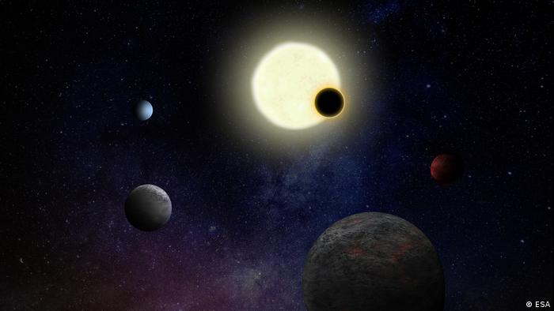
What effects could clouds have on an exoplanet?
Notes:
You may prompt students to think about what effects clouds have on earth, and which effects they might have on planets in our solar system. Many of these effects are also applicable to exoplanets.

Slide 13
Some possible effects of clouds
Make it hard for astronomers to see the surface of the planet
Trap heat and can cause a greenhouse effect
Reflect and absorb light from their host star
Change the chemical composition of a planet's atmosphere
Notes:
This is only an example of the effects that clouds can have on a planet. Students may suggest answers that are not on this slide, but they are not necessarily incorrect.
Because of the effects that clouds have on a planet, it is very important for exoplanet scientists to understand clouds and how they form.

Slide 14
Activity 1: Exoplanet Clouds
If astronomers observe an exoplanet with clouds on it this will tell them that this planet must have the correct conditions for clouds to form.
Ex 1. What do you think is needed for an exoplanet to have clouds?
Notes:
This question should be answered by students in their student worksheets. This can be done either individually or using ‘think, pair, share’.
You may select some students to share their answers with the class. Correct answers will not be given for this question at this stage, as the question should be answered by the students through their experiments during this lesson.

Slide 15
Activity 2: Demonstration
https://vimeo.com/802277701
Notes:
At this stage you will show the demonstration to the students. It is important that you do not explain the scientific concepts behind the demonstration to the students at this stage. This allows them to explore the experiment themselves.
It should also be made clear to the students that there are certain limitations to the demonstration. For example, the dish soap has no analogy in an exoplanet atmosphere, it is only used for practical purposes to that the glass does not fog.
The container acts as a mini-exoplanet atmosphere. In this demonstration, we have to use water to make the cloud because we are doing the experiment on earth. If we were really on another planet, other liquids could be used.

Slide 16
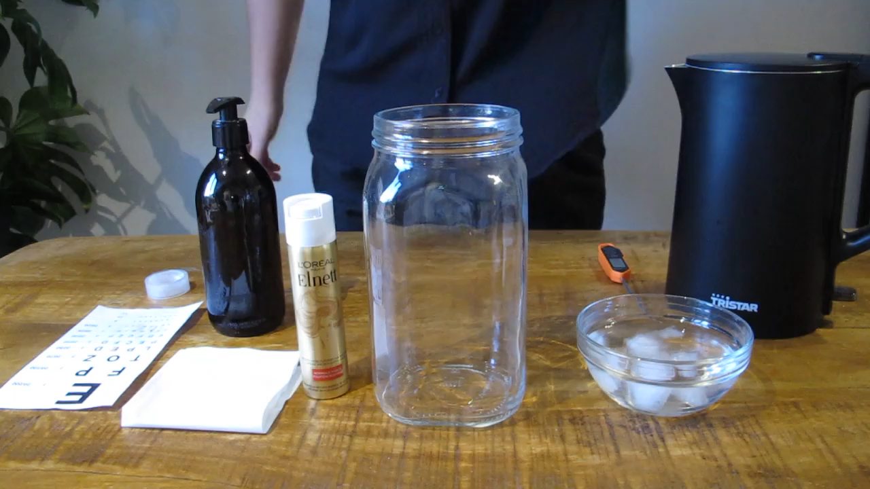
Activity 2: Demonstration
Notes:
At this stage you will show the demonstration to the students. It is important that you do not explain the scientific concepts behind the demonstration to the students at this stage. This allows them to explore the experiment themselves.
It should also be made clear to the students that there are certain limitations to the demonstration. For example, the dish soap has no analogy in an exoplanet atmosphere, it is only used for practical purposes to that the glass does not fog.
The container acts as a mini-exoplanet atmosphere. In this demonstration, we have to use water to make the cloud because we are doing the experiment on earth. If we were really on another planet, other liquids could be used.

Slide 17
Activity 2: Demonstration
Ex 2. Sketch the experiment set up in your worksheet
Notes:
At this stage you will show the demonstration to the students. It is important that you do not explain the scientific concepts behind the demonstration to the students at this stage. This allows them to explore the experiment themselves.
It should also be made clear to the students that there are certain limitations to the demonstration. For example, the dish soap has no analogy in an exoplanet atmosphere, it is only used for practical purposes to that the glass does not fog.
The container acts as a mini-exoplanet atmosphere. In this demonstration, we have to use water to make the cloud because we are doing the experiment on earth. If we were really on another planet, other liquids could be used.

Slide 18

Activity 3: Identifying Variables
What are the variables in this experiment?
How would each variable relate to an exoplanet atmosphere?
Ex 3. Discuss these questions as a class and write your answers up on the board
Notes:
The students should be given a few moments in groups to come up with variables. You may use think, pair, share for this.
You will then write the variables and their equivalent in an exoplanet atmosphere up on the board. Suggested answers for this can be found in the teacher guide.
Students may identify variables that are present in the demonstration that are not present in an exoplanet atmosphere and vice versa, this is because the demonstration has limitations, as many scientific models do.

Slide 19
Activity 4: Experimentation
Exoplanet scientists often rely on different types of models (for example computational models or laboratory experiments) to help them understand processes on other planets
In this activity, you will use a physical model to explore exoplanet cloud formation.
Ex 4. Plan and conduct an experiment to investigate the effect of one of these variables on the clouds that form in your mini-exoplanet atmosphere
Notes:
It is suggested to schedule approximately 25 minutes for the planning and conduction of the experiments, with no more than 10 minutes of this being spent on the planning. You may wish to set a timer for this so student can plan their time accordingly.

Slide 20
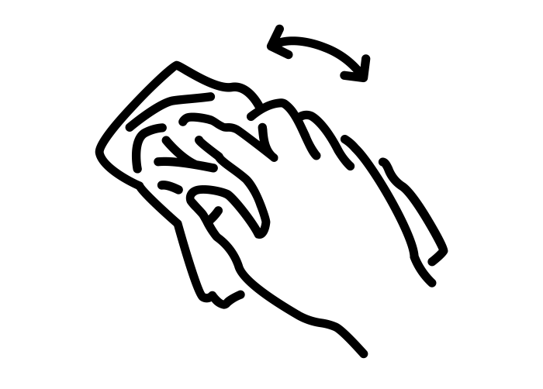
Activity 4: Experimentation
Notes:
It is suggested to schedule approximately 25 minutes for the planning and conduction of the experiments, with no more than 10 minutes of this being spent on the planning. You may wish to set a timer for this so student can plan their time accordingly.
This slide can be shown to students as a guide if you feel it is necessary

Slide 21
Activity 5: Share your findings
Share with the rest of your class what you learned from your experiments. This should include:
  Your hypothesis
  What you tested
  What results you got
  Did this align with your hypothesis?
  What did you learn
Notes:
When each group is sharing their findings you may wish to write a a few brief notes of the findings of each up on the board.

Slide 22
Activity 5: Share your findings
Share with the rest of your class what you learned from your experiments. This should include:
  Your hypothesis
  What you tested
  What results you got
  Did this align with your hypothesis?
  What did you learn
Ex 5. In a short paragraph, write up your class findings as if you are explaining it to a student in another class
Notes:
Being able to share your findings is an important part of the scientific process. By explaining their findings to peers this will help students not only practice this skill, but also make sure they understood the content.

Slide 23
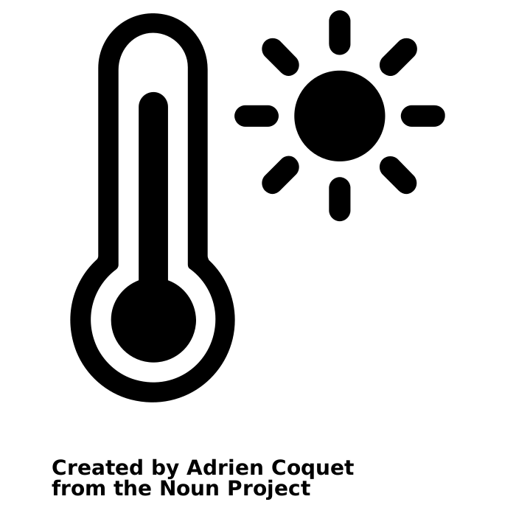
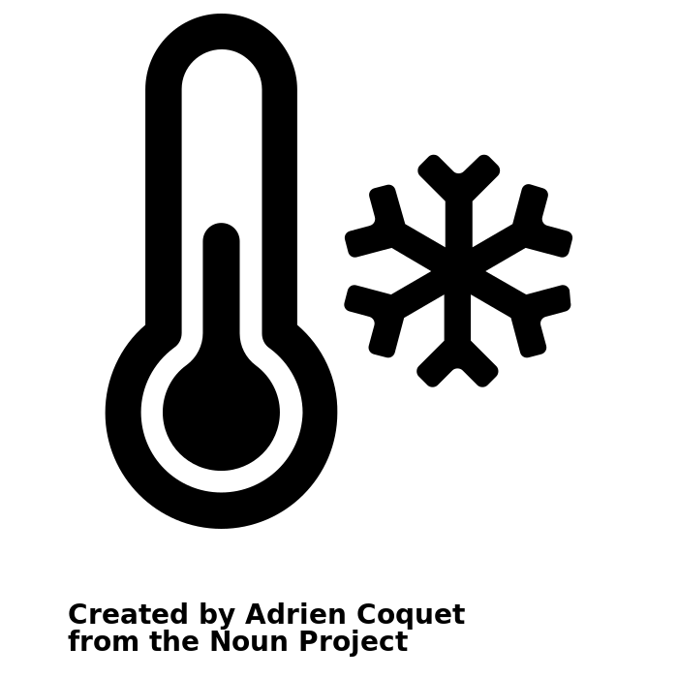



The maximum amount of moisture air can hold depends on its temperature. Hotter air can hold more moisture.
The absolute humidity of a pocket of air is the total amount of moisture in the air
The relative humidity of a pocket of air is the amount of moisture in the air as a percentage of the maximum amount of moisture it could hold at that temperature
20%
50%
Notes:
We will now introduce some important scientific concepts. These are a common ground between earth and exoplanets.

Slide 24
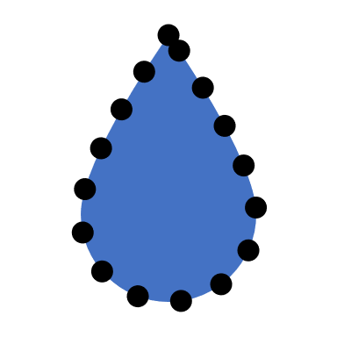
100%
When a pocket of air is holding as much vapour as is possible at a given temperature it has reached saturation point, e.g. the air is saturated
100%
Any extra vapour added past saturation point will condense onto any surface possible to remain at saturation point
You can see this in action when there is a car full of people breathing out water vapour and it starts to condense onto the windows
125%
If there is no surface for the extra vapour to condense onto then the vapour must stay in the air and the air will be super saturated

Slide 25


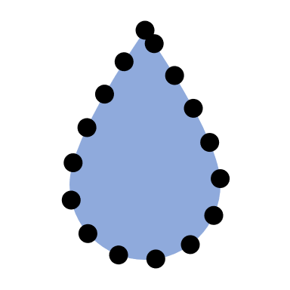
Super saturated air will condense onto any surface available.
Aerosols are small solid particles in the air.
Aerosols can act as a surface for vapour to condense onto.
These droplets will join together and form clouds.
Aerosols in the atmosphere are cloud condensation nuclei, also called ‘cloud seeds’.
Some examples of aerosols on exoplanets are: dust, tiny pieces of rock or other minerals, and smoke from volcanoes.

Slide 26
Activity 6: Applying your knowledge
The science behind cloud formation is the same both in your experiment and on exoplanets.
Because your experiment has a solid surface, in this activity we will compare it to a terrestrial exoplanet
Ex 6.1 Complete the table in your worksheet
Notes:
Suggested answers for Ex6 can be found in the teacher guide
A note on gas planets:
Many of the exoplanets that have been discovered are gaseous planets. This means they are mainly made up of gasses and do not have a rocky surface like terrestrial planets.
Because of this, there are no liquids on the surface that can be evaporated, instead the moisture in the air must already be in the atmosphere as vapour.
On terrestrial exoplanet planets, the aerosols in the air may come from ash from volcanoes or dust from storms on the surface. On gaseous planets, the aerosols must already be in the air. These may be small solid particles and minerals that form in the atmosphere.

