Slide 1

Pennsylvania National Guard Association PNGAS
Beyond the Uniform:
Your Benefits, Voice, and Legacy After Guard Service
Notes:
Welcome Retirees. Introduce PNGAS mission and purpose of this briefing.

Slide 2
Mission & Vision
Mission: To support, advocate for, and strengthen the Pennsylvania National Guard and its members, veterans, and families through professional development, legislative action, and community partnership. Vision: A ready, resilient, and respected Pennsylvania National Guard—fully supported by engaged leaders, informed advocacy, and enduring partnerships for generations to come.
Notes:
Explain how mission aligns with bylaws and charter. Emphasize readiness and welfare.

Slide 3
About PNGAS & Foundation
Established: 1987 PNGAS: 501(c)(6) nonprofit Foundation: 501(c)(3) charitable arm Purposes: Advocacy, education, relief for Guard families, heritage preservation.
Notes:
Highlight nonprofit status and foundation role in scholarships and family support.

Slide 4
Retirement is a transition — not an exit
PNGAS provides a continuing professional and advocacy home for retirees
Retirees retain voting rights, leadership opportunities, and committee seats
Retirees play a critical role mentoring junior Guardsmen, supporting families, and shaping policy
Why this matters: Many Guardsmen quietly feel like retirement = being “done” or disconnected. PNGAS can directly counter that.
Notes:
“PNGAS exists so your experience doesn’t walk out the door when you retire. We need retirees at the table — in advocacy, mentorship, and leadership — because no one understands Guard life better than you.”

Slide 5
Your Voice still matters – and here’s where!
State legislation (PA Title 51, tax relief, education benefits, family programs)
Federal Guard issues via NGAUS and EANGUS
Retiree-relevant priorities:
TRICARE & gray-area retiree healthcare
Cost-of-living adjustments (COLA)
Survivor benefits and spouse protections
Why this matters: Many retirees assume advocacy ends when drill ends. That’s false – and PNGAS is the bridge.
Notes:
“Lawmakers listen differently when the voice is a retiree — especially one who served decades. PNGAS amplifies that voice so it actually moves legislation.”

Slide 6
Protect your family, not just yourself – underused retiree value
What your family keeps after you retire:
Continue access to SSLI coverage (unchanged cost/benefit through PNGAS)
Education advocacy (ACT 32 / MFEP continuity)
DMVA family resources, crisis support, and survivor assistance
Networking for spouses (career transitions, education, peer support)
Why this matters: Families often lose institutional support post-retirement. PNGAS + DMVA can prevent that.
Notes:
“Retirement planning isn’t just about you — PNGAS and DMVA help ensure your spouse and dependents don’t lose support when the uniform comes off.”

Slide 7
Missed benefits are the biggest retiree regret – reality check
Top 5 things retirees say they wish they knew earlier:
Property tax relief existed – but they applied late
County VSO help was free and accredited
Retired pay is PA tax exempt
Benefits change with new legislation (and no one told them)
They lost connection to the Guard community unnecessarily
Why this matters: To increase awareness and urgency
Notes:
PNGAS prevents this by acting as an early-warning system for changes.

Slide 8
Ways to stay involved without over-committing – remove friction
How retirees stay involved – on their terms:
Receive legislative & benefits updates
Attend 1-2 events per year
Mentor a junior Officer / NCO
Serve on a short-term committee
Advocate during key legislative windows
Why this matters: Retirees fear getting “roped into too much”
Notes:
“PNGAS isn’t asking you to come back on orders — just to stay connected in a way that fits your life.”

Slide 9
PNGAS call-to-action (Critical)
Before you retire – do these 3 things:
Join PNGAS as a Life Member
Connect with your County Director of Veterans Affairs
Sign up for DMVA updates so you never miss a benefit change
https://pngas.org
Why this matters: You earned these benefits. PNGAS exists to make sure you keep them – and help the next generation do the same.
Notes:
Get involved, stay involved, help the next generation.

Slide 10
Connect with Us
PNGAS Website: https://pngas.org
PNGAS Email: pngas@pngas.org
PNGAS Facebook: https://facebook.com/pngas
DMVA Website: https://www.pa.gov/agencies/dmva
DMVA Facebook: https://facebook.com/padmva

Slide 11
Pending & Active Bills 2025-2026 PA Legislative Session
These bills would modify and enhance existing veteran provisions in PA law:
HB 799 — Requires workplace posting of veterans’ benefits/services.
SB 809 / SB 407 — Amend definitions and administration of the Disabled Veterans’ Real Estate Tax Exemption.
HB 1119 / HB 1578 — Further provisions for Real Estate Tax Exemption duties.
HB 512 — Amends Veterans’ Temporary Assistance benefits.
HB 471 — Grants amendment for Veterans’ Service Officer programs.
HB 1452 — Enhances provisions for the Veterans Registry and PA VETConnect programs.
HB 1264 — Establishes the Service Members, Veterans, and their Families Fund.
SB 870 — Amend Title 51 educational assistance provisions (e.g., Military Family Education Program eligibility).
Other Military/Veteran-Relevant Bills
SB 654 — Establishes Veterans Mental Health Services Program.
HB 1110 — Adds military sexual trauma awareness responsibilities for DMVA. (Note: These reflect patterns from Senate and House Veterans Affairs committees — status should be monitored for hearings and votes.)

Slide 12
Additional Legislative Items Impacting Veterans
Proposed Constitutional Amendment on Property Tax Exemption Expansion Legislation considered to exempt all veterans with ≥ 50 % disability (and surviving spouses) from property taxes — regardless of combat era — by amending the Pennsylvania Constitution.
Veterans’ Trust Fund Funding Expansion Senate Bill 146 seeks to increase support to statewide charitable organizations serving veterans and families.
Hunting License Equity Legislation Bills like Senate Bill 533 aim to waive or modify licensing barriers for disabled vets (e.g., Purple Heart recipients).
Federal laws that still matter to PA retirees
PACT Act (Sergeant First Class Heath Robinson Honoring our Promise to Address Comprehensive Toxics Act) — expands health care and disability benefits for toxic exposures.
Post-9/11 GI Bill — federal educational assistance for veterans and eligible dependents

Slide 13
BACKUP Slides

Slide 14


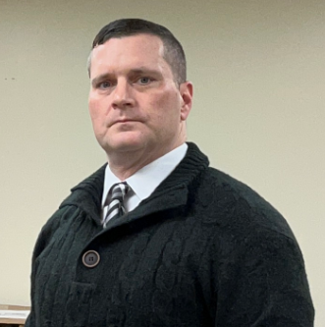

Organizational Structure
Executive Team
Executive Director
Chad Rettew
Office Manager
Ronda Fawber
IT Manager
Eric Kearns
Accountant
Miranda Willow
4
Notes:
Describe board, committees, and executive team responsibilities.

Slide 15


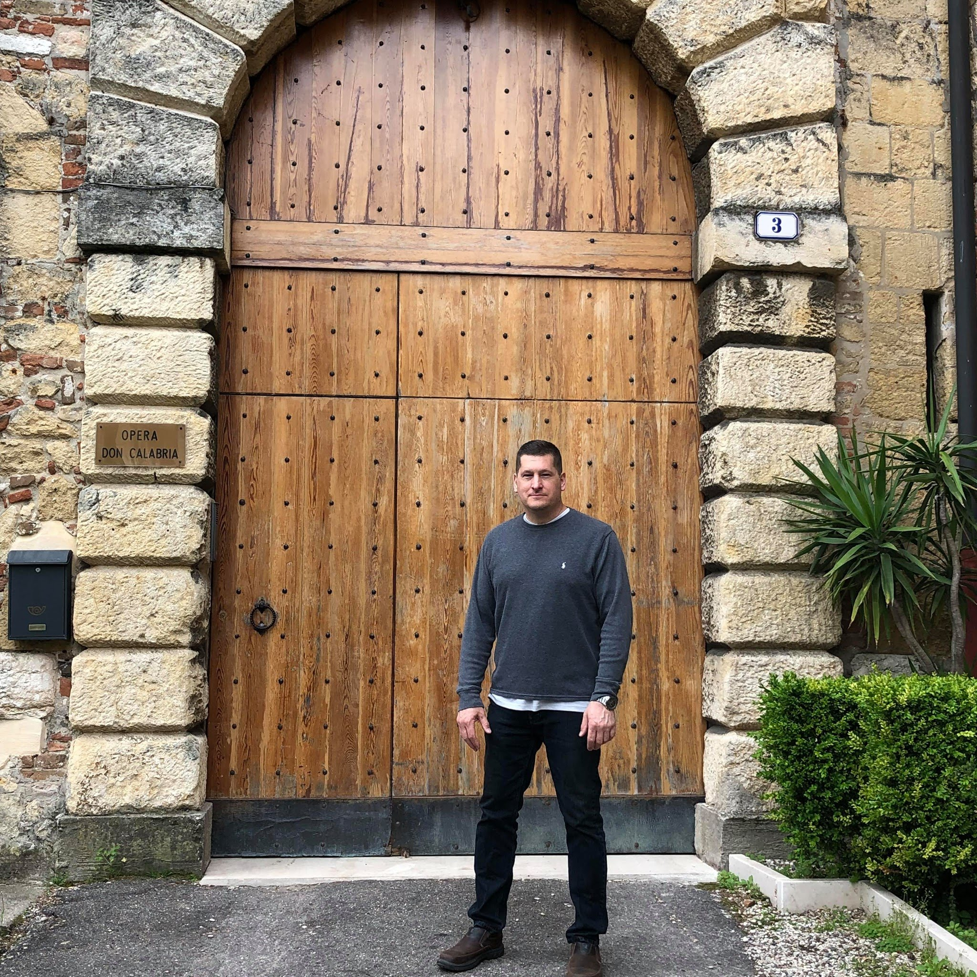
Organizational Structure
PNGAS Board
Chairman
Kaitlyn Fawber
Vice Chair
Frank Killeen
Secretary
Gillian Barrie
Scot Baughman
Retired Enlisted | Melanie Downey (Air) | Retired Officer | Rob Irving (Army)
Enlisted Elect 1 | JP Karpovich (Army) | Officer Elect 1 | Dan Fairbanks (Air)
Enlisted 2 | Tony Gambone (Air) | Officer 2 | Matthew Nieberding (Army)
Enlisted 3 | John Lambakis (Air) | Officer 3 | Reanna Keener (Air)
Enlisted 4 | Tyler Robbins (Air) | Officer 4 | Eric Schulden (Air)
Enlisted 5 | Adaline Killeen (Army) | Officer 5 | Michael Brent (Army)
4
Notes:
Describe board, committees, and executive team responsibilities.

Slide 16
Strategic Objective Plan FY26-28
Strategic Pillar 1: Advocacy & Legislative Leadership (501(c)(6))
Strategic Pillar 2: Strategic Partnerships & DMVA Alignment
Strategic Pillar 3: Member, Veteran & Family Support Programs (501(c)(3))
Strategic Pillar 4: Philanthropy & Resource Development (Foundation)
Strategic Pillar 5: Membership Growth & Leadership Development
Strategic Pillar 6: Communications, Public Awareness & Brand
Strategic Pillar 7: Governance, Compliance & Organizational Excellence
5
Notes:
Connect strategic objectives to Guard priorities and member benefits.

Slide 17
Strategic Pillar 1: Advocacy & Legislative Leadership (501(c)(6))
Objective
Establish PNGAS as the trusted, nonpartisan voice for Pennsylvania National Guard members, veterans, and families in state and federal policy.
Key Initiatives
Develop an annual PNGAS Legislative Agenda
Align Air/Army Resolutions with state priorities
Strengthen coordination with NGAUS, EANGUS, and DMVA policy offices
Conduct annual legislative education days
KPIs
Legislative agenda adopted annually
Number of legislative meetings conducted
Bills supported or influenced
Member participation in advocacy events
Opportunities for Support
Does PANG have specific goals that could feed into the PNGAS Legislative Agenda?
Develop a bi-annual event with Senior Leadership to receive bottom-up requests to feed legislative/resolution updates
Establish QTRLY PANG Leadership Updates
Establish QTRLY PPL Meetings
5
Notes:
Primary oversight will be our Legislative Committee and Air/Army Resolutions Committee, important to note MAR and APR resolutions are due to national every year. Also recommend layering state and federal in-session calendars with the National Associations

Slide 18
Strategic Pillar 2: Strategic Partnerships & DMVA Alignment
Objective
Formalize and expand collaboration with the Pennsylvania Department of Military and Veterans Affairs and aligned stakeholders.
Key Initiatives
Execute a formal PNGAS/PNG Foundation–DMVA MOU
Establish joint outreach and education initiatives
Coordinate veteran benefit awareness campaigns
Support DMVA readiness, resilience, and family programs
KPIs
MOU executed and reviewed annually
Joint programs launched
Number of co-branded outreach events
Opportunities for Support
State Conference Attendance – Professional Development with possible SUTA request approval
Support Unit briefs in conjunction with SSLI briefs
5
Notes:
We want to work with Mr. Metz, ethics counselor to ensure our brief, and how we brief is approved. Executive Committee will be primary oversight.

Slide 19
Strategic Pillar 3: Member, Veteran & Family Support Programs (501(c)(3))
Objective
Expand charitable programs that directly improve the welfare, resilience, and success of Guard members, veterans, and families.
Key Initiatives
Expand Guardsman-to-Guardsman (G2G) emergency assistance
Grow scholarship funding
Support family readiness and crisis assistance initiatives
KPIs
Funds distributed annually
Number of beneficiaries served
Program satisfaction outcomes
Reduction in unmet assistance requests
Opportunities for Support
Send informational notices out through the Joint Order to allow for maximum communication of emergency assistance process as well as scholarship information
5
Notes:
Primary oversight will be Foundation/PNGAS board, and the membership/awards committee.

Slide 20
Strategic Pillar 4: Philanthropy & Resource Development (Foundation)
Objective
Build a sustainable philanthropic engine to support long-term charitable impact.
Key Initiatives
Launch a 3-year fundraising growth plan
Expand corporate and foundation grant partnerships
Support fundraising for aligned initiatives such as the Pennsylvania Veterans Trust Fund
Implement donor stewardship and reporting systems
KPIs
Total funds raised annually
Donor retention rate
Grant success rate
Percentage of funds restricted to mission-critical programs
Opportunities for Support
Establishing a grant writer within the DMVA and or PNGAS
Bi-Annual PNGAS sponsored DMVA event in support of a specific goal
Corporate and foundation partners invited to FTIG Open House and VIP event at TAG quarters or where applicable
5
Notes:
Donor Stewardship: This encompasses all the activities an organization undertakes to acknowledge, appreciate, and engage its donors beyond simply processing their gift. The goal is to make donors feel valued and understood, reinforcing their decision to support the organization. Key activities include sending personalized thank-you letters, making appreciation calls, sharing impact stories, offering special event invitations, and ensuring clear, consistent communication [1].
Reporting Systems: These are the mechanisms used to track how donor funds are utilized and to communicate that information back to the donors and other stakeholders. This involves tracking contributions, allocating funds to specific projects or programs as intended, and creating clear, concise reports that demonstrate the impact of their generosity. These systems ensure compliance with regulations, build trust, and help measure the effectiveness of the organization's mission [1]

Slide 21
Strategic Pillar 5: Membership Growth & Leadership Development
Objective
Grow and retain an engaged, representative, and mission-driven membership.
Key Initiatives
Implementation of new CRM solution and membership engagement (Membersuite) – 4thQTR FY26
Targeted recruitment across Army, Air, Enlisted, Officer, and Retiree cohorts
First-year complimentary member engagement pathway
Leadership development and board pipeline programming
Unit-level ambassador program
KPIs
Net membership growth
Retention rate
New leader participation
Committee and volunteer engagement levels
Opportunities for Support
Opportunity for new PANG Service Members to receive complimentary membership
Unit representation at QTRLY membership meeting
Leadership to serve on committees when applicable
5
Notes:
Membership & Awards Committee Board Chair / Vice Chair

Slide 22
Strategic Pillar 6: Communications, Public Awareness & Brand
Objective
Strengthen public understanding of PNGAS, the Pennsylvania National Guard, and veteran needs.
Key Initiatives
Unified branding across PNGAS and Foundation
Strategic content calendar (legislative, programmatic, member stories)
Media and digital engagement strategy
Annual impact report publication
KPIs
Website and digital engagement metrics
Media placements
Stakeholder awareness surveys
Donor and member communications reach
Opportunities for Support
Sharing of PANG important events to support (attending or advertising)
5

Slide 23
Strategic Pillar 7: Governance, Compliance & Organizational Excellence
Objective
Ensure best-in-class nonprofit governance, financial stewardship, and legal compliance.
Key Initiatives
Annual board education and fiduciary training
Formal separation of 501(c)(3) and 501(c)(6) activities
Policy refresh (conflict of interest, whistleblower, records retention)
Annual strategic plan review and KPI dashboard
KPIs
On-time audits and filings
Board attendance and participation
Compliance findings (zero adverse)
Strategic milestones met annually
Opportunities for Support
NSTR
5

Slide 24
Membership & Benefits
Classes: Active, Retired/Life, Associate, Corporate, Honorary Benefits: Networking, leadership development, legislative voice, scholarships
6
Notes:
Emphasize membership benefits and encourage leaders to promote membership.

