Slide 1
IMPROVING Production Throughput of CNC ROUTERS with VACUUM PERFORMANCE Max Your vac™

Slide 4
Every Shop trying to hold parts with vacuum has Unique variables
Type of router(s)
Number of routers
History with CNC and CAD
Number of employees running a job
Vacuum Strength
Size of the Parts Being Cut
Up-Spiral vs Down-Spiral Cutting
Operating Feed Rates
Elevation levels
Materials being cut
Tooling Quality
Dust collector strength
Spoilboard / Fixture Board material
Hose and pipe fittings
Gasketing performance
More, more, more….

Slide 5
HOLDING PARTS ON A CNC ROUTER
A PASS / FAIL TEST: Were we able to hold the part?
PART SIZE
VACUUM PRESSURE LOSS

Slide 6
vacuum
VACUUS: Latin for Vacuum, means “void of matter or empty”
For CNC Router applications:
The higher the vac pressure, the greater the clamping force
Clamping force = parts hold
Parts hold = faster throughput
Sealed edge needed to prevent vacuum pressure loss
All Star gasketing products are the best “tool in the toolbox” to prevent vacuum pressure loss
THE best ROI for productivity

Slide 7
All star Grid gasketing

Slide 8
GRID GASKETING Intended FOR...
Intended for use with any CNC Router that utilizes vacuum to hold parts
Gasketing to seal under the spoilboard
Tables with zones need gasketing for each zone
One size/product does not fit all
All Star Grid Gasket cut specific to ea. router mfg. table for perfect fit
Specially engineered material components for longest life and performance

Slide 9
GRID GASKETING “Rules of thumb”
Non-Adhesive Material
Part of regular maintenance
Round Pegs Don’t Fit In Square Channels
Fill channel width-wise evenly, proud above by 1/16”

Slide 10
GRID GASKETING examples….

Slide 11
GRID GASKETING examples….

Slide 12
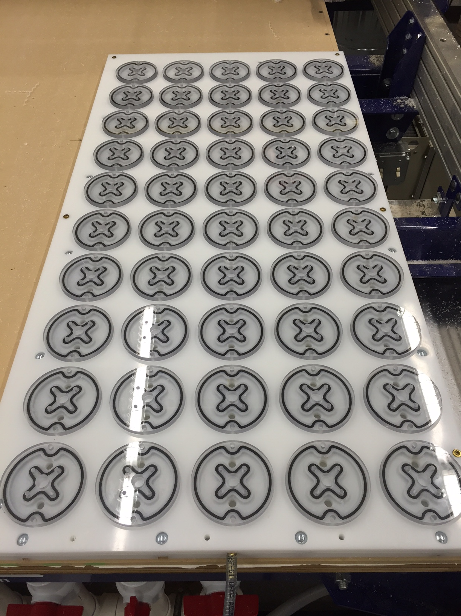
spoilboards vs. Dedicated fixtures

Slide 13
spoilboards vs. Dedicated fixtures
SPOILBOARDS
A material to “spoil”, chew into, or sacrifice
Typically, a porous MDF or LDF for straight-through downdraft holding
Most common method across the industry
The more it’s used, the less effective it becomes at holding parts

Slide 14
spoilboards vs. Dedicated fixtures
DEDICATED FIXTURES
Best for repetitive, production runs
Ideally a non-porous fixture board (Baltic Birch, HDPE, etc.) that will not leak
Takes time and material investment, storage to make Dedicated Fixtures, but excellent ROI.
Once vacuum clamped properly, increase router feed rates, eliminate tabbing, cleaner edge quality, improve tooling life, etc.
Working towards creating an air-tight fixture

Slide 15
In board gasketing

Slide 16
IN BOARD GASKETING Intended for…
Start Gasketing for parts
Dedicated Spoilboard environments
Inserted into pre-routed channels of a fixture to the inside of tool paths
Best for those doing repetitive parts
Ideal for those looking for tight z-depth tolerances
Longest lasting gasketing solution

Slide 17
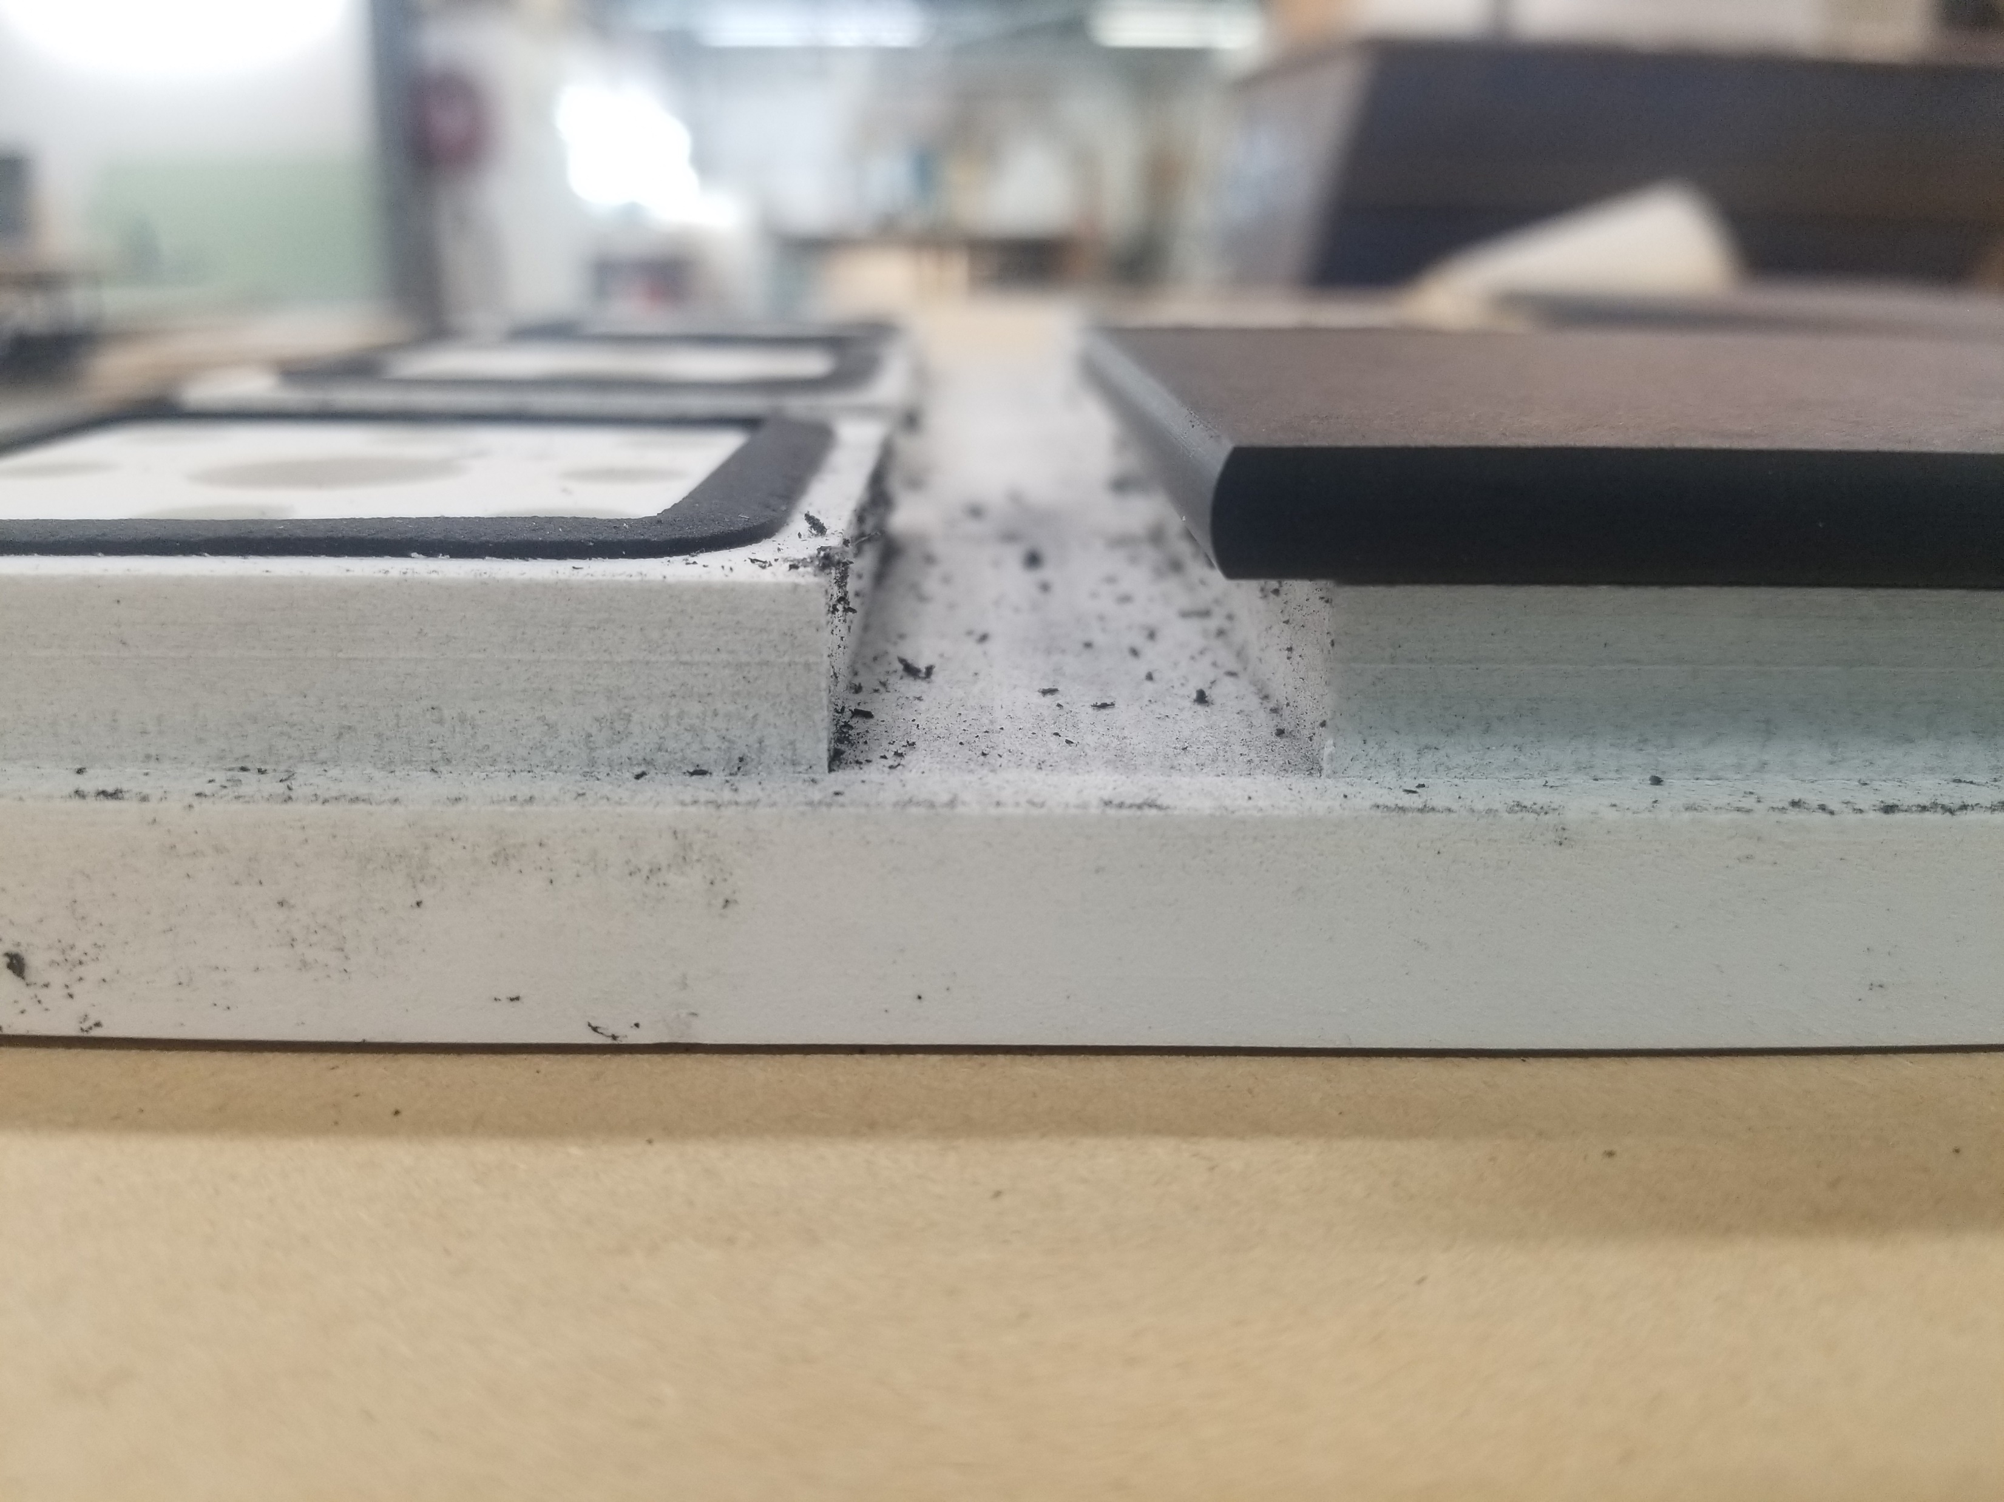
In-board GASKETING “Rules of thumb”
3-to-1 ratio of gasketing in the fixture vs above.
Account for waste and off-cuts
Three parallel paths: tool path, gasketing channel, vacuum channel
Chamfer or step tops of channels if Z-depth is critical, especially taller gaskets

Slide 18
In-board GASKETING examples….

Slide 19
In-board GASKETING examples….

Slide 20
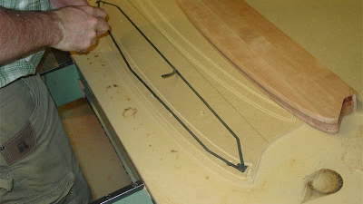
On board gasketing

Slide 21
oN BOARD GASKETING INTENTed for…
Quicker fixturing set-ups
Spoilboard environment
Shorter runs, prototyping jobs and custom work
Use existing CAD work to lay-out intended tool paths and gasketing to the inside

Slide 22
On-board gasketing “rules of thumb”
The thinner the better
The firmer the better
Gasketing never zeros-out, affecting Z-Depth

Slide 23
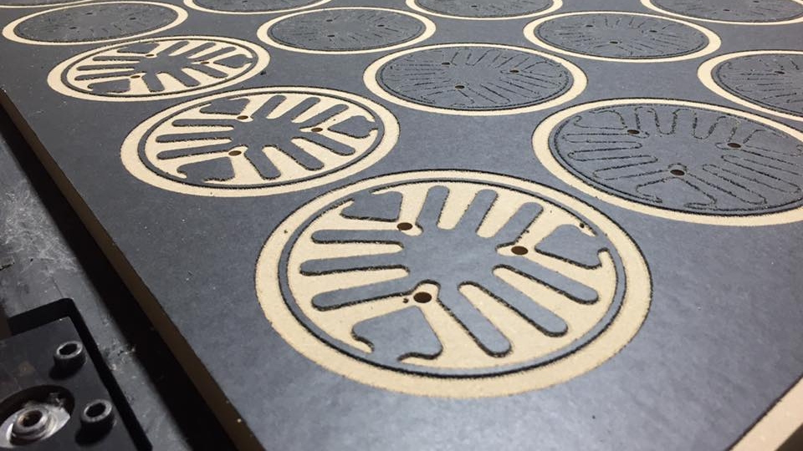
Cover Gasketing
For the Smallest of parts

Slide 24
Cover GASKETING Intended for…
- Dedicated Fixture environment
- Small repetitive parts
- Parts with excessive holes
- Uses existing CAD work, offsetting to create custom die-cut gasket sheet
- Maximizes vacuum surface area
- Low set-up time as CNC does work

Slide 25
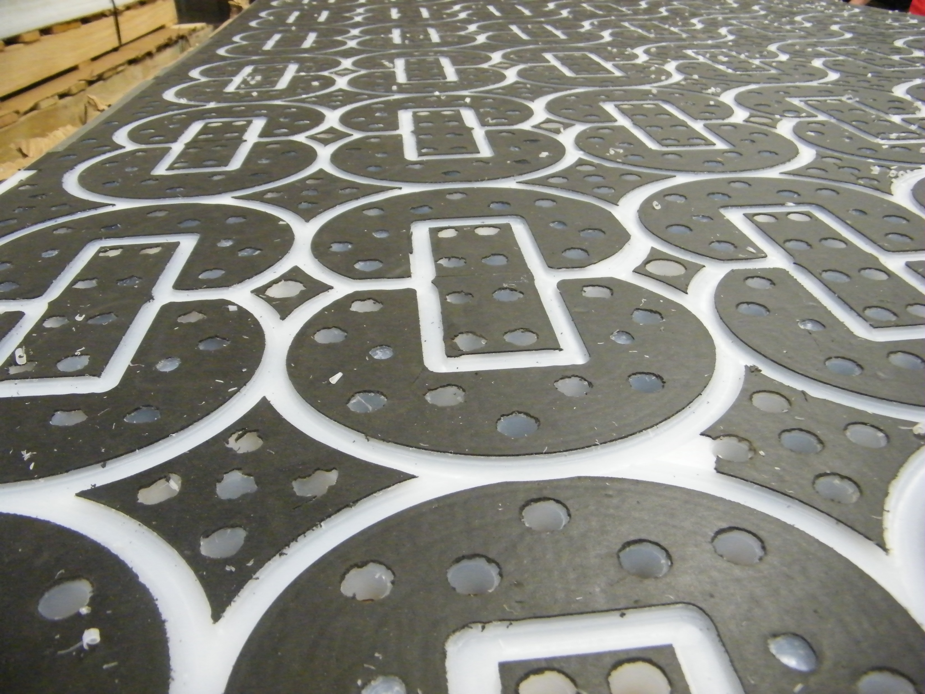
Cover gasketing “rules of thumb”
Essentially an On-Board Gasketing product, same rules apply
Engraving tool allows for accuracy and clean edges
Off-cuts and plunge holes need to be accounted for

Slide 26
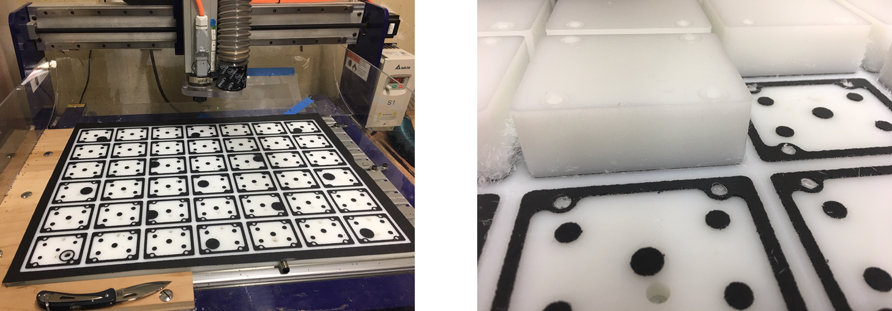
COVER GASKETING EXAMPLES

Slide 27
tile gasketing

Slide 28
tile gasketing
Intended for...
Spoilboard environment
For those looking for improved vacuum, but no time for fixturing short run jobs, or frequent changing parts/sizes
Vacuum loss prevention while also creating excellent vacuum clamp
Ability to make finished parts in a single pass, looking to eliminate the need for tab or onion-skin cutting

Slide 29
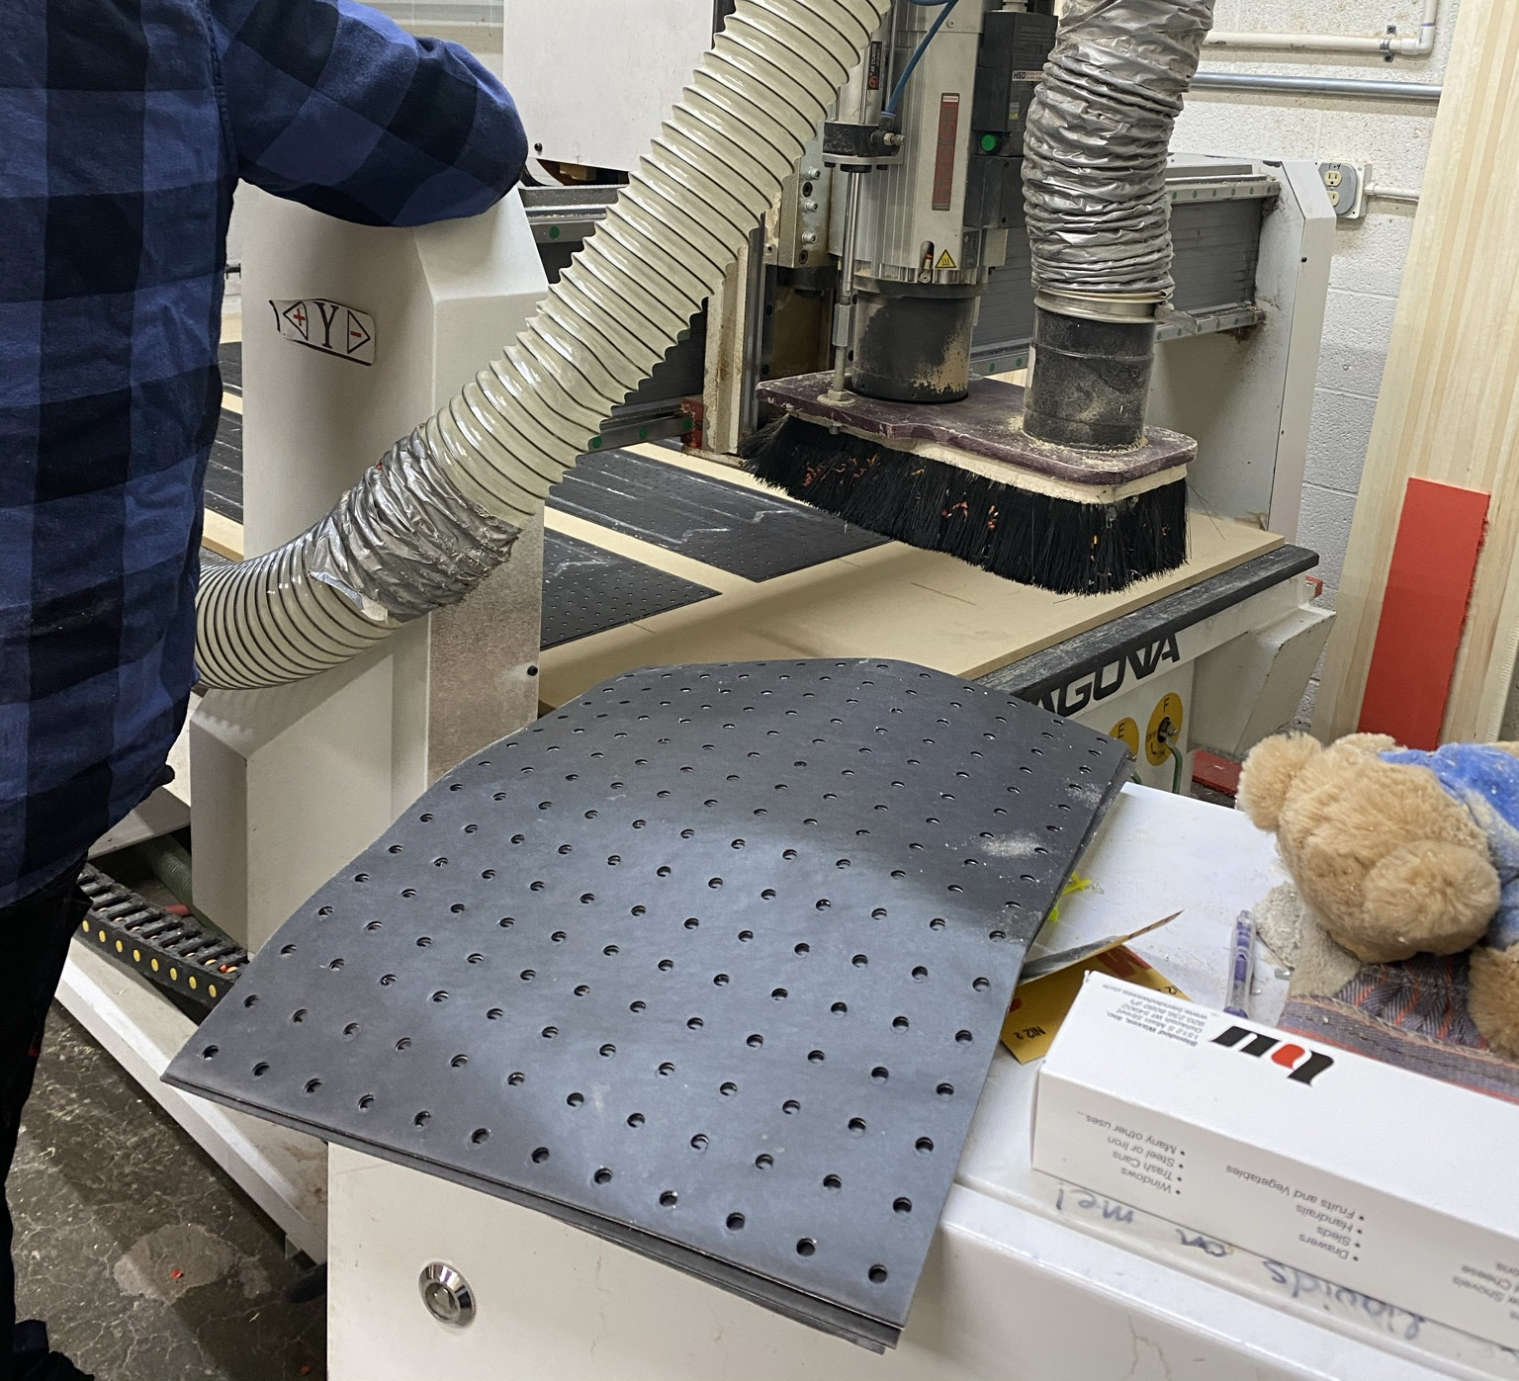
Tile gasketing “rules of thumb”
15% of area is a hole, 85% is closed-cell gasketing – concentrates vacuum
Set tooling to cut barely cut into gasketing material for repeat use
Cutting through gasketing material is not end of its usefulness
Replacing one tile at a time saves spoilboard resurfacing, production pauses, z-depth resets, etc.
Or fly cut off and reapply to fresh surface

Slide 30
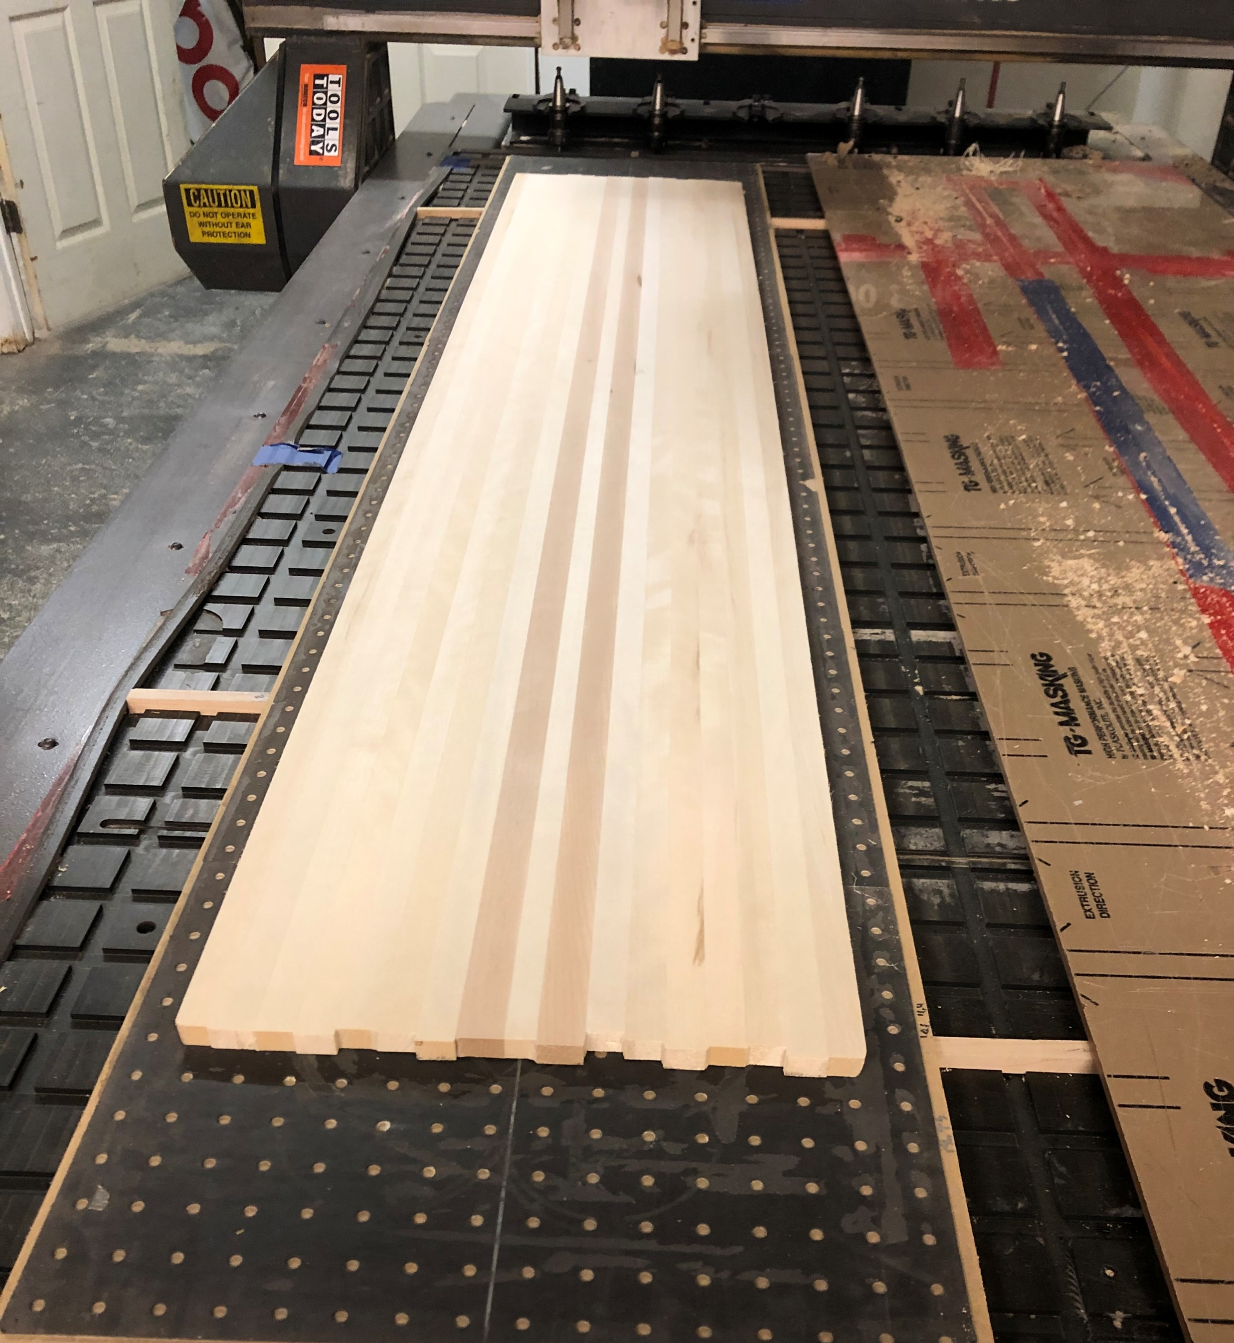
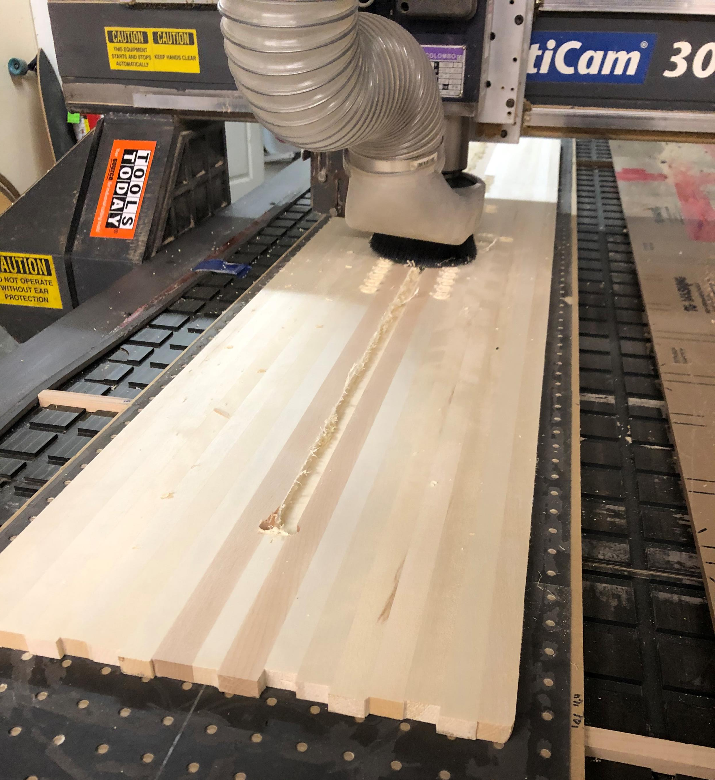
Tile gasketing examples

Slide 31
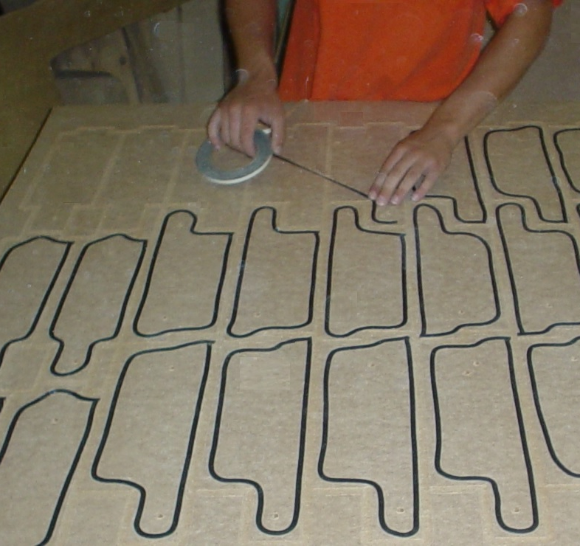
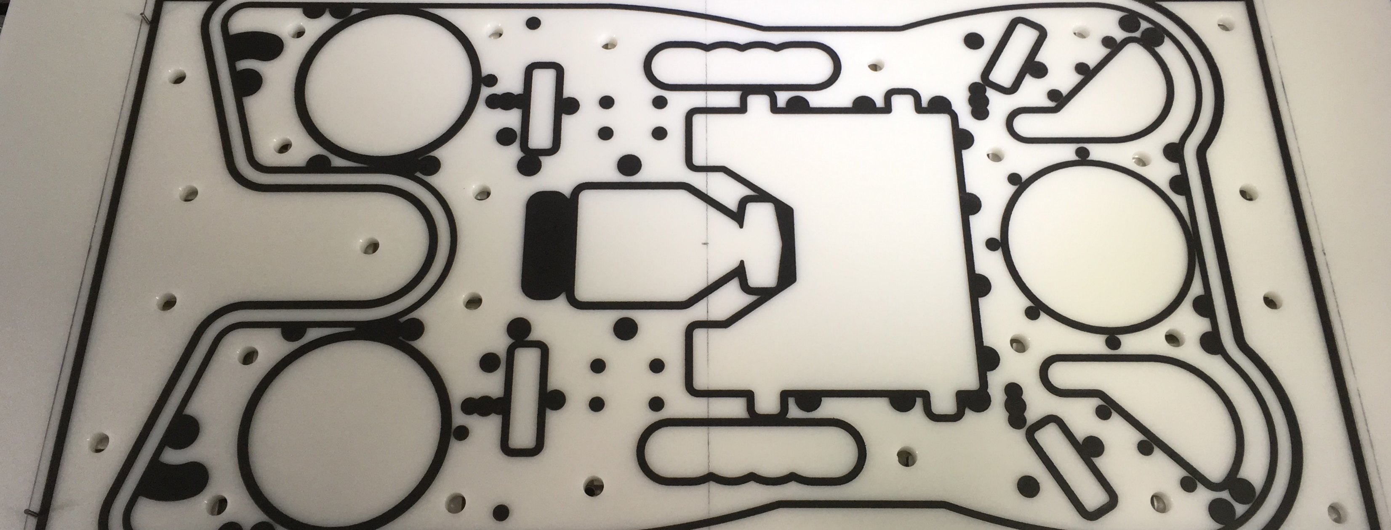
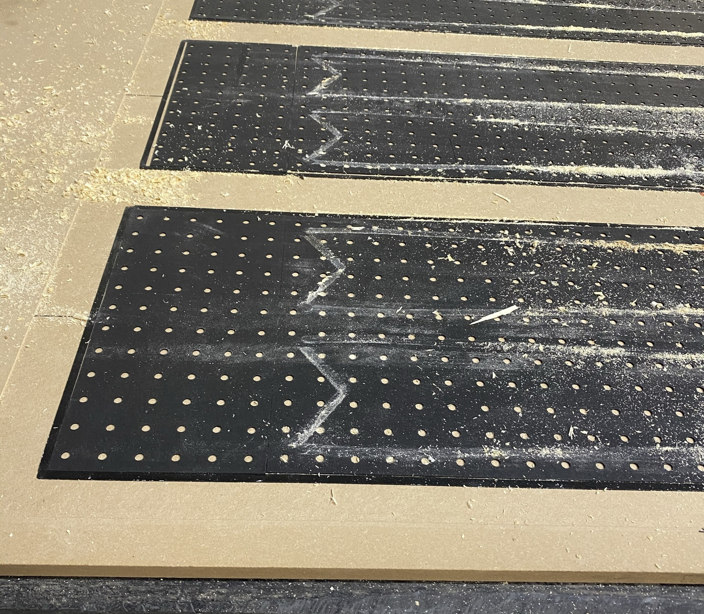
Thank You!

