Slide 1
SO YOU WANT TO BUILD A MUSEUM
A toolkit to starting your own museum project
Florence Schechter | Creative Consultant | info@floschechter.com | floschechter.com

Slide 2
CONTENTS
The Idea
Collections & Programming
Operations & Facilities
Finances
Marketing
Business Planning
Put It Into Practice
Case Studies
Appendices
004
027
045
058
070
080
088
097
105

Slide 3
There are roughly 100,000 museums in the world. But you haven’t made yours yet. Let’s make that happen.
Embarking on the journey of museum development can be as exhilarating as it is challenging. Museums are hard. I know, I did it. I am the founder of the Vagina Museum, the world’s first bricks and mortar museum dedicated to the vagina, vulva, clitoris and whole gynaecological anatomy. From humble beginnings as a project on my living room table in 2017, just a few years later it was a world-famous museum averaging over 100,000 annual visitors.
I’ve had to learn a lot along the way, and I’ve built this resource so you can do the same. I've distilled my hard-earned wisdom into this resource, tailored to empower aspiring museum founders like yourself to have the skillset to create your own museum. While my expertise primarily stems from navigating the UK market, the principles and insights shared transcend borders.
This resource is for people right at the start of their museum-building journey. You absolutely do not need to be able to answer every question right now. But you should have all these questions in the back of your mind as you build your museum. Consider this your compass as you chart the course for your museum venture. While you may not have all the answers now, each question posed here will serve as a beacon guiding your journey. You should be able to answer all these questions by the time your museum opens to the public.
You might be able to get a pop-up up and running pretty fast, but a stable location will undoubtedly take years. Whether you're envisioning a quick pop-up or dreaming of a permanent institution, remember: Rome wasn't built in a day, and neither are museums. Embrace the process - with patience and perseverance and a little bit of luck, it will materialise. Don’t be too daunted by the amount of information that is in here, all your answers will come in time. There is also a glossary at the end for any specific museum words you might not have come across.
If you’d like to discuss building a museum further or want to delve deeper into the intricacies of museum creation, don’t hesitate to schedule a 15 minute exploratory call with me on my website.
NOTE
This resource should not be taken as legal advice and is for informational purposes only. I shall have no liability nor responsibility to any person or entity regarding any loss or damage incurred, or alleged to have incurred, directly or indirectly, by the information contained in this resource. This document was published in July 2024 and all links were available at time of publishing. If any have broken, please contact me.

Slide 4
THE IDEA

Slide 5
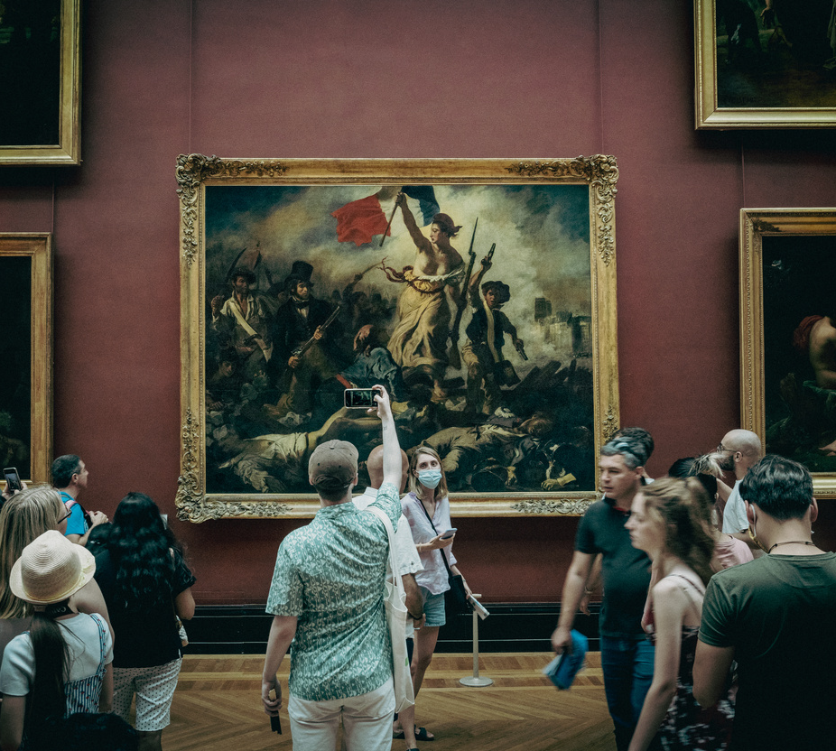
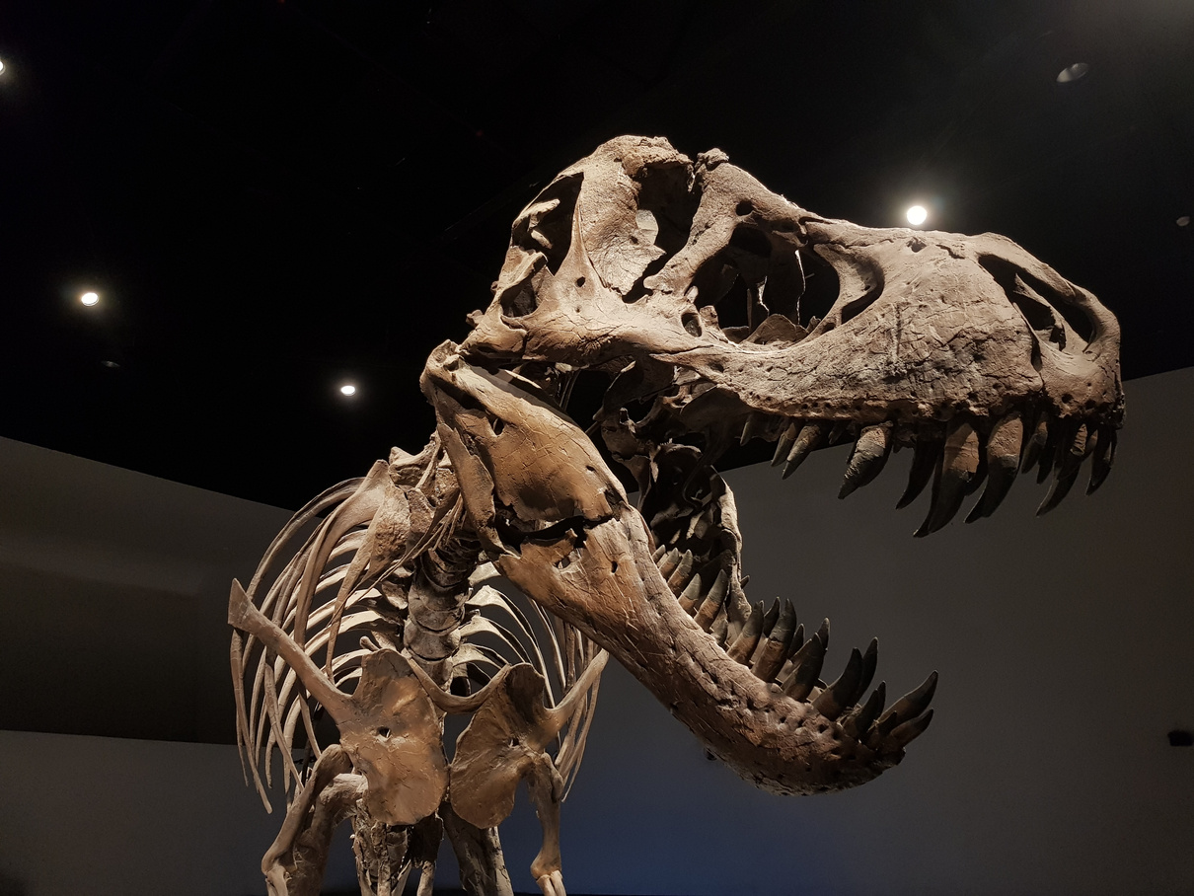
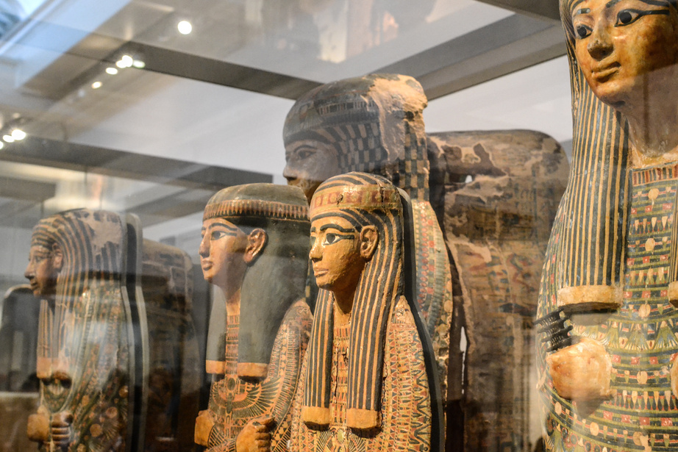
SO YOU WANT TO BUILD A MUSEUM
What is a museum?
THE
BASICS
This may seem like an obvious question, but working in museums has taught me that everyone has a different idea. Someone once demanded that the Vagina Museum wasn't a museum because we didn't have anything in a glass case. We had objects on display, but because they specifically weren't in a see-through box, this man didn't think we had the right to call ourselves a museum.
ICOM has an official definition that may be of use. It is an idealised definition rather than one actually reflective of the sector.
But your idea of what a museum is will likely inform what you focus on. Is it about objects? Histories? Stories? Visitors? Learning? Engagement? A building?
The Idea
Collections & Programming
Operations & Facilities
Finances
Marketing
Business Planning
Put It Into Practice
Case Studies
Appendices
Ironically enough, the questions in this section may in fact be the hardest to answer. Even though these are at the start, I would recommend reading them through and then only once you've had time to consider them and read the rest of the pack, to come back and answer them.
NOTE
Some people in the sector say that you can’t be a museum if you don’t have certain things, like a collection or a building. But don’t listen to them. Museology is changing fast - look at the back for case studies of real museums pushing the boundaries.
Florence
Schechter
floschechter.com

Slide 6
SO YOU WANT TO BUILD A MUSEUM
“
The Idea
Collections & Programming
Operations & Facilities
Finances
Marketing
Business Planning
Put It Into Practice
Case Studies
Appendices
“A museum is a not-for-profit, permanent institution in the service of society that researches, collects, conserves, interprets and exhibits tangible and intangible heritage. Open to the public, accessible and inclusive, museums foster diversity and sustainability. They operate and communicate ethically, professionally and with the participation of communities, offering varied experiences for education, enjoyment, reflection and knowledge sharing”
– ICOM’S definition of a museum
Florence
Schechter
floschechter.com

Slide 7
SO YOU WANT TO BUILD A MUSEUM
Why do you want to start a museum?
There are a lot of reasons to start a museum, and all are unique, including yours. Tick the ones relevant to yours or add your own.
The Idea
Collections & Programming
Operations & Facilities
Finances
Marketing
Business Planning
Put It Into Practice
Case Studies
Appendices
I want to give the public access to a collection
I want to address a need of your audience
I want to start a collection
I want to preserve a building
I want to preserve an intangible heritage
I want to share a history or story
I want to increase brand awareness
I want to put on exhibitions
I want to encourage participating in an activity
I want to research heritage
I want to promote certain values
write your own reason
Florence
Schechter
floschechter.com
I want to provide a space for my community

Slide 8
SO YOU WANT TO BUILD A MUSEUM
Exploring your purpose
The Idea
Collections & Programming
Operations & Facilities
Finances
Marketing
Business Planning
Put It Into Practice
Case Studies
Appendices
What is the aim of your museum?
What change in the world do you want as a result of your museum’s activities?
How do you want your visitors to have changed as a result of their visit?
What are your values and principles?
Florence
Schechter
floschechter.com

Slide 9
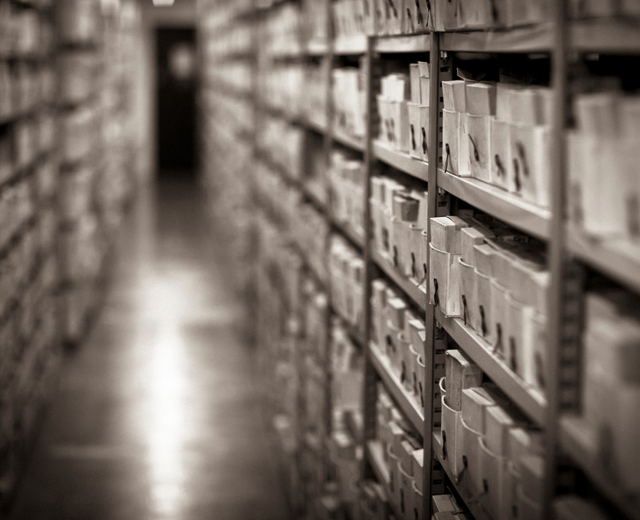
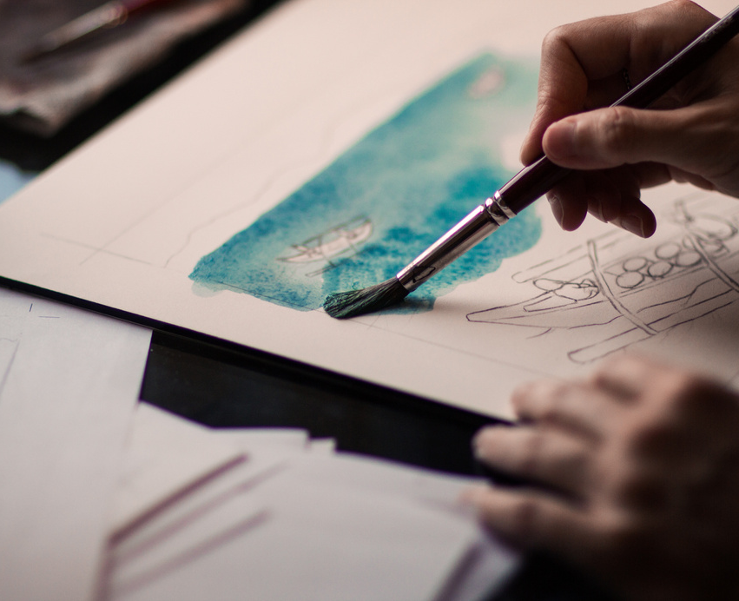
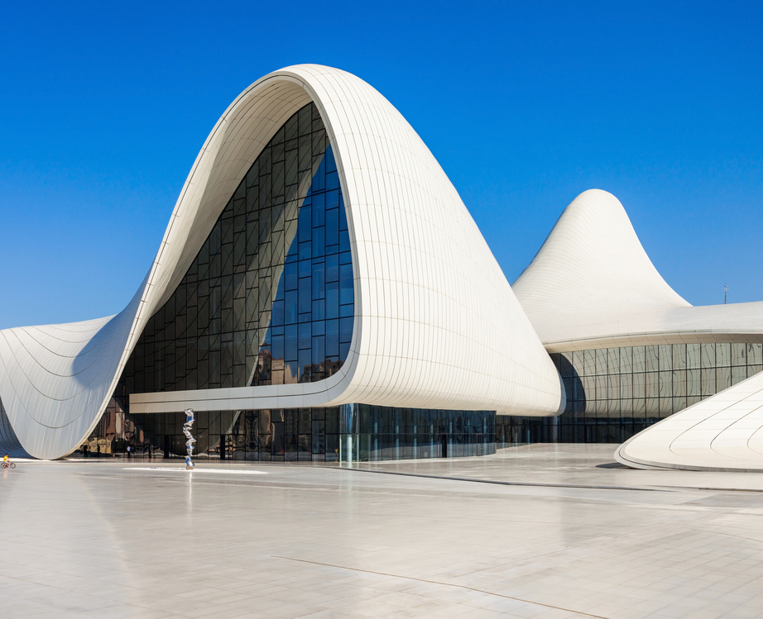
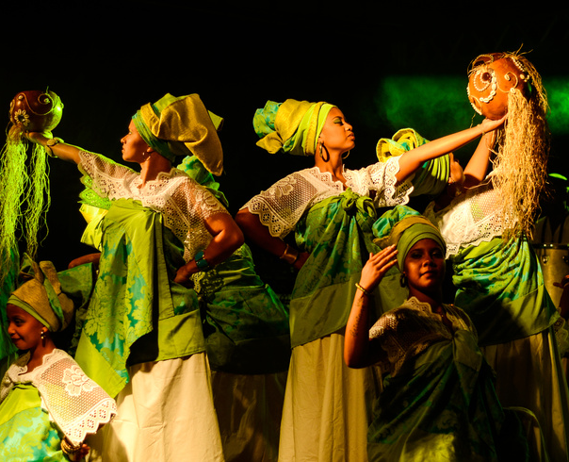
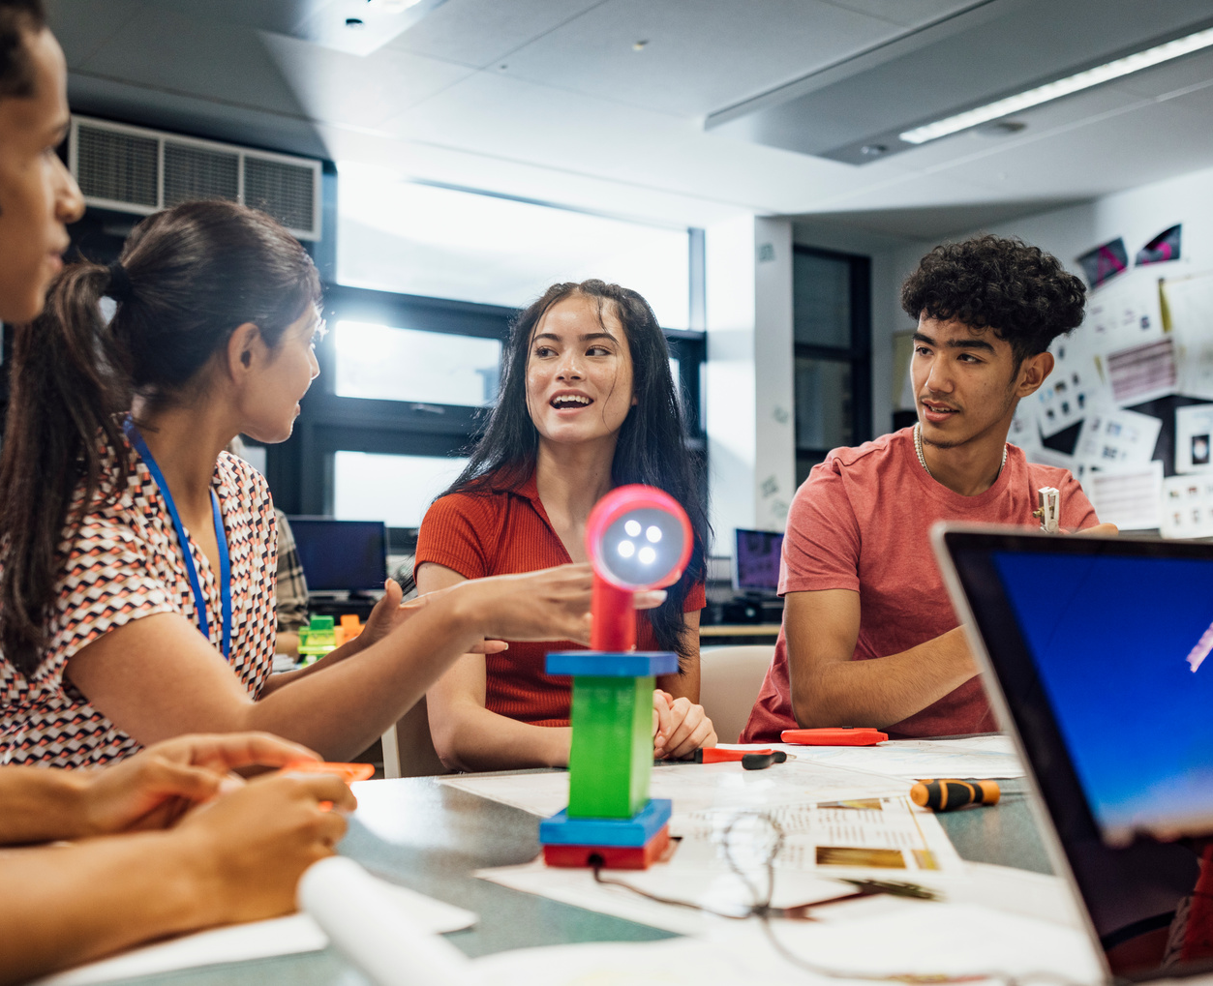
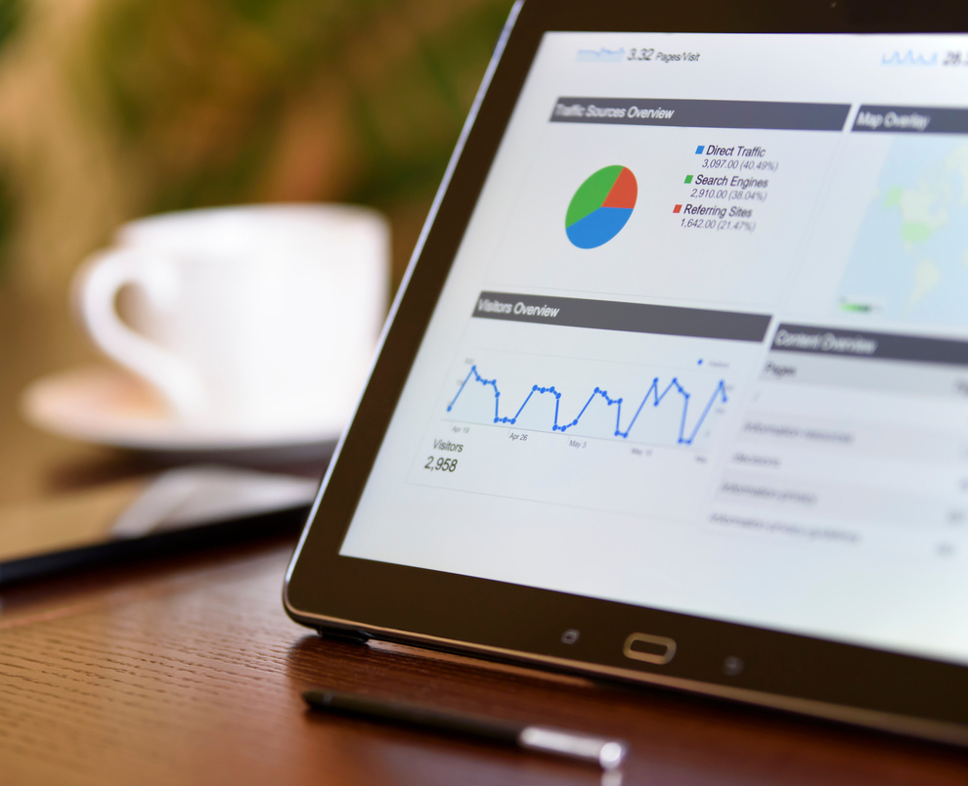
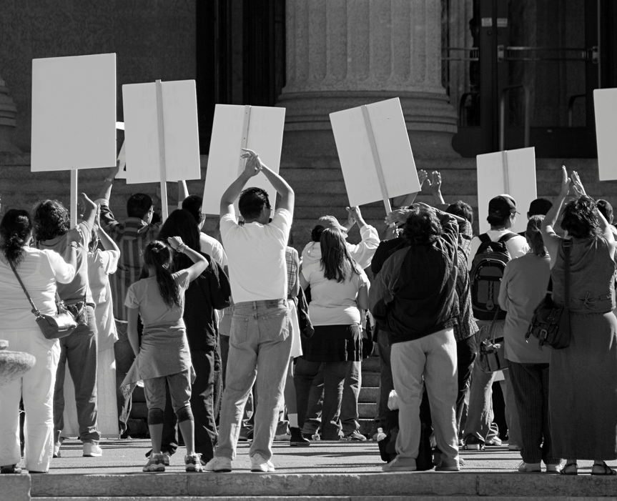
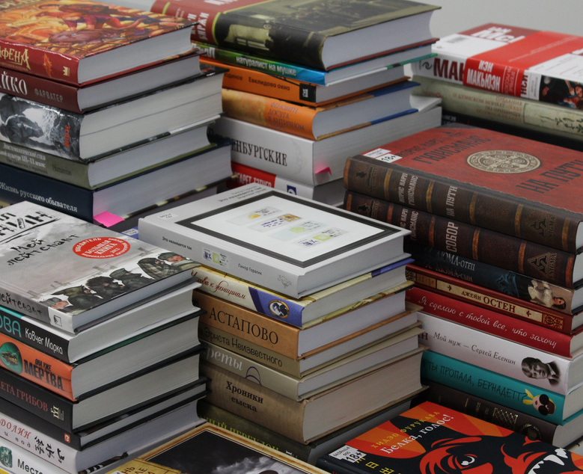
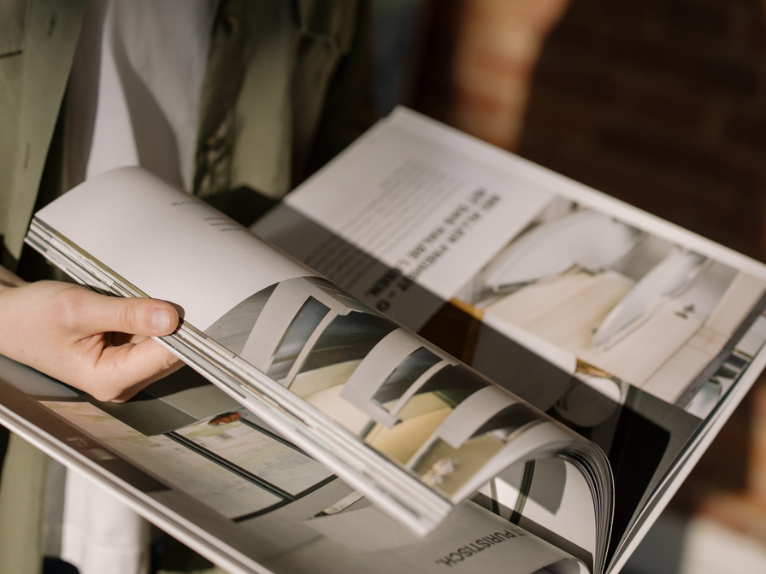
SO YOU WANT TO BUILD A MUSEUM
Is a museum the best medium for your aims?
archive
research service
art project
The Idea
Collections & Programming
Operations & Facilities
Finances
Marketing
Business Planning
Put It Into Practice
Case Studies
Appendices
event
heritage centre
performance
The prestige of the word ‘museum’ can be alluring, though you can often achieve your aims better in another way. Would it be better to create something else?
learning resource
website
movement
Florence
Schechter
floschechter.com
book
publication
outreach project

Slide 10
SO YOU WANT TO BUILD A MUSEUM
If a museum is the right medium, why?
What museums are out there that are similar to yours?
Would it be better to partner with an existing museum? If not, why?
The Idea
Collections & Programming
Operations & Facilities
Finances
Marketing
Business Planning
Put It Into Practice
Case Studies
Appendices
Florence
Schechter
floschechter.com
OK, so we’re making a museum

Slide 11
SO YOU WANT TO BUILD A MUSEUM
MUSEUM MODELS
Traditional museum
One off pop up
Travelling pop up
A permanent location
One exhibition for a limited time
Pop ups in many different locations
Pros
Cons
Pros
Cons
Pros
Cons
The Idea
Collections & Programming
Operations & Facilities
Finances
Marketing
Business Planning
Put It Into Practice
Case Studies
Appendices
There are a lot of different ways to make a museum and you don’t need to pick the traditional model to be valid. The case studies at the end will help elucidate the variety of ways a museum can exist.
The right model for you isn’t the right model for everyone, so write in the pros and cons of each model to help decide which is right for you.
Travelling museum
Online museum
Living history museum
Exists inside a travelling thing like a bus
The museum exists solely on the web
People engaging in intangible heritage
Pros
Cons
Pros
Cons
Pros
Cons
Florence
Schechter
floschechter.com

Slide 12
SO YOU WANT TO BUILD A MUSEUM
STAKEHOLDERS
A stakeholder is a member of a group who has an interest in your organisation.
The Idea
Collections & Programming
Operations & Facilities
Finances
Marketing
Business Planning
Put It Into Practice
Case Studies
Appendices
Primary stakeholders
Secondary stakeholders
People who directly involved, for example:
Staff
Volunteers
Trustees
Visitors
Suppliers
Donors
Members
People who aren’t directly involved but will be affected by your actions, for example:
Activists
Local community
Other museums
Unions
Local government
Florence
Schechter
floschechter.com

Slide 13
SO YOU WANT TO BUILD A MUSEUM
Stakeholder mapping
List all of your stakeholders, then place them in the matrix to figure out the best way to engage with them. The interest axis is how involved they are with your museum, the power axis is how much sway they have over it.
High interest
The Idea
Collections & Programming
Operations & Facilities
Finances
Marketing
Business Planning
Put It Into Practice
Case Studies
Appendices
Show
consideration
Manage most
thoroughly
Low
Power
High
Power
Minimal
contact
Keep
satisfied
Florence
Schechter
floschechter.com
Low interest

Slide 14
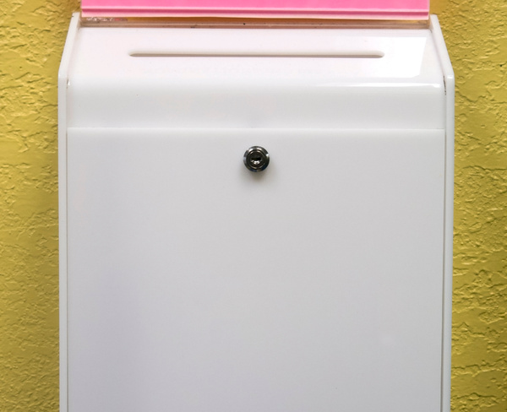
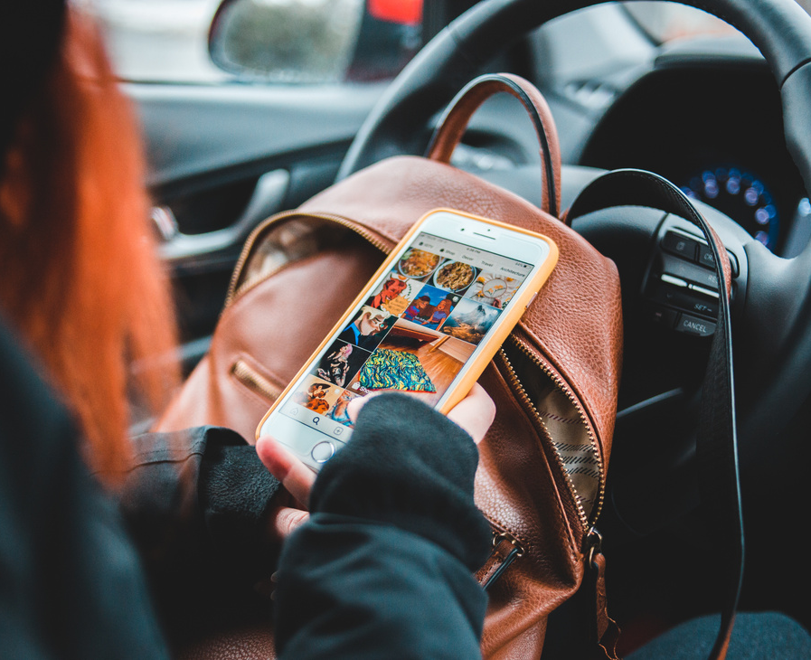
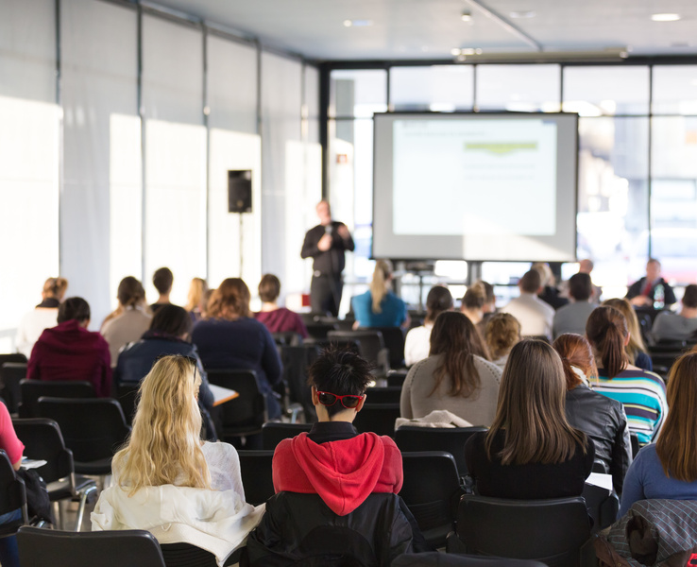
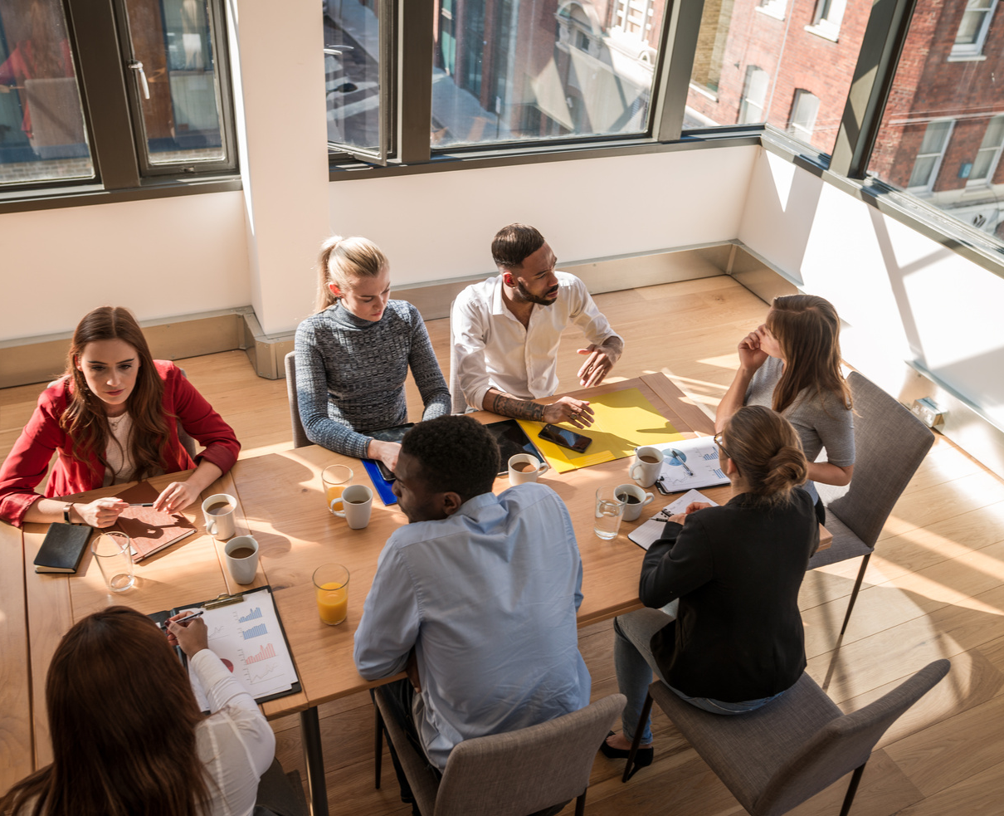
SO YOU WANT TO BUILD A MUSEUM
Community consultation
suggestion boxes
focus groups
vox pop
The Idea
Collections & Programming
Operations & Facilities
Finances
Marketing
Business Planning
Put It Into Practice
Case Studies
Appendices
online survey
drop ins
social media
Before embarking on a big project, it’s usually a good idea to make sure your community actually want it and give them an opportunity to be involved.
A good consultation has clear aims, deadlines, wide-reaching communication of how to participate and the resulting outcomes, is accessible and inclusive, and data collection that is meaningful and relevant.
writing campaign
community events
workshops
Florence
Schechter
floschechter.com
in-person surveys
public meeting
interviews

Slide 15
SO YOU WANT TO BUILD A MUSEUM
Having a target audience in mind is crucial for any project. You will likely have more than one type of visitor - the answers to these questions may be different or similar for each segment. On the next page is an audience segmentation exercise.
VISITORS
The Idea
Collections & Programming
Operations & Facilities
Finances
Marketing
Business Planning
Put It Into Practice
Case Studies
Appendices
Who are your visitors?
Why do you visitors want to come?
EXAMPLES
Affected community
Workforce
Tourists
Families
Students
Culture-goers
What benefit do you provide your visitors?
How do you want your visitors to behave when visiting?
EXAMPLES
QUIET AND REFLECTIVE
FUN AND SILLY
OPEN TO CONNECTION
Moved to action
Florence
Schechter
floschechter.com

Slide 16
SO YOU WANT TO BUILD A MUSEUM
Audience segmentation
An audience segment is a subgroup of people who visit your museum. You need to know your segments so you can cater to them effectively. Create a profile for each of your audience segments - and don’t forget to give the segment a good name!
Name of segment:
Age
Locality
Ethnicity
Job
Socioeconomic status
Education level
Comms preference
Preferred devices
Level of engagement
Why have they come to visit?
Who have they come with?
What might stop them from visiting?
What was their favourite part?
How did they feel about their visit?
What would they improve about their visit?
Where else do they visit?
What other interests do they have?
The Idea
Collections & Programming
Operations & Facilities
Finances
Marketing
Business Planning
Put It Into Practice
Case Studies
Appendices
Florence
Schechter
floschechter.com

Slide 17
HONING THE IDEA
There are hundreds of business planning tools and exercises available. Here are just a few that may help to explore your museum idea creatively.

Slide 18
SO YOU WANT TO BUILD A MUSEUM
 | Helpful to the project | Harmful to the project
 | Strengths | Weaknesses
 | Opportunities | Threats
SWOT analysis
The Idea
Collections & Programming
Operations & Facilities
Finances
Marketing
Business Planning
Put It Into Practice
Case Studies
Appendices
Internal
A SWOT analysis is a framework for evaluating your position to help with strategic planning. List out your internal factors in the strengths and weaknesses boxes. Then list out the external factors - the opportunities you have and the threats you currently face.
External
Florence
Schechter
floschechter.com

Slide 19
SO YOU WANT TO BUILD A MUSEUM
P | Political | Government policies Political issues Trade agreements
E | Economic | Inflation and growth Employment rates Interest rates
S | Social | Culture Lifestyle and health Education
T | Technological | Ecommerce Emerging tech Big data and computing
L | Legal | Laws Health and safety Regulations
E | Environmental | Climate change Sustainability Waste management
A PESTLE analysis is a tool for analysing how various external factors may affect your work. It takes a macro look at the environment you exist in.
The Idea
Collections & Programming
Operations & Facilities
Finances
Marketing
Business Planning
Put It Into Practice
Case Studies
Appendices
PESTLE analysis
Florence
Schechter
floschechter.com

Slide 20
SO YOU WANT TO BUILD A MUSEUM
Issues → | Resources → | Activities → | Outputs → | Short term outcomes | Long term outcomes
The Idea
Collections & Programming
Operations & Facilities
Finances
Marketing
Business Planning
Put It Into Practice
Case Studies
Appendices
NOTE
AN OUTPUT IS WHAT IS PRODUCED AS A RESULT OF YOUR ACTIVITIES, AN OUTCOME IS THE CHANGE THAT RESULTS. IT CAN BE EASY TO MIX UP THE TWO.
A Logic Model is a way of describing hypothesised cause and effects of your work. It is useful for planning your activities and making sure they are connected to your aims and desired outcomes.
Florence
Schechter
floschechter.com
Logic model

Slide 21
BRANDING
Though this may feel more like a marketing exercise, pinning down your branding is a key part of solidifying the identity and purpose of the museum. It's extremely important and do not skip this section thinking it is less worthy than collections or funding.
Branding isn't logos or colour schemes or fonts. Branding is the feeling your visitors have when they think about you. If you have a strong brand, everything else you do will be easier.

Slide 22
SO YOU WANT TO BUILD A MUSEUM
Awe | Anger | Accepted | Excited
Wonder | Fear | Love | Silly
Joy | Apprehension | Harmony | Suprised
Inspired | Distraction | Seriousness | Anticipation
Serenity | Connection | Remorse | Optimism
Amazement | Empathy | Grief | Energetic
Admiration | Nostalgia | Sadness | Courage
add your own
The Idea
Collections & Programming
Operations & Facilities
Finances
Marketing
Business Planning
Put It Into Practice
Case Studies
Appendices
What feelings do you want your museum to inspire?
Circle the feelings that you want to inspire. Add your own as well.
Florence
Schechter
floschechter.com

Slide 23
SO YOU WANT TO BUILD A MUSEUM
 | Acceptance | Compassion | Diversity | Fairness | Honesty | Joy | Sincerity
 | Accessibility | Communication | Dreams | Fame | Honour | Kindness | Spontaneity
 | Adventure | Community | Elegance | Family | Hope | Learning | Sustainability
 | Ambition | Courage | Empathy | Fascination | Humour | Mindfulness | Thoughtfulness
 | Balance | Creativity | Empowering | Freedom | Imagination | Originality | Tolerance
 | Beauty | Credibility | Wnwergy | Friendship | Impact | Passion | Trust
 | Belonging | Curiosity | Engagement | Fun | Individuality | Playfulness | Uniqueness
 | Bravery | Daring | Entertainment | Growth | Innovation | Pride | Variety
 | Change | Determination | Enthusiasm | Guidance | Insight | Progress | Warmth
 | Collaboration | Dignity | Equality | Harmony | Inspiration | Responsibility | Welcoming
 | Comfort | Discovery | Exploration | Heroism | Integrity | Simplicity | Wonder
add your own
The Idea
Collections & Programming
Operations & Facilities
Finances
Marketing
Business Planning
Put It Into Practice
Case Studies
Appendices
What values do you want people to associate with your museum?
Circle the values that you want to be associated. Add your own as well.
Florence
Schechter
floschechter.com

Slide 24
SO YOU WANT TO BUILD A MUSEUM
What is the name of your museum?
Example
At the Vagina Museum, many people asked why we weren't called the Vulva Museum (the intention being that it would be more accurate). The reason is that firstly it wouldn't be more accurate because the vulva is only external, but secondly one of our aims is to reach people who didn't know much about this part of the body, i.e. people who were unlikely to know the word vulva. So there was no point calling it the Vulva Museum because potential visitors wouldn't come because they didn't know what it was a museum of.
The Idea
Collections & Programming
Operations & Facilities
Finances
Marketing
Business Planning
Put It Into Practice
Case Studies
Appendices
Names are important. This will likely be the first thing any potential visitor or supporter knows about you. It should communicate instantly what the museum is about. It also should not be easily confused with another organisation.
your museum’s name:
TOP TIP
Once you decide on a name, grab the URLs and social media handles before they get taken by someone else!
Florence
Schechter
floschechter.com

Slide 25
SO YOU WANT TO BUILD A MUSEUM
PURPOSE
Using what you’ve written on the last few pages, you should be able to hone down the following to build your guiding principles.
The Idea
Collections & Programming
Operations & Facilities
Finances
Marketing
Business Planning
Put It Into Practice
Case Studies
Appendices
Vision | An image of the future you wish to create via your museum
Mission | What you will do to achieve your vision
Values | You should have 3-6
Florence
Schechter
floschechter.com

Slide 26
Museology
Stakeholders and visitors
Branding
ICOM
Audience Agency: Museum Audience Report 2018
Canva Brand Kit
MA: Code of Ethics
AIM: Understanding Your Audience 2020
Canny resources
AAM: Code of Ethics
Museum Next: Museum Audiences Article
Hubspot resources
MA: Measuring Social Engaged Practice toolkit
Kids In Museums
Hubspot: Brand style guide
FURTHER RESOURCES

Slide 27
COLLECTIONS & PROGRAMMING

Slide 28
SO YOU WANT TO BUILD A MUSEUM
COLLECTION
The Idea
Collections & Programming
Operations & Facilities
Finances
Marketing
Business Planning
Put It Into Practice
Case Studies
Appendices
A collection is the historical artefacts owned by your museum. These could be art, objects, photographs, recordings, or literally any type of physical object you can conceive. It can even include digital objects such as digital art, videos, or photographs.
Heritage can be intangible though - such as traditions, rituals and customs, performances, language, knowledge, skills and craftsmanship. History can be preserved not just with objects but also by passing these skills and knowledge on.
Florence
Schechter
floschechter.com

Slide 29
SO YOU WANT TO BUILD A MUSEUM
Building your collection
What do you want to collect? | What types of objects will you not collect?
Usually a museum will have a collections policy to help decide this - they make sure you only acquire objects that achieve your aims. | This is just as important to consider so you can avoid mission creep.
Will you be collecting anything restricted? | How will you ascertain provenance of your objects?
For example, human remains can only be held by certain organisations in the UK according to the Human Tissue Act 2004. | Many objects in collections have been stolen, obtained through colonialism or genocide, or otherwise unethically sourced. Examples include the Benin Bronzes of the British Museum, tsantsa of the Pitt Rivers Museum or Nazi looted art. What will you do if you discover part of your collection was unethically sourced?
The Idea
Collections & Programming
Operations & Facilities
Finances
Marketing
Business Planning
Put It Into Practice
Case Studies
Appendices
Florence
Schechter
floschechter.com

Slide 30
SO YOU WANT TO BUILD A MUSEUM
Managing your collection
Where will you get the expertise to manage your collection?
Will you maintain a digital collection?
How will your collection be stored?
The Idea
Collections & Programming
Operations & Facilities
Finances
Marketing
Business Planning
Put It Into Practice
Case Studies
Appendices
Florence
Schechter
floschechter.com

Slide 31
SO YOU WANT TO BUILD A MUSEUM
There are nine primary procedures that you’ll use the most.
Object entry
Acquisition and accessioning
Location and movement control
Inventory
Cataloguing
Object exit
Loans in
Loans out
Documentation planning
There are a further 12 secondary procedures:
Use of collections
Condition checking and technical assessment
Collections care and conservation
Valuation
Insurance and indemnity
Emergency planning for collections
Damage and loss
Deaccessioning and disposal
Rights management
Reproduction
Collections review
Audit
Spectrum
Spectrum is the UK collection management standard developed by The Collections Trust.
The Idea
Collections & Programming
Operations & Facilities
Finances
Marketing
Business Planning
Put It Into Practice
Case Studies
Appendices
Spectrum is a collection of 21 procedures that provide the minimum standard that is expected of organisations with a collection to help manage them effectively.
When you start your collection, starting by using these with these procedures will make your life easier in the long run. Only use a collection management software that complies with the Spectrum standard.
Source
Florence
Schechter
floschechter.com

Slide 32
SO YOU WANT TO BUILD A MUSEUM
Your collection goes outside
The Idea
Collections & Programming
Operations & Facilities
Finances
Marketing
Business Planning
Put It Into Practice
Case Studies
Appendices
Will you loan your objects? If yes, to whom and why?
How will you manage the copyright of your collection?
Florence
Schechter
floschechter.com

Slide 33
EXHIBITIONS

Slide 34
SO YOU WANT TO BUILD A MUSEUM
SERIES – S PRD
How to make an exhibition
The Idea
Collections & Programming
Operations & Facilities
Finances
Marketing
Business Planning
Put It Into Practice
Case Studies
Appendices
Concept
Name
Aims and Objectives
Target audience
Budget
Develop narrative
Style board
Create brief
Research
ANALYSE AUDIENCE
DEVELOP MAIN MESSAGE
IDENTIFY THEMES AND SUB THEMES
SOURCE OBJECTS
WRITE CONTENT
DEVELOP INTERACTIVES
Design
FINALISE CONTENT
GRAPHIC DESIGN
FLOOR PLAN
Visitor flow
INTERACTIVES
PROTOTYPE
LIGHTING PLAN
Accessibility measures
Build
PROCURE MATERIALS
CREATE OBJECT DISPLAYS
PRINT WRITING
Install panels and objects
Lighting and sound
Test interactives
Evaluate
COLLECT DATA
Analyse data
Compare outcomes with aims
Compile a report
Debrief
Florence
Schechter
floschechter.com
03

Slide 35
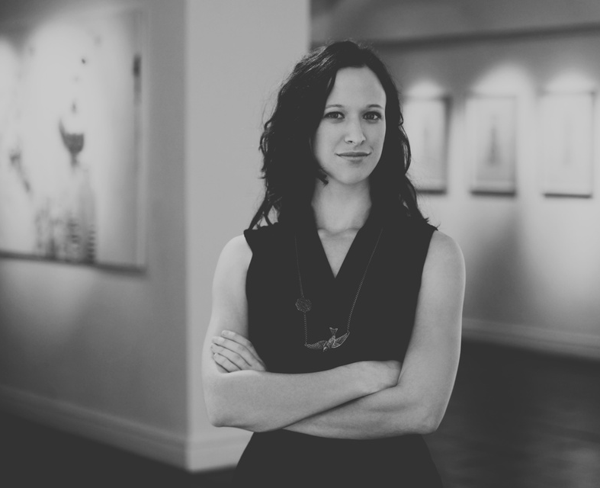
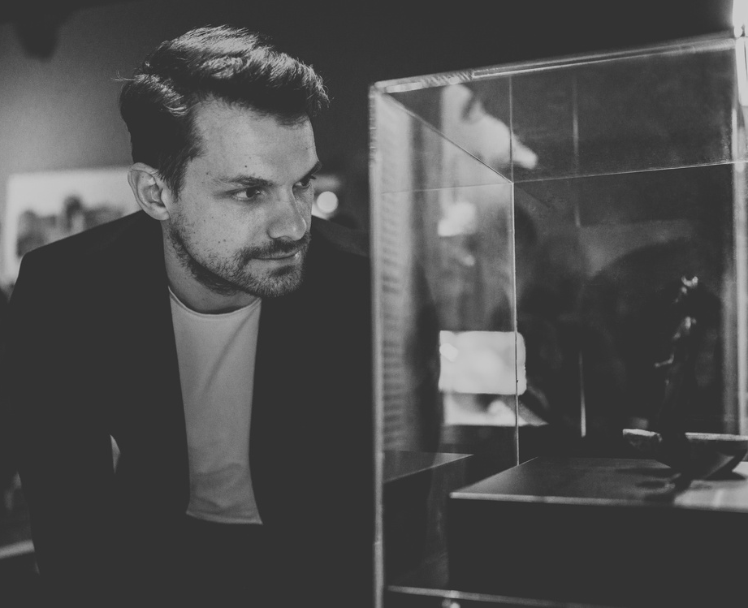
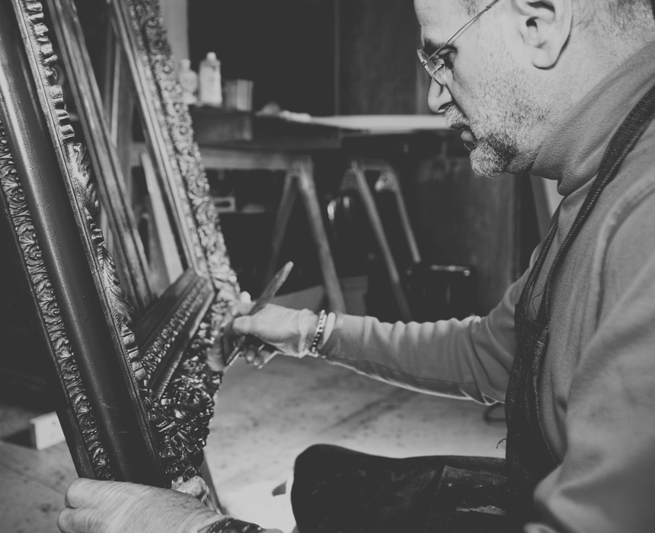
SO YOU WANT TO BUILD A MUSEUM
Building an exhibition team
Curator
Developer
A subject specialist who researches the topic, selects objects, provides information and fact checks
They define the message and narrative, translate the curator’s work to the public to make up the content of the exhibition
The Idea
Collections & Programming
Operations & Facilities
Finances
Marketing
Business Planning
Put It Into Practice
Case Studies
Appendices
Creating an exhibition involves a lot of different types of specialist work. You can have one person fulfil more than one role, but they all need to be done. For example, in small museums, curation and exhibition development are often done by the same person. You will also likely involve other staff such as learning and outreach specialists, events planners, marketing specialists and space planners.
Registrar
Technician
They manage the objects and art of a collection
They plan and maintain technical elements such as production, installing exhibition, AV and interactive displays
Conservator
Designer
They care for objects in a collection, preventing or reversing deterioration or damage
They create the visuals, graphics and other sensory elements (e.g. sound) to make the exhibition engaging
Front of house
Project manager
They are the front facing staff who interact with the visitors such as in the gallery and shop
They keep the team on schedule and on budget
Florence
Schechter
floschechter.com

Slide 36
SO YOU WANT TO BUILD A MUSEUM
Developing exhibitions
NOTE
An interpretation policy is a document that defines what you want your exhibitions to communicate, how, why and for whom.
The Idea
Collections & Programming
Operations & Facilities
Finances
Marketing
Business Planning
Put It Into Practice
Case Studies
Appendices
Will you take exhibitions on tour?
How will you decide what to make exhibitions about?
How will you use audience data to inform exhibition development?
Yes
No
Not sure
Will you put exhibitions online?
What will your interpretation policy include?
How will you make your exhibitions accessible?
Yes
No
Not sure
Florence
Schechter
floschechter.com

Slide 37
SO YOU WANT TO BUILD A MUSEUM
Interpretative tools
Where will you source objects for display?
Examples:
Your own collection
Loan objects from other GLAM organisations or people
Ask for object donations
Buy objects
Create your own
What other interpretative tools can you use?
Examples:
Images
Videos
Sound
Interactives
Models
Tactile elements
Text
The Idea
Collections & Programming
Operations & Facilities
Finances
Marketing
Business Planning
Put It Into Practice
Case Studies
Appendices
Florence
Schechter
floschechter.com

Slide 38
SO YOU WANT TO BUILD A MUSEUM
Exhibition brief template
Name of exhibition:
The Idea
Collections & Programming
Operations & Facilities
Finances
Marketing
Business Planning
Put It Into Practice
Case Studies
Appendices
Target audience
Dates
Location
Gallery size
Budget
Funding sources
Team
Aims
Abstract
Narrative
Evaluation methods
Themes and subthemes
Objects
Event and activities ideas
Marketing ideas
Florence
Schechter
floschechter.com

Slide 39
SO YOU WANT TO BUILD A MUSEUM
Exhibition text
Exhibition text usually follows a certain hierarchy. Exhibition text should be clear and concise - most visitors read less than you think. It should be engaging rather than academic - avoid “art speak”, no one likes it except curators.
Section | Length (words) | Example
Exhibition title | 1 - 10 | How To Build An Exhibition
Introduction text | 20 -200 | Every year, millions of people visit museum exhibitions just like this one...
Content warnings | as required | This exhibition contains references to difficult themes including...
Theme title | 1 - 15 | History of Exhibitions
Theme introduction | 20 - 150 | Exhibitions have been around for centuries. They were initially used to...
Sub theme title | 1 - 20 | The use of exhibitions in nationalist propoganda
Sub theme text | 20 - 100 | The modern model of a museum started as a way of nations to perpetuate a story...
Sidebars | max 50 | Did you know the earliest known museum existed in 530 BCE?
Quotes | max 50 | "I love how exhibitions are a fun way to learn” - You, 2024
Object labels | 10 - 50 | Conservator’s paintbrush. This paintbrush is used by conservators to...
Image captions | 10 - 50 | Exhibition of the Year (2006) This Museum won the award because...
Talkbalk labels | 5 - 30 | What has been your favourite exhibition you’ve seen?
Wayfinding | 1 - 5 | Exhibition continues this way
Credits | as required | Curator: Name, Designer: name. Thank you to our donors...
The Idea
Collections & Programming
Operations & Facilities
Finances
Marketing
Business Planning
Put It Into Practice
Case Studies
Appendices
Florence
Schechter
floschechter.com

Slide 40
SO YOU WANT TO BUILD A MUSEUM
EVENTS
The Idea
Collections & Programming
Operations & Facilities
Finances
Marketing
Business Planning
Put It Into Practice
Case Studies
Appendices
Events are a great way for your visitors to engage with you in a different way and on more than one occasion. Especially if you already have a location, it maximises the return on your asset.
There are all sorts of events you can do, for example:
Talks and lectures
Panels
Performances
Music
Dancing
Comedy
Plays
Poetry
Workshops
Crafting
Seminars
Classes
Conferences
Festivals
Escape rooms
Historical reenactment
Games and quizzes
Lates
Tours
Sleepover
Florence
Schechter
floschechter.com

Slide 41
SO YOU WANT TO BUILD A MUSEUM
Event planning
The Idea
Collections & Programming
Operations & Facilities
Finances
Marketing
Business Planning
Put It Into Practice
Case Studies
Appendices
How will you decide what events to put on?
What ticket system will you use?
How will you use audience data to inform your events planning?
Are there any events you can do specific to your mission/assets?
EXAMPLE
Dover Castle has an escape room themed around the WWII history of the site which takes you through its amazing tunnels
Florence
Schechter
floschechter.com

Slide 42
SO YOU WANT TO BUILD A MUSEUM
Event planning template
Name of event:
The Idea
Collections & Programming
Operations & Facilities
Finances
Marketing
Business Planning
Put It Into Practice
Case Studies
Appendices
Date and time
Location
Target audience
Risk assess-ment
Budget
Funding sources
Ticketing system
Description
Aims
Team
Catering
Technical requirements
Accessibility requirements
Marketing ideas
Evaluation methods
Florence
Schechter
floschechter.com

Slide 43
SO YOU WANT TO BUILD A MUSEUM
What communities will you target in your outreach programme?
How will you target these communities?
What resources will you make available?
Can you link your work to something in the curriculum?
Will you make available a handling collection?
Have you got a separate space for outreach activities?
GROUPS AND GUIDELINES
GEM
Engage
Culture, Health and Wellbeing Alliance
Guidelines for Collaboration
MA: Museum Manifesto
My Learning
The Idea
Collections & Programming
Operations & Facilities
Finances
Marketing
Business Planning
Put It Into Practice
Case Studies
Appendices
Outreach is an umbrella term for any activity done to engage a community that might otherwise struggle to come to a museum. This might be families, schools or young people; pensioners or elderly people; disadvantaged or marginalised communities.
Florence
Schechter
floschechter.com
OUTREACH

Slide 44
Collections
Exhibitions and events
Collections Trust
Glasgow Museums: Display Guidelines
NMS: Exhibitions for All Guidelines
Spectrum 5
V&A: Writing Gallery Text Guidelines
Jordan Schnitzer Museum of Art: Museum Exhibition Planning Tool
Culture Grid
Smithsonian: Guide to Interpretive Writing for Exhibitions
Science Museum exhibition proposal form
Institute of Conservation
Interpretation policy template
Art Institute Chicago: How To Read a Label
Rochdale Arts & Heritage Resource Centre Storage Virtual Tour
Museum Development South East: Event Planning Template
FURTHER RESOURCES

Slide 45
OPERATIONS & FACILITIES

Slide 46
SO YOU WANT TO BUILD A MUSEUM
GOVERNANCE
Who will be on your trustee board?
Who will be your advisors?
Will you need any specific committees?
The Idea
Collections & Programming
Operations & Facilities
Finances
Marketing
Business Planning
Put It Into Practice
Case Studies
Appendices
EXAMPLES
Youth Committee
Ethics Committee
Decolonisation Committee
Audit Committee
Florence
Schechter
floschechter.com

Slide 47
SO YOU WANT TO BUILD A MUSEUM
INCORPORATION
NOTE
Changing your legal form and constitution can be quite difficult after the fact, so check the latest accreditation guidance to make sure you are doing everything up to their required standard now. Get legal advice before incorporating.
The Idea
Collections & Programming
Operations & Facilities
Finances
Marketing
Business Planning
Put It Into Practice
Case Studies
Appendices
In what form will you incorporate?
Will you need a trading subsidiary?
Stay unincorporated
CIO/SCIO
If you register as a charity, there are restrictions on trading. If you engage in ‘primary purpose trading’ (i.e. making money commercially in a way that satisfies your charity’s purpose), you don’t need to pay tax on that income. Neither do you pay corporation tax if you engage in trade that isn’t purpose-related as long as it is under the exemption limit. The tax exemption is extended to ancillary activities such as a cafe in a museum.
If you want to trade in a way that is not related to your primary purpose (e.g. run a gift shop, hire your venue out, etc), then you will likely need a trading subsidiary.
Seek out legal advice before making any such decisions.
Yes
Private company limited by guarantee
Trust
No
Charitable company
Mutual society
Not
sure
CIC
CBS
Florence
Schechter
floschechter.com
other

Slide 48
SO YOU WANT TO BUILD A MUSEUM
What geographical area will the museum be?
What size do you need your building to be?
What transport links are there?
How will visitors find your location?
Have you got a relationship with local services such as the council?
What local partnerships might be available?
The Idea
Collections & Programming
Operations & Facilities
Finances
Marketing
Business Planning
Put It Into Practice
Case Studies
Appendices
LOCATION
Florence
Schechter
floschechter.com

Slide 49
SO YOU WANT TO BUILD A MUSEUM
What types of rooms/ areas do you need?
What amenities do you need?
How will you maintain the security?
A Building
Reception
Galleries
Events space
Teaching area
Office
Meeting room
Collection storage
Conservation area
Security room
Loading/unloading
Other
Gift shop
Cafe
Toilets
Baby changing
Nursing area
Pram storage
Cloakroom/lockers
Car parking
Cycle parking
Lift/ramps/access
Other
Alarm system
Locked cases
Key/fobs
Security guards
CCTV
Inspections
Staff training
Fire detection systems
Fire extinguishers
Emergency planning
Other
The Idea
Collections & Programming
Operations & Facilities
Finances
Marketing
Business Planning
Put It Into Practice
Case Studies
Appendices
What features do you need?
Heating
AC
Humidity control
Wifi
Water fountains
Seating
First aid
Other
Florence
Schechter
floschechter.com

Slide 50
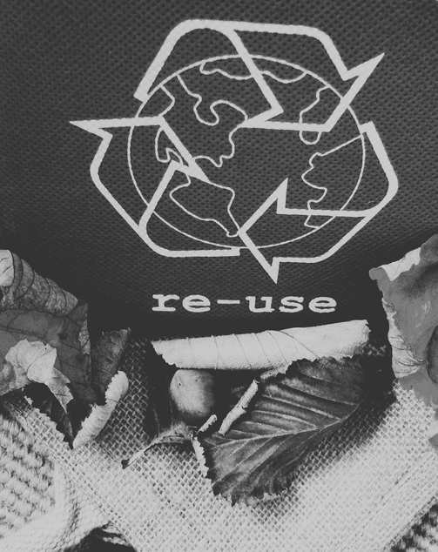
SO YOU WANT TO BUILD A MUSEUM
How can you minimise energy usage?
Where can you use recycled/ recyclable or sustainable materials?
The Idea
Collections & Programming
Operations & Facilities
Finances
Marketing
Business Planning
Put It Into Practice
Case Studies
Appendices
How can you minimise the waste your museum produces?
How can you promote environmental sustainability?
SUSTAINABILITY
Florence
Schechter
floschechter.com

Slide 51
SO YOU WANT TO BUILD A MUSEUM
VISITOR EXPERIENCE
Visitor experience is what it says on the tin: it is the sum of the experiences a visitor has. It is one of the biggest determiners of if someone will come back or recommend the visit to their friends.
It comprises so much, here are just some factors:
Admission
Transparent pricing structure
Easy to use ticketing system
Attitude of front of house staff
Location:
How easy it is to find
Condition of roads, steps, etc
Accessibility
Cleanliness and maintenance
Easy transport
Layout:
Easy of access and egress
Clear where to go/pay
Visitor flow
Amenities:
Well supplied and affordable cafe
Clean toilets
Enough facilities
Attractive decor
Clear wayfinding
Good quality gift shop
Translations
Digital
Ease of use of website
Sufficient and accurate information
Clear branding
How will you do visitor research?
The Idea
Collections & Programming
Operations & Facilities
Finances
Marketing
Business Planning
Put It Into Practice
Case Studies
Appendices
How will you ensure a positive visitor experience?
Will you cater to international visitors? If yes, how?
Florence
Schechter
floschechter.com

Slide 52
SO YOU WANT TO BUILD A MUSEUM
ACCESSIBILITY
Providing an accessible space is the moral duty of any building that invites members of the public. If you think about accessibility first when designing your space and activities, it will be an easier job than needing to add in access measures afterwards. There is a mantra in the disability community: “Nothing about us without us”. Don't install access measures without involving disability advocates and organisations - and paying them!
Some access needs can be contradictory and it is not possible to have all access measures at all times. There is no such thing as “fully accessible”. For example, a visitor with poor vision may need bright lighting, but a neurodivergent visitor may find this overwhelming.
Some access measures can be expensive and there's no easy of getting around it - such as installing a lift. But some can be very cheap and simple such as using alt text on images posted to your social media.
Sometimes in the GLAM sector, there will unfortunately be no way to make something accessible. For example, if you have a Grade I listed building, you may simply not be allowed to install a lift.
Are there any particular access needs your visitors may have?
The Idea
Collections & Programming
Operations & Facilities
Finances
Marketing
Business Planning
Put It Into Practice
Case Studies
Appendices
NOTE
Depending on your audience, you may need to prioritise certain needs over others. If your visitors tend to be quite old, you may need to focus on mobility access. If your audience are more likely to have infants, you may need to prioritise pram parking and changing stations.
Which disability groups will you work with?
Florence
Schechter
floschechter.com

Slide 53
SO YOU WANT TO BUILD A MUSEUM
STAFFING
The Idea
Collections & Programming
Operations & Facilities
Finances
Marketing
Business Planning
Put It Into Practice
Case Studies
Appendices
How many staff will you need and in what roles?
How will you ensure diversity and inclusion in your staffing team?
How will you find staff?
How will you ensure staff are well paid and well resourced?
Florence
Schechter
floschechter.com

Slide 54
SO YOU WANT TO BUILD A MUSEUM
Will you have volunteers? If so, in what capacity?
VOLUNTEERING
Regular volunteers on site e.g. front of house, events
The Idea
Collections & Programming
Operations & Facilities
Finances
Marketing
Business Planning
Put It Into Practice
Case Studies
Appendices
One off volunteers for specific projects
What will your volunteers get in return for donating their time?
Off site volunteers for outreach or research
Remote volunteers for digital work
other
How will you make sure you aren't over-reliant on volunteers for doing core work?
Florence
Schechter
floschechter.com

Slide 55
SO YOU WANT TO BUILD A MUSEUM
TEAM MANAGEMENT
How will you project manage your team?
Are there any special considerations you need to give to staff wellbeing?
Will you need a safeguarding policy, e.g. working with children or vulnerable adults?
The Idea
Collections & Programming
Operations & Facilities
Finances
Marketing
Business Planning
Put It Into Practice
Case Studies
Appendices
EXAMPLES
EXAMPLE
Florence
Schechter
floschechter.com
Trello
Asana
Notion
Monday
Slack
Basecamp
A war museum may need to consider the mental health of staff who need to discuss tragedies every time they are at work

Slide 56
Governance
Premises
Sustainability
The Charity Commission
Glasgow Museums: Display Guidelines
Design Declares
RSA: Regenerative Futures
Trustee guidance
Museum Buildings Guide
Art Not Oil
Design Museum: Design for a Greener Future
AIM: Successful Governance
The Council for Museums, Archives and Libraries: Security Guide
Culture Unstained
Community for Greener Exhibitions
Charities and Trading Guidance
Sustainable Cultural Production Toolkit
AFP: Building an Effective Board of
Directors
FURTHER RESOURCES

Slide 57
Accessibility
Visitor experience
Staffing and volunteering
Disability Collaborative Network
Tourism Northern Ireland: Criteria for visitor experiences grading
MA: Salary Recommendations
Smithsonian: Accessible Exhibition Guide
MGS: Connecting with visitors
Prospect Union
NMS: Exhibitions For All
Visitor Experience Group
Fair Museum Jobs
Euan’s Guide
Museum As Muck
National Museum Directors' Council
FURTHER RESOURCES CONT.

Slide 58
FINANCES

Slide 59
SO YOU WANT TO BUILD A MUSEUM
GENERAL INCOME
The Idea
Collections & Programming
Operations & Facilities
Finances
Marketing
Business Planning
Put It Into Practice
Case Studies
Appendices
Where will you get funding to get the idea off the ground?
What will be your sources of income?
How can you ensure your income streams are diversified enough?
How might your sources of income evolve over time?
Florence
Schechter
floschechter.com

Slide 60
SO YOU WANT TO BUILD A MUSEUM
GRANTS
The Idea
Collections & Programming
Operations & Facilities
Finances
Marketing
Business Planning
Put It Into Practice
Case Studies
Appendices
Which grants might you apply to?
How can you provide a track record to a potential funder or major donor?
Florence
Schechter
floschechter.com

Slide 61
SO YOU WANT TO BUILD A MUSEUM
DONATIONS
The Idea
Collections & Programming
Operations & Facilities
Finances
Marketing
Business Planning
Put It Into Practice
Case Studies
Appendices
Do you have any donors who can donate a significant amount?
Do you have an existing community who could donate?
Will you register for gift aid?
Can you get donations in kind?
EXAMPLES
Materials
Space
Transport
Marketing/PR
Software
Services
Labour
Equipment
Investment
Furniture
Accountancy
Advice
Florence
Schechter
floschechter.com

Slide 62
SO YOU WANT TO BUILD A MUSEUM
COSTS
What will be your main costs?
How might your costs evolve over time?
The Idea
Collections & Programming
Operations & Facilities
Finances
Marketing
Business Planning
Put It Into Practice
Case Studies
Appendices
Florence
Schechter
floschechter.com

Slide 63
SO YOU WANT TO BUILD A MUSEUM
Everyone loves a museum gift shop. Anyone can get a bar of chocolate with their logo on. But the best gift shops are ones that sell things you can't get anywhere else.
RETAIL
EXAMPLE
Museum of London has an exclusive range with Tatty Devine
The Idea
Collections & Programming
Operations & Facilities
Finances
Marketing
Business Planning
Put It Into Practice
Case Studies
Appendices
What types of things will you stock? |  | Which Point of Sale system will you use?
Will you create your own merchandise and/or resell? |  | Will you also sell online? What e-commerce site will you use?
Who will be your suppliers? |  | What kind of retail partnerships could you utilise?
What can you stock that will be unique to your mission? |  | How will you package your stock?
Florence
Schechter
floschechter.com

Slide 64
SO YOU WANT TO BUILD A MUSEUM
Membership schemes are helpful for building a loyal visitor base and having a reliable income.
MEMBERSHIP SCHEME
The Idea
Collections & Programming
Operations & Facilities
Finances
Marketing
Business Planning
Put It Into Practice
Case Studies
Appendices
What will you offer your members?
How much will it cost?
Who will you target for the scheme?
What database management system will you use for your membership roster?
Florence
Schechter
floschechter.com

Slide 65
SO YOU WANT TO BUILD A MUSEUM
OTHER FORMS OF INCOME
The Idea
Collections & Programming
Operations & Facilities
Finances
Marketing
Business Planning
Put It Into Practice
Case Studies
Appendices
Could you run a cafe as a form of income?
Will your location be available for venue hire?
Can you use your assets creatively e.g. renting hotdesks?
Are there any creative ways you can generate commercial income specific to your museum?
EXAMPLE
The Met Gala is at its heart a fundraising event for the Metropolitan Museum of Art's Costume Institute
Florence
Schechter
floschechter.com

Slide 66
There will be many organisations out there who are trying to achieve similar goals to you. This might be in their main activities, or it could be as part of their CSR. Partnerships can sometimes be obvious - such as Gilette and Movember - but you might be surprised who could be your potential partner so don't be afraid to think outside the box.
Partnering is a very useful thing to do as it can expand your reach, spread the workload, provide funding, and be a testing ground for creativity.
But it's important that the give and take of partnerships are balanced. There are a lot of businesses out there who don't understand that museums are usually charities and therefore expect them to provide services and goods for free. But businesses aren't the beneficiaries of your museum (probably!), so make sure you get enough in return for what you offer them.
PARTNERSHIPS

Slide 67
SO YOU WANT TO BUILD A MUSEUM
Network mapping
People you’d like to know
The Idea
Collections & Programming
Operations & Facilities
Finances
Marketing
Business Planning
Put It Into Practice
Case Studies
Appendices
Businesses
Acquaintances
GLAM Sector
Close
associates
Other charities
Individuals
Florence
Schechter
floschechter.com

Slide 68
SO YOU WANT TO BUILD A MUSEUM
What do you need your partners to give to you?
The Partnership Relationship
Funding
Physical space
What can you offer your partners?
The Idea
Collections & Programming
Operations & Facilities
Finances
Marketing
Business Planning
Put It Into Practice
Case Studies
Appendices
Audience
Stock
Marketing/PR
Services/expertise
other
Are there any partnerships you wouldn't consider?
EXAMPLES
Museums often have ethical values they want to stick to and this should be reflected in everything you do.
At the Vagina Museum, we wouldn't accept money from companies who profited from vulva shame, turning down offers from companies that made vulva lightening creams and vulva skin serums
I would suggest the many science museums out there should be ashamed of themselves for partnering with oil companies.
Florence
Schechter
floschechter.com

Slide 69
Fundraising
Income and costs
Partnerships
Heritage Funding Directory
Income Generation and Fundraising for Museums
UKGov: Work with other charities
CAF UK Giving Report
NMDC Valuing Museums Report
Ecclesiastial Corpororate Partnerships Report
Fundraising Regulator
Museums and Galleries Exhibition Tax Relief
How to build corporate partnerships that compete
Chartered Institute of Fundraising
AIM Finance resources
How To Form Great Business And Charity Partnerships
Museum Store Association
Charity Finance Group
Charity Digital
FURTHER RESOURCES

Slide 70
MARKETING

Slide 71
SO YOU WANT TO BUILD A MUSEUM
MARKETING STRATEGY
The Idea
Collections & Programming
Operations & Facilities
Finances
Marketing
Business Planning
Put It Into Practice
Case Studies
Appendices
A marketing strategy will usually contain the following sections:
Executive summary
Organisational vision/goals
Market analysis
Target audience
Competitor analysis
Branding and messaging
Marketing channels
A marketing plan is how you will execute your strategy. It will usually contain the following sections:
Campaign goals
Messaging
Activities
Content plan
Responsibilities
Timeline
Budget
KPIs
Much of a traditional marketing strategy will include most of the same information that you have started building throughout this pack such as brand position and audience segmentation. In the resources page, there are templates you can use to build your marketing strategy. This section will focus only on parts of your marketing strategy that aren’t covered elsewhere.
Marketing glossary
Florence
Schechter
floschechter.com

Slide 72
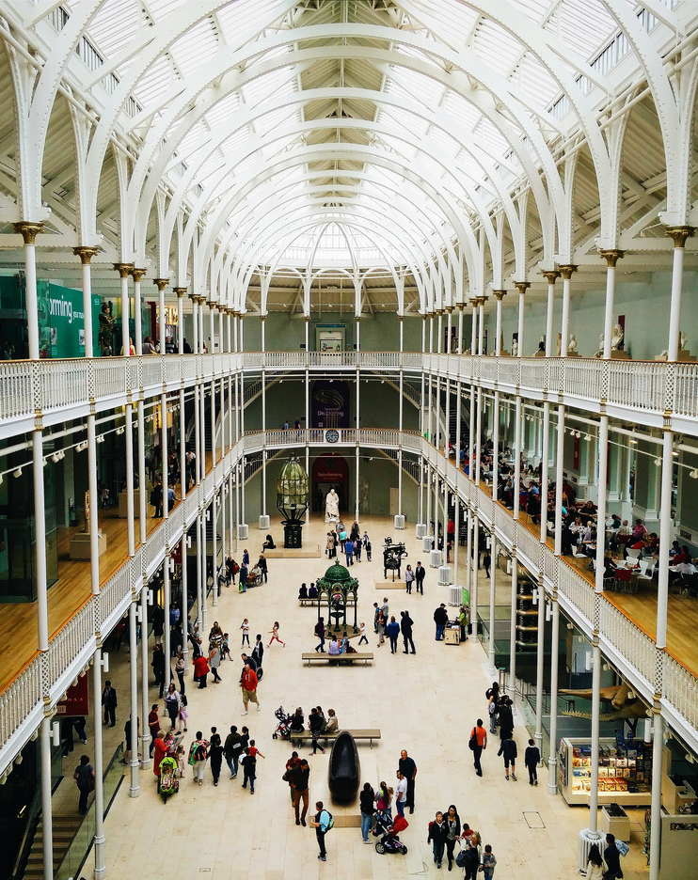
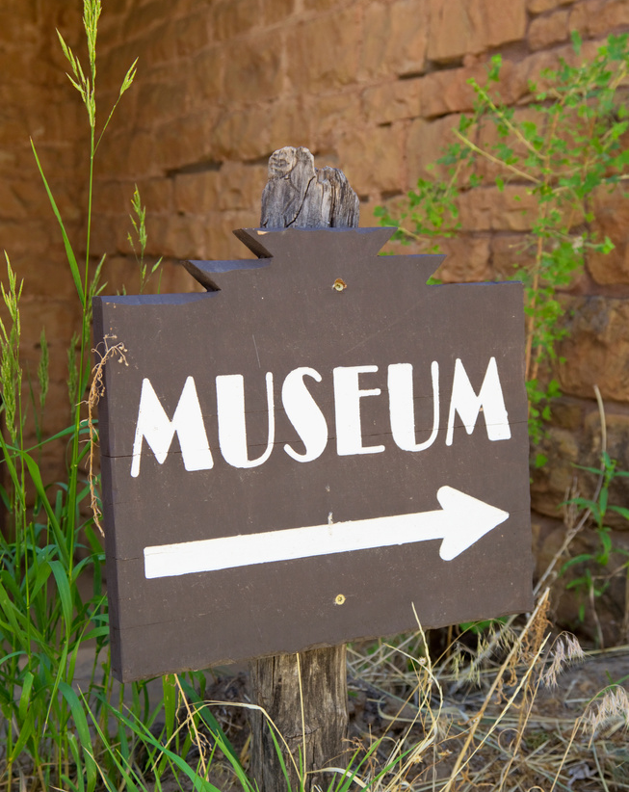
SO YOU WANT TO BUILD A MUSEUM
Product
Price
What are you selling?
In the case of a museum, this could be a visit to the museum site, products in the shop or cafe, an event, venue hire, consultancy or anything else you can offer your visitors.
What is the price?
Visitors are not going to engage in something if they don’t have an idea of what the price is. Make sure this is readily available and within their budget.
The Idea
Collections & Programming
Operations & Facilities
Finances
Marketing
Business Planning
Put It Into Practice
Case Studies
Appendices
Place
Promotion
Where are you selling?
This is most likely your museum premises, but it can also be online or at other sites.
How will you promote what you’re selling?
This is the list of activities you’ll be engaging in to promote the museum. This will be covered in the next few pages.
A marketing mix is the set of variables that you can control to meet the needs of your target audience. There are different ways of defining these variables, the “4 Ps” are just one method.
Florence
Schechter
floschechter.com
Marketing Mix

Slide 73
SO YOU WANT TO BUILD A MUSEUM
Set Objectives
Marketing objectives should be SMART - Specific, Measurable, Attainable, Relevant and Timebound. This will make both measuring and achieving them easier.
The Idea
Collections & Programming
Operations & Facilities
Finances
Marketing
Business Planning
Put It Into Practice
Case Studies
Appendices
 | Poor example | Good example
Smart | I want the museum to be buzzing | I want to increase the number of museum visitors
Measurable | I want to increase the number of museum visitors loads | I want to increase the number of visitors to 3,000 per month
Attainable | I want more visitors than the British Museum | I want to be in the top 200 visited museum in the UK
Relevant | I want a celebrity to visit the museum | I want a celebrity to visit the museum and then post about it to engage new audiences
Timebound | I want to increase visitor numbers soon | I want to increase visitor numbers by the end of the financial year
Final objective | I want to increase the number of visitors to 3,000 per month by the end of the financial year | I want to increase the number of visitors to 3,000 per month by the end of the financial year
Florence
Schechter
floschechter.com

Slide 74
SO YOU WANT TO BUILD A MUSEUM
Marketing funnel
A marketing funnel is the journey a person takes to turn into a customer. In an age where people are growing up with the internet however, many believe the traditional funnel model isn’t working anymore.
 | Aim | Activity examples | KPIs
TOFU (Top of the funnel) | Attract | Paid advertising Guest blog post Press | Reach Impressions Engagement Click through rate
MOFU (Middle of the funnel) | Inform | Content marketing Social media Competitor comparison Newsletter | Page views Time on page Bounce rate
BOFU (Bottom of the funnel) | Convert and engage | Promo codes/free trials Testimonials/Reviews Demos | Return on advertising spend Advertising cost of sales Customer acquisition cost Conversion rate
Awareness
The Idea
Collections & Programming
Operations & Facilities
Finances
Marketing
Business Planning
Put It Into Practice
Case Studies
Appendices
This is the stage when a potential customer/visitor knows about your existence
Consideration
This is when the potential customer is thinking about buying/visiting
Conversion
This is when the customer makes the leap and purchases/visits
Florence
Schechter
floschechter.com
Loyalty
They come back again and again

Slide 75
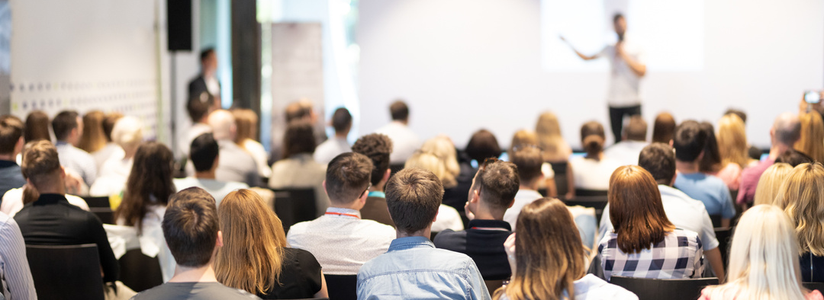
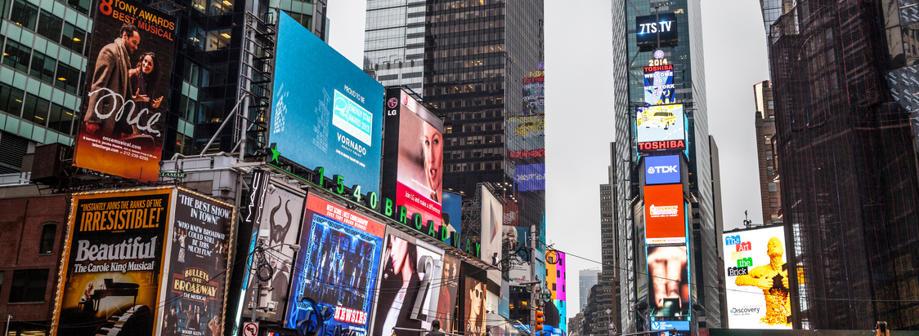
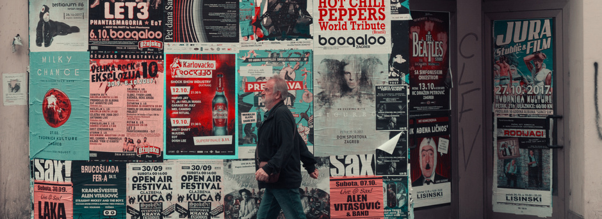
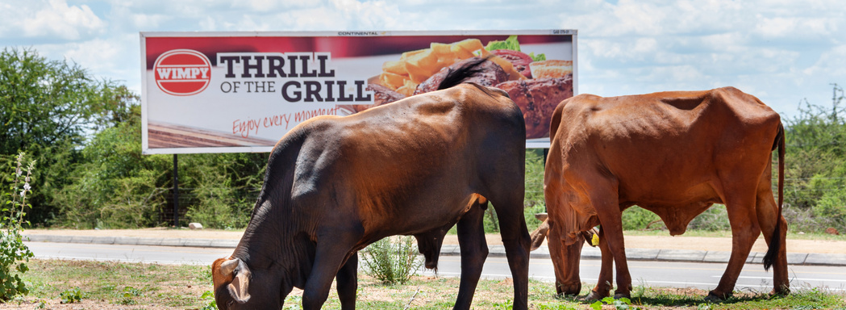
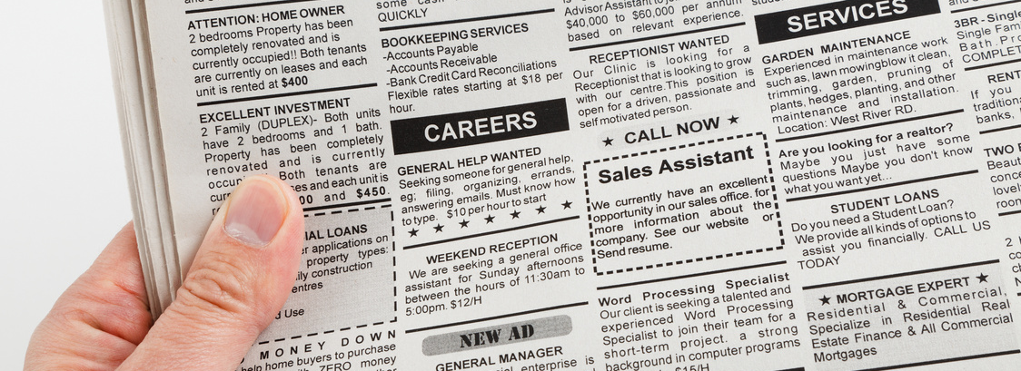
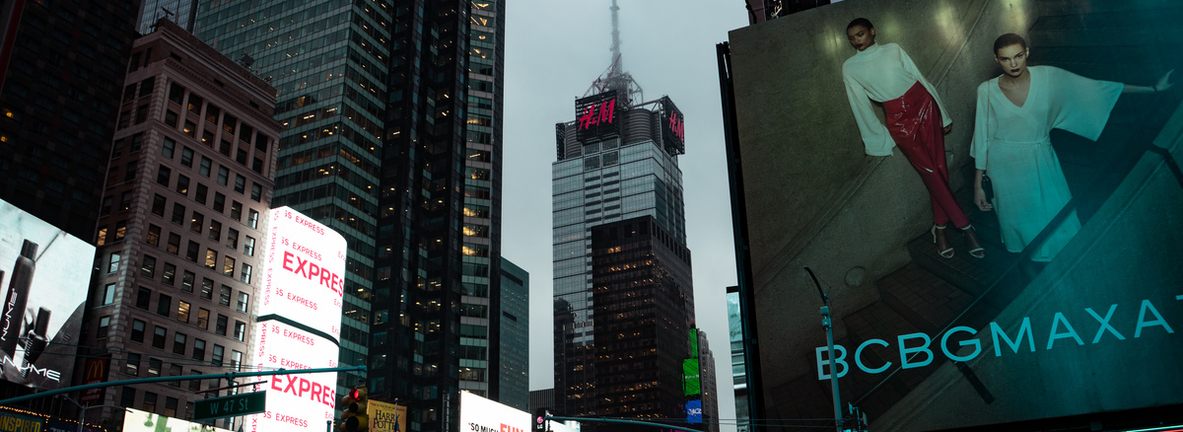
SO YOU WANT TO BUILD A MUSEUM
CHANNEL TYPES
The Idea
Collections & Programming
Operations & Facilities
Finances
Marketing
Business Planning
Put It Into Practice
Case Studies
Appendices
Inbound marketing
Outbound marketing
Free
Paid for
Inbound marketing is when a customer initiate interaction with a brand - e.g. visiting a website or attending an event
Outbound marketing is when the brand initiates the interaction - e.g. a billboard or television ad
Free or organic marketing is things like posting on social media or word of mouth
This is any marketing with an upfront cost
Traditional
Digital
Direct
Indirect
Also known as offline, this is marketing that isn’t in the digital world e.g. print
This is marketing in the digital world such as online ads, social media, etc
This is when you are specifically asking the audience to buy from you or visit
This is when you don’t try to sell a specific product or inspire a specific action, but rather just raise awareness
Florence
Schechter
floschechter.com

Slide 76
SO YOU WANT TO BUILD A MUSEUM
Specific channel types
The Idea
Collections & Programming
Operations & Facilities
Finances
Marketing
Business Planning
Put It Into Practice
Case Studies
Appendices
Traditional
Digital
Direct
Indirect
Print
Magazine
Newspapers
Leaflets
Direct mail
TV
Radio
Broadcasting
Events
Press coverage
Telemarketing
Digital ads
Email
Website
Social media
SEO
SEM
Content marketing
Affiliate
Native ads
Influencer
Demo
Consultation
Promo code
Free trial
Telemarketing
Pay per click
Referrals
Ebook
Blog
Podcast
Testimonials
Reviews
Free tools
Quizzes
Videos
Infographic
How to guide
Webinar
Newsletter
Florence
Schechter
floschechter.com

Slide 77
SO YOU WANT TO BUILD A MUSEUM
SOCIAL MEDIA
Which channels will you use?
Twitter/X
Tik Tok
The Idea
Collections & Programming
Operations & Facilities
Finances
Marketing
Business Planning
Put It Into Practice
Case Studies
Appendices
Social media is practically mandatory in today’s world.
What platforms you use and how you use them should be informed by your audience. And the best way to know how your audience uses their channels is to be part of that discussion. Regularly engage with their posts - social media is learnt best by doing rather than theory.
Social media should be considered an indirect marketing strategy, not direct - the most important thing is always authenticity.
Instagram
Mastadon
Facebook
Snapchat
LinkedIn
YouTube
Reddit
Pinterest
other
Tumblr
Weibo
Florence
Schechter
floschechter.com
Discord
Threads

Slide 78
SO YOU WANT TO BUILD A MUSEUM
Content pillars
Content pillars are topics that you regularly post about. Whereas you sometimes want to react quickly to a topic, having pillars will enable you to plan content in advance and prevent not knowing what to post about.
The Idea
Collections & Programming
Operations & Facilities
Finances
Marketing
Business Planning
Put It Into Practice
Case Studies
Appendices
 | Pillar 1 (example) | Pillar 2 | Pillar 3 | Pillar 4
Topic | Museum history
Audience | Museum professionals
Channel | LinkedIn, Twitter
Format | Short form posts, blogs
Florence
Schechter
floschechter.com

Slide 79
Groups
Strategy
Social media
Arts Marketing Association
Hubspot: Marketing strategy
Buffer: Content pillars
Culture Hive
Wrike: Marketing Strategy
Mailchimp: Marketing resources
Digital Culture Network
Shopify: Marketing Strategy
How Museums Use Social Media to Engage the Public
Institute of Conservation
AMA: Marketing Strategy
Sprout Social Guide
Rochdale Arts & Heritage Resource Centre Storage Virtual Tour
Google: Free digital training
Museum Development South East: Event Planning Template
FURTHER RESOURCES

Slide 80
BUSINESS PLANNING

Slide 81
SO YOU WANT TO BUILD A MUSEUM
What sections will you include?
BUSINESS PLAN
Title page
Contents
Executive summary
Museum description
Market analysis
Staffing and organisation
Strategies
Programme
Marketing plan
Budget
Projections
Risks
Evaluation plan
Other
The Idea
Collections & Programming
Operations & Facilities
Finances
Marketing
Business Planning
Put It Into Practice
Case Studies
Appendices
There are lots of different ways to build a business plan. They can range from one page summaries to 100 page tomes. You need to pick a format that works for you.
Examples
Royal Ontario Museum 17-18
Museum of Cambridge 22-27
Fort Museum 21-23
Amgueddfa Cymru 21-26
People’s History Museum 22-23
Royal Tyrrell Museum
21-26
Florence
Schechter
floschechter.com
Thackray Museum of Medicine 22-23
National Museum of Ireland 23-28

Slide 82
SO YOU WANT TO BUILD A MUSEUM
Extra business planning questions
A lot of the business plan will be populated from your answers elsewhere in this pack. Here are some extra questions you may need to consider that haven’t been covered elsewhere.
The Idea
Collections & Programming
Operations & Facilities
Finances
Marketing
Business Planning
Put It Into Practice
Case Studies
Appendices
What experience do you have building a business plan? |  | What resources do you already have available to you?
What method will you use to track your income and costs? |  | Where will you bank?
What level of reserves will you need? |  | What insurance will you need?
How will you manage cashflow? |  | What timeline are you expecting?
Florence
Schechter
floschechter.com

Slide 83
SO YOU WANT TO BUILD A MUSEUM
Build A Draft Budget - Revenue
 |  | Q1 | Q2 | Q3 | Q4 | Total
Charitable income | Individual giving
Charitable income | Corporate giving
Charitable income | Membership
Charitable income | Grants and foundation
Charitable income | Fundraising events
Charitable income | Legacies and wills
Earned income | Retail
Earned income | Admission fees
Earned income | Venue hire
Earned income | Events
Earned income | Cafe/bar
Earned income | School fees and tour groups
Earned income | Copyright and image licencing
Earned income | Sponsorship
Earned income | Contracts
Earned income | Investments/Interest
TOTAL | TOTAL
The Idea
Collections & Programming
Operations & Facilities
Finances
Marketing
Business Planning
Put It Into Practice
Case Studies
Appendices
Florence
Schechter
floschechter.com

Slide 84
SO YOU WANT TO BUILD A MUSEUM
Build A Draft Budget - Costs
 |  | Q1 | Q2 | Q3 | Q4 | Total
Operations | Salaries and pensions
Operations | Rent/mortgage
Operations | Utilities and rates
Operations | Office costs
Operations | Legal, accounting, consultancy
Operations | Insurance
Operations | Staff development
Operations | Subscriptions
Programming | Exhibition development
Programming | Events costs
Programming | Advertising and marketing
Variable costs | Retail costs
Variable costs | Cafe/bar costs
Variable costs | Fundraising costs
VAT | 0-20%
Contingency | 5-10%
TOTAL | TOTAL
The Idea
Collections & Programming
Operations & Facilities
Finances
Marketing
Business Planning
Put It Into Practice
Case Studies
Appendices
Florence
Schechter
floschechter.com

Slide 85
SO YOU WANT TO BUILD A MUSEUM
A risk register is a document that identifies risks to your project and how you will address them. Every project has risks, they pose the biggest challenge when you don’t know about them.
Build A Risk Register
Risk identification | Risk description | Date identified | Risk category | Likelihood | Impact | Current risk level | Current risk status | Risk mitigation plan | Date of plan completion | New likelihood | New impact | New risk level
Name of the risk | Short description of what the risk is | Date the risk was first brought to your attention | These should be unique to you but they could be operations, budget, programming | How likely the risk is to happen. 1 = very unlikely, 5 = almost certain | The level of impact the risk would have if it came to pass. 1 = almost no impact, 5 = catastrophic consequences | This is calculated by multiplying the likelihood with the impact of the risk. The risk matrix is on the next page. | How far along you are with dealing with the risk. It could be “open”, “in progress” or “closed. | The actions you will take to either lessen the likelihood or impact of the risk | When the risk mitigation plan will be ready and in place | New likelihood after mitigation | New impact after mitigation | Refer to risk matrix
The Idea
Collections & Programming
Operations & Facilities
Finances
Marketing
Business Planning
Put It Into Practice
Case Studies
Appendices
Florence
Schechter
floschechter.com

Slide 86
SO YOU WANT TO BUILD A MUSEUM
Risk Matrix
Some risks are of low enough impact or likelihood that they are acceptable and you don’t really need to do anything about them. Some are high enough they must be addressed immediately. This matrix will help identify you prioritise your risks.
The Idea
Collections & Programming
Operations & Facilities
Finances
Marketing
Business Planning
Put It Into Practice
Case Studies
Appendices
Risk impact | Risk impact | Risk impact | Risk impact | Risk impact | Risk impact | Risk impact | Risk impact
 |  |  | 1 | 2 | 3 | 4 | 5
 |  |  | Insignificant | Minor | Moderate | Major | Catastrophic
 | 1 | Rare | 1 | 2 | 3 | 4 | 5
 | 2 | Unlikely | 2 | 4 | 6 | 8 | 10
 | 3 | Possibly | 3 | 6 | 9 | 12 | 15
 | 4 | Likely | 4 | 8 | 12 | 16 | 20
 | 5 | Almost certain | 5 | 10 | 15 | 20 | 25
1 - 4: Low level risks
No action required at this time, only monitoring
5-9: Medium level risks
Mitigation plans should be sufficient but low priority
10-16: High level risks
Mitigation plans should be put in place as a high priority
20-25: Extreme level risks
Relevant activities must cease and immediate action taken
Risk likelihood
Florence
Schechter
floschechter.com

Slide 87
Business planning
Budgets
Risk management
AIM Business Planning Guide
National Council of Non Profits: Budgeting
Asana: How to build a risk register
SHARE Museums East: Forward Planning
Smartsheet: Budgeting templates
Project Management Academy: Risk Register
Scrut Automation: How to build a risk register
Wrike: Risk matrix
FURTHER RESOURCES

Slide 88
PUT IT INTO PRACTICE

Slide 89
SO YOU WANT TO BUILD A MUSEUM
Do your own research
Name
Location
Visit date
Contact details
If you want to write, read. If you want to build a museum, visit museums. This worksheet is to help you analyse museums you visit and see what you can learn from them.
The Idea
Collections & Programming
Operations & Facilities
Finances
Marketing
Business Planning
Put It Into Practice
Case Studies
Appendices
Areas (What you liked/What you didn’t like/Notes) | Areas (What you liked/What you didn’t like/Notes)
Exhibitions
Reception
Gift shop
Cafe
Back of house
Visitor experience (What you liked/What you didn’t like/Notes) | Visitor experience (What you liked/What you didn’t like/Notes)
Staffing
Ticketing
Toilets
Accessibility
Wayfinding
Research | Research
Annual visitors
Income (sources, amount)
Costs (categories, amount)
Florence
Schechter
floschechter.com

Slide 90
SO YOU WANT TO BUILD A MUSEUM
PROOF OF
CONCEPT
The Idea
Collections & Programming
Operations & Facilities
Finances
Marketing
Business Planning
Put It Into Practice
Case Studies
Appendices
After having considered all the things in this resource, you may think that building a museum is a lot of work. It is.
Museums are absolutely amazing, but you need to make sure you understand what you're getting yourself into. Don’t try to run before you can walk - start at a scale appropriate to your experience and resources and work your way towards your ultimate goal.
There is no better way to see if your museum is a good idea than to just give it a go. Here are some ways you can do a proof of concept:
Pop up exhibition
Online exhibition
Event
School resource
Museum in a box
Walking tour
Florence
Schechter
floschechter.com

Slide 91
SO YOU WANT TO BUILD A MUSEUM
Evaluation
As with any idea, you need to know how to know if you're doing well and where you need to improve. You can’t go off vibes alone. Don’t forget - your objectives you are evaluating against should be SMART (see the marketing section).
The Idea
Collections & Programming
Operations & Facilities
Finances
Marketing
Business Planning
Put It Into Practice
Case Studies
Appendices
What are your KPIs? (KPI stands for “Key Performance Indicator”) | What are your KPIs? (KPI stands for “Key Performance Indicator”) | What are your KPIs? (KPI stands for “Key Performance Indicator”) | What are your KPIs? (KPI stands for “Key Performance Indicator”) | What are your KPIs? (KPI stands for “Key Performance Indicator”) | What are your KPIs? (KPI stands for “Key Performance Indicator”)
Audience | Visitor count (break down by visitor type/demographic/time) | Financial | Income (break down by type) | Internal | Staff/volunteer satisfaction
Audience | Visitor satisfaction/feedback | Financial | Expenditure (break down by type) | Internal | Volunteer hours
Audience | Dwell time | Financial | Profit | Environmental | Carbon footprint
Audience | Number of members | Financial | Grants received (number/amount) | Environmental | Waste reduction
Collection | Size of collection | Digital | Website visits | Other
Collection | Collection inquiries | Digital | Newsletter subscribers | What methods will you use to measure these KPIs?
Programme | Number of exhibitions | Digital | Click through rate | What methods will you use to measure these KPIs?
Programme | Number of events | Digital | Social media engagement | What methods will you use to measure these KPIs?
Florence
Schechter
floschechter.com

Slide 92
SO YOU WANT TO BUILD A MUSEUM
What were the barriers you faced doing your proof of concept?
What would you have done differently?
NOTE
The UK has a museum accreditation scheme. It’s not necessary to have in order to call yourself a museum, but it does provide a useful framework for best practice and opens funding streams. The process takes years however, so it’s not something to do at the start of your journey. But it’s helpful to keep in the back of your mind because in order to get accredited, the museum must work to a certain standard. So it’s easier to set up compliant systems to start with rather than change them later and do the work twice.
The Idea
Collections & Programming
Operations & Facilities
Finances
Marketing
Business Planning
Put It Into Practice
Case Studies
Appendices
Will you consider becoming accredited?
How will you avoid founder syndrome?
After Your Proof Of Concept
Florence
Schechter
floschechter.com

Slide 93
SO YOU WANT TO BUILD A MUSEUM
DOCUMENTATION CHECKLIST
The Idea
Collections & Programming
Operations & Facilities
Finances
Marketing
Business Planning
Put It Into Practice
Case Studies
Appendices
Statement of purpose
Collections policy
Staff handbook
Branding guidelines
Constitution
Interpretations policy
Safeguarding policy
Audience development plan
Code of ethics
Programming plan
Risk register/Risk assessment
Marketing strategy
Florence
Schechter
floschechter.com
Business plan
Exhibition brief
Emergency plan
Access plan

Slide 94
Worldwide
UK
South Africa
ICOM
Heritage Trust Network
South African Museums Association
Worldwide
UK
Australia
muscon
Museums Association
Australian Museums and Galleries Association
Worldwide
UK
Europe
International Coalition of Sites of Conscience
Museum Development
Network of European Museum Organisations
North America
UK
Europe
American Alliance of Museums
National Museum Directors' Council
European Museum Forum
Ireland
UK
Asia
Irish Museums Association
Association of Independent Museums
Asian National Museums Association
MUSEUM NETWORKS

Slide 95
CONFERENCES
Worldwide
London, UK
IAAPA Expos
Museum Ideas
Worldwide
London, UK
Madrid, Spain
ICOM Conferences
Museums + Heritage Show
Next In Summit
Leeds, UK
London, UK
Vienna, Austria
Museums Association Conference 2024
VACC 2024
Inclusive Museum Research Network
London, UK
Edinburgh, UK
Seoul, South Korea
MuseumNext 2024
IMCC 2024
The Arts in Society
Dudley, UK
Paris, France
Sibiu, Romania
AIM Conference 2024
Museum Connections 2025
NEMO European Museum Conference

Slide 96
Museums
Evaluation
Accreditation
Wikipedia List of Museums
Glasgow Museums: Display Guidelines
NMS: Exhibitions for All Guidelines
Museums of the World
V&A: Writing Gallery Text Guidelines
Jordan Schnitzer Museum of Art: Museum Exhibition Planning Tool
Google Arts and Culture
Smithsonian: Guide to Interpretive Writing for Exhibitions
Science Museum exhibition proposal form
UNESCO Museums
Interpretation policy template
Art Institute Chicago: How To Read a Label
Museum Development South East: Event Planning Template
FURTHER RESOURCES

Slide 97
CASE STUDIES

Slide 98
SO YOU WANT TO BUILD A MUSEUM
Vagina Museum
History
The Vagina Museum was founded by Florence Schechter (author of this pack!) after discovering there was a penis museum in Iceland but no vagina equivalent.
It started with pop ups around the country, then opened its first temporary location in Camden Market in 2019. It then moved to a property guardianship in 2022 before settling into its long-term location in Bethnal Green in 2023 in a railway arch.
Particular highlights include the museum’s social media output and health awareness efforts.
Short description | World’s first bricks and mortar museum about the gynaecological anatomy
Current location | 275-276 Poyser Street, London, E2 9RF
Year founded | 2017
Website | vaginamuseum.co.uk
Social media | Insta: vagina_museum Twitter: vagina_museum
The Idea
Collections & Programming
Operations & Facilities
Finances
Marketing
Business Planning
Put It Into Practice
Case Studies
Appendices
Florence
Schechter
floschechter.com

Slide 99
SO YOU WANT TO BUILD A MUSEUM
Museum Of Homelessness
History
Museum of Homelessness was founded Matt and Jess Turtle. It is run by people with direct experience of homelessness. They run exhibitions, events and campaign for the rights of their community.
They started doing pop ups around the UK and then in 2020, completely pivoted to do pandemic support. In 2022, they returned to exhibition work with the award-winning “Secret Museum”.
In 2023, they secured a permanent home in Finsbury Park which opened to the public in 2024 with their exhibition “How To Survive The Apocalypse”.
Their campaigning efforts include the Dying Homeless Project, Pandemic On The Edge and voter registration.
Short description | A museum about homeless issues with a focus on practical action
Current location | Manor House Lodge, Finsbury Park, London, N4 2DE
Year founded | 2015
Website | museumofhomelessness.org
Social media | Insta: our_moh Twitter: our_MoH Fb: MuseumofHomelessness
The Idea
Collections & Programming
Operations & Facilities
Finances
Marketing
Business Planning
Put It Into Practice
Case Studies
Appendices
Florence
Schechter
floschechter.com

Slide 100
SO YOU WANT TO BUILD A MUSEUM
Queer Britain
History
Queer Britain was founded by Joseph Galliano-Doig, previous editor of the Gay Times and someone with varied experience in the charity sector. The purpose was to build the first ever national LGBTQ+ museum in the UK.
It started with pop up exhibitions and events, and they opened their first building in 2022 in the same building as the Art Fund headquarters.
Corporate partnerships have been a big part of their journey such as wine brand Madame F sponsoring an art award. Other partnerships include Levis, Diageo and Coutts.
Short description | The UK’s first and only museum dedicated to the LGBTQ+ community
Current location | 2 Granary Square, London N1C 4BH
Year founded | 2018
Website | queerbritain.org.uk
Social media | Instagram: QueerBritain Twitter: QueerBritain
The Idea
Collections & Programming
Operations & Facilities
Finances
Marketing
Business Planning
Put It Into Practice
Case Studies
Appendices
Florence
Schechter
floschechter.com

Slide 101
SO YOU WANT TO BUILD A MUSEUM
Museum of Migration
History
The Migration Museum was founded by Barbara Roche, former Minister of State for Asylum and Immigration (1999-2001). She had seen that migration in other museums was generally portrayed as either neutral or negative, which was in contrast to her experience that migration was a net good for a county and wanted to see that reflected in museums.
The project started as pop ups, then in 2017-19 was based in London Fire Brigade workshop in Lambeth. In 2020, they moved to an empty unit in Lewisham Shopping Centre and will remain in place until at least 2025. They are currently planning a move to a permanent home in Aldgate.
They do a lot of work with schools and local communities, and have a robust education programme.
Short description | A museum which explores how migration has shaped the UK
Current location | Lewisham Shopping Centre, London SE13 7HB
Year founded | 2013
Website | migrationmuseum.org/
Social media | Insta: migrationmuseumuk Twitter: MigrationUK Fb: MigrationMuseumUK
The Idea
Collections & Programming
Operations & Facilities
Finances
Marketing
Business Planning
Put It Into Practice
Case Studies
Appendices
Florence
Schechter
floschechter.com

Slide 102
SO YOU WANT TO BUILD A MUSEUM
Crab Museum
History
The Crab Museum was founded by Ned Suesat-Williams, Bertie Suesat-Williams and Chase Coley. They don’t have a background in marine biology, but chose crabs as a jumping off point to discuss wider issues such as climate change, capitalism and colonialism.
The museum opened to the public in 2022 in a small set of rooms in Margate. Work on the project started while the team were out of work during the Covid lockdowns.
The museum is an expert in using humour to tackle big topics - such as the model village on display, Crabton-on-Tyne, which has little figurines of crabs engaging in union strikes and suffragette action.
Short description | Europe’s only museum about crabs. But it’s not really about crabs
Current location | 9 Broad St, Margate CT9 1EW
Year founded | 2020
Website | crabmuseum.org/
Social media | Insta: crabmuseum Fb: crabmuseum
The Idea
Collections & Programming
Operations & Facilities
Finances
Marketing
Business Planning
Put It Into Practice
Case Studies
Appendices
Florence
Schechter
floschechter.com

Slide 103
SO YOU WANT TO BUILD A MUSEUM
People’s Museum Somers Town
History
The People’s Museum Somers Town evolved out of the Somers Town History Club and is led by local working class residents. Their guiding values are that of local ownership and community organisation. The museum was set up with the aim of playing a part in sustainable development of cities and civic society, and reducing inequality.
In addition to exhibitions, they have produced 4 books, 2 films, and over 400 events with over 500 contributors.
Short description | A community museum for to local working class history and the sustainable city development
Current location | 52 Phoenix Road, London, NW1 1ES
Year founded | 2016
Website | aspaceforus.club/
Social media | Insta: aspaceforusnow Twitter: HistoryTown Fb: aspaceforus
The Idea
Collections & Programming
Operations & Facilities
Finances
Marketing
Business Planning
Put It Into Practice
Case Studies
Appendices
Florence
Schechter
floschechter.com

Slide 104
SO YOU WANT TO BUILD A MUSEUM
Museum of Neoliberalism
History
The Museum of Neoliberalism is curated by Darren Cullen and Gavin Grindon, the team behind art-activist project, Spelling Mistakes Cost Lives. It was founded in response to a proposal for a museum for Margaret Thatcher (which was not realised).
The central exhibition is focused around parodic dioramas, characteristic of the founding artists. Its collection includes objects such as a bottle of urine from an Amazon warehouse worker who was not able to take toilet breaks whilst on shift.
The museum is planned to close in 2024 as the landlord is preparing to demolish the building to replace it with a shopping centre development with luxury flats.
Short description | A political museum about the effects of neoliberalist capitalism on society.
Current location | 16 Eltham Road, London, SE12 8TF
Year founded | 2019
Website | spellingmistakescostlives.com/museumofneoliberalism
Social media | Insta: aspaceforusnow Twitter: HistoryTown Fb: aspaceforus
The Idea
Collections & Programming
Operations & Facilities
Finances
Marketing
Business Planning
Put It Into Practice
Case Studies
Appendices
Florence
Schechter
floschechter.com

Slide 105
APPENDICES

Slide 106
SO YOU WANT TO BUILD A MUSEUM
The Idea
Collections & Programming
Operations & Facilities
Finances
Marketing
Business Planning
Put It Into Practice
Case Studies
Appendices
GLOSSARY
Accession: Entering an object into a collection
Accreditation: A scheme that sets national standards for museum
Deaccession: Removing an object from a collection
GLAM: Stands for Galleries, Libraries, Archives and Museums
Interpretation: The way a collection is communicated to the public
Interpretative media: The tangible things used to engage with visitors
Provenance: The history of the ownership of an object
Provenience: The place an object was found, particularly in archaeology
Other glossaries
British Museum: Conservation & Scientific Research glossary
MoMA: Art terms
Tate: Art terms
Florence
Schechter
floschechter.com

Slide 107
SO YOU WANT TO BUILD A MUSEUM
MUSEUM BUILDING RESOURCES
The Idea
Collections & Programming
Operations & Facilities
Finances
Marketing
Business Planning
Put It Into Practice
Case Studies
Appendices
Museums Galleries Scotland: First steps towards creating a museum
MGF of NSW: museums and galleries in heritage buildings
AAM: Starting a Museum
AIM: Successfully Setting up a New Museum
Museums 101
MERL: Make Your Own Museum of the Intangible
UNESCO: Running a museum - a practical handbook
Charity Excellence Framework
Key concepts of Museology
NPS: Museum Handbook
AAM: From the Ground Up: A Toolkit for Starting a Museum
Florence
Schechter
floschechter.com
AAM: From the Ground Up: A Toolkit for Starting a Museum
Our Museum

Slide 108
LEARN MORE
Ready to start your museum building journey? Book a free 15 minute consultation to see if we can work together to make your dream a reality.
Book a call now
Florence Schechter | Creative Consultant | info@floschechter.com | floschechter.com

