Slide 1
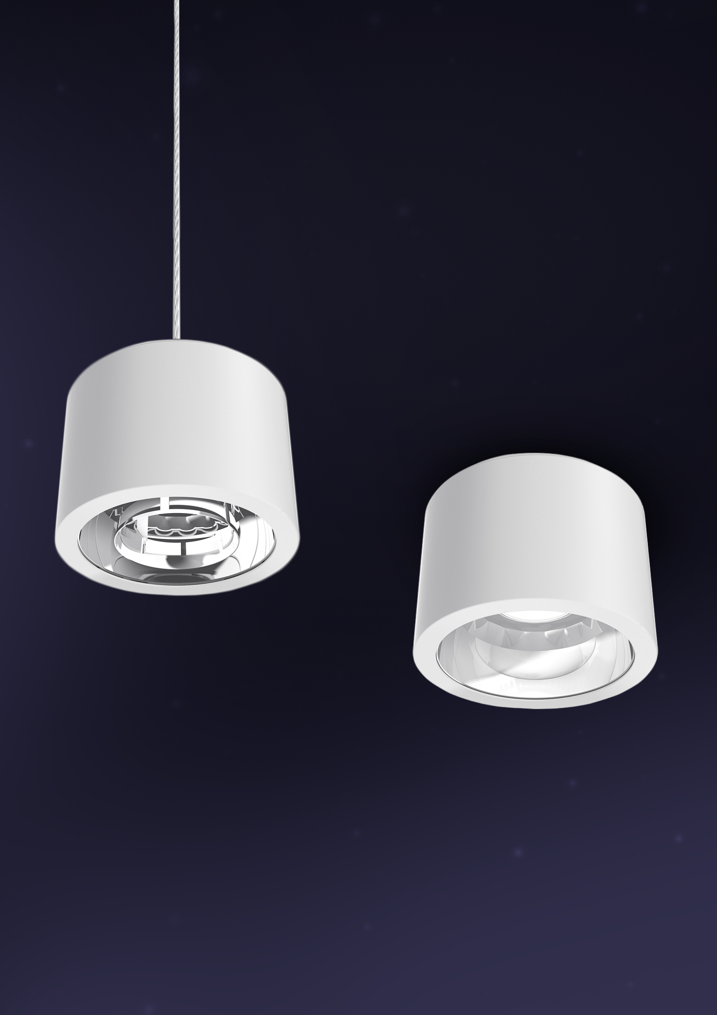

Drum
A versatile cylinder downlight with a variety of finish options

Slide 2
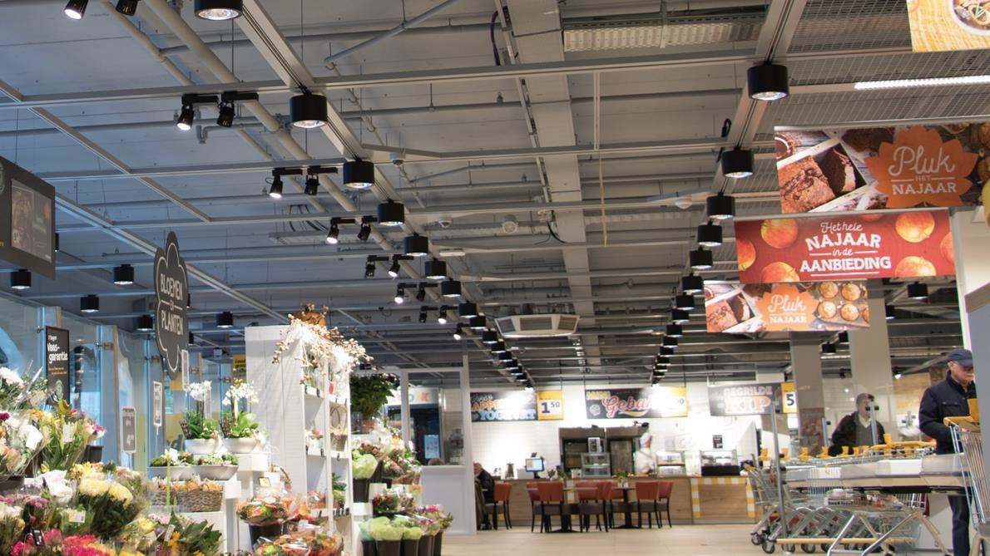


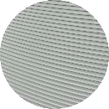
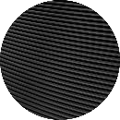
Drum
Colors
Bringing glare control of downlights to open ceilings by having surface mounting, track mounting and pendant, with a variety of finish options.
WH401 GR402
Satin White Satin Grey
BK402
Satin Black
A digitally manufactured lightweight housing provides a distinctive aesthetic to traditional downlighting applications with multiple design options available.

Slide 3
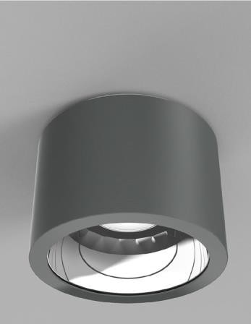
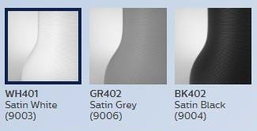
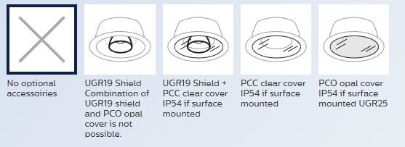
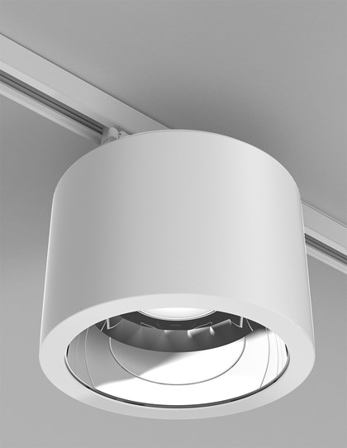
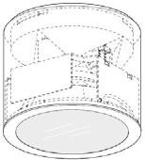
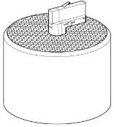
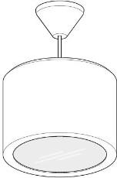
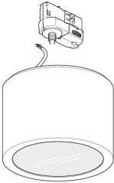
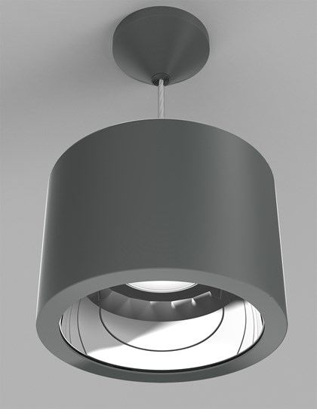
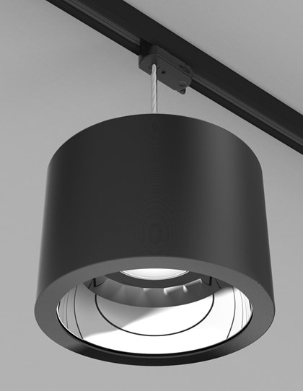
Finish Options
HOUSING | 3D PRINTED UV-STABILIZED POLY-CARBONATE PLASTIC HOUSING AND CANOPY. AVAILABLE WITH POLYCARBONATE OPTICAL COVER (PCC&PCO)
 | CONSULT THE ONLINE CONFIGURATOR ON POSSIBLE COMBINATIONS OF OPTIONS
Mounting
_{DESCRIPTION} SURFACE MOUNTED, TRACK MOUNTED, PENDANT SURFACE MOUNTE AND PENDANT TRACK MOUNTED
FIXTURE WEIGHT MAX 1.3 KG
Electrical
DESCRIPTION | PHILIPS XITANIUM MINI AND WH DRIVER
TYPE | PSE | PSU | DIA | WIA
CONTROL | NON DIM | NON DIM | DALI INTERACT READY | WIRELESS INTERACT
DC FEATURE | YES | NO | YES | YES
VLC POSSIBLE | NO | NO | YES | NO
CONNECTION | THROUGH-WIRING POSSIBLE FOR SURFACE MOUNTED VERSIONS
INPUT VOLTAGE |  | 220-240vac
FREQUENCY |  | 50-60Hz
POWER FACTOR |  | >0,9
DRIVER FAILURE RATE |  | <1% @ 5,000 hrs
Optical
DESCRIPTION | COB LED WITH SPECULAR REFLECTOR
CCT | 3000K, 4000K
CRI | 80+ / 90+
BINNING | CRI80+, 3000K (0.44, 0.40) SDCM<5 CRI90+, 4000K (0.38, 0.38) SDCM<5
LIFETIME | 100,000hrs to L90 @ 25°C Ta

Slide 4
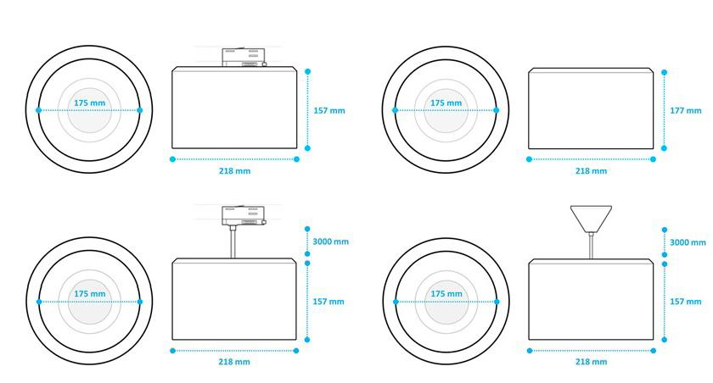
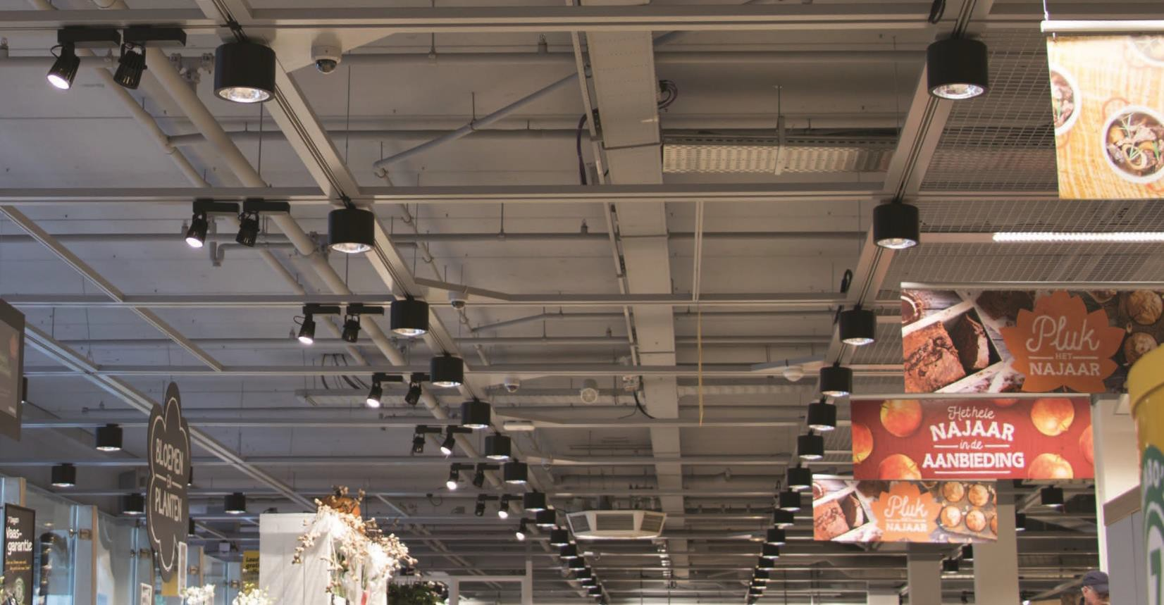
Operational & Certifications
PROTECTIONCLASS | IP20 / IK02 for OCPCC with sensor and without front glass IP54 / IK06 for PCO without sensor Electrical Class II
AMBIENT RANGE | +10° TO +40° / - 15° TO +40° FOR PCO & PCC
CERTIFICATIONS | CE, RoHS
GLOW WIRE TEST | 750°C
WARRANTY | 5 YEARS
© 2021Signify Holding. All rights reserved. The information provided here in is subject to change, without notice. Signify does not give any representation or warranty as to the accuracy or completeness of the information included herein and shall not be liable for any action in reliance thereon. The information presented in this document is not intended as any commercial offer and does not form part of any quotation or contract. Trademarks are owned by Signify Holding or their respective owners.

