Slide 1

Stop the Bus!
Play a game of Stop the Bus with your classmates and see who can get top score!
To play the game, print each player one of the grids provided (we’ve given you some example categories but feel free to come up with your own and use the blank grid).
Choose a slide to use for each game and try to be the first person to complete every box. If you’re the first, shout, “Stop the bus!” and all other players must stop – no matter how many boxes they’ve completed!
As a variation to the game, you could always set a timer for when all players must be finished by. (We’ve provided one of those for you too!).
Scoring: 5 points for a unique word 2 points for a word other players have

Slide 2

Stop the bus!
 | Includes the letter “e” | Includes the letter “o” | 2-syllabled word | 3-syllabled word | 4-syllabled word
Bubble 1
Bubble 2

Slide 3
Stop the bus!
 | Includes the letter “a” | Includes the letter “s” | Noun or adjective | 3-syllabled word | 4-syllabled word
Bubble 1
Bubble 2

Slide 4
Stop the bus!
Choose your own categories!
Bubble 1
Bubble 2

Slide 5

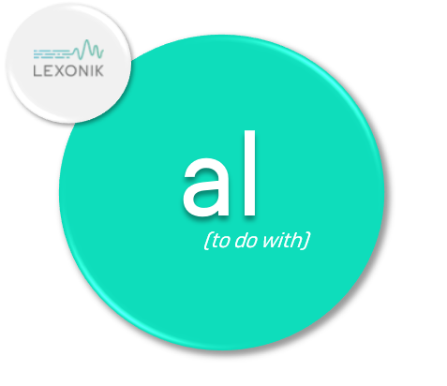

Stop the bus!
3 minute timer

Slide 6


Stop the bus!
3 minute timer

Slide 7
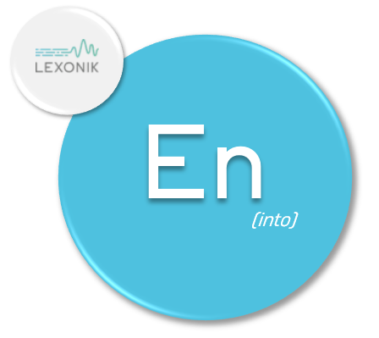

Stop the bus!
3 minute timer

Slide 8
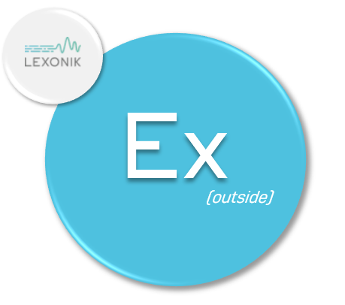
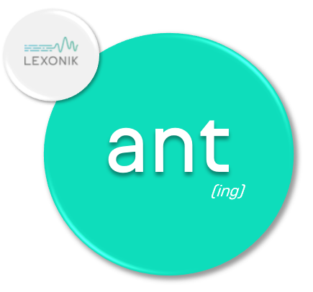
Stop the bus!
3 minute timer

Slide 9
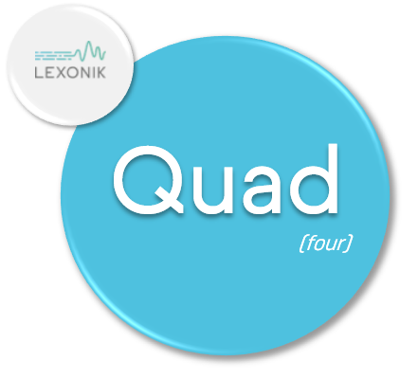

Stop the bus!
3 minute timer

Slide 10


Stop the bus!
3 minute timer

Slide 11


Stop the bus!
3 minute timer

Slide 12

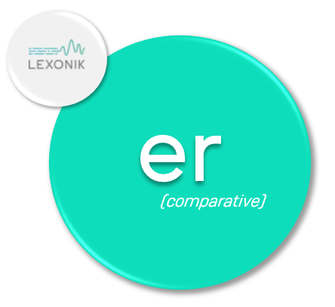
Stop the bus!
3 minute timer

Slide 13


Stop the bus!
3 minute timer

Slide 14


Stop the bus!
3 minute timer

