Slide 1
Expression on interest

Slide 2
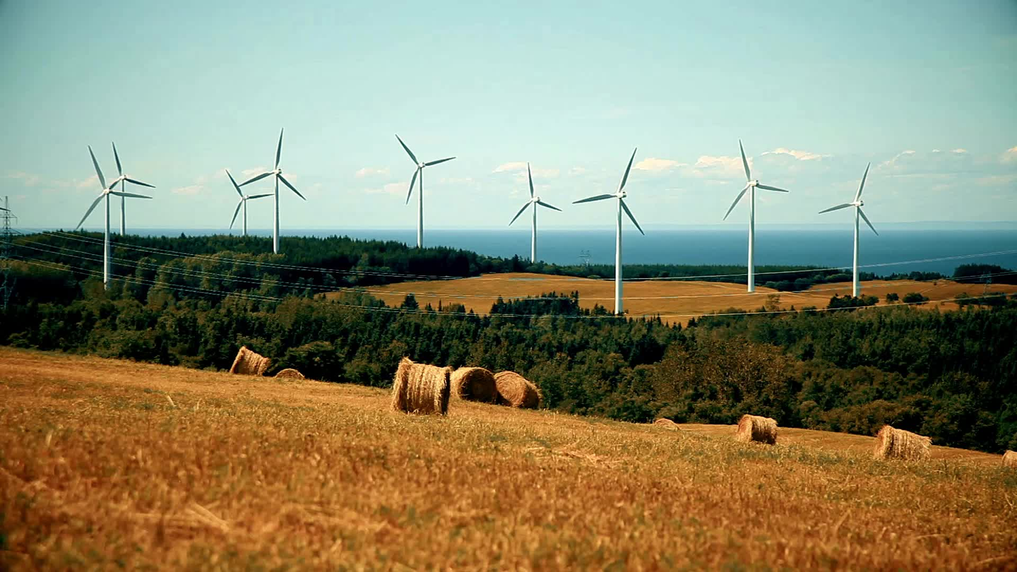
Our mission
To change this…

Slide 3
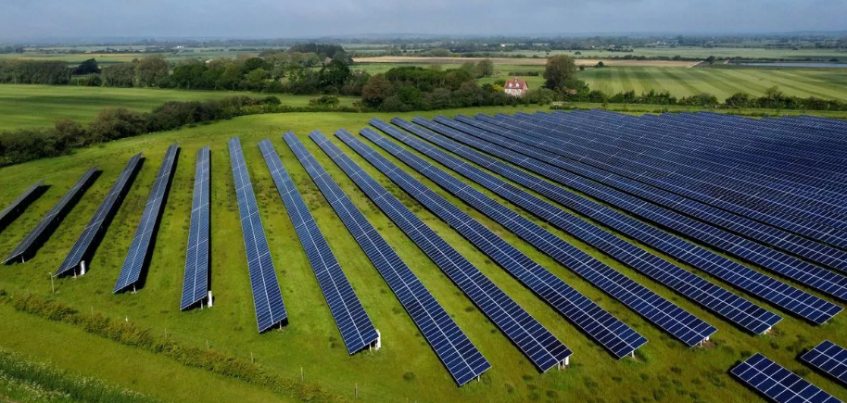
And this…

Slide 4
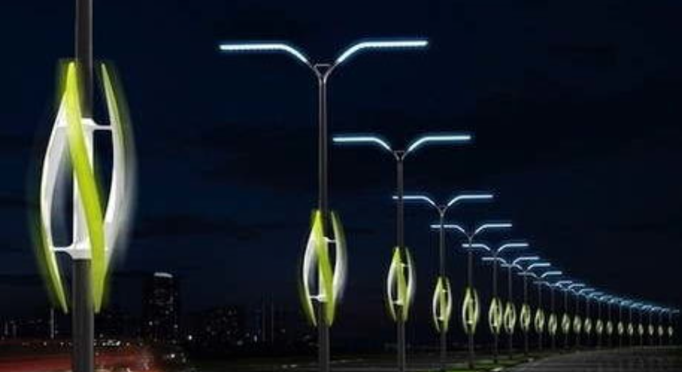
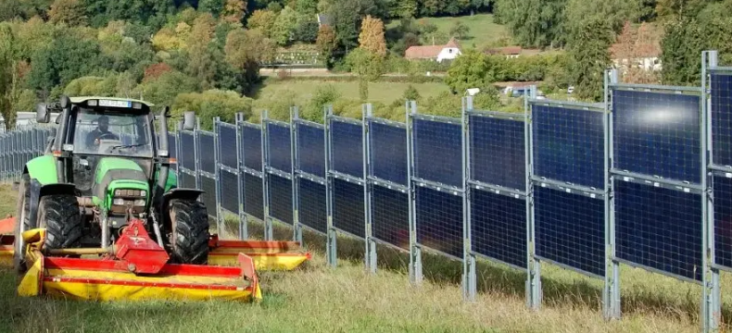
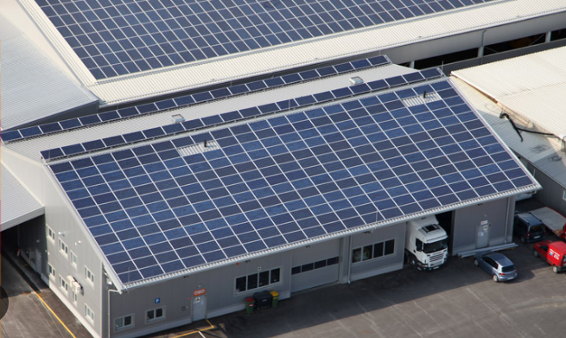
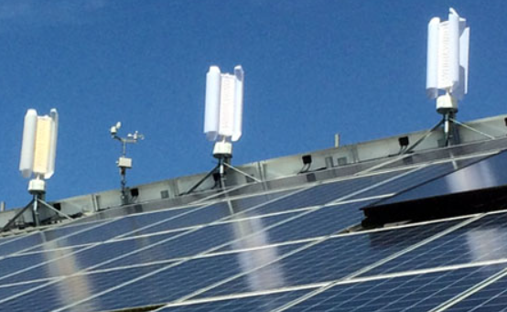
To this.
Integration not exploitation

Slide 5
The Concept
USP
Robust Dual Nacelle
Retrofitted streetlight mount
3D printed interchangeable rotor blades (tailored to location/climate/season/purpose)
Integrated Solar panel for additional applications (camera/aerial/etc.)

Slide 6
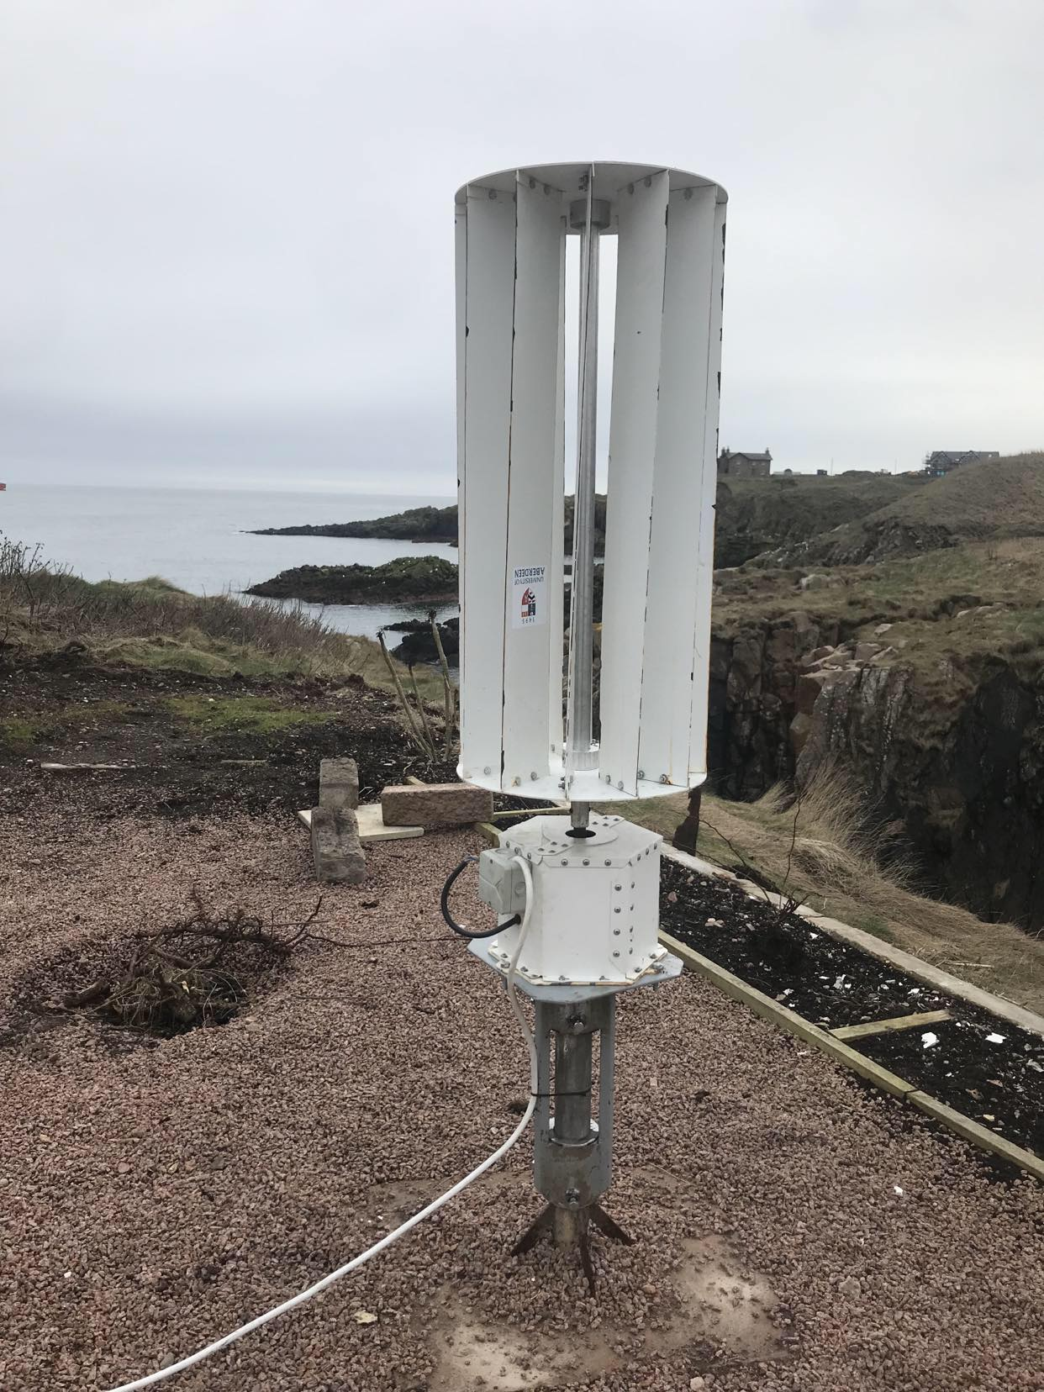
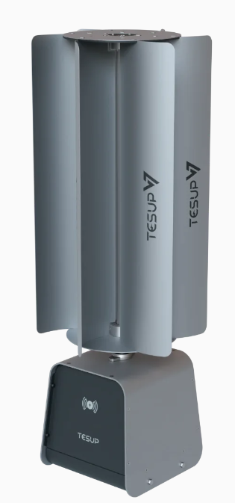
Benchmarked market leader

Slide 7
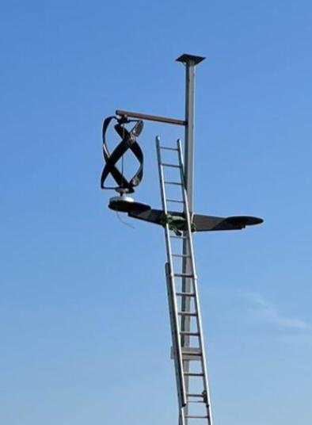
Prototype 1.
Issues identified
Timely to print helix blades
One piece printing means hard to repair
Generators performance was poor
Generator suppliers are limited and poor QA
Curved blades made fixing solar panels

Slide 8
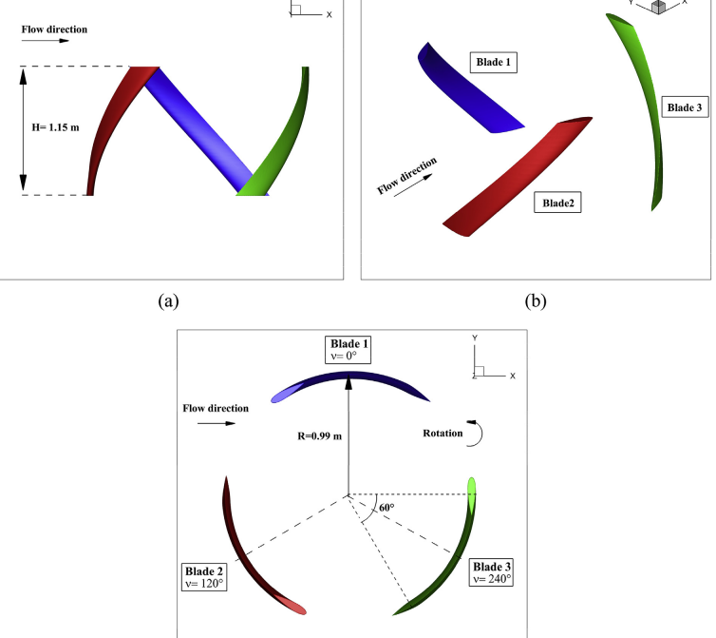
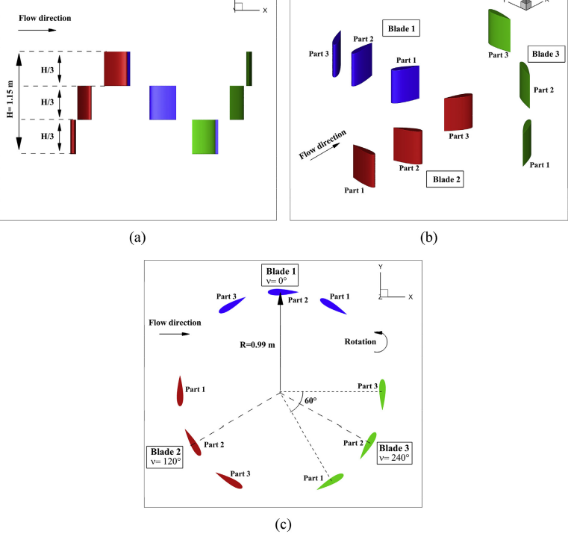
Insight to Prototype 2. Straight Blade Helix (SBH)

Slide 9
What else can I tell you…
Market Opportunity
Technology
Business Model
Go-to-Market Strategy
Financials
Team
Competitive Landscape

