Slide 1
Fusion
Reactors
unlocking the future of energy

Slide 2
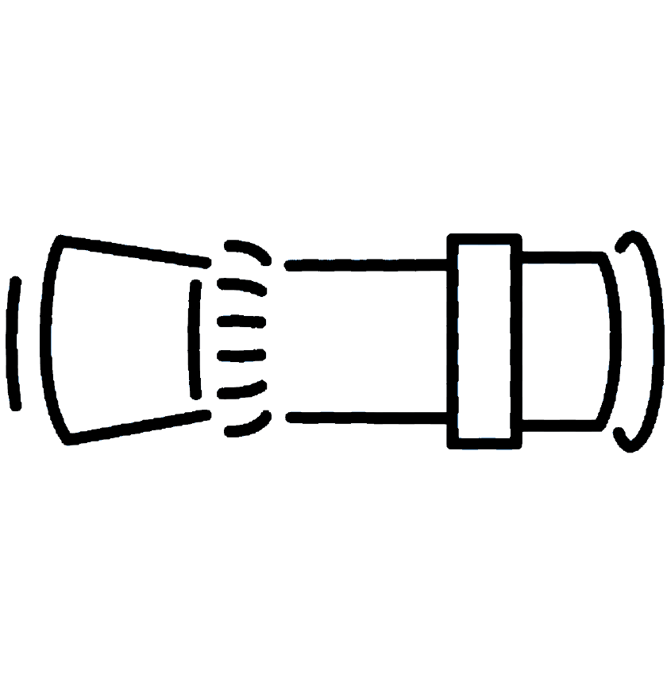
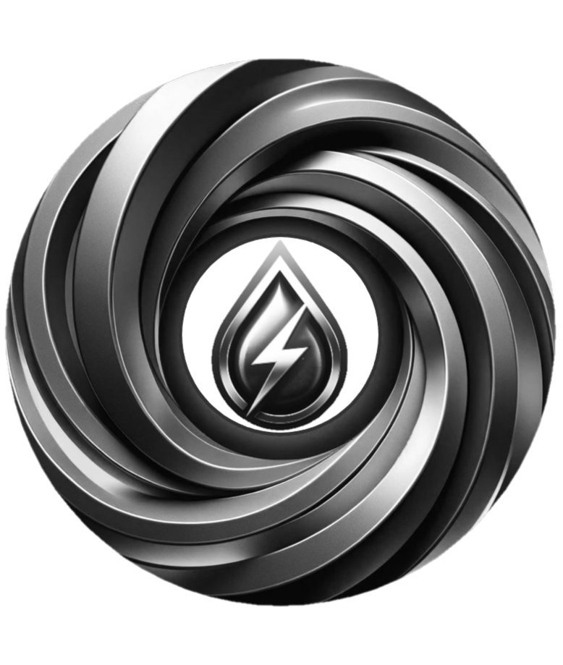
Summary
Fusion Reactors is replacing fossil fuel burning in thermal power stations with clean energy
BEFORE | AFTER
CO₂
Turbine
Generator
Turbine
Generator
Steam
Steam
_{Helium}
Burner
Cooling tower
The grid
ARG3S
Cooling tower
The grid
Water
Water
Our product

Slide 3
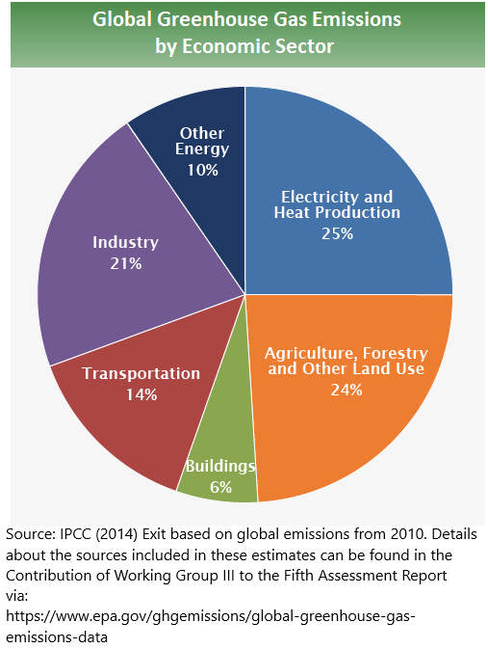
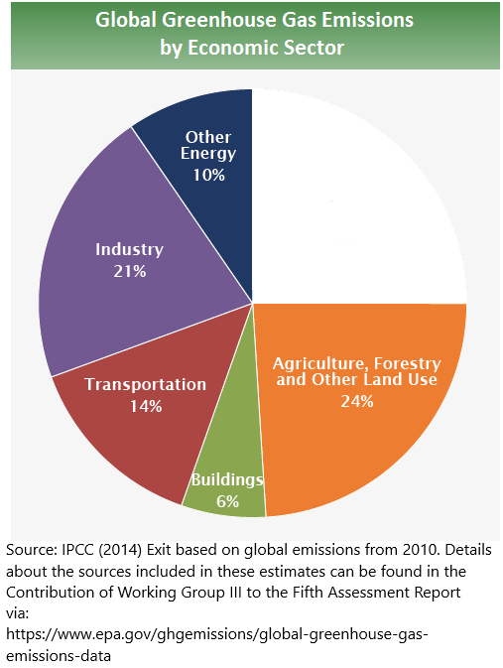
Raison d’être
Fusion Reactors will contribute towards eliminating 25% of human greenhouse gas emissions.
BEFORE | AFTER
> 14.6
Gt / y
Our potential impact

Slide 4
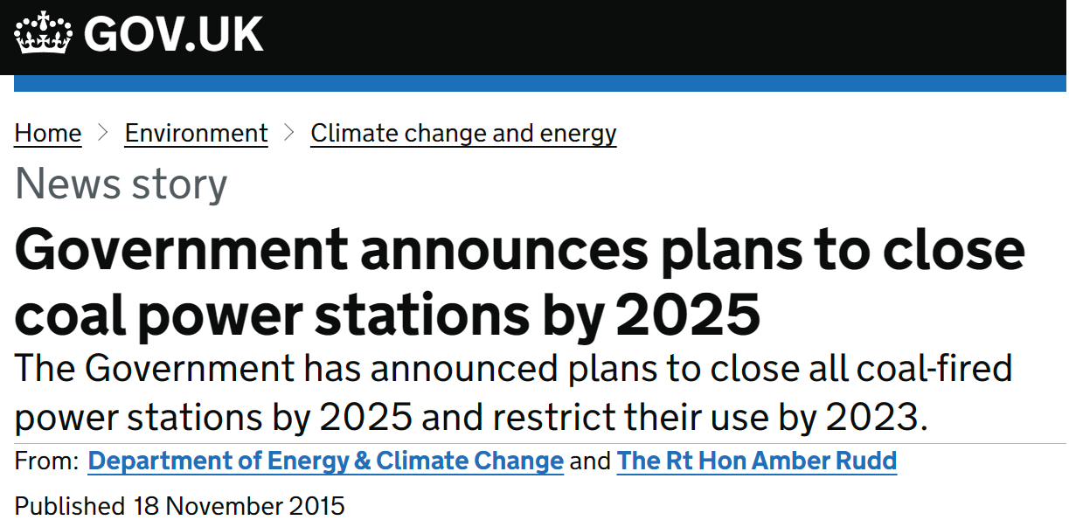
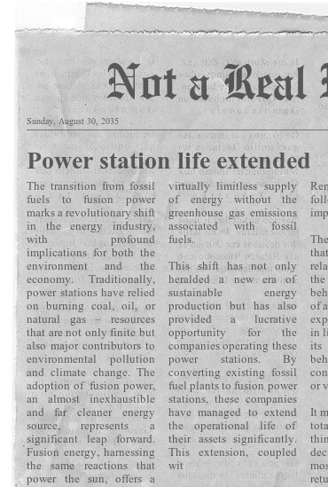
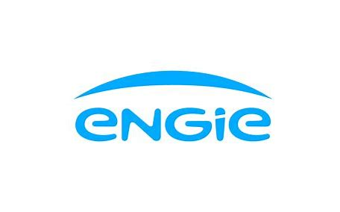
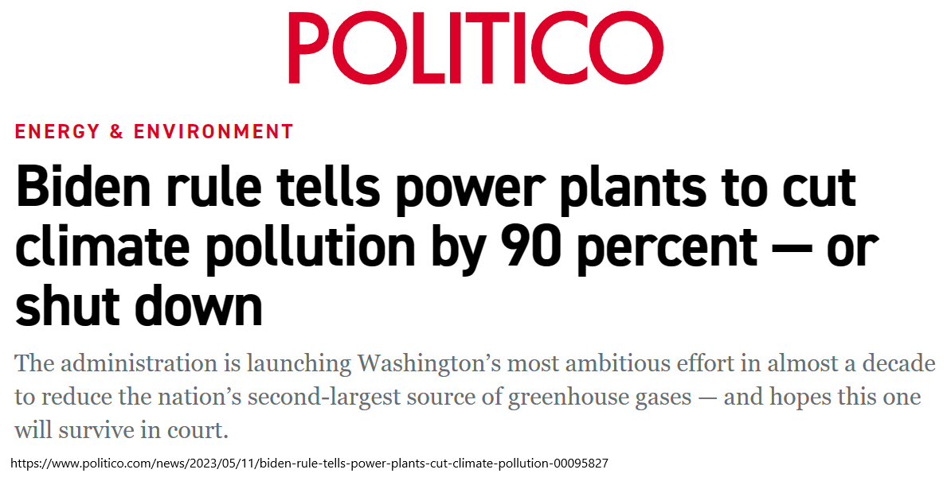
Customer
Fusion Reactors is saving assets worth in excess of $2T from becoming obsolete.
BEFORE | AFTER
What a newspaper article could say when Fusion Reactors brings our product to the market!
stranded assets in coal capacity range between US$150 billion and US$1.4 trillion¹
German power companies … may suffer absolute losses worth €4.8 billion and more than €7 per share outstanding if the coal phase-out is implemented in 2030 as opposed to 2038¹.
By converting existing fossil fuel plants to fusion power stations, these companies can extend the operational life of their assets significantly.
almost 2.8 TW of fossil power plant capacity must be stranded globally between 2021 and 2050 … stranded assets worth more than US$ 500 billion¹
1. von Dulong, A. Concentration of asset owners exposed to power sector stranded assets may trigger climate policy resistance. Nat Commun 14, 6442 (2023).

Slide 5
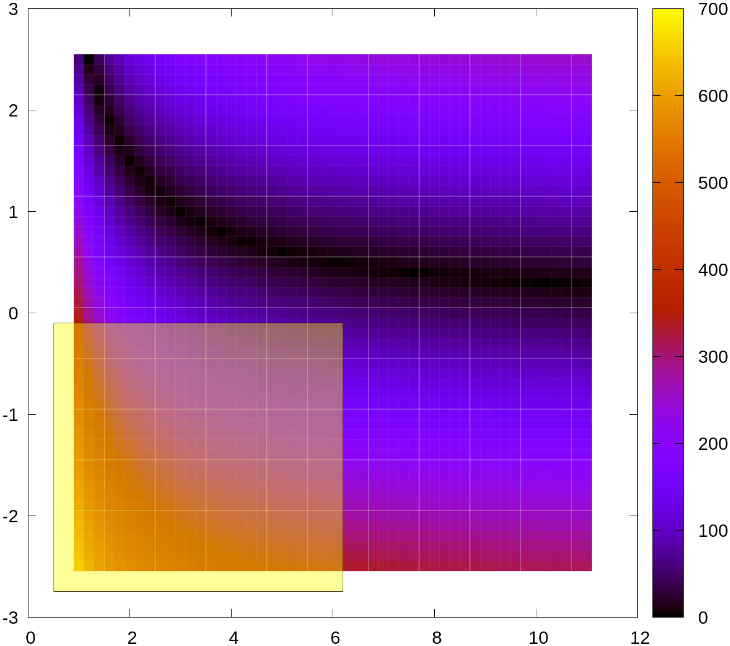
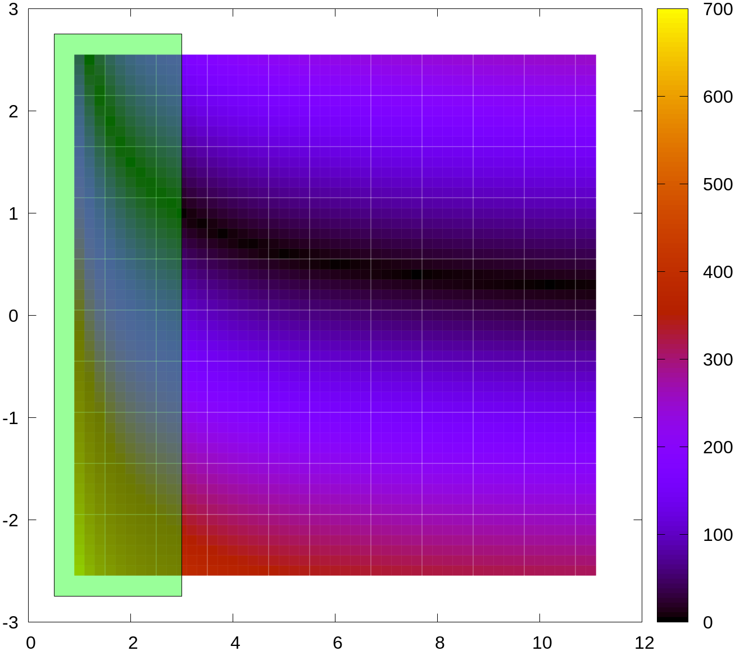
Product
ARG3S can access commercially relevant regimes at price points well below our competitors.
Commercially favourable regime
Others | ARG3S
Tokamak operational space
ARG3S operational space

Slide 6
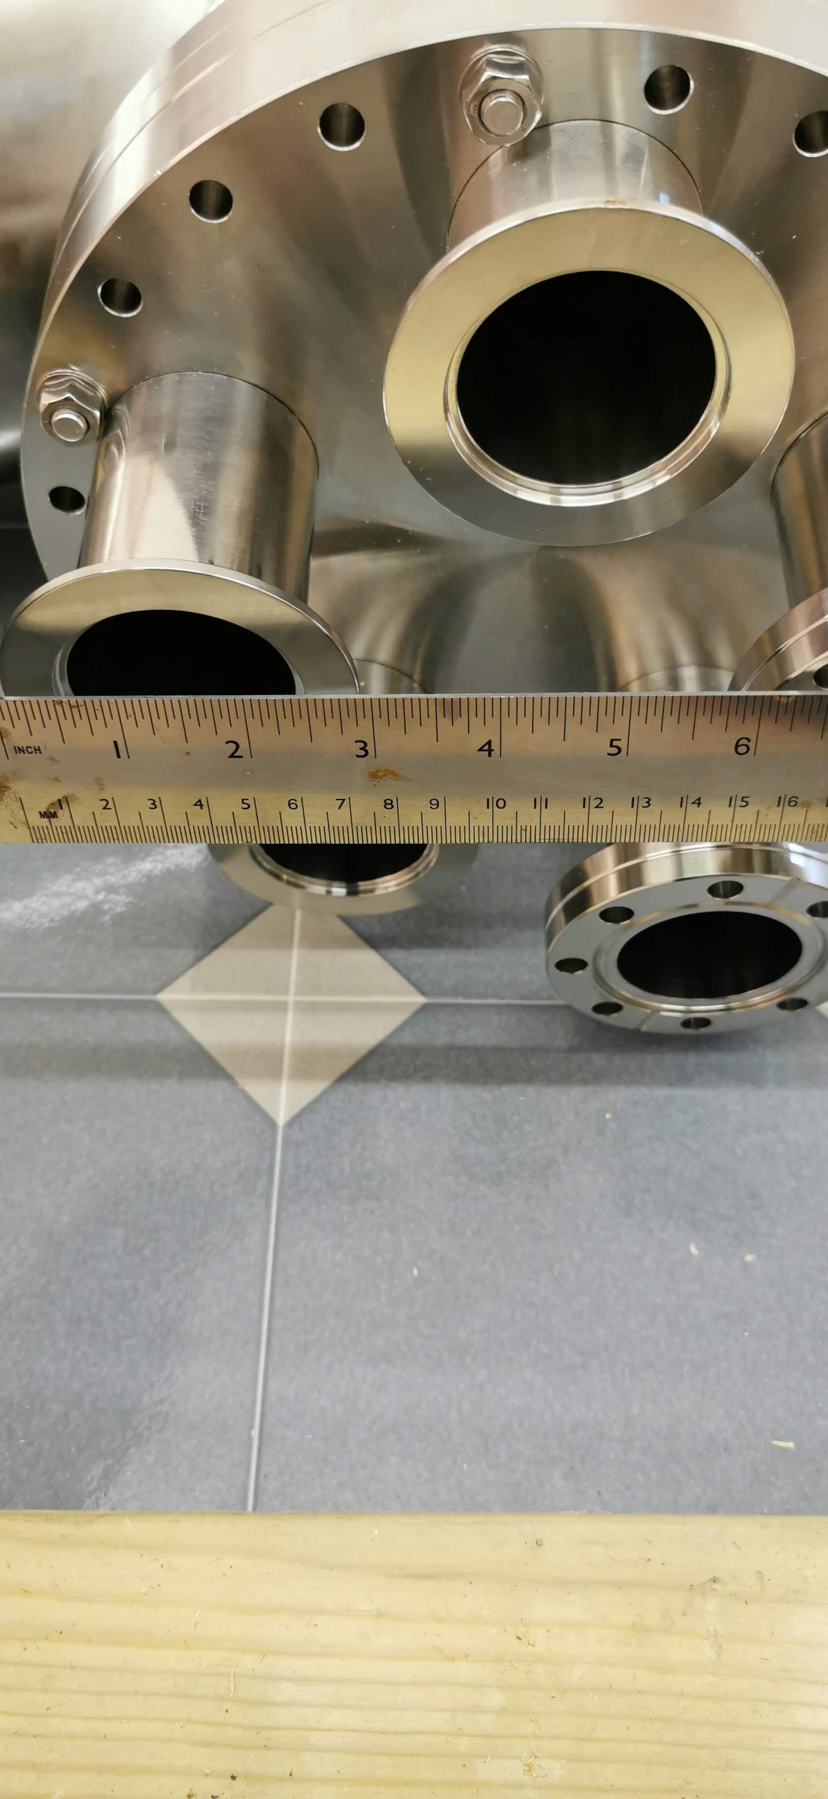
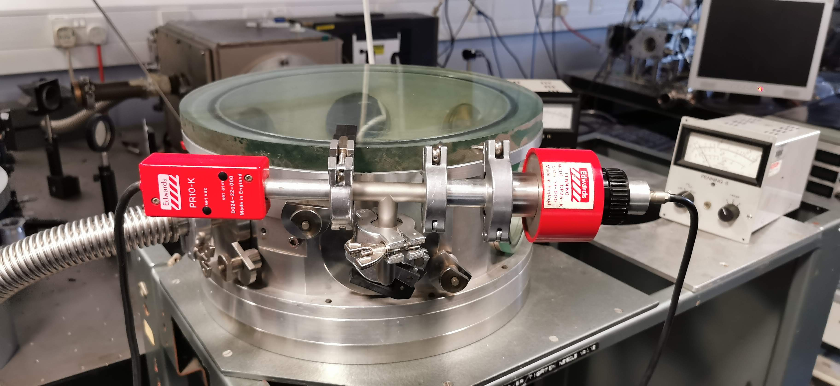
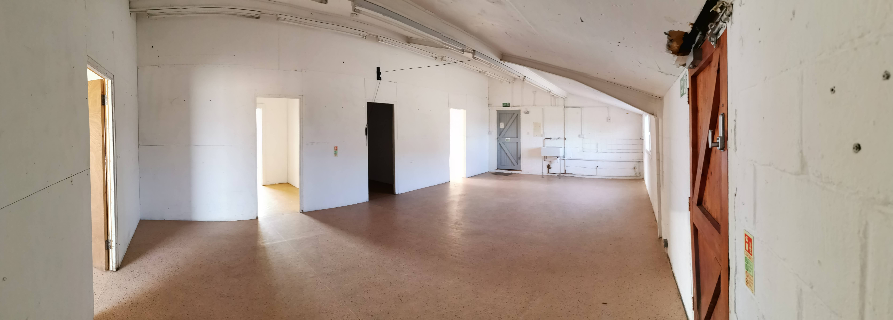
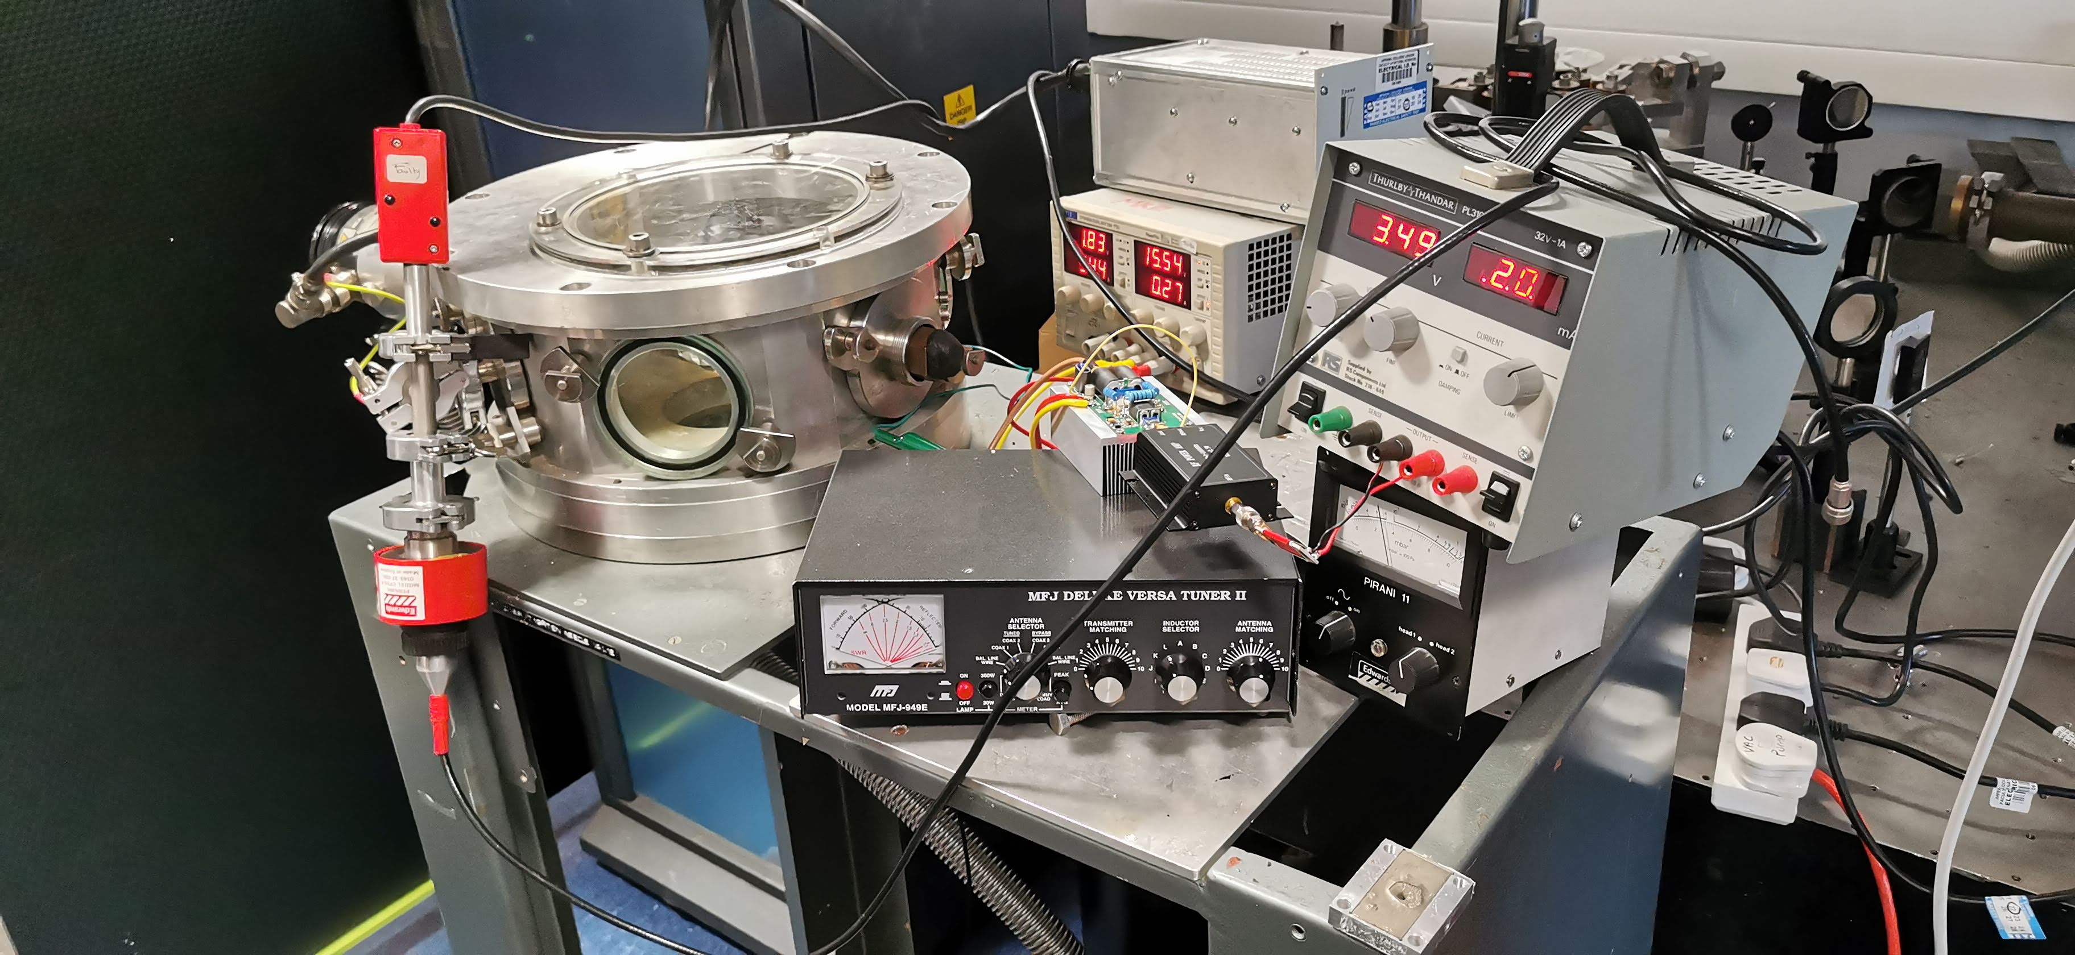
RIFF
Fusion Reactors is developing a novel, optimised procedure for commercial fusion development.
Others | Fusion Reactors
Optimised for testing a single design.
Monolithic approach.
Allows for specialised development of a single design.
Optimised for testing multiple designs.
Modular approach and component sharing.
Allows for rapid and cost-effective device testing.

Slide 7
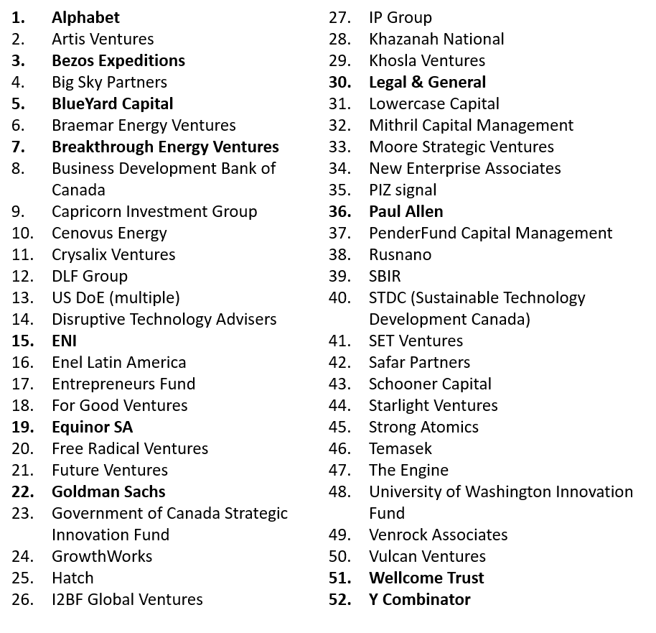
Market
More than 40 private fusion companies have so far attracted more than $6B in private investment.
Private investment into private fusion | Selected investors

Slide 8
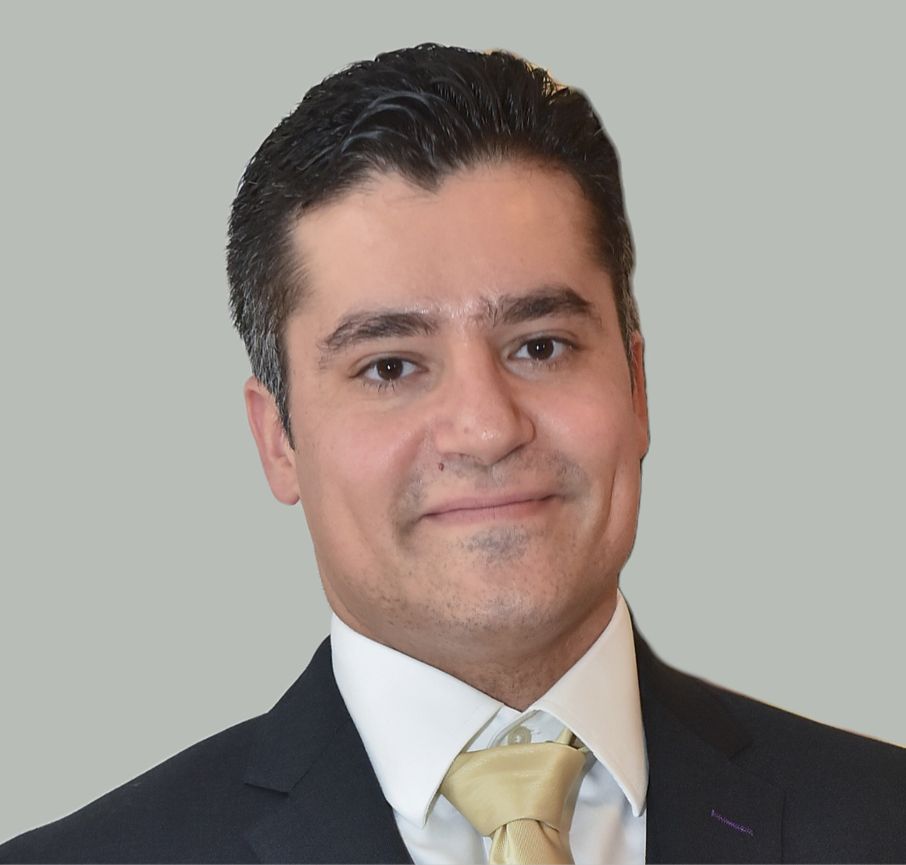
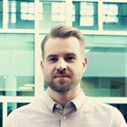
Team
We have the skills and experience, from both the public and the private fusion sector, to deliver.
CEO & CTO
Dr. Christos Stavrou
COO
Mr. Reidar Marin Berg
Tokamak Energy Ltd:
Led creation of new test facility (skill-set for RIFF)
Led the design for critical reactor sections
Joint European Torus:
Led two successful experiment proposals (>£2.4M)
PhD Plasma Physics (Imperial College)
MSc Fusion Energy (University of York)
PGCE Physics (University of Oxford)
BSc Physics (University of Bristol)
Norsk Titanium: Operations and Tech Management (Eggemoen Tech Center)
Cisco: Product Operations with New Product Introduction/Development.
Exec. Master of Management (BI Norwegian Business School)
MSc Industrial Economics (University of Stavanger)
BSc Mechanical Engineering (University of Stavanger)
Lean Six Sigma Green Belt (Lean Communications AS)
Certified Scrum Master (Scrum Alliance)
Fusion Technology
Prof. David Ruzic**

Slide 9
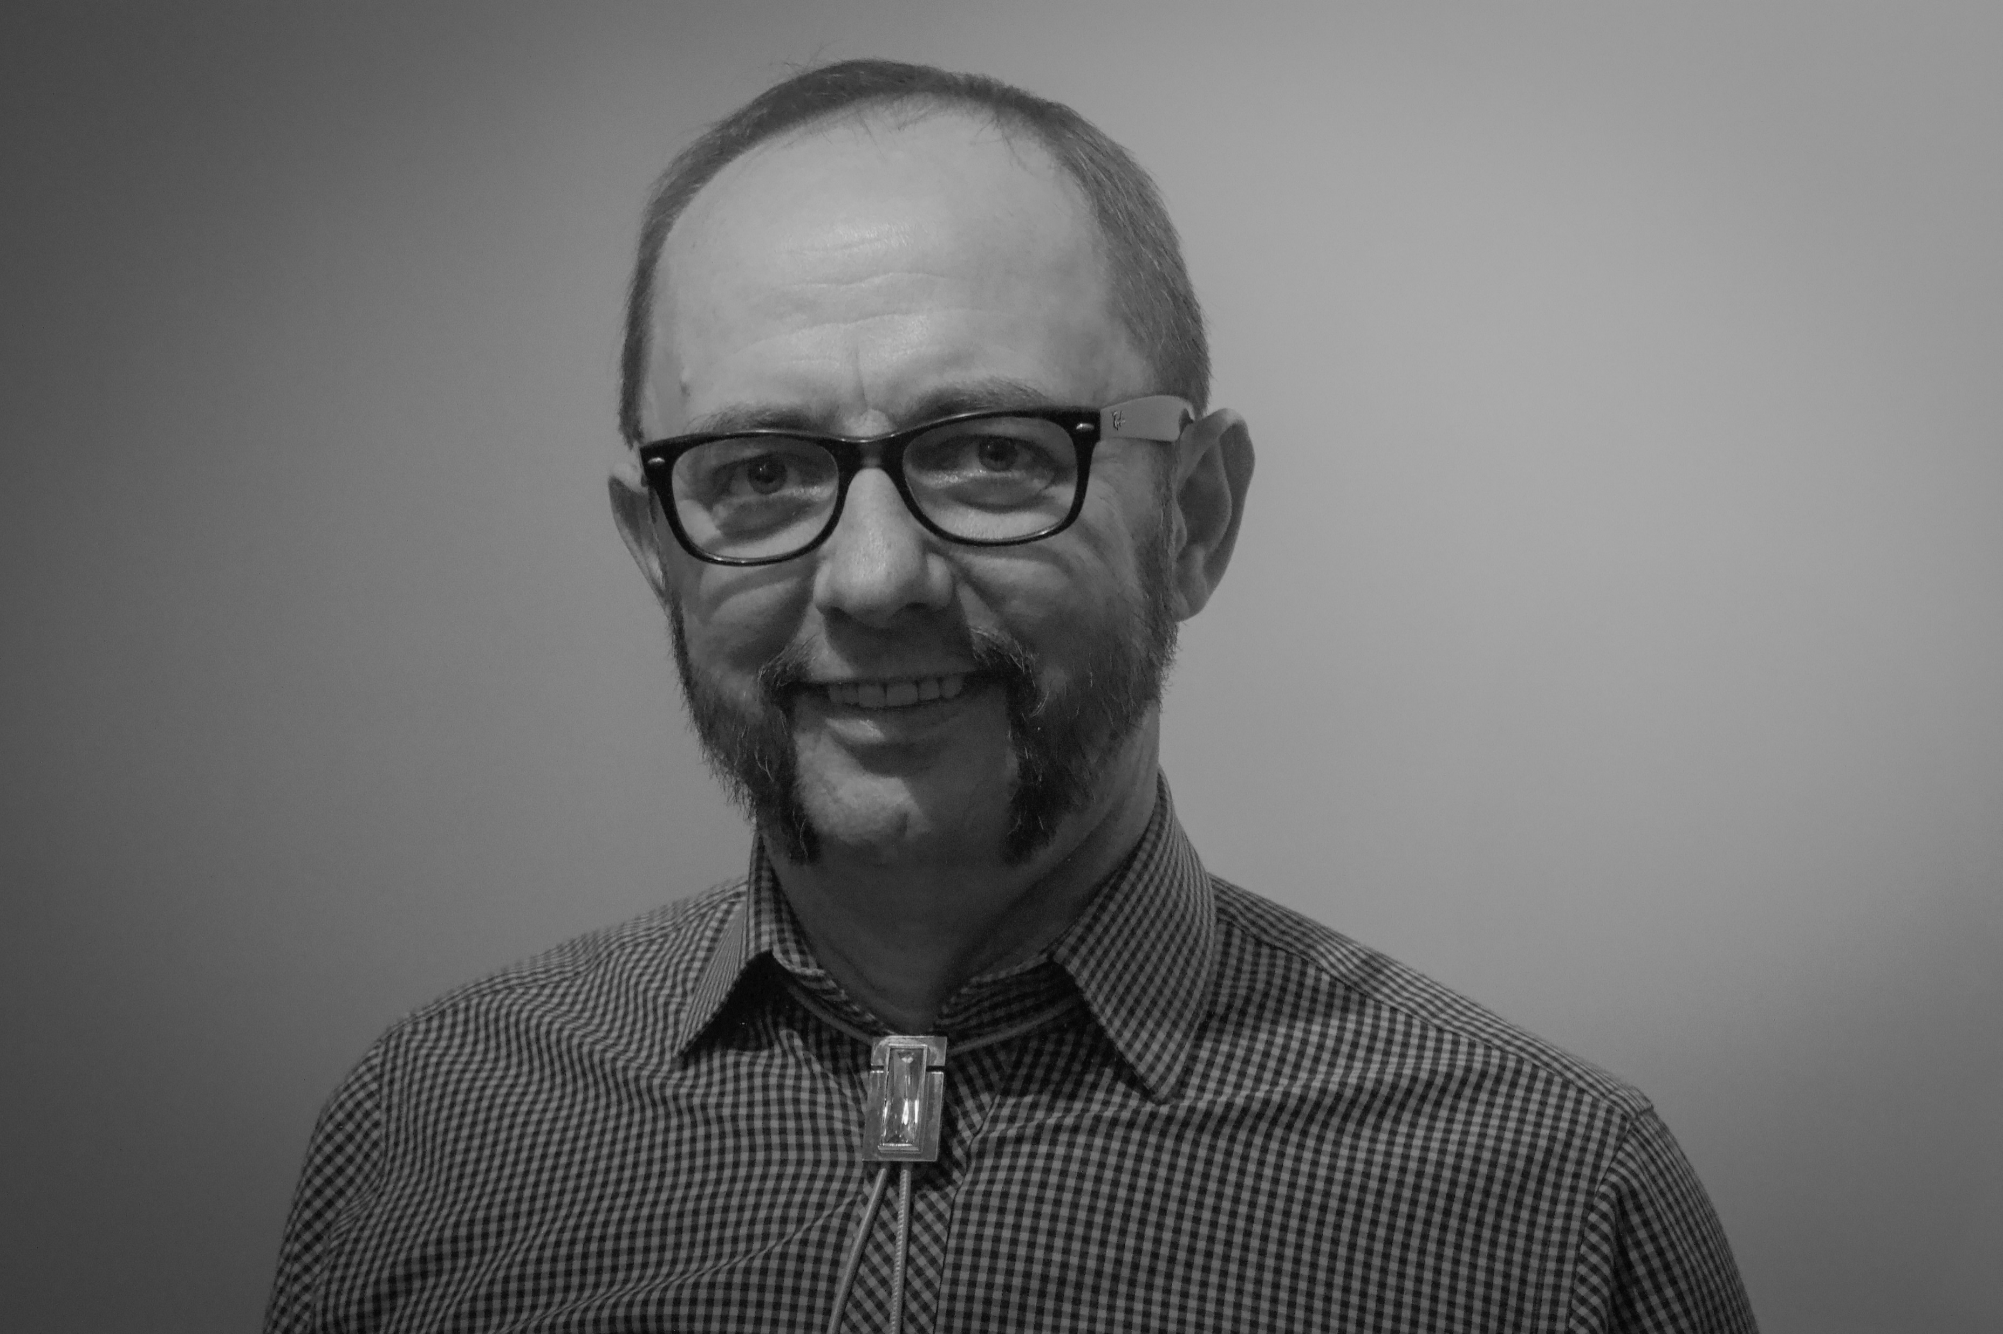
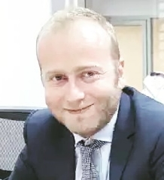
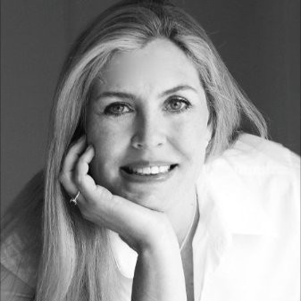
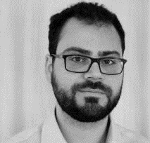
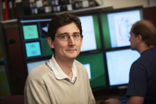
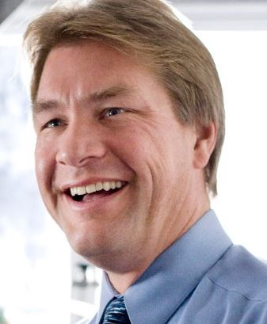
Team
We have the skills and experience, from both the public and the private fusion sector, to deliver.
CEO & CTO
Dr. Christos Stavrou
COO
Mr. Reidar Marin Berg
Development Engineer
Dr. David Toebaert
Vacuum Technology Mr. H. S.*
ADVISORS
COLLABORATOR
Fast iteration & Lean
Mr. Stephanos Marcou
Business Development Janet Murray
Thermal Management Dr. A. Sergis**
Fusion & Simulations
Dr. Ben Dudson**
Fusion Technology
Prof. David Ruzic**

Slide 10
Roadmap
Our roadmap is optimized to deliver commercial fusion within a decade from start of operations.
Phase 1
Technology demonstration
Phase 2
Scaling & Optimising
Phase 3
Pilot Construction
2.5
years
6
years
9
years
Phase 1 roadmap
Milestone 1: Team, IP, RIFF modules
Milestone 2: Rapid Iteration Fusion Facility ready
Milestone 3: 1st design testing
Milestone 4: 2nd design testing
12
months
18
months
21
months
24
months

Slide 11
Investment
Phase 1 has been costed to be £3.5M.
Phase 1
Technology demonstration
Team Staffing
Complete Rapid Iteration Fusion Facility (RIFF)
Grant writing
Legal & IP
Early engineering & procurement
Construct and characterise 2 designs, ARG3S 1.0 and Brontes
Develop ENBE (patent pending)
2.5
years
2.5
years
Phase 1 roadmap
£3.5M
Milestone 1: Team, IP, RIFF modules
Milestone 2: Rapid Iteration Fusion Facility ready
Milestone 3: 1st design testing
Milestone 4: 2nd design testing
12
months
18
months
21
months
24
months

Slide 12
Fusion
Reactors
unlocking the future of energy

