Slide 1
Shell StartUp Engine
Copyright Hilo EV Limited 2024
Strictly private and confidential

Slide 5
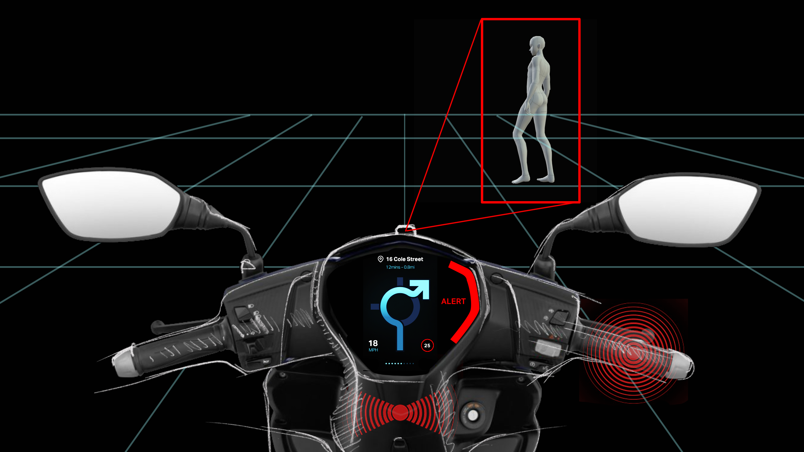

Slide 7
www.hiloev.co

